Slide 1


Title 2A and 2B Options
Welcome to 2021 Edition of the KSU Hackathon
The Challenge: Discovery of Risks Associated with Missing Children
e.g. if a child goes missing, what is some of the critical information that we can provide law enforcement that helps in the quick recovery?

Slide 2
LexisNexis Risk Solutions, A Company Introduction
Public Records
Decreasing Content Volume
Entity Resolution
Proprietary Data
Financial Services
Big Data
Link Analysis
Government
News Articles
Health Care
Unstructured Records
Fusion
Insurance
Linking
Clustering Analysis
Structured Records
Increasing Content Quality
Refinery
Complex Analysis
Data Collection
Data Processing
Analysis Applications
Key Capabilities
Public Records (e.g. court cases, criminal registries)
State Agencies (e.g. DMV, Police records)
Contributors (e.g. Insurance policy and claims, Telematics)
Data Curation (e.g. profiling, cleaning)
Advanced Analytics (e.g. Social Graph Construction)
Superior Technology (HPCC Systems)
KYC and On Boarding Workflows (e.g. opening a bank account)
Complex Social Network Fraud (e.g. Insurance fraud)
Risk Assessment ( e.g. Risk to an insurer, risk to a job hiring company)

Slide 3





Why KSU?
Fantastic Partners
Prof. Dawn Tatum
Dr. Jon Preston
Dr. Jeff Chastine
Adriana Clark – Project Manager
Fantastic Students
Vannel Zeufack – Employed at DataSeers a HPCC Systems partner

Slide 4


Why KSU?
Fantastic Alumna
Trish McCall – HPCC Systems Director of Program, ADAM Program Leader
Prof. Bahar Fardanian – HPCC Systems Evangelist, KSU Professor

Slide 5


Title 2A and 2B Options
The ADAM Program Introduction
Automated Delivery of Alerts on Missing children

Slide 6
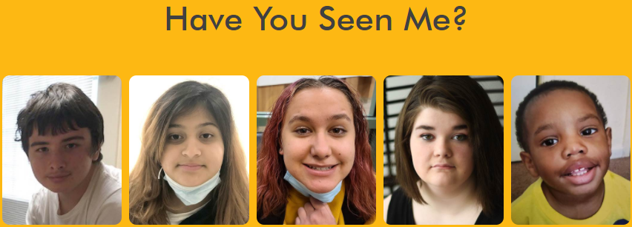


National Center for Missing & Exploited Children
In 2020 NCMEC assisted law enforcement and families with more than 29,800 cases of missing children.
91 % endangered runaways.
5 % family abductions.
3 % critically missing young adults, ages 18 to 20.
Less than 1 % nonfamily abductions.
1 % lost, injured or otherwise missing children
Of the nearly 26,500 runaways reported to NCMEC in 2020, 1 in 6 were likely victims of child sex trafficking.
*Source: http://www.missingkids.org/footer/media/keyfacts https://www.missingkids.org/gethelpnow/search

Slide 7
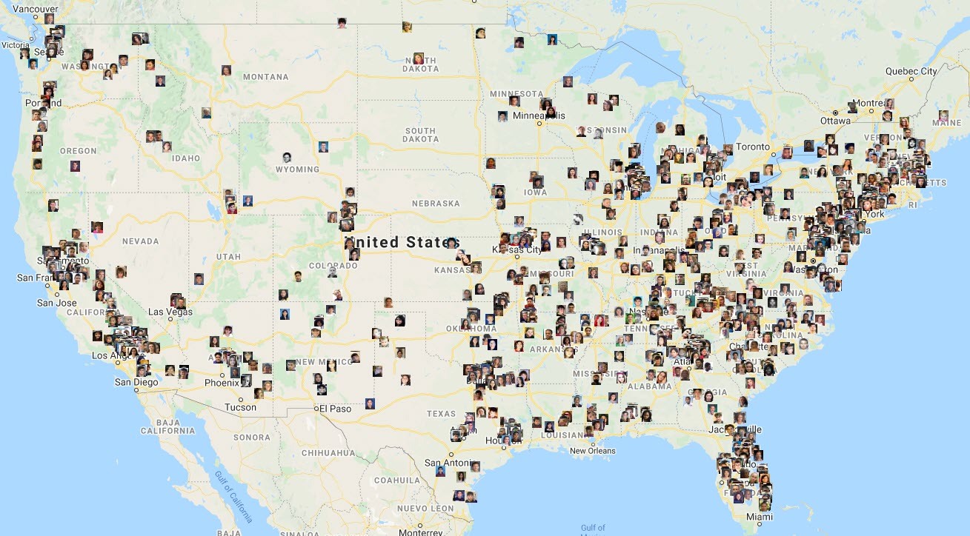
Missing Children in the U.S.
At any given time, The ADAM Program can have a few thousand active cases in the U.S.
As of today, there are over 1,600 active missing child cases in The ADAM Program.

Slide 8
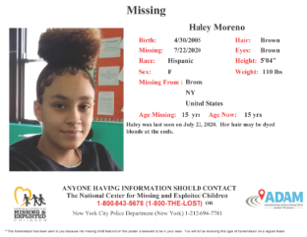
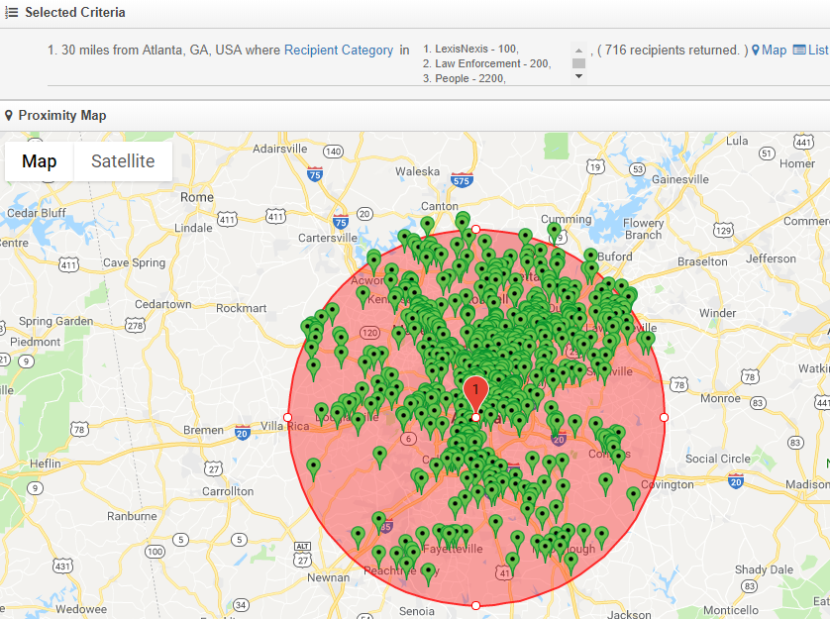
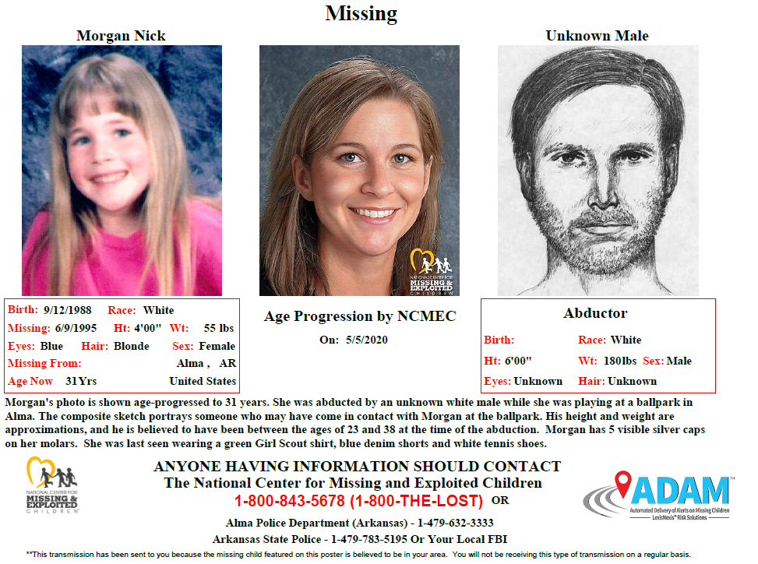
How Does it Work?
1
2
3
4
5
6
Missing child is reported to authorities
Parents or police relay information and photo to NCMEC
NCMEC assigns case number and creates missing child poster
NCMEC uploads poster and selects search criteria in ADAM Program
ADAM examines all possible recipients within target criteria
ADAM instantly broadcasts the missing child poster and information to recipients
Missing
Missing
8

Slide 9

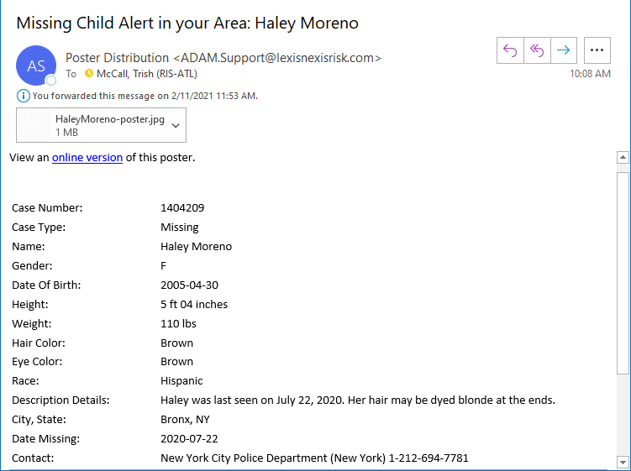

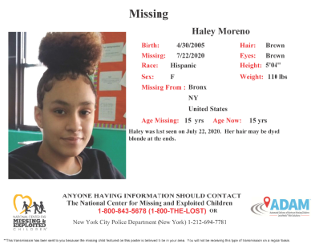
Sample Poster
Email delivery for individuals, businesses or organizations
Fax delivery for businesses or organizations
9

Slide 10
We need your help in
Of the nearly 26,500 runaways reported to NCMEC in 2020, 1 in 6 were likely victims of child sex trafficking.
Your Assets
Data
Georgia Sex Offender Database
Kids Reported Missing in Georgia in Jan 2021
All US Cities/Counties Lat, Long and FIPS
Tools
HPCC Systems Data Lake Cluster to manipulate and analyze this data
ECL Cloud IDE for programming
Mentors
A star studded team of experts
Getting Started Tutorial
https://github.com/hpccsystems-solutions-lab/Hackathon-AdamProject

Slide 11
Finally
Trish McCall, the Leader of the LexisNexis ADAM Program will give a detailed presentation of the program on Tuesday the 23rd, 4 PM
We will be hosting a live Q&A session 3/19 at 1 PM
Please reach out to us if you need to. The contact information is on the Getting Started site
Good Luck and Happy Hacking!

