Slide 1

The NEW Big Data Journey
How Technology is impacting how we process Data
Notes:
NOTE:
To change the image on this slide, select the picture and delete it. Then click the Pictures icon in the placeholder to insert your own image.

Slide 2
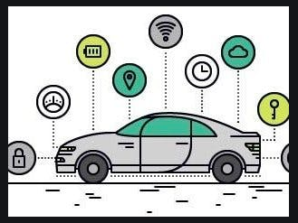
Let us start by answering some questions
Do you drive a connected car?

Slide 3
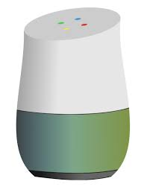

Some more questions…
How about a Smart Watch?
How about a Smart Home Systems?

Slide 4
The NEW (IoT) Big Data Analytics Landscape
OUTSIDE
Logistics & Navigation
FACTORIES
Safety, Operations & Equipment Optimization
VEHICLES
Autonomous Vehicles & Driver Behavior
CITIES
Public Health, Safety, Security & Transportation
HOME
Automation & Security
OFFICES
Security & Energy
Bringing data together is not easy, and
data is growing at a rapid pace and scale
A processing platform is vital for bringing all your data together across all verticals

Slide 5

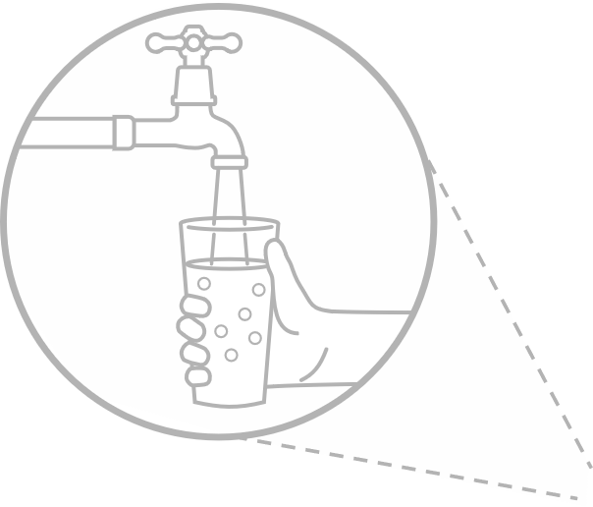


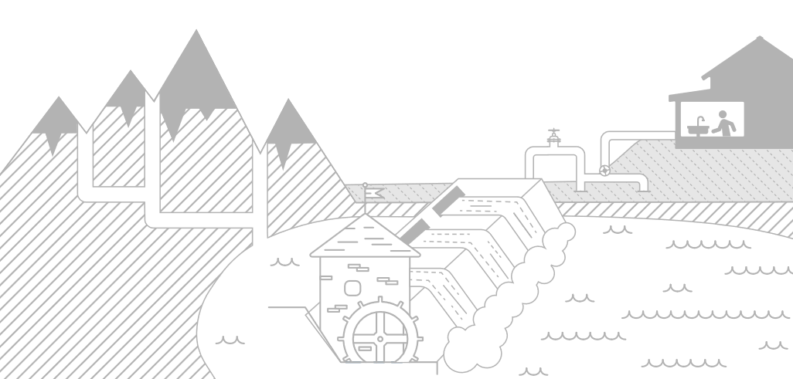


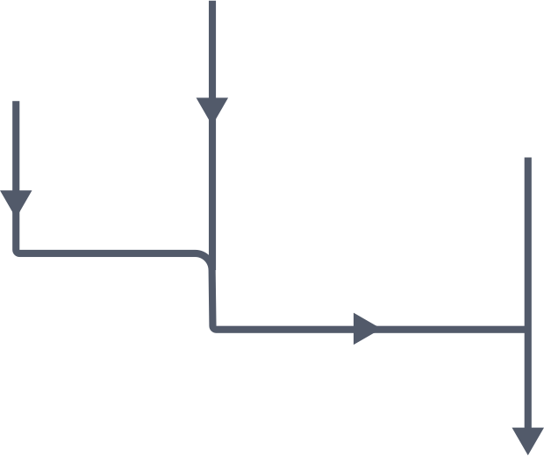

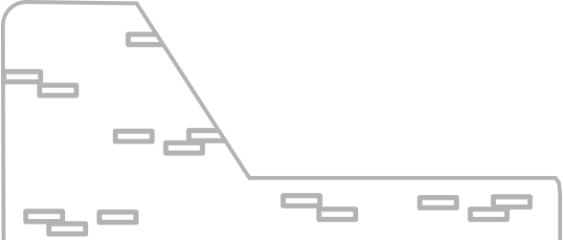
The Traditional Big Data Solution – A water sanitation plant analogy
1. Multiple types of raw data
5. Information Delivery
2. Batch, real-time and streaming ingestion
4. Data wrangling and machine learning
3. Open source data lake

Slide 6
What are the key data processing differences in the IoT world?
Advantages
Sensor based data might have less errors but might need translation
Almost real-time feedback and analysis
Disadvantages
Manage Gigantic volume of data
Privacy is one of the biggest concerns

Slide 7
Use Case 1 – LexisNexis Insurance Telematics

Slide 8
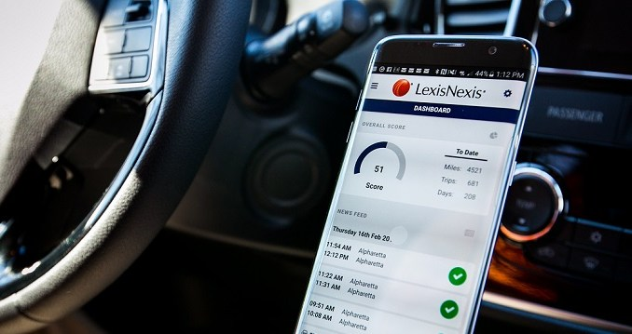
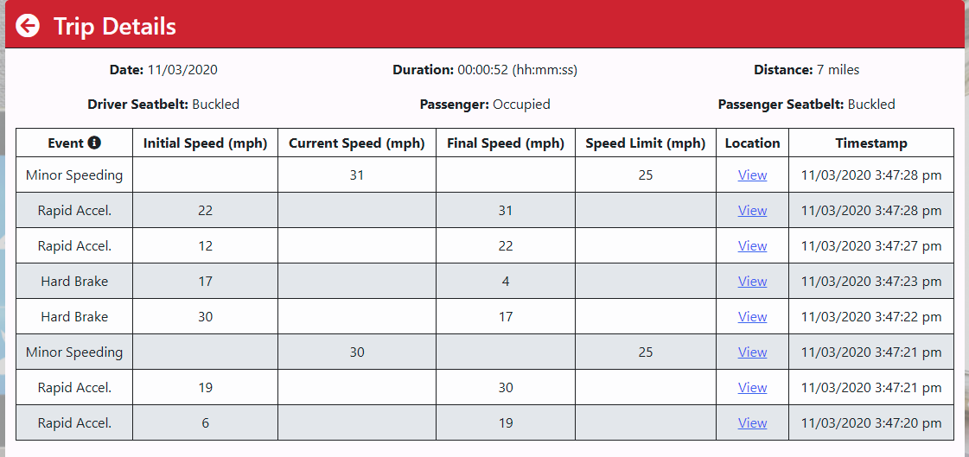
Traditional Workflow
All Trip Data is Uploaded
Car to Phone
Analytics

Slide 9

New Workflow
Only Upload the Score
Historic Scores
Central Data Lake Analytics
Use the Cars On Board Computer (Edge device)
Minimal data is sent to the Data Lake
An emphasis to protect privacy

Slide 10
Use Case 2 – INSURANCE FRAUD

Slide 11
A LexisNexis Public Records Data Processing Workflow
Public Records
Financial Services
Decreasing Content Volume
Entity Resolution
Government
Proprietary Data
Health Care
Big Data
Insurance
News Articles
Link Analysis
Legal
Fusion
Retail
Unstructured Records
Linking
Clustering Analysis
Scientific Technical Medical
Structured Records
Increasing Content Quality
Exhibitions
Refinery
Complex Analysis
Unstructured and Structured Content
High Performance Computing Cluster Platform (HPCC)
Analysis Applications
Key Capabilities
Over 4 petabytes of content
50 billion records
10,000 sources
7.5 billion unique name and address combinations
Grid computing
Data-centric language (ECL)
Integrated delivery system that offers data plus analytics
Multi-bureau/multi-source models and bureau roll-over support
Extensive experience leveraging atomic level data, combining and leveraging disparate data
Approximately 400 models deployed (custom and flagship)
Data and analytics
Identity verification and authentication
Fraud detection and prevention
Investigation
Screening
Receivables management
Open Source Components

Slide 12
Traditional Data Analytics: Data Quality is Key
A single source of data is insufficient to overcome inaccuracies
Absorbing data from many data sources and transforming them to actionable smart data

Slide 13
Insurance Claims
Detecting hidden and comprehensive insurance claim fraud
The data only found connections between two of the seven claims — with one being weakly connected

Slide 14
And the FRAUD
Family #1
The LexisNexis Social Graph revealed the key relationships that connected the various actors.
Family #2

Slide 15
Use Case 3 – Covid 19 Tracker

Slide 16
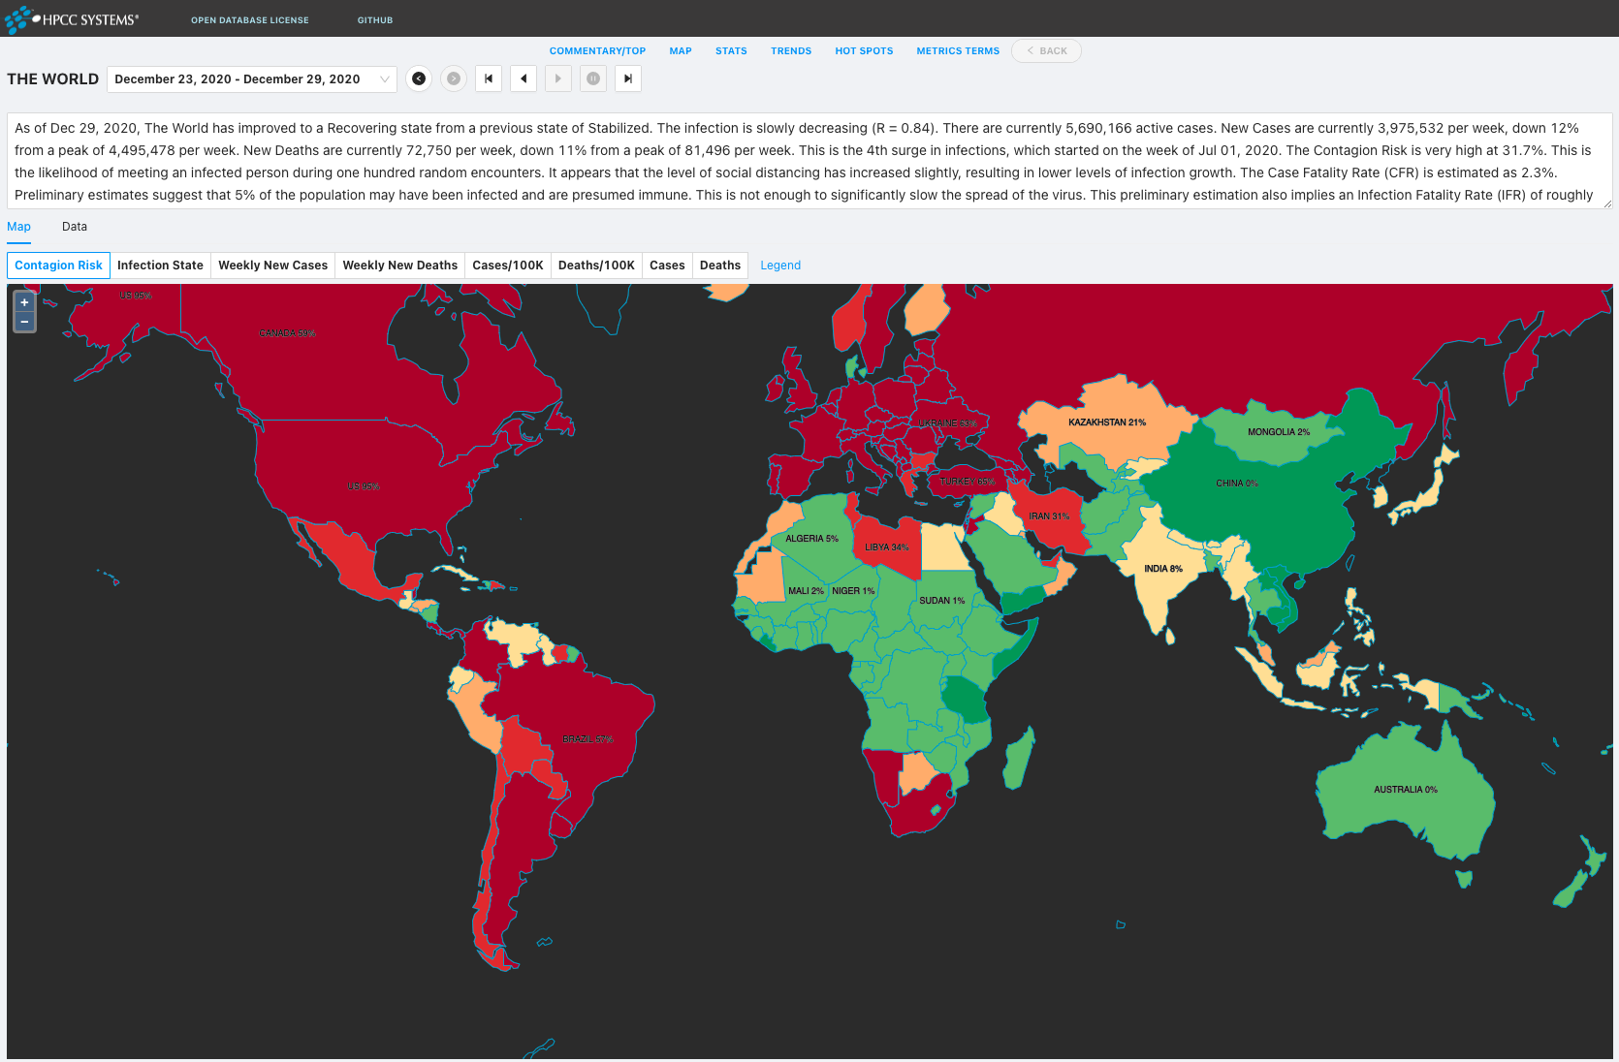
https://covid19.hpccsystems.com

Slide 17

Covid 19 Data Processing Workflow
Integrate
Profile
Clean
Standardize
Aggregate
Machine Learning
Deliver
Daily Cases
Daily Deaths
Testing
Transportation Infrastructure
Tourism Infrastructure
Hospitalization
Socioeconomic
Flight Schedules
People Density
People Movement
Decreasing Content Volume
Metrics and Statistics
Relate &
Profile & Clean
Standardize
Risk Models
Analyze
Interactive Visualization
Increasing Content Quality
Data Sources
HPCC Systems Data Lake
Analysis Applications

Slide 18
Questions?

