Slide 1



Introduction to Big data & ECL
Notes:
NOTE:
To change the image on this slide, select the picture and delete it. Then click the Pictures icon in the placeholder to insert your own image.

Slide 2
Objective
Intro to big data
Big data architecture
Intro to HPCC systems

Slide 3

Big Data
Big data is complex and massive volume of data sets that need to be processed and analyzed to uncover valuable information.
According to Gartner
“Big data” is high-volume, velocity, and variety information assets that demand cost-effective, innovative forms of information processing for enhanced insight and decision making.

Slide 4
Big Data Types
Structured
Data can be processes, analyzed, stored and retrieved in a fixed (defined) format. It has both form and format.
Exp: Employee table, address book.
Unstructured
Unstructured data refers to the data that lacks any specific form or structure whatsoever. Processing data is difficult, time consuming and prone to errors.
Exp: Email, pictures, videos, audios.
Semi-structured
Contains both Structure and Unstructured data. Exp: CSV, Json, YAML

Slide 5
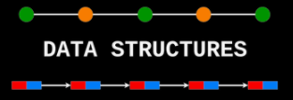
Note
To work with data you absolutely must impose a structure on the data before you start working with it. So, structured vs unstructured describes data at a certain point in time instead.

Slide 6
Architecture - Big Data Life Cycle
Collection: Collecting data in structured or unstructured format
Ingestion: Extracting, transform, loading, data to cluster
Discovery: Getting to know data, cleaning and shaping it
Integration: Linking, indexing, data fusion
Analysis: Machine learning, analytics and statics, visualization
Delivery: Query, summary, result, and availability
Data fusion is the process of getting data from multiple sources in order to build more sophisticated models and understand more about a project.

Slide 7
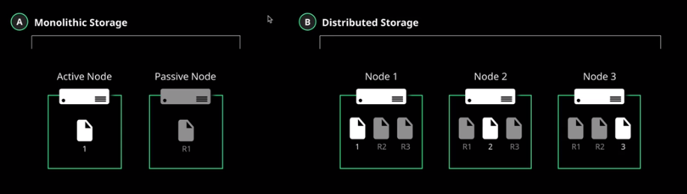
Architecture – Distributed Storage
Distributed Storage
Master node to manage all nodes
Data is spread across all nodes
Data on one node is replicated to another (DR – Disaster Recovery)
Horizontally scalable
Fault tolerant
Monolithic Storage
Write to Active Node
Active Node in sync with Passive Node
Read is preferred from Active Node

