Slide 1



Introduction to Big data & ECL
Notes:
NOTE:
To change the image on this slide, select the picture and delete it. Then click the Pictures icon in the placeholder to insert your own image.

Slide 2
Housekeeping
All materials are uploaded in GitHub:
https://github.com/hpccsystems-solutions-lab/ScheduledFlights-Workshop
Some slides include additional information and are for students to study on their own
The HPCC cluster used for this workshop, will be available for a week
ECL Watch URL: http://52.167.137.162:8010/
A public HPCC cluster is also available for experimentation
http://play.hpccsystems.com:8010/
Contents of repo are subject to minor changes during workshop, please always use the latest copy
It’s strongly suggested to try and review/finish TODOs part after workshop

Slide 3
Big data Introduction

Slide 4

Big Data
Big data is complex and massive volume of data sets that need to be processed and analyzed to uncover valuable information.
According to Gartner
“Big data” is high-volume, velocity, and variety information assets that demand cost-effective, innovative forms of information processing for enhanced insight and decision making.

Slide 5
Big Data’s “Three V”s
Velocity
Speed at which data is created in real-time. How fast data can be processed.
Variety
Data can come from many different sources, from tables and databases to pictures, emails, audios, and much more.
Volume
How big is the dataset?

Slide 6
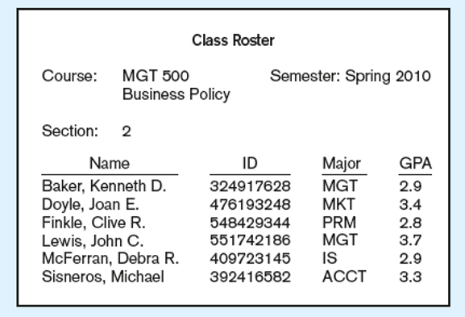
Data In Context
Context helps users understand data
Record Layout
Data Types
Format of each field
Field size
Allowable values
Does it help with data quality?
YES, the more you know about the data,
The better you can handle it!
It’s all about knowing your data

Slide 7
Big Data Types
Structured
Data can be processes, analyzed, stored and retrieved in a fixed (defined) format. It has both form and format.
Exp: Employee table, address book.
Unstructured
Unstructured data refers to the data that lacks any specific form or structure whatsoever. Processing data is difficult, time consuming and prone to errors.
Exp: Email, pictures, videos, audios.
Semi-structured
Contains both Structure and Unstructured data. Exp: CSV, Json, YAML

Slide 8
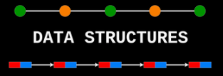
Note
To work with data, you absolutely must impose a structure on the data before you start working with it. So, structured vs unstructured describes data at a certain point in time instead.

Slide 9
Big Data Life Cycle
Collection: Collecting data in structured or unstructured format
Ingestion: Extracting, transform, loading, data to cluster
Discovery: Getting to know data, cleaning and shaping it
Integration: Linking, indexing, data fusion
Analysis: Machine learning, analytics and statics, visualization
Delivery: Query, summary, result, and availability
Data fusion is the process of getting data from multiple sources in order to build more sophisticated models and understand more about a project.

Slide 10
Batch Processing
Method of running high-volume, repetitive data jobs. The batch method allows users to process data when computing resources are available, and with little or no user interaction.
- Not time sensitive, but needs to be delivered in agreeable time
Benefits
Does Automation help?
Can Automation be used for everything?
Managing large amount of data
Time efficiency
Cost reduction
Reduce labor

Slide 11
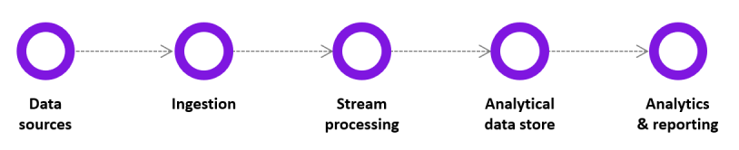
Real-Time & Streaming Processing
Real-Time
Clients needs result immediately
In seconds or milliseconds
Stream
Continues input and output
Events that are happening frequently
Continues processing as data flows through the system
Close to Real-Time
Examples
Credit cards
Google search
Stock market
Examples
Fraud detection
Cyber security

Slide 12
Hpcc systems

Slide 13
HPCC Platform Supports
High performance data delivery through web services, API and SQL
Easy integration with end user BI tools and workflows
Built-in plugins to support other languages such as Python, SQL, C++
Machine Learning library
Deep Learning built on top of TenserFLow
Built-in Data Profiling tool
Batch, stream, real-time processing

Slide 14
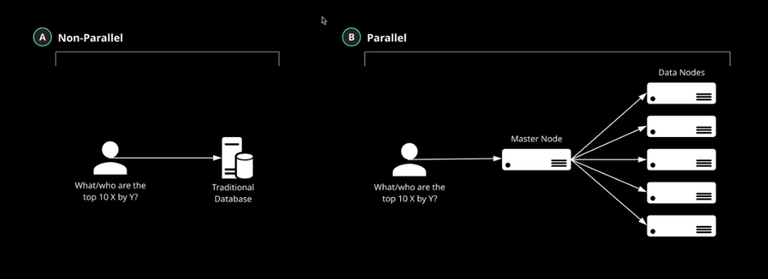
Architecture - Parallel Processing
Capability to scale horizontally
Primary node is your cluster management code
Data node processes the job and returns the result to primary node
Primary node collects and combines individual results
Near infinite scale of compute ability

Slide 15
Anatomy of Big Data Processing System
Big Data
Smaller Data
Compute
Divide

Slide 16
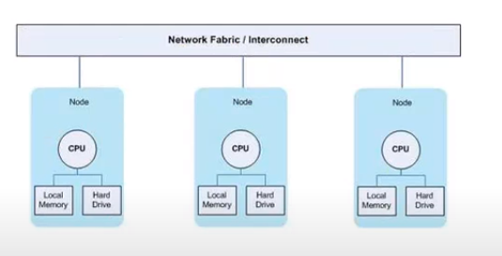
HPCC Systems Infrastructure
Complete data lake management platform
From a personal computer to hundred nodes to cloud
Commodity Cluster: Multiple independent processing nodes.
Commercial off-the-shelf components(COTS)
ECL (Enterprise Control Lang)
Supports different data types: XML, JSON, CSV, native, etc
Clusters
Thor
hthor
ROXIE
Servers
Dali
Sasha

Slide 17
Thor
Data refinery, data transformation
Process one job at a time, unless you have multiple master nodes define
Parallel processing using indexing
Horizontally scalable
Can work with mixed schema data
Zero fault tolerant
Batch processing
Integrates with: Couchbase, MySQL, Kafka, MariaDB

Slide 18
Thor Cluster
Analytics
Profiling
Transform
Thor cluster
Data Refinery
Engine
Manage data more quickly and efficiently
Cleaning

Slide 19
ROXIE
Data delivery
Real-time, stream processing
Query base
High throughput data ingestion and processing
Interfaces: SOAP, XML, REST, SQL
Integrates with: Couchbase, MySQL, Kafka, MariaDB
Different type of data storage, fuzzy logic, multi-key retrieval, key-value store and more
Scalable
Zero fault tolerance

Slide 20
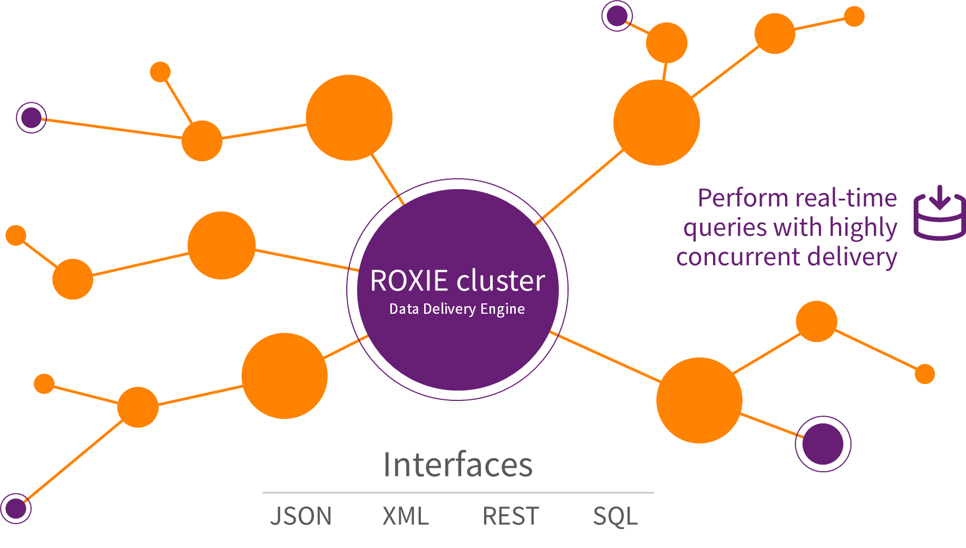
ROXIE Cluster

Slide 21



CrazyBigData – Play Time
Please Open CrazyBigData PowerPoint

Slide 22
IDE Setups & ECL watch

Slide 23
ECL Watch
Browser-based interface that provides admin control over a cluster
Monitor cluster status
Job information
View Data Profile
Schedule and reschedule periodic tasks
Manage data
Maintain ROXIE queries
Security management
Default URL
http://hostname:8010

Slide 24
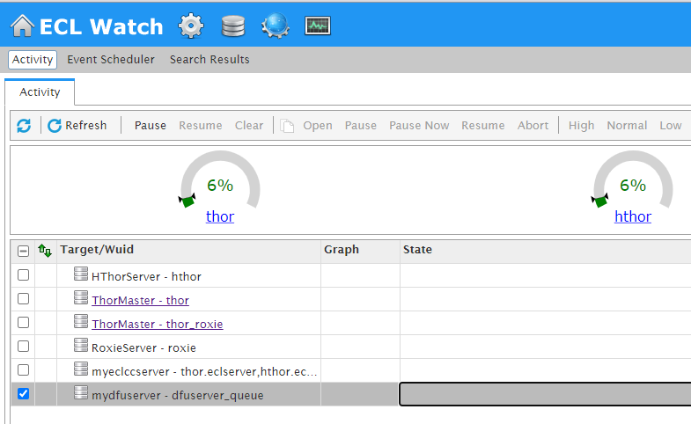
View Workunits
View Files
Published Queries
Cluster Information
Data Usage
Cluster Names

Slide 25
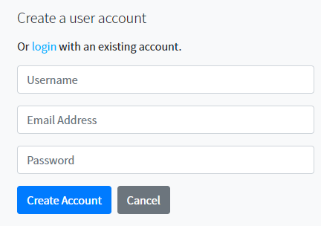
CloudIDE
CloudIDE is our cloud-based IDE which developers can simply login and start coding.
ECL Cloud IDE (hpccsystems.com)
Select Register
Enter required information
Username: FirstName_LastNameInitial
Select Create Account
A confirmation email is sent
Confirm the account

Slide 26
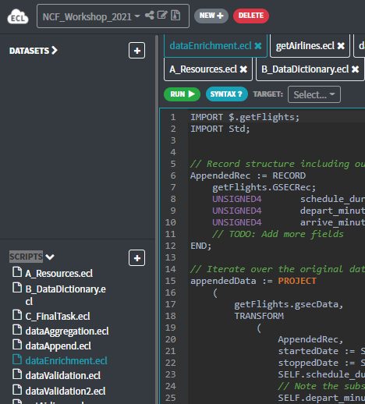
ECL CloudIDE
Once logged in please click on the following:
https://ide.hpccsystems.com/workspaces/share/8ccac7cb-2af6-47f9-ba12-1066e41aedf8

Slide 27

VSCode
Clone or copy the repo in your local machine:
https://github.com/hpccsystems-solutions-lab/ScheduledFlights-Workshop/Workshop
Open VSCode
Extension installation: search for ECL Language
Install the plugin
Select File/Open Folder
Select SourceCode folder from BigData-Workshop

Slide 28
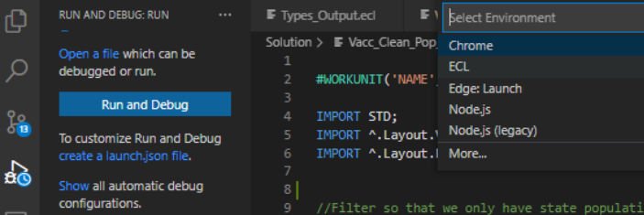

VSCode
Once plugin is installed and you have SourceCode open, select Run/Debug from left panel.
3
Now you have the default lunch.json
Loaded.
From Github copy the content of json file.
Update “user”
1
2
Json: https://raw.githubusercontent.com/hpccsystems-solutions-lab/BigData-Workshop/main/launch.json?token=AGG25XI46SJE7H4ASBUDRPTASBEWS

Slide 29
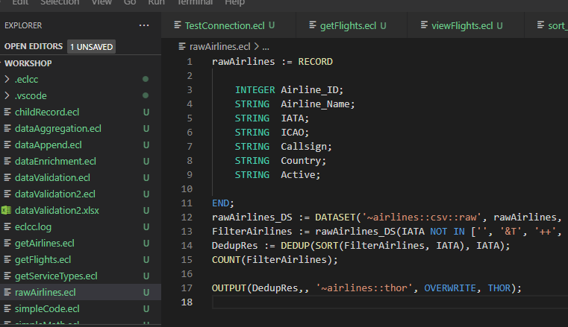
VSCode
Once you have source code open you should see the same files on the left panel

Slide 30
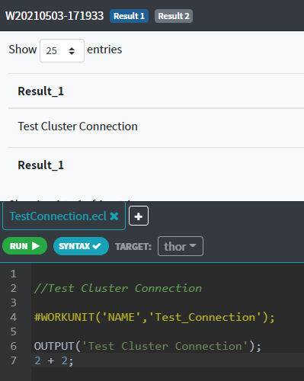
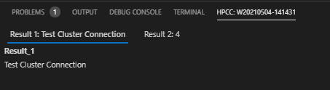
Test Connection Cloud IDE & VSCode
Please run TestConnection.ecl to make sure everything is working.
Results can be viewed in both platform (VSCode and CloudIDE)
Select Thor

Slide 31

Let’s Get Real
Let’s look around ECL Watch
Can you find the WUID you just ran? TestConnection.ecl?
http://52.167.137.162:8010/

Slide 32
Aviation Industry

Slide 33



Aviation Industry: What used to be
US
Worldwide Annually
Over $800 billion in revenue
Over 4 billion passengers
Over 40,000 airports
US (FAA, Federal Aviation Administration) Annually
Over $200 billion in revenue
Over 16 million flights
Over 1 billion passengers

Slide 34

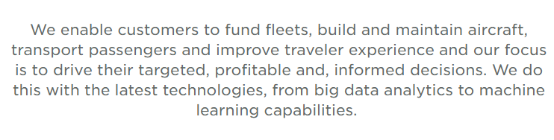
Cirium a sister company to LexisNexis Risk and both under RELX.
Collecting data from trusted industry relationships with IATA, ARC, airlines, airports, GDSs, the FAA, OEMs, banks, lessors...it equates to over 2000 sources.
We have data sets that can be delivered in real time, refreshed weekly or extracted from our extensive historical records, including the most comprehensive archive of fleet data sources.
Employing sophisticated tools and statistics to corroborate information, throw out outliers and fill in gaps.
https://www.cirium.com/

Slide 35
The Data – Scheduled Flight Information
GSEC
Meaning: “Global Sectorized”
Each record represents one, possibly repeating, scheduled flight
4.88M rows of data
~4.5GB in size
Originally in CSV format
General contents
Plane
Carrier
Seating
Meal options
Flight
Flight number
Source and destination
Departure/arrival times
Connection info
Dates
Valid date range for schedule
Operating days of week
Notes:
Click links to see raw data

Slide 36
ECL Basics

Slide 37
ECL
ECL is a language design to query/manipulate massive data and is used for ETL (Extract, Transform, Load) and data visualization.
Extract
Reading data from different type of datasets
Transform
Formatting/converting data to needed shape, so it can be used
Load
Writing dataset to it’s target location
Source
Extract
Transfer
Load
Destination

Slide 38
House Keeping
C++ compiler
Declarative Lang: You say want you want to be done, not how to do it
Not case-sensitive // Using upper case for keywords are recommended
White space is ignored // Using white space and line break are recommended for clean code and readability
Formatting is recommended
// This is a single line comment
/* A block comment */
Object.Property syntax is used to qualify definition scope and disambiguate field references within datasets:
ModuleName.Definition // Reference a definition from another module/folder
Dataset.Field // Reference a field in a dataset or record set

Slide 39
House Keeping Cont.
Definition assignment is :=
Semicolon terminator: num := 12;
Equality test is = valOne = valTwo
Attributes can be defined only once
Only those definitions that contribute to a result are compiled and used
There are no loops. TRANSFORM and PROJECT is used instead.
Order of operators remains the same

Slide 40
Statement Types
Two Statement Types
Definition
Assign an expression to an attribute
Action
Actually do something that affects the outside world
Plot Twist
You can define an attribute as an action

Slide 41
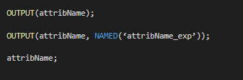
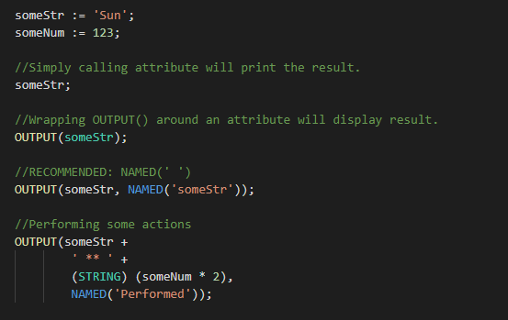
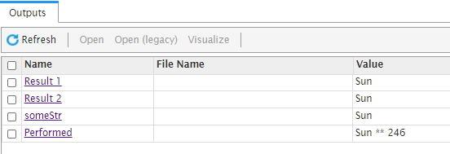
OUTPUT Function
Used to display result.
OUTPUT Optional, recommended.
NAMED Optional, recommended.

Slide 42
Let’s Get Real
// Open simpleCode, review it and run it
// Let’s review the result together
TODO
// Display the following:
// My random value is : (the number) and my fave day is Friday.
// Hint: use RANDOM() function to get a random value.
// Exp: My random value is: 32 and my fave day is Friday.
WU Name

Slide 43
Common Data Types
Character
STRING[n]
UTF8: unicode character string
UNICODE[_locale][n]: A UTF-16 encoded unicode character string of n characters
Other
BOOLEAN
SET OF <type>
RECORD
DATASET
Numeric
INTEGER[n]: An n-byte integer value. Valid values for n are: 1, 2, 3, 4, 5, 6, 7,or 8
UNSIGNED[n]:
REAL[n]: An n-byte standard IEEE floating point value. Valid values are 4, and 8
DECIMAL<n>[_y]: A packed decimal value of n total digits with y digits after the decimal. Example: DECIMAL6_3

Slide 44
Data Structure

Slide 45
Data Structure
Data structure is about data management, storage format, retrieving and processing it.
A collection of data types which are stored and organized for further usage.
Benefits
Increased efficiency
Easy modification
Easy access to data

Slide 46

RECORD
Linear representation of file’s record structure.
Defines the layout of fields.
Defines fields types
Defines the order of fields
It can include child record.
A dataset within dataset

Slide 47
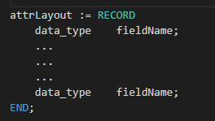
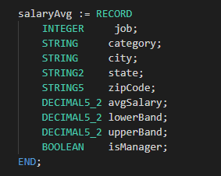
RECORD
Standalone Record Structure:
attrLayout: The name by which the record will be invoked
RECORD: Required
data_type: Data type of the field (string, integer, Boolean, …)
fieldname: The name by which the field will be invoked
END: Required. Indicates the end of record layout

Slide 48
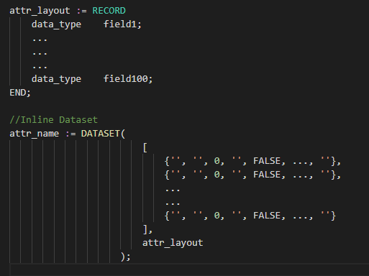
Inline DATASET
Creates a temporary dataset in memory
Dataset is only available at run time, unless it’s saved in a file
Data is written manually
Will result in a logical/Thor file
attr_name Dataset name
DATASET Required
attr_layout Record structure the dataset is using

Slide 49
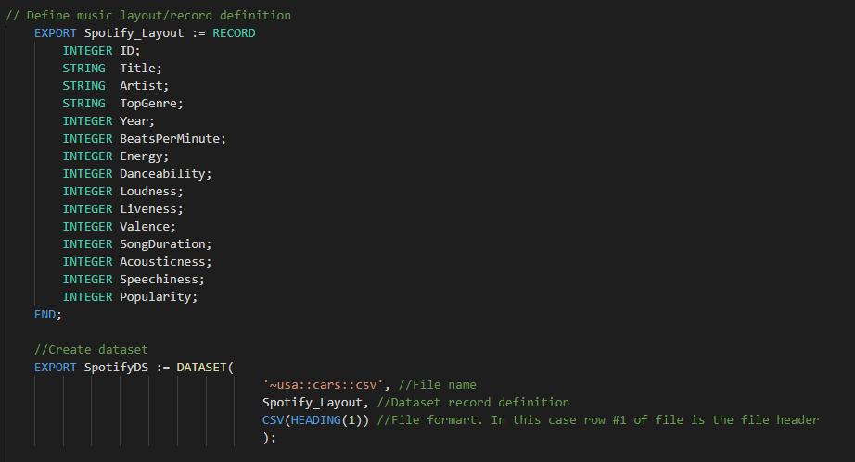
DATASET - Files

Slide 50
Dataset File Types
FLAT: Native file type for Thor; also used for fixed-length raw records
CSV: Any kind of delimited data, including CSV-encoded data
JSON: Data stored as a series of JSON objects
XML: Data stored as a series of XML documents
PIPE: Data obtained dynamically via process calls

Slide 51
MODULE
Is a container that allows you to group related definitions. The parameters passed to the module are shared by all the related members definitions.
Your file name should be exactly the same as Module name.
Variable Scope
Local Definitions are visible only up to an EXPORT or SHARED
SHARED Definitions are visible through module.
EXPORT Definitions are visible within and outside of a module .

Slide 52
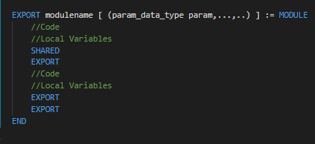
Module
EXPORT Optional, indicates that this module is available outside of this file
moduleName The name of the function
MODULE Required
param_data_type Data type of each parameter (string, integer, Boolean, …)
END Required. Indicates the end of module
SHARED The attribute or function can be accessed within the module
EXPORT The attribute or function can be accessed from outside of the module as well as with the module

Slide 53
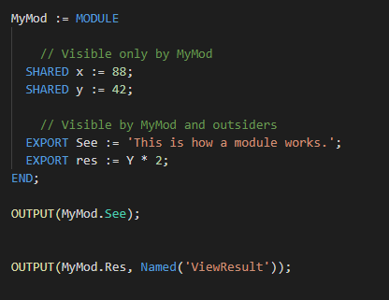


MODULE

Slide 54
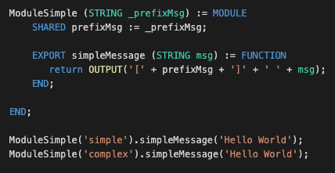
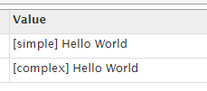
Module Example

Slide 55
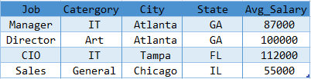
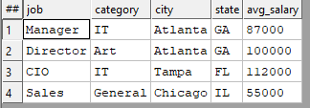
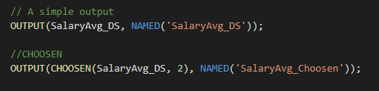

CHOOSEN
Returns the first n number of records.

Slide 56
Let’s Get Real
// Let’s start by reviewing getFlights module. // Open viewFlights file
TODO
// Display the first 200 rows and name it DisplayFlights
WU Name

Slide 57
SORT Function
Ascending or descending sort
attr_name The name by which the function will be invoked
SORT Required
dataset_name The dataset to perform action on
- To sorts descendingly
field(s) Field or fields to sort on

Slide 58
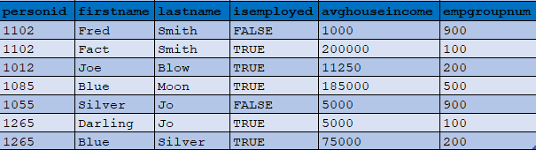
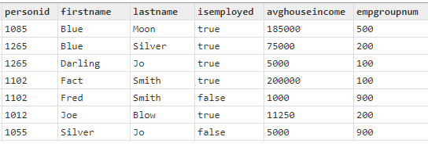

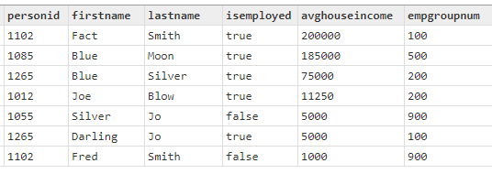
SORT

Slide 59

FILTER
Choosing a smaller part of dataset
It’s recommended to filter down to the desire dataset before any processing
If filtering on STRING value, it is case sensitive
attr_name The name by which the function will be invoked
dataset_name The dataset to perform action on
Filtering conditions Field and required filtering conditions

Slide 60

FILTER
All records within dataset will be evaluated
If boolean_expression evaluates to TRUE for a particular record, it will be included in the result
Comparison Operators
=
<> or !=
<
>
<=
>=
<=>
Logical Operators
AND
OR
NOT or ~

Slide 61

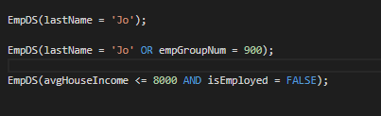
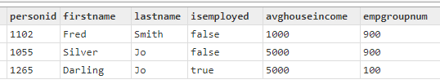

FILTER

Slide 62
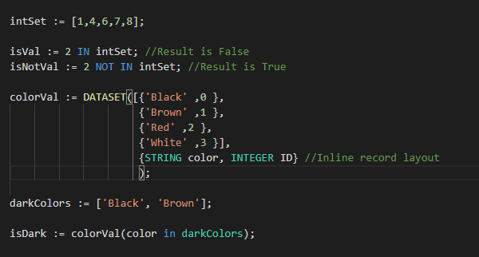

IN – NOT IN Operators
It’s an operator
A collection of OR conditions
Search a SET to check for result
It can be used on a dataset field

Slide 63


BETWEEN Operator
It’s an operator for range check.
Same as <= and >=
attr_name The name by which the operation will be invoked
seek_val The value to be checked. Can be a dataset field
BETWEEN Required
NOT Usen for certain searches
Low_val Low value in the range
AND Required
high_val High value in the range

Slide 64
Let’s Get Real
// Open sort_filter file
TODO
// Filter down to only Delta(DL) flights operating in November 2019
// Display result as filteredData
// Display Flights that thier DepartStationCode are in LHR or ORD
// and ArriveStationCode is in JFK, ATL, or ORD.
// Sort the result Carrier and FlightNumber
//Hint: remember to use CHOOSEN for the OUTPUT to view results
WU Name

Slide 65
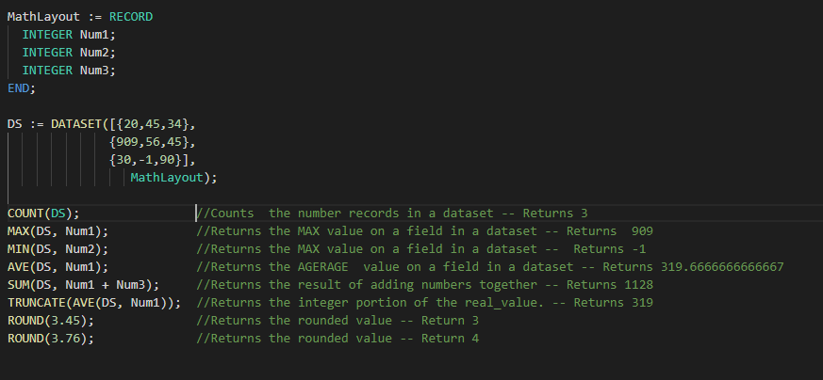

Math Functions

Slide 66

Let’s Get Real
//Open simpleMath file
TODO
// Filter your dataset for minFlightNumber and display results as getFlightNumbers
// How may rows are in getFlightNumbers?
//Hint: remember to use CHOOSEN for the OUTPUT to view results
WU Name

Slide 67
Data cleansing & validation

Slide 68
Data Cleansing
Data Cleansing is the process of fixing or removing incorrect, corrupted, incorrectly formatted, duplicate, or incomplete data within a dataset.
Part of Data Validation process
Used upon receiving raw data and structuring the data
Also used when combining multiple datasets (in case of duplication, or incomplete data)
Data Cleansing Techniques
Removing duplicates
Removing irrelevant data
Fix structural errors/inconsistent data: “N/A” vs “Not Available”
Handling missing data

Slide 69
Data Validation
It is often a good idea to test specific values within records for validity
What you do with the results is a different matter
Recommendation: Mark the record as having problems, but don’t delete it
Validation is usually fast and easy
Define a new record structure with new fields containing test results
BOOLEAN values with descriptive names
Include a final “is this valid” BOOLEAN field that summarizes all tests
This makes it easy to filter the records
All of the above can be done in one pass, using the PROJECT() function

Slide 70
Data Transformation
Data Transformation is the process of converting data from one format or structure into another
Changing the shape/format of data
Part of Data Validation and Data Cleansing processes
Also used when combining multiple datasets (in case of duplication, or incomplete data)
Examples
Address cleaning: breaking one line address to different fields
Converting all SSN or DOB to a business approved format
Adding leading 0 or blanks to make all values in a field unified
Can you think of other examples?

Slide 71
TRANSFORM Function
A specialized function, and its purpose is to create a record.
Return value is the output record definition.
It acts like an object constructor.
Specifies exactly how each field in an output record receives its value.
The result of a call to a TRANSFORM is one record
The body of a TRANSFORM defines how fields within the resulting record are populated
TRANSFORM is used with PROJECT, JOIN, ITERATE, ROLLUP and more.

Slide 72
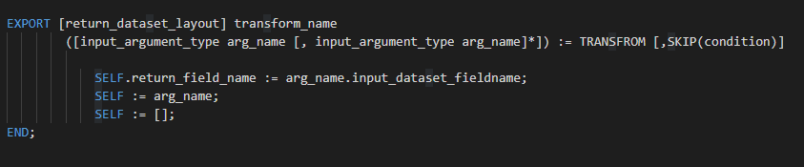
TRANSFORM Function
EXPORT
ECL Keyword
Optional, used for constants, or in modules
return_dataset_layout
Record-definition/layout of result dataset
transform_name
The name by which the transform will be invoked
Input_arguments_types
The argument’s data type
If passing a dataset, the data type is DATASET(record_definition)
arg_name
Used to reference your argument in the transform

Slide 73
TRANSFORM Function
TRANSFROM
ECL Keyword
Required
SKIP Optional. Specifies the condition under which the TRANSFORM function operation is skipped.
SELF
Reference the field in the return/result datatype
argname.inputDataset_fieldname
Refers to the field in the input dataset
END
ECL Keyword
Required

Slide 74
TRANSFORM Function
Attribute Definition
SELF := [];
For every field in result layout that doesn’t have a defined operation or doesn’t exists in input dataset, assign default value.
For example if there is a STRING field in result layout, that transform didn’t assign a definition for, it will be assigning to blank.
If included, it is almost always the last assignment.
SELF := LEFT;
SELF := RIGHT;
Get the original values from input dataset for all fields that don’t have an operation defined.
NOTE You can write inline function or call other functions or modules in your transform.

Slide 75
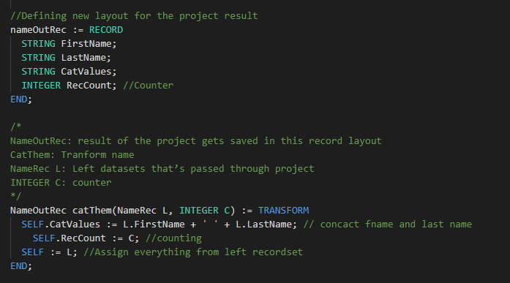
TRANSFORM Function
TRANSFORM should be used with other functions such as JOIN, PROJECT, to generate result.

Slide 76
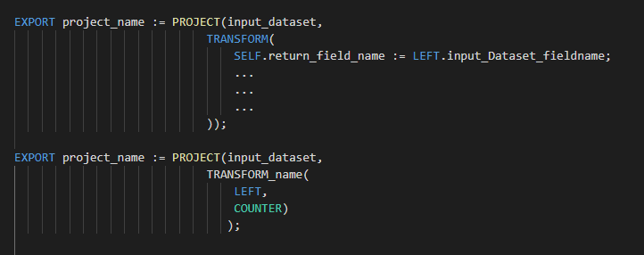
PROJECT Function
The PROJECT function processes through all records in the record-set performing the transform function on each record in turn.
For every record in input ds, create a record in new dataset
PROJECT is like SQL's SELECT … INTO TABLE …
EXPORT
ECL Keyword
Optional, used for constants, or in modules
project_name
The name by which the project will be invoked
input_dataset
The input dataset

Slide 77
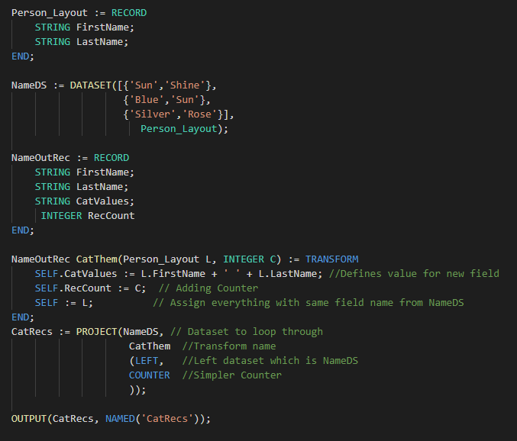


Example
NameOutRec: Result Layout
CatThem: Transform Name
Person_Layout: Input Dataset Layout
L : Reference to Person_Layout fields
SELF: Refers to fields in result dataset
C: Will do the Counting

Slide 78
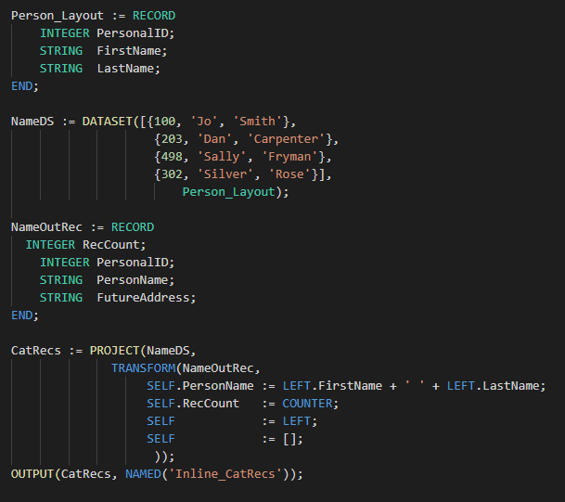
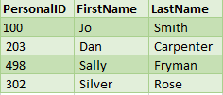
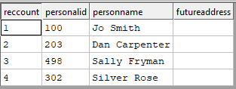
Example
CatRecs: Project Name
NameDS: Input Dataset to loop through
NameOutRec: Result layout
SELF: Refers to fields in result dataset
SELF := LEFT: Assign everything with same field name from NameDS
SELF := [ ]: All un-assigned fields will be set to default values

Slide 79
Let’s Get Real
// Open dataValidation file
// Let’s review dataValidation
// Looking at the fields in the datasets, what other fields we can validate?
TODO
// Add 4 more validations

Slide 80
Data enrichment

Slide 81
Data Enrichment/Enhancement
Data Enrichment is the process of adding new data elements to an existing data for more complete data
Combining data also counts as data enrichments
Breaking complex fields
Standardizing similar fields (dates, time)
It mostly happens after receiving raw data and structuring it, but keep in mind that it’s a continuous process.
Can be used to improve data quality as part of data validation process
Examples
Enhancement of a company’s customer files:
Companies often collect basic information on their clients such as phone numbers, emails, or addresses. A data append takes the information they have, matches it against a larger database of business data, allowing the desired missing data fields to be added.

Slide 82

Let’s Get Real
// Open dataEnrichment file
// Let’s review dataEnrichment
// Looking at the fields in the datasets, what other fields we can Enriched?
TODO
// Add 3 more enrichments
//Hint: remember to use CHOOSEN for the OUTPUT
WU Name

Slide 83
Data Enrichment From Without – Append From Other Data Sources
Three major purposes
Provide a greater or more precise context for the data
Example: Append cell carrier name by matching the phone number
Add new information relating to an entity within a record
Example: Given a record with only a customer ID, append the customer’s name, address, phone, etc.
Join coinciding information
Used most often in time-oriented data to find possible correlations between disparate data
Example: Given data on fast-food sales in a city, append city traffic conditions to see if traffic jams affect the sale of hamburgers
Joining datasets is not always straightforward
Easy: Finding customer information given a customer ID
Harder: Finding customer information given a customer’s first and last name, and the match can include typos or misspellings

Slide 84

JOIN
JOIN is used to combine data or rows from two or more tables/datasets based on at least one common field between them.
Part of Data Append or Data Enrichment.

Slide 85
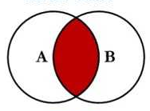
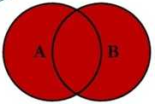
Join Types
INNER Join selects all rows from both datasets if the condition satisfies.
This join will create the result-set by combining all rows from both the datasets where the condition satisfies. This is the default JOIN.
FULL OUTER Join selects all rows from both the datasets regardless of join condition.
This join will create the result-set by combining all rows from both the datasets, including matched and non matched rows.
For non matched rows, the fields from opposite dataset will remain null.

Slide 86
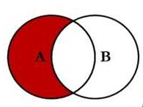
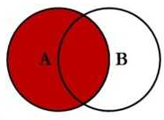
Join Types
LEFT ONLY Join returns all the rows of the dataset on the left side of the join that didn’t match any rows from right dataset.
LEFT OUTER Join returns all the rows of the dataset on the left side of the join and matching rows for the dataset on the right side of join.

Slide 87
Join Types
INNER | Default, keep only those records that exist in both datasets.
LEFT OUTER | Keep all records from LEFT, even if there are no matches.
RIGHT OUTER | Keep all records from RIGHT, even if there are no matches.
LEFT ONLY | One record for each left record with no match in the right.
RIGHT ONLY | One record for each right record with no match in the left.
FULL ONLY | One record for each left and right record with no match in the opposite.
FULLER OUTER | One record for each record in left and right dataset.

Slide 88

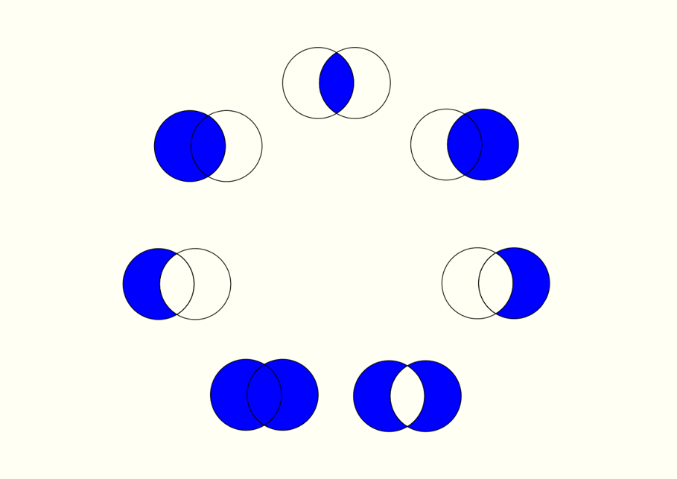
Inner
Left Outer
Right Outer
Join Types
Left Only
Right Only
Full Outer
Inner Join

Slide 89
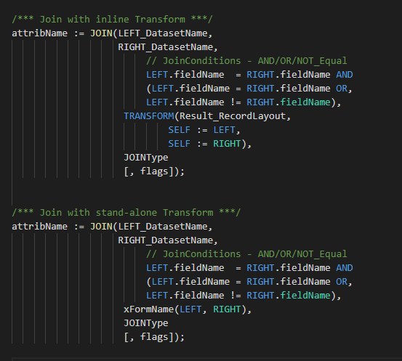
JOIN
attribName The name by which the join will be invoked
LEFT_DatasetName Left dataset name
RIGHT_DatasetName Right dataset name
LEFT.fieldName = RIGHT.fieldName
Join condition
can use equal (=) or not-equal (!=)
multiple conditions can exists using AND/OR
Transform/xFormName
Join, inline or stand-alone transform
JoinType Default is Inner join
Flags Optional
Note: When join condition is on STRING, case sensitivity matters.

Slide 90
JOIN Condition & Transform
Condition
Boolean test of arbitrary complexity
Normally contains at least one equality test
Reference attributes within the input datasets via LEFT and RIGHT - ds1 = LEFT - ds2 = RIGHT
Join conditions can be arbitrarily complex but should include at least one equality test
Transform
If using an explicit TRANSFORM, it should accept at least two arguments
One representing a LEFT record and the other representing a RIGHT record
If using an inline TRANSFORM, use LEFT and RIGHT to reference input data

Slide 91
Optional Flags
LOOKUP The right dataset is relatively small and there should be only one match for any LEFT record
ALL The right dataset is relatively small and can be copied to every node in its entirety
Can have multiple matches (unlike LOOKUP)
Supports join conditions that contain no equalities
Required if there are no equality tests in the condition
Few Specifies the LOOKUP right dataset has few records, so little memory is used
NOSORT Performs the JOIN without dynamically sorting the tables. This implies that the left and/or right record-set must have been previously sorted and partitioned based on the fields specified in the join Condition
KEYED Specifies using indexed access into the right record-set
LOCAL JOIN performed on each supercomputer node independently, and maintains the pervious distribution of data
KEEP(n) Specifies the maximum number of matching records (n) to generate into the result set. If omitted, all matches are kept.
LIMIT Specifies a maximum number of matching records which, if exceeded, either fails the job, or eliminates all those matches from the result set.

Slide 92
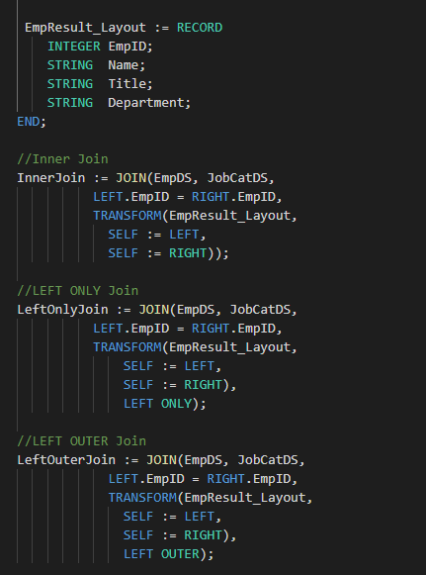
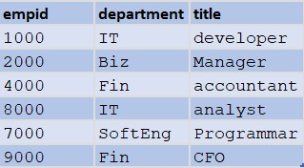




JobCatDS
EmpDS

Slide 93
Let’s Get Real
// Open dataAppend file
// Let’s review dataAppend
TODO
// Complete Part One
// Complete Part Two
WU Name

Slide 94
Data aggregation

Slide 95
Data Aggregation
Data Aggregation is the process of gathering data and presenting it in a summarized format.
Data can be gathered from multiple resources
Data should be high quality to represent valid information
The result can uncover all kind of od information about your data
Can lead to improving business decision
Can help with target marketing
Can help with research
Purpose
Data Reduction: To reduce the amount of data
Change of Scale: Data can be viewed in a higher level. Exp: State level info
More Stable Data: Tends to have less variability. A way to reduce the effect of unwanted noise. Exp: human errors, sample collection erros

Slide 96
Data Aggregation
Examples
Average age of customer by product. Each individual customer is not identified, but the average age of the customer is saved for each product
Number of customers by country
Can you think of a few usage?
Class average
Survey result
Voting result per demographic

Slide 97
TABLE Function
Creates a new dataset in memory while job is running.
The new table inherits the implicit relationality the record-set has (if any), unless the optional expression is used to perform aggregation.
There are two types of Table:
Basic concept is similar to SQL’s GROUP BY
Group records that evaluate to identical expressions, then perform aggregations across each group
Examples
MIN/MAX/AVE flight distance
Record counts
Variances

Slide 98

TABLE Function
out_recorddef Result layout
Record definition that will contain both the grouping condition results and any new attributes computed as part of the aggregation
Functions that operate on TABLE groups
SUM, MAX, MIN, COUNT, AVE, VARIANCE, COVARIANCE, CORRELATION
When used within TABLE, these functions accept the keyword GROUP to denote currently-grouped table data
dataset.field Field(s) from input dataset.
filed_name Creating new fields
attr_name The name by which the table will be invoked
Dataset Input dataset to create the table from
Outrecorddef The name by which the record layout will be invoked

Slide 99
TABLE Function
Grouping Conditions
One or more comma-delimited expressions
An expression could simply be an attribute name within the dataset; this is the most common usage
An expression could be a computed value, such as (myValue % 2) to group on even/odd values
All records within dataset that evaluate to the same set of condition values will be grouped together
Each group will result in one output record
Functions evaluated within outrecorddef will operate on the group

Slide 100
TABLE Function
Flag Options
FEW | Indicates that the expression will result in fewer than 10,000 distinct groups. This allows optimization to produce a significantly faster result.
MANY | Indicates that the expression will result in many distinct groups.
UNSORTED | Specifies that you don’t care about the order of the groups. This allows optimization to produce a significantly faster result.
LOCAL | Specifies the operation is performed on each node independently; the operation maintains the distribution of any previous DISTRIBUT.
KEYED | Specifies the activity is part of an index read operation, which allows the optimizer to generate optimal code for the operation.
MERGE | Specifies that results are aggregated on each node and then the aggregated intermediaries are aggregated globally. This is a safe method of aggregation that shines particularly well if the underlying data was skewed.
SKEW | Indicates that you know the data will not be spread evenly across nodes.

Slide 101
GROUP Keyword
The GROUP keyword is used within output format parameter (RECORD Structure) of a TABLE definition.
GROUP replaces the recordset parameter of any aggregate built-in function used in the output to indicate the operation is performed for each group of the expression.
This is similar to an SQL “GROUP BY” clause.

Slide 102



TABLE Function

Slide 103




Slide 104

Let’s Get Real
// Open dataAggregation file
// Let’s review dataAggregation
TODO
// Create your own aggregation
WU Name

Slide 105
Final Project
Let’s book a flight ☺
Maximum Team of two
Due Monday Jan 31th @7 PM
Submission by email: Bahareh.Fardanian@lexisnexisrisk.com
WUID
Team’s participants names

Slide 106


Data Profiling
Please open Data-Profiling PowerPoint.

Slide 107
Finale project

Slide 108
Final Project
I want to fly from Austin to Chicago sometime during the month of March, 2020. Exactly when is not important. During that trip, I want to visit some relatives during a brief overnight stay in Bloomington, IL. Output a dataset to the workunit where every record contains a flight that satisfies the following criteria Depart from Austin, TX airport (AUS) Arrive at the Bloomington/Normal airport in Illinois (BMI)
Hint: There will be one layover
For the connecting flight, I want to stay on the same airline because I want my bags to be transferred automatically The layover time should be no less than 1 hour and no more than 2 hours The very next day, before 10am, depart from the Bloomington/Normal airport and fly to O’Hare International Airport in Chicago (ORD) Only the record(s) matching the minimum sum total flight time + layover should be shown

Slide 109

Final Project Hints - 1
1- Filter down to the month you are after
2- Keep in mind what your final dataset should look like
3- Since you are building connections, you need to join gsec withself
4- Calculate depart or arrival time in min:
depart_minutes_after_midnight := ((UNSIGNED1)LEFT.DepartTimePassenger[1..2] * 60 +
(UNSIGNED1)LEFT.DepartTimePassenger[3..4]);
5- Keep in mind your layover time is between one to two hours, so your operation day should be same day
6- We are staying with same Carrier

Slide 110

Final Project Hints - 2
RECORDOF: https://hpccsystems.com/training/documentation/ecl-language-reference/html/RECORDOF.html

