Slide 1



Data Profiling
Notes:
NOTE:
To change the image on this slide, select the picture and delete it. Then click the Pictures icon in the placeholder to insert your own image.

Slide 2
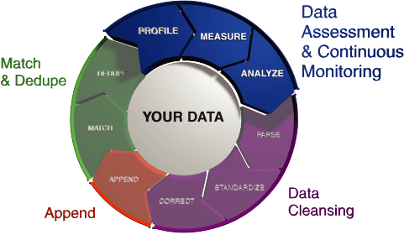
What Is Data Profiling?
A method of examining data to collect statistics and information about that data
Determines the “shape” of the data
Data types
Lengths
Cardinality
Prominent discrete values
Patterns
Also known as “Data Discovery”

Slide 3

When Would You Profile Data?
Explore a new dataset
Determine the real data types
Determine field population
Spot garbage data
Find highly-correlated fields
Verify data updates
Ensure that structure has not changed
Check for expected cardinality
Check for expected fill rates
Check for unexpected garbage

Slide 4

DataPatterns.Profile()
Availability
Built into the ECL Std library
As a separate ECL bundle (includes more functionality)
Can be invoked within ECL Watch (Thor/flat files only)
Written entirely in ECL
It is a single FUNCTIONMACRO
No library or module dependencies
Numerous parameters for controlling analysis and output
Analyze all rows in a dataset or just a sample
Analyze all fields or only certain fields
Enable only specified profiling checks
Specify returned pattern counts
Performs all profiling checks by default
Creates a single dataset as a result
One record for each field analyzed

Slide 5
DataPatterns.Profile() – The Usual Analysis
Output | Description
attribute | The name of the field in the input dataset
given_attribute_type | The ECL type of the attribute as it was defined in the RECORD definition
best_attribute_type | An ECL data type that both allows all values in the input dataset and consumes the least amount of memory
rec_count | The number of records analyzed
fill_count | The number of rec_count records containing non-nil values
fill_rate | The percentage of rec_count records containing non-nil values
cardinality | The number of unique, non-nil values
modes | The most common value(s) in the attribute, after coercing all values to STRING, along with the number of records in which the values were found
min_length | The shortest length of a value when expressed as a string
max_length | The longest length of a value when expressed as a string
ave_length | The average length of a value when expressed as a string

Slide 6
DataPatterns.Profile() – Analysis For Numeric Fields
Output | Description
is_numeric | Boolean indicating if the original attribute was numeric and therefore whether or not the numeric_xxxx output fields will be populated with actual values
numeric_min | The smallest non-nil value as a DECIMAL
numeric_max | The largest non-nil value as a DECIMAL
numeric_mean | The mean (average) non-nil value as a DECIMAL
numeric_std_dev | The standard deviation of the non-nil values as a DECIMAL
numeric_lower_quartile | The value separating the first (bottom) and second quarters of non-nil values as a DECIMAL
numeric_median | The median non-nil value as a DECIMAL
numeric_upper_quartile | The value separating the third and fourth (top) quarters of non-nil values as a DECIMAL
numeric_correlations | A child dataset containing correlation values comparing the current numeric attribute with all other numeric attributes, listed in descending correlation value order

Slide 7

DataPatterns.Profile() – Text Patterns
Text patterns give you an idea of what your data looks like when it is expressed as a human-readable generalized string
Very useful for spotting data that doesn’t belong
Converts each character of the string into a fixed character palette to produce a new string pattern
Any uppercase letter => A
Any lowercase letter => a
Any numeric digit => 9
Any boolean value => B
All other characters remain as-is
By counting the unique patterns and ranking them, you can easily see what kind of data is very common or very rare

Slide 8
DataPatterns.Profile() – Text Pattern Analysis
Output | Description
popular_patterns | The most common patterns of values; patterns are listed from most- to least-common and an example (pulled from the data) is shown for each
rare_patterns | The least common patterns of values; patterns are listed from least- to most-common and an example (pulled from the data) is shown for each; patterns already shown in popular_patterns are not repeated here
Examples
Original Value | Pattern
45816.01 | 99999.99
Dan Camper | Aaa Aaaaaa
For *only* $10! | Aaa *aaaa* $99!

Slide 9
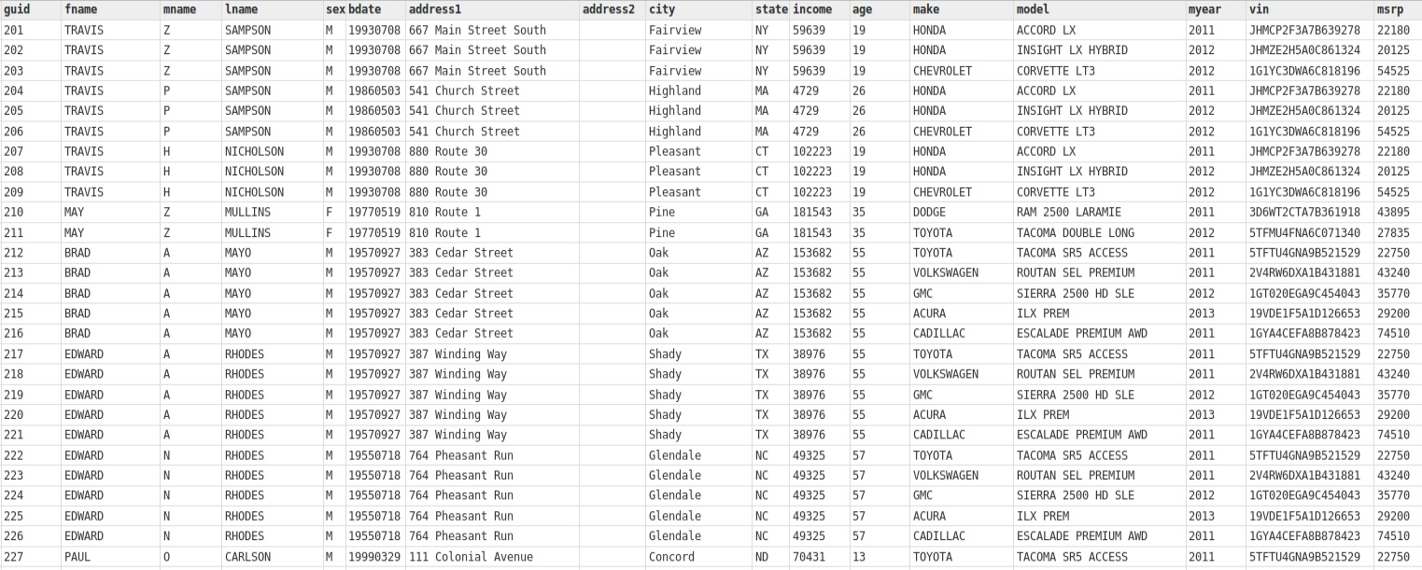
Some Data To Profile …

Slide 10
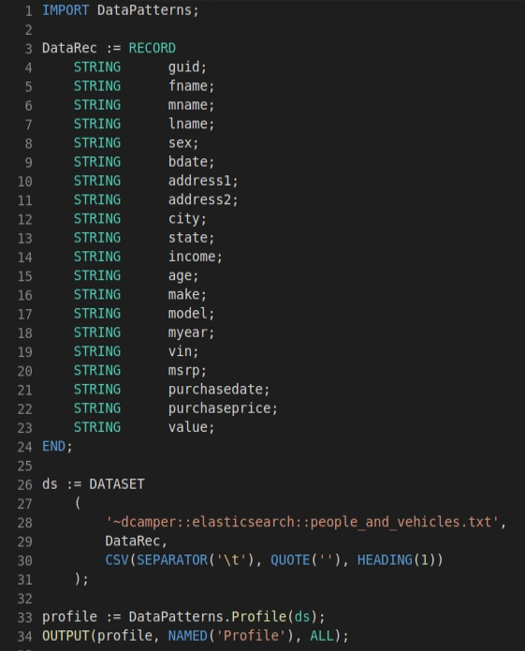
… And How To Profile It
Import the DataPatterns module
Define a record structure
Declare the dataset
Call the profiler
Show result

Slide 11
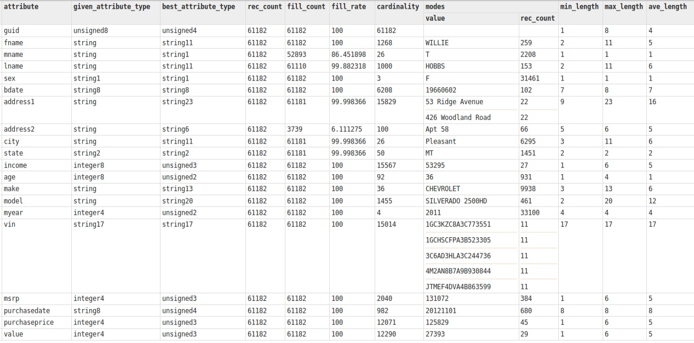
Profiling Results – The Usual Suspects

Slide 12
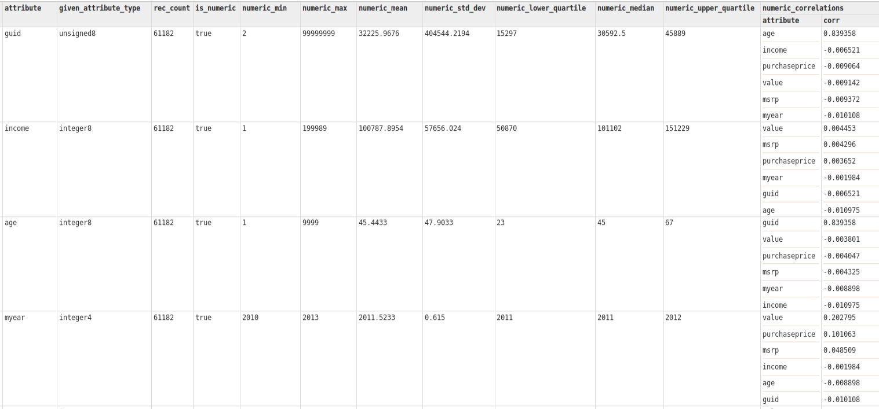
Profiling Results – Numeric Fields

Slide 13
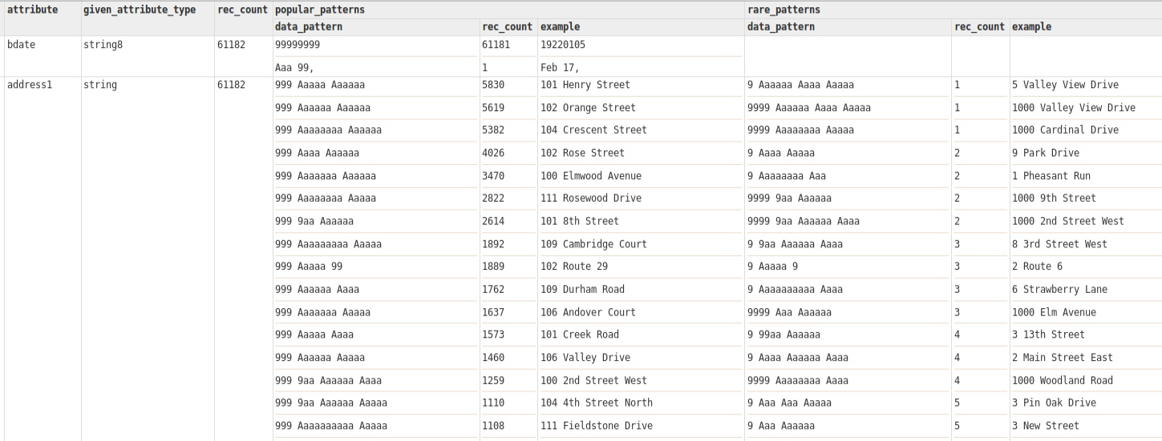
Profiling Results – Data Pattern Analysis

Slide 14
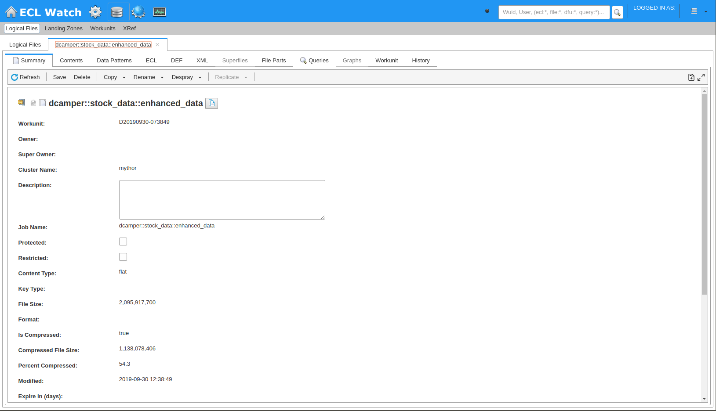
Data Profiling from ECL Watch

Slide 15
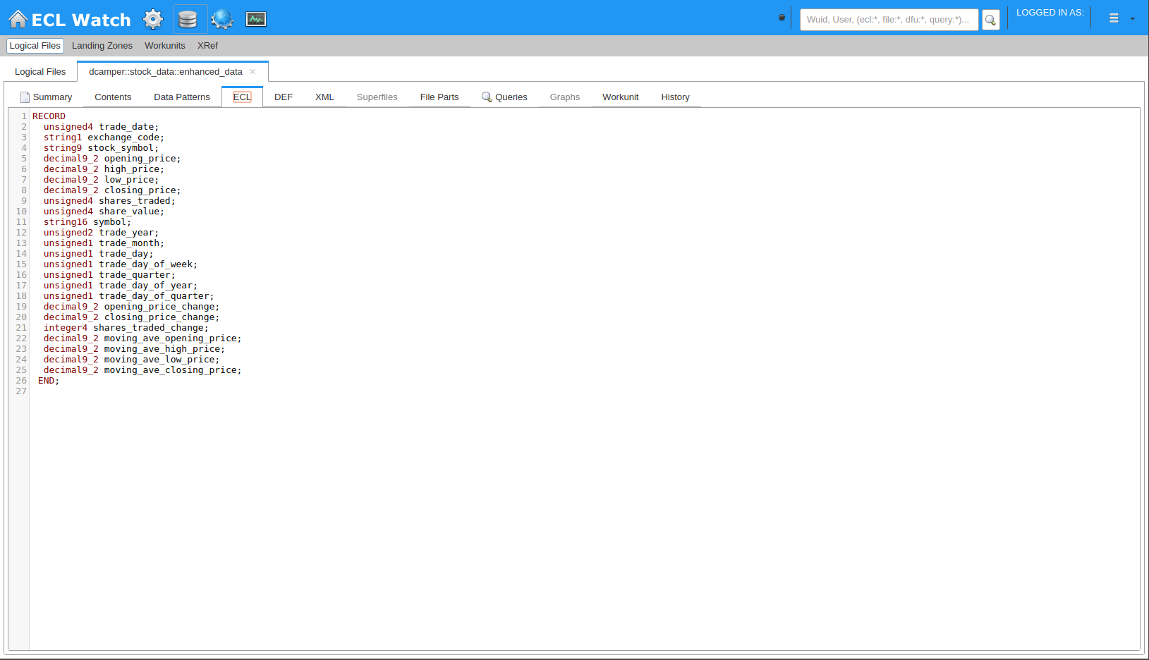
Logical File’s Record Structure

Slide 16
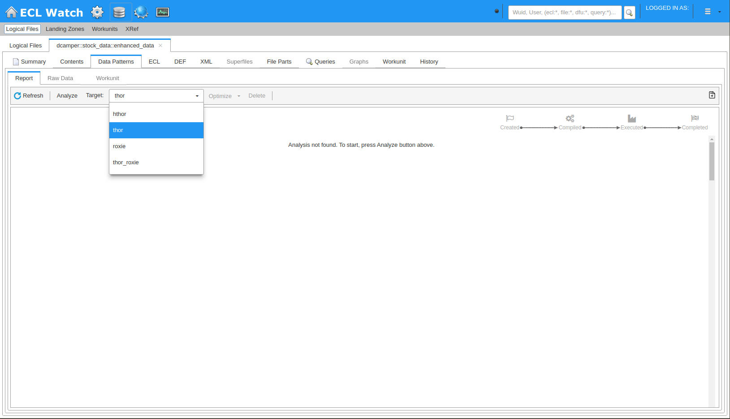
Executing DataPatterns.Profile()

Slide 17
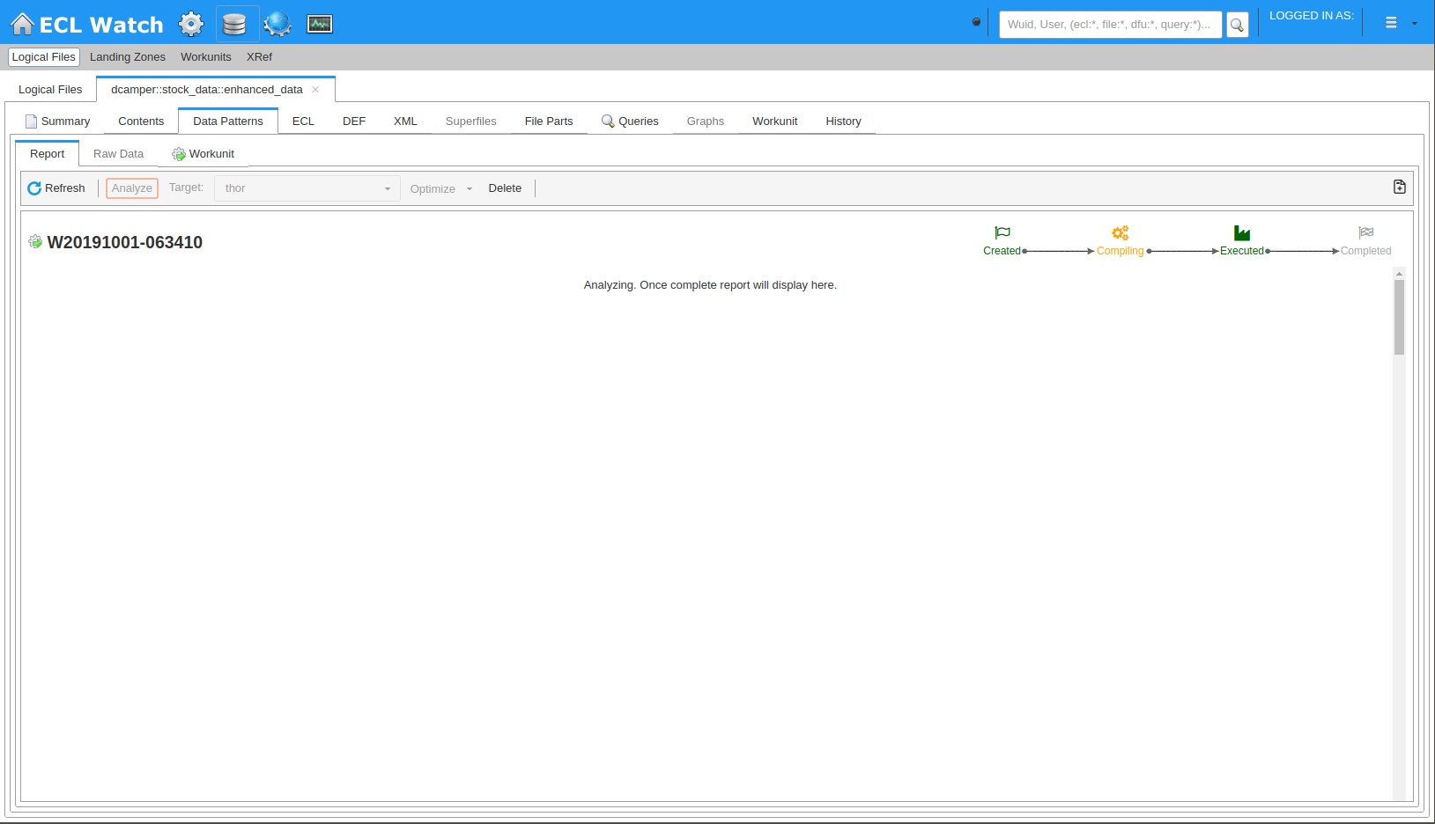
DataPatterns.Profile() In Progress

Slide 18
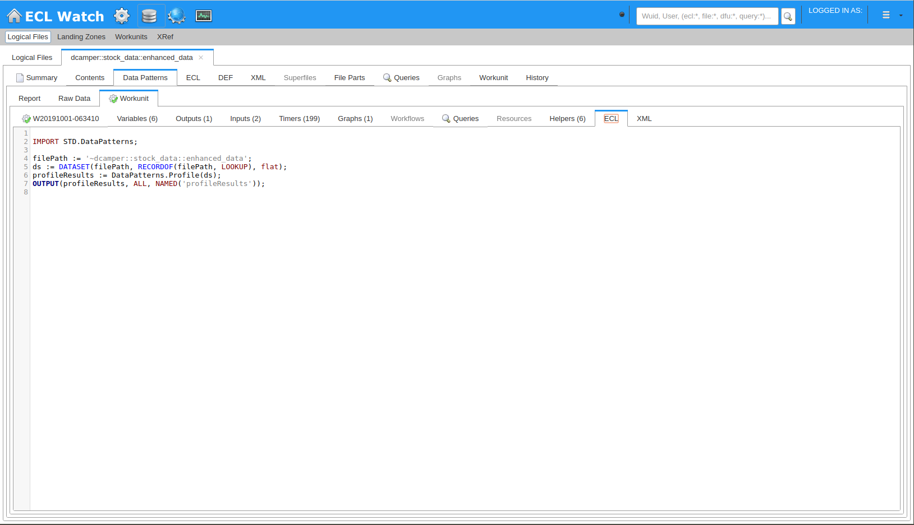
DataPatterns.Profile() Workunit ECL

Slide 19
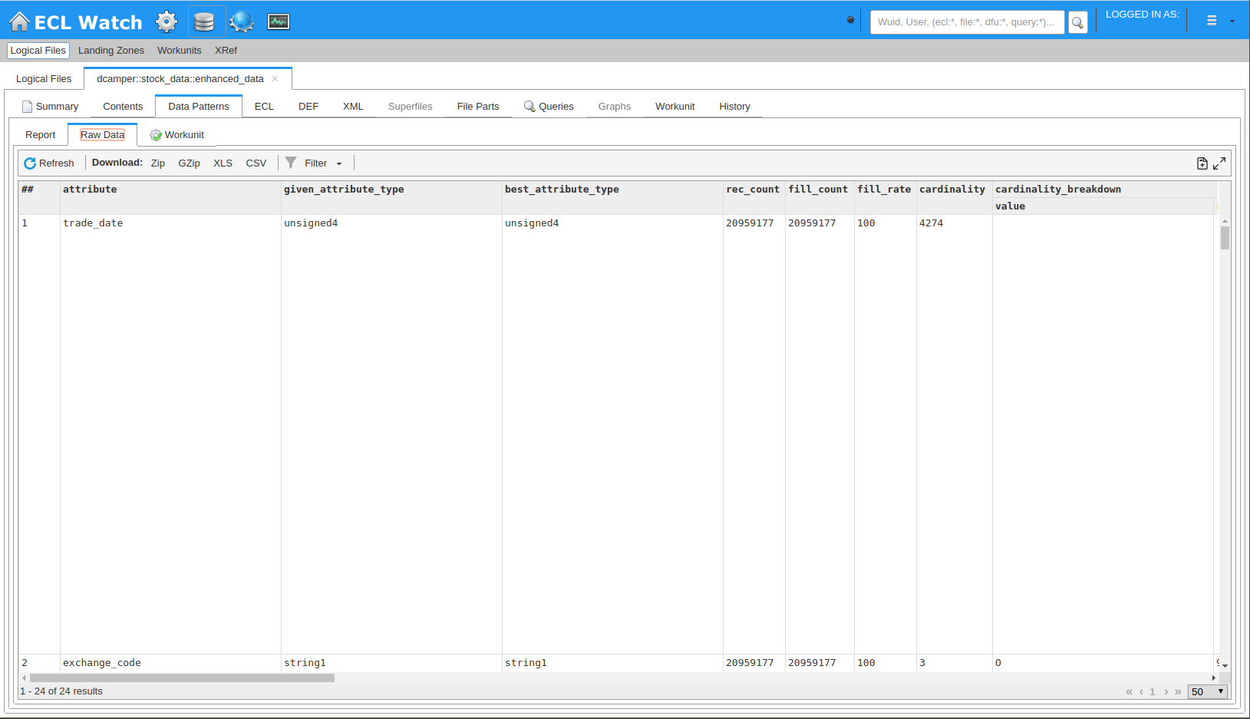
DataPatterns.Profile() Raw Results

Slide 20
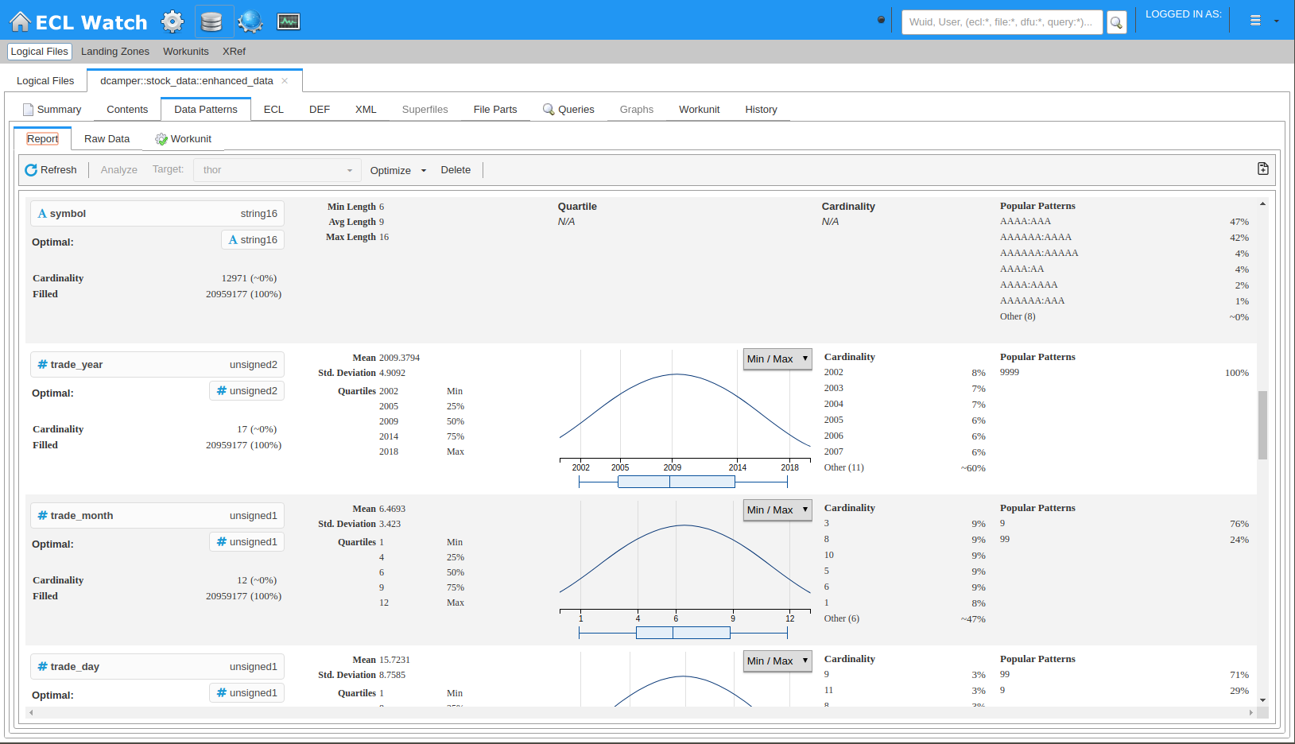
DataPatterns.Profile() Report Results

Slide 21
Availability
DataPatterns is available as an open-source ECL bundle
https://github.com/hpcc-systems/DataPatterns.git
Bundle contains a number of functions
Profile()
Data profiling
BestRecordStructure()
Generate ECL RECORD and TRANSFORM functions for converting an existing dataset to an optimally-defined dataset
NormalizeProfileResults()
Rewrite the results from Profile() into a simple, standardized three-field flat dataset to ease analysis of profile results
Validation.Validate()
Simplified data validation checks, ideal for integration with an external tool
Validation.Fix()
Simplified repair of problems found with Validate()
Benford()
Easily check numeric data with Benford’s Law
Parts of the DataPatterns bundle are built in to the ECL Std library
Functions above, in red
Within Std.DataPatterns

Slide 22
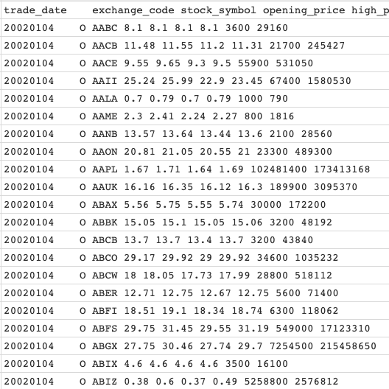
Exercise – The Data
Stock price data
January 1, 2002 through November 1, 2018
Selected American exchanges
~21M rows of data (~1GB) in a tab-delimited text file
First line of file contains field names
Data points
Trade Date in YYYYMMDD format
Exchange Code
Stock Symbol
Opening Price
High Price
Low Price
Closing Price
Number of shares traded
Share value
Closing price * number of shares traded

Slide 23
Exercise – Apply Some Logic
Field | Internal Checks | External Checks
trade_date
exchange_code
stock_symbol
opening_price
high_price
low_price
closing_price
shares_traded
share_value

Slide 24

Exercise – Go Forth And Validate

Slide 25

Questions?

