Slide 1
Accelerating Production-Scale Large Eddy
Simulations of Wind Farms on GPUs
Cunyang Wei, Wenyuan Chen, Abhinav Bhatele, Charles Meneveau, Zheng Li
University of Maryland · Morgan State University · Johns Hopkins University
Notes:
Title. This talk presents the first GPU port of LESGO, a pseudo-spectral large-eddy simulation code for wind farms.

Slide 2
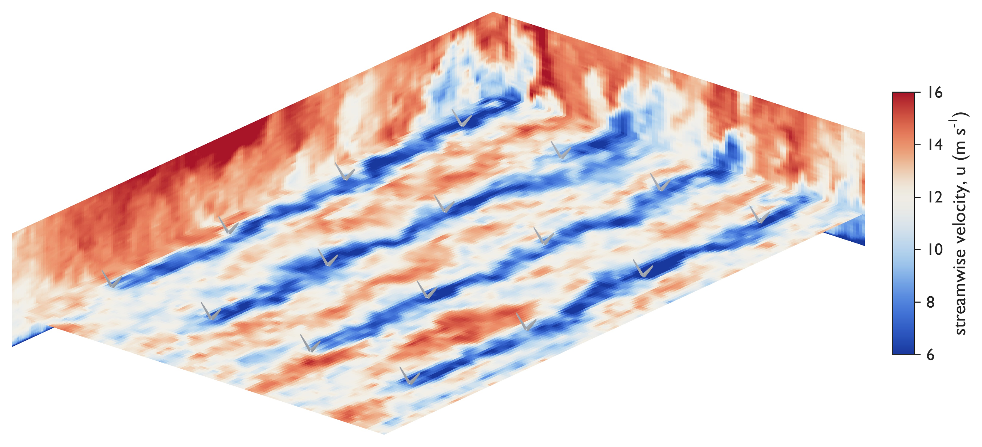
Why Accelerate Wind-Farm LES?
Fidelity needs fine grids and long physical times. The CPU code can't provide both.
Wakes cost 10–20% of farm power
Studying them means tens of turbines in kilometers of turbulent atmosphere, over hours of physical time.
LES resolves the turbulence directly
LESGO is a widely used open-source pseudo-spectral LES code: little numerical dissipation, high accuracy per grid point.
Production benchmark wf60: instantaneous streamwise velocity, 4×4 turbine section
Production runs take hours to days
Converged statistics need hundreds of thousands of steps, at 6.48 s per step on 4 CPU nodes.
60
604M
28 km
wind turbines
grid cells
domain length
Notes:
Wake losses reduce farm output by 10 to 20 percent. LES is the standard tool, and LESGO is a widely used pseudo-spectral code for this regime. The problem: a production run of our 60-turbine case needs hundreds of thousands of steps, and the CPU code tops out at 6.48 seconds per step.

Slide 3
One LESGO Time Step
for n = 1, N do
…
adaptive time-step control (elided)
Derivatives()
Derivatives Velocity gradients: 2D FFTs in x–y, centered differences in z.
SGS()
SGS Subgrid stress from the LASD model. Every 5th step (c = 5) it filters 21 fields at two widths and interpolates along particle paths, the most irregular routine in the solver.
if n mod c = 0 then
UpdateLASDCoefficient()
Opt. 2
SGSStress()
StressDivergence()
Convection()
Opt. 3
Convection Nonlinear term with 3/2-rule dealiasing: FFT to a 1.5× padded grid and back. The most FFT-heavy stage.
Turbines()
Turbines Actuator line: interpolate velocity at thousands of blade points, look up lift and drag in airfoil tables, then spread the forces back with a Gaussian kernel.
SampleBladeVelocities()
Opt. 2
ComputeBladeForces()
Opt. 3
SpreadBladeForces()
Opt. 2
…
explicit time integration (elided)
Pressure()
Pressure 2D FFTs split the Poisson equation into ~590K tridiagonal systems along z, one per wavenumber pair, and Thomas solves them. ProjectVelocity() then removes the divergence.
PoissonFFT()
PoissonTridiag()
Opt. 1
PoissonInvFFT()
ProjectVelocity()
end for
Notes:
This is the main time loop from the paper's Algorithm 1, with minor routines elided. Five components take most of the step time. Derivatives and convection are FFT-heavy; the LASD subgrid model and the actuator-line turbines are irregular; the pressure solve couples all processes along z. The tags on the left mark which optimization later targets each routine. Every one of these routines sweeps dozens of persistent 3D arrays, so data placement matters a lot on the GPU.

Slide 4
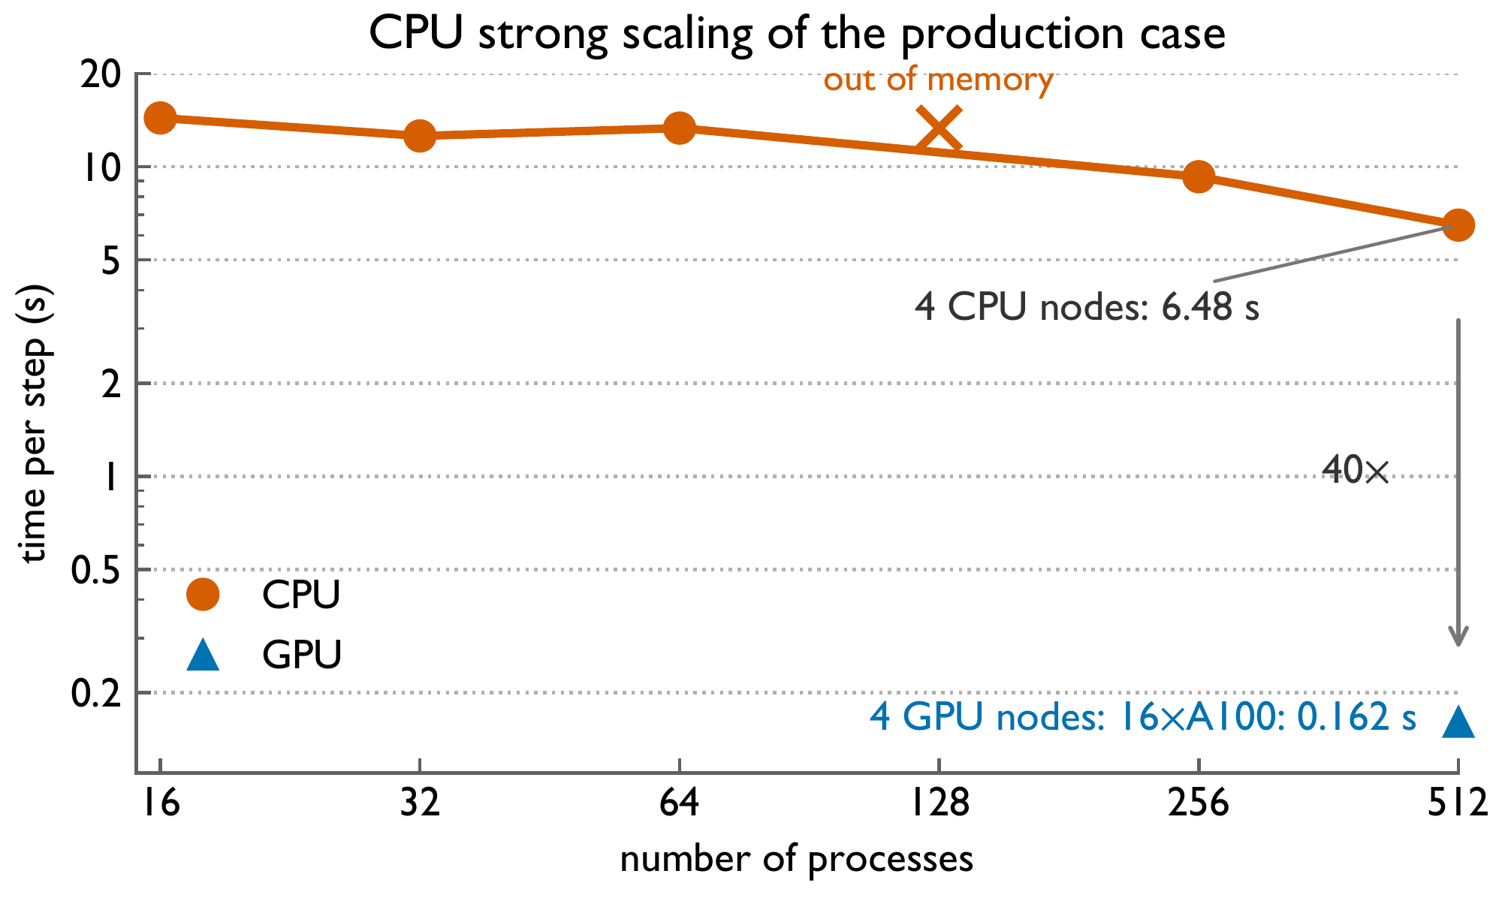
1D Slab Decomposition Hits a CPU Ceiling
More cores barely help: the node saturates memory bandwidth, then runs out of memory.
Process 3 · full x–y planes
Process 2 · full x–y planes
z
Process 1 · full x–y planes
Process 0 · full x–y planes
2D horizontal FFTs stay local: no all-to-all transposes
Halo exchange: single planes between neighbors
Poisson solve is global: every tridiagonal system spans all processes in z
1.08×
OOM
2.1×
16 → 64 cores
at 128 processes
4 nodes vs. 1
Notes:
LESGO splits the domain into horizontal slabs along z. This keeps 2D FFTs local but makes the pressure solve a serial chain across processes. On Perlmutter CPU nodes, 16 to 64 cores gives only 1.08x, 128 processes run out of memory, and four nodes plateau at 6.48 seconds per step.

Slide 5
Porting the Kernels with OpenACC
Offloading the computation is the straightforward part.
Example: a field update loop
One directive per loop nest. LESGO's kernels are loops over x, y, and z with independent iterations, so each one is offloaded as is.
collapse(3) merges the three loop levels, so every grid cell gets its own GPU thread.
default(present) stops with an error if an array is not already on the device, so no data moves behind our back.
FFTs call batched cuFFT on the same CUDA stream as the OpenACC kernels, so transforms and loops run in order without host synchronization.
One source tree. Without -acc the directives are plain comments, so the CPU build stays our correctness reference.
!$acc parallel loop collapse(3) default(present)
do k = 1, nz
do j = 1, ny
do i = 1, nx
u(i,j,k) = u(i,j,k) + dt * rhs(i,j,k)
end do
end do
end do
Notes:
Porting the computation is the easy part. Every LESGO kernel is a loop nest over x, y, and z with independent iterations, so one OpenACC parallel loop with collapse(3) offloads it. default(present) guarantees that no data is copied implicitly. FFTW calls become batched cuFFT on the same CUDA stream as the loops, so there is no host synchronization between them. The loop shown is a representative update loop, not a verbatim excerpt.

Slide 6
Computation Is Easy, Data Placement Is Not
Every solver array holds O(N³) values, so each needless transfer moves a whole field.
Directive-based ports commonly pick one of three data strategies:
1
Array mirroring
Keep a device copy of every host array, and copy data back wherever host code reads it.
2
CUDA managed memory
Let the driver migrate pages between host and device on demand.
3
Fine-grained explicit residency
Decide, array by array and access by access, where each field lives and which part of it crosses PCIe.
Strategies 1 and 2 need few code changes, so we try them first.
Notes:
Where the data lives is the hard part. Every solver array is O(N^3), so any unnecessary host-device transfer moves a whole field. Directive-based ports usually pick one of three strategies: mirroring every array, letting CUDA managed memory migrate pages, or fine-grained explicit residency. The first two need few code changes, so we tried them first.

Slide 7
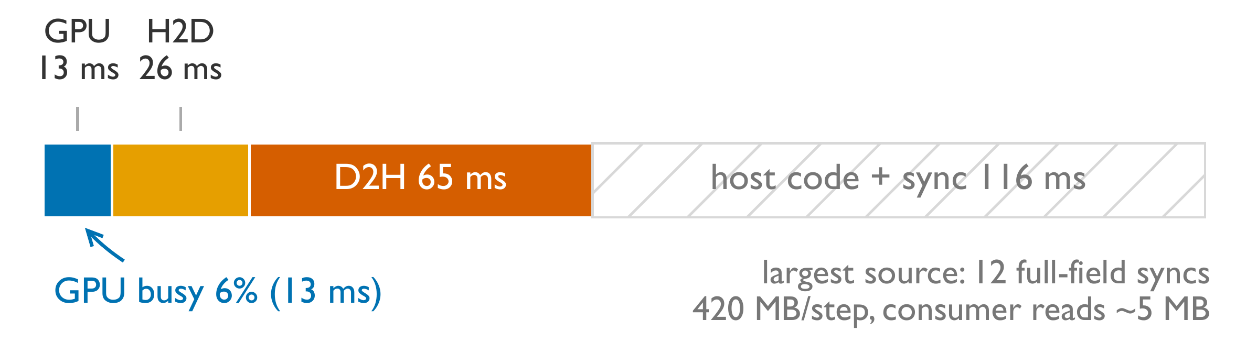
Strategy 1: Array Mirroring
Only 13 ms of a 220 ms step runs on the GPU: it sits idle 94% of the time.
Time-step breakdown on a 256³ grid with two turbines, 4 A100 GPUs (Nsight Systems)
Host routines still need full fields. Several routines run slower on the GPU and stay on the host, so full fields cross PCIe wherever they read solver state. The largest source is twelve full-field syncs, 420 MB per step, while the host reads about 5 MB.
Memory is wasted. LESGO keeps dozens of O(N³) fields plus 3/2-padded spectral scratch. Mirroring arrays that no kernel reads takes device memory, so a given grid needs more GPUs.
Notes:
Mirroring works well when every kernel moves to the GPU and data only comes back for diagnostics and checkpoints. LESGO does not fit this mold. Some routines run slower on the GPU and stay on the host, so full fields cross PCIe wherever they read solver state. On the 256-cubed reference case, only 13 of 220 ms per step is GPU execution; the rest is transfers and host synchronization. The biggest item is twelve full-field syncs, 420 MB per step, although the host only reads about 5 MB. Mirroring every array also wastes device memory.

Slide 8
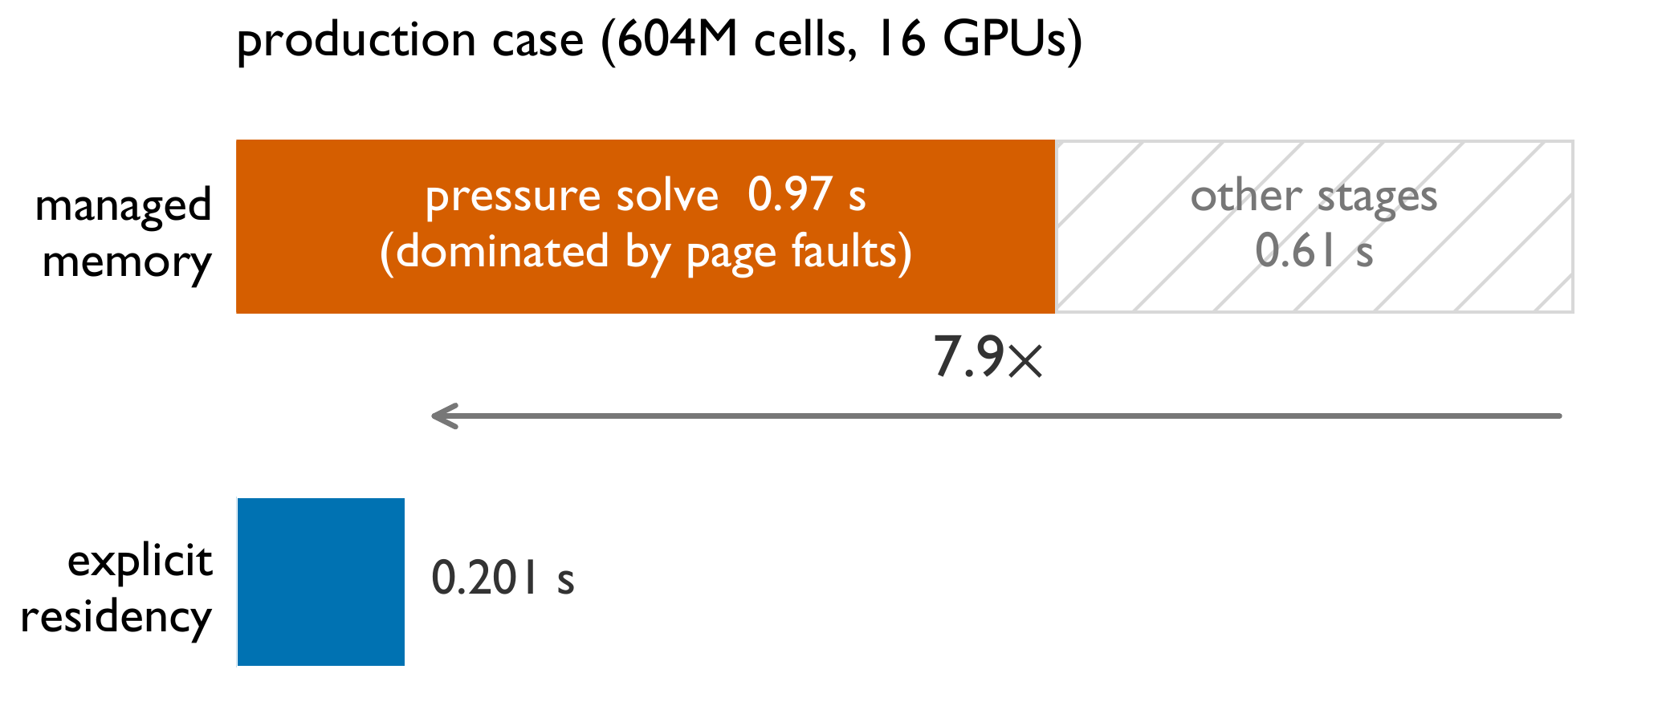
Strategy 2: CUDA Managed Memory
The least porting effort, but page faults stall execution.
nvfortran -acc -gpu=mem:managed ...
One compiler flag, no data directives to write. We run the production benchmark (604M cells) on 16 A100 GPUs.
nsys shows page faults and on-demand migration, inherent to demand-paged unified memory, stalling execution, most of all in the pressure solve.
The traffic is also invisible in the source code, so there is nothing to tune.
Same root cause for strategies 1 and 2: after the kernels move to the GPU, routines left on the host still demand full-field transfers. Fixing that needs fine-grained control over residency and transfer footprints, which is strategy 3.
Notes:
Managed memory is the least effort: one compiler flag. On the production benchmark with 16 A100s, nsys shows page faults and on-demand migration stalling execution. The figure shows the pressure solve alone taking 0.97 s per step, dominated by page faults, so the step is far slower than with explicit residency. The traffic is also invisible in the source. Both strategies fail for the same reason: after the kernels move to the GPU, the routines that stay on the host still demand full-field transfers. That leads to strategy 3.

Slide 9
Consumer-Driven Explicit Residency
Strategy 3: keep every field on the device, and size each host transfer by what the host touches.
Residency by construction. Device memory holds the primary copy of every field. All persistent arrays get the declare create directive at module scope, and every kernel asserts default(present). Host code touches solver state only at coupling points.
Classify each coupling point by the footprint the host routine actually accesses (scalar, column, plane, or subvolume), how often it runs, and whether it reads, writes, or both. LESGO has nine classes (next slide).
Four treatments, tried in order:
Gate skips the transfer on steps where its consumer does not run, such as the SGS fallback gradients and output steps.
Relocate ports the consumer to the GPU so the transfer disappears: time integration and projection, diagnostics, the actuator line, and the Thomas chains.
Slice keeps serial or I/O routines on the host but moves only the section they touch, such as wall planes and the pressure DC column.
Overlap hides irreducible host work, such as the airfoil polar lookups, behind GPU execution.
Notes:
Our port keeps device memory as the primary copy of every field. We declare arrays device-resident at module scope and assert presence in every kernel, which exposes every coupling point. We then classify each coupling point and apply four treatments in order: gate, relocate, slice, and overlap. We move to the next only if the previous one does not apply.

Slide 10
Nine Coupling-Point Classes, Four Treatments
The classes recur across pseudo-spectral multiphysics codes: a reusable porting checklist.
Class | Instance in LESGO | Naive cost per step | Treatment
Boundary plane | Wall-stress model reads u, v, w at the walls | Full fields, 420 MB | slice to wall planes, later relocate
Conditional | Velocity gradients read only by CPU SGS fallback | 9 fields, 315 MB | gate on the SGS model choice
Spectral mode | Pressure zero-wavenumber recurrence (serial in z) | 3 full-field round trips | slice to the DC column (~1 KB)
Stale entry | copyin of pressure at solver entry | 34 MB | slice to a seeded ghost plane
Pipeline state | Time integration and projection read u, v, w, RHS | 210 MB | relocate; keep pipeline on device
Actuator | Blade sampling and force projection | 2 full-field crossings | relocate; exchange O(blade points)
Diagnostics | Energy, divergence, checkpoint writes | 963 MB | relocate reductions, gate output
Serial chain | Thomas chains spanning processes | Host-staged relays | relocate; pipelined GPU exchange
Host physics | Tabulated airfoil polar lookups | Serialized 28 ms | overlap with the GPU backlog
Notes:
This table lists all nine classes we found in LESGO, what a naive port pays per step, and the treatment we apply. Most full-field transfers are either relocated to the GPU or sliced to a tiny footprint. After all treatments, steady-state PCIe traffic is 1.6 MB up and 2.0 MB down per step.

Slide 11
Example: Slicing the Pressure DC Mode
Leave the serial recurrence on the CPU, but ship only the column it touches.
Horizontal FFTs split the Poisson equation into N²−1 independent tridiagonal systems, solved as one batched GPU call
The zero-wavenumber (DC) mode is singular and needs a serial first-order recurrence in z
O(N) serial work runs faster on one CPU core than on the GPU, so it stays on the host
Naive: three full-field round trips per step
!$acc update self(p) ! 34 MB
call dc_recurrence(p) ! DC column only
!$acc update device(p) ! 34 MB
Sliced: O(1) traffic
!$acc update self(rH_z(1:2,1,:)) ! 1 KB in
call dc_recurrence_column(p_col)
!$acc update device(p(1:2,1,:)) ! 1 KB out
34 MB → 1 KB
per transfer, three round trips per step
Notes:
Here is one slice in practice. The batched tridiagonal solve for all non-zero modes runs on the GPU. The DC mode needs a tiny serial recurrence that is faster on the CPU. Our first port wrapped it in full 3D transfers, three 34 MB round trips per step. Slicing moves only the 1 KB column in and out, with the exact same arithmetic.

Slide 12
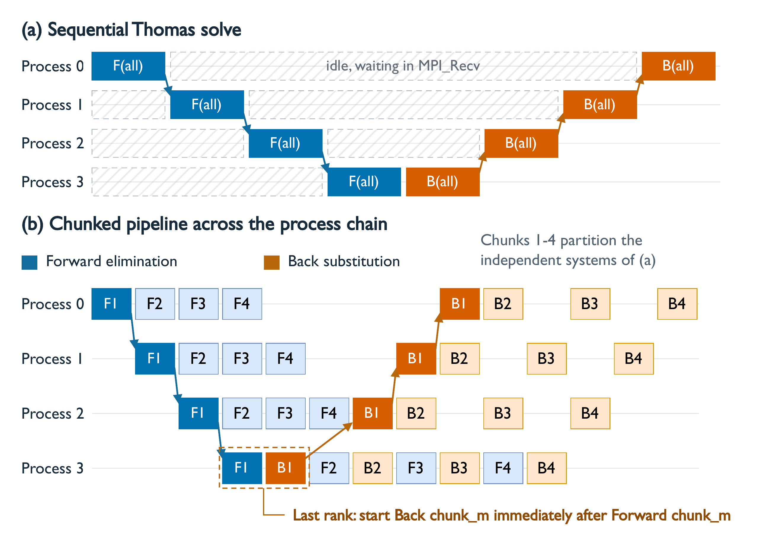
Opt. 1: Chunk Pipelining the Thomas Solve
Independent systems let each process start the next chunk instead of waiting.
Problem
~590K systems of 512 unknowns span all 16 processes. Thomas sweeps are serial in z, so process k idles until k−1 finishes.
Idea
Split the systems into chunks. Pass chunk m's boundary coefficients downstream and move straight to m+1. The last process starts back substitution right away.
1.9×
Exact
faster time step
Thomas loops untouched
Notes:
The pressure solve gives about 590 thousand independent tridiagonal systems, each distributed across all processes. The Thomas algorithm is serial along z, so processes wait on each other. Because the systems are independent, we split them into chunks and pipeline them, and the last process turns around each chunk immediately. The inner loops are unchanged, so results match the sequential solve. This gives a 1.9x step speedup.

Slide 13
Opt. 2: Batching Many Small Work Items
Per-turbine and per-plane work units are too small to fill a GPU, so we fuse them.
Actuator-line turbines
LASD subgrid model
BEFORE
BEFORE
Per-turbine uploads, launches and syncs; over 1,000 MPI_Allreduce calls per process per step.
Thousands of single-plane 2D FFTs per update: 21 fields × 2 filter widths × every z level.
AFTER
AFTER
Blade tables stay on the device. One sampling kernel and one projection kernel cover all points; one packed MPI_Allreduce.
2D scratch planes promoted to 3D. One batched cuFFT call filters all z levels of a field: a few dozen launches.
1.6×
~10×
15–18%
step speedup from batching turbines
fewer kernel launches and collectives
faster other stages (no in-loop allocations)
Notes:
Several components break into many small independent units. For the turbines, we batch the whole farm: one sampling kernel, one projection kernel, and a single packed reduction instead of over a thousand. Removing in-loop device allocations also sped up other stages by 15 to 18 percent. For the LASD model, promoting 2D scratch planes to 3D lets one batched cuFFT call filter every vertical level at once.

Slide 14
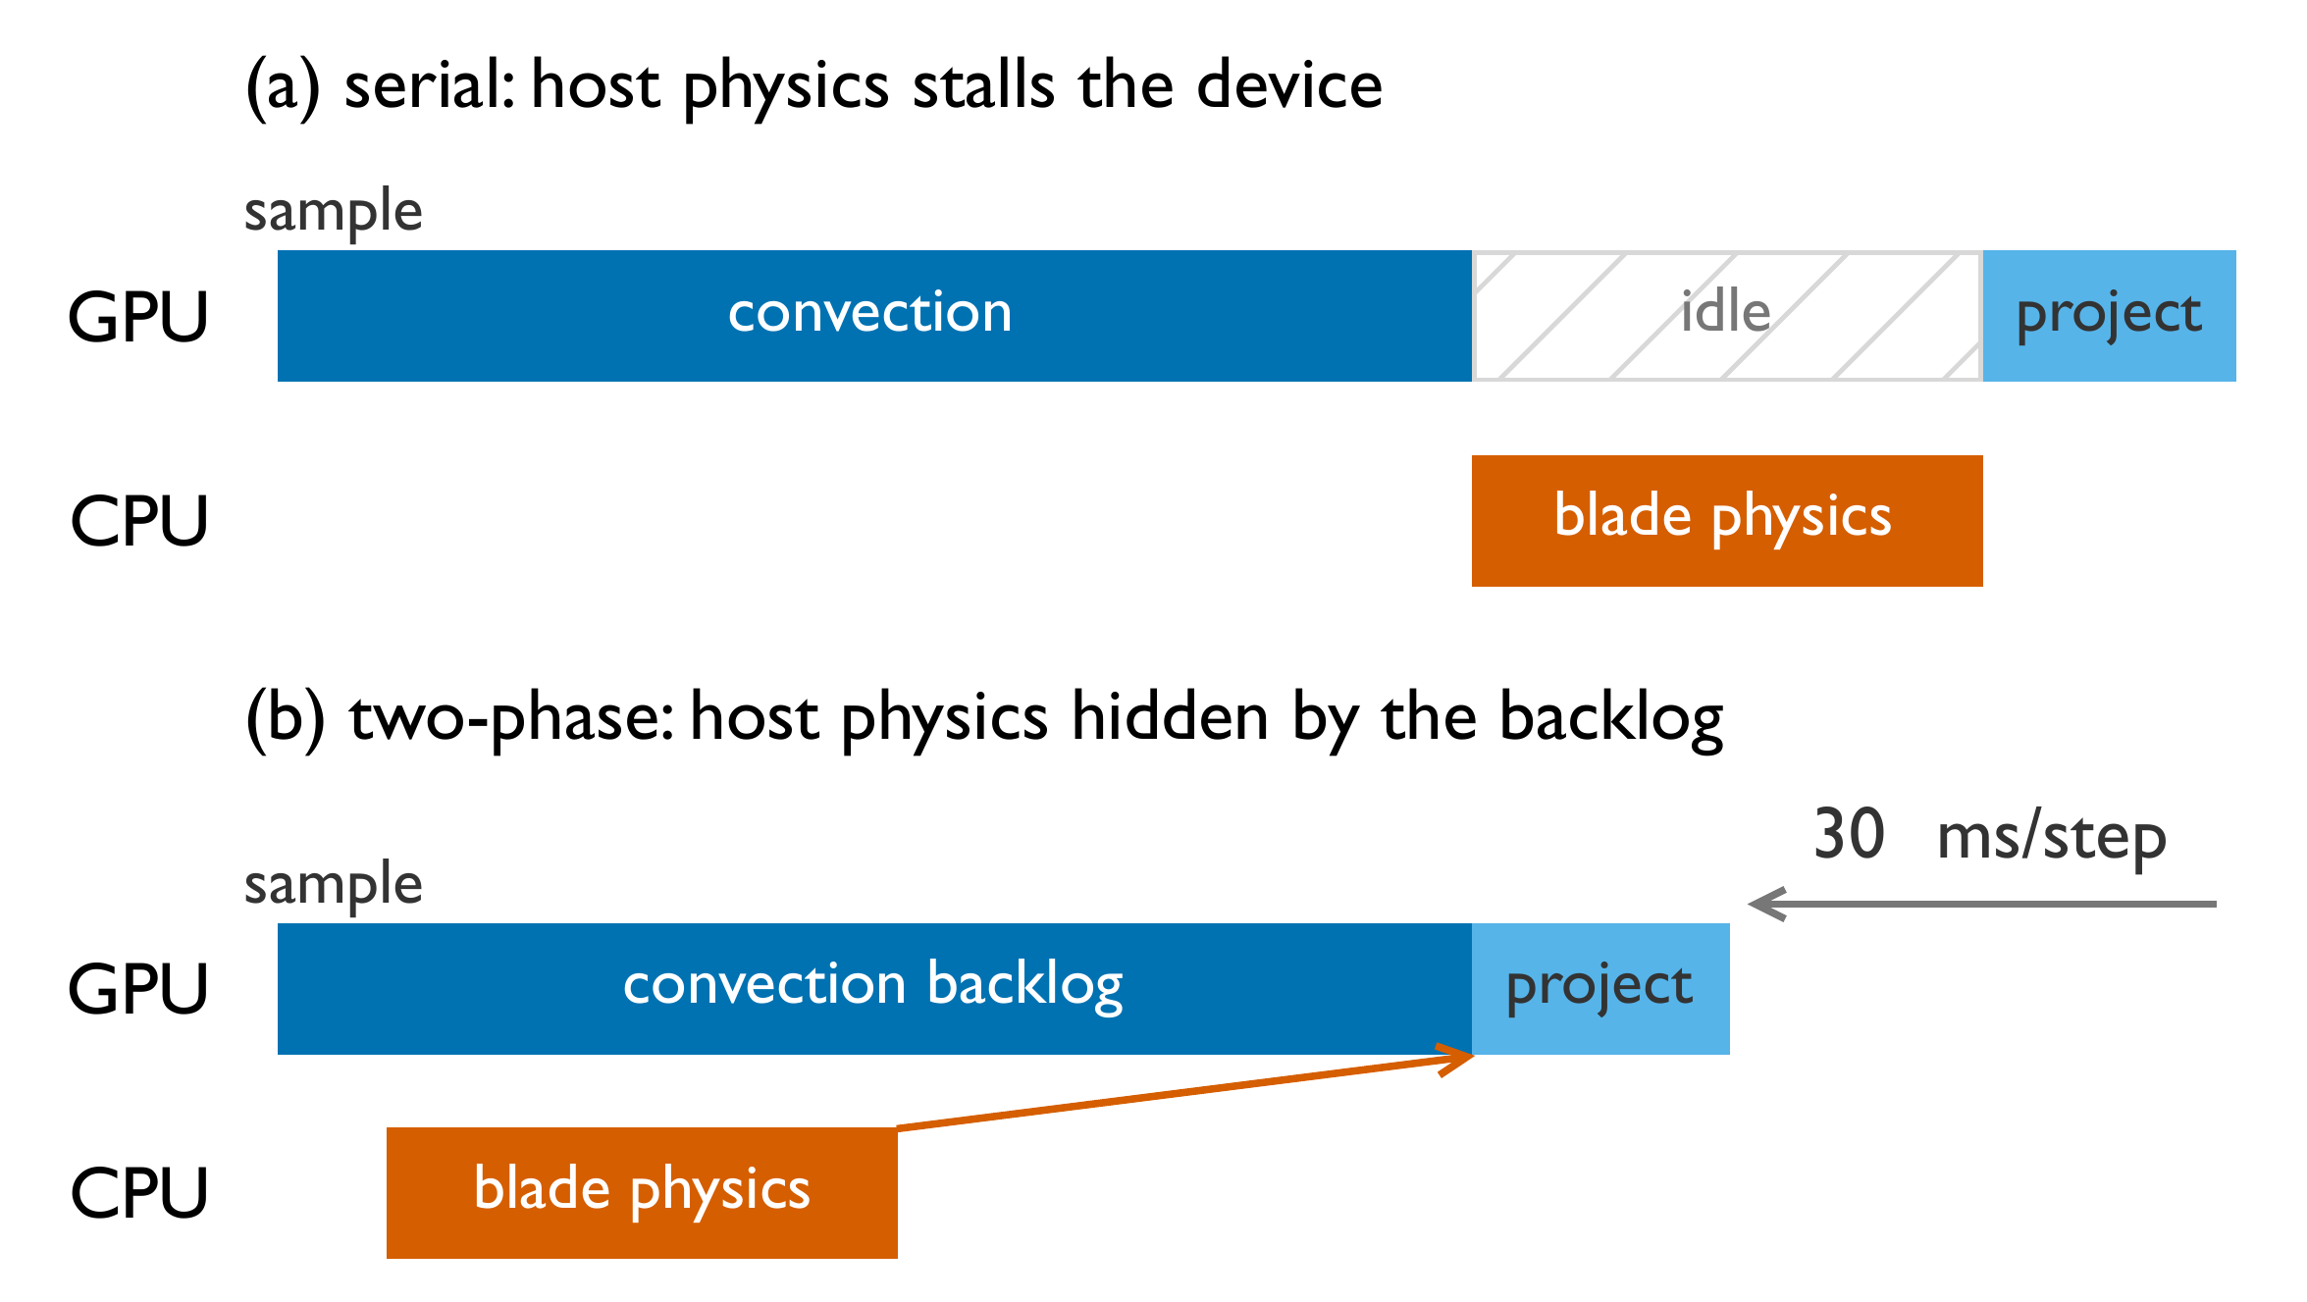
Opt. 3: Heterogeneous CPU–GPU Execution
Some physics runs better on the CPU. Hide it behind the GPU backlog.
Why keep blade forces on the CPU?
Only 10,800 actuator points, too few to fill a GPU, and data-dependent airfoil lookups diverge warps.
The catch
Host work costs ~28 ms per step. Run synchronously, the GPU sits idle.
Two-phase split
Sample on the GPU and copy a small packet out without flushing the queue. The CPU computes forces during convection, then forces go back for projection.
30 ms
93%
saved per step
GPU busy fraction
Notes:
Blade-force evaluation actually ran slower on the GPU: only 10,800 points, and the airfoil lookups branch per point. So it stays on the CPU. Its inputs are fixed at the start of the step and its outputs are not needed until force projection. We split the turbine model into two phases around convection, so the CPU works while the GPU drains its backlog. This saves 30 ms per step and raises GPU utilization to 93 percent.

Slide 15
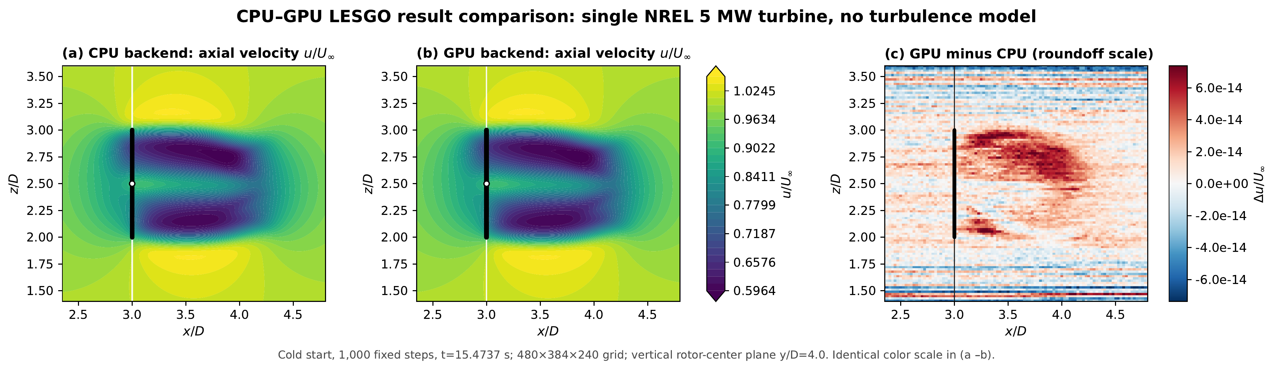
Setup and Correctness
GPU and CPU backends agree to floating-point roundoff.
Platform
Software
CPU baseline
wf60 case
NERSC Perlmutter: 4× A100 per node, Slingshot-11
NVHPC 25.5 OpenACC, CUDA 12.9, cuFFT, Cray MPICH
2× 64-core AMD EPYC 7763 per node, fastest configuration
60 turbines, 604M cells; scaling series up to 1.36B cells
1.5×10⁻¹³
relative L2 difference
9.0×10⁻¹⁴
max normalized difference
1.0
Single NREL 5-MW turbine, 480×384×240 grid, 1,000 steps from the same cold start. CPU: 48 MPI processes. GPU: 2 A100s.
wake-pattern correlation
Notes:
All runs use Perlmutter A100 nodes; CPU baselines use its Milan CPU nodes, and we always compare against the fastest CPU configuration. Before measuring speed, we checked correctness with matched single-turbine runs: after 1,000 steps the GPU-minus-CPU difference is at roundoff, around 1e-13.

Slide 16
Each Optimization Stacks: 40× on 16 GPUs
604M cells, 60 turbines. 4 CPU nodes (512 processes) vs. 4 GPU nodes (16 A100s).
6.48 s → 0.162 s
per time step (0.27 ms per million cells)
93%
73%
GPU busy
of peak DRAM BW
1.6 MB
2.0 MB
host→device / step
device→host / step
LASD every 5th step: 8.18 s → 0.206 s (39.7×)
Notes:
Each technique fixes a different bottleneck, and the gains multiply. Explicit residency alone gives 4.9x. Moving the actuator line to the GPU adds 2.3x, pipelining 1.9x, batching 1.6x, and overlap the final 1.2x, for 40x overall. The final profile shows the GPU busy 93 percent of the time and only a few MB of PCIe traffic per step: no O(N^3) transfers remain.

Slide 17
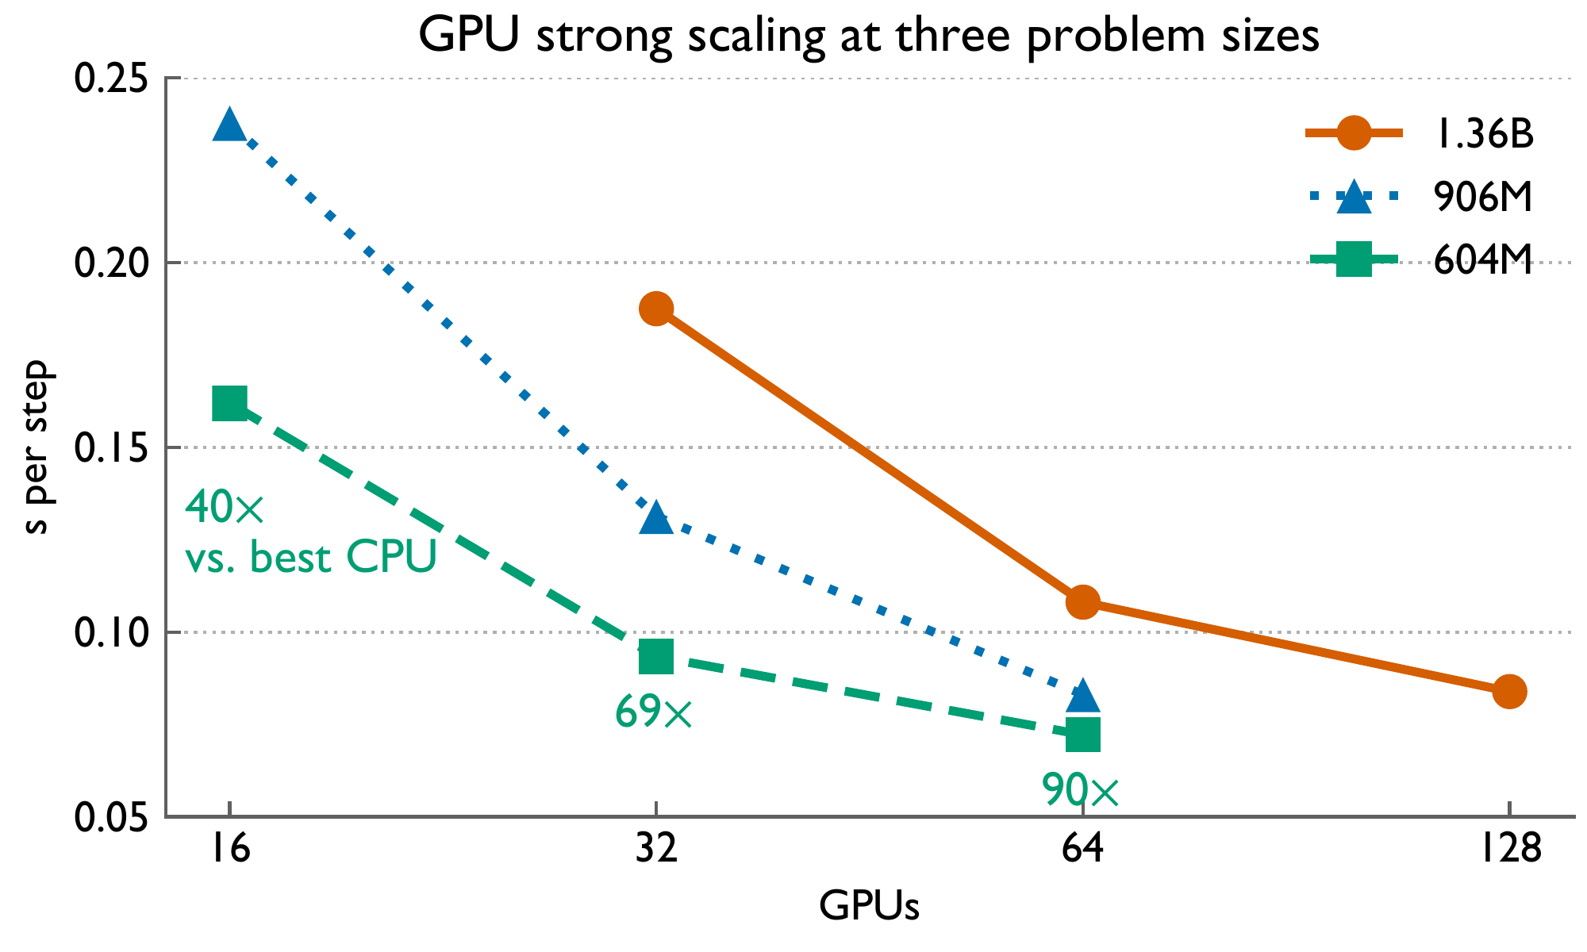
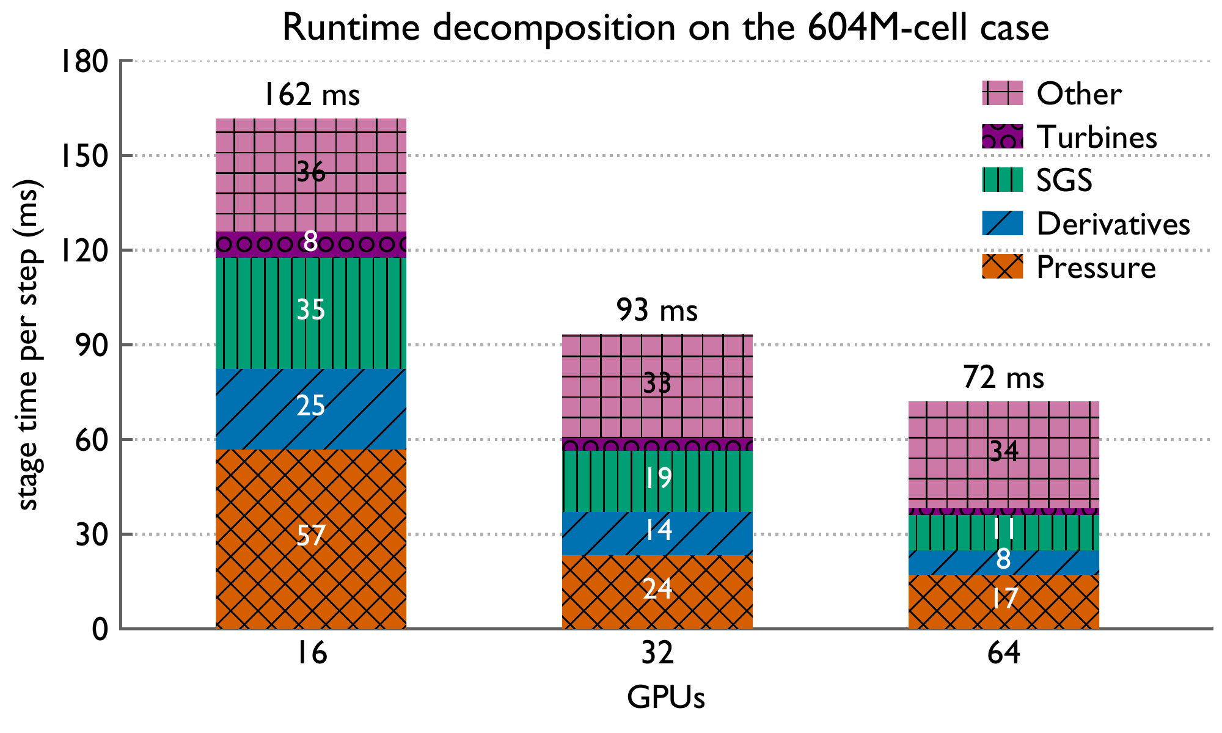
Strong Scaling to 128 GPUs
90× over the best CPU run on 64 GPUs; 1.36B cells at 0.084 s per step on 128 GPUs.
87–90%
16.2B
33–36 ms
parallel efficiency when GPU count doubles
cell updates per second on 128 GPUs
flat Other stage: collectives + launches
Notes:
Strong scaling at three grid sizes. On the production grid, 64 GPUs reach 0.072 s per step, 90x the best CPU run. Efficiency stays around 87 to 90 percent per doubling. The stage breakdown shows compute stages shrinking, pressure scaling superlinearly as the pipeline deepens, and a roughly constant 'Other' floor from latency-bound collectives and kernel launches.

Slide 18
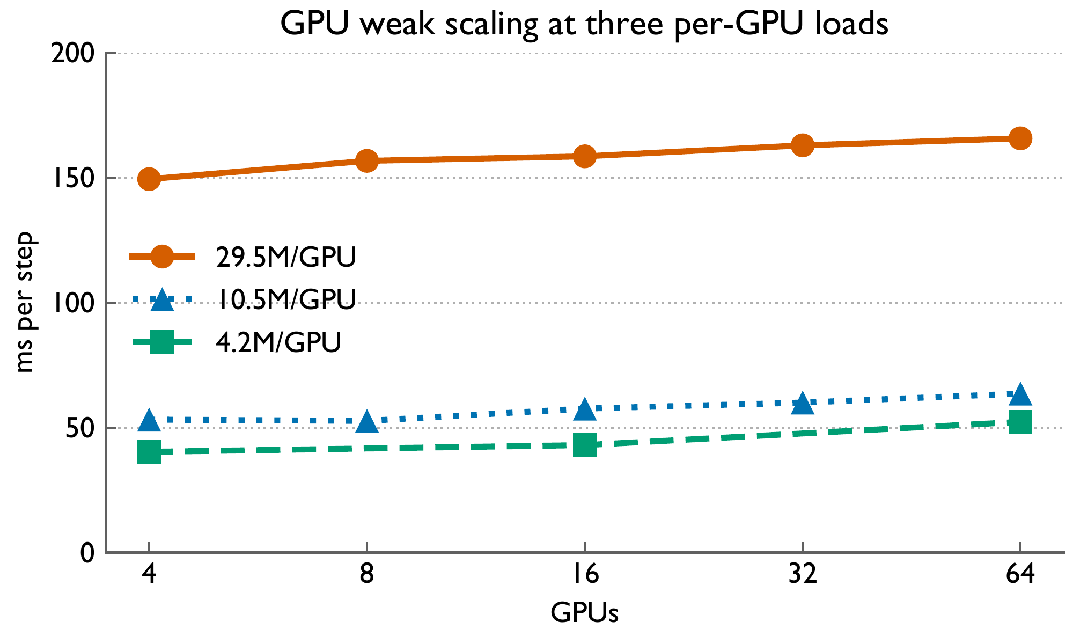
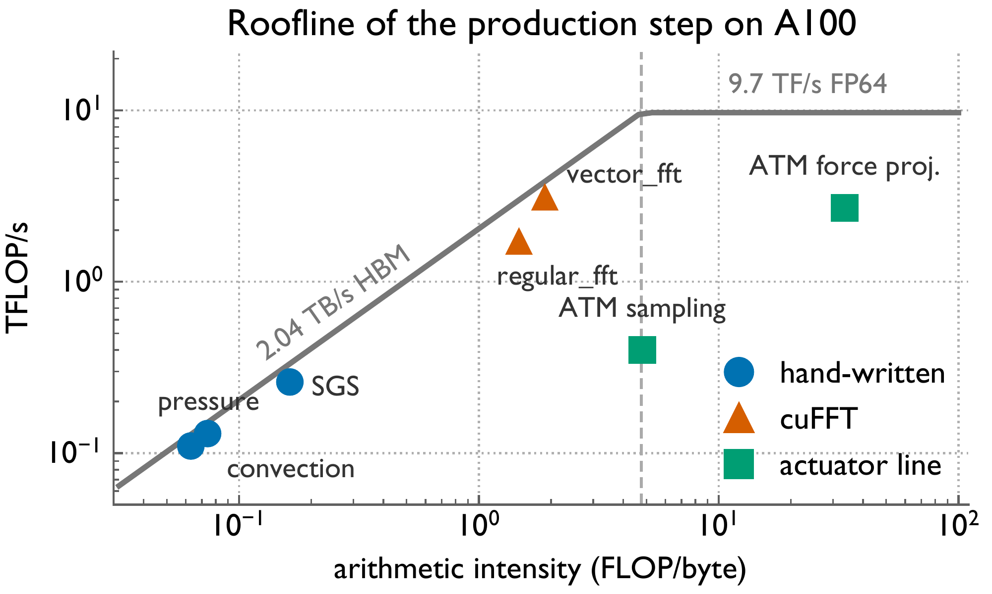
Weak Scaling and Kernel Efficiency
Kernels run near the memory-bandwidth roof, and efficiency holds when each GPU stays busy.
90%
67–88%
48–82%
weak-scaling efficiency, 4 → 64 GPUs
of peak DRAM bandwidth, custom kernels
of peak DRAM bandwidth, batched cuFFT
Notes:
At the production load of 29.5 million cells per GPU, weak scaling keeps 90 percent efficiency out to 64 GPUs. The roofline shows the main kernels sitting on the bandwidth roof: custom field kernels reach 67 to 88 percent of peak DRAM bandwidth. The remaining gap is inside cuFFT library kernels. The 1D slab layout is enough for this physics, since grid size is set by turbulence scales, not domain size.

Slide 19
Takeaways
1
First GPU port of LESGO
~70K lines of Fortran, full physics pipeline, one OpenACC source tree.
40–90×
2
Data movement governs performance
Nine coupling-point classes, resolved by gate, relocate, slice, and overlap.
speedup over the fastest CPU run on the production wind farm (604M cells)
3
Three structural optimizations
Chunk pipelining, batching, and CPU–GPU overlap: 93% GPU utilization.
Production campaigns: months → days.
4
Production-scale speed
Strong scaling to 128 GPUs on a 1.36B-cell grid.
Notes:
To wrap up: this is the first GPU port of LESGO. The key lesson is that for this class of solver, data movement, not kernel speed, sets performance, and a small set of treatments covers every coupling point. With three further optimizations, we get 40 to 90x over the best CPU runs, which turns months-long production campaigns into days. The code will be open-sourced.

Slide 20
Thank you!
Questions?
Accelerating Production-Scale Large Eddy Simulations of Wind Farms on GPUs

