Slide 1
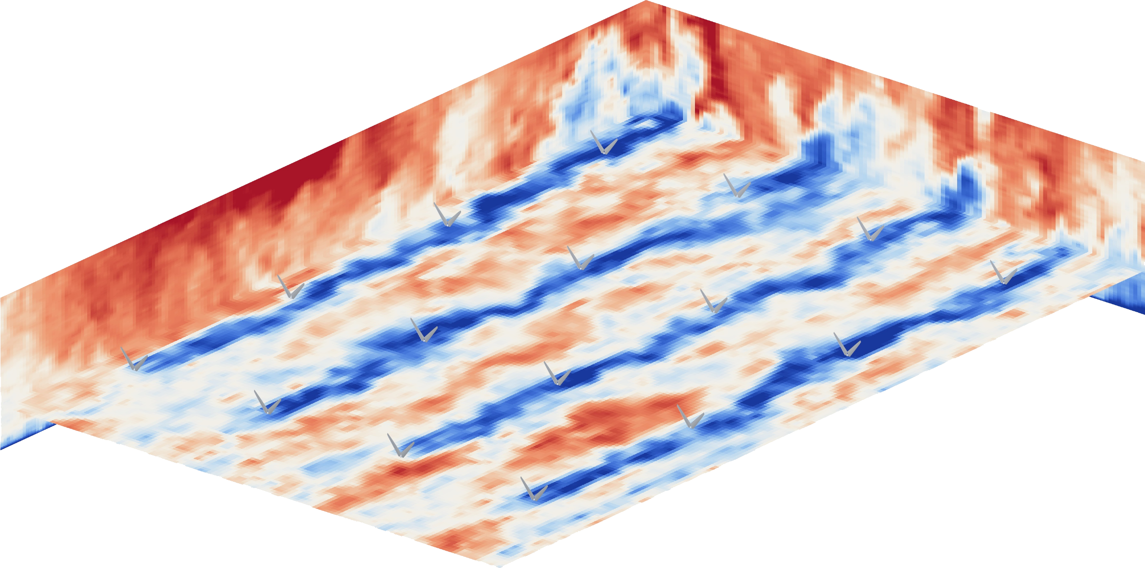
Accelerating Production-Scale Large Eddy Simulations of Wind Farms on GPUs
Porting the LESGO pseudo-spectral wind-farm solver to GPUs with OpenACC
Cunyang Wei, Wenyuan Chen, Abhinav Bhatele,
Charles Meneveau, Zheng Li
University of Maryland · Morgan State University
Johns Hopkins University
Streamwise velocity in the 60-turbine wf60 farm at t = 1800 s
Notes:
Title. This talk presents the first GPU port of LESGO, a pseudo-spectral large-eddy simulation code for wind farms. The image shows the 60-turbine production case we use throughout: blue streaks are turbine wakes.

Slide 2
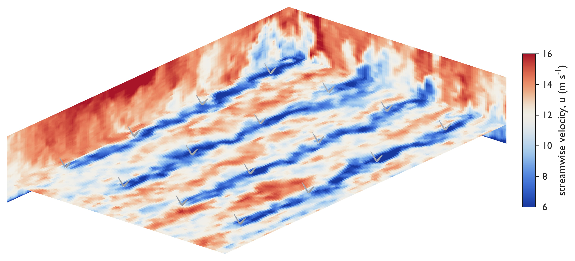



Why Accelerate Wind-Farm LES?
Fidelity needs fine grids and long physical times. The CPU code can't provide both.
Wakes cost 10–20% of farm power
Studying them means tens of turbines in kilometers of turbulent atmosphere, over hours of physical time.
LES resolves the turbulence directly
LESGO is a widely used open-source pseudo-spectral LES code: little numerical dissipation, high accuracy per grid point.
Production benchmark wf60: instantaneous streamwise velocity, 4×4 turbine section
Production runs take hours to days
Converged statistics need hundreds of thousands of steps, at 6.48 s per step on 4 CPU nodes.
60
604M
28 km
wind turbines
grid cells
streamwise domain
2
Notes:
Wake losses reduce farm output by 10 to 20 percent. LES is the standard tool, and LESGO is a widely used pseudo-spectral code for this regime. The problem: a production run of our 60-turbine case needs hundreds of thousands of steps, and the CPU code tops out at 6.48 seconds per step.

Slide 3

LESGO: Anatomy of One Time Step
FFT-heavy spectral numerics plus two irregular physics models.
Derivatives
SGS
Convection
Turbines
Pressure
Projection
Spectral x–y derivatives via 2D FFTs; 2nd-order finite differences in z. Wall-stress model at the boundary.
Lagrangian scale-dependent dynamic model (LASD): two test filters on 9 tensor fields, averaged along particle paths.
Nonlinear term with 3/2-rule dealiasing: forward and inverse FFTs on a padded grid. The most FFT-intensive stage.
Actuator-line model: sample velocity at blade points, look up airfoil polars, spread forces with a Gaussian kernel.
AB2 advance, then a Poisson solve: 2D FFTs decouple it into ~590K tridiagonal systems along z.
Subtract the pressure gradient to make velocity divergence-free, then exchange halo planes.
Why it matters on GPUs: the solver state is dozens of persistent O(N³) arrays (velocity, gradients, SGS stress, padded spectral scratch). Any needless host–device sync moves O(N³) bytes.
3
Notes:
Each step has six stages, colored as in the paper's Algorithm 1. Derivatives, convection, and pressure are FFT-driven. The LASD subgrid model and the actuator-line turbine model are irregular: filtering, trajectory interpolation, and thousands of moving off-grid points. Nearly every kernel sweeps large 3D fields, so data placement dominates.

Slide 4
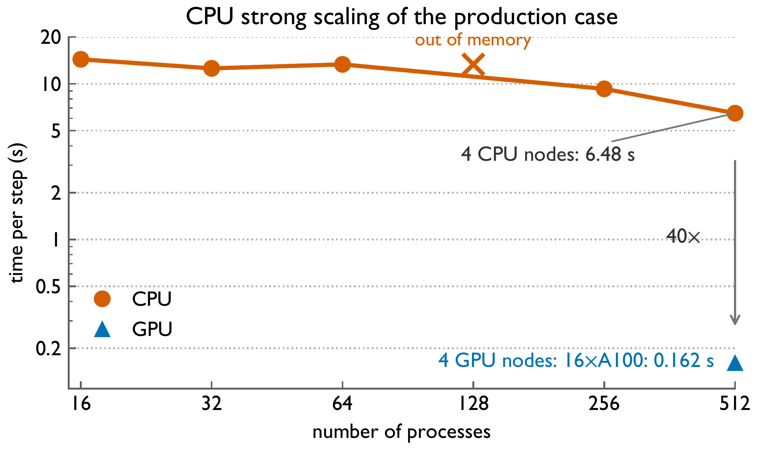
1D Slab Decomposition Hits a CPU Ceiling
More cores barely help: the node saturates memory bandwidth, then runs out of memory.
Process 3 · full x–y planes
Process 2 · full x–y planes
z
Process 1 · full x–y planes
Process 0 · full x–y planes
2D horizontal FFTs stay local: no all-to-all transposes
Halo exchange: single planes between neighbors
Poisson solve is global: every tridiagonal system spans all processes in z
1.08×
OOM
2.1×
16 → 64 cores
at 128 processes
4 nodes vs. 1 node
4
Notes:
LESGO splits the domain into horizontal slabs along z. This keeps 2D FFTs local but makes the pressure solve a serial chain across processes. On Perlmutter CPU nodes, 16 to 64 cores gives only 1.08x, 128 processes run out of memory, and four nodes plateau at 6.48 seconds per step.

Slide 5


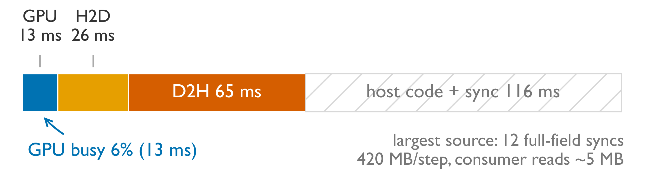
The Bottleneck Is Data Movement, Not Kernels
Both standard directive-based data strategies leave the GPU starving.
Array mirroring
256³ grid, 2 turbines, 4 A100s
CUDA managed memory
Least effort: one compiler flag
Page faults and on-demand migration stall execution on 16 A100s
Traffic is hidden from the source, so it can't be tuned
Mirroring every array also wastes device memory, so the same grid needs more GPUs
13 ms of a 220 ms step runs on the GPU: 94% idle
12 full-field syncs move 420 MB/step; consumers read ~5 MB
Root cause: routines still on the host demand full-field transfers. We need residency control that knows what each host consumer reads.
5
Notes:
We first tried the two common strategies. With array mirroring, Nsight shows only 13 of 220 ms on the GPU; the rest is PCIe transfers and host sync. Twelve full fields move every step even though the host reads about 5 MB. Managed memory is easy but page faults stall execution. Both point to the same root cause.

Slide 6




Consumer-Driven Explicit Residency
Keep every field on the device. Size each host transfer by what the host touches.
1 Residency by construction
All persistent arrays use !$acc declare create; every kernel asserts default(present).
2 Classify every coupling point
By footprint (scalar, column, plane, subvolume), frequency, and access intent.
Gate
Relocate
Slice
Overlap
Exploits temporal frequency
Exploits a parallel consumer
Exploits a small footprint
Exploits known inputs
Skip the transfer on steps where its consumer does not run.
Port the host routine to the GPU so the transfer disappears.
Keep serial or I/O routines on the host; move only what they touch.
Run irreducible host work while the GPU keeps executing.
In LESGO: SGS fallback gradients, output steps
In LESGO: AB2 + projection, diagnostics, actuator line, Thomas chains
In LESGO: Wall planes, pressure DC column
In LESGO: Airfoil polar lookups
6
Notes:
Our port keeps device memory as the primary copy of every field. We declare arrays device-resident at module scope and assert presence in every kernel, which exposes every coupling point. We then classify each coupling point and apply four treatments in order: gate, relocate, slice, and overlap. We move to the next only if the previous one does not apply.

Slide 7
Nine Coupling-Point Classes, Four Treatments
The classes recur across pseudo-spectral multiphysics codes: a reusable porting checklist.
Class | Instance in LESGO | Naive cost per step | Treatment
Boundary plane | Wall-stress model reads u, v, w at the walls | Full fields, 420 MB | slice to wall planes, later relocate
Conditional | Velocity gradients read only by the CPU SGS fallback | 9 fields, 315 MB | gate on the SGS model choice
Spectral mode | Pressure zero-wavenumber recurrence (serial in z) | 3 full-field round trips | slice to the DC column (~1 KB)
Stale entry | copyin of pressure at solver entry | 34 MB | slice to a seeded ghost plane
Pipeline state | Time integration and projection read u, v, w, RHS | 210 MB | relocate; keep pipeline on device
Actuator | Blade sampling and force projection | 2 full-field crossings | relocate; exchange O(blade points)
Diagnostics | Energy, divergence, checkpoint writes | 963 MB | relocate reductions, gate output
Serial chain | Thomas chains spanning processes | Host-staged relays | relocate; pipelined GPU exchange
Host physics | Tabulated airfoil polar lookups | Serialized 28 ms | overlap with the GPU backlog
7
Notes:
This table lists all nine classes we found in LESGO, what a naive port pays per step, and the treatment we apply. Most full-field transfers are either relocated to the GPU or sliced to a tiny footprint. After all treatments, steady-state PCIe traffic is 1.6 MB up and 2.0 MB down per step.

Slide 8
Example: Slicing the Pressure DC Mode
Leave the serial recurrence on the CPU, but ship only the column it touches.
Horizontal FFTs split the Poisson equation into N²−1 independent tridiagonal systems, solved as one batched GPU call
The zero-wavenumber (DC) mode is singular and needs a serial first-order recurrence in z
O(N) serial work runs faster on one CPU core than on the GPU, so it stays on the host
Naive: three full-field round trips per step
!$acc update self(p) ! 34 MB
call dc_recurrence(p) ! DC column only
!$acc update device(p) ! 34 MB
Sliced: O(1) traffic
!$acc update self(rH_z(1:2,1,:)) ! 1 KB in
call dc_recurrence_column(p_col)
!$acc update device(p(1:2,1,:)) ! 1 KB out
34 MB → 1 KB
per transfer, three round trips per step
8
Notes:
Here is one slice in practice. The batched tridiagonal solve for all non-zero modes runs on the GPU. The DC mode needs a tiny serial recurrence that is faster on the CPU. Our first port wrapped it in full 3D transfers, three 34 MB round trips per step. Slicing moves only the 1 KB column in and out, with the exact same arithmetic.

Slide 9
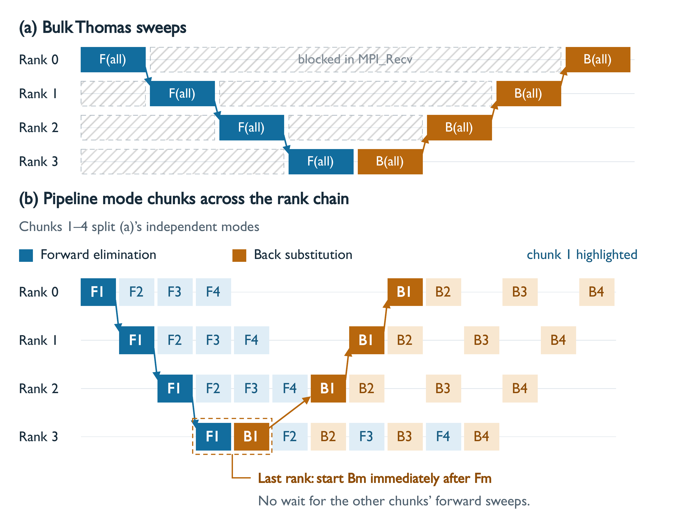
Opt. 1: Chunk Pipelining the Thomas Solve
Independent systems let each process start the next chunk instead of waiting.
Problem
~590K systems of 512 unknowns span all 16 processes. Thomas sweeps are serial in z, so process k idles until k−1 finishes.
Idea
Split the systems into chunks. Pass chunk m's boundary coefficients downstream and move straight to m+1. The last process starts back substitution right away.
1.9×
Exact
faster time step
inner Thomas loops untouched
9
Notes:
The pressure solve gives about 590 thousand independent tridiagonal systems, each distributed across all processes. The Thomas algorithm is serial along z, so processes wait on each other. Because the systems are independent, we split them into chunks and pipeline them, and the last process turns around each chunk immediately. The inner loops are unchanged, so results match the sequential solve. This gives a 1.9x step speedup.

Slide 10

Opt. 2: Batching Many Small Work Items
Per-turbine and per-plane work units are too small to fill a GPU, so we fuse them.
Actuator-line turbines
LASD subgrid model
BEFORE
BEFORE
Per-turbine uploads, launches and syncs; over 1,000 MPI_Allreduce calls per process per step.
Thousands of single-plane 2D FFTs per update: 9 tensor fields × 2 filter scales × every z level.
AFTER
AFTER
Blade tables stay on the device. One sampling kernel and one projection kernel cover all points; one packed MPI_Allreduce.
2D scratch planes promoted to 3D. One batched cuFFT call filters all z levels of a field: a few dozen launches.
1.6×
~10×
15–18%
step speedup from batching turbines
fewer kernel launches and collectives
faster other stages (no in-loop allocations)
10
Notes:
Several components break into many small independent units. For the turbines, we batch the whole farm: one sampling kernel, one projection kernel, and a single packed reduction instead of over a thousand. Removing in-loop device allocations also sped up other stages by 15 to 18 percent. For the LASD model, promoting 2D scratch planes to 3D lets one batched cuFFT call filter every vertical level at once.

Slide 11
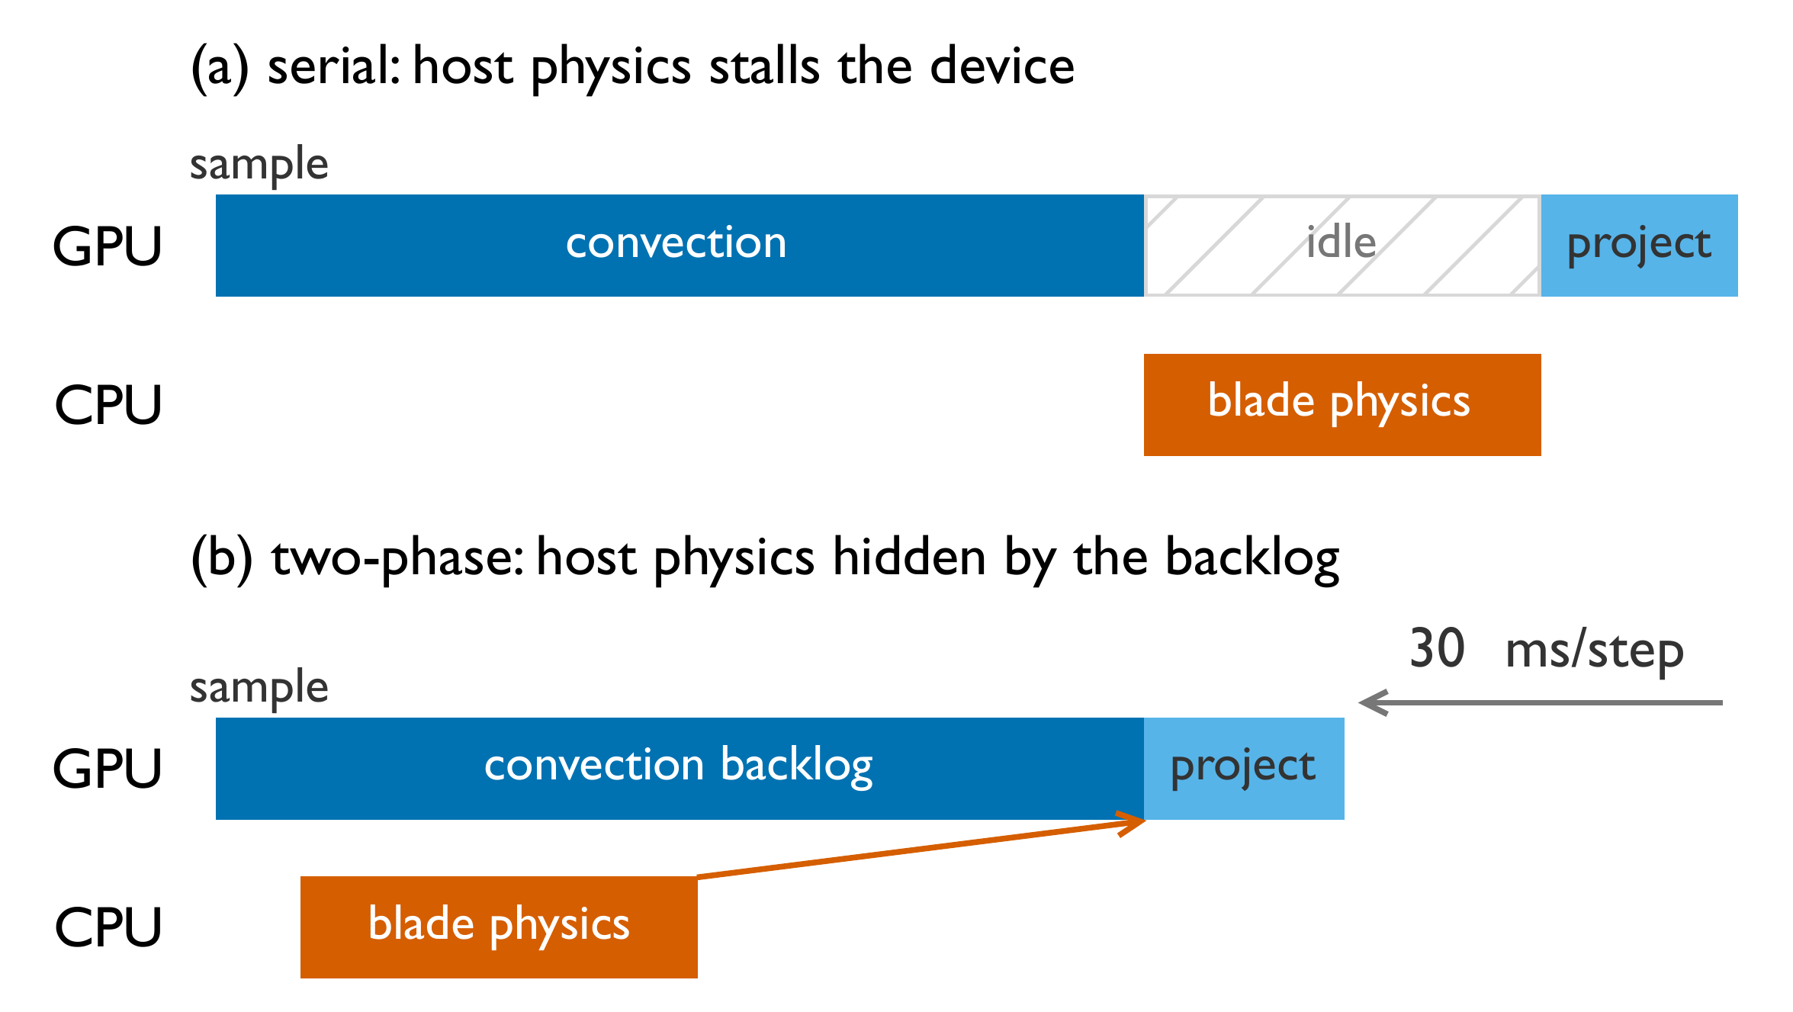
Opt. 3: Heterogeneous CPU–GPU Execution
Some physics runs better on the CPU. Hide it behind the GPU backlog.
Why keep blade forces on the CPU?
Only 10,800 actuator points, too few to fill a GPU, and data-dependent airfoil lookups diverge warps.
The catch
Host work costs ~28 ms per step. Run synchronously, the GPU sits idle.
Two-phase split
Sample on the GPU and copy a small packet out without flushing the queue. The CPU computes forces during convection, then forces go back for projection.
30 ms
93%
saved per step
GPU busy fraction
11
Notes:
Blade-force evaluation actually ran slower on the GPU: only 10,800 points, and the airfoil lookups branch per point. So it stays on the CPU. Its inputs are fixed at the start of the step and its outputs are not needed until force projection. We split the turbine model into two phases around convection, so the CPU works while the GPU drains its backlog. This saves 30 ms per step and raises GPU utilization to 93 percent.

Slide 12
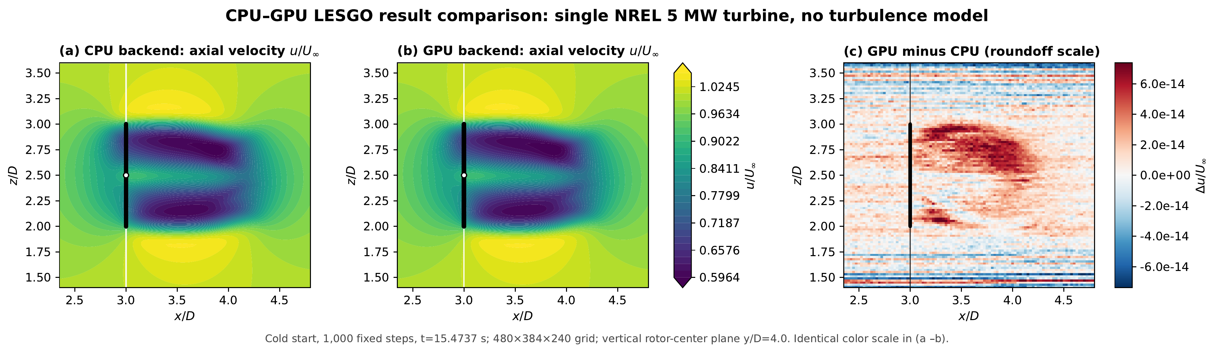
Setup and Correctness
GPU and CPU backends agree to floating-point roundoff.
Platform
Software
CPU baseline
wf60 case
NERSC Perlmutter: 4× A100 per node, Slingshot-11
OpenACC (NVHPC 25.5), CUDA 12.9, cuFFT, CUDA-aware MPICH
2× 64-core AMD EPYC 7763 per node, fastest configuration
60 turbines, 604M cells; scaling series up to 1.36B cells
1.5×10⁻¹³
relative L2 difference
9.0×10⁻¹⁴
max normalized difference
Single NREL 5-MW turbine, 480×384×240 grid, 1,000 steps from the same cold start. CPU: 48 MPI processes. GPU: 2 A100s.
1.0
wake-pattern correlation
12
Notes:
All runs use Perlmutter A100 nodes; CPU baselines use its Milan CPU nodes, and we always compare against the fastest CPU configuration. Before measuring speed, we checked correctness with matched single-turbine runs: after 1,000 steps the GPU-minus-CPU difference is at roundoff, around 1e-13.

Slide 13
Each Optimization Stacks: 40× on 16 GPUs
604M cells, 60 turbines. 4 CPU nodes (512 processes) vs. 4 GPU nodes (16 A100s).
6.48 s → 0.162 s
per time step (0.27 ms per million cells)
93%
73%
GPU busy
of peak DRAM BW
1.6 MB
2.0 MB
host→device / step
device→host / step
With LASD updates every 5th step: 8.18 s → 0.206 s (39.7×)
13
Notes:
Each technique fixes a different bottleneck, and the gains multiply. Explicit residency alone gives 4.9x. Moving the actuator line to the GPU adds 2.3x, pipelining 1.9x, batching 1.6x, and overlap the final 1.2x, for 40x overall. The final profile shows the GPU busy 93 percent of the time and only a few MB of PCIe traffic per step: no O(N^3) transfers remain.

Slide 14
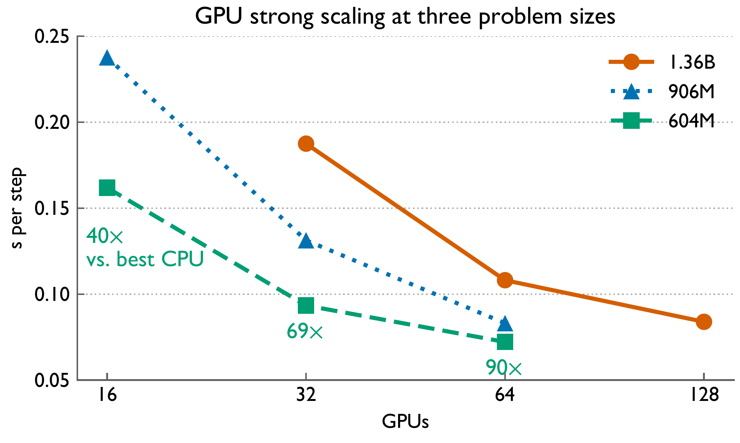
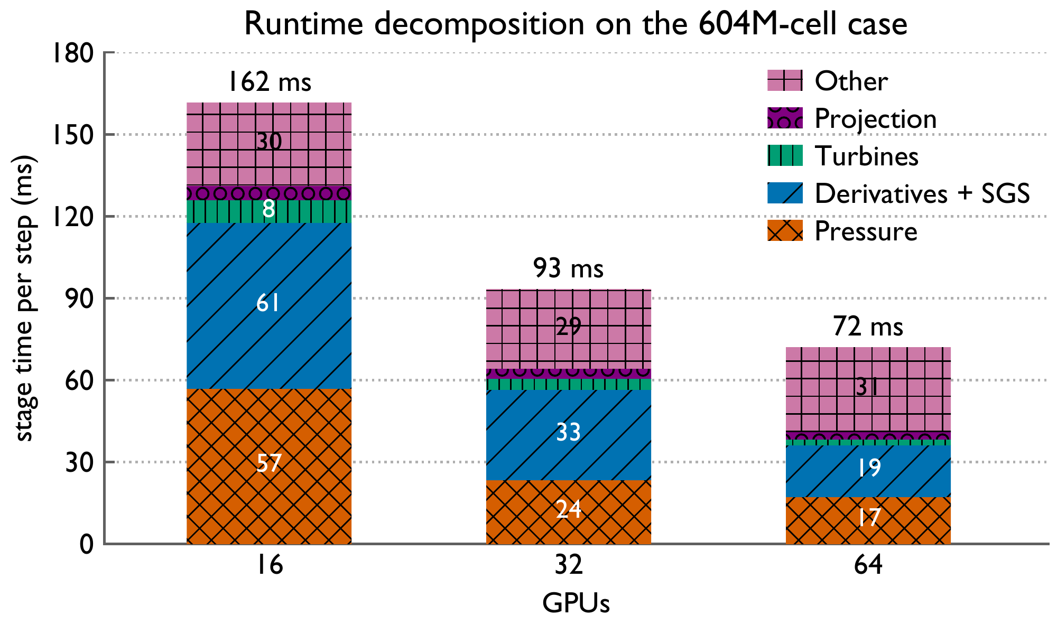
Strong Scaling to 128 GPUs
90× over the best CPU run on 64 GPUs; 1.36B cells at 0.084 s per step on 128 GPUs.
87–90%
16.2B
~30 ms
parallel efficiency when GPU count doubles
cell updates per second (1.36B cells, 128 GPUs)
latency floor: CFL reduction + launch budget
14
Notes:
Strong scaling at three grid sizes. On the production grid, 64 GPUs reach 0.072 s per step, 90x the best CPU run. Efficiency stays around 87 to 90 percent per doubling. The stage breakdown shows compute stages shrinking, pressure scaling superlinearly as the pipeline deepens, and a roughly constant 'Other' floor from latency-bound collectives and kernel launches.

Slide 15
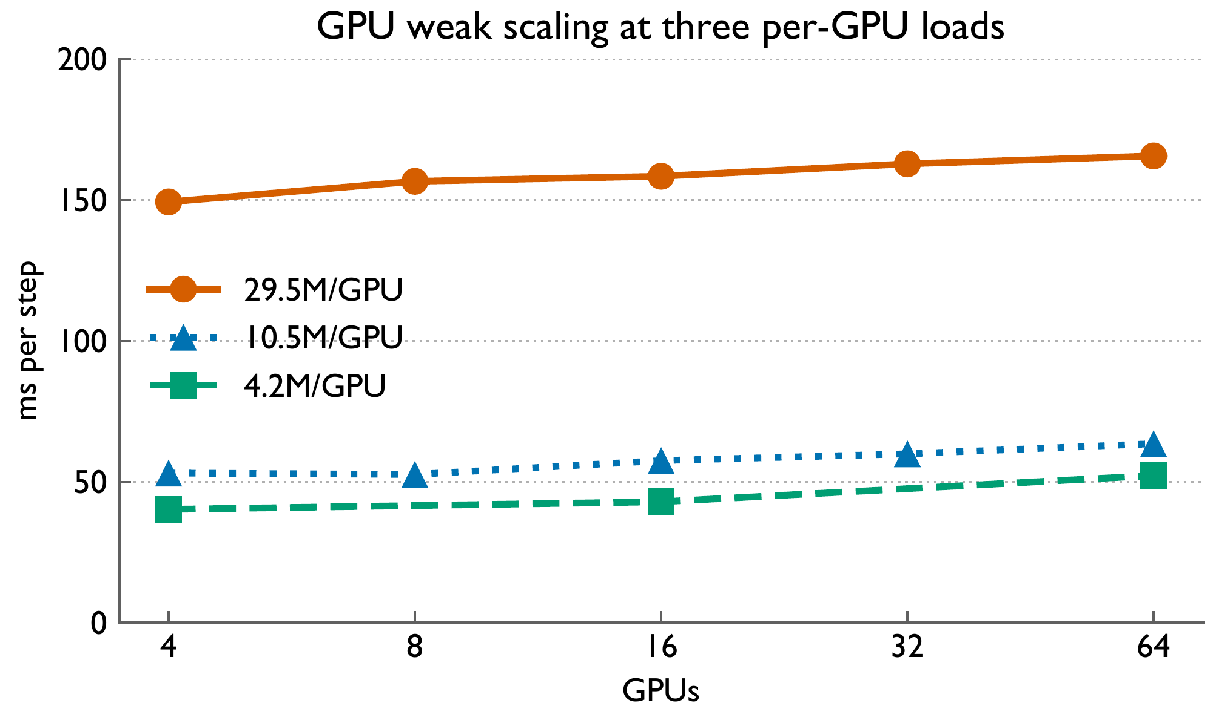
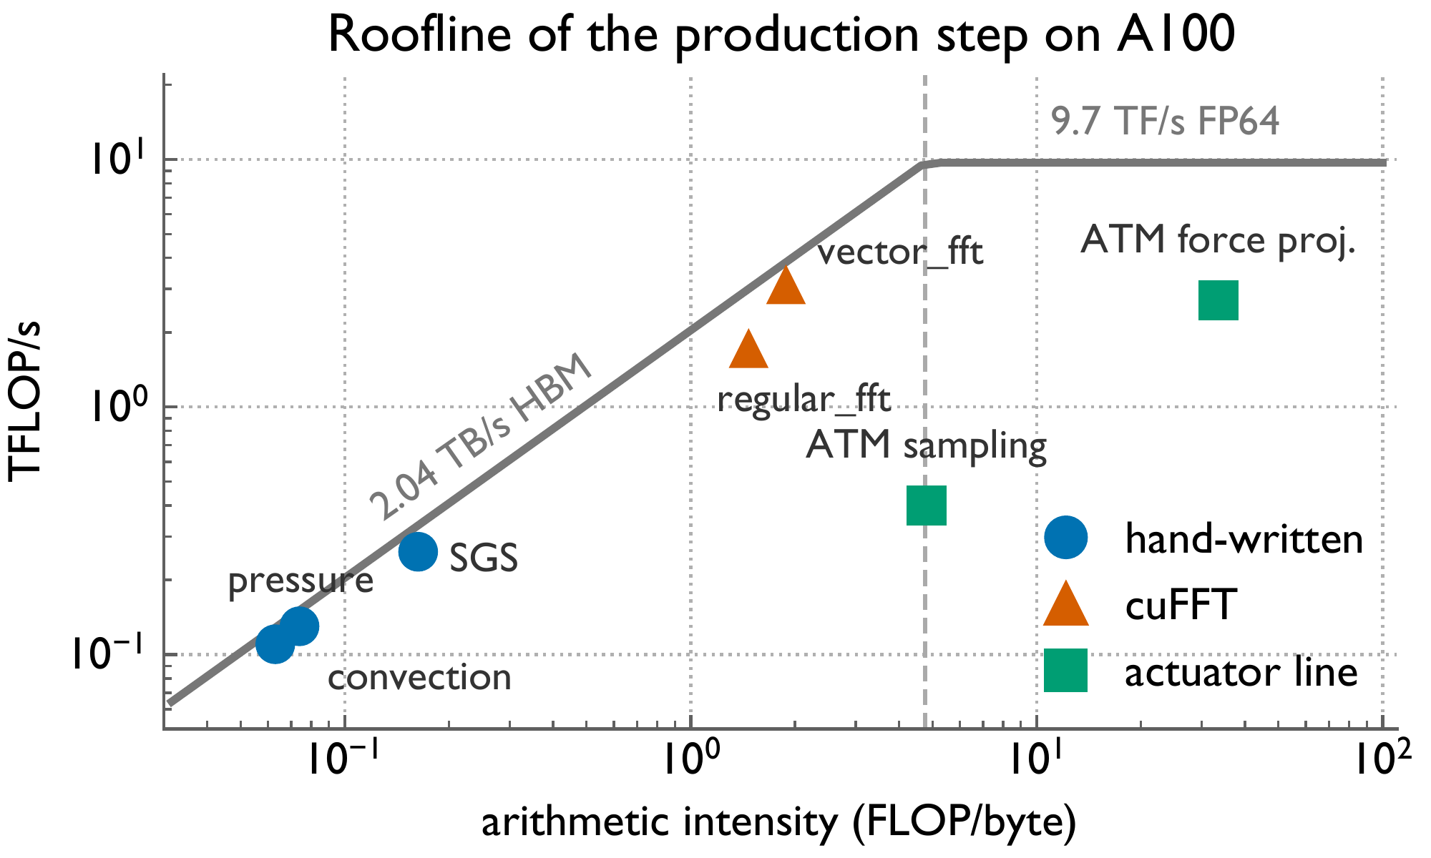
Weak Scaling and Kernel Efficiency
Kernels run near the memory-bandwidth roof, and efficiency holds when each GPU stays busy.
90%
67–88%
48–82%
weak-scaling efficiency, 4 → 64 GPUs
of peak DRAM bandwidth, custom kernels
of peak DRAM bandwidth, batched cuFFT
15
Notes:
At the production load of 29.5 million cells per GPU, weak scaling keeps 90 percent efficiency out to 64 GPUs. The roofline shows the main kernels sitting on the bandwidth roof: custom field kernels reach 67 to 88 percent of peak DRAM bandwidth. The remaining gap is inside cuFFT library kernels. The 1D slab layout is enough for this physics, since grid size is set by turbulence scales, not domain size.

Slide 16
Takeaways
1
First GPU port of LESGO
40–90×
~70K lines of Fortran, full physics pipeline, one OpenACC source tree.
2
Data movement governs performance
speedup over the fastest CPU run on the production wind farm (604M cells)
Nine coupling-point classes, resolved by gate, relocate, slice, and overlap.
Production campaigns: months → days.
3
Three structural optimizations
Chunk pipelining, batching, and CPU–GPU overlap: 93% GPU utilization.
4
Production-scale speed
Strong scaling to 128 GPUs on a 1.36B-cell grid.
Thank you! Questions?
Notes:
To wrap up: this is the first GPU port of LESGO. The key lesson is that for this class of solver, data movement, not kernel speed, sets performance, and a small set of treatments covers every coupling point. With three further optimizations, we get 40 to 90x over the best CPU runs, which turns months-long production campaigns into days. The code will be open-sourced.

