Slide 1

CMake introduction
https://hpcleuven.github.io/CMake-intro/

Slide 2

Build system
  Build system is the collection of tools for automating program compilations
  At the core there is normally a functional based language which maps a set of sources (files) to the target (executable, library)
  Build systems:
    Make
    Ninja
    Ant
    Gradle

Slide 3
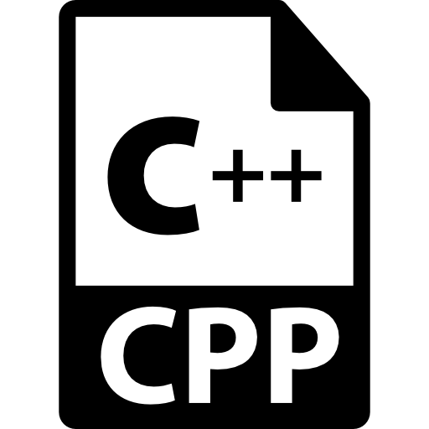
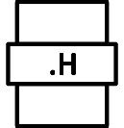
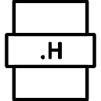
Build systems
compile
  Why – the number of files can go to hundreds
  Challenge to keep track of files and dependencies
  Compilation may take a lot of files, not well maintained – need to start from beginning
  Build systems – automated source code compilation and linking process
  $ g++ main.cpp addition.cpp division.cpp print_result.cpp –o calculator
compile

Slide 4
Build systems
  Build file – to compile and link source code
  Build process
Source files
*.cpp
*.h
*.hpp
Build File
Makefile
Build system
make

Slide 5
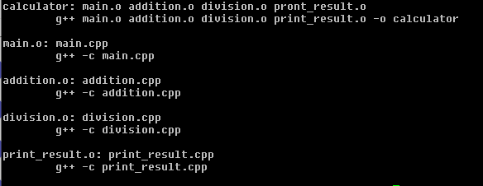
Build systems
  Build file – to compile and link source code

Slide 6
Build systems
  CMake is able to write Makefiles for us
  Why – building of the project is not standard across platfoms - > CMake will create the platform-based build system files
  Make vs CMake
    Make - Uses build system files to generate executable
    CMake - Used to generate build system files

Slide 7
CMake
  CMake is the cross-platform make,
  It is a build system manager
  Can build multiple make systems (like make - default)
  Build systems are called generators
  Provides possibilities to manage all unit tests (ctest)
  Why CMake?
    Open source
    Can be used for multiple programming languages

Slide 8
CMake
  Treat as project-oriented programming
  CMake is organized in targets (libraries, executables created in the end)
  Every target contains
    properties (e.g., compiler options) and
    usage requirements (e.g., dependencies between targets)
Target 1
Property 1
Property 2
Usage requirement 1
Usage requirement 2
Executable/Library
Target 2
Property 1
Property 2
Usage requirement 1
Usage requirement 2
Executable/Library
Target 3
Property 1
Property 2
Usage requirement 1
Usage requirement 2
Executable/Library
Library1/CMakeLists.txt
depends
includes
Library2/CMakeLists.txt
CMakeCache.txt
…
  CMake generates build files and meta files (stored in CMake cache)
CMake
Build file
Generator

Slide 9
CMake on the cluster
  Which module to choose on the cluster – avoid conflicts (go for GCC/GCCcore)
  Compiled code and source files available – in case new version necessary
  $module load CMake/3.31.3-GCCcore-14.2.0

Slide 10


Requirements to run CMake
  CMakeLists.txt file (fixed name – renamed will cause CMake error)
  Separate directory to store build system files (can be anything)
  Using CMake
CMakeLists.txt
example0
Project folder
Build folder
Other files/folders

Slide 11

Requirements to run CMake
  CMakeLists.txt file (fixed name – renamed will cause CMake error)
  Separate directory to store build system files (can be anything)
  cmake .. – run in the build dir,
  .. – informs that CMakeLists.txt is in the main dir
CMakeLists.txt
example0
Project folder
Build folder
$cmake ..
Other files/folders

Slide 12
Requirements to run CMake
  CMakeLists.txt file (fixed name – renamed will cause CMake error)
  Separate directory to store build system files (can be anything)
  cmake .. – run in the build dir,
  .. – informs that CMakeLists.txt is in the parent folder
  Makefile created – we can run make

Slide 13
CMakeLists.txt
  Used to create executable
  Name of executable should be the 1st argument
  CMakeLists.txt composition
command1 (arg_a1 arg_a2 arg_a3 … )
command2 (arg_b1 arg_b2 arg_b3 … )
command3 (arg_c1
arg_c2
… )
command4 (arg_d1 arg_d2 arg_d3 … )

Slide 14
Project
  project() - Sets the name of the project, and stores it in the variable PROJECT_NAME. When called from the top-level CMakeLists.txt also stores the project name in the variable CMAKE_PROJECT_NAME.
project(<project-name> VERSION <major.minor.patch> … )

Slide 15


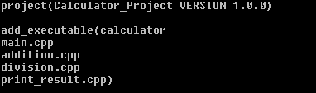
add_executable
  add_executable – executable with the given name is created
  executable created from compiling the files given after the name
  Arguments
add_executable(
calculator
addition.cpp
division.cpp
print_result.cpp
main.cpp)
add_executable(
calculator
main.cpp
addition.cpp
division.cpp
print_result.cpp)
add_executable(
addition.cpp
calculator
division.cpp
print_result.cpp
main.cpp)

Slide 16
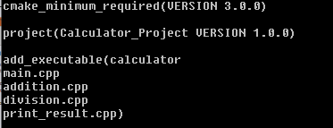
cmake_minimum_required
  Minimum version requirement – developer must test – depending on features used
example1

Slide 17
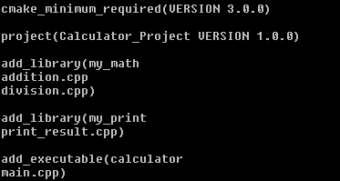
add_library
  add_library - To add a library we use the add_library() command and specify which source files should make up the library. Rather than placing all of the source files in one directory, we can organize our project with one or more subdirectories. In this case, we will create a subdirectory specifically for our library.
example2

Slide 18
Hierarchy
  Making project modular - hierarchy
main.cpp
addition.cpp
division.cpp
print_result.cpp

Slide 19
target_link_libraries
  target_link_libraries is responsible for adding a library into the linker's command line. If you use some library but do not specify it for the linker, you will get an "undefined reference" (or an "unresolved externals") error when creating an executable or a shared library
target_link_libraries(<executable> <lib1> <lib2>)

Slide 20
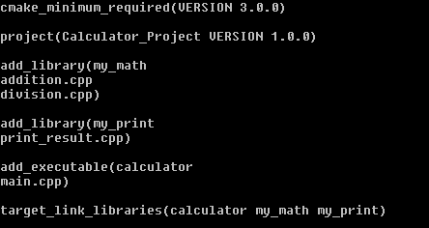
target_link_libraries
  Target link libraries
example3

Slide 21
Targets
  Targets
    Libraries
    Executables

Slide 22
Target Properties
  Every target has properties and dependencies
  Hint: check CMake help webpage https://cmake.org/cmake/help/latest
  Target Properties
    INTERFACE_LINK_DIRECTORIES
    INCLUDE_DIRECTORIES
    VERSION
    SOURCES

Slide 23
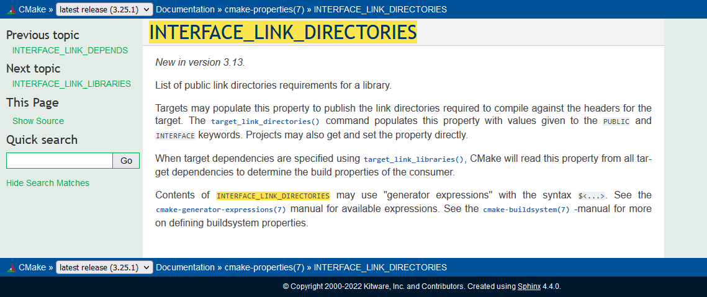
Target Properties

Slide 24
Properties
  Modify or retrieve properties
  In CMake, we can set target properties as either PRIVATE, PUBLIC, or INTERFACE. Both PUBLIC and INTERFACE properties are inherited by any targets that depend on the current target.
set_target_properties()
set_property
get_property
get_target_property()

Slide 25
Properties
Include Inheritance | Description
PUBLIC | All the directories following PUBLIC will be used for the current target and the other targets that have dependencies on the current target, i.e., appending the directories to INCLUDE_DIRECTORIES and INTERFACE_INCLUDE_DIRECTORIES.
PRIVATE | All the include directories following PRIVATE will be used for the current target only, i.e., appending the directories to INCLUDE_DIRECTORIES.
INTERFACE | All the include directories following INTERFACE will NOT be used for the current target but will be accessible for the other targets that have dependencies on the current target, i.e., appending the directories to INTERFACE_INCLUDE_DIRECTORIES.

Slide 26
Target dependecy
  Target dependency
  Target A
  Target B (Dependency of Target A)
  Target C (Dependency of Target B)

Slide 27
Target vs. dependency
  calculator is the target
  my_math and my_print are the dependencies

Slide 28
Target properties
  PRIVATE, PUBLIC, INTERFACE
  Propagating target properties
  target_link_libraries (myapp PUBLIC <item1> <item2>)
    Property: INTERFACE_LINK_LIBRARIES
  target_link_libraries (myapp INTERFACE <item1> <item2>)
    Property: INTERFACE_LINK_LIBRARIES

Slide 29
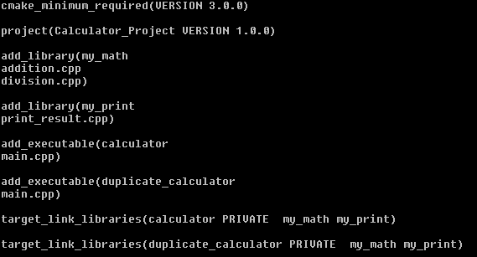
Requirements to run CMake
  Can we have multiple executables in CMakelists
  Yes
example4

Slide 30
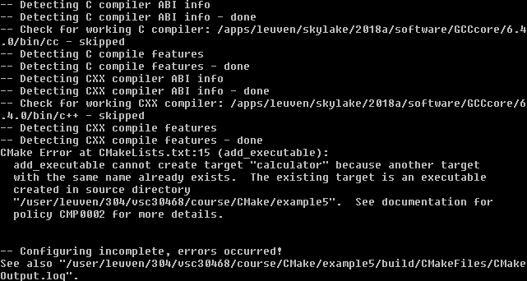
Requirements to run CMake
  Can we have 2 targets with the same name – no
  CMake will return the error
example5

Slide 31
Target files: prefix and suffix
  Do we have target files saved on computer – yes
  In build dir
  Actual name can be different
  Library .lib .dll .so .a – depending on operating system
  Prefix and extension
    calculator -> calculator.exe
    my_math -> my_math.lib
    my_math -> libmy_math.so

Slide 32
Subdirectories
  Build or debug+release for separate compiler options
CMakeLists.txt
Build folder (debug)
Project folder
Build folder (release)
Other files/folders

Slide 33
Subdirectories
  Subdirs – to go to subdirectory, find another CMakefile.txt file there and run one by one
  Build tree
CMakeLists.txt
in the calculator project
CMakeLists.txt
in my_math dir
CMakeLists.txt
in my_print dir

Slide 34
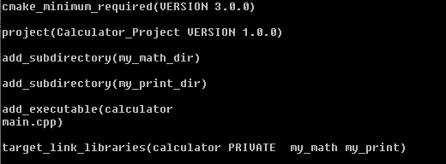


Subdirectories
  Subdirs – to go to subdirectory, find another CMakefile.txt file there and run one by one
CMakeLists.txt
in the calculator project
CMakeLists.txt
in my_math dir
CMakeLists.txt
in my_print dir

Slide 35

Subdirectories
CMakeLists.txt
main.cpp
addition.cpp
my_math_dir
example6
division.cpp
CMakeLists.txt
calculator_project
my_print_dir
print_result.cpp
build
CMakeLists.txt
Header files

Slide 36
Library
  Good practice – keep files belonging to one library in the same place
*.h
*.cpp
library1
CMakeLists.txt

Slide 37
Library Folder Structure
*.h
include
*.cpp
src
library1
CMakeLists.txt

Slide 38
Libraries
  Avoiding compatibility issues
addition.cpp
division.cpp
#include <addition.h>
…
…
…
#include <division.h>
…
…
…

Slide 39
Header files
  If header file is in another folder – we need to inform preprocessor where (define the dir)
*.h
include
*.cpp
src
#include “../include/addition.h”
library1
CMakeLists.txt

Slide 40
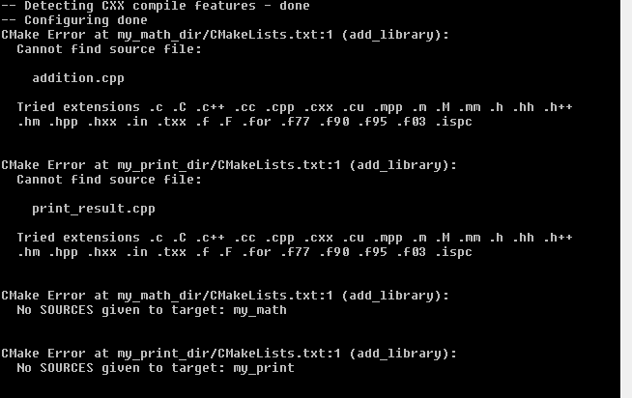
Source files
  If header or source file is in another folder – we need to inform preprocessor where (define the dir)
example7

Slide 41

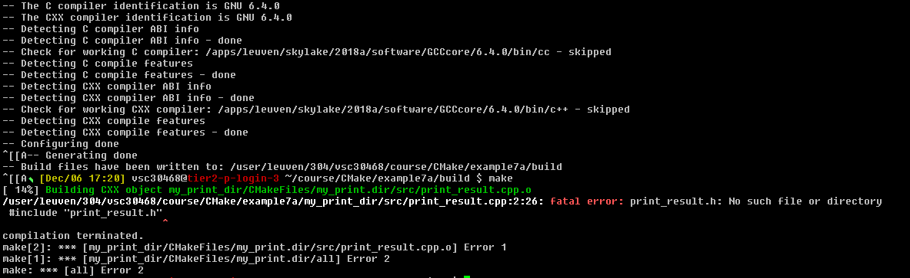
Header files
CMakeLists.txt
example7a

Slide 42

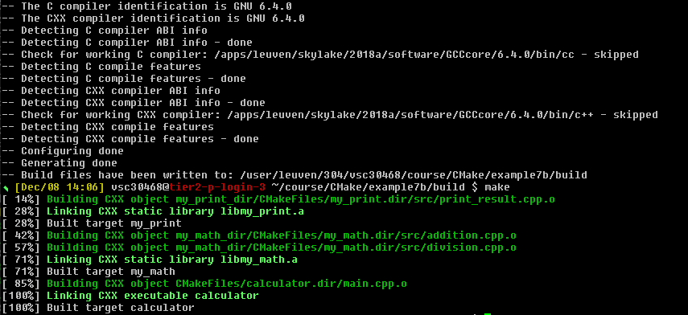
Header files
CMakeLists.txt
addition.cpp
example7b

Slide 43

Header files
  Ask CMake to take care of it
addition.h
target_include_directories(<target>
<scope>
<dir1>
<dir2>
…
)
include
addition.cpp
src
my_math_dir
CMakeLists.txt

Slide 44


Header files
  Ask CMake to take care of it
CMakeLists.txt
example7c
addition.cpp

Slide 45

Header files
  We can include multiple dirs at the same time
addition.h
include
addition.cpp
src
#include “../include/addition.h”
#include “addition.h”
my_math_dir
CMakeLists.txt

Slide 46
Header files
  In main.cpp we do not need any path for include header files – the PUBLIC keyword:
  PUBLIC: All the directories following PUBLIC will be used for the current target and the other targets that have dependencies on the current target, i.e., appending the directories to INCLUDE_DIRECTORIES and INTERFACE_INCLUDE_DIRECTORIES.

Slide 47
Target properties
  target_include_directories(my_print PUBLIC include)
  target_include_directories(my_print INTERFACE include)
  Property: INTERFACE_INCLUDE_DIRECTORIES of target my_print
  Is set to $VSC_HOME/courses/Cmake/exercise7c/my_print/include

Slide 48
Target properties
  Calculator dependencies
  target_link_libraries(calculator my_math my_print)
calculator
my_math
my_print

Slide 49
Property propagation
  Properties are visible to main.cpp
  property propagation
Properties of my_math
Property A=aaa
Property B=bbb
Property C=ccc
Properties of my_print
Property X=xxx
Property Y=yyy
Property Z=zzz

Slide 50
Property propagation
  PUBLIC, PRIVATE vs INTERFACE
  Private – does not set the interface of include dir or any other property, main.cpp will not be able to find them
  target_include_directories(my_print PRIVATE include)
  Property: INTERFACE_INCLUDE_DIRECTORIES of target my_print
  Is set to: <not-set>

Slide 51
Property propagation
  PUBLIC, INTERFACE and PRIVATE
Question: | Answer | Answer | Answer
Does ‘my_math’ need the directory | Yes | No | Yes
Do the other targets, depending upon ‘my_math’ are going to need this include directory? | Yes | Yes | No
 | PUBLIC | INTERFACE | PRIVATE

Slide 52
Property propagation
  Other commands that will use it:
Command | Property set by the command
target_compile_definitions | INTERFACE_COMPILE_DEFINITIONS
target_sources | INTERFACE_SOURCES
target_compile_features | INTERFACE_COMPILE_FEATURES
target_compile_options | INTERFACE_COMPILE_OPTIONS
target_link_directories | INTERFACE_LINK_DIRECTORIES
target_link_libraries | INTERFACE_LINK_LIBRARIES
target_link_options | INTERFACE_LINK_OPTIONS
target_precompile_headers | INTERFACE_PRECOMPILE_HEADERS

Slide 53
Scopes
  Scope specifier allows to propagate requirements to another top-level target
  target_include_directories(my_print PRIVATE include)
  target_include_directories(Target Name | Scope | Arguments)

Slide 54
Property propagation
  Target with both private and public
  target_include_directories(target PRIVATE xxx PUBLIC yyy)
  or
  target_include_directories(target PRIVATE xxx)
  target_include_directories(target PUBLIC yyy)

Slide 55
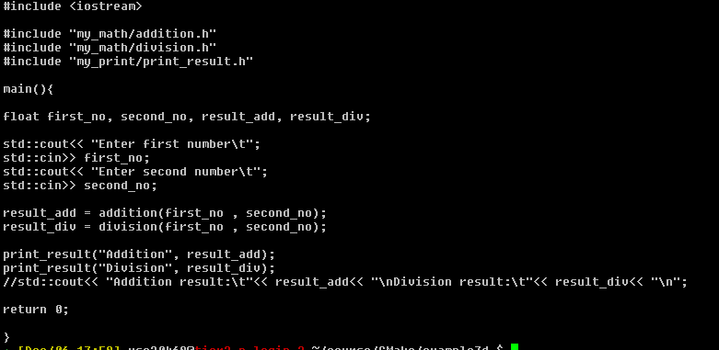


Property propagation
  How to know to which code lib belongs?
main.cpp
addition.cpp
print_result.cpp

Slide 56
Property propagation
*.h
include
my_math
example7d
*.cpp
src
my_math
CMakeLists.txt

Slide 57
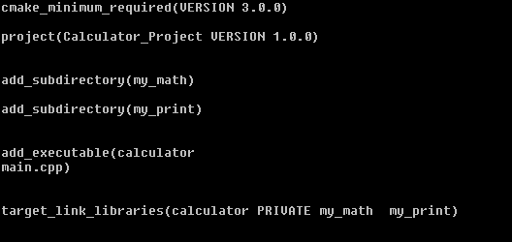
Requirements to run CMake
  Upper-level vs lower-level dir

Slide 58
Message
  Message records the specified message text in the log. If more than one message string is given, they are concatenated into a single message with no separator between the strings.
message(<mode-of-display> “the message”)

Slide 59
Message
  Modes of message display
  message(“Hello world”)
  message(STATUS “Hello world”)
  message(DEBUG “Hello world”)
  message(WARNING “Hello world”)
  message(FATAL ERROR “Hello world”)

Slide 60

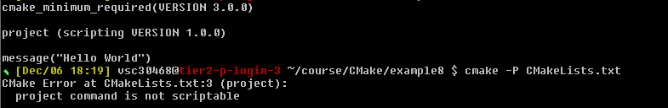
CMake scripting
  Scripts run commands and do not build any target
  $ cmake -P filename (any name)
  The message will be printed
  Project will give us error as it is not descriptible
example8

Slide 61
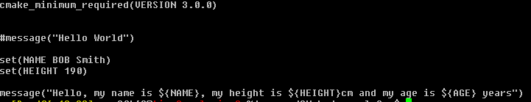
CMake scripting
  All variables in CMake are string type
  Referencing to not set variable – will give empty string
  CMake command:
  set(<variable_name> <variable_value>)
  Variable dereferencing:
  ${variable_name}

Slide 62
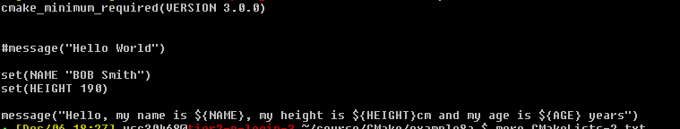
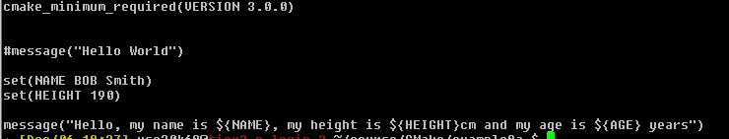
CMake strings/lists
  Without “”
  A list in CMake is items with ; separation
  String is a list with single item
Set(Name “BOB Smith”) -> String ‘Name’=BOB Smith
Set(Name BOB Smith) -> List ‘Name’=BOB;Smith

Slide 63
String/List
  CMake commands:
  list() - List operations. A list in CMake is a ; separated group of strings. To create a list the set command can be used. For example, set(var a b c d e) creates a list with a;b;c;d;e, and set(var "a b c d e") creates a string or a list with one item in it.
  string() - String operations.

Slide 64
String/List
Set command | Value of VAR | message(${VAR}) | message(“${VAR}”)
set(VAR aa bb cc) | aa;bb;cc | aabbcc | aa;bb;cc
set(VAR aa;bb;cc) | aa;bb;cc | aabbcc | aa;bb;cc
set(VAR “aa” “bb” “cc”) | aa;bb;cc | aabbcc | aa;bb;cc
set(VAR “aa bb cc”) | aa bb cc | aa bb cc | aa bb cc
set(VAR “aa;bb;cc”) | aa;bb;cc | aabbcc | aa;bb;cc

Slide 65
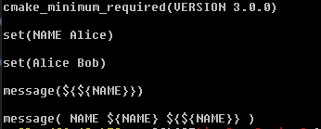
String/List
  CMake combined everything as 1 string

Slide 66
String/List
Message command | Output
message( NAME ${NAME} ${${NAME}} ) | NAMEAliceBob
message( NAME${NAME}${${NAME}} ) | NAMEAliceBob
message( “NAME ${NAME} ${${NAME}}“ ) | NAME Alice Bob

Slide 67
Generator expressions
  Variable ${VAR}
  Generator Expressions: $<TARGET_FILE:library>
  Generator expressions are evaluated during build system generation to produce information specific to each build configuration. They have the form $<...>. For example:
  target_include_directories(PRIVATE /opt/include/$<CXX_COMPILER_ID>)
  This would expand to /opt/include/GNU etc. depending on the C++ compiler used.
  Generator expressions are allowed in the context of many target properties, such as LINK_LIBRARIES, INCLUDE_DIRECTORIES, COMPILE_DEFINITIONS and others. They may also be used when using commands to populate those properties, such as target_link_libraries(), target_include_directories(), target_compile_definitions() and others. They enable conditional linking, conditional definitions used when compiling, conditional include directories, and more.

Slide 68
Lists
  Indexing of list starts from 0
  Negative index – indexing done from the end, last index is -1
  List() command
  list(<subcommand>…)
    APPEND
    INSERT
    FILTER
    GET
    JOIN
    https://cmake.org/cmake/help/latest/command/list.html?highlight=list

Slide 69
Lists
  Items to modify input list
    APPEND
    REMOVE_ITEM
    REMOVE_AT
    INSERT
    REVERSE
    REMOVE_DUPLICATES
    SORT
  Add to the list
  Remove 2 items at position 2 and -3
  Remove item 2.7 from the list
  Inset 2 items at position 2
  Reverse the list
  Remove the duplicates
  Sort the list

Slide 70
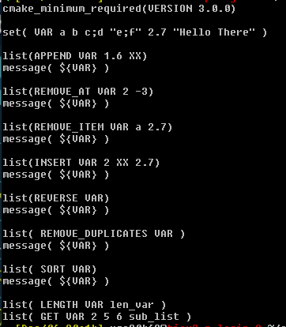
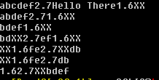
Lists
  Add to the list
  Remove 2 items at position 2 and -3
  Remove item 2.7 from the list
  Inset 2 items at position 2
  Reverse the list
  Remove the duplicates
  Sort the list
example9

Slide 71
Lists
  set( VAR a b c;d "e;f" 2.7 "Hello There" )
List commands | Output | Action
list(APPEND VAR 1.6 XX) | abcdef2.7Hello There1.6XX | Add to the list
list(REMOVE_AT VAR 2 -3) | abdef2.71.6XX | Remove 2 items at position 2 and -3
list(REMOVE_ITEM VAR a 2.7) | bdef1.6XX | Remove item 2.7 from the list
list(INSERT VAR 2 XX 2.7) | bdXX2.7ef1.6XX | Inset 2 items at position 2
list(REVERSE VAR) | XX1.6fe2.7XXdb | Reverse the list
list(REMOVE_DUPLICATES VAR) | XX1.6fe2.7db | Remove the duplicates
list(SORT VAR) | 1.62.7XXbdef | Sort the list

Slide 72
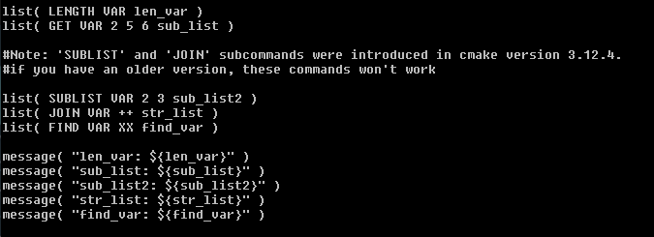
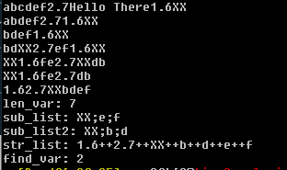
Lists
  set( VAR a b c;d "e;f" 2.7 "Hello There" )
list(SUBLIST <list> <begin> <length> <output variable>)
New in version 3.12.
Returns a sublist of the given list. If <length> is 0, an empty list will be returned. If <length> is -1 or the list is smaller than <begin>+<length> then the remaining elements of the list starting at <begin> will be returned.

Slide 73
Lists
  Negative – if specified element not found
  Current list: 1.6;2.7;XX;b;d;e;f
  Index: 0 1 2 3 4 5 6
  list(JOIN <list> <glue> <output variable>)
  New in version 3.12.
  Returns a string joining all list's elements using the glue string. To join multiple strings, which are not part of a list, use JOIN operator from string() command.
list( LENGTH VAR len_var )
list( GET VAR 2 5 6 sub_list )
list( SUBLIST VAR 2 3 sub_list2 )
list( JOIN VAR ++ str_list )
list( FIND VAR XX find_var )
len_var: 7
sub_list: XX;e;f
sub_list2: XX;b;d
str_list: 1.6++2.7++XX++b++d++e++f
find_var: 2

Slide 74
Strings
  Commands for string
    FIND
    REPLACE
    PREPEND
    APPEND
    TOLOWER
    TOUPPER
    COMPARE

Slide 75
Strings
  String() command
  set(VAR “CMake for Cross-Platform C++Projects”)
  string(FIND ${VAR} “for” find_var)
  message(${find_var}) -> 6
  string(REPLACE “Projects” “Project” replaced_var${VAR})
  message(${replaced_var}) -> CMake for Cross-Platform C++Project

Slide 76
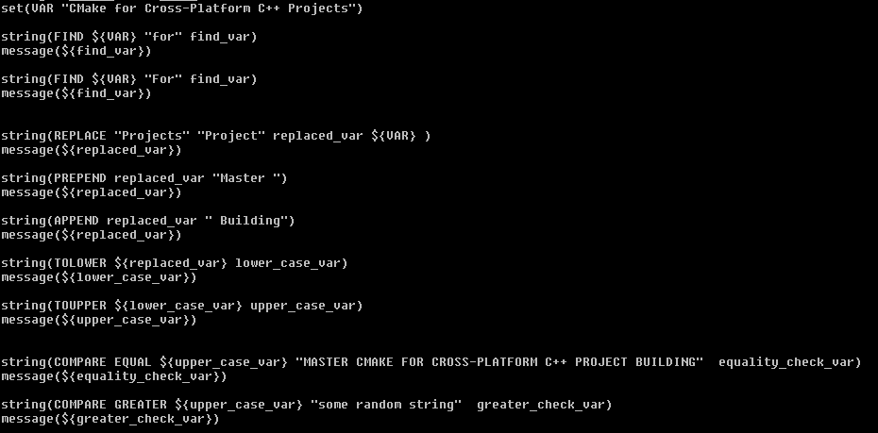
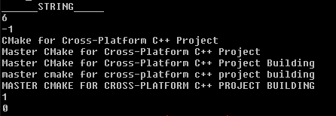
Strings
example9

Slide 77
File
  command file() command to operate on files
    READ
    WRITE
    RENAME
    REMOVE
    COPY
    DOWNLOAD
    LOCK

Slide 78
Loops
Loopings:
  Flow control commands
    If-else
    Loop
      while
      foreach
  Function command
  Scopes
  Macro command
  Modules

Slide 79
Loops
if(<condition>)
<command1>
<command1>
…
…
endif()

Slide 80
Loops
if(<condition>)
<commands>
elseif(<condition>)
<commands>
else
<commands>
endif()

Slide 81
Constants
  1, ON, YES, TRUE, Y, a non-zero number: TRUE
  0, OFF, NO, FALSE, N, IGNORE, NOTFOUND, the empty string,
  string ending with –NOTFOUND: FALSE

Slide 82
Constants with if
  Checking the condition
  if(YES)
  <commands>
  endif()
  if(N)
  <commands>
  endif()
  if(ON)
  <commands>
  endif()
  if(OFF)
  <commands>
  endif()

Slide 83
Variables with if
  Using variables with if()
  Constant
  if(YES)
  <commands>
  endif()
  Variable
  if(YE)
  <commands>
  endif()

Slide 84
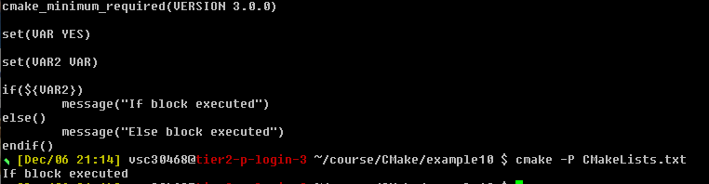
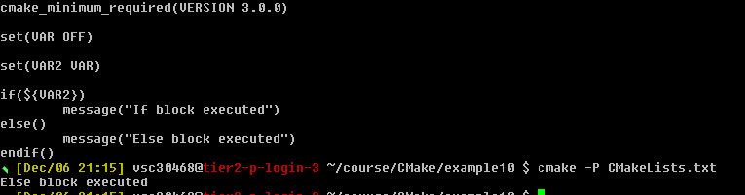
Tests
  If-else does dereferencing for us of VAR
  If VAR is empty string = > false condition
example10

Slide 85
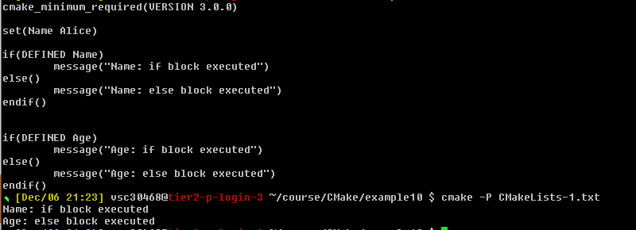
Unary tests
  Unary test– If something exists or not
  Defined – if variable set or not, command – if command exists or not and exists – if file or dir exists or not
  If() Conditions
    Unary tests
    Binary tests
    Boolean operators
  If() Conditions | Unary tests
    DEFINED
    COMMAND
    EXISTS

Slide 86
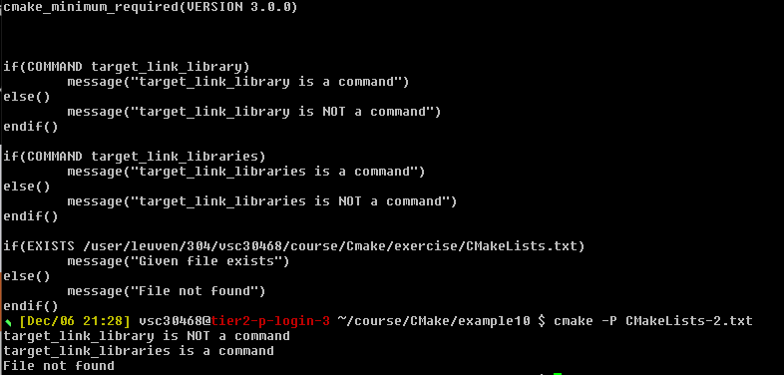
Unary tests

Slide 87
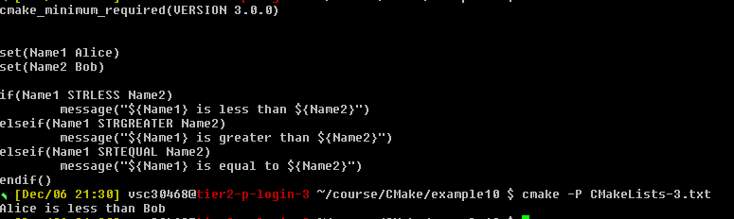
Binary tests
  Binary tests – if 2 strings
  string or variable are = < >
  strings compared lexically (according to alphabet – upper case before lower case)

Slide 88
Boolean operators
  If () condition | Boolean operators
  if(NOT DEFINED VAR)
  if(NOT(VAR STREQUAL “test” OR VAR2 STREQUAL “test2”))
  if(NOT(VAR STREQUAL “test” AND VAR2 STREQUAL “test2”))

Slide 89
While loop
  Loops:
    while
    foreach
while(<condition>)
<commands>
endwhile()

Slide 90
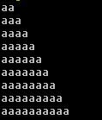
Foreach
  Dereference in the message not in the condition
  foreach – iterate over list of items or range of numbers
while(NOT VAR STREQUAL “aaaaaaaaaa”)
set(VAR ${VAR}a)
message(${VAR})
endwhile()
foreach(<loop_variable> <items>)
<commands>
endforeach()
example11

Slide 91
Foreach
  Space or semicolon separated- output the same
  foreach() command
    foreach(Name Alice Bob Charlie)
    foreach(Name Alice;Bob;Charlie)

Slide 92
Foreach
  X in
    0-10: foreach(x RANGE 10)
    10-20: foreach(x RANGE 10 20)
    10-20 steps of 3: foreach(x RANGE 10 20 3)

Slide 93
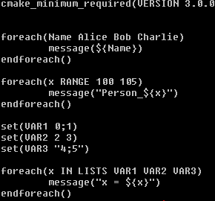
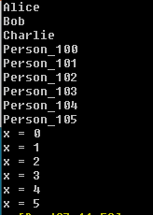
Foreach
  foreach() command
    foreach(x IN LISTS <list1> <list2> <list3>)
    foreach(Name Alice;Bob;Charlie)
example11
  With ; loop executed 6 times

Slide 94
Function
function(<function_name> <function_agrs>)
<commands>
endfuction()

Slide 95
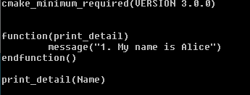
Function
example12

Slide 96
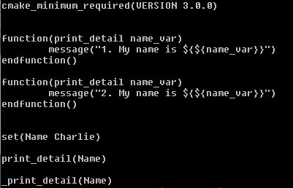

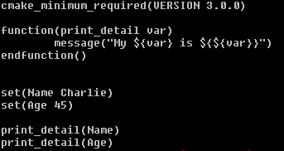

Functions
  If we define twice - CMake renames original to _function-name
  Prepending twice _ does not work
example12

Slide 97
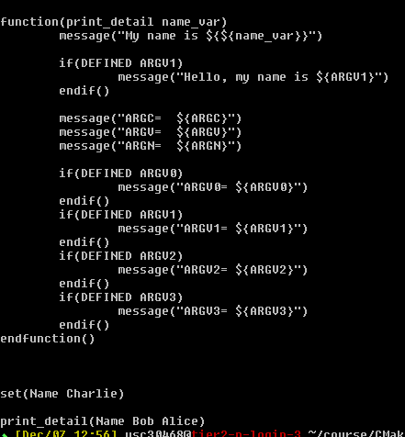
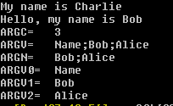
Functions
  Optional arguments
Special variables | Description
ARGC | Total count of arguments (named+optional)
ARGV | List of all arguments(named+optional)
ARGN | List of optional arguments
ARGV0 | First argument
ARGV1 | Second argument
ARGV2 | Third argument
example12

Slide 98
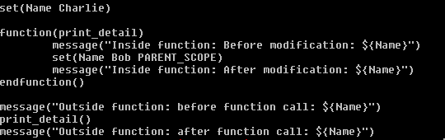

Scopes
  Whenever function is called in CMake a new scope created inside a current scope
  All the changes to variables inside function are local
  Functions do not return value in CMake
example13
Variable ‘Name’ modified
Parent Scope Name = Charlie | Parent Scope Name = Charlie | Parent Scope Name = Bob | Parent Scope Name = Bob
 | Function Scope Name = Charlie | Function Scope Name = Charlie
Function called ‘Name’ variable copied |  | Function execution ended

Slide 99
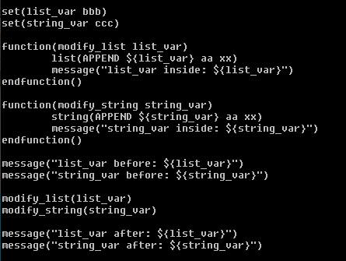

Scopes
  Modification is local
  Modifying lists and strings
function(modify_list list_var)
list(APPEND ${list_var} aa xx)
endfuction()
function(modify_string string_var)
string(APPEND ${string_var} aa xx)
endfuction()

Slide 100
Scopes
  add_subdirectory not scriptable, we need to build
  Adds a subdirectory to the build. The dir1, … specifies the directory in which the source CMakeLists.txt and code files are located. If it is a relative path, it will be evaluated with respect to the current directory (the typical usage), but it may also be an absolute path.
  The CMakeLists.txt file in the specified source directory will be processed immediately by CMake before processing in the current input file continues beyond this command.
add_subdirectory(<dir1> <dir2> <dir3>…)

Slide 101
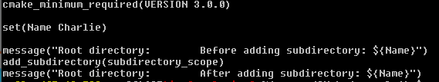
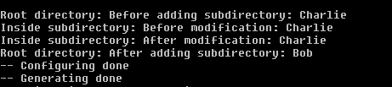

Scopes
example14
CMakeLists.txt
subdirectory_scope/CMakeLists.txt

Slide 102
Macros
  Macros look like functions, accept named and optional arguments
  Marcos do not introduce a new scope
  Commands are executed in parent scope
macro(<function_name> <function_agrs>)
<commands>
endmacro()

Slide 103
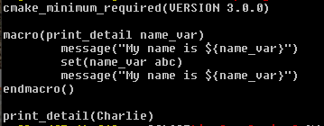

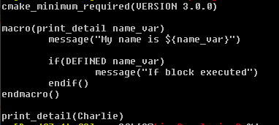
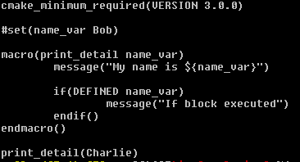
Macros
  Function vs macro
example15

Slide 104
Macros
  CMake commands, function names and macro names are case insensitive
  function(FOO)
    <commands>
  endfuction()
  foo()
  fOo()
  FoO()
  target_link_library()
  TARGET_LINK_LIBRARY()
  target_Link_library()
  target_link_LIBrary()

Slide 105
Modules
  So far, we have been writing our CMake codes in CMakelists.txt files. These files are collectively called the ListFiles.
  Apart from the listfiles, we also have the concept of modules, where the CMake codes are written. These modules have .cmake extension.
  CMake provides some standard modules containing the CMake codes so that we can directly use those in any project. You can find those in the $EBROOTCMAKE/share/cmake-3.31/Modules directory.
  These modules can be used with the include() command. If you want to use this module, you need to write these 2 lines of code and then the variable VAR will contain the number of processors.
    include(ProcessorCount)
    ProcessorCount(VAR)
    message("Number of processors are: ${VAR}")

Slide 106
Modules
  You can use this VAR variable in your project if you want to run parallel jobs of any process.
  Apart from the standard modules, you can also make your own module.

Slide 107
Modules
  We can create this directory structure with 2 files CMakeLists.txt and my_module.cmake
  The CMakeLists.txt file will contain the following lines:
    cmake_minimum_required(VERSION 3.0.0)
    project(Calculator_Project VERSION 1.0.0)
    include(my_module)
  and the my_module.cmake file will contain just the following line:
    message("Hello from the my_module.cmake file!")
  At this time running the CMake command will give an error, because we also need to specify the path which contains the my_module.cmake file.

Slide 108
Modules
  To specify that path, we have a variable called CMAKE_MODULE_PATH which contains the lists of paths to search the module. This variable is a cache variable
    cmake_minimum_required(VERSION 3.0.0)
    project(Calculator_Project VERSION 1.0.0)
    list(APPEND CMAKE_MODULE_PATH <path-to-example16-directory>)
    include(my_module)
  Now we can run the cmake .. command from the build directory and the output will be:
    Hello from the my_module.cmake file!
example16

Slide 109
Modules
  Now you might think that this command is similar to add_subdirectory() command, but it's not! When we use the include() command, we do not introduce a new scope. This means that if we set or modify a variable inside the my_module.cmake file, that modification is going to reflect inside the CMakeLists.txt file.
  The modules are often used if we want to have reusable code in our project. Also, if your CMakeLists.txt file is too long, some part of it can be written inside another .cmake file; to improve the readability of the code.

Slide 110
Normal variables
  Normal variables
  set(Name Charlie)
  set Age (50)
  function(print_detail var)
  message (“My ${var} is ${${var}}”)
  endfuction()
  print_detail(Name)
  print_detail(Age)
New scope
Another new scope

Slide 111
Global variables
  2 types of variables with global scope
    Persistent cache variables
    Environment variables

Slide 112
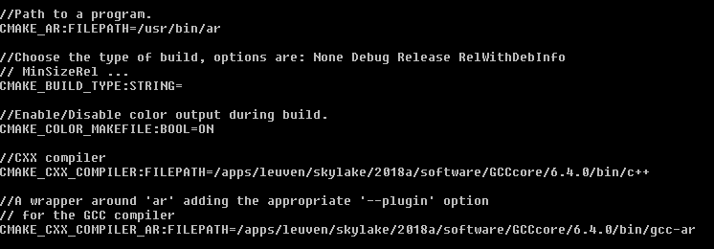
Cache variables
  All variables written inside CMake cache file are cache variables
  Cache variables:
    Set by CMake, depending on the Development environment
    Set by commands inside CMakeList.txt

Slide 113
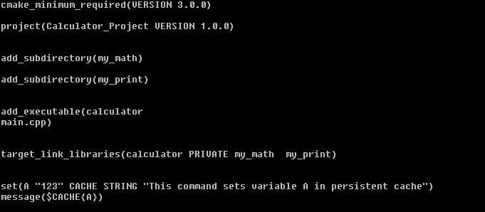

Cache variables
CMakeLists.txt
CMakeCache.txt
example17

Slide 114
Cache variables
  Cache variable dereferencing
  $CACHE(variable_name)

Slide 115
Cache variables
  First searched in local scope, if not found – in global scope (cache)
  set(A “000“)
  set(A “123” CACHE STRING "A is a cache variable")
  message(${A})
  set(A “000“)
  set(A “123” CACHE STRING "A is a cache variable")
  message($CACHE{A})
Output: 000
Output: 123
Direct lookup in cache, ignoring existing normal variable

Slide 116
Environment variables
  Environment variables
    Global scope
    Not stored in CMakeCache.txt
  Setting env variables:
    set(ENV <variable_name> <variable_value>)
  Dereferencing env variables
    $ENV{variable_name}

Slide 117


Cache variables
  Cache entry not modified
example18

Slide 118
Cache variables
  Running CMake first time –> CMakeCache.txt is created, modify is going to be rejected
  Modifying cache variables:
    Edit CMakeCache.txt file
    Use FORCE keyword
    Use –D flag
  Recommended not to use force, using -D recommended
  Using both force and –D -> Force has higher priority

Slide 119

Cache variables
example18
CMakeCache.txt

Slide 120
Cache variables
  Most frequently used cache variables
  For CMAKE_VERSION 3.20.1
  CMAKE_MAJOR_VERSION 3
  CMAKE_MINOR_VERSION 20
  CMAKE_PATCH_VERSION 1
  CMAKE_PROJECT_NAME: set to the name of the project (PROJECT_NAME) when we execute project command, can be specified in any directory, always refers to top project name

Slide 121



Generators
  About the build system, currently make – can be verified from cache variable entry CMAKE_GENERATOR
  cmake –help shows available generators (should be installed first)
  cmake –DCMAKE_GENERATOR=Ninja ..; ninja (for build.ninja file generated)
  We can also change generator with –G flag: cmake –GNinja ..
$ module load Ninja/1.10.2-GCCcore-10.3.0
$ cmake -GNinja ..
example19
Tip: Clean the build dir before changing generator
$ rm –r *

Slide 122
Installation
  Library on the system is usually part of package (download-compile-install process)
  Install – is copying the files – items to copy and the destination
  How to check: where - print message({CMAKE_INSTALL_PREFIX})
install(FILES<file_name> DESTINATION<dir>)
or
install(TARGETS<tgt_name> DESTINATION<dir>)

Slide 123
Installation
  Recommendation:
    install() command -> destination
    Header files: -> /usr/local/include/<package_name>
    Targets: -> /usr/local/lib/<package_name>
  Nothing is installed in include or lib folder after make command, only after (sudo) make install
  If we edited CMakefile and forgot to run cmake the maketool will run cmake for us.
  BUT: not available when first time building project – there is no Makefile yet.

Slide 124



Installation
example20

Slide 125

Installation

Slide 126
Comments in CMake
  We can have single line comment by prepending a line with # , for example:
    # This is a comment
  We can also have multi-line comment by wrapping the lines between #[[ and #]] , for example:
    #[[ This is comment line 1
    This is comment line 2
    This is comment line 3
    #]]
  We can also un-comment the multi-line comments by prepending #[[ and #]] with # , for example:
    ##[[ This is NOT comment line 1
    This is NOT comment line 2
    This is NOT comment line 3
    ##]]

Slide 127
Comments in CMake
  We can also have nested comments, with the help of =, like this:
    #[==[ This is comment line 1
    This is comment line 2
    #[=[This is comment line 3
    This is comment line 4
    #[[This is comment line 5
    #]]This is comment line 6
    This is comment line 7
    #]=]This is comment line 8
    This is comment line 9
    #]==]

Slide 128
CMake scripting
example21
  Running CMakeLists.txt in Script mode using -P option:
    cmake -P CMakeLists.txt
  There is another fancy way of doing this in the Linux terminal, which is similar to executing a bash or a python script.
  Run the command which cmake in your terminal. It will give you the location of the cmake executable. In my case, it is /apps/leuven/rocky8/skylake/2025a/software/CMake/3.31.3-GCCcore-14.2.0/bin/cmake
  Open the CMakeLists.txt file and paste the following code in its first line
    #! /apps/leuven/rocky8/skylake/2025a/software/CMake/3.31.3-GCCcore-14.2.0/bin/cmake -P
  Give the execution permission to the CMakeLists.txt file by running the command: chmod +x CMakeLists.txt
  Now, you can either use the command ./CMakeLists.txt to run the CMakeLists.txt file in the script mode.

Slide 129
Debug vs Release
  How can we handle different build configurations like debug, release etc. using CMakeLists.txt file?
    Make a project, which does not dependent on any external library. In this case, you can directly set a normal variable CMAKE_BUILD_TYPE to Debug or Release, while generating build system files. To do that, simply execute
    cmake -DCMAKE_BUILD_TYPE=Debug .. or
    cmake -DCMAKE_BUILD_TYPE=Release .. commands.
    Release build is faster and also has less file size compared to the debug build. When you set the CMAKE_BUILD_TYPE variable, the compiler flags are automatically modified to offer you the desired optimization levels.

Slide 130
Command line usage
  Can be used from scripts
  Go to the build directory
  Pass path to source tree
  Use -G to select build system generator
  Use -D to set cache variables

Slide 131


GUI usage
  $ccmake .. (Linux)
  CMakeSetup (Windows)
  Editing cache entries to configure the build
  Use configure (c) button after the change
  Use generate (g) button after config is done

Slide 132

GUI usage
  t – advanced mode (more settings)

Slide 133
Developer Documentation
  Command-line documentation:
    Run cmake --help for summary
    Run cmake --help COMMAND for detailed help with a specific list/file command
    Try “cmake --help IF”
  Online documentation:
    https://cmake.org/cmake/help/latest/

Slide 134
VSC
Questions
Helpdesk:
hpcinfo@kuleuven.be or https://admin.kuleuven.be/icts/HPCinfo_form/HPC-info-formulier
VSC web site:
http://www.vscentrum.be/
VSC documentation: https://docs.vscentrum.be
VSC agenda: training sessions, events
Systems status page:
http://status.vscentrum.be

Slide 135


Slide 136
VSC training
Infosessions:
Containers
Notebooks
Jupyterhub
Julia, the good, the bad, the ugly
Introductory
Intermediate
Advanced
Specialized track
Matlab (Supercalculator)
Matlab Programming
Linux for HPC
Linux scripting
Make intro
Linux tools
Linux
HPC intro
CMake intro
Version control with Git
Python introduction
Python: System programming
Scientific Python
Python for Software engineering
Python for data science
Python for machine learning
Python-on-GPUs
Python Dashboards
worker/atools
Scientific C
C++ for scientific computing
Workflows on HPC
Fortran for programmers
MLOps on HPC
C++ for software engineering
High Performance Python
Heterogeneous Programming with Kokkos
Debugging techniques
MPI
OpenMP
Code optimization
?
Deploying Large Language Models Locally
edX MOOC Fortran for Programmers (announced by e-mail)
edX Defensive programming and debugging
Stay up-to-date https://www.vscentrum.be/en/education-and-trainings

