Slide 1

Cmake introduction
https://hpcleuven.github.io/CMake-intro/

Slide 2

Build system
Build system is the collection of tools for automating program compilations
At the core there is normally a functional based language which maps a set of sources (files) to the target (executable, library)
Build systems:
Make
Ninja
Ant
Gradle

Slide 3
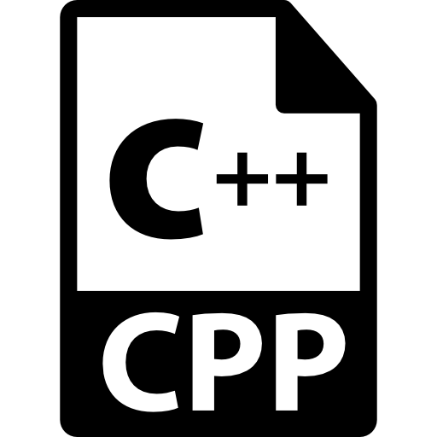
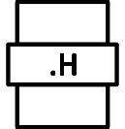
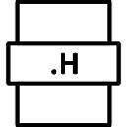
Build systems
compile
Why – the number of files can go to hundreds
Challenge to keep track of files and dependencies
Compilation may take a lot of files, not well maintained – need to start from beginning
Build systems – automated source code compilation and linking process
$ g++ main.cpp addition.cpp division.cpp print result.cpp –o calculator
compile

Slide 4
Build systems
Build file – to compile and link source code
Build process
Source files
*.cpp
*.h
*.hpp
Build File
Makefile
Build system
make

Slide 5
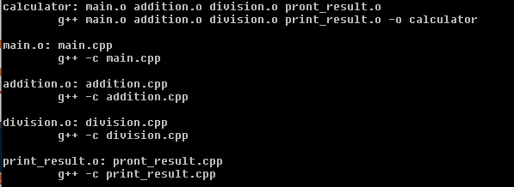
Build systems
Build file – to compile and link source code

Slide 6
Build systems
CMake is able to write Makefiles for us
Why – building of the project is not standard across platfoms - > CMake will create the platform-based build system files
Make vs Cmake
Make - Uses build system files to generate executable
CMake - Used to generate build system files

Slide 7
CMake
CMake is the cross-platform make,
It is a build system manager
Can build multiple make systems (like make - default)
Build systems are called generators
Provides possibilities to manage all unit tests (ctest)
Why CMake?
Open source
Can be used for multiple programming languages

Slide 8
CMake
Treat as project oriented programming
Cmake is organized in targets (libraries, executables created in the end)
Every target contains
properties (e.g. compiler options) and
usage requirements (e.g. dependencies between targets)
Target 1
Property 1
Peroperty 2
Usage requirement 1
Usage requirement 2
Executable/Library
Target 2
Property 1
Peroperty 2
Usage requirement 1
Usage requirement 2
Executable/Library
Target 3
Property 1
Peroperty 2
Usage requirement 1
Usage requirement 2
Executable/Library
Library1/CMakeLists.txt
depends
includes
Library2/CMakeLists.txt
CMakeCache.txt
…
Cmake generates build files and meta files (stored in cmake cache)
CMake
Build file
Generator

Slide 9
CMake on the cluster
Which module to choose on the cluster – avoid conflicts (go for GCC/GCCcore)
Compiled code and source files available – in case new version necessary
$module load CMake/3.20.1-GCCcore-6.4.0

Slide 10


Requirements to run CMake
CMakeLists.txt file (fixed name – renamed will case CMake error)
Separate directory to store build system files (can be anything)
Using CMake
CMakeLists.txt
example0
Project folder
Build folder
Other files/folders

Slide 11

Requirements to run CMake
CMakeLists.txt file (fixed name – renamed will cause CMake error)
Separate directory to store build system files (can be anything)
cmake .. – run in the build dir,
.. – informs that CMakeLists.txt is in the main dir
CMakeLists.txt
Project folder
Build folder
$cmake ..
Other files/folders

Slide 12
Requirements to run CMake
CMakeLists.txt file (fixed name – renamed will cause CMake error)
Separate directory to store build system files (can be anything)
cmake .. – run in the build dir,
.. – informs that CmakeLists.txt is in the parent folder
Makefile created – we can run make

Slide 13
CMakeLists.txt
Create executable
Name of executable should be the 1st argument
CMakeLists.txt composition
command1 (arg_a1 arg_a2 arg_a3 … )
command2 (arg_b1 arg_b2 arg_b3 … )
command3 (arg_c1
arg_c2
… )
command4 (arg_d1 arg_d2 arg_d3 … )

Slide 14


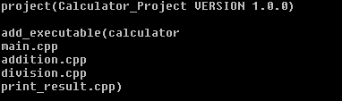
add_executable
add_executable – executable with the given name is created
executable created from compiling the files given after the name
Arguments
add_executable(
calculator
addition.cpp
division.cpp
print_result.cpp
main.cpp)
add_executable(
calculator
main.cpp
addition.cpp
division.cpp
print_result.cpp)
add_executable(
addition.cpp
calculator
division.cpp
print_result.cpp
main.cpp)

Slide 15
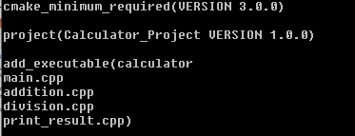
cmake_minimum_required
Minimum version requirement – developer must test – depending on featured used
example1

Slide 16
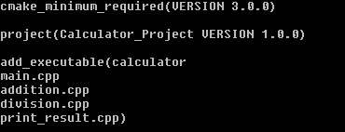
add_library
add_library - To add a library we use the add_library() command and specify which source files should make up the library. Rather than placing all of the source files in one directory, we can organize our project with one or more subdirectories. In this case, we will create a subdirectory specifically for our library.
example2

Slide 17
Requirements to run CMake
Making project modular - hierarchy
main.cpp
addition.cpp
division.cpp
print_result.cpp

Slide 18
target_link_libraries
target_link_libraries is responsible for adding a library into the linker's command line. If you use some library but doesn't specify it for the linker, you will get an "undefined reference" (or an "unresolved externals") error when create an executable or a shared library
target_link_libraries(<executable> <lib1> <lib2>)

Slide 19
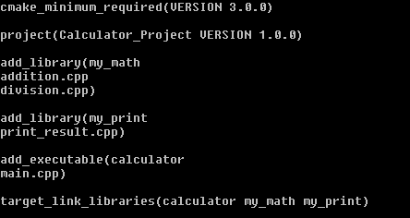
target_link_libraries
Target link libraries
example3

Slide 20
Targets
Targets
Libraries
Executables

Slide 21
Target Properties
Every target has properties and dependencies
Hint: check CMake help webpage https://cmake.org/cmake/help/latest
Target Properties
INTERFACE_LINK_DIRECTORIES
INCLUDE_DIRECTORIES
VERSION
SOURCES

Slide 22
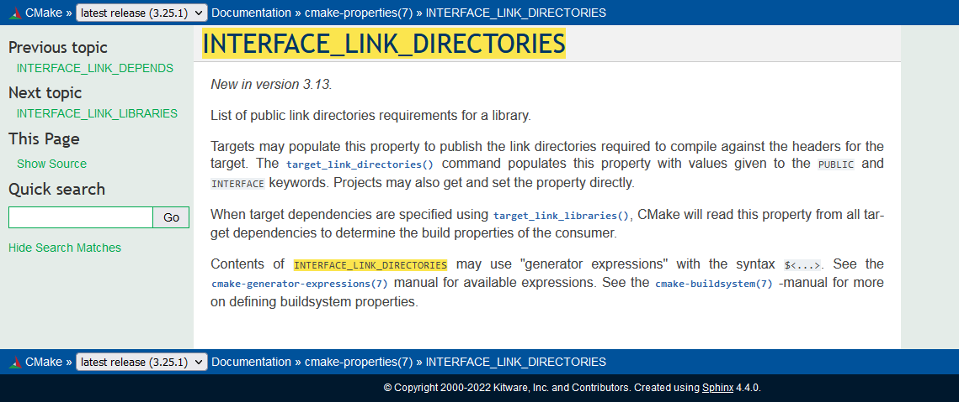
Target Properties

Slide 23
Properties
Modify or retrieve properties
In CMake, we can set target properties as either PRIVATE, PUBLIC, or INTERFACE. Both PUBLIC and INTERFACE properties are inherited by any targets that depend on the current target.
set_target_properties()
set_property
get_property
get_target_property()

Slide 24
Properties
Include Inheritance | Description
PUBLIC | All the directories following PUBLIC will be used for the current target and the other targets that have dependencies on the current target, i.e., appending the directories to INCLUDE_DIRECTORIES and INTERFACE_INCLUDE_DIRECTORIES.
PRIVATE | All the include directories following PRIVATE will be used for the current target only, i.e., appending the directories to INCLUDE_DIRECTORIES.
INTERFACE | All the include directories following INTERFACE will NOT be used for the current target but will be accessible for the other targets that have dependencies on the current target, i.e., appending the directories to INTERFACE_INCLUDE_DIRECTORIES.

Slide 25
Target dependecy
Target dependency
Target A
Target B (Dependency of Target A)
Target C (Dependency of Target B)

Slide 26
Target vs. dependency
calculator is the target
my math and my_print are the dependencies

Slide 27
Target properties
PRIVATE, PUBLIC, INTERFACE
Propagating target properties
target_link_libraries (myapp PUBLIC <item1> <item2>)
Property: INTERFACE_LINK_LIBRARIES
target_link_libraries (myapp INTERFACE <item1> <item2>)
Property: INTERFACE_LINK_LIBRARIES

Slide 28
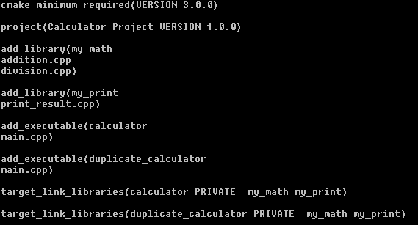
Requirements to run CMake
Can we have multiple executables in CMakelists
Yes
example4

Slide 29
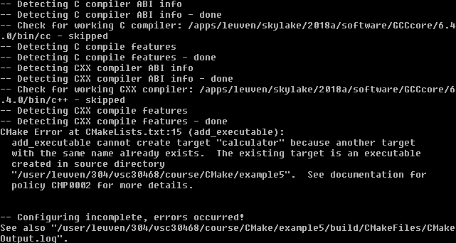
Requirements to run CMake
Can we have 2 targets with the same name – no
CMake will return the error
example5

Slide 30
Target files: prefix and suffix
Do we have target files saved on computer – yes
In build dir
Actual name can be different
Library .lib .dll .so .a – depending on operating system
Prefix and extension
calculator -> calculator.exe
my_math -> my_math.lib
my_math -> libmy_math.so

Slide 31
Subdirectories
Build or debug+release for separate compiler options
CMakeLists.txt
Build folder (debug)
Project folder
Build folder (release)
Other files/folders

Slide 32
Subdirectories
Subdirs – to go to subdirectory, find another CMakefile.txt file there and run one by one
Build tree
CMakeLists.txt
in the claculator project
CMakeLists.txt
in my_math dir
CMakeLists.txt
in my_print dir

Slide 33
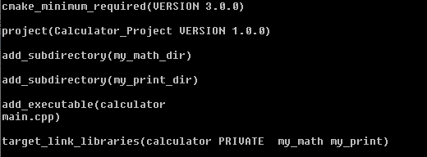


Subdirectories
Subdirs – to go to subdirectory, find another CMakefile.txt file there and run one by one
CMakeLists.txt
in the claculator project
CMakeLists.txt
in my_math dir
CMakeLists.txt
in my_print dir

Slide 34

Subdirectories
CMakeLists.txt
main.cpp
addition.cpp
my_math_dir
example6
division.cpp
CMakeLists.txt
calculator_project
my_print_dir
print_result.cpp
build
CMakeLists.txt
Header files

Slide 35
Library
Good practice – keep files belonging to one library in the same place
*.h
*.cpp
library1
CMakeLists.txt

Slide 36
Library Folder Structure
*.h
include
*.cpp
src
library1
CMakeLists.txt

Slide 37
Libraries
Avoiding compatibility issues
addition.cpp
division.cpp
#include <addition.h>
…
…
…
#include <division.h>
…
…
…

Slide 38
Header files
If header file is in another folder – we need to inform preprocessor where(define the dir)
*.h
include
*.cpp
src
#include “../include/addition.h”
library1
CMakeLists.txt

Slide 39
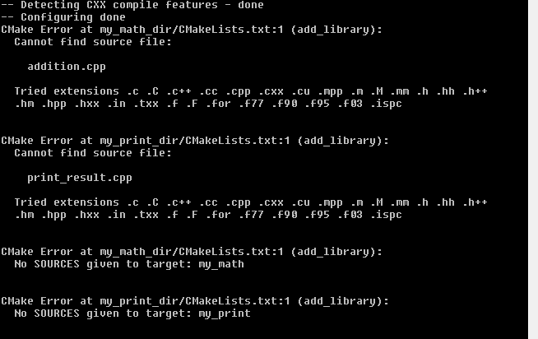
Source files
If header or source file is in another folder – we need to inform preprocessor where (define the dir)
example7

Slide 40

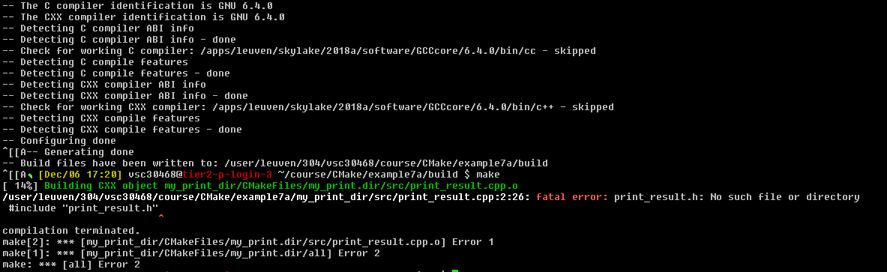
Header files
CMakeLists.txt
example7a

Slide 41

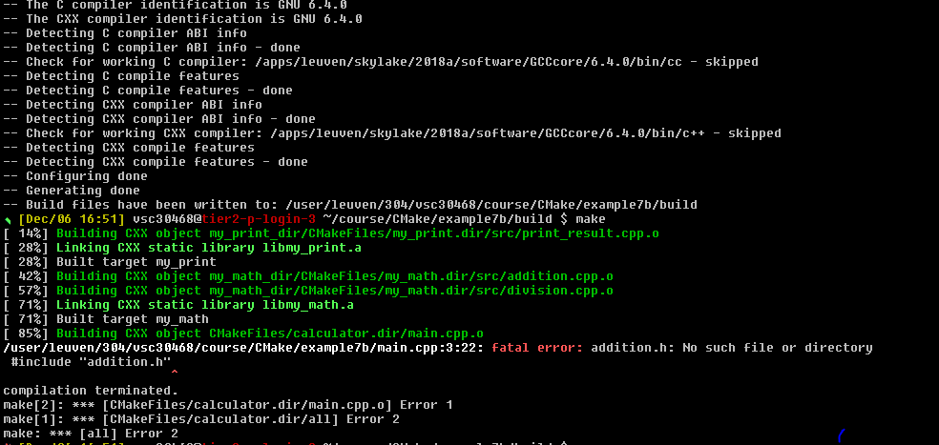
Header files
CMakeLists.txt
addition.cpp
example7b

Slide 42
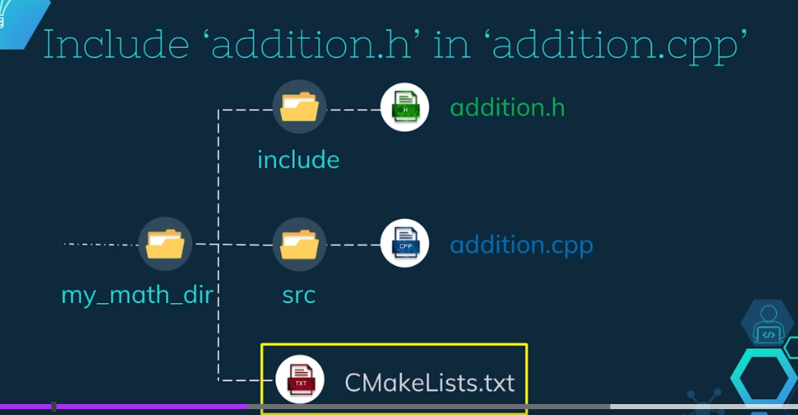

Header files
Ask CMake to take care of it
target_include_directories(<target>
<scope>
<dir1>
<dir2>
…
)
addition.h
include
addition.cpp
src
my_math_dir
CMakeLists.txt

Slide 43


Header files
Ask CMake to take care of it
CMakeLists.txt
example7c
addition.cpp

Slide 44

Header files
We can include multiple dirs at the same time
addition.h
include
addition.cpp
src
#include “../include/addition.h”
#include “addition.h”
my_math_dir
CMakeLists.txt

Slide 45
Header files
In main.cpp we do not need any path for include header files – the PUBLIC keyword:
PUBLIC: All the directories following PUBLIC will be used for the current target and the other targets that have dependencies on the current target, i.e., appending the directories to INCLUDE_DIRECTORIES and INTERFACE_INCLUDE_DIRECTORIES.

Slide 46
Target properties
target_include_directories(my_print PUBLIC include)
target_include_directories(my_print INTERFACE include)
Property: INTERFACE_INCLUDE_DIRECTORIES of target my_print
Is set to $VSC_HOME/courses/Cmake/exercise7c/my_print/include

Slide 47
Target properties
Calculator dependencies
target_link_libraries(calculator my_math my_print)
calculator
my_math
my_print

Slide 48
Property propagation
Properties are visible to main.cpp
property propagation
Properties of my_math
Property A=aaa
Property B=bbb
Property C=ccc
Properties of my_print
Property X=xxx
Property Y=yyy
Property Z=zzz

Slide 49
Property propagation
PUBLIC, PRIVATE vs INTERFACE
Private – does not set the interface of include dir or any other property, main.cpp will not be able to find them
target_include_directories(my_print PRIVATE include)
Property: INTERFACE_INCLUDE_DIRECTORIES of target my_print
Is set to: <not-set>

Slide 50
Property propagation
PUBLIC, INTERFACE and PRIVATE
Question: | Answer | Answer | Answer
Does ‘my_math’ need the directory | Yes | No | Yes
Do the other targets, depending upon ‘my_math’ are going to need this include directory? | Yes | Yes | No
 | PUBLIC | INTERFACE | PRIVATE

Slide 51
Property propagation
Other commands that will use it:
Command | Property set by the command
target_compile_definitions | INTERFACE_COMPILE_DEFINITIONS
target_sources | INTERFACE_SOURCES
target_compile_features | INTERFACE_COMPILE_FEATURES
target_compile_options | INTERFACE_COMPILE_OPTIONS
target_link_directories | INTERFACE_LINK_DIRECTORIES
target_link_libraries | INTERFACE_LINK_LIBRARIES
target_link_options | INTERFACE_LINK_OPTIONS
target_precompile_headers | INTERFACE_PRECOMPILE_HEADERS

Slide 52
Requirements to run CMake
Scope specifier allows to propagate requirements to another top-level target
target_include_directories(my_print PRIVATE include)
target_include_directories(Target Name | Scope | Arguments)

Slide 53
Property propagation
Target with both private and public
target_include_directories(target PRIVATE xxx PUBLIC yyy)
or
target_include_directories(target PRIVATE xxx)
target_include_directories(target PUBLIC yyy)

Slide 54
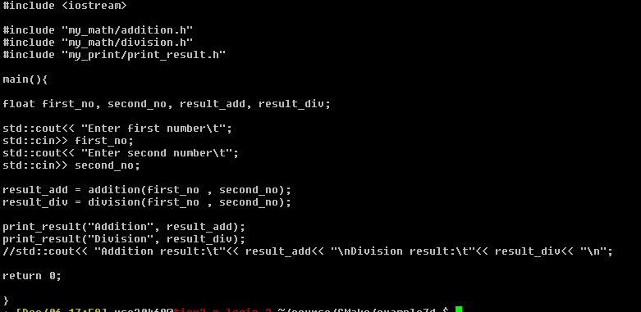


Property propagation
How to know to which code lib belongs?
main.cpp
addition.cpp
print_result.cpp

Slide 55
Property propagation
*.h
include
my_math
example7d
*.cpp
src
my_math
CMakeLists.txt

Slide 56
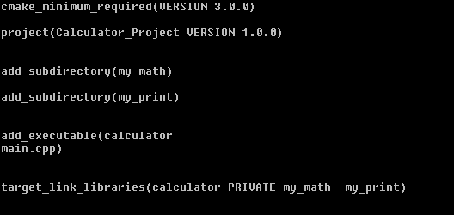
Requirements to run CMake
Upper-level vs lower-level dir

Slide 57
Message
Message records the specified message text in the log. If more than one message string is given, they are concatenated into a single message with no separator between the strings.
message(<mode-of-display> “the message”)

Slide 58
Message
Modes of message display
message(“Hello world”)
message(STATUS “Hello world”)
message(DEBUG “Hello world”)
message(WARNING “Hello world”)
message(FATAL ERROR “Hello world”)

Slide 59

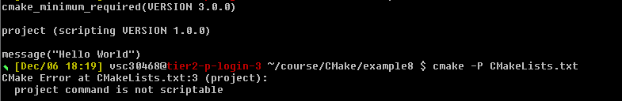
CMake scripting
Scripts run commands and do not build any target
$ cmake -P filename (any name)
The message will be printed
Project will give us error as it is not descriptible
example8

Slide 60
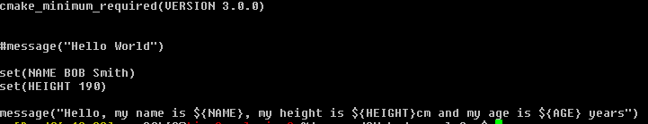
CMake scripting
All variables in CMake are string type
Referencing to not set variable – will give empty string
CMake command:
set(<variable_name> <variable_value>)
Variable dereferencing:
${variable_name}

Slide 61
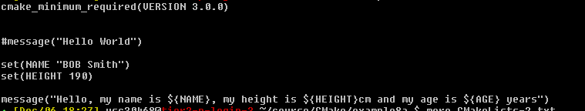
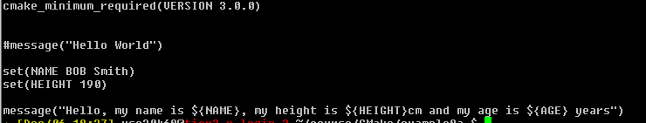
CMake strings/lists
Without “”
A list in CMake is items with ; separation
String is a list with single item
Set(Name “Bob Smith”) -> String ‘Name’=Bob Smith
Set(Name Bob Smith) -> List ‘Name’=Bob;Smith

Slide 62
String/List
CMake commands:
list() - List operations. A list in CMake is a ; separated group of strings. To create a list the set command can be used. For example, set(var a b c d e) creates a list with a;b;c;d;e, and set(var "a b c d e") creates a string or a list with one item in it. (
string() - String operations.

Slide 63
String/List
Set command | Value of VAR | message(${VAR}) | message(“${VAR}”)
set(VAR aa bb cc) | aa;bb;cc | aabbcc | aa;bb;cc
set(VAR aa;bb;cc) | aa;bb;cc | aabbcc | aa;bb;cc
set(VAR “aa” “bb” “cc”) | aa;bb;cc | aabbcc | aa;bb;cc
set(VAR “aa bb cc”) | aa bb cc | aa bb cc | aa bb cc
set(VAR “aa;bb;cc”) | aa;bb;cc | aabbcc | aa;bb;cc

Slide 64
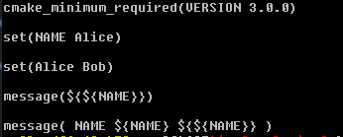
String/List
CMake combined everything as 1 string

Slide 65
String/List
Message command | Output
message( NAME ${NAME} ${${NAME}} ) | NAMEAliceBob
message( NAME${NAME}${${NAME}} ) | NAMEAliceBob
message( “NAME ${NAME} ${${NAME}}“ ) | NAME Alice Bob

Slide 66
Generator expressions
Variable ${VAR}
Generator Expressions: $<TARGET_FILE:library>
Generator expressions are evaluated during build system generation to produce information specific to each build configuration. They have the form $<...>. For example:
target_include_directories( PRIVATE /opt/include/$<CXX_COMPILER_ID>)
This would expand to /opt/include/GNU etc. depending on the C++ compiler used.
Generator expressions are allowed in the context of many target properties, such as LINK_LIBRARIES, INCLUDE_DIRECTORIES, COMPILE_DEFINITIONS and others. They may also be used when using commands to populate those properties, such as target_link_libraries(), target_include_directories(), target_compile_definitions() and others. They enable conditional linking, conditional definitions used when compiling, conditional include directories, and more.

Slide 67
Lists
Indexing of list starts from 0
Negative index – indexing done from the end, last index is -1
List() command
list(<subcommand>…)
APPEND
INSERT
FILTER
GET
JOIN
https://cmake.org/cmake/help/latest/command/list.html?highlight=list

Slide 68
Lists
Items to modify input list
APPEND
REMOVE_ITEM
REMOVE_AT
INSERT
REVERSE
REMOVE_DUPLICATES
SORT
Add to the list
Remove 2 items at position 2 and -3
Remove item 2.7 from the list
Inset 2 items at position 2
Reverse the list
Remove the duplicates
Sort the list

Slide 69
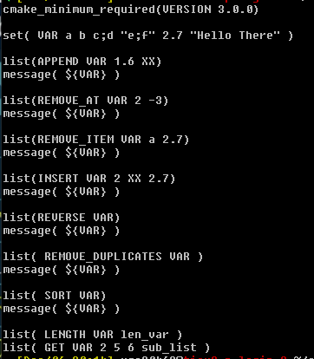
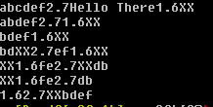
Lists
Add to the list
Remove 2 items at position 2 and -3
Remove item 2.7 from the list
Inset 2 items at position 2
Reverse the list
Remove the duplicates
Sort the list
example9

Slide 70
Lists
set( VAR a b c;d "e;f" 2.7 "Hello There" )
List commands | Output | Action
list(APPEND VAR 1.6 XX) | abcdef2.7Hello There1.6XX | Add to the list
list(REMOVE_AT VAR 2 -3) | abdef2.71.6XX | Remove 2 items at position 2 and -3
list(REMOVE_ITEM VAR a 2.7) | bdef1.6XX | Remove item 2.7 from the list
list(INSERT VAR 2 XX 2.7) | bdXX2.7ef1.6XX | Inset 2 items at position 2
list(REVERSE VAR) | XX1.6fe2.7XXdb | Reverse the list
list( REMOVE_DUPLICATES VAR ) | XX1.6fe2.7db | Remove the duplicates
list( SORT VAR) | 1.62.7XXbdef | Sort the list

Slide 71
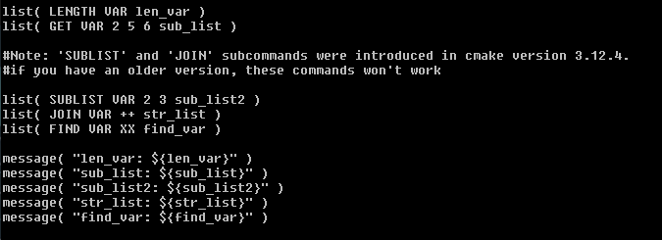
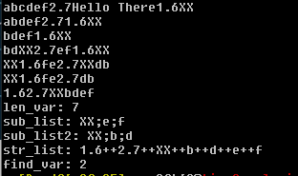
Lists
set( VAR a b c;d "e;f" 2.7 "Hello There" )
list(SUBLIST <list> <begin> <length> <output variable>)
New in version 3.12.
Returns a sublist of the given list. If <length> is 0, an empty list will be returned. If <length> is -1 or the list is smaller than <begin>+<length> then the remaining elements of the list starting at <begin> will be returned.

Slide 72
Lists
Negative – if specified element not found
Current list: 1.6;2.7;XX;b;d;e;f
Index: 0 1 2 3 4 5 6
list(JOIN <list> <glue> <output variable>)
New in version 3.12.
Returns a string joining all list's elements using the glue string. To join multiple strings, which are not part of a list, use JOIN operator from string() command.
list( LENGTH VAR len_var )
list( GET VAR 2 5 6 sub_list )
list( SUBLIST VAR 2 3 sub_list2 )
list( JOIN VAR ++ str_list )
list( FIND VAR XX find_var )
len_var: 7
sub_list: XX;e;f
sub_list2: XX;b;d
str_list: 1.6++2.7++XX++b++d++e++f
find_var: 2

Slide 73
Strings
Commands for string
FIND
REPLACE
PREPEND
APPEND
TOLOWER
TOUPPER
COMPARE

Slide 74
Strings
String() command
set(VAR “CMake for Cross-Platform C++Projects”)
string(FIND ${VAR} “for” find_var)
message(${find_var}) -> 5
string(REPLACE “Projects” “Project” replaced_var${VAR})
message(${replaced_var}) -> CMake for Cross-Platform C++Project

Slide 75
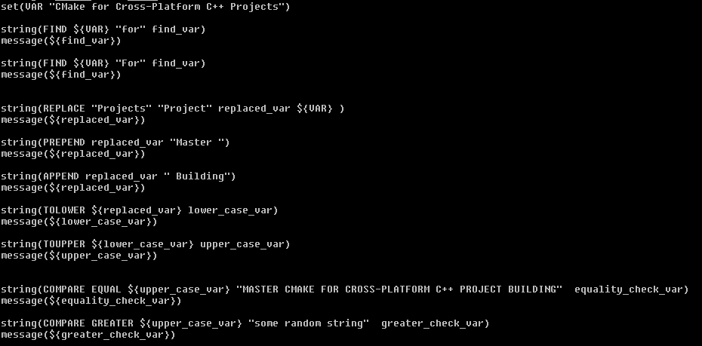
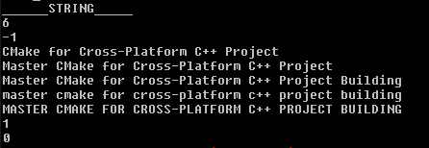
Strings
example9

Slide 76
File
command file() command to operate on files
READ
WRITE
RENAME
REMOVE
COPY
DOWNLOAD
LOCK

Slide 77
Loops
Loopings:
Flow control commands
If-else
Loop
while
foreach
Function command
Scopes
Macro command
Modules

Slide 78
Loops
if(<condition>)
<command1>
<command1>
…
…
endif()

Slide 79
Loops
if(<condition>)
<commands>
elseif(<condition>)
<commands>
else
<commands>
endif()

Slide 80
Constants
1, ON, YES, TRUE, Y, a non-zero number: TRUE
0, OFF, NO, FALSE, N, IGNORE, NOTFOUND, the empty string,
string ending with –NOTFOUND: FALSE

Slide 81
Constants with if
Checking the condition
if(YES)
<commands>
endif
if(N)
<commands>
endif
if(ON)
<commands>
endif
if(OFF)
<commands>
endif

Slide 82
Variables with if
Using variables with if()
Constant
if(YES)
<commands>
endif
Variable
if(YE)
<commands>
endif

Slide 83
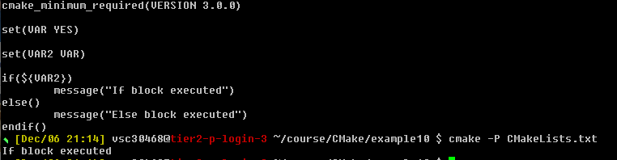
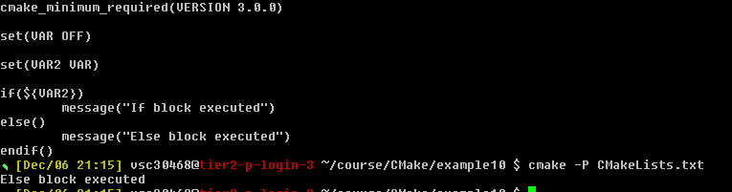
Tests
If-else does dereferencing for us of VAR
If VAR is empty string = > false condition
example10

Slide 84
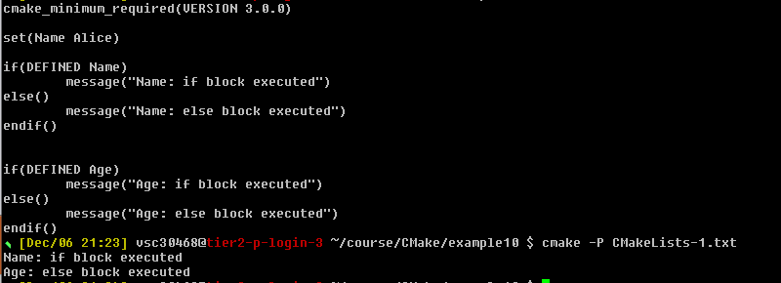
Unary tests
Unary test– If something exists or not
Defined – if variable set or not, command – if command exists or not and exists – if file or dir exists or not
If() Conditions
Unary tests
Binary tests
Boolean operators
If() Conditions | Unary tests
DEFINED
COMMAND
EXISTS

Slide 85
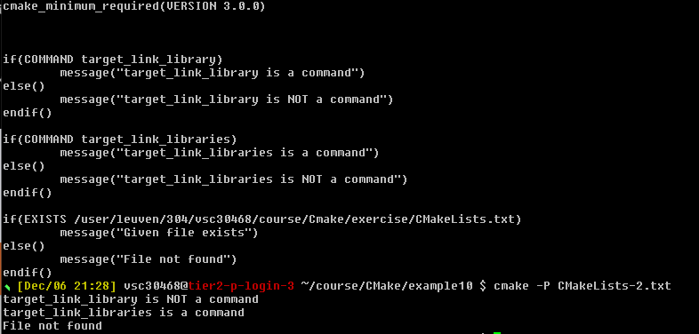
Unary tests

Slide 86
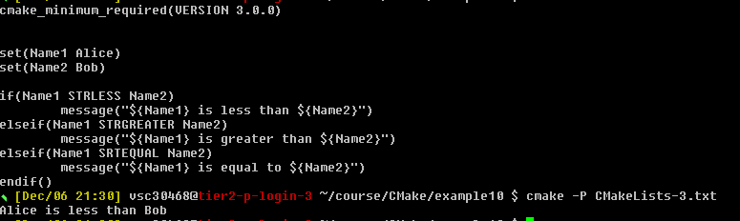
Binary tests
Binary tests – if 2 strings
string or variable are = < >
strings compared lexically (accoring to alphabet – upper case before lower case)

Slide 87
Boolean operators
If () condition | Boolean operators
if(NOT DEFINED VAR)
if(NOT(VAR STREQUAL “test” OR VAR2 STREQUAL “test2”))
if(NOT(VAR STREQUAL “test” AND VAR2 STREQUAL “test2”))

Slide 88
While loop
Loops:
while
foreach
while(<condition>)
<commands>
endwhile()

Slide 89
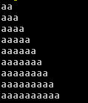
Foreach
Dereference in the message not in the condition
foreach – iterate over list of items or range of numbers
while(NOT VAR STREQUAL “aaaa”)
set(VAR ${VAR}a)
message(${VAR})
endwhile()
foreach(<loop_variable> <items>)
<commands>
endforeach()
example11

Slide 90
Foreach
Space or semicolon separated- output the same
foreach() command
foreach(Name Alice Bob Charlie)
foreach(Name Alice;Bob;Charlie)

Slide 91
Foreach
X in
0-10: foreach(x RANGE 10)
10-20: foreach(x RANGE 10 20)
10-20 steps of 3: foreach(x RANGE 10 20 3)

Slide 92
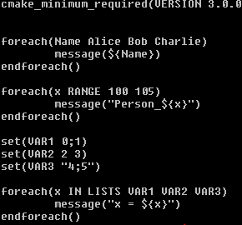
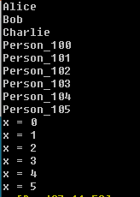
Foreach
foreach() command
foreach(x IN LISTS <list1> <list2> <list3>)
foreach(Name Alice;Bob;Charlie)
example11
With ; loop executed 6 times

Slide 93
Function
function(<function_name> <function_agrs>)
<commands>
endfuction()

Slide 94
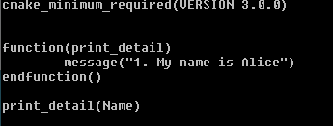
Function
example12

Slide 95
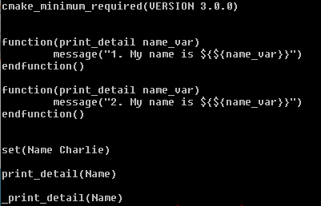

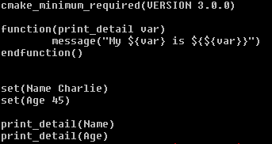

Functions
If we define twice - CMake renames original to _function-name
Prepending twice _ does not work
example12

Slide 96
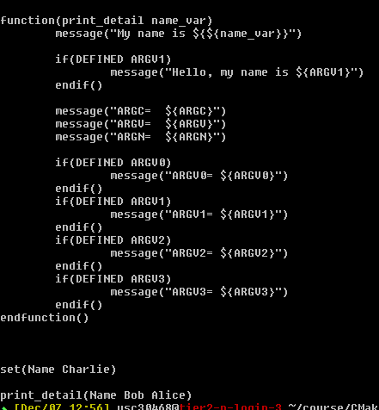
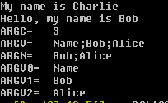
Functions
Optional arguments
Special variables | Description
ARGC | Total count of arguments (named+optional)
ARGV | List of all arguments(named+optional)
ARGN | List of optional arguments
ARGV0 | First argument
ARGV1 | Second argument
ARGV2 | Third argument
example12

Slide 97
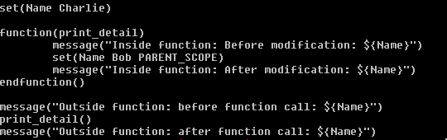

Scopes
Whenever function is called in CMake a new scope created inside a current scope
All the changes to variables inside function are local
Functions do not return value in CMake
example13
Variable ‘Name’ modified
Parent Scope Name = Charlie | Parent Scope Name = Charlie | Parent Scope Name = Bob | Parent Scope Name = Bob
 | Function Scope Name = Charlie | Function Scope Name = Charlie
Function called ‘Name’ variable copied |  | Function execution ended

Slide 98
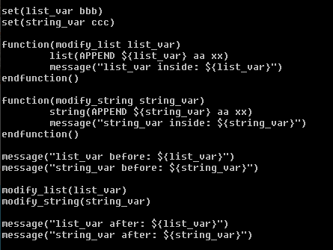

Scopes
Modification is local
Modifying lists and strings
function(modify_list list_var)
list(APPEND ${list_var} aa xx)
endfuction()
function(modify_string string_var)
string(APPEND ${string_var} aa xx)
endfuction()

Slide 99
Scopes
add_subdirectory not scriptable, we need to build
Adds a subdirectory to the build. The dir1, … specifies the directory in which the source CMakeLists.txt and code files are located. If it is a relative path it will be evaluated with respect to the current directory (the typical usage), but it may also be an absolute path.
The CMakeLists.txt file in the specified source directory will be processed immediately by CMake before processing in the current input file continues beyond this command.
add_subdirectory(<dir1> <dir2> <dir3>…)

Slide 100
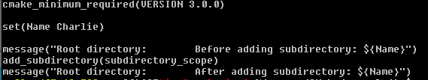
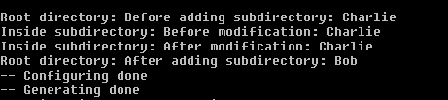

Scopes
example14
CMakeLists.txt
subdirectory_scope/CMakeLists.txt

Slide 101
Macros
Macros look like functions, accept named and optional documents
Marcos do not introduce a new scope
Commands are executed in parent scope
macro(<function_name> <function_agrs>)
<commands>
endmacro()

Slide 102
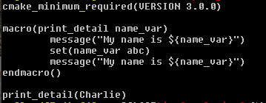

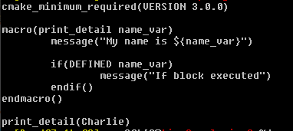
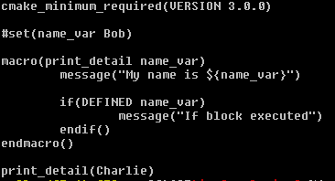
Macros
Function vs macro
example15

Slide 103
Macros
CMake commands, function names and macro names are case insensitive
function(FOO)
<commands>
endfuction()
foo()
fOo()
FoO()
target_link_library()
TARGET_LINK_LIBRARY()
target_Link_library()
target_link_LIBrary()

Slide 104
Modules
So far, we have been writing our CMake codes in CMakelists.txt files. These files are collectively called the ListFiles.
Apart from the listfiles, we also have the concept of modules, where the CMake codes are written. These modules have .cmake extension.
CMake provides some standard modules containing the CMake codes so that we can directly use those in any project. You can find those in the $EBROOTCMAKE/share/cmake-3.20/Modules directory.
These modules can be used with the include() command. If you want to use this module, you need to write these 2 lines of code and then the variable VAR will contain the number of processors.
include(ProcessorCount)
ProcessorCount(VAR)
message("Number of processors are: ${VAR}")

Slide 105
Modules
You can use this VAR variable in your project if you want to run parallel jobs of any process.
Apart from the standard modules, you can also make your own module.

Slide 106
Modules
We can create this directory structure with 2 files CMakeLists.txt and my_module.cmake
The CMakeLists.txt file will contain the following lines:
cmake_minimum_required(VERSION 3.0.0)
project(Calculator_Project VERSION 1.0.0)
include(my_module)
and the my_module.cmake file will contain just the following line:
message("Hello from the my_module.cmake file!")
At this time running the CMake command will give an error, because we also need to specify the path which contains the my_module.cmake file.

Slide 107
Modules
To specify that path, we have a variable called CMAKE_MODULE_PATH which contains the lists of paths to search the module. This variable is a cache variable
cmake_minimum_required(VERSION 3.0.0)
project(Calculator_Project VERSION 1.0.0)
list(APPEND CMAKE_MODULE_PATH <path-to-example16-directory>)
include(my_module)
Now we can run the cmake .. command from the build directory and the output will be:
Hello from the my_module.cmake file!
example16

Slide 108
Modules
Now you might think that this command is similar to add_subdirectory() command, but it's not! When we use the include() command, we do not introduce a new scope. This means that if we set or modify a variable inside the my_module.cmake file, that modification is going to reflect inside the CMakeLists.txt file.
The modules are often used if we want to have reusable code in our project. Also if your CMakeLists.txt file is too long, some part of it can be written inside another .cmake file; to improve the readability of the code.

Slide 109
Normal variables
Normal variables
set(Name Charlie)
set Age (50)
function(print_detail var)
message (“My ${var} is $[$[var}}”)
endfuction()
print_detail(Name)
print_detail(Age)
New scope
Another new scope

Slide 110
Global variables
2 types of variables with global scope
Persistent cache variables
Environment variables

Slide 111
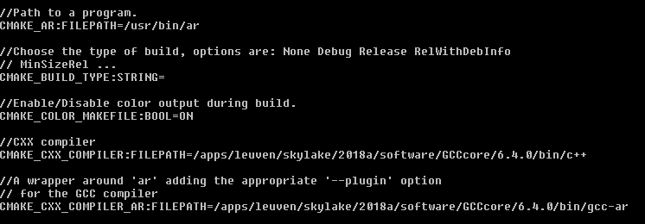
Cache variables
All variables written inside CMake cache file are cache variables
Cache variables:
Set by CMake, depending on the Development environment
Set by commands inside CMakeList.txt

Slide 112


Cache variables
CMakeLists.txt
CMakeCache.txt
example17

Slide 113
Cache variables
Cache variable dereferencing
$CACHE(variable_name)

Slide 114
Cache variables
First searched in local scope, if not found – in global scope (cache)
set(A “000“)
set(A “123” CACHE STRING "A is a cache variable")
message(${A})
set(A “000“)
set(A “123” CACHE STRING "A is a cache variable")
message($CACHE{A})
Output: 000
Output: 123
Direct lookup in cache, ignoring existing normal variable

Slide 115
Environment variables
Environment variables
Global scope
Not stored in CMakeCache.txt
Setting env variables:
set(ENV <variable_name> <variable_value>)
Dereferencing env variables
$ENV{variable_name}

Slide 116


Cache variables
Cache entry not modified
example18

Slide 117
Cache variables
Running CMake first time –> CMakeCache.txt is created, modify is going to be rejected
Modifying cache variables:
Edit CMakeCache.txt file
Use FORCE keyword
Use –D flag
Recommended not to use force, using -D recommended
Using both force and –D -> Force has higher priority

Slide 118

Cache variables
example18
CMakeCache.txt

Slide 119
Cache variables
Most frequently used cache variables
For CMAKE_VERSION 3.20.1
CMAKE_MAJOR_VERSION 3
CMAKE_MINOR_VERSION 20
CMAKE_PATCH_VERSION 1
CMAKE_PROJECT_NAME: set to the name of the project (PROJECT_NAME) when we execute project command, can be specified in any directory, always refers to top project name

Slide 120



Generators
About the build system, currently make – can be verified from cache variable entry CMAKE_GENERATOR
cmake –help shows available generators (should be installed first)
cmake –DCMAKE_GENERATOR=Ninja ..; ninja (for build.ninja file generated)
We can also change generator with –G flag: cmake –GNinja ..
$ module load Ninja/1.8.2-foss-2018a
$ cmake -GNinja ..
C
example19

Slide 121
Installation
Library on the system is usually part of package (download-compile-install process)
Install – is copying the files – items to copy and the destination
How to check: where - print message({CMAKE_INSTALL_PREFIX})
install(FILES<file_name> DESTINATION<dir>)
or
install(TARGETS<tgt_name> DESTINATION<dir>)

Slide 122
Installation
Recommendation:
install() command -> destination
Header files: -> /usr/local/include/<package_name>
Targets: -> /usr/local/lib/<package_name>
Nothing is installed in include or lib folder after make command, only after (sudo) make install
If we edited CMakefile and forgot to run cmake the maketool will run cmake for us BUT: not available when first time building project – there is no Makefile yet

Slide 123



Installation
C
C
example20
C

Slide 124

Installation
C

Slide 125
Comments in CMake
We can have single line comment by prepending a line with # , for example:
# This is a comment
We can also have multi-line comment by wrapping the lines between #[[ and #]] , for example:
#[[ This is comment line 1
This is comment line 2
This is comment line 3
#]]
We can also un-comment the multi-line comments by prepending #[[ and #]] with # , for example:
##[[ This is NOT comment line 1
This is NOT comment line 2
This is NOT comment line 3
##]]

Slide 126
Comments in CMake
WE can also have nested comments, with the help of =, like this:
#[==[ This is comment line 1
This is comment line 2
#[=[This is comment line 3
This is comment line 4
#[[This is comment line 5
#]]This is comment line 6
This is comment line 7
#]=]This is comment line 8
This is comment line 9
#]==]

Slide 127
CMake scripting
Running CMakeLists.txt in Script mode using -P option:
cmake -P CMakeLists.txt
There is another fancy way of doing this in the Linux terminal, which is similar to executing a bash or a python script.
Run the command which cmake in your terminal. It will give you the location of the cmake executable. In my case, it is /apps/leuven/skylake/2018a/software/CMake/3.20.1-GCCcore-6.4.0/bin/cmake
Open the CMakeLists.txt file and paste the following code in its first line
#!/apps/leuven/skylake/2018a/software/CMake/3.20.1-GCCcore-6.4.0/bin/cmake -P
Give the execution permission to the CMakeLists.txt file by running the command: chmod +x CMakeLists.txt
Now, you can either use the command ./CMakeLists.txt to run the CMakeLists.txt file in the script mode.

Slide 128
Debug vs Release
How can we handle different build configurations like debug, release etc. using CMakeLists.txt file?
Make a project, which does not dependent on any external library. In this case, you can directly set a normal variable CMAKE_BUILD_TYPE to Debug or Release, while generating build system files. To do that, simply execute
cmake -DCMAKE_BUILD_TYPE=Debug .. or
cmake -DCMAKE_BUILD_TYPE=Release .. commands.
Release build is faster and also has less file size compared to the debug build. When you set the CMAKE_BUILD_TYPE variable, the compiler flags are automatically modified to offer you the desired optimization levels.

Slide 129
Command line usage
Can be used from scripts
Go to the build directory
Pass path to source tree
Use -G to select build system generator
Use -D to set cache variables

Slide 130


GUI usage
$ccmake .. (Linux)
CMakeSetup (Windows)
Editing cache entries to configure the build
Use configure (c) button after the change
Use generate (g) button after config is done

Slide 131

GUI usage
t – advanced mode (more settings)

Slide 132
Developer Documentation
Command-line documentation:
Run cmake --help for summary
Run cmake --help COMMAND for detailed help with a specific list/file command
Try “cmake --help IF”
Online documentation:
https://cmake.org/cmake/help/latest/

Slide 133
VSC
Questions
Helpdesk: hpcinfo@kuleuven.be or https://admin.kuleuven.be/icts/HPCinfo_form/HPC-info-formulier
VSC web site: http://www.vscentrum.be/
VSC documentation: https://docs.vscentrum.be
VSC agenda: training sessions, events
Systems status page: http://status.vscentrum.be

Slide 134


Slide 135
VSC training
Infosessions:
Containers
Notebooks
Jupyterhub
Introductory
Intermediate
Advanced
Specialized track
Matlab (Supercalculator)
Matlab Programming
Linux for HPC
Linux scripting
Make intro
Linux tools
Linux
HPC intro
CMake intro
Version control with Git
Python as a second language
Python: System programming
Scientific Python
Python for Software engineering
Python for data science
Python for machine learning
worker/atools
C
C++ for scientific computing
Quantum computing (ext – online)
Fortran for programmers
High Performance Python
Debugging techniques
OpenMP
MPI
Code optimization
?
PRACE MOOC Defensive programming and debugging and Fortran for Programmers (announced by e-mail)
Stay up-to-date https://www.vscentrum.be/en/education-and-trainings

