Slide 1

VSC HPC introduction course
https://hpcleuven.github.io/HPC-intro

Slide 2

Training material
Everything is available on Github: https://hpcleuven.github.io/HPC-intro/
Video recordings - Scan the QR code - Recommended videos: ~2 hrs - Optional videos: ~1 hr
By registering and participating in VSC trainings, you accept to abide by the VSC training Code of Conduct
2

Slide 3

What is High Performance Computing?
Software Layer
Using many computers together to solve large-scale, complex problems faster than one computer can
Concept
Linux OS + system libraries (GCC) Compilers Parallel libraries (OpenMP, MPI, …) Parallelized software
Applications
Hardware Layer
Genomics Numerical (CFD) simulations Molecular dynamics Long-term weather predictions Machine learning and AI data pre-/post-processing
Hundreds of nodes Tens of cores per node
Large memory
Fast interconnect
GPUs and Network filesystem

Slide 4

What is High Performance Computing?
The concept is simple: parallelism = employing multiple processors for a single problem
Notes:
In practice, there is a pool of computing resources made available to you which are waiting to receive instructions from the user. The nodes are all inter-connected, which means you can employ more than one node in a specific compute task, and the nodes within the task can communicate with one another at runtime, whenever needed.

Slide 5
Training outline
Part 1: Basics
Part 2: Hands-on
VSC
Tier-2 clusters
Storage
Accounting
Login Open OnDemand SSH client & terminal
Data transfer FileZilla rsync Globus
Using Open OnDemand
Software
Miniconda
Batch jobs
Demo: try things yourself
5

Slide 6

VSC (Vlaams Supercomputer Centrum)

Slide 7




















VSC PARTNERSHIP
A n t w e r p e n
O o s t - Vlaanderen
Supported by
W e s t - Vlaanderen
L i m b u r g
V l a a m s - B r a b a n t
B r u s s e l
vscentrum.be
7
Notes:
VSC is a partnership between 5 major universities and associations in Flanders, namely … and is spread among 4 sites. VSC is sponsored by the Flemish research organization FWO. The idea is that the academics (scientists, students) and industrial partners in Flanders have an easy access to compute and storage facilities. Hence any individual with a single VSC account is eligible to compute on any cluster/site that he/she deires

Slide 8

Visit https://vscentrum.be
Extensive set of courses every academic year
Links to the VSC account page and the VSC documentation (answers >80% of your questions!)

Slide 9

9

Slide 10
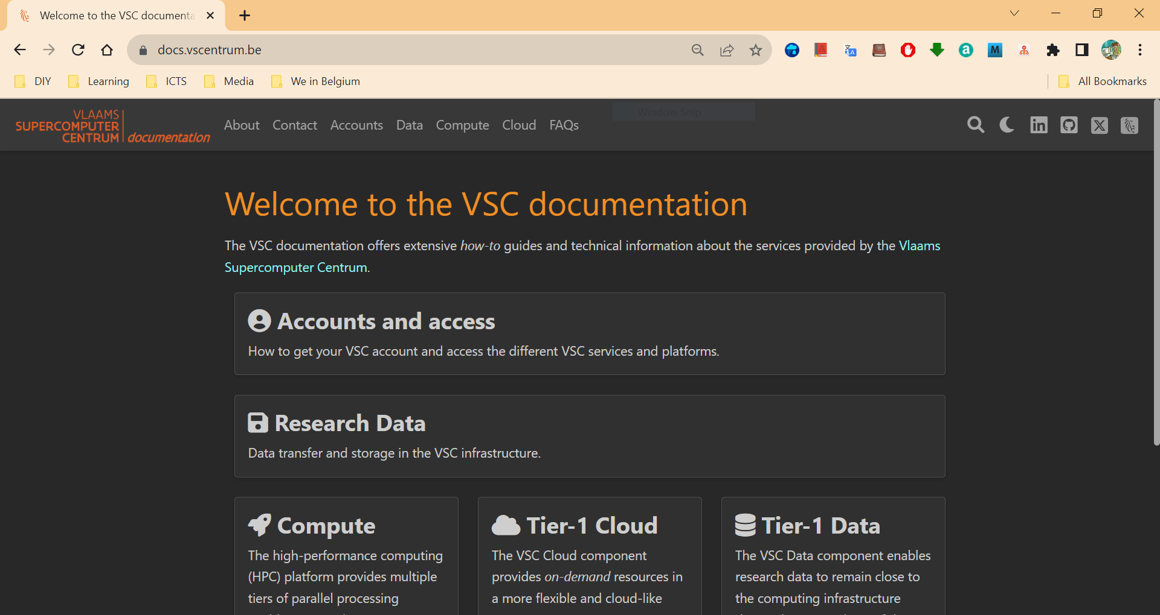
https://docs.vscentrum.be
Enter your keywords here; e.g. ‘Ondemand’
Notes:
All items are indexed
There is a power search engine there.
Just put a keyword there.

Slide 11
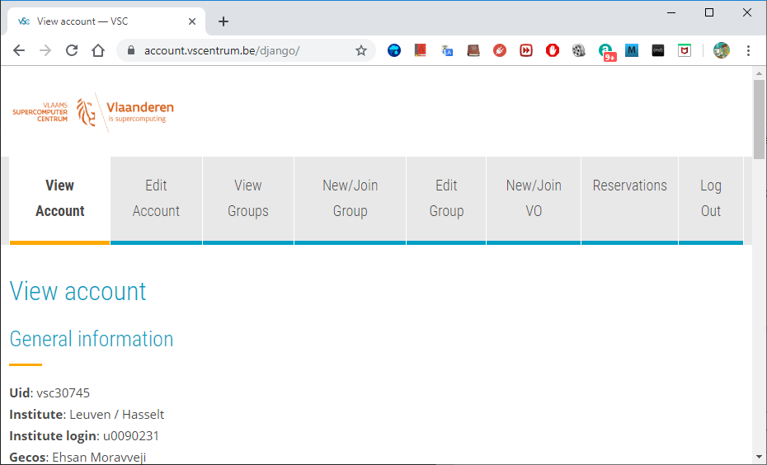
Manage your VSC account at https://account.vscentrum.be
Add/remove your public keys
View public keys Request account
Create or request to join a new group
Moderate your VSC groups (add/remove users)

Slide 12
Support and services
Basic support
Helpdesk (hpcinfo@kuleuven.be)
Monitoring and reporting
Application support
Installation and porting
Optimisation and debugging
Benchmarking
Workflows and best practices
Training
Documentation and tutorials
Scheduled trainings and workshops
Workshops on request
One-to-one sessions

Slide 13
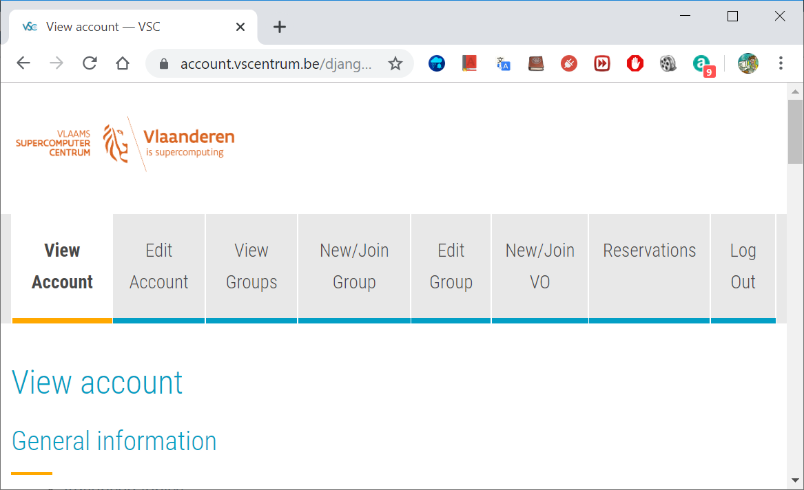
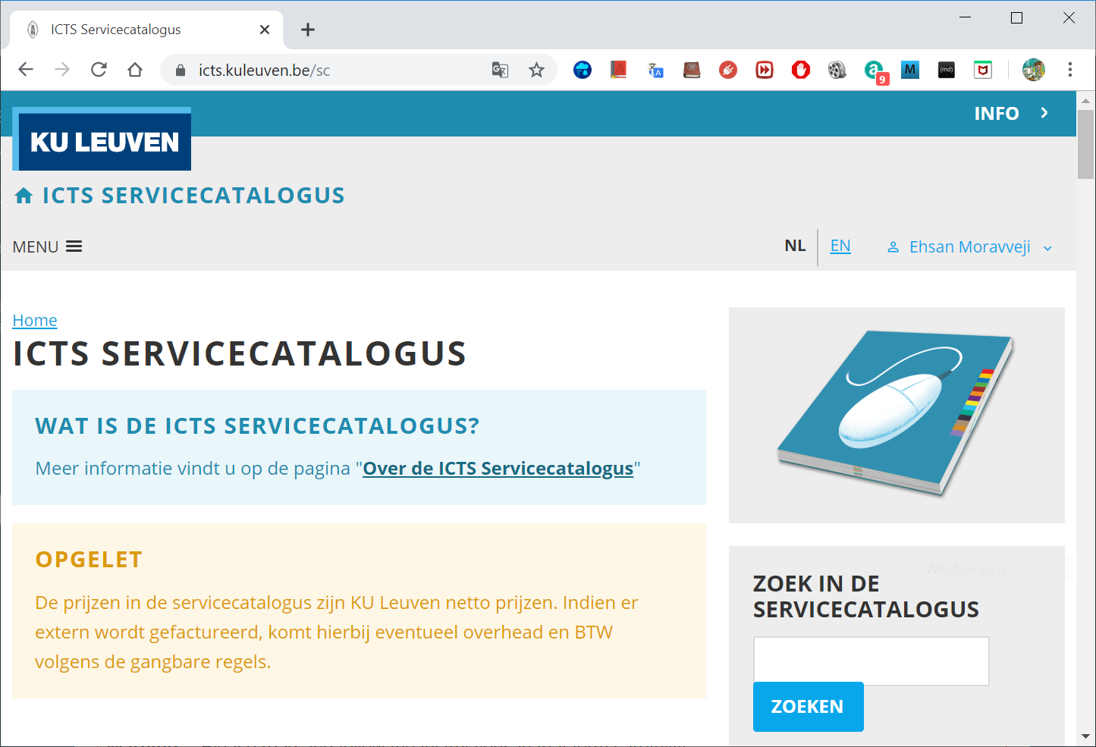
Become a VSC user
(Optional) Create a secure (4096 bit) SSH key pairs Upload it on the account page: https://account.vscentrum.be
You need to request a VSC account Normally gets processed swiftly
Request introductory credits (2M free credits for 6 months)
Request project credits (for supervisors and project leaders) You need to create a VSC group Add users to the group to give them access to use credits Fill out the request form
Extra storage requests Scratch extension: free of charge Staging storage: 20 € per TB per year
All service costs (compute and storage) are described in the ICTS service catalog: https://icts.kuleuven.be/sc Click on High Performance Computing (NL/EN)
13

Slide 14
Infosessions:
Containers
Notebooks
VSC training
Matlab (Supercalculator)
Matlab programming
Linux for HPC
Linux scripting
Introductory
Intermediate
Advanced
Specialized track
Make intro
Linux tools
Linux
HPC intro
CMake intro
Version control systems
C
Python Introduction
Python: System programming
Scientific Python
Python for software engineering
Python for data science
Python for machine learning
worker/atools
C++ for scientific computing
Julia good bad ugly
Fortran for programmers
High Performance Python
Debugging techniques
OpenMP
?
MPI
Code optimization
Stay up-to-date https://www.vscentrum.be/en/education-and-trainings

Slide 15
How to acknowledge VSC in publications
Why?
For KU Leuven users
a contractual obligation for the VSC
helps VSC to secure funding
you will benefit from it in the long run
add the relevant papers to the “KUL-HPC” virtual collection in Lirias
In het Nederlands
In English
De infrastructuur en dienstverlening gebruikt in dit werk werd voorzien door het VSC (Vlaams Supercomputer Centrum), gefinancierd door het FWO en de Vlaamse overheid.
The resources and services used in this work were provided by the VSC (Flemish Supercomputer Center), funded by the Research Foundation - Flanders (FWO) and the Flemish Government.

Slide 16
Tier-2 clusters

Slide 17








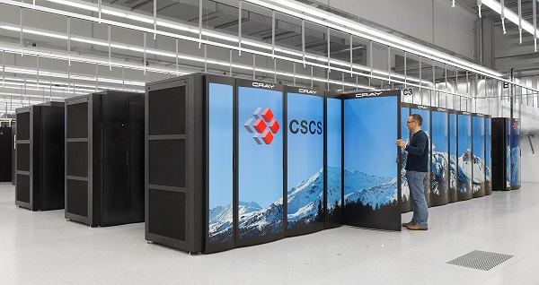



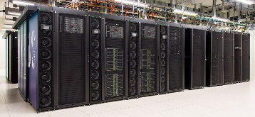





VSC HPC infrastructure
Tier-0
Tier-1
(VUB, 2026)
Hortense (UGent, 2022 - 2026)
Tier-2
STEVIN | HYDRA | LEIBNIZ/VAUGHAN | Genius/wICE/Mindwell
17
Notes:
All VSC users can use Tier-2 clusters from any site they desire.
If you still require more compute resources which does not fit into available Tier-2 limits, you can apply for Tier-1 compute time.
Even if Tier-1 level is insufficient, you can apply for Tier-0 level where Belgium is also part of a European consortium.

Slide 19


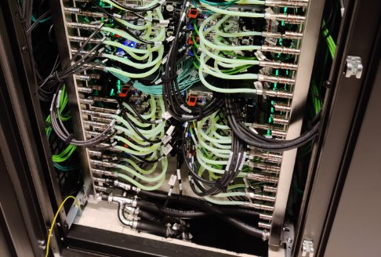
Tier-2 clusters @ KU Leuven
Genius (2018 - 2026) 16 nodes | 576 cores | 72 GPUs
wICE (since September 2022) 260 nodes | 20272 cores
Mindwell (since May 2026) 55 nodes | 10560 cores
19

Slide 20
Tier-2 cluster – Genius
Node type | CPU type | # cores | Total mem | Mem per core (MB) | Partition | Planned end of life
Skylake P100 GPU | Xeon Gold 6140 4xP100 SXM2 16GB | 36 | 192 GB | 5000 | gpu_p100 | 2027 (?)
Cascadelake V100 GPU | Xeon Gold 6240 8xV100 SXM2 32GB | 36 | 768 GB | 21000 | gpu_v100 | 2027 (?)
Access: login.hpc.kuleuven.be
CPU nodes: Decommissioning: March 2026
GPU nodes: Will stay until 2027
Current OS: Rocky8
Future OS: Rocky9 (soon)
Remarks

Slide 21
Tier-2 cluster – wICE
Node type | CPU type | # cores | Total mem | Mem per core (MB) | Partition
Icelake | Xeon 8360Y | 72 | 256 GB | 3455 | batch_icelake
Sapphire Rapids | Xeon 8468 | 96 | 256 GB | 2500 | batch_ sapphirerapids
Icelake large mem | Xeon 8360Y | 72 | 2 TB | 28000 | bigmem
Icelake large mem | Xeon 8360Y | 72 | 8 TB | 111900 | hugemem
Icelake A100 GPU | Xeon 8360Y 4xA100 SXM2 80GB | 72 | 512 GB | 7000 | gpu_a100
Genoa H100 GPU | Epyc 9334 4xH100 SXM5 80GB | 64 | 768 GB | 11700 | gpu_h100
Icelake interactive | Xeon 8358 1xA100 SXM2 80GB | 64 | 512 GB | 7500 | interactive
OS: Rocky 9.6 (after 18 Feb ’26)
Access: login.hpc.kuleuven.be
Interconnect: InfiniBand HDR (100 Gb/s)
SSD Disks: 960 GB
Interactive partition: max resources: 8 cores, 1 GPU, 16hr
Remarks

Slide 22

Tier-2 cluster – wICE
Thin nodes
Large memory nodes
GPU nodes
5x IceLake 72c 2048 GB
4x IceLake 72c 512 GB
4 A100 SXM4 80GB
Interactive nodes
No Dedicated Login Nodes
172x IceLake 72c 256 GB
4x IceLake 64c 512 GB
1 A100 80GB
22

Slide 23
Tier-2 cluster – wICE extension
Thin nodes
Huge memory node
GPU nodes
1x IceLake 72c 8 TB
4x AMD Genoa 64c 768 GB
4x H100 SXM5 80GB
68x Sapphire Rapids 96c 256 GB
23

Slide 24
Storage

Slide 25

Overview of the Tier-2 storage locations
Only you own your files (POSIX) Users can share folders via VSC groups
A VSC account has 3 default storages (free of charge)
$VSC_HOME
$VSC_DATA
$VSC_SCRATCH
You can additionally request staging storage
Different storage volumes have different:
mount point
size and performance
use case
backup and maintenance policy
For more info, see the ICTS Service Catalog (EN/NL)

Slide 26
Storage locations
Example
Avoid using /tmp ($TMPDIR)on the login nodes It is only 10 GB and is needed by the operating system Your application can crash if using /tmp
You are automatically logged into your home folder upon login. Best to immediately switch to some other storage, e.g. $ cd $VSC_DATA
Always check your storage balance using myquota command
$ myquota
file system $VSC_HOME
Blocks: 1479M of 3072M
Files: 12934 of 100k
file system $VSC_DATA
Blocks: 12G of 75G
Files: 1043k of 10000k
file system $VSC_SCRATCH
Blocks: 15M of 1.5T
Request form for extra storage
More info in the service catalog
26

Slide 27
Storage | Home folder
Env. variable | $VSC_HOME
Filesystem type | NFS
Access | Global
Backup | Hourly, daily, weekly (until last month) inside .snapshot folders
Default quotum | 3 GB
Quotum increase | Not possible
Usage | Only storing SSH keys, config files, …
Remarks | - Stay away from using it - Can easily overflow: + Your jobs may crash + Login issues
Storage locations
home
data
scratch
node scratch
staging
Tier-1 data
27

Slide 28
Storage | Data folder
Env. variable | $VSC_DATA
Filesystem type | NFS
Access | Global
Backup | Hourly, daily, weekly (until last month) inside .snapshot folders
Default quotum | 75 GB
Quotum increase | On purchase
Usage | Your data, code, software, results
Remarks | Permanent storage for initial/final results Not optimal for intensive or parallel I/O
Storage locations
home
data
scratch
node scratch
staging
Tier-1 data
28

Slide 29

Storage | Scratch folder
Env. variable | $VSC_SCRATCH
Filesystem type | Lustre & GPFS
Access | Local
Backup | Files get deleted 30 days after last access
Default quotum | 500 GB for both
Quotum increase | Free
Usage | Intensive, parallel I/O, temporary files
Remarks | Recommended storage for all jobs Copy scratch files to VSC_DATA or local storage after jobs are done Deleted files cannot be recovered Avoid folders with >10,000 files
Storage locations
home
data
scratch
node scratch
staging
Tier-1 data
The Lustre filesystem is nearly full. Momentarily, we don’t extend user quota’s with more than 1TB.
29

Slide 30
Storage | Node scratch folder
Env. variable | $VSC_SCRATCH_NODE
Filesystem type | Ext4
Access | On compute node, only at runtime
Backup | None
Default quotum | 591 GB
Extension | Read about beeOND
Usage | Temporary storage at runtime
Remarks | Fastest I/O, attached to the node Is cleaned after job terminates Copy the data to your home, scratch, or staging before job ends
Storage locations
home
data
scratch
node scratch
staging
Tier-1 data
30

Slide 31
Storage | Staging folder
Path | /staging/leuven/stg_000XX
Filesystem type | Lustre
Access | On demand, only Tier-2@KUL
Backup | None
Default quotum | None
Extension | On purchase, from 1 TB
Usage | Permanent; share with a group
Remarks | Accessible from login/compute nodes Fast, parallel I/O
Storage locations
home
data
scratch
node scratch
staging
Tier-1 data
The Lustre filesystem is nearly full. Momentarily, we don’t create or extend users’ staging quota requests.
31

Slide 32
Storage locations
VSC offers Tier-1 Data as a large storage service
Only for active data (no archiving)
Supports metadata (search & discover)
Share within VSC (permission management)
Share outside VSC (via Globus)
Stage-in/stage-out data workflow
Free of charge for academic use
Starting volume is 5 TB
Submit a proposal to get access You can apply at any time
Tier-1 data
staging
scratch
data
home
node scratch
32

Slide 33

Extra (KU Leuven) storage locations
Dataset
Archived package
In production
For active data
Data should stage in/out
Has backup
See the ICTS service catalog
In development
For inactive data
Storage until 10 years
Has backup
See the ICTS service catalog
Also see the KU Leuven storage guide for even more storage possibilities

Slide 34
ManGO
Central, secure,
highly available
Apply rich metadata,
enforce conventions,
standardize
STORE
DESCRIBE
Implement rule-based
policies & workflows
Collaborate securely & efficiently
AUTOMATE
SHARE
Notes:
How can ManGO help your research?
- Centralization of your data
- Consistent, usable description of your data
- Organization of permissions
- Automation

Slide 35
Compute credits

Slide 36
Tier-2 credit system
Node types | Credits per node-hour
Genius Skylake 4 GPUs | 20 000
Genius Cascadelake 8 GPUs | 39 900
wICE IceLake thin node | 11 000
wICE IceLake Large Memory | 19 000
wICE IceLake GPU node | 45 000
wICE IceLake interactive node | Free
wICE IceLake hugemem node | 80 000
wICE Sapphire Rapids | 20 000
wICE AMD Zen-4 4 GPUs | 150 000
What?
Credits are a measure for compute resources
Mandatory for accessing these resources
Traceability and accountability
Why?
Incentive to optimize your code and workflow
How?
1 million credits = 3.5 EUR
Pay-as-you-go model
Credit rates on the right = for fully allocated nodes (if you request less cores, you also get billed less)
See the ICTS service catalog for more info
Notes:
What is a credit? A credit is nothing more than a measure for an amount of compute time. How we came to the current credit ratio is a long history, which is not really relevant.
The list below shows the current types of nodes in our Tier-2 environment and there credit usage ratio. Please consult the service catalogue for up to date available systems, their credit rates and the credit cost.
From the table you can see that a GPU node is a lot more expensive. But these also includes the four or eight GPUs in the machine. Which are actually very expensive, so it's reasonable that these nodes consume a lot more credits. As Superdome has 6TB of RAM with 144 cores, you can understand that this is our most expensive node at the moment.
Slurm allows us to configure the different type of resources that should be accounted. We have focused it on usage of CPU cores and GPU devices. each resource will use a number of credits for a given time. The table shows the credits usage of a full node (all available cores/GPU’s) when using it for one hour.
Why are the ratios so high, yu might ask? When we started using Slurm, the credits/hour ratio was multiplied with a factor 1000 to assure that Slurm internals is billing the credits with enough accuracy. But no worries you are also getting 1000 times more credits for your money.
Note that nodes can be used in a shared mode, When submitting a job with only one GPU and a quarter of the cores, it will be only charged for using one single GPU. The same goes for the CPU nodes, you will be only charged for the CPUs that are used. But mind that in case you are using more than defualt RAM memory per core, also the additional cores will be charged. In the extrem case if you would use a single core and the whole node memory, you will be charged for the full node.

Slide 37
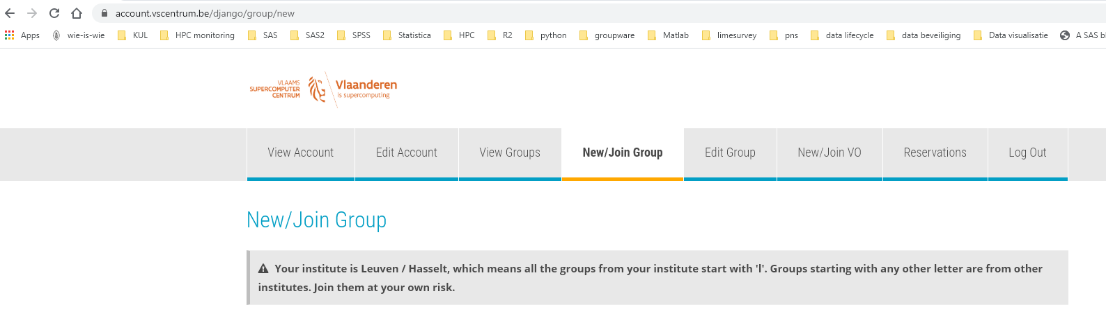
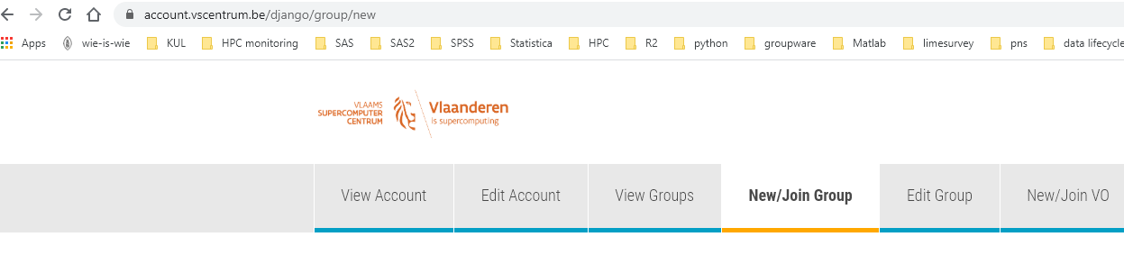
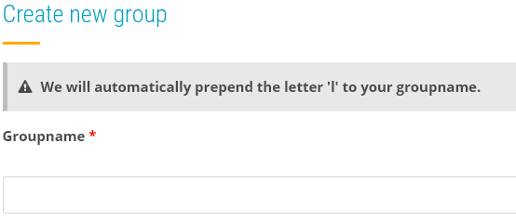
Tier-2 credit system – how to request credits
Check the ICTS service catalog
Request your introduction credits
Every new user can request them once
Free of charge
6 months
Request permission to join a group
Request project credits
Create group on the VSC account page
Start the name preferably with p_
Your group will start with lp_
Creator of the group can add and remove users
Tier-2 credits can be used on all (Leuven) Tier-2 clusters
Notes:
How do you get your hands on some compute credits?
Well first of all each user can request introduction credits. It is a one time thing, you get 2 million credits free of charge.
As the name indicates, it is meant to to give you some time to get acquainted with the Tier-2 cluster.
Check the service catalog for the procedure to follow to request these introduction credits.
If you will be joining a research group that already is computing on the cluster then probably they already have a project with compute credits.
In that case just ask your fellow researchers the name of this project.
Then go to the account page, do a join request,
select the join group option,
type in the name of the of the project and
then send a request to be added to the group.
The moderator will see this group and can accept or reject. Once accepted you will be able to use the credits that are linked to this project group.
If you're starting, you have your own research group and you want to request project credits for yourself it's also possible.
The procedure is in the service catalog but know that you best
first create a new group,
give it a name that makes sense to for you and start the name with P underscore. This will make it clear that is is a project meant for project credits.
the system will automatically prefix your name with an L because it's a group created in Leuven.
Groups created by users in Ghent will have a G as a prefix and groups from Antwerp will have an A as a prefix.
When you create a group you will be moderator of the group and you can decide who to invite, accept or remove from your group.
You're in complete control of who has access to the compute credits that are bound to this group.
By default the credits are available on all Tier-2 systems.

Slide 38
Tier-2 credit system – how
Submit your jobs with a suitable credit account
#SBATCH –A lp_myproject
sbatch -A lp_myproject … myjob.slurm
Before submitting the job, Slurm checks if the account has enough available credits for the job (in addition to any other already-running jobs)
Once a job start running, it starts consuming credits from the account
Notes:
So once you have access to the compute credits how do you use them?
Well this has already been shown in the videos before.
You need to specify your project on the SBATCH directive with a minus A option and then the name of your project.
You can do this both in a Slurm script as on the SBATCH command line.
How does charging actually works?
First of all when you submit your job the maximum amount of credits that your job can cost will be computed. This is based on the number of CPU cores that you request, the number of requested GPUs , The type of the cpu and the requested wall time.
This gives the maximum amount of credits that will be used for this job.
Before the jobs get submittted, the system will check if there are enough credits available. This will take into account the current balance and the number of credits that are needed for any job that is currently running.
When the job is finished only the actual cost will be charged. So if you request three days wall time but your job is finished after one day you only will be charged for this one day of computation.
With the sam-quote tool you can get a calculation of the credit cost, based on the specified parameters.

Slide 39
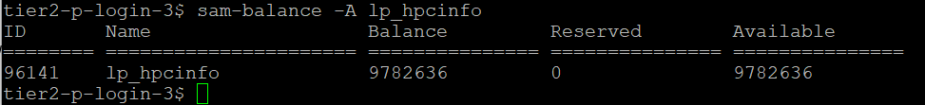
Tier-2 credit system – manage your credits
We provide various sam-commands to facilitate credit related queries
Command | Purpose
sam-balance [-A account] | List active projects and available credits
Notes:
There are a number of commands that you can use to manage your credits.
One thing all the commands have in common that is that they start with sam-
It is the abbreviation for "Slurm Accounting Manager" . These scripts wrapp standard slurm commands, but give you an easy to read output.
The first one is sam-balance. It will give you an overview of all your active projects and their status. With the optional minus A you can query a specific account .
In the overview The reserved column are credits of jobs that are still running and not yet have substracted from the account. The available column shows the effective amount of credits available to submit new jobs.

Slide 40
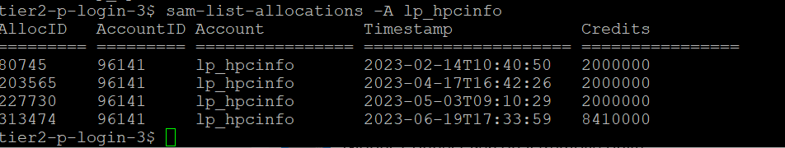
Tier-2 credit system – manage your credits
We provide various sam-commands to facilitate credit related queries
Command | Purpose
sam-list-allocations –A <account-name> | List the credit deposits and refunds (if any)
Notes:
Another command which is very useful is the sam-list allocations, followed with minus A and the account name. The different deposits in this project will be shown, in this account and they all had a different deposit date.

Slide 41
Tier-2 credit system – manage your credits
We provide various sam-commands to facilitate credit related queries
Command | Purpose
sam-quote sbatch [sbatch args] [myjob.slurm] | Estimates the (max) amount of credits a job will use
Notes:
Sam-quota will give you an estimated of the amount of credits you need to run the job. You can run it by supplying a batch script or by adding specific SBATCH directives on the command line.

Slide 42
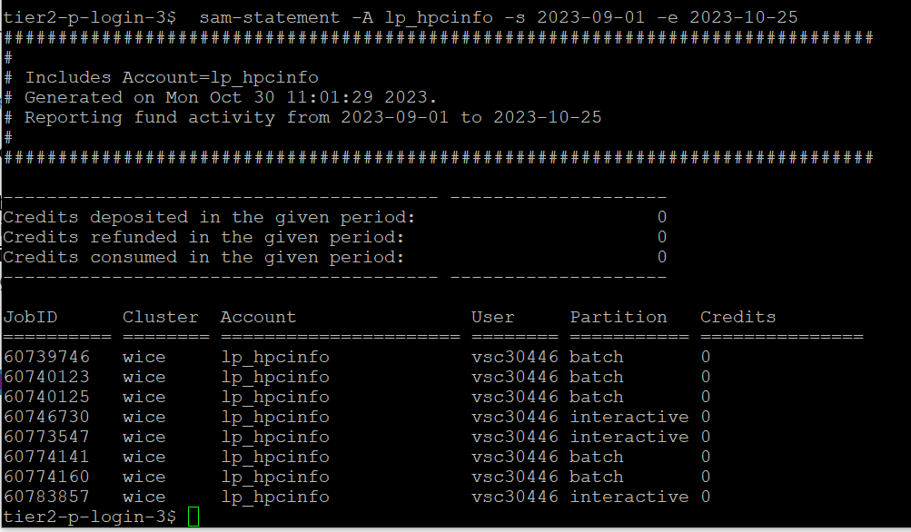
Tier-2 credit system – manage your credits
We provide various sam-commands to facilitate credit related queries
Command | Purpose
sam-statement -A <account-name> -s <start-date> -e <end-date> | Overview of credits used by each job in some time window
Notes:
Sam-Statement will give you an overview off all jobs that you submitten in a specific time period. You will only see your own jobs, unless you have elevated rights on the project account.

Slide 43
Tier-2 credit system – manage your credits
We provide various sam-commands to facilitate credit related queries
Command | Purpose
sam-balance | Lists active projects and available credits
sam-list-allocations –A <account-name> | Lists the credit deposits and refunds (if any)
sam-quote sbatch [sbatch args] [myjob.slurm] | Estimates the (max) number of credits a job will use
sam-statement -A <account-name> -s <start-date> -e <end-date> | Overview of credits used by each job in some time window
Notes:
To summarize this is an overview of the different sam commands that are really useful for you so
sam-balance to get an overview of the balance.
sam-list allocations to have an overview of different deposits
Sam-quote to get an estimation for the amut of credits that you need to run a job
Sas-statement to giveyou a detailed overview of jobs that have run in a specific time window.
This completes the basic information about the credit system. There are other things to tell but this is outside the scope of th eintroduction. If you have specific questions just don't hesitate to ask them in the follow-up online session or just send them to your service desk email address.

Slide 44
Connecting to a login node

Slide 45

Accessing a cluster
Compute nodes
Firewall
Infiniband interconnect
Connections to other VSC sites
User
SSH connection (terminal, OOD) with MFA through your IDP
Login nodes
Service nodes
Job scheduler, (credit) account management, …
Storage
45

Slide 46
How to login?
Open OnDemand
SSH client
Web-based login via your browser
https://ondemand.hpc.kuleuven.be
Multi-Factor Authentication (MFA): Login through your institute’s IDP
No SSH key needed
Windows: PuTTY, MobaXterm, … MacOS/Linux: any terminal
Optional: for VSC clusters not hosted at KU Leuven you need an (open)SSH key pair (upload the public key to the VSC account page and wait ≥ 30mins)
Hosts: login.hpc.kuleuven.be:22 Recommended to use an SSH agent
Can open GUIs if X11 forwarding is enabled
46

Slide 47
Using the login nodes
To develop code
To check your storage and credit balance
To manage jobs (submit, check status, debug, resubmit, …)
To move data around
within VSC: use data, scratch, staging
outside VSC: copy/sync from/to your local storage (e.g. Globus)
To pre- or postprocess your data
To visualize your data
To share files and folders
Tips
Warning
Do NOT execute CPU- or memory-intensive tasks here
Login nodes are shared resources
Submit jobs instead (you can e.g. compile software on compute nodes via an interactive job) Use slurmtop to see how busy the cluster is
47

Slide 48
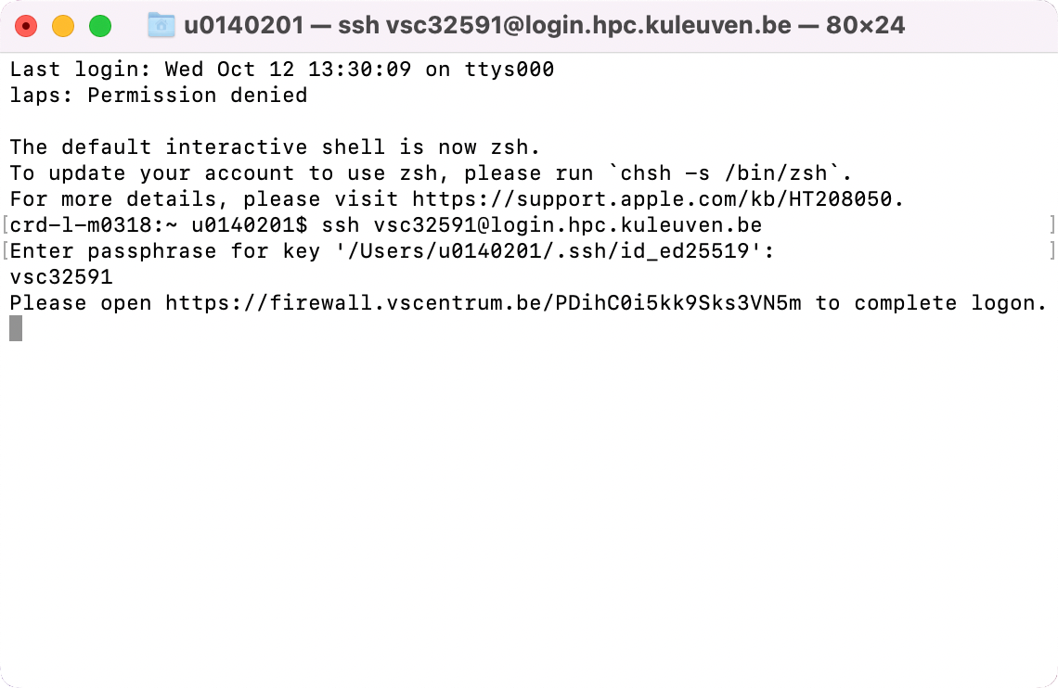
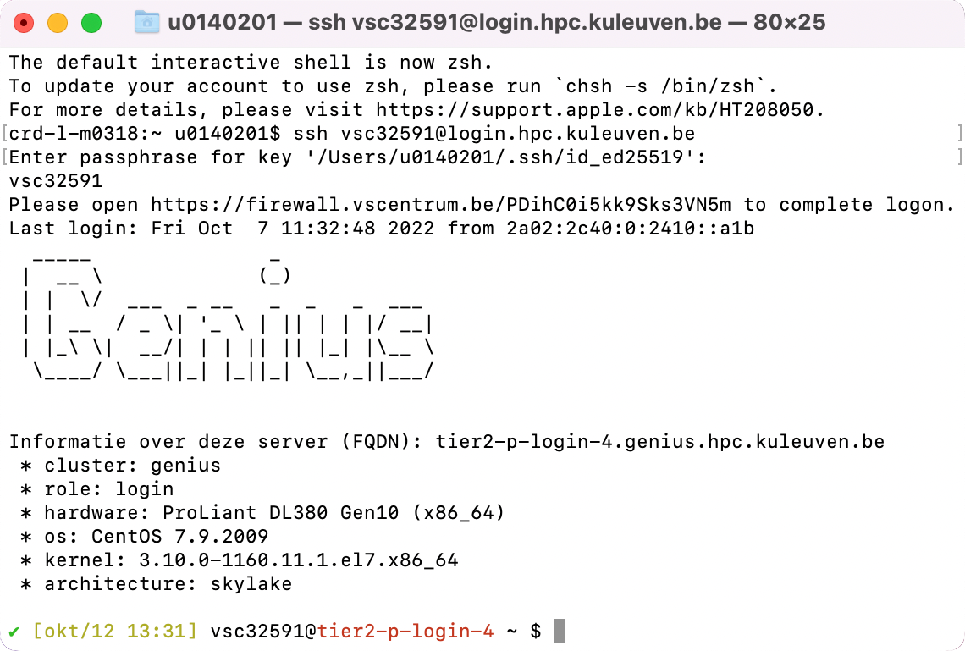
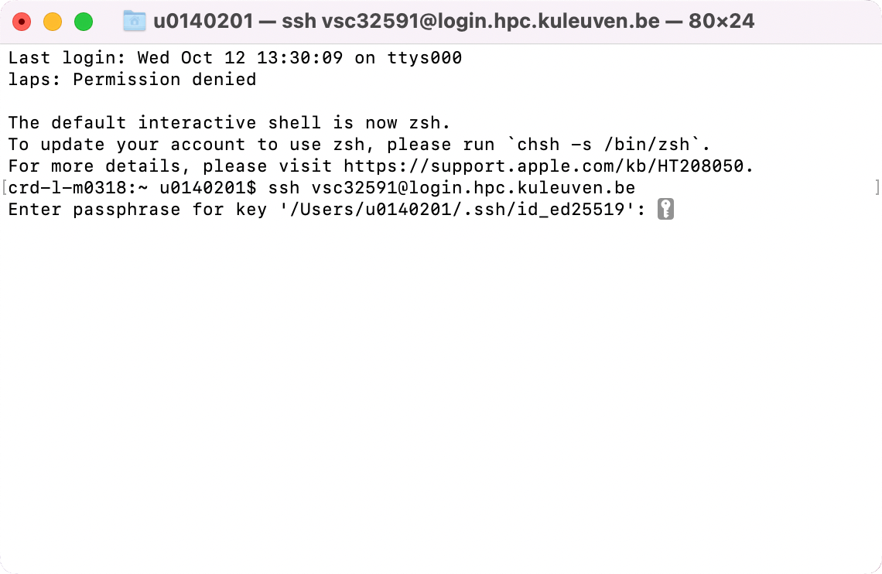
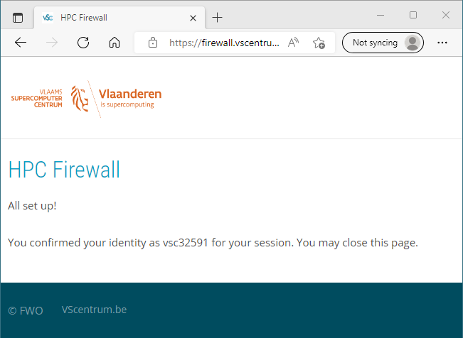
Connecting via a terminal
Hostname: login.hpc.kuleuven.be
(Linux and Mac)
Use ssh to connect: $ ssh -A vscXXXXX@<host_name>
If key not found: $ ssh -i </path/to/keyfile> ...
If asked for password, please stop connecting and contact support, otherwise after a few attempts you will be blocked for 24h.

Slide 49
Connecting via a terminal
Hostname: login.hpc.kuleuven.be
(Linux and Mac)
With an SSH agent
Check your SSH agent Is your SSH key found? $ ssh-add –l
If your SSH agent is not running: $ eval $(ssh-agent)
If your key is not found, add it to the agent: $ ssh-add </path/to/keyfile>
Use ssh to connect: $ ssh -A vscXXXXX@<hostname>

Slide 50
Data transfer

Slide 51




File transfer tools
Local files
VSC account
Application | OS
FileZilla | Windows, Linux, Mac
WinSCP | Windows
rsync, scp | Linux, Mac
Globus | Window, Linux, Mac
51

Slide 52
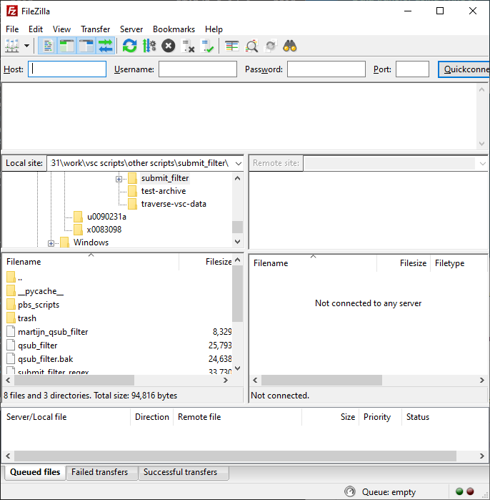
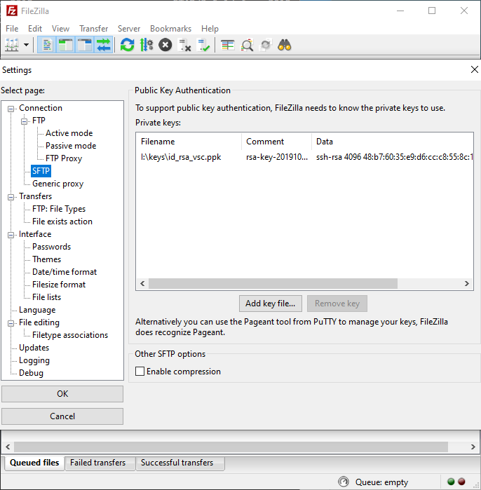
File transfer with FileZilla
1
Edit -> Settings
2
4
3
52

Slide 53
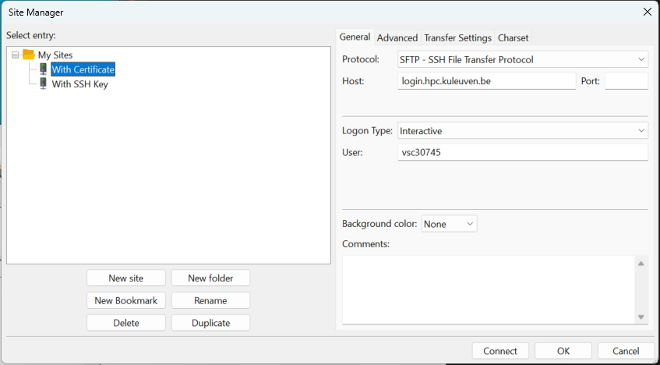
File transfer with FileZilla
6
7
8
5
9
53

Slide 54
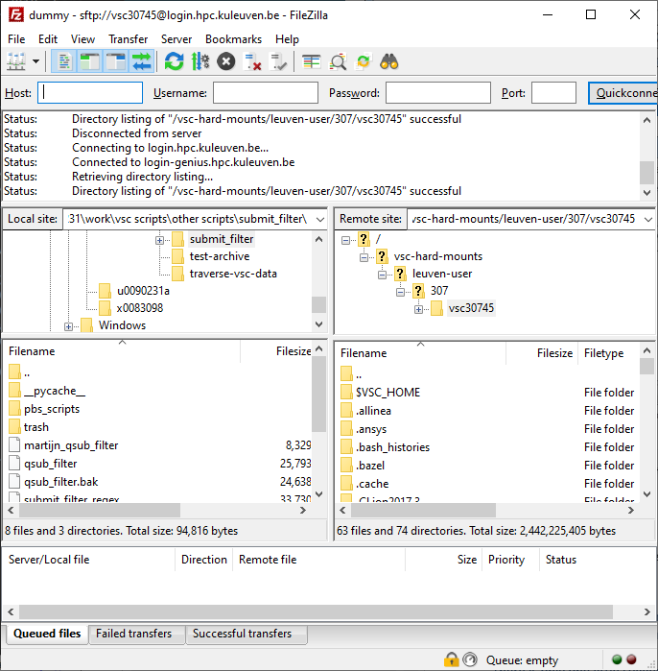
It can be convenient to bookmark your data and scratch folders
Navigate here to to your $VSC_DATA folder, e.g. /data/leuven/399/vsc39934
Content on your local machine (e.g. laptop)
Content of your chosen folder
WARNING: by default you will land in your $VSC_HOME which is typically NOT where you want to store data
54

Slide 55
File transfer with rsync
For Linux, Mac and Windows WSL users
Synchronize source and destination
Listens to your SSH agent
Example usage: $ rsync –av /path/to/source vsc3XXXX@login.hpc.kuleuven.be:/path/to/destination
55

Slide 56

File transfer with Globus
Web interface for transferring, sharing and searching within data
Schedule and resume (large) transfers
Workflow: Define “endpoint” on the source Define “endpoint” on the destination Transfer between endpoints
Endpoints on all VSC sites: all Tier-2 clusters: home, data, scratch* all Tier-1 clusters: scratch, projects
* You can also access staging storage through this endpoint (Leuven Tier-2 only)
56

Slide 57

57

Slide 58
Open OnDemand

Slide 59

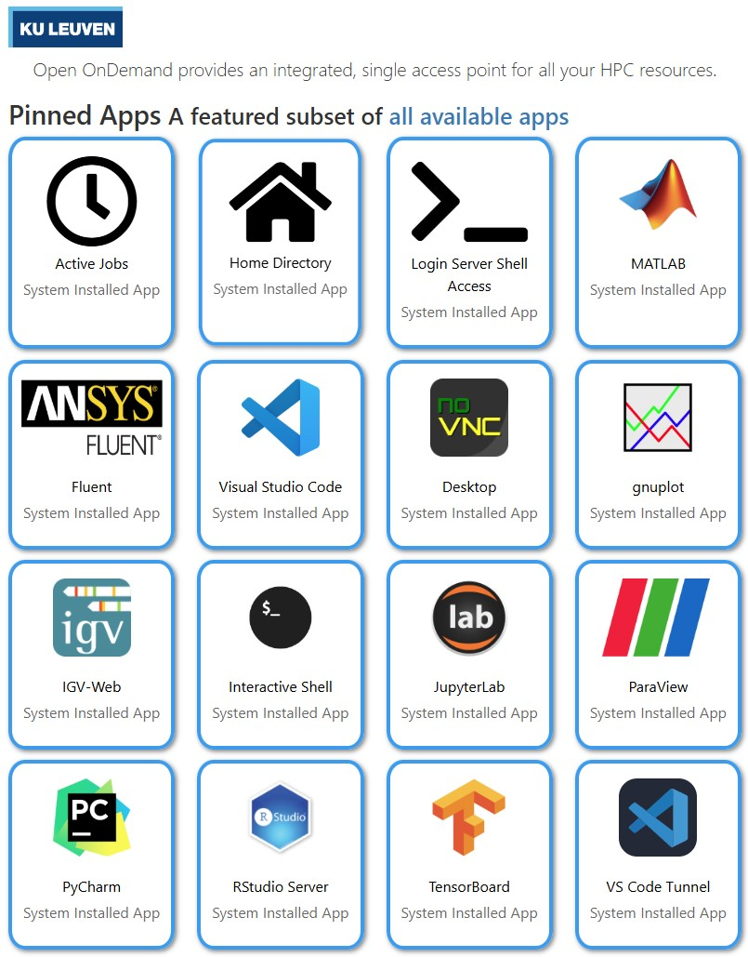
Open OnDemand
Access clusters via your web browser
https://ondemand.hpc.kuleuven.be
Login via your institute’s IDP
File browser + Data Transfer (Globus)
Develop, compile and test your code
Interactive apps + integrated shell
noVNC Desktop for graphical apps
VSCode and PyCharm editors
Fluent, Jupyter Lab, Rstudio, MATLAB, ParaView, Tensorboard, Gnuplot
💡
Please close your interactive sessions when you no longer actively use them!
59

Slide 60

Open OnDemand
Access your VSC storage
Use the “Files” tab to access your VSC_HOME and VSC_DATA
VSC_SCRATCH is not available from this menu
File/Folder management
OK for transferring small files/folders
Open any (sub)folder in terminal (will open a new tab)
Deleted files/folders can be retrieved from (hourly, daily, weekly) snapshots
60

Slide 61
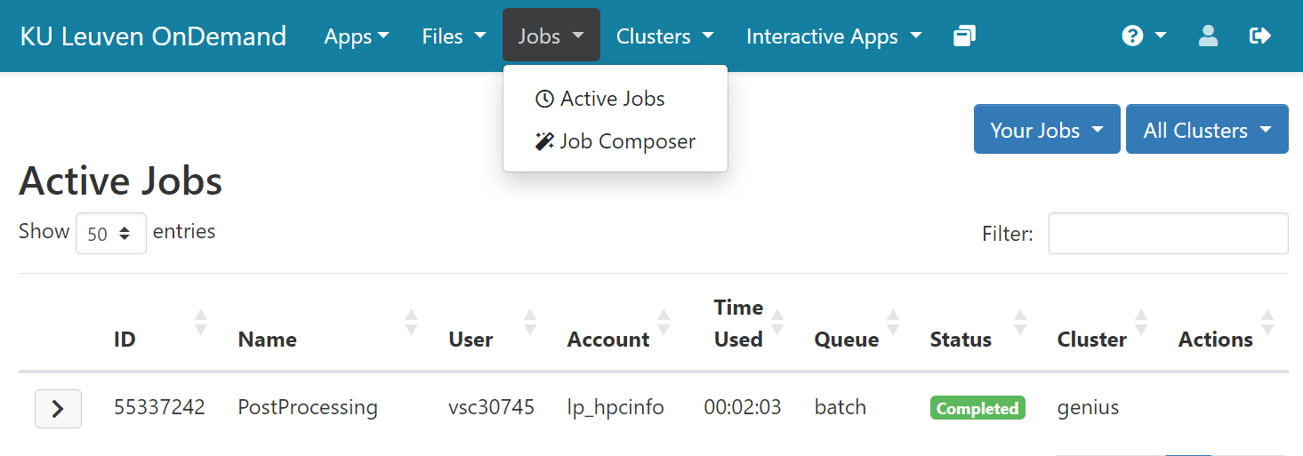
Open OnDemand
Monitor your active jobs
61

Slide 62
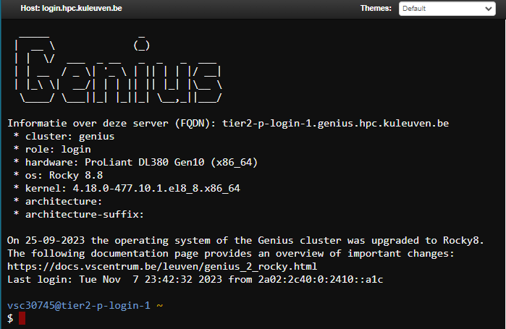
Open OnDemand: Login Server Shell Access
Login shell
Starts a shell in a new browser tab
You land on a Genius login node (from which you can also access wICE)
You land on your VSC_HOME. cd to data/scratch/staging immediately
Do NOT compute on the login nodes
Try: $ sam-balance $ myquota
62

Slide 63
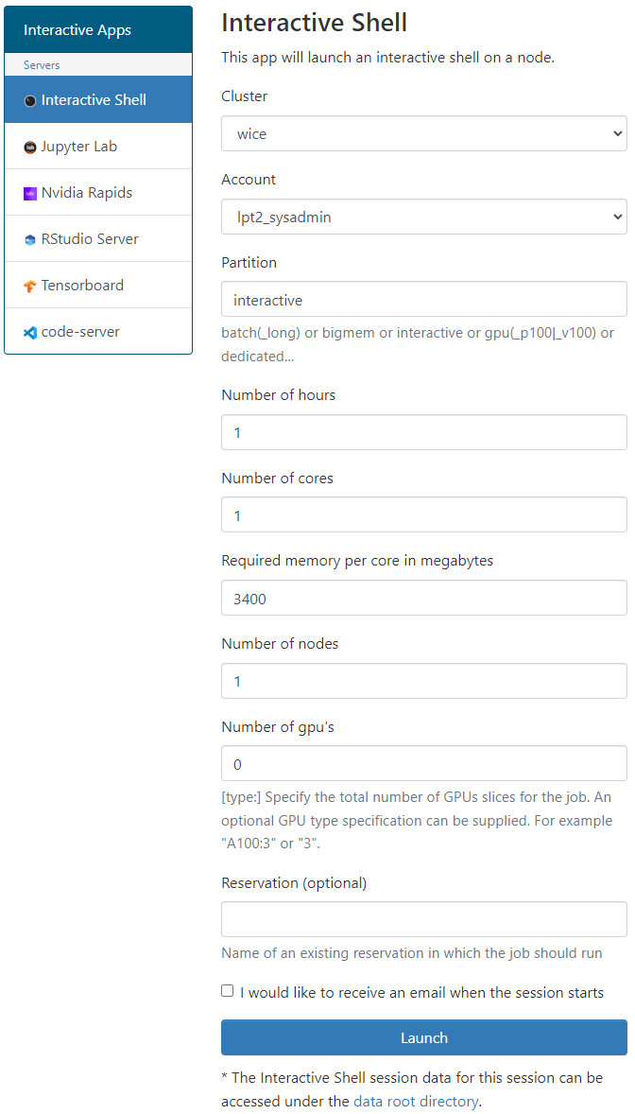
Open OnDemand: Interactive Shell
Interactive Shell
Start a shell as a job (on a compute node)
Recommended to: Install your own software (in VSC_DATA) Test/run your program interactively Debug a program
Choose the relevant cluster, partition and resources (cores, memory, GPU)
63

Slide 64
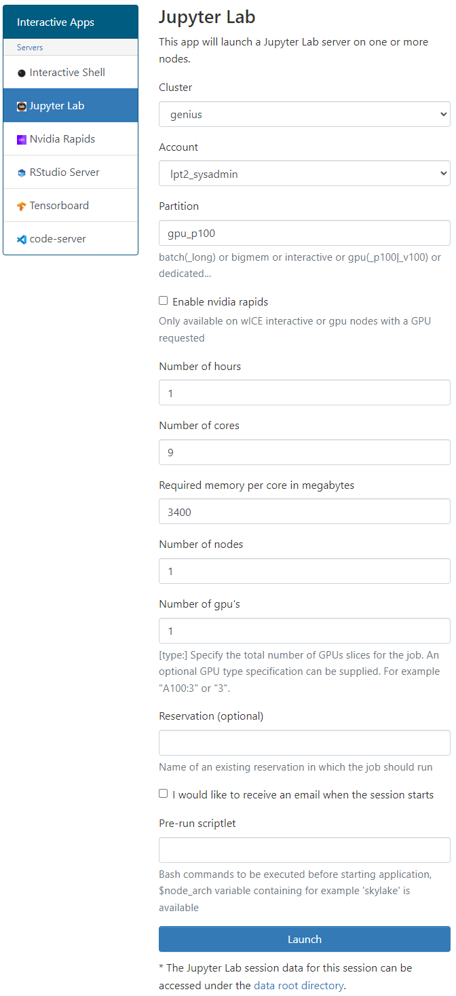
Open OnDemand: JupyterLab
Jupyter Lab
Create a notebook as a job (on a compute node)
Suitable for: pre/post-processing your data prototyping adding figures and text for pedagogical purposes
Choose the appropriate cluster, partition and resources (cores, memory, GPU)
User your own Python/R kernels (next slide)
64

Slide 65
Open OnDemand: Custom R/Python kernels
Custom kernels
The default kernels may not offer the R/Python/… interpreter version or packages you want
You can create a miniconda env and add it to your OnDemand kernels
Step 1: Miniconda
Start an Interactive Shell
Go to your data folder $ cd ${VSC_DATA}
Download Miniconda $ wget https://repo.continuum.io/miniconda/Miniconda3-latest-Linux-x86_64.sh
Install Miniconda in your VSC_DATA $ bash Miniconda3-latest-Linux-x86_64.sh -b –p $VSC_DATA/miniconda3
Permanently add the path to Miniconda to your ~/.bashrc $ echo 'export PATH="${VSC_DATA}/miniconda3/bin:${PATH}" ' >> ~/.bashrc
65

Slide 66
Open OnDemand: Custom R/Python Kernels
Step 2: Environment setup
Create a new environment <env_name> with all packages you need, e.g. $ conda create --name=<env_name> numpy scipy … Enable your new environment $ source activate <env_name> Add the ipykernel package $ conda install -c conda-forge ipykernel
Step 3: Register your kernel
$ python -m ipykernel install --user --env PYTHONPATH "" \ --name <env_name> --display-name <env_name>
Step 4: Launching JupyterLab
Now start a new Jupyter Lab session
Your new kernel should be available there
66

Slide 67
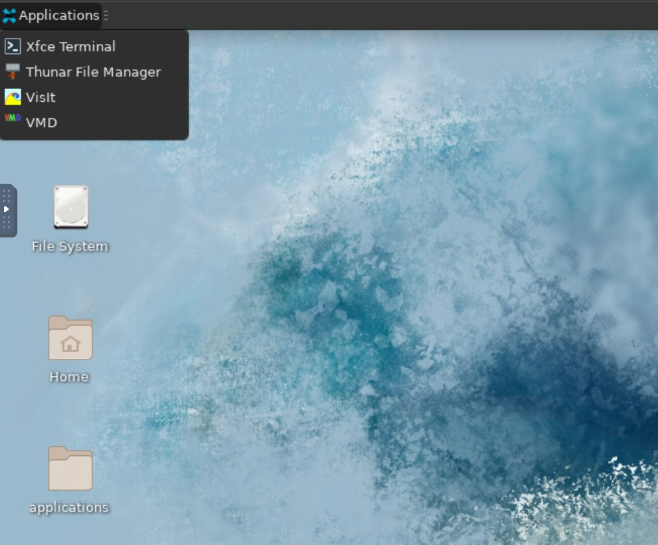
Open OnDemand: noVNC Desktop
Desktop
Ideal for apps with GUI
Load (graphical) modules in Terminal, e.g. MATLAB, Fluent, ncview, VisIt, …
Minimalistic Terminal (different from login node)
Two visualization apps (VisIt and VMD)
67

Slide 68

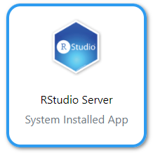

Open OnDemand: Other apps
Start Visual Studio Code server as a job
Develop, deploy and debug your workflow directly on HPC
Use of the interactive partitions is free of charge and is a good choice
Supports many languages + Github integration
Start RStudio IDE as a job
Install your own packages in VSC_DATA
Track machine learning metrics and visualize data during the workflow
You need to provide a log folder
68

Slide 69



Open OnDemand: Other apps
Start PyCharm IDE as a job
Develop, deploy and debug your Python workflow directly on HPC
Use Python environment based on Conda or virtual environments
Use Fluent for CFD simulations (single-node)
You need to be in a license group before being able to see the app logo
Contact your supervisor to help you joining an existing license group
Tunnel to the cluster from your local VSCode, so that you code locally, but run remotely! You can enable extensions such as Copilot and more.
69

Slide 70
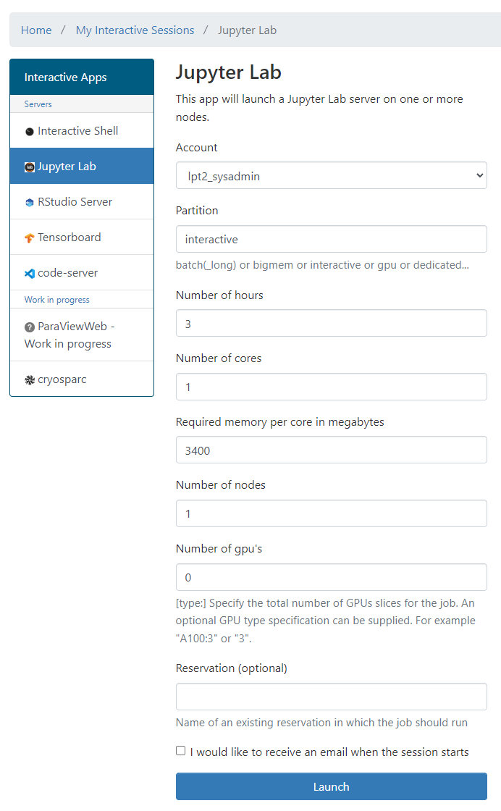
Open OnDemand: Resources
E.g. to start a Jupyter notebook
Pick a valid Slurm credit account
Default partition for most apps: interactive (interactive: max 8 cores, 1 GPU instance, 16 hr)
Default resources: 1 core, 1 hour, 3400 MB RAM, no GPU
lp_myproject
70

Slide 71
Software

Slide 72
Software: Centrally installed modules
OS: wICE is running on Rocky Linux 9.6 and Genius (GPU nodes) migrate to that, soon.
Toolchains:
intel (icc, icpc, ifort; Intel MPI; Intel MKL)
foss (gcc, g++, gfortran; OpenMPI; ScaLAPACK, OpenBLAS, FFTW)
Toolchain year on Genius from 2018a onwards; on wICE from 2021a onwards
Note: not all toolchains are compatible with each other (conflicting dependencies) For example, never mix …-foss-… and …-intel-… modules
Command | Remark
module av | List all available modules
module av Python | List all Python-related modules
module spider Python | Get more info
module load Python/3.12.3-GCCcore-13.3.0 | Load a specific module
module list | List all loaded modules and their dependencies
module unload Python/3.12.3-GCCcore-13.3.0 | Unload a module (but dependencies still stay)
module purge | Remove all modules from your work session

Slide 73
Software: Your specific needs
If you need a software package that is not yet available as a module, you can ask us to provide it
For Python and R packages, however, we prefer that you install it yourself
Read more about Python Package Management
Read more about R Package Management
If you want to compile software yourself:
Best install it in your VSC_DATA
Use intel or foss toolchains
Compile your code on a compute node (with interactive job)
If you run into problems, don’t hesitate to contact us

Slide 74
Starting to compute

Slide 75







Resource glossary
Cluster: which machine to use? Genius or wICE?
Nodes: how many compute servers to allocate?
Cores: how many cores per node to allocate?
Memory: how much CPU memory to allocate?
Partition: batch, gpu, bigmem, …?
Walltime: how long to allocate the resources?
Storage: how much storage (data, scratch, etc) will the job require?
Credits: how many compute credits will the job consume?

Slide 76
Default resources
Cluster: the cluster associated with the node you’re on (Genius or wICE)
Nodes: 1
Cores: 1
Memory: depends on which node(s) you use
Partition: batch
Walltime: typically 1 hour
Storage: no default
Credits: no default

Slide 77
Serial application 1 process on 1 core
Single process
One node
Thread group
Multi-threaded application N threads on N cores on 1 node
Process group
Distributed application Many processes on
multiple cores, possibly spread over multiple nodes

Slide 78
cores
time

Slide 79



Interactive job
Compute nodes
Login node
srun …
Batch job
Compute nodes
Login node
sbatch script.slurm

Slide 80
Example interactive job on wICE
Request an interactive job
Credit account for compute credits
For special hardware or queue
Target cluster
$ srun --account=<project name> --partition=interactive –-clusters=wice \ --nodes=1 --ntasks=4 --time=01:00:00 --pty bash -l
-
-
Number of nodes
Number of processes or cores
Max. runtime
Interpret with Bash
Remark
Specifying <project name> for credits is mandatory, e.g. –A lp_hpcinfo
Implicit defaults for an interactive job on wICE are -n 1 -t 01:00:00 –p batch --mem-per-cpu=3400M

Slide 81
Slurm command-line tools
Command | Purpose
$ sbatch ... | Submit a batch job
$ srun ... | Submit an interactive job
$ scancel --cluster=wice <JobID> | Cancel a specific pending or running job
$ scontrol show job --clusters=wice <JobID> $ slurm_jobinfo <JobID> | Detailed job info (very useful to diagnose issues)
$ squeue --clusters=wice --me --long | Status of all recent jobs
$ squeue --clusters=wice --me --start | Give a rough estimate of when your jobs will start
$ sinfo --clusters=wice | Info about the state of available partitions and nodes
$ sacct --clusters=wice --batch --job <JobID> | Show the jobscript used for a given batch job
$ slurmtop | Overview of the cluster
$ sam-balance | Overview of all your available credit projects
$ sam-list-allocations | Detailed overview of your credit allocation history

Slide 82
Slurm job submit options
Slurm option | Remarks
--nodes=X --ntasks-per-node=Y --ntasks=X*Y --ntasks=X --cpus-per-task=Y | or or (e.g. Hybrid MPI + OpenMP)
--partition=<partition_name> | Default: "batch" partition
--mem-per-cpu=<size><M> | Min memory per core, e.g. 5000M (Genius)
--time=<dd-hh:mm:ss> | e.g. 1-12:30:00
--job-name=<job_name>
--output=<file_template> | STDOUT; defaullt=“slurm-%j.out”
--error=<file_template> | Default: redirect to STDOUT
--mail-type=FAIL,BEGIN,END
--mail-user=<email-address>
--export=<ALL,key=value> | Additional variables to pass to the job
--account=<account_name> | Credit account (mandatory)
82

Slide 83
Slurm job submit options
Slurm option | Remarks
--account=<account_name> | Mandatory (credits)
--partition=<partition_name> | Default: "batch" partition
--time=<dd-hh:mm:ss> | e.g. 1-12:30:00
--nodes=X --ntasks-per-node=Y --ntasks=X*Y --ntasks=X --cpus-per-task=Y | or or (e.g. Hybrid MPI + OpenMP)
--mem-per-cpu=<size><M> | Min memory per core, e.g. 5000M (Genius)
--job-name=<job_name>
--output=<file_template> | STDOUT+STDERR; defaullt=“slurm-%j.out”
--mail-type=FAIL,BEGIN,END
--mail-user=<email-address>
--export=<ALL,key=value> | Additional variables to pass to the job
83

Slide 84
Long and short options
Short version | Long version | Meaning
-A | --account | Slurm account name
-a | --array | Job array range
-M | --clusters | Cluster name
-c | --cpus-per-task | Number of cores per task (default: 1)
-d | --dependency | Job dependency (after, afterok, afterany, …)
-i | --input | STDIN filename
-e | --error | STDERR filename
-o | --output | STDOUT filename
-t | --time | Maximum walltime
-N | --nodes | Minimum num nodes
-n | --ntasks | Maximum num tasks
-p | --partition | Partition name
Some (not all) of the sbatch, srun and salloc command line options also have
a short version

Slide 85
Interactive jobs
Interactive job with default options (1 core for 1 hour on the batch partition) $ srun --clusters=wice --account=lp_hpcinfo --pty bash -l
Interactive job with X-forwarding $ srun --clusters=wice --account=lp_hpcinfo --x11 --pty bash -l
Interactive job with multiple cores, on the interactive partition $ srun --clusters=wice --account=lp_hpcinfo --nodes=1 --ntasks=4 \ --partition=interactive --pty bash –l
Interactive job with multiple cores and a GPU device $ srun --clusters=wice --account=lp_hpcinfo --nodes=1 --ntasks=18 \ --partition=gpu --gpus-per-node=1 --pty bash -l
To join one of your running jobs (connecting to the first compute node in the job’s allocation): $ srun –M wice --jobid=<JobID> --overlap –pty bash -l

Slide 86
Example Slurm job script
jobscript.slurm
#!/bin/bash –l
#SBATCH --clusters=wice #SBATCH --account=lp_hpcinfo #SBATCH --nodes=1 #SBATCH --ntasks=4 #SBATCH --mem-per-cpu=3400M #SBATCH --job-name=hpc_workflow #SBATCH --mail-type=BEGIN,END,FAIL #SBATCH --mail-user=my.name@kuleuven.be
module load intel/2024a module load Python/3.12.3-GCCcore-13.3.0
which python
cd $VSC_SCRATCH/projects/simulations
cp –r $VSC_DATA/input_data .
python modelling.py
cp –r output_data $VSC_DATA
rm –rf ./input_data ./output_data
Shebang
Resource list
Loading modules
Move data
Execute commands
Move data
86

Slide 87
Job script
Batch job workflow
#!/bin/bash -l
…
Submit the job to the scheduler
Receive a unique JobID
Error and output files
Submit command
$ sbatch simulation.slurm
JobID
Submitted batch job 60042478 on cluster wice
stderr, stdout
$ ls *.out slurm-60042478.out

Slide 88
Output files
STDOUT + STDERR
STDERR and STDOUT are by default redirected to a single file: slurm-<JobID>.out
Contains job info, all errors and warnings, and printouts
Worth going through (especially if it’s a new kind of job)
Address all warnings and errors (if you can)
Typical error examples on the right
$ ls slurm-*.out slurm-60042478.out
Out of memory
slurmstepd: error: Detected 1 oom-kill event(s). Some of your processes may have been killed by the cgroup out-of-memory handler.
Short walltime
slurmstepd: error: *** JOB 60042478 ON s28c11n2 CANCELLED AT 2023-02-08T10:03:43 DUE TO TIME LIMIT ***
Low disk space
IOError: [Errno 122] Disk quota exceeded

Slide 89
Output files
Output file
SLURM_JOB_ID: 60033947
SLURM_JOB_USER: vscXXXXX
SLURM_JOB_ACCOUNT: lp_wice_pilot
SLURM_JOB_NAME: testjob
SLURM_CLUSTER_NAME: wice
SLURM_JOB_PARTITION: batch
SLURM_NNODES: 1
SLURM_NODELIST: m28c30n4
SLURM_JOB_CPUS_PER_NODE: 72
Date: Tue Jan 10 17:02:04 CET 2023
Walltime: 00-01:00:00
==================================
/apps/leuven/rocky8/icelake/2021a/softwar
e/intel-compilers/2021.2.0/compile
r/2021.2.0/linux/bin/intel64/icc
cp: cannot stat '/apps/leuven/trai
ning/test': No such file ordirecto
ry
Hello World
Standard output and error channels can be redirected to other files: #SBATCH --output … #SBATCH --error …
Resource summary
stdout
stdout
$ ls slurm-*.out slurm-60041238.out

Slide 90
Job monitoring
Example
$ scontrol show job --clusters=wice 60049330
JobId=60049330 JobName=f70.slurm
UserId=vsc3…(253…) GroupId=vsc3…(253…) Account=lp_my_project QOS=lp_my_project
JobState=PENDING Reason=QOSGrpBillingMinutes SubmitTime=2023-02-16T00:24:58 EligibleTime=2023-02-16T00:24:58 Partition=batch NodeList= NumNodes=4-4 NumCPUs=288 NumTasks=288 CPUs/Task=1
TRES=cpu=288,mem=979200M,node=4,billing=733 MinCPUsNode=72 MinMemoryCPU=3400M WorkDir=/vsc-hard-mounts/leuven-data/3../vsc3…/Odonate_SOM
StdErr=/vsc-hard-mounts/leuven-data/3../vsc3…/Odonate_SOM/slurm-60049330.out
StdIn=/dev/null
StdOut=/vsc-hard-mounts/leuven-data/3../vsc3…/Odonate_SOM/slurm-60049330.out
Diagnosis
Why does my job remain in a pending state? Check out the “Reason” on Slurm docs: https://slurm.schedmd.com/resource_limits.html

Slide 91
Other wICE partitions
GPU
Big memory
#SBATCH --partition=gpu #SBATCH --nodes=1 #SBATCH --ntasks=18 #SBATCH --gpus-per-node=1
#SBATCH --partition=bigmem #SBATCH --nodes=1 #SBATCH --tasks-per-node=72 #SBATCH --mem-per-cpu=28000M

Slide 92
Interactive partitions
Accessible via command line and Open OnDemand
To quickly compile, test, debug your (parallel) application
To pre- or postprocess your data (incl. visualizations)
Short queue time
12 nodes on Genius: 36 cores/node, 192 GB mem
4 nodes on wICE: 64 cores/node, 512 GB mem, 1 physical GPU (split in 7 instances)
Max resource per user: 8 cores, 1 GPU instance, 16 hour walltime
Free of charge
Interactive job
$ srun --account=lp_myproject --clusters=wice \
--partition=interactive --nodes=1 --time=16:00:00 \
--gpus-per-node=1 --pty bash -l

Slide 93
Debugging partitions
Accessible via command line and Open OnDemand
Quickly test if your (parallel) application works
Short queue time
Only one job at a time, max walltime: 1 hr
Cluster | Partition | Resources
Genius | batch_debug | 2 Cascadelake nodes
 | gpu_p100_debug | 1 Skylake node with 4 P100 GPUs
wICE | interactive | 4 Icelake nodes, each with 7 MIG instances of 1 A100 GPU
 | gpu_a100_debug | 1 Icelake node with 1 A100 GPU

Slide 94
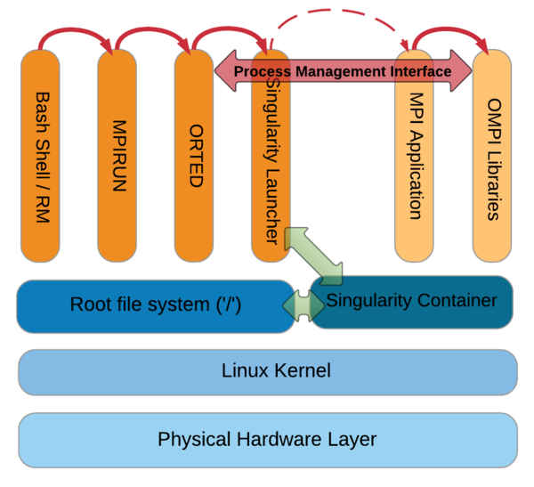
Containers: Apptainer (Singularity)
What?
Self-contained OS image in which you can install software and include data
Why?
Package managers like apt can be convenient
Portability: images can be used on various hardware (but performance may be sub-par)
How?
Create the image
Run it on wICE or Genius
Parallelization should work (multi-node MPI runs may require some care)
#!/bin/bash -l
#SBATCH --time=30:00 #SBATCH --nodes=1 #SBATCH --ntasks=72 #SBATCH --clusters=wice #SBATCH --account=lp_hpcinfo
apptainer run Project.sif ./model.exe
script.slurm

Slide 95
High-throughput computing with atools
You can use atools to handle high-throughput computing workloads
module load atools/<version>
VSC training: Workflows for Data Science
Training material: https://github.com/gjbex/Workflows-for-HPC
Recording: https://www.youtube.com/watch?v=GlwaRyi1LVA
User documentation: https://atools.readthedocs.io/en/latest/

Slide 96
Demo: try things yourself

Slide 97
Demo: try things yourself
Request to become a member of the lp_hpcinfo group via account.vscentrum.be
Transfer a file with FileZilla
Check your disk quota
Check your available credits
Check/load/list/unload/purge module

Slide 98
Demo: try things yourself
Copy /apps/leuven/training/HPC_intro/ to your $VSC_DATA
Submit cpujob.slurm to the cluster
List all your jobs with squeue -M wice
Check the information about the job with slurm_jobinfo -M wice <job_ID>
Modify the mpi.slurm script to request 1 node, 72 cores for 30 minutes, with job start/end e-mail notifications
Check the status of all the jobs

Slide 99
Demo: job monitoring
Submit an interactive job
Run your program on a compute node
Open a new terminal and ssh to the allocated compute node
Check the resources usage with htop
Submit a GPU batch job
While the job is running, check its details with slurm_jobinfo
and check resource on the compute node using ssh, htop and nvidia-smi

Slide 100
Useful links
Helpdesk (email): hpcinfo@kuleuven.be
Helpdesk (online form): https://admin.kuleuven.be/icts/HPCinfo_form/HPC-info-formulier
VSC website: https://www.vscentrum.be
VSC documentation: https://docs.vscentrum.be
VSC agenda, training sessions, events (User Day): https://www.vscentrum.be/vsctraining
System status page: https://status.vscentrum.be

