Slide 1




Linux - introduction
Wouter Van Assche
ICTS Leuven
https://hpcleuven.github.io/Linux-intro/

Slide 2
Overview
Introduction
Hands-on 1
Command line basics
The Linux file system
Hands-on 2
File manipulation
Text editing
Hands-on 3
Archiving
Users, groups & security
Process control
Hands-on 4

Slide 3

Remark
Commands will be displayed with a mono space font and will start always with prompt sign ($) – which is already included in the command line
Key take aways are indicated as:

Slide 4
Introduction

Slide 5
Purpose
Get a grip on the very basics: an introduction to the (basic) Linux commands as normally used for computational research (e.g. HPC cluster)
Focus on using the command line
Short hands-on examples

Slide 6
Information
Most of the presentation is based on the information found in:
Introduction to the Command Line (Second Edition) Nicholas Marsh https://dontfearthecommandline.blogspot.com/
The Linux Command Line William Shotts https://linuxcommand.org/tlcl.php
Ten Steps to Linux Survival James Lehmer https://www.oreilly.com/programming/free/ten-steps-to-linux-survival.csp?download=yes&order=1274753
The Unix and GNU/Linux command line Michael Opdenacker & Thomas Petazzoni https://bootlin.com/doc/legacy/command-line/unix_linux_introduction.pdf

Slide 7
Websites?
https://www.howtogeek.com/tag/linux/
Includes help, tutorials, tips and how-to guides for Linux.
https://www.tldp.org
The Linux Documentation Project
https://www.lwn.net
Linux Weekly News:Covering the Linux and free software communities since 1998.
https://www.linuxjournal.com
The monthly magazine of the Linux community, promoting the use of Linux worldwide.

Slide 8
Try it?
Install Windows Subsystem for Linux
Installing WSL2 on windows — VSC documentation
Web-based linux terminal
Arch Linux - v86 https://copy.sh/v86/?profile=archlinux

Slide 9
Windows and Linux
Both Linux and Windows are based on foundations developed in the mid-1970s
Both DOS, MAC and UNIX are proprietary, i.e., the source code of their kernel is protected
No modification is possible without paying high license fees
1970
1980
1990
2000
v2.0
v2.1
v2.2
v2.3
UNIX public
UNIX V6
Linux v1.0
v2.4
v2.6
UNIX born
1970
1980
1990
2000
VMS v1.0
NT 4.0
Server 2003
Windows XP
Windows NT 3.1
Windows 2000

Slide 10

Some history
GNU project:
Established in 1984 by Richard Stallman
Goal: software should be free from restrictions against copying or modification in order to make better and efficient computer programs.
GNU is a recursive acronym for “GNU's Not Unix”,
Aim at developing a complete Unix-like operating system which is free for copying and modification,
Companies make their money by maintaining and distributing the software, e.g. optimally packaging the software with different tools,
Stallman built the first free GNU C Compiler in 1991. But still, an OS was yet to be developed

Slide 11
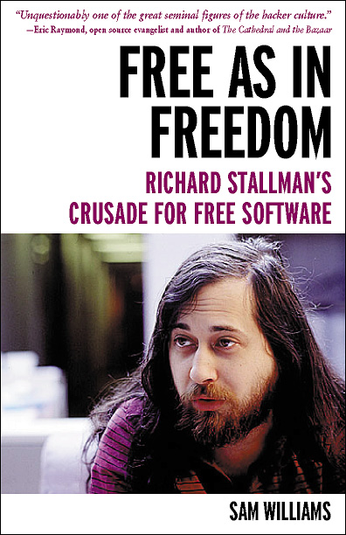

Open Source Software
Open Source Software (OSS) generally refers to software for which the source code is available and which the licensing scheme permits the user to modify it and redistribute it in modified or unmodified form.
GNU copyleft (www.gnu.org)
Nobody should be restricted by the software they use. There are four freedoms that every user should have:
the freedom to use the software for any purpose,
the freedom to change the software to suit your needs,
the freedom to share the software with your friends and neighbors, and
the freedom to share the changes you make.
When a program offers users all of these freedoms, we call it free software.

Slide 12

Linux: some history
UNIX: roots in Bell Labs (AT&T)
1985 Free Software Foundation (FSF) founded by Richard Stallman. Along with other programmers creates the tools needed to make a UNIX compatible OS
1985 Professor Andy Tannenbaum creates a UNIX like operating system based on System V Unix for the IBM PC & PC/AT computers. It is called Minix.
1989 Richard Stallman releases GPL and GNU software but lacks a free kernel.
1991 Building on the concepts in Minix, Linus Torvalds (Finnish college student) develops Linux along with help from other users on the web.

Slide 13
Operating system?
Distribution: OS + apps
Ubuntu, Debian …
Strictly speaking Linux refers to the kernel
GNU/Linux more accurately describes the Operating System. Linux Kernel combined with GNU utilities and libraries
Distribution – GNU/Linux bundled with other applications. Examples Red Hat Linux, Debian, Ubuntu, Suse, Knoppix, etc.
Distributions can be compiled and maintained by an individual or corporation.
www.distrowatch.com for more information
Operating System: kernel + GNU tools GNU/Linux
Kernel: Linux

Slide 14
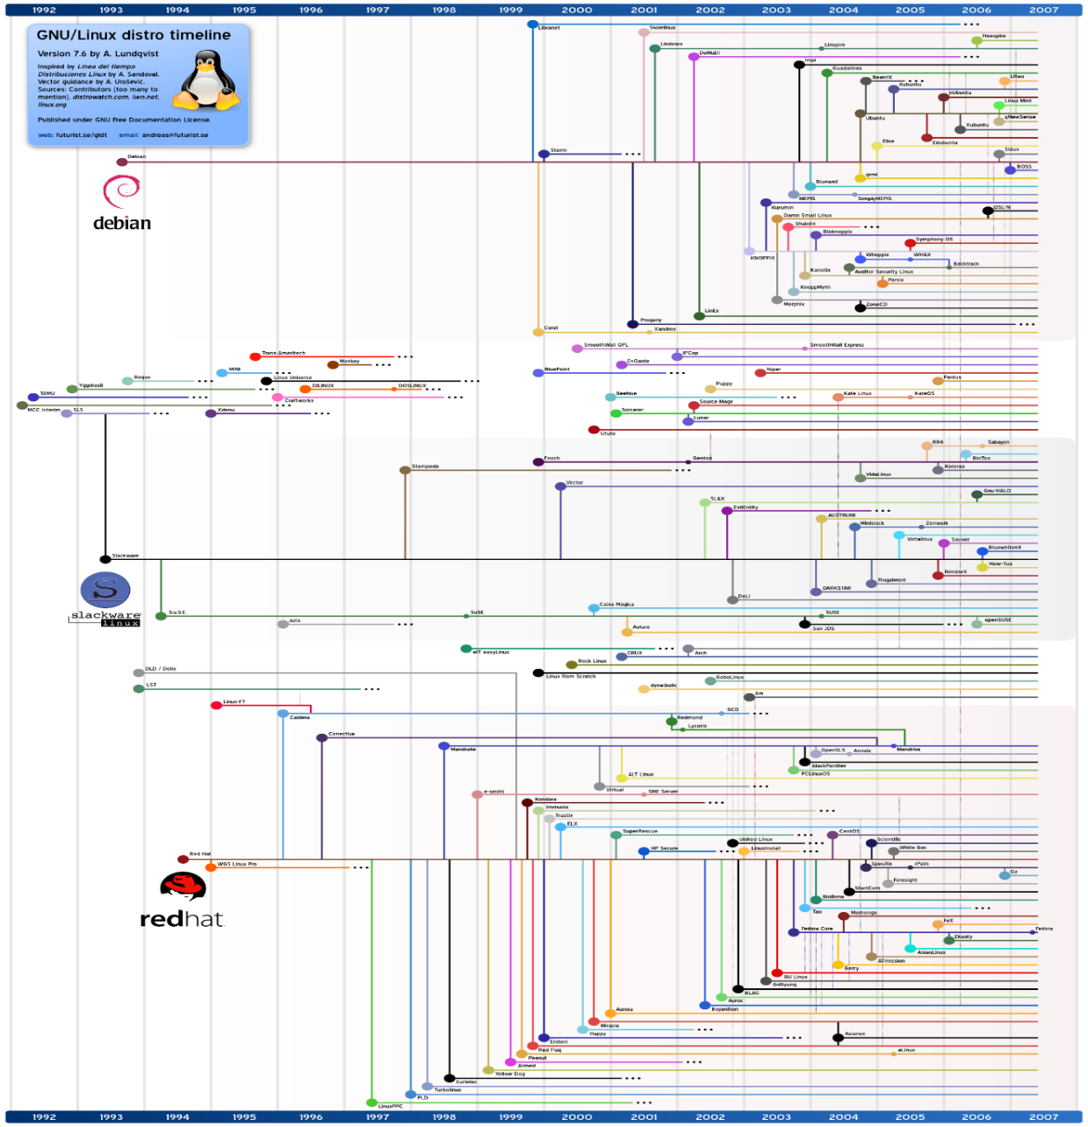
Which Linux Distribution is better?
Source: http://futurist.se/gldt/
Ubuntu
Debian
Debian
Knoppix
Slackware
Slackware
Gentoo
CentOS
CentOS
Redhat
Redhat
Red Hat (Enterprise) Linux is the largest commercial Linux vendor. Focus on stability and long term support.
http://www.cs.ucr.edu/~weesan/cs183/

Slide 15
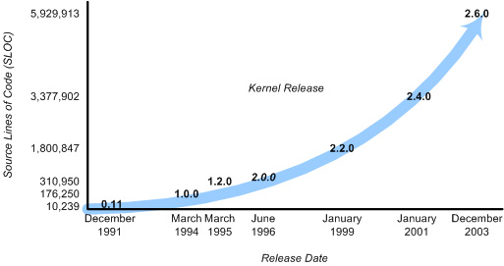
Linux Kernel
aka: executive, system monitor.
The kernel provides a layer between the computer hardware and user applications.
Provides an interface for software to use hardware (no direct access)
Planning and assigning:
memory, CPU, disk, etc.
security aspects
Fulfill user requests (system calls).
File system, networking, ...

Slide 16
Applications: Compilers, word processors, X-based GUI
Linux OS
AUI
LINUX Shell: Bourne Again (bash), TC, Z, etc.
Language libraries
API
System call interface
Memory management
File management
Process Management
Kernel
Device Drives
BIOS
Computer Hardware
Kernel
The part of an OS where the real work is done
System call interface
Comprises a set of functions (often known as Application Programmer's Interface API) that can be used by the applications and library routines to use the services provided by the kernel
Application User’s Interface
Interface between the kernel and user
Allows user to make commands to the system
Divided into text based and graphical based

Slide 17
Linux Kernel
File Management
Controls the creation, removal of files and provide directory maintenance
For a multiuser system, every user should have its own right to access files and directories
Process Management
For a multitask system, multiple programs can be executed simultaneously in the system
When a program starts to execute, it becomes a process
The same program executing at two different times will become two different processes
Kernel manages processes in terms of creating, suspending, and terminating them
A process is protected from other processes and can communicate with the others

Slide 18
Linux Kernel
Memory management
Memory in a computer is divided into main memory (RAM) and secondary storage (usually refer to hard disk)
Memory is small in capacity but fast in speed, and hard disk is vice versa
Data that are not currently used should be saved to hard disk first, while data that are urgently needed should be retrieved and stored in RAM
Device drivers
Interfaces between the kernel and the BIOS
Different device has different driver

Slide 19
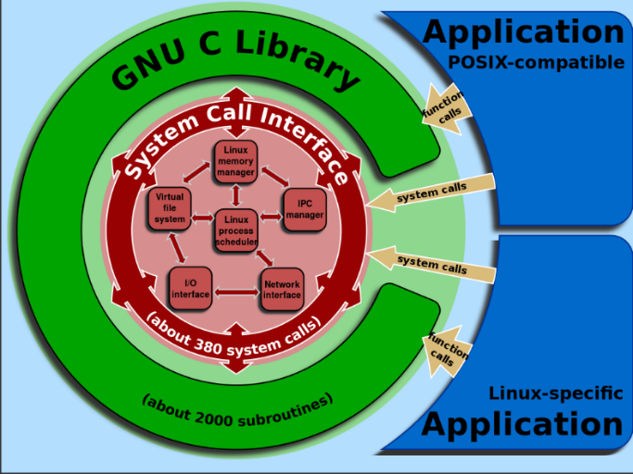
Compatibility Statement
Source: http://en.wikipedia.org/wiki/GNU_C_Library
Definition of the OS version
Kernel + GNU Tools
Kernel version (i.e. kernel 5.19.7)
glibc version (i.e. GNU libc 2.36)
Determining the OS Version
System distribution $ uname –a
Kernel version $ uname –r
glibc version $ ldd --version
Determining the OS Flavor/release
$ cat /etc/*-release

Slide 20
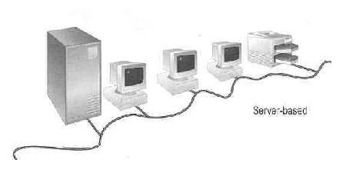
User login
Linux is a multiuser OS ,
Allows multiple users to use the resource of a computer at the same time
Every user needs to login the system with the password provided to identify their right in using the resource
Requires for both client-server based system or desktop
Linux Server

Slide 21
Linux User Interface
Traditional Linux (Unix also) uses command-driven interface (or text-based interface)
User needs to type lines of command to instruct the computer to work, similar to DOS
Advantage: fast in speed. Very few resource is required for its implementation
Disadvantages: user needs to type, hence can easily make error. Besides, user needs to memorize all commands
Suitable for expert users and for the systems that interaction with user is not frequent, such as servers

Slide 22
Linux User Interface
By adopting the X-Window technology, graphical user interface (GUI) is available for Linux:
Uses pointing devices (e.g. mouse) to control the system, similar to Microsoft’s Windows
Provide menu-driven and/or icon-driven interfaces
menu-driven: user is provided with a menu of choices. Each choice refers to a particular task
icon-driven: tasks are represented by pictures (icon) and shown to user. Click on an icon invokes one task
Advantages: No need to memorize commands. Always select task from menus or icons
Disadvantages: Slow and require certain resource for its implementation
Suitable for general users and systems, such as PC

Slide 23
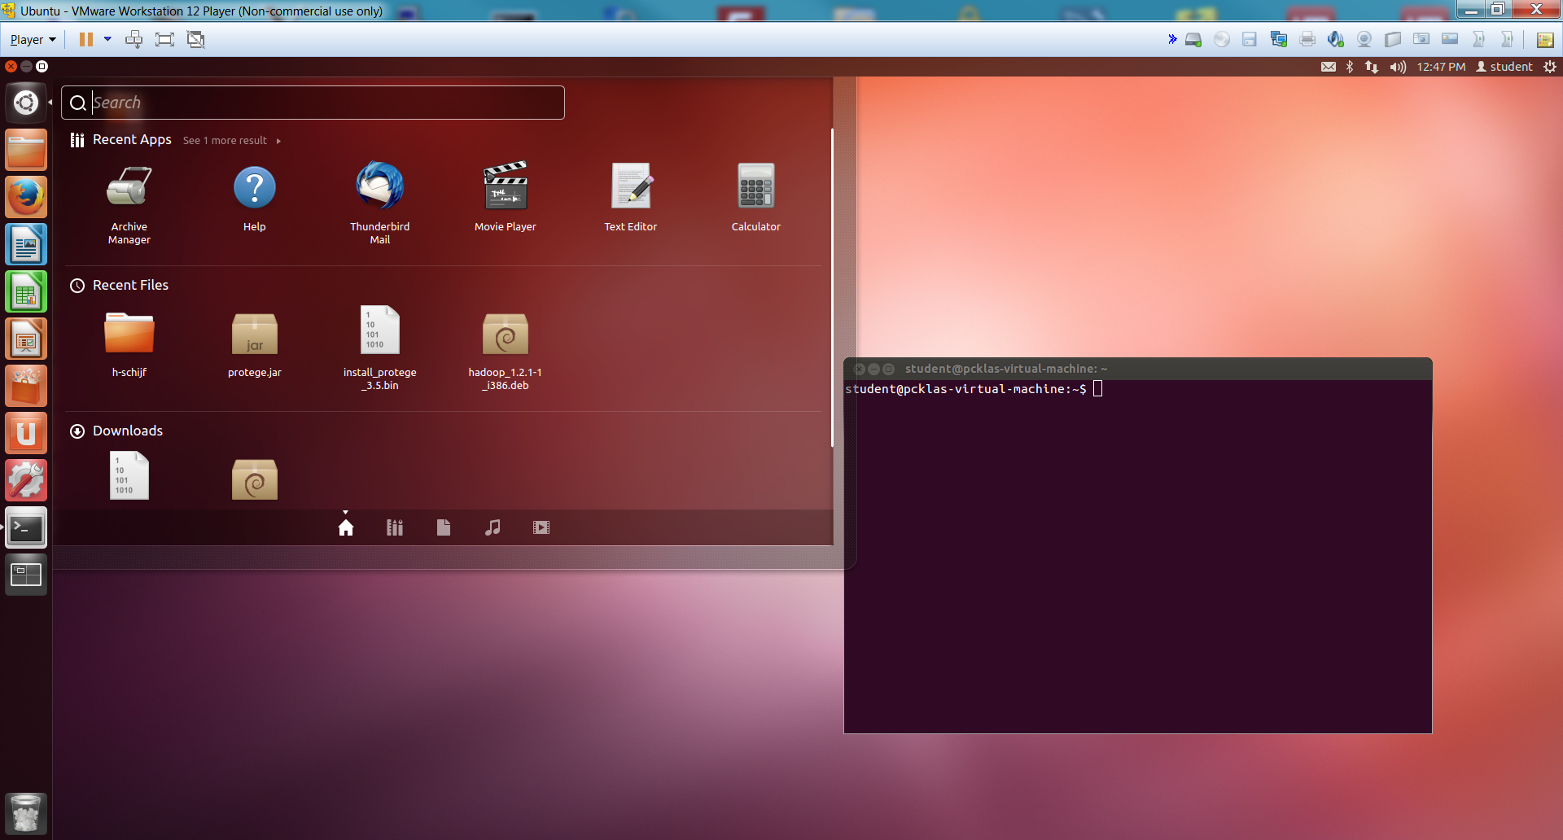
Linux User Interface

Slide 24
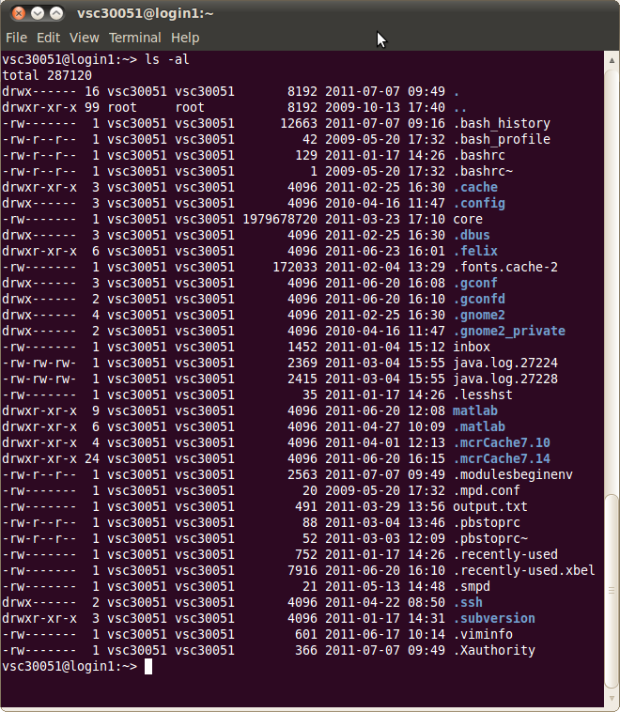
Command Line
Text mode
Provides a way to control the computer via the keyboard.
Is common use on HPC
Is somewhat archaic, but very powerful.
Can be much quicker than a GUI.
Implicitly assumes that you know what you are doing
Don't be scared!
If anything goes wrong, you can stop the command with Ctrl+C

Slide 25
Linux text based interface: The shell
Is the command line interpreter: a program that accepts input from a user (e.g. a command) and performs the requested task.
The shell's prompt identifies the type of shell being used. There are two basic types of shell prompts:
$ Normal user shell (may also be % or > on some systems)
# Root user shell (login as root or $ su)
Warning: The root user can do anything on Linux systems. It is important to know when you are working as root to prevent accidental damage to your system. Identify who you are with: $ whoami

Slide 26
Using the root account
If you have the root password: $ su - (switch user)
In modern distributions, the sudo (super user do) command gives you access to some root privileges with your own user password. Example: $ sudo mount /dev/hda4 /home
root user privileges are only needed for very specific tasks with security risks: mounting, creating device files, loading drivers, starting networking, changing file ownership, package upgrades...
Check the prompt #

Slide 27
Most popular shells
There are several types of shells for Linux.
Check it with: $ echo $SHELL
Shell | Prompt | Name | Note
sh | $ | Bourne Shell | Default on some Unix systems
bash | $ | Bourne Again Shell | Enhanced replacement for the Bourne shell Default on most Linux and Mac OS X systems
csh | % | C Shell | Default on many BSD systems
tcsh | > | TC Shell | Enhanced replacement for the C shell
ksh | $ | Korn Shell | Default on AIX systems

Slide 28
Hands-on 1

Slide 29
Command line basics

Slide 30
Important rules on the command line
Linux systems are case (and space) sensitive.
MyFile is not same as myfile
There is no "recycle bin" or "trash can" when working in the command line environment. When files are deleted on the command line, they instantly disappear forever.
You should always practice new commands on a test system that is not used in a production environment. This minimizes the chances of an accident that can take down an important system

Slide 31
Important rules on the command line
“\” vs. “/”:
In Linux, the “/” is the directory separator, and the “\” is an escape character.
In Windows, the forward-slash “/” is the command argument delimiter, while the backslash “\” is a directory separator
Filenames:
In Linux, there is no such thing as a file extension. Periods can be placed at any part of the filename, and “extensions” may be interpreted differently by all programs, or not at all.
Windows uses the “.extension” filename convention, (e.g. FILENAME.TXT).

Slide 32
Auto-Completion
Have the shell automatically complete commands or file paths.
Activated using the <TAB> key on most systems
examples
$ dat<TAB>
$ date
$ ls -l /etc/en<TAB>
$ ls -l /etc/environment
When more than one match is found, the shell will display all matching results (use <TAB> twice)
$ ls -l /etc/host<TAB>

Slide 33
Command history: Arrow Up
Previously executed commands can be recalled by using the Up Arrow key on the keyboard.
Most Linux distributions remember the last five hundred commands by default.
Display commands that have recently been executed
The history command displays a user's command line history.
You can execute a previous command using ![NUM] where NUM is the line number in history you want to recall.
Your command history is stored in ~/.bash_history
You can also search the history with ctrl+R

Slide 34
Getting help: command built-in
Help on most Linux commands is typically built into the command themself
These flags usually look like “-h” or “--help”.
$ ls --help

Slide 35
Getting help: man pages
Best source of information can be found in the online manual pages, “man pages” for short. type “man command”.
$ man grep
Tips:
To search for a particular word (e.g. file) within a man page, type “/word”.
To quit from a man page, type the “q” key.
If you do not remember the name of Linux command and you know a keyword relating to the command, search the man pages with the –k $ man -k control

Slide 36
Getting help: info pages
Info pages are similar to man page, but instead of being displayed on one long scrolling screen, they are presented in shorter segments with links to other pieces of information.
Access with the “info” command $ info ls
Tips:
To exit an info page, type the “q” key.
Type “h” to get more help on the info

Slide 37
Getting help
bash has a built-in help facility available for each of the shell builtins. $ help cd $ help pwd
whatis displays a very brief description of a command $ whatis pwd

Slide 38
Useful commands
Clear the contents of the current screen $ clear
$ logout
The logout command logs your account out of the system (in a text mode).
This will end your terminal session and return to the login screen.
Some systems may have a file called .logout or .bash_logout in each user's home directory.
$ exit
Exit the current shell. The exit command is similar to the logout command with the exception that it does not run the logout script located in the user's home directory.

Slide 39
Standard output
All the commands outputting text on your terminal do it by writing to the standard output. This is where the normal output from a program goes.
Standard output can be written (redirected) to a file using the > symbol
$ ls > /tmp/list.txt
$ date > date.txt (writes date info to date.txt)
Standard output can be appended to an existing file using the >> symbol
$ ls >> /tmp/list.txt

Slide 40
Standard output
There are two different types of output:
1. Standard output (STDOUT)
2. Error output (STDERR)
$ ls -l /NonExistFile 1>ls.out 2>ls.err
$ ls -l ls*
$ cat ls.out
$ cat ls.err
ls: cannot access /NonExistFile: No such file or directory

Slide 41
Standard input
In addition to STDOUT and STDERR you can also redirect input from another location (such as a file) to a command. This is known as standard input or STDIN.
the source of input data for command line programs
STDIN: usually keyboard
redirect also possible
$ sort < tabel.dat

Slide 42

Pipes
Pipes (also referred to as pipelines) can be used to direct the output of one command to the input of another. The Shell arranges it so that the standard output of one command is fed to another command
use the | key on the keyboard
$ ls /etc | sort sorts ls output alphabetically (compare with $ ls /etc > sort)

Slide 43
Globbing: use wildcard
Wildcard | Function
* | Matches 0 or more characters
? | Matches 1 character
[abc] | Matches one of the characters listed
[a-c] | Matches one character in the range
[!abc] | Matches any character not listed
[!a-c] | Matches any character not listed in the range
{tacos,nachos} | Matches one word in the list
$ ls -l /etc/host*
$ ls -l /etc/host.{conf,allow}
$ ls -l /etc/host[!s]*
$ ls -l /etc/host?

Slide 44
The Linux file system

Slide 45
Linux File System
hierarchical directory structure: files are organized in a tree-like pattern of directories (folders), which may contain files and other directories, etc.
Everything is a file:
Regular files
Directories: files listing a set of files
Symbolic links: files referring to the name of another file
root /: the first directory in the file system.
Note: comparison with Windows,
Windows has a separate file system tree for each storage device (e.g. C-drive, D-drive, I-drive, …)
Linux has a single file system tree, regardless of how many drives or storage devices are attached to the computer. Storage devices are attached (or mounted) at various points on the tree.

Slide 46
Linux File System
/
/root
/etc
/mnt
/sys
/bin
/lib
/boot
/home
/proc
/dev
/sbin
/usr
Super user home directory
General purpose mount point
Libraries
Executables
Kernel image
View of internal kernel data
/bin
/sbin
/lib
System configuration files
Kernel view of the hardware
More Executables
More Libraries
User home directories
Special device files
Source: http://linuxsuperuser07.blogspot.be/2011/09/rhel-6-file-system.html

Slide 47
Linux File System
Not imposed by the system. Can vary from one system to the other, even between two GNU/Linux installations!
/ Root directory /bin/ Basic, essential system commands /boot/ Kernel images, initrd, configuration files /dev/ Files representing devices /etc/ System configuration files /home/ User directories /lib/ Basic system shared libraries
/media/ Mount points for removable media

Slide 48
Linux File System
/lost+found/ Corrupt files the system tried to recover /mnt/ Mount points for temporarily mounted file systems /opt/ Specific tools installed by the sysadmin /usr/local/ often used instead /proc/ Access to system information /sbin/ Administrator-only commands /sys/ System and device controls
/tmp/ Temporary files
The Unix file system structure is defined by the File system Hierarchy Standard (FHS): http://www.pathname.com/fhs/pub/fhs-2.3.html
http://en.wikipedia.org/wiki/Filesystem_Hierarchy_Standard

Slide 49
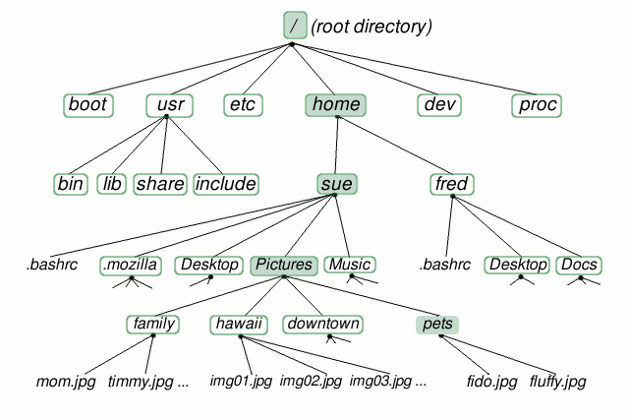
Linux File System-home directory
Source: http://www.linuxplanet.com/linuxplanet/tutorials/6666/1/screenshot3894/

Slide 50
ls command
Lists the files in the current directory, in alphanumeric order, except files starting with the “.” character.
$ ls -a (all) Lists all the files (including .* files)
$ ls -l (long) Long listing (type, date, size, owner, permissions)
$ ls -t (time) Lists the most recent files first
$ ls -S (size) Lists the biggest files first
$ ls -r (reverse) Reverses the sort order
$ ls -ltr (options can be combined) Long listing, most recent files at the end

Slide 51
ls command
$ ls *txt The shell first replaces *txt by all the file and directory names ending by txt (including .txt), except those starting with ., and then executes the ls command line.
$ ls -d .* Lists all the files and directories starting with . -d tells ls not to display the contents of directories. $ ls -d */
$ ls ?.log Lists all the files which names start by 1 character and end by .log
http://www.thegeekstuff.com/2009/07/linux-ls-command-examples/

Slide 52
ls command
vsc30051@login1:~/matlab/test> ls -al
total 1156
drwxr-xr-x 9 vsc30051 vsc30051 8192 2011-03-29 16:10 .
drwxr-xr-x 9 vsc30051 vsc30051 4096 2011-06-20 12:08 ..
drwxr-xr-x 3 vsc30051 vsc30051 4096 2010-01-08 10:54 courseAndreas
-rwxr--r-- 1 vsc30051 vsc30051 149326 2011-03-10 15:14 fibonacci
-rw-r--r-- 1 vsc30051 vsc30051 681 2011-03-10 15:09 fibonacci.m
-rwxr--r-- 1 vsc30051 vsc30051 149068 2011-03-10 12:16 ftest
-rw-r--r-- 1 vsc30051 vsc30051 443 2011-03-10 12:17 ftest_compiled.sh
-rw-r--r-- 1 vsc30051 vsc30051 442 2011-03-10 11:28 ftest_compiled.sh~
-rw-r--r-- 1 vsc30051 vsc30051 70 2011-03-10 12:15 ftest.m
In Linux, file is defined as simply the thing that deals with a sequence of bytes
Hence everything are files: an ordinary file is a file; a directory is also file; a network card, a hard disk, any device are also files since they deal with a sequence of bytes

Slide 53
Moving around
Symbolic (soft) link
Not a real file, just a link to another file
Allows giving another name to a file without actually duplicating it – hence saves memory space
Special file (device)
Each hardware device, e.g. keyboard, hard disk, CD-ROM, etc. is associated with at least one file
Usually store in /dev directory
Applications can read and write any devices by reading and writing their associate file – hence the access method is known as device independent
Divide into two types: character special files, e.g. keyboard, and block special files, e.g. disk

Slide 54
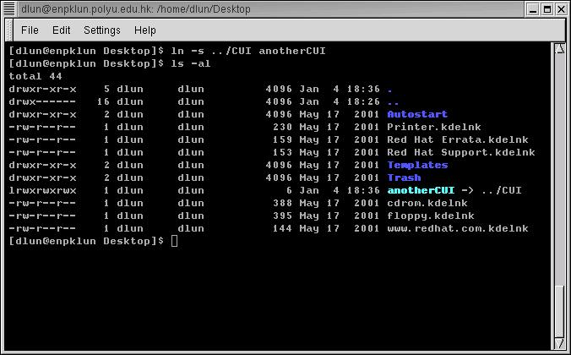
ls command
Command that sets a symbolic link to a file called CUI to anotherCUI
Names in blue are directories, indicated by a letter d at the beginning of the line
A symbolic link begins with a letter l

Slide 55
Moving around
Display the current/working directory
$ pwd
Print Working Directory
displays your current location within the file system.
Change (navigate) directories.
$ cd dir_name
Change Directories
changes the position to the specific directory
You can specify directory names in two ways:
Absolute pathname (starts from the root of the tree)
$ cd /u/home/hpc/test/bin
Relative pathname (relative to your current directory)
$ cd
$ cd .
$ cd ..
$ cd test/bin

Slide 56
Special directories
.
The current directory.
Useful for commands taking a directory argument.
Useful to run commands in the current directory
./readme.txt and readme.txt are equivalent.
..
The parent (enclosing) directory. Always belongs to the . Directory
Typical usage: cd ..
~
Shells just substitute it by the home directory of the current user.
-
cd – jump back to the previous directory

Slide 57
Linux File System - directories
cd .
Source: http://www.linuxplanet.com/linuxplanet/tutorials/6666/1/screenshot3894/

Slide 58
Linux File System - directories
cd ..
Source: http://www.linuxplanet.com/linuxplanet/tutorials/6666/1/screenshot3894/

Slide 59
Linux File System - directories
cd ../..
Source: http://www.linuxplanet.com/linuxplanet/tutorials/6666/1/screenshot3894/

Slide 60
Linux File System - directories
cd /
Source: http://www.linuxplanet.com/linuxplanet/tutorials/6666/1/screenshot3894/

Slide 61
Linux File System - directories
cd -
Source: http://www.linuxplanet.com/linuxplanet/tutorials/6666/1/screenshot3894/

Slide 62
Linux File System - directories
cd ~
Source: http://www.linuxplanet.com/linuxplanet/tutorials/6666/1/screenshot3894/

Slide 63
Linux File System - directories
Relative path
cd ../Desktop
Source: http://www.linuxplanet.com/linuxplanet/tutorials/6666/1/screenshot3894/
Notes:
Linux File System-home directory

Slide 64
Linux File System - directories
Relative path
cd ~/Desktop
Source: http://www.linuxplanet.com/linuxplanet/tutorials/6666/1/screenshot3894/

Slide 65
Linux File System - directories
Full path
cd /home/sue/Desktop
Source: http://www.linuxplanet.com/linuxplanet/tutorials/6666/1/screenshot3894/

Slide 66
File paths
A path is a sequence of nested directories with a file or directory at the end, separated by the / character
Relative path: documents/fun/file1 Relative to the current directory
To work with relative paths they need to have connection on the linux tree
Absolute path: /home/user/leuven/file2
/ : root directory. Start of absolute paths for all files on the system
Not a superuser’s home directory (-> /root)

Slide 67
More on files
What does a file contain?
Determine a file's type: file
will print a brief description of the file's contents
$ file filename
Search for files and directories
The find command performs a raw search on a file system to locate the specified items.
$ find location –name some-name
($ find /home/student -name *desktop)
Be careful: results can sometimes be slow
Search the locate database for files and directories
The locate command displays the location of files that match the specified name.
Faster than find because it searches a database of indexed filenames.
Disadvantage: lacks the ability to search for advanced characteristics such as file owner, size, and modification time.

Slide 68
More on files
Display extended information about a file system, file, or directory
The stat command displays extended information about files. It includes helpful information not available when using the ls command

Slide 69
File names
File name features:
Case sensitive
No obvious length limit (255 characters)
Can contain any character (including whitespace, except /).
File name extensions not needed and not interpreted. Just used for user convenience. (File types stored in the file)
a hidden file is any file that begins with a “.” (not seen with the bare ls

Slide 70
File names – Best Practices
Be concise, you don’t want to type long file names
Try to stick to alphanumeric characters [0-9A-z].
Avoid spaces in file names, use “_” or “-” instead
Good file names
.bashrc
project_report_2025.pdf
backup_2025-01-01.tar.gz
README.md
image_001.png
user_data.csv

Slide 71
File names – Best Practices
Be concise, you don’t want to type long file names
Try to stick to alphanumeric characters [0-9A-z].
Avoid spaces in file names, use “_” or “-” instead
Bad file names
Why spaces in file names are the worst.pdf
Tabs\tAndOtherStr@ngeCharacters.txt

Slide 72
Measuring disk usage
$ du -h <file> -h: returns size on disk of the given file, in human readable format: K (kilobytes), M (megabytes) or G (gigabytes), Without -h, du returns the raw number of disk blocks used by the file (hard to read). Note that the -h option only exists in GNU du.
$ du -sh <dir> -s: returns the sum of disk usage of all the files in the given directory.

Slide 73


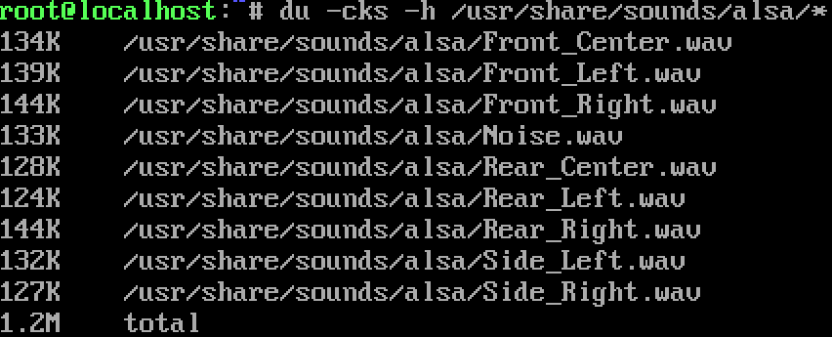
Measuring disk usage
$ du –cks -h <dir> Returns the total disk usage of the directory and shows a total at the end.

Slide 74
Measuring disk space
$ df -h <dir> Returns disk usage and free space for the file system containing the given directory. Similarly, the -h option only exists in GNU df.
Example: $ df -h . File system Size Used Avail Use% Mounted on /dev/hda5 9.2G 7.1G 1.8G 81% /
$ df -h Returns disk space information for all file systems available in the system. When errors happen, useful to look for full file systems.

Slide 75
Hands-on 2

Slide 76
File manipulation

Slide 77
File Manipulation
For all file manipulation commands relative or absolute paths can be used (or just files in the current directory when no extra path specified)
Most of the commands are intuitive – shortcuts of English names

Slide 78
Directories
Create directories
The mkdir command is used to create directories
$ mkdir dir1 dir2 dir3
Create a full path (-p)
$ mkdir –p dir1/subdir1/subdir2
Remove directories
The rmdir command removes directories
$ rmdir dir1
rmdir will only remove empty directories. To remove a non-empty directory, use
$ rm -r [DIRECTORY] instead.

Slide 79
Copy a file
The cp command copies files and directories
The default behavior will overwrite any existing file(s). The -i option overrides this behavior and prompts the user before overwriting the destination file.
syntax: cp [OPTIONS] [SOURCE] [DESTINATION]
$ cp <source_file> <target_file> Copies the source file to the target.
$ cp file1 file2 file3 ... dir Copies the files to the target directory (last argument).
$ cp -i (interactive) Asks for user confirmation if the target file already exists
$ cp -r <source_dir> <target_dir> (recursive) Copies the whole directory.
$ cp –v (verbose)
Displays what has been copied

Slide 80

Move or rename files
Move or rename files and directories: mv
The default behavior will overwrite any existing file(s).
syntax: mv [OPTIONS] [SOURCE] [DESTINATION]
$ mv old_name new_name Renames the given file or directory.
$ mv -i (interactive) If the new file already exits, asks for user confirm
The mv command can also be used to move or rename directories
$ mv NewFiles/ OldFiles/
-r option is not necessary

Slide 81
Remove files
The rm command removes files.
$ rm file1 file2 file3 ... Removes the given files.
$ rm -i (interactive) Always ask for user confirmation.
$ rm -r dir1 dir2 dir3 (recursive) Removes the given directories with all their contents.
Tip: Whenever you use wildcards with rm (besides carefully checking your typing!), test the wildcard first with ls. This will let you see the files that will be deleted. Then press the up arrow key to recall the command and replace the ls with rm.

Slide 82
Create links
Create links (shortcuts) to files or directories: ln
Symbolic links are created when using the -s option with the ln command.
Allows to jump to other files or locations on the file system
Editing a symbolic link file is the same as editing the source file, but deleting the symbolic link does not delete the source file.
$ ln -s file_v5.doc file_final.doc
creates a symbolic link called file_final.doc that points to file_v5.doc
$ ln -s /home/demo/dir1/dir2/dir3 /home/demo/jump2dir
creates a symbolic link called jump2dir that points to a deep directory - allows for quicker access)

Slide 83
wget
Instead of downloading files from your browser, just copy and paste their URL and download them with wget
main features
http, https, ftp and ftps support
Can resume interrupted downloads (-c)
Can download entire sites or at least check for bad links
Very useful in scripts or when no graphics are available

Slide 84
Text editing

Slide 85
Text editors
Text-only text editors
Often needed for sysadmins and great for power users
vi, vim
nano
Graphical text editors
Fine for most needs
Gedit,
Kate, Nedit
Emacs, Xemacs
http://www.thegeekstuff.com/2009/07/top-5-best-linux-text-editors/

Slide 86
Text editors
How to start:
Create a file
$ touch filename (creates an empty file)
start editing (non)-existing file:
$ vi filename
$ nano filename

Slide 87
vi
Text-mode text editor available in all Linux systems.
Created before computers with mice appeared.
Difficult to learn for beginners used to graphical text editors.
Very productive for power users.
Check the web for tutorials:
https://upload.wikimedia.org/wikipedia/commons/d/d2/Learning_the_vi_Editor.pdf
ftp://ftp.vim.org/pub/vim/doc/book/vimbook-OPL.pdf

Slide 88
vi
2 basic modes of operation:
command mode and editing mode.
Within Command Mode, signals from the terminal are interpreted as editing commands.
Editing mode: letters typed at the keyboard are inserted into the editing buffer.
Pressing Esc on the keyboard activates command mode.
Key(s) | Function | Key(s) | Function
:w | Save | A | Append text after
:x | Save and exit | r | Replace text before cursor
:q | Quit | R | Replace text after cursor
I | Insert text after | i | Insert text before
P | Paste copied text | yy | Copy current line
a | Append text before | /[TEXT] | Search for the specified text

Slide 89
vi
2 modes
Input mode
ESC to back to cmd mode
Command mode
Cursor movement
h (left), j (down), k (up), l (right)
^f (page down)
^b (page up)
^ (first char.)
$ (last char.)
G (bottom page)
:1 (goto first line)
Switch to input mode
a (append)
i (insert)
o (insert line after
O (insert line before)
Delete
dd (delete a line)
d10d (delete 10 lines)
d$ (delete till end of line)
dG (delete till end of file)
x (current char.)
Paste
p (paste after)
P (paste before)
Undo
u
Search
/
Save/Quit
:w (write)
:q (quit)
:wq (write and quit)
:q! (give up changes)

Slide 90
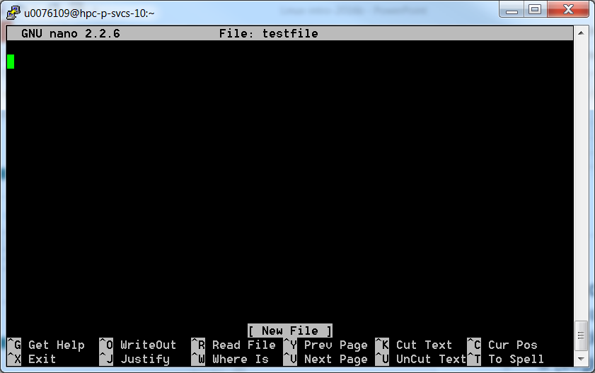
Nano
Exit=Ctrl+X

Slide 91
Displaying file contents
Several ways of displaying the contents of files.
$ cat file1 displays the contents of the given file.
$ cat file1 file2 file3 ... (concatenate) Concatenates and outputs the contents of the given files.
$ more file1 Display the output of a command or text file one page at a time.
Can also jump to the first occurrence of a keyword (/ command).

Slide 92
Displaying file contents
$ less file1 Does more than more. Doesn't read the whole file before starting. Supports backward movement in the file (? command). Supports searching with /<string to search>
Press q to exit
Less is more

Slide 93
The head and tail commands
$ head [-<n>] <file> Displays the first <n> lines (or 10 by default) of the given file. Doesn't have to open the whole file to do this!
$ tail [-<n>] <file> Displays the last <n> lines (or 10 by default) of the given file. No need to load the whole file in RAM! Very useful for huge files.
$ tail -f <file> (follow) Displays the last 10 lines of the given file and continues to display new lines when they are appended to the file. Very useful to follow the changes in a log file, for example.

Slide 94
The grep command
$ grep <pattern> <files> Scans the given files and displays the lines which match the given pattern.
$ grep error *.log Displays all the lines containing error in the *.log files
$ grep -i error *.log Same, but case insensitive
$ grep -ri error . Same, but recursively in all the files in the current directory and its subdirectories
$ grep -v info *.log Outputs all the lines in the files except those containing info.
http://www.thegeekstuff.com/2009/03/15-practical-unix-grep-command-examples/

Slide 95
Hands-on 3

Slide 96
Archiving

Slide 97
File Archiving: tar
Saves and restores multiple files to/from a single file. Directories followed recursively.
Format:
$ tar [options] [options_values] [files]
c – create a new archive
v – verbosely list files which are processed.
f – following is the archive file name
z – filter the archive through gzip (compress)
x – extract files from archive
j - filter the archive through bzip (compress)

Slide 98
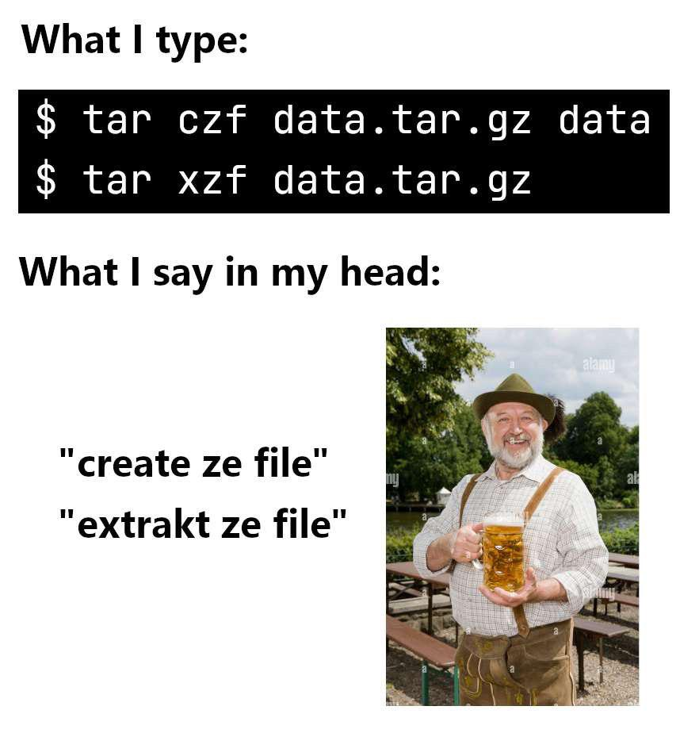
File Archiving: tar
Examples:
Backup the specified item(s) $ tar -cf [FILE] [ITEM]
Compress the archive to save space $ tar -czf [FILE] [ITEM]
Restore the specified item(s) $ tar -xzf [FILE] [ITEM]
http://www.thegeekstuff.com/2010/04/unix-tar-command-examples/
Notes:
Create Ze File, Extrakt Ze File · ProgrammerHumor.io

Slide 99
File Compression: gzip
Compressing files: gzip filename or bzip2 filename
$ gzip backup.tar
$ bzip2 backup.tar
The resulted file is backup.tar.gz/ backup.tar.bz2
Uncompressing files: gzip -d filename.gz or bzip2 –d filename.bz2
$ gzip –d backup.tar.gz
$ bzip2 –d backup.tar.bz2
The uncompressed file is backup.tar

Slide 100
Users, groups & security

Slide 101
File access rights
Linux File Access Privilege
Linux is a multiuser system, the files of all users are stored in a single file structure
Mechanism is required to restrict one user to access the files of another user, if he is not supposed to
User can impose access permission to each file to restrict its access
The term “access permission” refers to
read permission
write permission
execute permission

Slide 102
File access rights
3 types of access rights
Read access (r)
reading, opening, viewing, and copying the file is allowed
Write access (w)
writing, changing, deleting, and saving the file is allowed
Execute rights (x)
executing and invoking the file is allowed. This is required for directories to allow searching and access.
Use ls -l to check file access rights

Slide 103
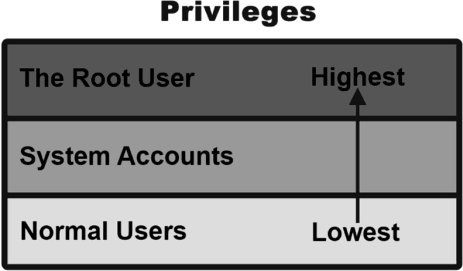
File access rights
3 types of access levels
User (u): for the owner of the file
Group (g): each file also has a “group” attribute, corresponding to a given list of users
Others (o): for all other users

Slide 104
File access rights
File last modified date
Hard link no
Owner’s group
Owner
d rwx r-x r-x 2 wva wva 4096 Sep 25 2025 Autostart
It is a directory
file size
file name
The directory can be read, written and executed by the user dlun
The directory can be read and executed but not written by other users in the same group of dlun
The directory can be read and executed but not written by any other users
The group of a user is assigned by the administrator when a user is added to the system

Slide 105
File access rights
Access permission can also be assigned to a directory
Directory is also a file that contains the attributes of the files inside it
If read permission is not given to a directory
cannot show the structure of this directory
e.g. cannot use ls
If write permission is not given to a directory
cannot modify anything of the directory structure
e.g. cannot copy a file into this directory since it will modify the directory structure by adding one more file
If execute permission is not given to a directory
nearly nothing can be done with this directory, even cd

Slide 106
Access rights examples
-rw-r--r-- Readable and writable for file owner, only readable for others
-rw-r----- Readable and writable for file owner, only readable for users belonging to the file group.
drwx------ Directory only accessible by its owner
-------r-x File executable by others but neither by your friends nor by yourself. Nice protections for a trap...

Slide 107
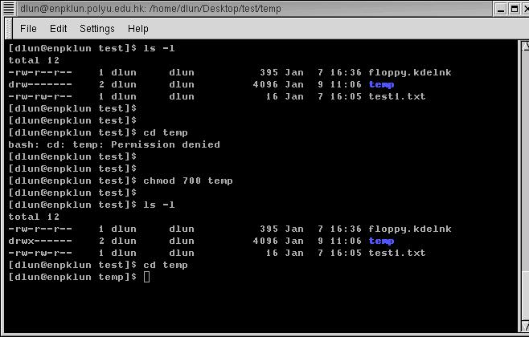
Access rights examples
temp does not have execution right
even cd is not workable
execution right is added
now we can change the directory to temp

Slide 108
chmod: changing permissions
Permissions allow you to share files and directories or to lock them down to be private.
$ chmod (change mode)
$ chmod <permissions> <files>
2 formats for permissions:
symbolic format
More practical for updating permissions (add or remove)
octal format (3 digit octal [0-7] form)
Best used when setting permissions

Slide 109
chmod: changing permissions
ls -l shows the symbolic form of the file permissions
The symbolic form translates to binary which corresponds to octal form.
-rwxr-xr–- 1 root root 4096 Sep 25 09:00 myprog | | |
| | | symbolic binary octal
| | └── other permissions: r-- → 100 → 4
| └───── group permissions: r-x → 101 → 5
└──────── user permissions: rwx → 111 → 7

Slide 110
chmod: changing permissions
Read = 4 Write = 2 Execute = 1
$ chmod 710 myprog → rwx--x--- ugo
Permissions | Symbolic | Binary | Octal
None | --- | 000 | 0
Execute | --x | 001 | 1
Write | -w- | 010 | 2
Execute and write | -wx | 011 | 3
Read | r-- | 100 | 4
Read and execute | r-x | 101 | 5
Read and write | rw- | 110 | 6
Read write and execute | rwx | 111 | 7

Slide 111
chmod: changing permissions
symbolic format: $ chmod go+r add read permissions to group and others. $ chmod u-w remove write permissions from user. $ chmod a-x remove execute permission from all (a).
Example: $ chmod o+x myprog rwx--x--- → rwx--x--x

Slide 112
Access right constraints
x is sufficient to execute binaries Both x and r and required for shell scripts.
Both r and x permissions needed in practice for directories: r to list the contents, x to access the contents.
You can't rename, remove, copy files in a directory if you don't have w access to this directory.
If you have w access to a directory, you can remove a file even if you don't have write access to this file (remember that a directory is just a file describing a list of files). This even lets you modify (remove + recreate) a file even without w access to it.

Slide 113
Process control

Slide 114
time
time a helpful command for doing simple benchmarking
run your scripts along with the time command and compare their’s execution time.
Example: $ time ls real 0m0.064s (actual elapsed time) user 0m0.006s (CPU time running program code) sys 0m0.048s (CPU time running system calls) real = user + sys + waiting waiting = I/O waiting time + idle time (running other tasks)

Slide 115
Process
“Everything in Unix is a file. Everything in Unix that is not a file is a process”
Processes
Instances of a running programs
Several instances of the same program can run at the same time
Processes are assigned a unique identifier which is used to monitor and control the process (PID)

Slide 116
Process
A program that is claimed to be executing is called a process
For a multitasking system, a process has at least the following three states:
Start execution
Ready
Running
Finish execution
Sleeping

Slide 117
Process
Ready state
All processes that are ready to execute but without the CPU are at the ready state.
Running state
The process that actually possesses the CPU is at the running state
If there is only 1 CPU in the system, at most there is only one process is at the running state
Sleeping stateThe process that is waiting for other resources, e.g. I/O, is at the sleeping state

Slide 118
ps
Display running processes (cfr. Windows Task Manager ctrl-shift-esc)
$ ps Display the current user's processes
$ ps -e Display all processes running on the system
$ ps -ef Display detailed information about running processes
$ ps -u [USER] Display processes owned by the specified user
$ ps -a Display extra info (running state)

Slide 119
Process
PID TTY STAT TIME COMMAND
14748 pts/1 S 0:00 –bash
pts/0 S 0:00 –bash
14974 pts/0 S 0:00 vi test1.txt
14876 pts/1 R 0:00 ps …
How much time the process is continuously executing
State:
S – Sleeping
(waiting for input)
R – Running
Process ID
Terminal name
For the example above, both bash processes, which are the shell of both terminals, are waiting for the input of user. They must be in the sleeping state
The vi process, which is an editor, is also waiting for the input of user. Hence it is also in sleeping state
When ps reporting the processes in the system, it is the only process that is running. Hence it is in running state

Slide 120
kill
Sends an abort signal to the given processes. Lets processes save data and exit by themselves. Should be used first.
$ kill <pid> Example: $ kill 3039 3134 3190 3416
$ kill -9 <pid> Sends an immediate termination signal. The system itself terminates the processes. Useful when a process is really stuck.

Slide 121
killall
The killall command terminates all processes that match the specified name
$ killall [-<signal>] <command> Example: $ killall bash

Slide 122
xkill
xkill Lets you kill a graphical application by clicking on it! Very quick! Convenient when you don't know the application command name.

Slide 123
&
& is a command line operator that instructs the shell to start the specified program in the background.
This allows you to have more than one program running at the same time without having to start multiple terminal sessions.
Starting a process in background: add & at the end of your line: $ gedit & check with ps

Slide 124
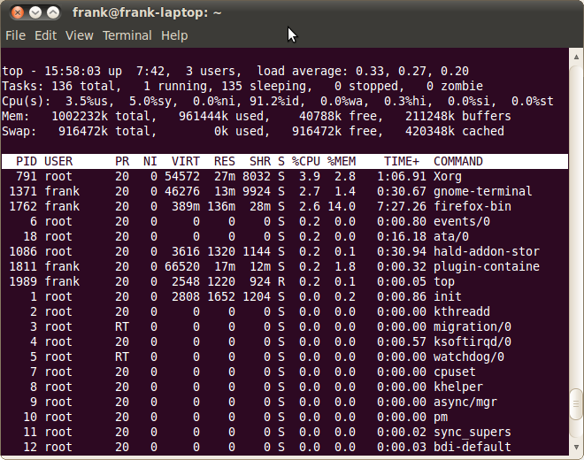
top
Displays most important processes, sorted by cpu percentage (use > or < to change the order)
http://www.thegeekstuff.com/2010/01/15-practical-unix-linux-top-command-examples/

Slide 125
List of basic commands
Managing files and directories:
cp, mv, rm, mkdir, rmdir, touch
Displaying content of files
cat, more, less, head, tail
Moving around
pwd, cd, ls
Asking for help
help, man, info, whatis
+ understanding of Linux directory tree (relative and absolute paths)
+ understanding of file permissions

Slide 126
Hands-on 4

Slide 127
Handout

Slide 128
VSC training 2019/2020
Info sessions:
Containers
Notebooks
Matlab
Linux scripting
Introductory
Intermediate
Advanced
Specialist track
Linux for HPC
Linux
HPC intro
worker/atools
Linux tools
Make intro
Version control with Git
Python as a second language
Python: System programming
Scientific Python
Software engineering
Python for data science
C
C++ for scientific computing
Fortran for programmers
Python for HPC
OpenMP
Debugging techniques
MPI
Code optimization
?
Stay up-to-date https://www.vscentrum.be/training

