Slide 1


Linux scripting Mag Selwa
https://hpcleuven.github.io/Linux-scripting/

Slide 2
Overview
I/O, pipes, redirections
Scripts (bash)
Variables and quotes
Expressions
Loops
Arrays
Some useful commands/features
Hands-on: script out of control -> press Ctrl+C to terminate

Slide 3
Input and Output
Programs and commands can contain an input and output. These are called ‘streams’. UNIX programming is oftentimes stream based.
STDIN – ‘standard input,’ or input from the keyboard
SDTOUT – ‘standard output,’ or output to the screen
STDERR – ‘standard error,’ error output which is sent to the screen.

Slide 4
File Redirection
Often we want to save output (stdout) from a program to a file. This can be done with the ‘redirection’ operator.
myprogram > myfile – using the ‘>’ operator we redirect the output from myprogram to file myfile
Similarly, we can append the output to a file instead of rewriting it with a double ‘>>’
myprogram >> myfile – using the ‘>’ operator we append the output from myprogram to file myfile

Slide 5
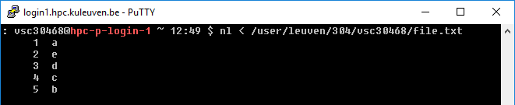
Input Redirection
Input can also be given to a command from a file instead of typing it to the screen, which would be impractical.
mycommand < programinput – using the ‘< ’ operator we redirect the input from the file programinput to mycommand
programinput is printed to stdout, which is redirected to a command mycommand.
Not all commands read standard input (ls, date, who, pwd, cd, ps, …)

Slide 6
Redirecting stderr
Performing a normal redirection will not redirect sdterr. In Bash, this can be accomplished with ‘2>’
command 2> file1
Or, one can merge stderr to stdout (most popular) with ‘2>&1’
command > file 2>&1

Slide 7
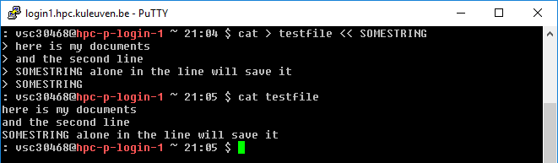
Redirecting: here docs and here strings
‘Here docs’ are files created inline in the shell.
The ‘trick’ is simple. Define a closing word, and the lines between that word and when it appears alone on a line become a file.
Notice that:
the string could be included in the file if it was not ‘alone’ on the line
the string SOMEENDSTRING is more normally END, but that is just convention
Lesser known is the ‘here string’:
$ cat > testfile <<< 'This file has one line'

Slide 8
Pipes
Using a pipe operator ‘|’ commands can be linked together. The pipe will link the standard output from one command to the standard input of another.
Very helpful for searching files
e.g. when we want to list the files, but only the ones that contain test in their name:
ls -la|grep test

Slide 9
Pipes
INPUT
0
Lots of Little Tools
echo “Hello” | \
wc -c
echo
OUTPUT
ERROR
1
2
A Pipe!
INPUT
0
wc
OUTPUT
ERROR
1
2

Slide 10
Difference Between Single, Double, and Backwards Quote
Single quotes (‘) do not interpret any variables
Double quotes (“) interpret variables
Backwards quotes (`) interpret variables and treat them as a program to run and return the results of that program

Slide 11
Quote characters
There are three different quote characters with different behaviour. These are:
“ : double quote, weak quote. If a string is enclosed in “ ” the references to variables (i.e $variable ) are replaced by their values. Also back-quote and escape \ characters are treated specially.
‘ : single quote, strong quote. Everything inside single quotes are taken literally, nothing is treated as special.
` : back quote. A string enclosed as such is treated as a command and the shell attempts to execute it. If the execution is successful the primary output from the command replaces the string.
Example: echo “Today is:” `date`

Slide 12
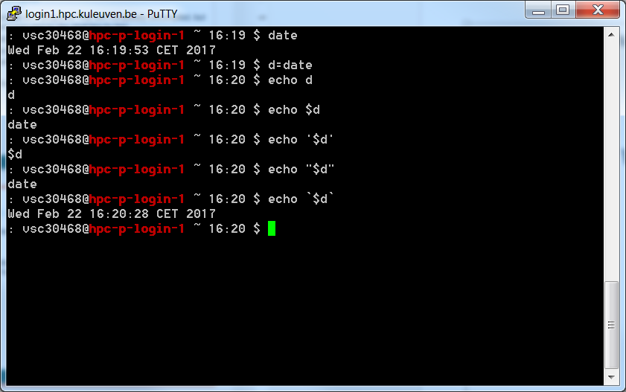
Example Of Quote Difference

Slide 13
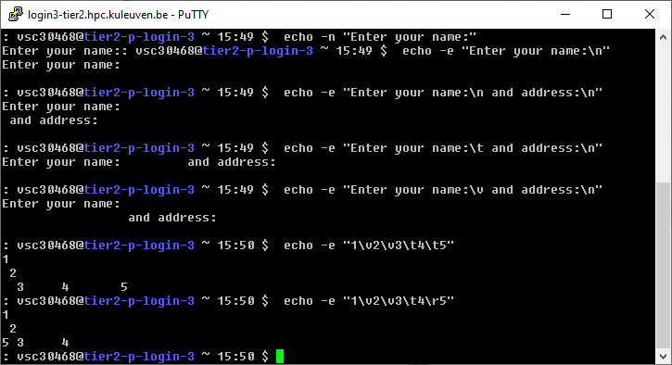
Printing/output
Basic use: echo (remember quotes!)
$ echo –n -> do not output the trailing newline
$ echo -e -> enable interpretation of backslash escapes
\n new line
\r carriage return
\t horizontal tab
\v vertical tab

Slide 14
Printing/output
Alternatively (when formatting needed): printf
printf [-v var] format [arguments]
Writes the formatted arguments to the standard output under the control of the format. The -v option causes the output to be assigned to the variable var rather than being printed to the standard output.
d - Format a value as a signed decimal number.
u - Format a value as an unsigned decimal number.
s - Format a value as a string.
Format specifiers can be preceded by a field width to specify the minimum number of characters to print. A positive width causes the value to be right-justified; a negative width causes the value to be left-justified. A width with a leading zero causes numeric fields to be zero-filled. Usually, you want to use negative widths for strings and positive widths for numbers.
Precision: The precision for a floating- or double-number can be specified by using .<DIGITS>, where <DIGITS> is the number of digits for precision
\n – new line

Slide 15
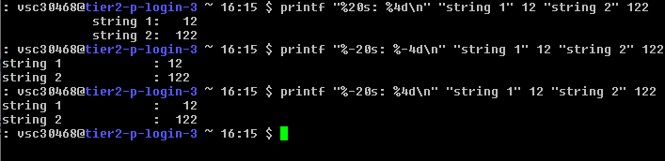
Printing/output
$ printf "%50s\n" "This field is 50 characters wide..." -> will be printed as a string of 50 characters ended with the new line
$ printf "%20s: %4d\n" "string 1" 12 "string 2" 122 -> prints string 1 in 20 character fiels and corresponding number 12 where 4 digits are reserved for it. Next it starts new line and prints string 2 and number 122.
Note that printf reuses the format if it runs out of format specifiers, which in the examples above allows you to print two lines (four values) with only two format specifiers.

Slide 16
Printing/output
The default behaviour of %f specifier is to print floating point numbers with 6 decimal places. To limit a decimal places to 2 we can specify a precision in a following manner:
$ printf "%.2f\n" 255 -> will print: 255.00
Formatting to three places with preceding with 0, separated with tab:
$ printf "%03d\t" 2 3 -> will print: 002 003

Slide 17
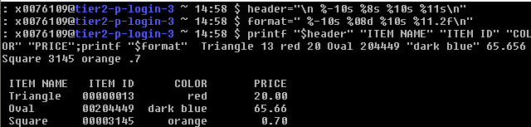
Printing/output
How to create a table with multiple items?
Definition of formats:
header="\n %-10s %8s %10s %11s\n"
format=" %-10s %08d %10s %11.2f\n"
Values to print:
printf "$header" "ITEM NAME" "ITEM ID" "COLOR" "PRICE";printf "$format" Triangle 13 red 20 Oval 204449 "dark blue" 65.656 Square 3145 orange .7

Slide 18
Sequences
seq - to print sequence of numbers
seq [OPTION]... FIRST INCREMENT LAST
-f, --format=FORMAT (use printf style floating-point FORMAT)
-s, --separator=STRING (use STRING to separate numbers, default: \n)
-w, --equal-width
$ seq 1 10 -> prints sequence of numbers between 1 and 10 in new lines
$ seq 1 2 10 -> prints every other number between 1 and 10
$ seq -s "," -w 10 -1 1 -> prints decreasing numbers from 10 to 1, separated with “,” and each number in 2 digits decimal representation
$ seq -s " " -f "%4.2f" 1 10 -> prints sequence of numbers between 1 and 10, separated with space, with 2 digits precision

Slide 19
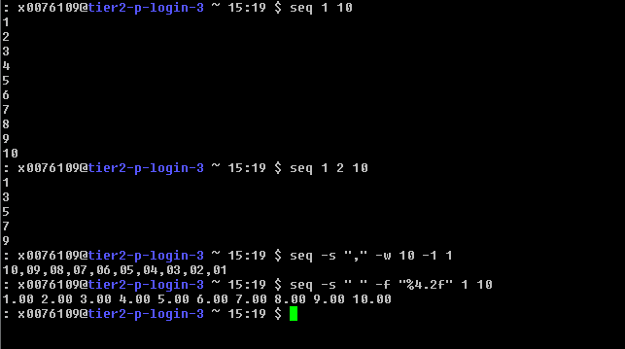
Sequences

Slide 20
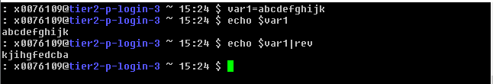
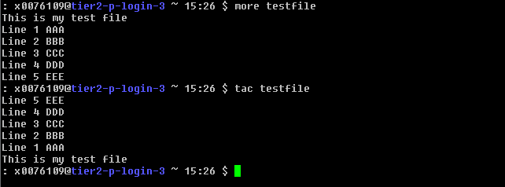
Reverse string
rev - reverse lines of a file or files or a string
tac – print files in reverse

Slide 21
Bash scripts

Slide 22
To Script or not to Script
Pros
File processing
Glue together compelling, customized testing utilities
Create powerful, tailor-made manufacturing tools
Cross-platform support
Custom testing and debugging
Cons
Performance slowdown
Accurate scientific computing

Slide 23
So Many Commands…
Unix has a lot of commands, but there is no way it has everything
What do you do if no command exists that does what you want?
Build it yourself!
The shell itself is actually a programming language
A shell program consists of a sequential list of commands
Think of it as a listing of programs to run in order (interpreted language)

Slide 24
Sequential…
A shell program consists of a sequential list of commands
-> bash script on HPC cluster will run sequentially
Socket 0
Socket 1
#!/bin/bash
My_program 1
My_program 2
My_program 3
…
…
My_program 20
L3
L3
DDR
0
5
10
15
DDR
DDR
1
6
QPI
11
16
DDR
2
L1
L2
QPI
17
core0
7
12
DDR
DDR
3
8
13
18
DDR
4
9
14
19
DDR
IB
I/O

Slide 25
Sequential…
A shell program consists of a sequential list of commands
-> bash script on HPC cluster will run sequentially
Socket 0
Socket 1
#!/bin/bash
My_program 1
My_program 2
My_program 3
…
…
My_program 20
L3
L3
DDR
0
5
10
15
DDR
DDR
1
6
QPI
11
16
DDR
2
L1
L2
QPI
17
core0
7
12
DDR
DDR
3
8
13
18
DDR
4
9
14
19
DDR
IB
I/O
Use worker on the cluster

Slide 26
When Not to Use Bash?
Resource-intensive tasks, especially where speed is a factor (sorting, hashing, etc.)‏
Procedures involving heavy-duty math operations, especially floating point arithmetic arbitrary precision calculations, or complex numbers
Cross-platform portability required
Complex applications, where structured programming is a necessity (need type-checking of variables, function prototypes, etc.)‏
Project consists of subcomponents with interlocking dependencies
Extensive file operations required (Bash is limited to serial file access, and that only in a particularly clumsy and inefficient line-by-line fashion)‏
Need native support for multi-dimensional arrays or data structures, such as linked lists or trees
Need to generate or manipulate graphics or GUIs
Need direct access to system hardware or port or socket I/O

Slide 27
First Thing: Comments
A comment line in a shell script starts with the # symbol
Example:
# This is a comment
Comments are not processed and are only there to help people read your program
Use them to explain your code
A comment may be in the middle of a line, e.g. Name=‘John Smith’ # FirstName LastName

Slide 28
Using the Shell
In a file
We can execute those commands in the order in which they appear in the file:
$ bash newscript
$ source newscript
$ . newscript
Run in a sub-shell (as a child process)
Run in the current process/shell/context. Note: you need a shebang on top of the script

Slide 29
Using the Shell
As a shell script
BUT we can take the last step and start to create self-contained scripts that run on their own.
We will need to do two things:
1. Set Shebang to specify the CLI to use, and
2. Make our file executable chmod u+x myscript.sh
User (u) is granted execution (x) rights
The file extension (.sh) is meaningless (only reminder to us)
Change mode

Slide 30
The “Shebang”
To specify that a file is to become a shell script you specify the interpreter like this at the very start of the file:
#!/bin/bash
(or #!/usr/bin/perl or …)
This is known as the “Shebang” (#!).

Slide 31
Example
Now let's create a very simple shell script. This will simply echo back what you enter on the command line:
#!/bin/bash
echo Hello
Enter this in a file new.sh, then do:
$ chmod 755 new.sh
or
$ chmod u+x new.sh
To run the script do:
$ ./new.sh

Slide 32
chmod: changing permissions
Permissions allow you to share files or directories or to lock them down to be private.
$ chmod (change mode)
$ chmod <permissions> <files> 2 formats for permissions:
octal format (3 digit octal form)
symbolic format

Slide 33
chmod: changing permissions
octal format (abc): a,b,c = r*4+w*2+x*1 (r, w, x: booleans)
0 none ---
1 execute-only --x
2 write -w-
3 execute and write -wx
4 read-only r–
5 read and execute r-x
6 read and write rw-
7 read, write, and execute rwx
$ chmod 644 <file> (rw for u, r for g and o)
660 : 110 110 000
⇒ rw- rw- ---
540 : 101 100 000
⇒ r-x r-- ---

Slide 34
chmod: changing permissions
symbolic format: $ chmod go+r: add read permissions to group and others. $ chmod u-w: remove write permissions from user. $ chmod a-x: (a: all) remove execute permission from all.
$ chmod u+rwx g+r: add all permissions for the user, read permissions to group and none to the others. $ chmod 740

Slide 35
umask
The user file creation mode mask (umask) is used to determine the file permission for newly created files. It can be used to control the default permissions of newly created files.
Default umask is 022
Final permission for the files:
666-022=644 (rw- r--r--)
Final permission for directories:
777-022=755 (drwxr-xr-x)

Slide 36
Shell scripts
Shell scripts are “programs” that are completely uncompiled, but read and executed by the shell line by line.
Typically end in .sh (optional)
Must be chmod’ed executable.
Start with a “shebang” – tells the shell what to use to interpret it. e.g.,
#! /bin/bash for a bash script.
Otherwise it can be called as
$ bash newscript
Easy hello world program: #! /bin/bash echo “Hello World”

Slide 37
Return Values And exit
Every program and shell returns an integer value (exit status) to indicate success or failure (mainly of the last command)
Used to inform other programs how things went
0 = Success
Any other number = Failure (different type)

Slide 38
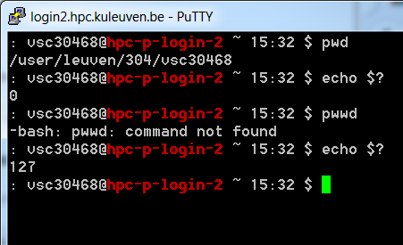
Key concepts
Upon exiting, every command returns an integer to its parent called a return value.
The shell variable $? expands to the return value of previously executed command (e.g. 0 when success).
compare:
$ pwd
$ echo $?
with
$ pwwd (does not exist,
mistyped)
$ echo $?

Slide 39
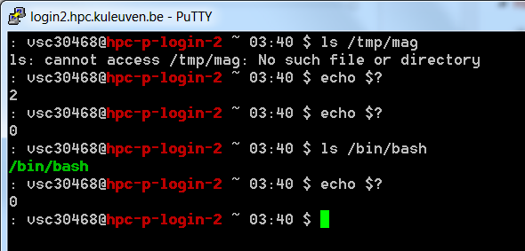
Exit Status
$?
0 is True
$ ls /does/not/exist
$ echo $?
1
$ echo $?
0

Slide 40
Reserved exit codes
Exit Code Number | Meaning | Example | Comments
1 | Catchall for general errors | let "var1 = 1/0" | Miscellaneous errors, such as "divide by zero" and other impermissible operations
2 | Misuse of shell builtins (according to Bash documentation) | empty_function() {} | Missing keyword or command, or permission problem (and diff return code on a failed binary file comparison).
126 | Command invoked cannot execute | /dev/null | Permission problem or command is not an executable
127 | "command not found" | illegal_command | Possible problem with $PATH or a typo
128 | Invalid argument to exit | exit 3.14159 | exit takes only integer args in the range 0 - 255 (see first footnote)
128+n | Fatal error signal "n" | kill -9 $PPID of script | $? returns 137 (128 + 9)
130 | Script terminated by Control-C | Ctl-C | Control-C is fatal error signal 2, (130 = 128 + 2, see above)
255* | Exit status out of range | exit -1 | exit takes only integer args in the range 0 – 255. An exit value greater than 255 returns an exit code modulo 256. For example, exit 3809 gives an exit code of 225 (3809 % 256 = 225).

Slide 41
Variables
In order to hold values, variables are supported
Any combination of letters, numbers, and _
Must start with a letter or _
Case sensitive
D and d are two separate variables
Different from filenames concept!

Slide 42
Setting And Using Variables
Setting variables is done through the = operation
No prior declaration is needed
All variables are just strings of characters
$ d=date
export exports to children of the current process, by default they are not exported
$ export d=date
Reading variables and accessing variables is done with the $
Variable is replaced with its value
$ echo $d
$ echo ${d}

Slide 43
Child process
Each process may create many child processes but will have at most one parent process; if a process does not have a parent this usually indicates that it was created directly by the kernel.
When a child process terminates, some information is returned to the parent process.
When a child process terminates before the parent has called wait, the kernel retains some information about the process, such as its exit status, to enable its parent to call wait later. Because the child is still consuming system resources but not executing it is known as a zombie process.
Structure of the processes can be checked with pstree command that shows running processes as a tree:
$ pstree vsc3XXXX
screen───bash───ssh
screen───bash───sudo───su───bash
sshd───bash───pstree
sshd───bash───ssh
sshd───bash───top
sshd───bash───gedit

Slide 44
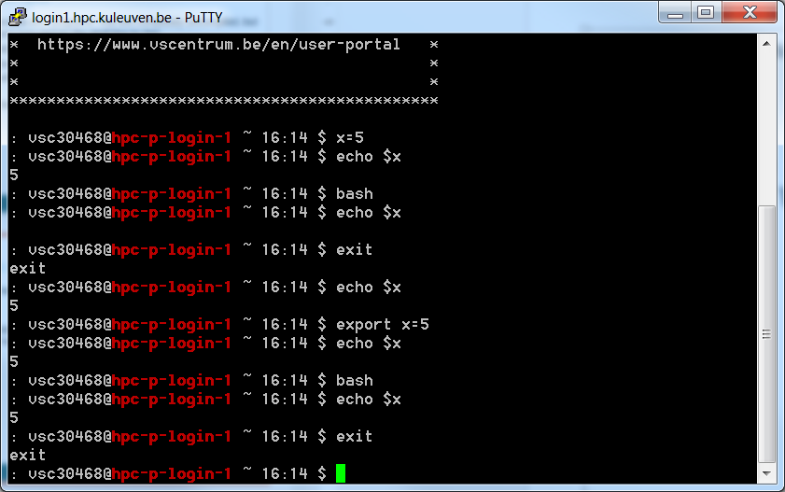
Setting And Using Variables

Slide 45
Defining local variables
As in any other programming language, variables can be defined and used in shell scripts.
Unlike other programming languages, variables in Shell Scripts are not typed.
Examples :
a=1234 # a is NOT an integer, a string instead
b=$a+1 # will not perform arithmetic but be the string ‘1234+1’
b=`expr $a + 1` will perform arithmetic so b is 1235 now.
Note : +,-,/,*,**, % operators are available.
b=abcde # b is string
b=‘abcde’ # same as above but much safer.
b=abc def # will not work unless ‘quoted’
b=‘abc def’ # i.e. this will work.
IMPORTANT: DO NOT LEAVE SPACES AROUND THE =

Slide 46
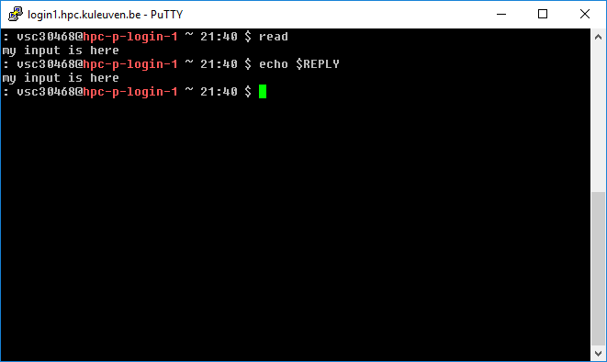
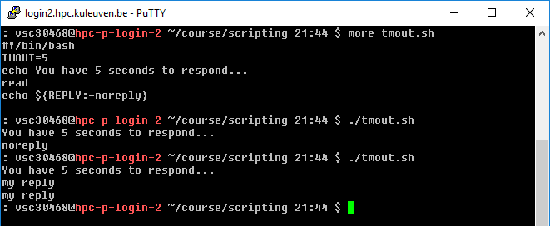
Reading User Input Into Variables
REPLY
No need to give a variable name for read
TMOUT
You can timeout reads, which can be really handy

Slide 47
Reading User Input Into Variables
Usage: read var1 var2 …
Reads values from standard input and assigns them to each variable
If more words are typed in then the excess gets assigned to the last variable
If more variables are assigned than values given, the excess variables are empty
REPLY
No need to give a variable name for read

Slide 48
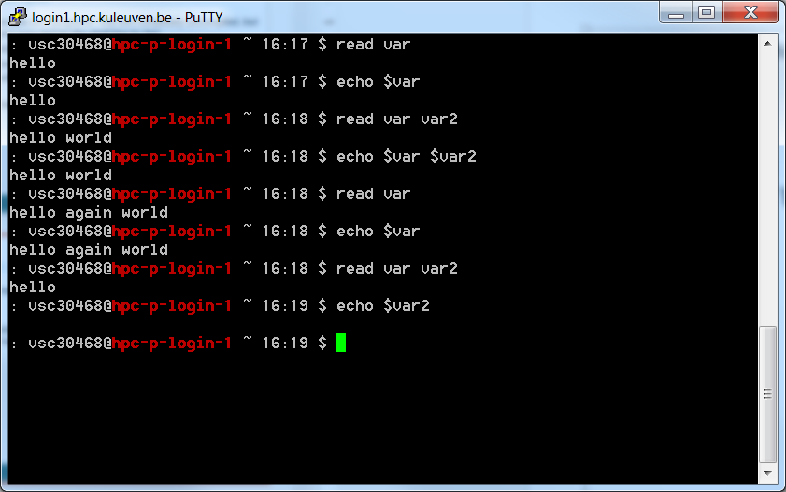
Example Of User Input

Slide 49
Command Line Parameters
Just like all other Unix programs, shell scripts can read parameters of the command line
Different from user input
Value is known before execution, not typed in during execution
Example:
$ testScript.sh testFile

Slide 50
Special Variables For Command Line Parameters
Accessing command line parameters requires special variables
$0
The name of the running program
$1-$9
The first nine arguments to the program
$* or $@
All of the command line arguments
$#
The total number of command line arguments

Slide 51
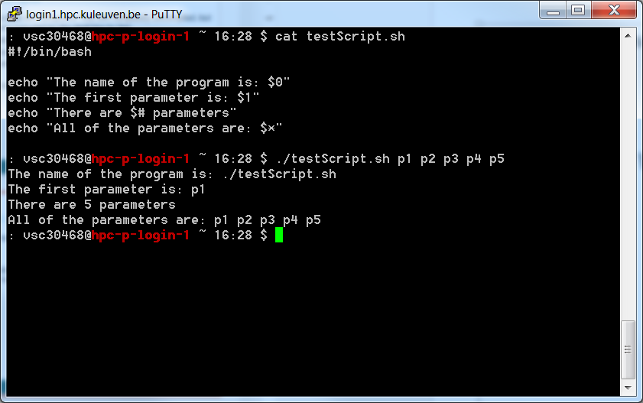
Example Of Command Line Parameters

Slide 52
What If There Are More?
Shell programs aren’t limited to only 9 arguments
Unfortunately, you can only access 9 at a time
Using $var instead of ${var} is shorthand in bash. Bash internally treats variables that start with a digit as a "positional parameter." When bash detects a positional parameter it only looks at the first digit, e.g. $10 returns $1"0". By calling ${10} you are instructing bash to look at the complete variable instead of its built-in default of the first digit.
shift command
Shifts the arguments to the left and brings new values in from the right

Slide 53
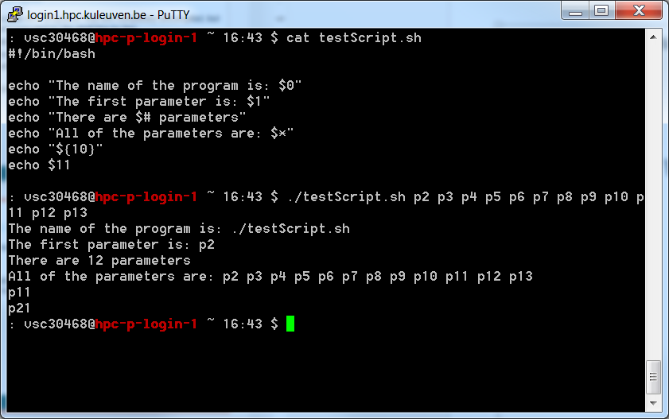
What If There Are More?

Slide 54
Visual Representation Of shift
$1
$2
$3
$4
$5
$6
$7
$8
$9
a
b
c
d
e
f
g
h
i
j
shift
b
c
d
e
f
g
h
i
j
$1
$2
$3
$4
$5
$6
$7
$8
$9

Slide 55
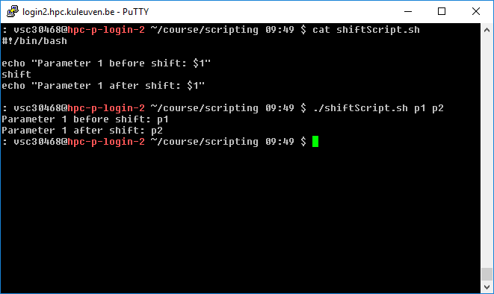
Example Of Shift

Slide 56
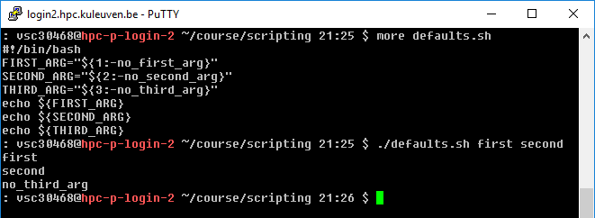
Command Line Parameters - defaults
If you have a variable that’s not set, you can ‘default’ them by
ARGUMENT="${1:-default_argument}"

Slide 57
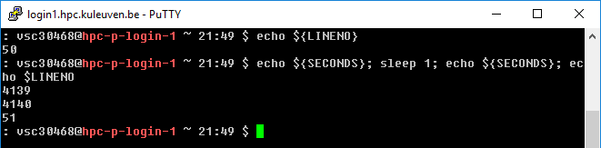
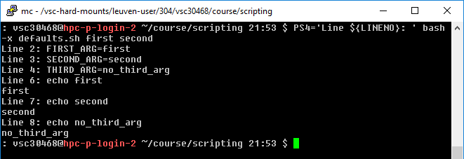
Handy for debugging: LINENO and SECONDS
The variable PS4 denotes the value of the prompt printed before the command line is echoed when the -x option is set and defaults to : followed by space.
PS4 can be changed to emit the LINENO (The line number in the script or shell function currently executing).
$ PS4='Line ${LINENO}: ' bash -x script

Slide 58
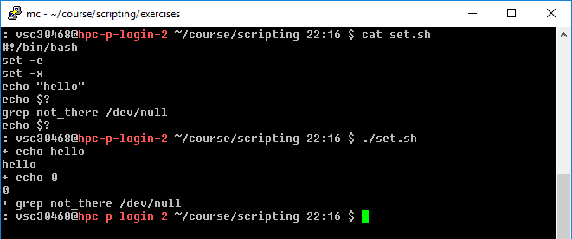
Handy for debugging: set
Bash has configurable options which can be set on the fly.
set -e
exits from a script if any command returned a non-zero exit code
set -x
outputs the commands that get run as they run

Slide 59
Hands-on 1

Slide 60
Write the simplest script that greets you with your name (e.g. “Hello Mag!”) after the execution – echo command and run it
Change your name to be taken from environment variables ($USER) and execute it
Check the exit code
Create a variable today that refers to the command date. Add to the first script a line that says “Today is …..” where the date is taken from the today variable.
Add an extra line to the first script that repeats given parameter in the sentence: “Your input is: “

Slide 61
Arithmetic and expr
Variables that contain numbers can be treated as numbers
You can perform the following operations on them: +, -, \*, /, **, %
Shell programming is not good at numerical computation, it is good at text processing.
However, the expr command allows simple integer calculations, e.g.
$ i=1
$ expr $i + 1
2
To assign the result of an expr command to another shell variable, surround it with backquotes:
$ i=1
$ i=`expr $i + 1`
$ echo "$i"
2

Slide 62
expr
The * character normally means “all the files in the current directory”, so you need a “\” to use it for multiplication:
$ i=2
$ i=`expr $i \* 3`
$ echo $i
6
expr also allows you to group expressions, but the “(“ and “)” characters also need to be preceded by backslashes:
$ i=2
$ echo `expr 5 + \( $i \* 3 \)`
11

Slide 63
Expr Command: Basic Usage
Usage: expr EXPRESSION
+ add
- subtract
\* multiply
/ divide
% remainder after division (modulo operation)
Examples (do not forget spaces!)
expr 1 + 6 -> 7
expr 2 \* 3 -> 6
expr 4 % 3 -> 1

Slide 64
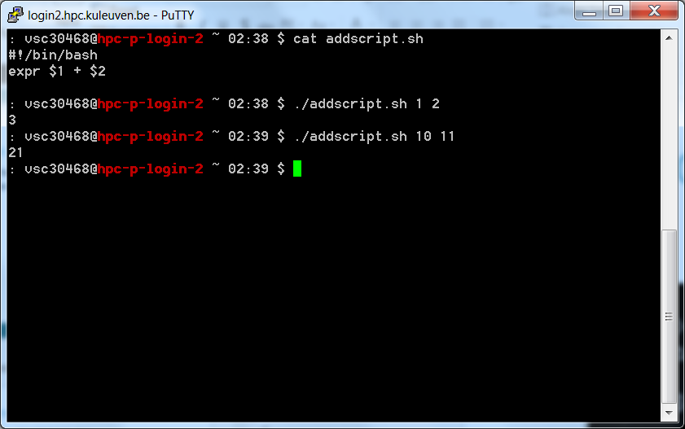
Example Of Expr

Slide 65
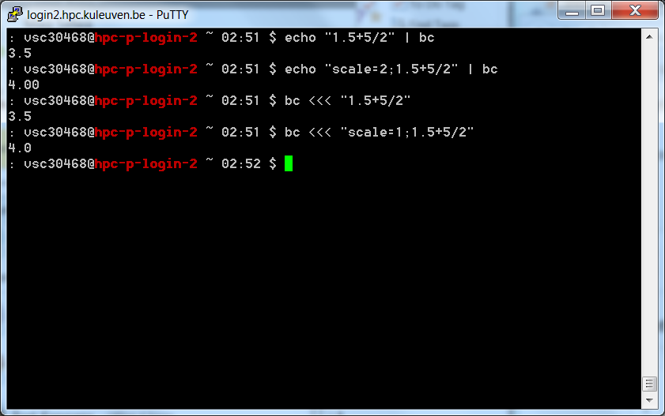
Alternative Of Expr
<<< passes the string on the right to the standard input of the command on the left.

Slide 66
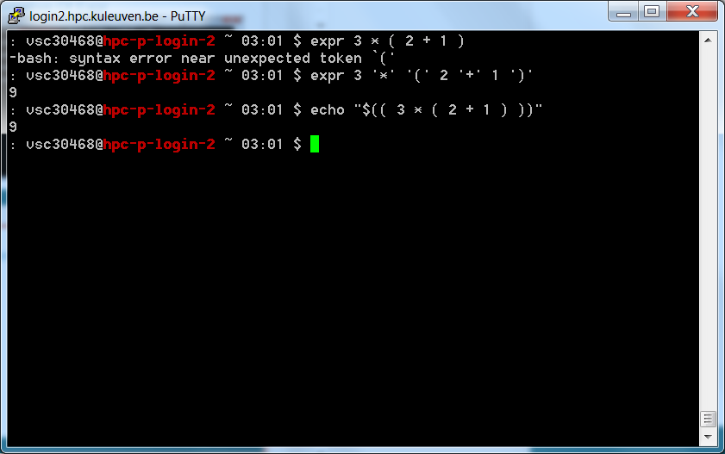
Complex Expr?
Single quotes
Arithmetic Expansion allows the evaluation of an arithmetic expression and the substitution of the result. The format for arithmetic expansion is:
$((expression))
Bash uses the $(( )) syntax to do arithmetic. The expression is treated as if it were within double quotes, but a double quote inside the parentheses is not treated specially. All tokens in the expression undergo parameter expansion, string expansion, command substitution, and quote removal. Arithmetic expansions may be nested.

Slide 67
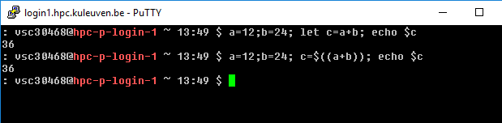
Let
let performs arithmetic on shell variables.
Note that each arithmetic expression has to be passed as a single argument to the let command, so you need quotes if there are spaces or globbing characters.
Let is very similar to (( but is simpler way to do arithmetic operations.
$ a=12;b=24; let c=a+b; echo $c
36

Slide 68
Let
let "a += 5" # Equivalent to let "a = a + 5" (Double quotes and spaces make it more readable.)
let "a /= 4" # Equivalent to let "a = a / 4"
let "a -= 5" # Equivalent to let "a = a - 5"
let "a *= 10" # Equivalent to let "a = a * 10"
let "a %= 8" # Equivalent to let "a = a % 8"

Slide 69
Arithmetic operators
Operator | Description | Example | Result
+ | Addition | echo $(( 7 + 5 )) | 12
- | Subtraction | echo $(( 7 - 5 )) | 2
/ | Division | echo $(( 6 / 3 )) | 2
* | Multiplication | echo $(( 2 * 3 )) | 6
% | Modulo | echo $(( 5 % 3 )) | 2
** | Exponentiation | echo $(( 2 ** 3 )) | 8
$RANDOM is an internal Bash function (not a constant)
that returns a pseudorandom integer in the range 0 - 32767
How to generate an inclusive random number between 1 to 10
r=$(( RANDOM % 10 + 1 )); echo $r

Slide 70
Pre/Post Increment/Decrement
x++ post-increment
x-- post-decrement
++x pre-increment
--x pre-decrement
The post-increment and post-decrement operators increase (or decrease) the value of their operand by 1, but the value of the expression is the operand's original value prior to the increment (or decrement) operation.
The pre-increment and pre-decrement operators increment (or decrement) their operand by 1, and the value of the expression is the resulting incremented (or decremented) value.

Slide 71
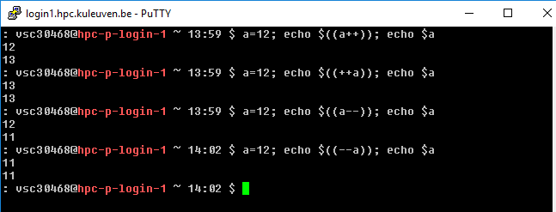
Pre/Post Increment/Decrement
x++ post-increment – makes a copy, increases x, returns the copy (old value)
x-- post-decrement – makes a copy, decreases x, returns the copy (old value)
++x pre-increment – increases x, and returns x (new value)
--x pre-decrement – decreases x, and returns x (new value)

Slide 72
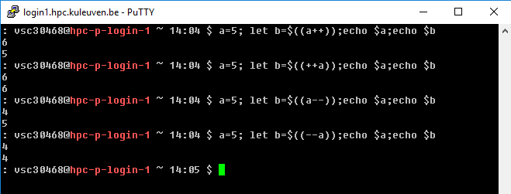
Pre/Post Increment/Decrement
x++ post-increment
x-- post-decrement
++x pre-increment
--x pre-decrement

Slide 73
Other expr Options
|
Logical or
&
Logical and
Many others… check the man page
ARG1 < ARG2 ARG1 is less than ARG2
ARG1 <= ARG2 ARG1 is less than or equal to ARG2
ARG1 = ARG2 ARG1 is equal to ARG2
ARG1 != ARG2 ARG1 is unequal to ARG2
ARG1 >= ARG2 ARG1 is greater than or equal to ARG2
ARG1 > ARG2 ARG1 is greater than ARG2

Slide 74
Control Flow And Conditionals
Shell scripts can be more powerful than just a list of commands
Sometimes you want to perform some commands only if certain conditions are true
Example: Only print out a file if it is not a binary file

Slide 75
The test Command
Used to check if certain conditions are true
Usage: test EXPRESSION
You get 0 (true) or 1 (false) in the exit code (echo $?).

Slide 76
Conditions test Checks
Comparisons
-eq
-ne
-lt
-le
-gt
-ge

Slide 77
More Conditions
System conditions
-d
File is a directory: test –d $VSC_HOME
-e
File exists: test –e ~/.bashrc
-f
File is a normal file (not a directory, device)
-s
File is non-empty
-r
True if ‘file’ is readable
-w
True if ‘file’ is writable
-x
True if ‘file’ is executable

Slide 78
More test Conditions
!
Not
Negates the next check
Example: test ! –x File
-a
And two conditions
Example: test $1 –eq $2 –a $2 –gt 5
-o
Or two conditions
Example: test $1 –eq $2 –o $2 –gt 5

Slide 79
Relational operators
Meaning | Numeric | String
Greater than | -gt
Greater than or equal | -ge
Less than | -lt
Less than or equal | -le
Equal | -eq | = or ==
Not equal | -ne | !=
str1 is less than str2 |  | str1 < str2
str1 is greater str2 |  | str1 > str2
String length is greater than zero |  | -n str
String length is zero |  | -z str

Slide 80
Shortcut For Test
Because this is used very often, a shortcut exists
[]
Example: [ -f File ]
test -f File

Slide 81
When Do You Use This?
test is used to control the operation of your script
The answer from test should guide the execution of your code one way or another
Used in conditional statements

Slide 82
Logic: test
$ test 1 -lt 10
$ echo $?
0
$ test 1 == 10
$ echo $?
1

Slide 83
Logic: test
Notice the mandatory space between brackets and the arguments
test
[ ]
[ 1 –lt 10 ]
[[ ]]
[[ “this string” =~ “this” ]]
(( ))
(( 1 < 10 ))
The =~ Regular Expression matching operator within a double brackets test expression.

Slide 84
Logic: test
Number (arithmetic comparisons):
-eq
-ge
-le
-ne
-gt
-lt
Use with [ ]
[ $var1 –lt $var2 ] -> true if var1 less than var2 , else false

Slide 85
Logic: test
Comparisons operators
>
>=
<
<=
Use with (( ))
(( $var1 < $var2 )) -> true if var1 less than var2 , else false

Slide 86
Logic: test
[ -f /etc/passwd ]
[ ! –f /etc/passwd ]
[ -f /etc/passwd –a –f /etc/shadow ]
[ -f /etc/passwd –o –f /etc/shadow ]

Slide 87
Key concepts
Multiple commands can be separated with a ;
e.g. cd $VSC_HOME;pwd
&& and || conditionally separate multiple commands. When commands are conditionally joined, the first will always execute. The second command may execute or not, depending on the return value of the first command. For example, a user may want to create a directory, and then move a new file into that directory. If the creation of the directory fails, then there is no reason to move the file. The two commands can be coupled as follows:
echo „one two three four five” > numbers.txt;
mkdir /tmp/my-dir && mv numbers.txt /tmp/my-dir

Slide 88
Key concepts
Similarly, multiple commands can be combined with ||. In this case, bash will execute the second command only if the first command "fails" (has a non zero return value). This is similar to the "or" operator found in programming languages. In the following example, we attempt to change the permissions on a file. If the command fails, a message to that effect is echoed to the screen.
chmod 600 /tmp/my-dir/numbers.txt || echo ”chmod failed”
chmod 600 /tmp/my-dir/Numbers.txt || echo “chmod failed”
In the first case, the chmod command succeeded, and no message was echoed. In the second case, the chmod command failed (because the file didn't exist), and the "chmod failed" message was echoed (in addition to chmod's standard error message).

Slide 89
Key concepts: escape character
", $, `, and \ are still interpreted by the shell, even when they're in double quotes.
The backslash (\) character is used to mark these special characters so that they are not interpreted by the shell, but passed on to the command being run (for example, echo)
E.g. to output the string: (Assuming that the value of $X is 5):
A quote is ", backslash is \, backtick is `.
A few spaces are and dollar is $. $X is 5.
we would have to write:
$ echo "A quote is \", backslash is \\, backtick is \`."
A quote is ", backslash is \, backtick is `.
$ echo "A few spaces are ; dollar is \$. \$X is ${X}."
A few spaces are ; dollar is $. $X is 5.

Slide 90
Key concepts: escape character
$ is used for interpreting a variable which has some value assigned
When you create a file that contains space in it, e.g. touch ”my file” it is difficult to use it later
How to copy the file (cp source destination)
-> use escape character so that space is understood as a part of the file and not as a separator in comand syntax
cp my\ file myfile
Better avoid using „special” characters (", $, `, \, … ) in your filenames!

Slide 91
Key concepts: history
! is used in history event designators: you can execute a previous command using ![N] where N is the line number in history you want to recall (or 2 commands before !-2)
echo “Hi $USER!” works from the script, but gives an error “-bash: !": event not found” from interactive bash shell (because of history)
There are 2 ways to deal with that:
echo “Hi $USER”’!’
$ set +H - switch off –H option in bash (-H is used to enable ! style history substitution. This option is on by default when the shell is interactive). To set it back use $ set -H

Slide 92
Hands-on 2

Slide 93
Write the script that reads integer input and displays the result Initial value is: value. Next it adds 2 to the read value and displays the result Value after adding is value. After that it multiplies the result by 3 and displays the new result Value after multiplying is value. Finally, it calculates modulo 2 and displays the result as Value after performing modulo is value. Run the script.
Try to run the script for input parameter that is not integer, but real, e.g. 1.5. What happens?
Correct the script so that it does the same for real parameters. Use the -n option for echo to skip printing newline at the end.
Write the script that reads 2 integer parameters and checks if the first value is greater or equal than the second value. Display the exit code. Test the script with different values.
Modify the script such that it tests if the first value is greater than the second one. If test is succeeded it should display “True”, if test fails it should display “False”.

Slide 94
Shell logic structures
The four basic logic structures needed for program development are:
Sequential logic: to execute commands in the order in which they appear in the program
Decision logic: to execute commands only if a certain condition is satisfied
Looping logic: to repeat a series of commands for a given number of times
Case logic: to replace “if then/else if/else” statements when making numerous comparisons

Slide 95
Loops
Loop is a block of code that is repeated a number of times.
The repeating is performed either a pre-determined number of times determined by a list of items in the loop count ( for loops ) or until a particular condition is satisfied ( while and until loops)
To provide flexibility to the loop constructs there are also two statements namely break and continue are provided.

Slide 96
if then fi
Mandatory space needed around the brackets [ … ]
if [ CONDITION ] ; then
STATEMENTS
fi
Mandatory semi-colon after the closing bracket

Slide 97
Flowchart of if
if
Is Condition True?
No
Yes
Statements
fi

Slide 98
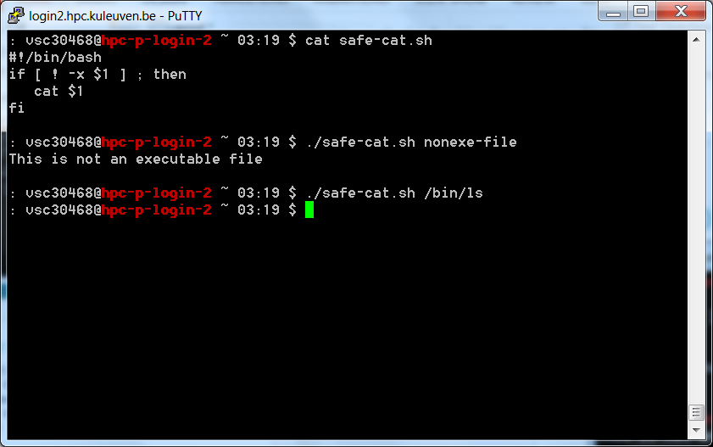
Example of if
This is the content of the nonexe-file

Slide 99
If then else fi
if [ CONDITION ] ; then
STATEMENTS-YES
else
STATEMENTS-NO
fi

Slide 100
Flowchart of if else
if
Is Condition True?
Yes
No
Statements-Yes
Statements-No
fi

Slide 101
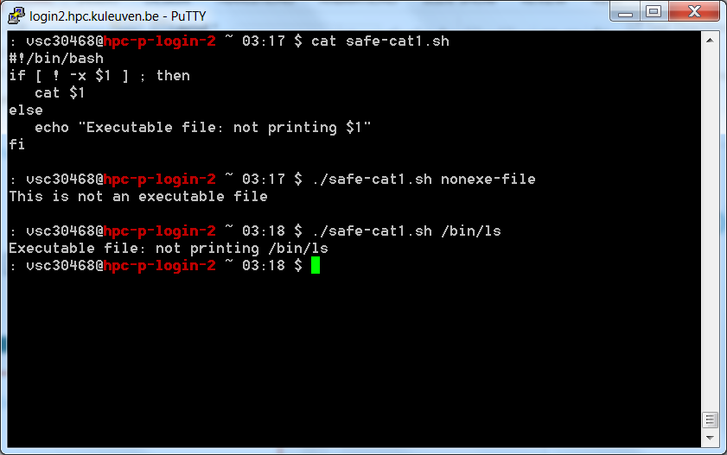
Example of if else

Slide 102
if then elif else fi
if [ CONDITION1 ] ; then
STATEMENTS-1
elif [ CONDITION2 ] ; then
STATEMENTS-2
else
STATEMENTS-3
fi

Slide 103
Flowchart of if elif else
if
Is Condition1 True?
No
Is Condition2 True?
No
Yes
Yes
Statements-1
Statements-2
Statements-3
fi

Slide 104
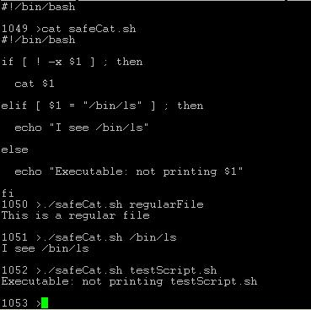
Example Of if elif else

Slide 105
case; esac
Note: right-sided parenthesis
case STRING in
pattern1)
STATEMENTS-1 ;;
pattern2)
STATEMENTS-2 ;;
…
patternN)
STATEMENTS-N ;;
esac
Note: Two semi-colons ;; at the end of each statement group

Slide 106
Flowchart of case
case
pattern 1
pattern N
pattern 2
…
Statements-1
Statements-2
Statements-N
esac

Slide 107
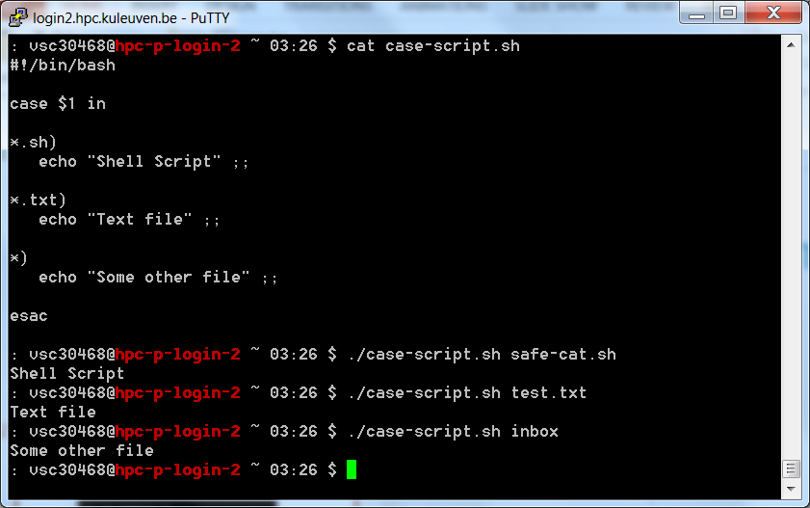
Example of case

Slide 108
Universal customization
Universal .bashrc - written to run on all (relevant) clusters:
case ${VSC_INSTITUTE_CLUSTER} in
wice)
export PS1=': \u@\[\e[1;31m\]\h\[\e[0m\] \w `date +%H:%M` $‘ ;;
genius) echo “Genius has Skylake and CascadeLake partitions”
export EDITOR="/usr/bin/vim"
export PS1=': \u@\[\e[1;34m\]\h\[\e[0m\] \w `date +%H:%M` $ '
;;
esac

Slide 109
select
Use 1: Creating a simple menu
select command will retrieve each data from the list and print the data as a menu.
After executing the script it will create a menu and ask the user to choose anything. It will print the name of the selected case.
The user has to press Ctrl+c to terminate from the script unless break statement is used.

Slide 110
select
select ITEM in [LIST]
do
[COMMANDS]
done
The [LIST] can be a series of strings separated by spaces, a range of numbers, output of a command, an array, and so on.
When the select construct is invoked, each item from the list is printed on the screen (standard error), preceded with a number.

Slide 111
select
select ITEM in [LIST]
do
[COMMANDS]
done
If the user enters a number that corresponds to the number of one of the displayed items, then the value of [ITEM] is set to that item. The value of the selected item is stored in the variable REPLY.

Slide 112
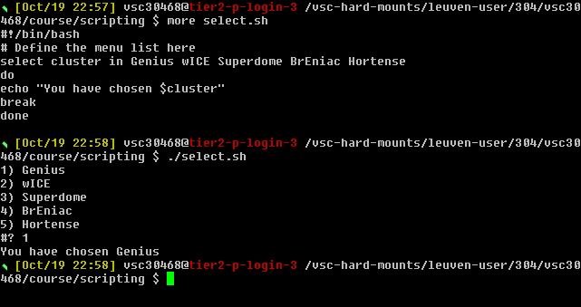
select
The user has to press Ctrl+c to terminate from the script or break has to be used.

Slide 113
select
Use 2: Select command with a case statement
After running the script, the user will select any menu item and case statement will match the selected value with case value.
Here multiple case values can be used for matching with the selected menu item. If none of the case value matches with the selected menu item then “Invalid entry” will print.

Slide 114
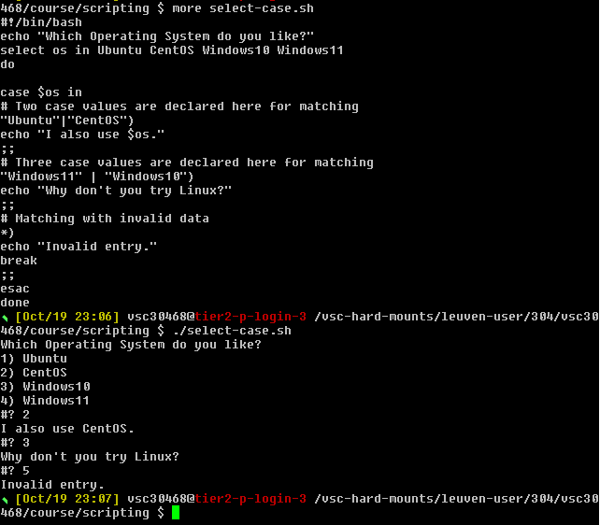
select

Slide 115
Hands-on 3

Slide 116
Write the script that performs summation of two integers. Before adding the numbers introduce the if statement that checks if 2 parameters were given. Test it with 2 and more parameters given.
Write the script that finds the biggest number of 3 given integer numbers Use if - elif block multiple times.
Add the check in the beginning of the script that detects faulty execution and instructs how to use the script, e.g. “Use biggest.sh: number1 number2 number3”. Test it with 2 and 3 parameters.
Add extra checks to the script that detects if all the values are the same and displays "All the three numbers are equal" and the information printed if the values are not integer values that can be compared "I can not figure out which number is bigger"
Write the script that performs 4 operations (summation, subtraction, multiplication and division) of two given integer numbers and the operator. Use case statement.

Slide 117
Looping
Sometimes you want to do something many times
Loop for a set number of times
Loop while a condition is true
Loop until a condition is false

Slide 118
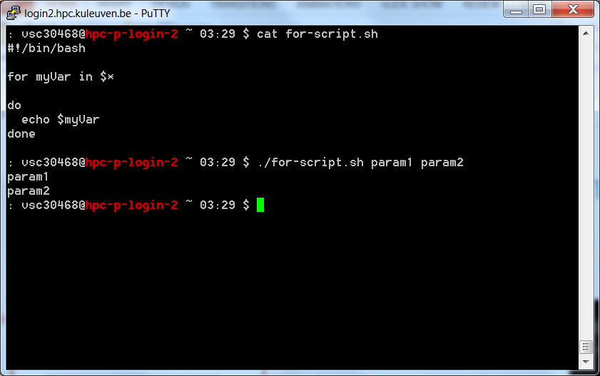
for loop
Syntax
for VAR in LIST
do
STATEMENTS
done

Slide 119
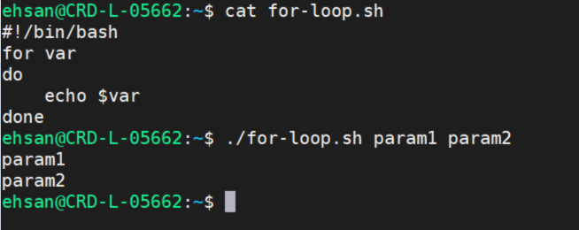
Special form of for loop
Syntax
Without a list, it will go through all of the command line arguments
for var
do
STATEMENTS
done

Slide 120
Flowchart of for loop
for
List empty?
No
var = next
Yes
Statements
done

Slide 121
Example of for loop

Slide 122
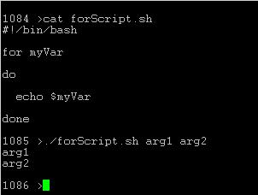
Example Of Special For Loop

Slide 123
Logic: C-style for
Note the two parenthesis
for (( expr1;
expr2;
expr3 ))
do
STATEMENTS
done
Lower bound
Upper bound
Incrementing rule

Slide 124
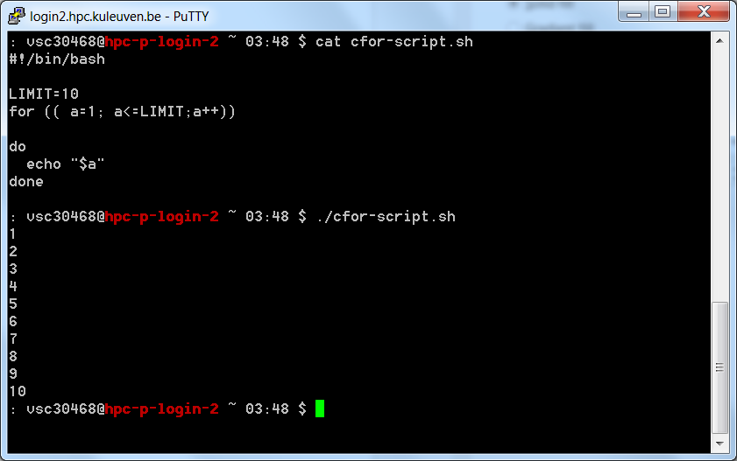
Logic: C-style for
LIMIT=10
for (( a=1 ;
a<=LIMIT ;
a++ ))
do
echo –n “$a ”
done

Slide 125
While loop
while CONDITION
do
STATEMENTS
done

Slide 126
Flowchart of while loop
while
Is Condition True?
No
Yes
Statements
done

Slide 127
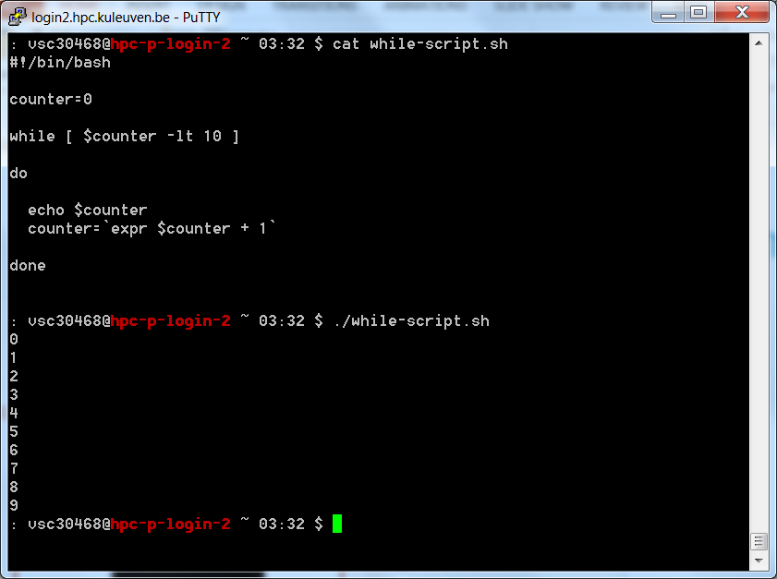
Example of while loop

Slide 128
while loop – reading files
read from STDIN
While loop continues until end-of-file EOF is reached
while read line do
echo $line
done < file
Redirection of STDIN
Input filename to read from

Slide 129
break and continue
Interrupt for, while or until loop
The break statement
transfer control to the statement AFTER the done statement
terminate execution of the loop
The continue statement
transfer control to the done statement
skip the test statements for the current iteration
continues execution of the loop

Slide 130
The break command
while [ condition ]
do
cmd-1
break
cmd-n
done
echo "done"
This iteration is over and there are no more iterations

Slide 131
The continue command
while [ condition ]
do
cmd-1
continue
cmd-n
done
echo "done"
This iteration is over; do the next iteration

Slide 132
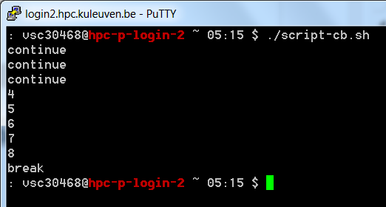
Example:
for index in 1 2 3 4 5 6 7 8 9 10
do
if [ $index –le 3 ]; then
echo "continue"
continue
fi
echo $index
if [ $index –ge 8 ]; then
echo "break"
break
fi
done

Slide 133
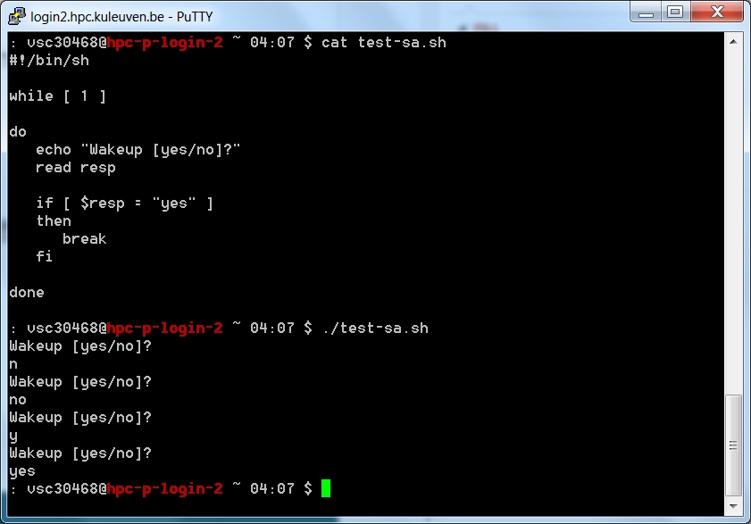
break
The break command works like in C++, breaking out of the innermost loop :
$ cat test12
#!/bin/sh
while [ 1 ]
do
echo "Wakeup [yes/no]?"
read resp
if [ $resp = "yes" ]
then
break
fi
done
$ test12
Wakeup [yes/no]?
no
Wakeup [yes/no]?
y
Wakeup [yes/no]?
yes
$

Slide 134
continue
#!/bin/bash
for i in 1 2 3 4 5 6 do
### just skip printing $i; if it is 3 or 6
if [ $i -eq 3 -o $i -eq 6 ]
then
continue
### resumes iteration of an enclosing for loop
fi
echo "$i"
done

Slide 135
Until loop
until CONDITION
do
STATEMENTS
done

Slide 136
Flowchart of until loop
until
Is Condition True?
Yes
No
Statements
done

Slide 137
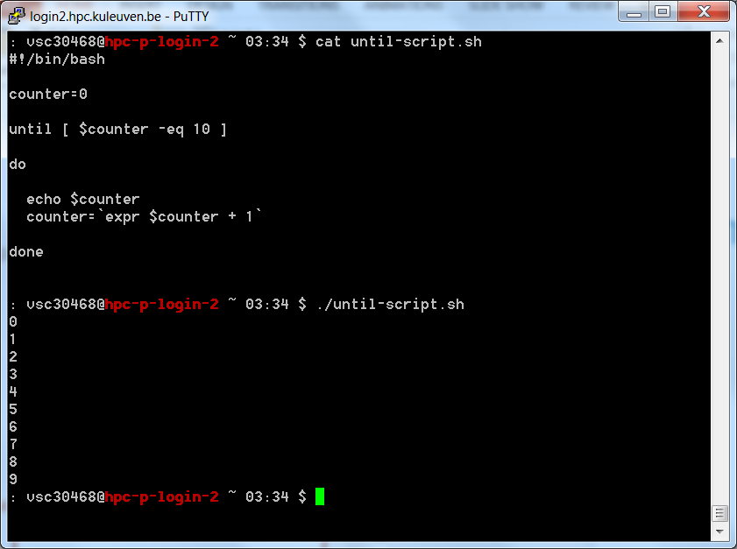
Example of until loop

Slide 138
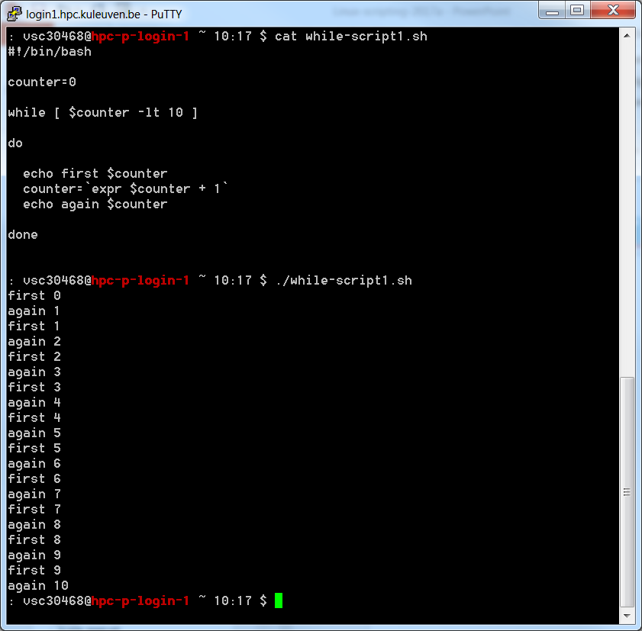
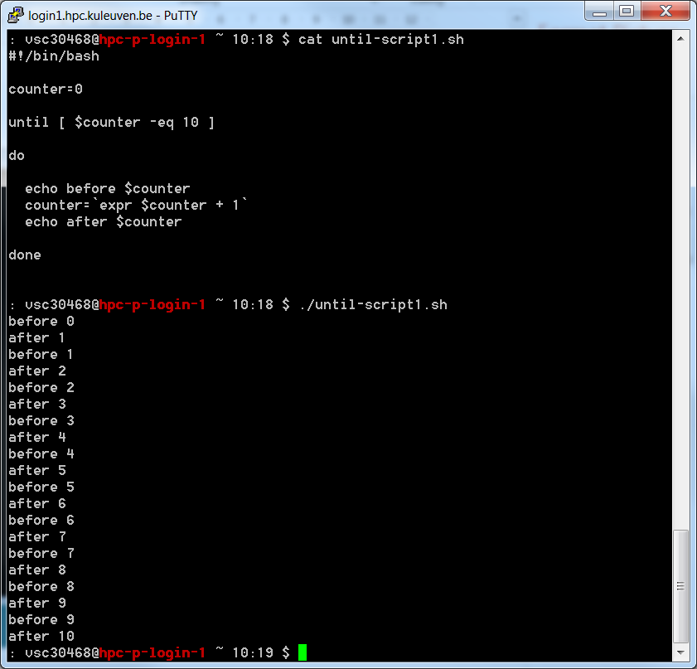
While vs. Until

Slide 139
Bash shell programming
Input
prompting user
command line arguments
Decision:
if-then-else
case
Repetition
do-while, repeat-until
for
select
Functions

Slide 140
Bash Arrays
An array is a variable containing multiple values. Any variable may be used as an array.
There is no maximum limit to the size of an array, nor any requirement that member variables be indexed or assigned contiguously.
Arrays are zero-based: the first element is indexed with the number 0.
Indirect declaration is done using the following syntax to declare a variable:
ARRAY[INDEXNR]=value

Slide 141
Bash Arrays
Bash arrays have numbered indexes only, but they are sparse, so you don't have to define all the indexes.
An entire array can be assigned by enclosing the array items in parenthesis:
arr=(Hello World)
Individual items can be assigned with the familiar array syntax (unless you're used to Basic or Fortran):
arr[0]=Hello arr[1]=World
But it gets a bit ugly when you want to refer to an array item:
echo ${arr[0]} ${arr[1]}

Slide 142
Bash Arrays
In addition, the following funky constructions are available:
${arr[*]} # All of the items in the array
${!arr[*]} # All of the indexes in the array
${#arr[*]} # Number of items in the array
${#arr[0]} # Length of item zero
Note that the "@" sign can be used instead of the "*" in constructs such as ${arr[*]}. The result is the same except when expanding to the items of the array within a quoted string:
${arr[*]} returns all the items as a single word, whereas ${arr[@]} returns each item as a separate word.

Slide 143
Bash Arrays
Output:
Array size: 5
Array items:
one
two
three
four
five
Array indexes:
0
1
2
3
5
Array items and indexes:
0: one
1: two
2: three
3: four
5: five
#!/bin/bash
array=(one two three four [5]=five)
echo "Array size: ${#array[*]}"
echo "Array items:"
for item in ${array[*]}
do
printf " %s\n" $item
done
echo "Array indexes:"
for index in ${!array[*]}
do
printf " %d\n" $index
done
echo "Array items and indexes:"
for index in ${!array[*]}
do
printf "%4d: %s\n" $index ${array[$index]}
done

Slide 144
Bash Arrays
#!/bin/bash
array=("first item" "second item" "third" "item")
echo "Number of items in original array: ${#array[*]}"
for ix in ${!array[*]}
do
printf " %s\n" "${array[$ix]}"
done
arr=(${array[*]})
echo "After unquoted expansion: ${#arr[*]}"
for ix in ${!arr[*]}
do
printf " %s\n" "${arr[$ix]}"
done
arr=("${array[*]}")
echo "After * quoted expansion: ${#arr[*]}"
for ix in ${!arr[*]}
do
printf " %s\n" "${arr[$ix]}"
done
arr=("${array[@]}")
echo "After @ quoted expansion: ${#arr[*]}"
for ix in ${!arr[*]}
do
printf " %s\n" "${arr[$ix]}"
done
Output:
Number of items in original array: 4
first item
second item
third
item
After unquoted expansion: 6
first
item
second
item
third
item
After * quoted expansion: 1
first item second item third item
After @ quoted expansion: 4
first item
second item
third
item

Slide 145
Hands-on 4

Slide 146
Write a script calculating average of given integer numbers on command line arguments. Use for loop. You can add if statement that checks if at least 2 parameters are given.
Write a script to reverse a given integer number (numbers in reverse order). Use while block.
Write a script that calculates factorial of a given number. Use until block.
Write a script that sorts the given five numbers in ascending order (using bubble sort algorithm*). Use for loop and array.
* see https://en.wikipedia.org/wiki/Bubble_sort
or
http://www.geeksforgeeks.org/bubble-sort/

Slide 147
Shell Functions
A shell function is similar to a shell script
stores a series of commands for execution later
shell stores functions in memory
shell executes a shell function in the same shell that called it
Where to define
In .profile (.bash_profile)
In your script
Or on the command line
Remove a function
Use unset built-in

Slide 148
Shell Functions
must be defined before they can be referenced
usually placed at the beginning of the script
Syntax:
function-name () {
statements
}

Slide 149
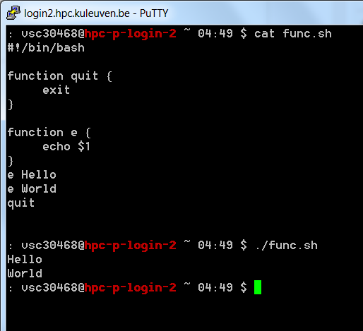
Example: function
#!/bin/bash
function quit {
exit
}
function e {
echo $1
}
e Hello
e World
quit

Slide 150
An aside: $(( )) for Math
$ echo $(( 1 + 2 ))
3
$ echo $(( 2 * 3 ))
6
$ echo $(( 1 / 3 ))
0

Slide 151
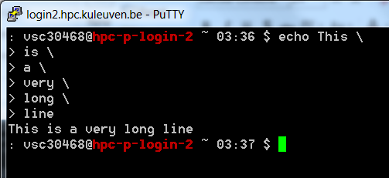
Continuing Lines: \
$ echo This \
Is \
A \
Very \
Long \
Command Line
This Is A Very Long Command Line
$

Slide 152
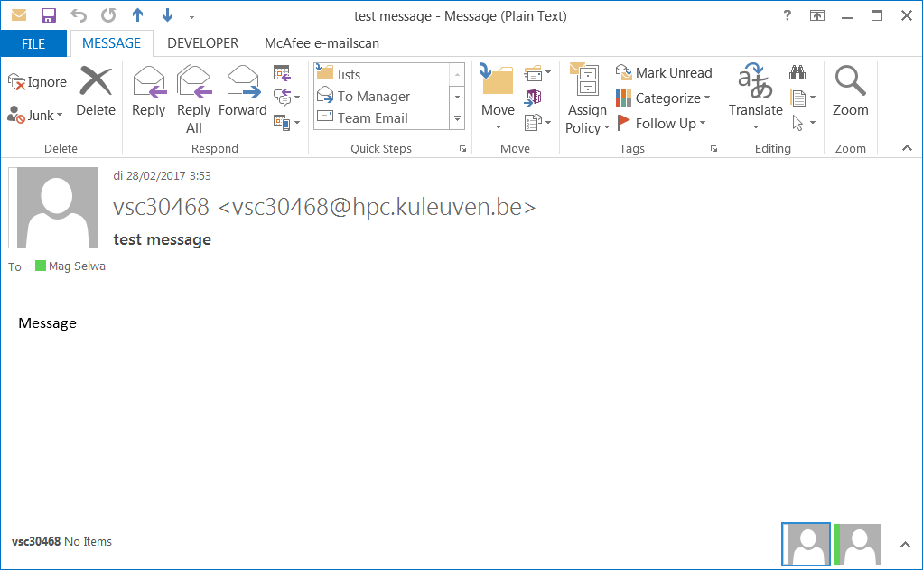
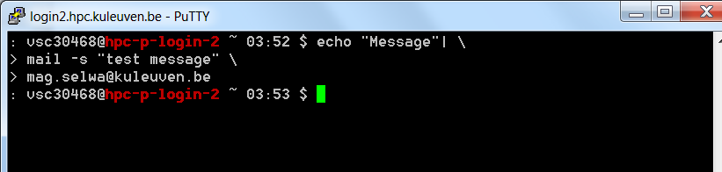
Email Notification
% echo “Message” | \
mail –s “Here’s your message” \
my.name@kuleuven.be

Slide 153
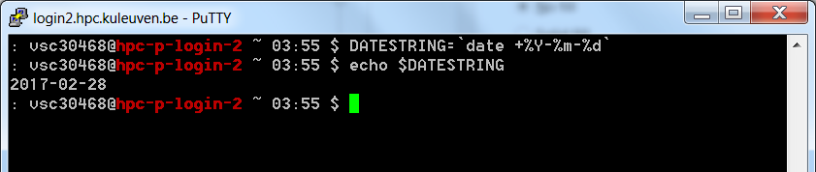
Dates
$ DATESTRING=`date +%Y%m%d`
$ echo $DATESTRING
20170227
$ man date

Slide 154
pushd/popd
$ cd /tmp
$ pushd /var/log
/var/log /tmp
$ cd ..
$ pwd
/var
$ popd
/tmp

Slide 155
Hands-on 5

Slide 156
Write a more complicated greeting shell script that based on time (taken from date) adjusts the greeting to “Good morning/afternoon/evening”, etc. in if statement.
Modify the script so that each if statement is a separate function.
Submit the job to the cluster (or just execute it from the login node). The job should:
Copy the file /apps/leuven/training/HPC_intro/helloworldmpi.c into your home directory
Load the intel module
Compile the code: mpicc helloworldmpi.c -o hello.exe
Set the value of variable check to 2
Increase it by 16
Initialize value of test to 0
Set the random number between 1 and 20 as variable rand
Check in the until loop how many iterations are needed until rand is equal to check
Print that information
Check if ~/exercise.txt exists. If so – run the mpi job saving the output to exercise.txt (mpirun -np $check ./hello.exe > exercise.txt). If not – first create the file and then run mpi code.
Read the exercise.txt file line by line, assign each line intro array arr and print the 5th item of arr.

Slide 157
VSC
Questions
Helpdesk: hpcinfo@kuleuven.be or https://admin.kuleuven.be/icts/HPCinfo_form/HPC-info-formulier
VSC web site: http://www.vscentrum.be/
VSC documentation: https://docs.vscentrum.be
VSC agenda: training sessions, events
Systems status page: http://status.vscentrum.be

②
→
①
✶


Slide 158


Slide 159
VSC training
Infosessions:
Containers
Notebooks
Jupyterhub
Introductory
Intermediate
Advanced
Specialized track
Matlab (Supercalculator)
Matlab Programming
Linux for HPC
Linux scripting
Make intro
Linux tools
Linux
HPC intro
CMake intro
Version control with Git
Python as a second language
Python: System programming
Scientific Python
Python for Software engineering
Python for data science
Python for machine learning
worker/atools
C
C++ for scientific computing
Fortran for programmers
High Performance Python
Debugging techniques
OpenMP
MPI
Code optimization
?
PRACE MOOC Defensive programming and debugging and Fortran for Programmers (announced by e-mail)
Stay up-to-date https://www.vscentrum.be/en/education-and-trainings

