Slide 1

Slurm Lunchbox
https://github.com/hpcleuven/Slurm-lunchbox

Slide 2


Agenda
About Slurm and wICE
Basic Slurm Commands
Accounting in Slurm
From Torque to Slurm
Basic Job Examples
Advanced Job Examples
Using Worker Framework

Slide 3

Why (not) Slurm?
Uniform user experience across all VSC sites
Recently developing faster than Torque
Free and open-source (GNU General Public License v2)
Excellent documentation
Possibility for commercial support
Allowing extra features (for experienced users)
https://www.schedmd.com/

Slide 4
Slurm
Slurm Workload Manager, formerly known as Simple Linux Utility for Resource Management (since 2002 at LANL).
Genius and wICE use Slurm (for resource management, job scheduling and accounting)
More than 50% of Top500 systems use Slurm (see link)
Modular design:
database integration for accounting
~100 optional plugins used for sophisticated configurations
management of resource limits
and workload prioritization

Slide 5

wICE: Node Counts
GPU Island
4 nodes
Thin node Island
172 nodes
Large memory Island
5 nodes
Interactive Island
No specific
login nodes
5 nodes

Slide 6
Job & Accounting Info
Job submission currently happens from Genius login nodes
Main commands
Job submission: sbatch and srun or salloc + ssh Job information: squeue, scontrol Cluster status: sinfo MAM-like tools: to be used from Genius or wICE (interactive nodes) sam-balance sam-list-allocations sam-list-usagerecords sam-statement
Job options Slurm job options are different from Torque (see next slides) #SBATCH jobscript directives instead of #PBS Suggested jobscript name extension: *.slurm

Slide 7

Job Overview
Use squeue command
Lists only recent (running R and pending PD) jobs
From Genius login node or wICE interactive node
Target wice or genius clusters explicitly with --cluster

Slide 8
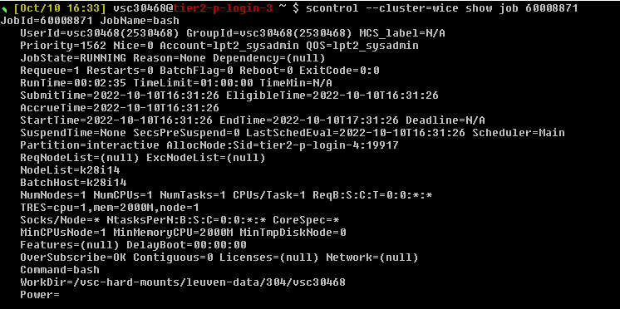
Job Info
scontrol: native Slurm command

Slide 9
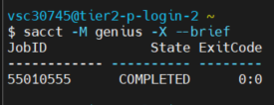

Job Info
sacct: get job information
Provides --brief or --long job information
Use –X flag to see only the actual job allocation

Slide 10
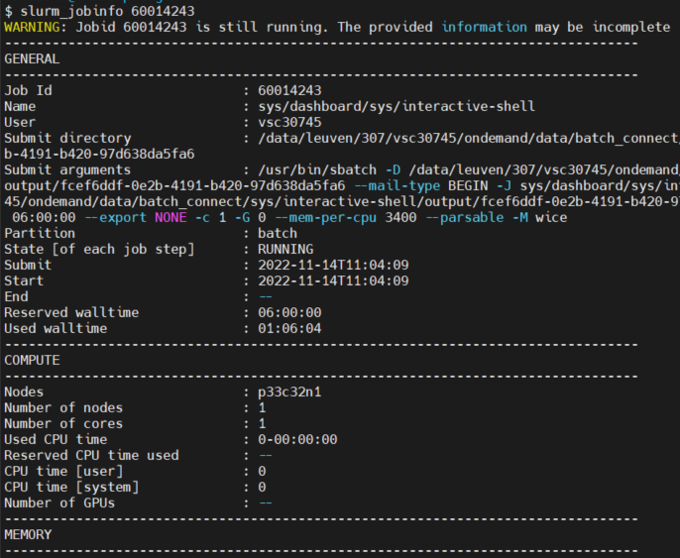
Job Info
slurm_jobinfo <jobID>
Home-brewed tool
User-friendly output
Job and resource information
For more info: --help

Slide 11
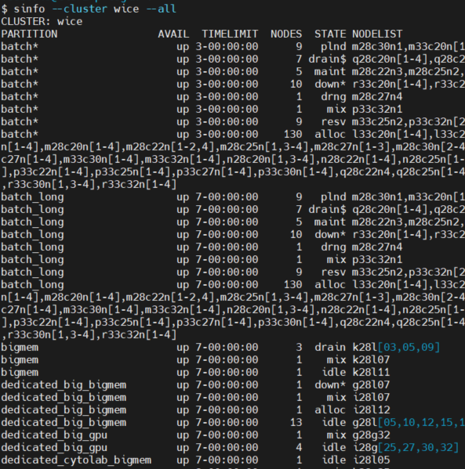
Cluster Info
sinfo --cluster wice|genius
Native Slurm tool
All partitions, states and nodes are listed

Slide 12


Accounting
SAM-commands: Slurm Account Manager
Home-brewed tools
Mimicking MAM (=MOAB Account Management) commands

Slide 13
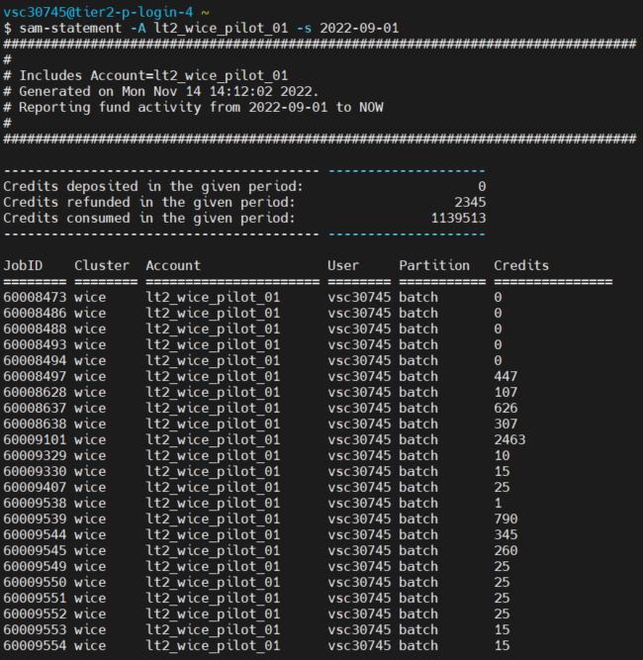
Accounting
sam-statement
Detailed accounting records
You see your own usage
You do not see the usage of the whole group

Slide 14
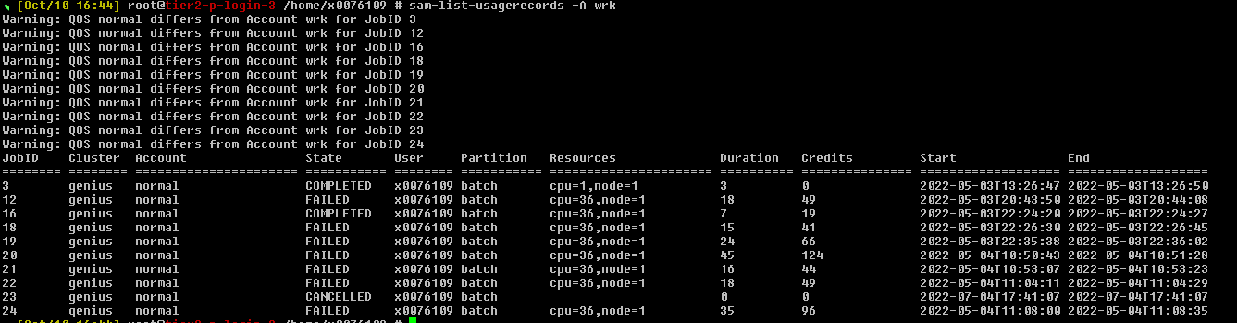
Accounting
sam-list-usagerecords
Lists only your own records (not from other members of the group)

Slide 15
Jobs: Torque to Slurm conversion
Torque | SLURM | Action
qsub job.pbs | sbatch --cluster=wice job.slurm | Submit a script as a batch job
qsub [resources] -I | srun [resources] --cluster=wice --pty /bin/bash -l | Start an interactive job (with login shell)
qdel <JOB_ID> | scancel --cluster=wice <JOB_ID> | Delete a job
qstat | squeue --cluster=wice --states=all | Show job queue status
qstat -f <JOB_ID> | scontrol show job <JOB_ID> --cluster=wice | Show details about a job
pbsnodes | sinfo --cluster=wice | View information about nodes and partitions
showstart <job_id> | squeue --cluster=wice -j <job_id> --start | Get estimated start time of job

Slide 16
Jobs: Torque to Slurm conversion
Torque | SLURM | Remarks
-l nodes=X:ppn=Y | --nodes=X --ntasks-per-node=Y --ntasks=X*Y --ntasks=X –-cpus-per-task=Y | or or (for Hybrid MPI/OpenMP only)
-l partition=gpu | --partition=gpu | Default: "batch" partition
-l pmem=Xgb | --mem-per-cpu=XG | Default: average memory/core
-l walltime=hh:mm:ss | --time=d-hh:mm:ss
-N jobname | -J jobname
-o file | -o <file_template> | See next slide
-e file | -e <file_template> | Default: same as stdout
-m ae | --mail-type=FAIL,BEGIN,END
-M <mailaddress> | --mail-user=<mailaddress>
-v key=value | --export=ALL,key=value | Additional variables to pass to job
-A account | -A account | Mandatory

Slide 17
Jobs: Torque to Slurm conversion
Torque | SLURM
PBS_JOBNAME | SLURM_JOB_NAME %j in <filename templates>
PBS_JOBID | SLURM_JOB_ID
PBS_NODEFILE | Replaced by a variable specifying the nodes rather than a node file: SLURM_JOB_NODELIST
PBS_NUM_NODES | SLURM_JOB_NUM_NODES
PBS_NUM_PPN | SLURM_JOB_CPUS_PER_NODE
PBS_NP | SLURM_JOB_NUM_NODES * SLURM_JOB_CPUS_PER_NODE or SLURM_NTASKS * SLURM_CPUS_PER_TASK
PBS_O_WORKDIR | SLURM_SUBMIT_DIR
PBS_ARRAYID | SLURM_ARRAY_TASK_ID

Slide 18
How to start
For beginners we have a tool pbs2slurm
It can translate directives of the pbs script and display on the screen
MAM accounts will not allow the tool to start translating, you need to provide a valid Slurm account (in pbs script)
It does not understand partition concept
May create conflicts if your own conda is active
(in PYTHONPATH, uses python3)
$ more test.pbs
#!/bin/bash
#PBS -A lpt2_sysadmin
#PBS -l nodes=2:ppn=36
#PBS -l walltime=6:30:00
#PBS -N my_job
#PBS -M mag.selwa@kuleuven.be
#PBS -m ae
cd $PBS_O_WORKDIR
module purge
module load foss/2018a
mpirun hello.exe

Slide 19
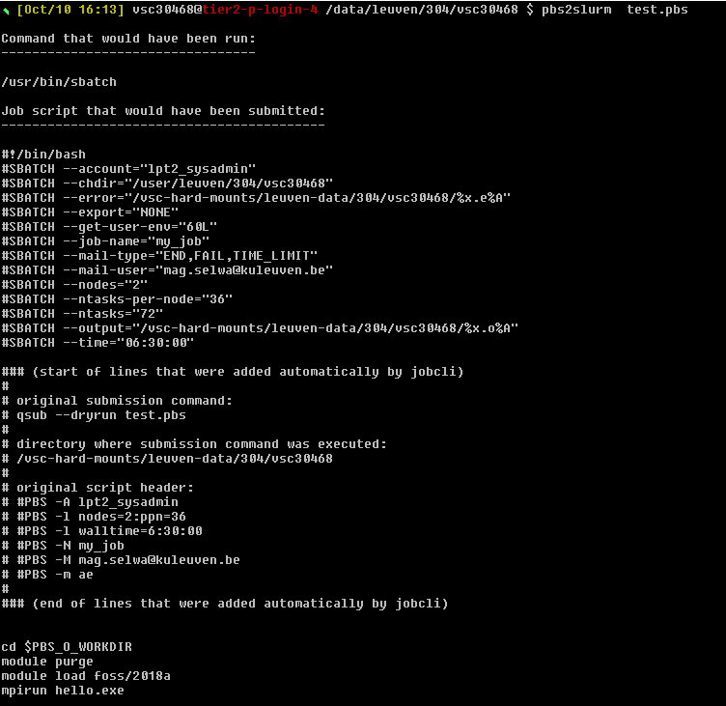
$ pbs2slurm test.pbs
Command that would have been run:
---------------------------------
/usr/bin/sbatch
Job script that would have been
submitted:
------------------------------------------

Slide 20
#!/bin/bash -l
#SBATCH --account="lpt2_sysadmin"
#SBATCH --chdir="/user/leuven/304/vsc30468"
#SBATCH --error="/vsc-hard-mounts/leuven-data/304/vsc30468/%x.e%A"
#SBATCH --export="NONE"
#SBATCH --get-user-env="60L"
#SBATCH --job-name="my_job"
#SBATCH --mail-type="END,FAIL,TIME_LIMIT"
#SBATCH --mail-user="mag.selwa@kuleuven.be"
#SBATCH --nodes="2"
#SBATCH --ntasks-per-node="36"
#SBATCH --ntasks="72"
#SBATCH --output="/vsc-hard-mounts/leuven-data/304/vsc30468/%x.o%A"
#SBATCH --time="06:30:00"

Slide 21
### (start of lines that were added automatically by jobcli)
#
# original submission command:
# qsub --dryrun test.pbs
#
# directory where submission command was executed:
# /vsc-hard-mounts/leuven-data/304/vsc30468
#
# original script header:
# #PBS -A lpt2_sysadmin
# #PBS -l nodes=2:ppn=36
# #PBS -l walltime=6:30:00
# #PBS -N my_job
# #PBS -M mag.selwa@kuleuven.be
# #PBS -m ae
#
### (end of lines that were added automatically by jobcli)

Slide 22
cd $PBS_O_WORKDIR
module purge
module load foss/2018a
mpirun hello.exe
Adjust the commands yourself
Ensure working correctly on wICE
Compiled software: Recompile on wICE
Conda: Recreate conda on wICE

Slide 23
Extra Remarks
Slurm starts the job in the directory it was submitted from (Torque: in $VSC_HOME).
Slurm partitions are
a combination of Torque partitions and Torque queues
Regular Slurm partitions on wICE have a maximum walltime of 3 days
For up to 7-day jobs on the thin nodes, specify --partition=batch_long
there are currently no bigmem_long or gpu_long partitions (3-day jobs max)
scontrol show partitions --cluster=wice|genius
For a reliable clean start, we recommend to:
deactivate any Conda environments before submitting
executing module --force purge before submitting (or adding this line to the beginning of your jobscripts)
More information on this topic can be found here.

Slide 24
Available Partitions
Cluster | Partition Name | Max Nodes | Max Walltime | Max Resources
Genius | batch (_long) | 226 (229) | 3 days (7 days)
 | bigmem (_long) | 7 (7)
 | gpu_p100 (_long) | 17 (17)
 | gpu_v100 (_long) | 2 (2)
 | amd (_long) | 4 (4)
 | superdome (_long) | 1 (1) |  | 112 cores, 6TB RAM, 6TB disk
 | batch_debug | 2 | 30 minutes
wICE | batch (_long) | 172 (172) | 3 days (7 days)
 | bigmem | 5
 | gpu | 4
 | interactive | 5 | 16 hours | 8 cores, 1 GPU instance

Slide 25
Jobs: Defaults
PBS (on Genius)
If no explicit resources are given your job will start
with 1 node 1 core,
with walltime of 1hr
in batch partition
jobs with no cluster given start on Genius cluster (and get job-id ~760)
Slurm accounts are already available on Genius (with the same account name)

Slide 26
Argument Shorthands
PBS (on Genius)
Shorthand | Full Argument | Meaning
-A | --account | Slurm account name
-a | --array | Job array range
-M | --cluster | Machine or cluster name
-c | --cpus-per-task | Num cores per task (default=1)
-d | --dependency | Job dependency (after, afterok, afterany, …)
-I | --input | STDIN filename
-e | --error | STDERR filename
-o | --output | STDOUT filename
-G | --gpus | Num GPUs per job
-t | --time | Maximum walltime
-N | --nodes | Minimum num nodes
-n | --ntasks | Maximum num tasks
-p | --partition | Partition name
Some of the sbatch, srun and salloc command line arguments have shorthands

Slide 27
Example: Thin Node (Batch Script)
PBS (on Genius)
Torque (on Genius)
Slurm (on wICE)
#!/bin/bash
#PBS -N hello_world
#PBS -l nodes=2:ppn=36
#PBS -l walltime=6:16:00:00
#PBS -l pmem=5gb
#PBS –A lp_pilot
#PBS -j oe
#PBS -o $PBS_JOBNAME-$PBS_JOBID.log
cd $PBS_O_WORKDIR module load intel/2018a
mpirun hello_world
#!/bin/bash
#SBATCH --cluster=wice
#SBATCH --job-name="hello_world"
#SBATCH -N 1
#SBATCH --ntasks-per-node=72
#SBATCH -t 6-16:00:00
#SBATCH –p batch_long
#SBATCH --mem-per-cpu=3400M
#SBATCH –A lp_pilot
#SBATCH --output=%x-%j.log
module --force purge
module use /apps/leuven/icelake/2021a/modules/all
module load intel/2021a mpirun hello_world

Slide 28
Example: Large Memory Job
PBS (on Genius)
Slurm (on wICE)
~$ sbatch –-cluster=wice -J MyBatchJob --time=00:15:00 --nodes=2 --ntasks-per-node=72 --constraint=icelake --switches=1 --partition=bigmem --mem-per-cpu=27G --account=lp_pilot job.slurm
or in a short format:
~$ sbatch –M wice -J MyBatchJob -t 00:15:00 -N 2 --ntasks-per-node=72 -C icelake --switches=1 -p bigmem --mem-per-cpu=27G -A lp_pilot job.slurm

Slide 29
Example: GPU Job
PBS (on Genius)
Slurm (on Genius)
~$ sbatch –M genius -J MyGPUJob -A lp_pilot -N 1 --ntasks=18 --gpus-per-node=2 -p gpu_p100 job.slurm
Slurm (on wICE)
~$ sbatch –M wice -J MyGPUJob -A lp_pilot -N 1 --ntasks=36 --gpus-per-node=2 -p gpu job.slurm

Slide 30
Example: Job Arrays
PBS (on Genius)
Slurm job arrays allow to set up and manage series of similar jobs. For an array of 72 single-core calculations (which will normally end up running on the same node): #!/bin/bash #SBATCH -n 1 ... #SBATCH --array=1-72 Each array element will have a task ID given by ${SLURM_ARRAY_TASK_ID} The total number of tasks (here: 72) will be given by ${SLURM_ARRAY_TASK_COUNT} Default output file names will be formatted as slurm-<jobID>_<1-…>.out
Note: worker and atools are available on wICE

Slide 31
Example: Interactive Job
From (Genius) Login Node
Use srun
Specify interactive or batch partition, e.g. $ srun --ntasks 18 –A lp_wice_pilot -M wice --pty /bin/bash -l $ srun –n 8 –t 16:00:00 –p interactive –M wice --pty /bin/bash –l # max possible $ srun --tasks-per-node 36 --gpus 2 <other_options> -p gpu –M wice --pty /bin/bash –l
To enable X-forwarding, add the --X11 option
To also request one GPU instance, add the --gpus=1 option
From (wICE) Interactive Node/Job
Use sbatch, e.g. $ srun –N 1 –ntasks 4 –A lp_wice_pilot –M wice --pty /bin/bash –l # step 1 $ sbatch <jobscript> # step 2

Slide 32
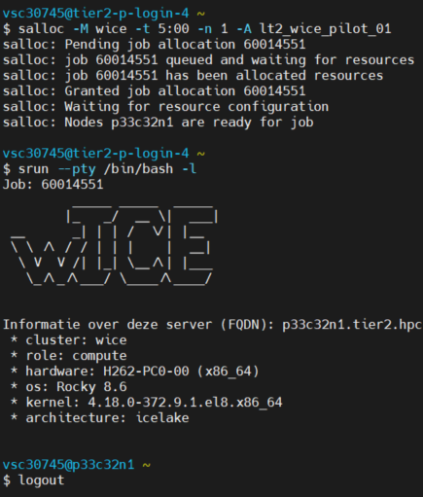
Example: Interactive Job
Alternatively
For using srun you need to first request resources:
$ salloc –M wice -A lp_wice_pilot -n 1 -t 30:00
And only then run
$ srun --pty /bin/bash –l
Or ssh directly to the reserved node.

Slide 33
Jobs: Tips and Tricks
PBS (on Genius)
Job id on wICE start from 60000000
scancel command does not give any feedback. Verify with squeue
Do not copy-paste the commands, Slurm is sensitive not only to – but also spaces that look normal, but have a different encoding. You can check the command with cat –tve -

Slide 34
Jobs: status codes
The squeue --cluster=wice command will display one of the following status codes for a job:
CD COMPLETED Job has terminated all processes on all nodes with an exit code of zero.
CA CANCELLED Job was explicitly cancelled by the user or system admin. The job may or may not have been initiated.
CF CONFIGURING Job has been allocated resources, but are waiting for them to become ready for use (e.g. booting).
CG COMPLETING Job is in the process of completing. Some processes on some nodes may still be active.
F FAILED Job terminated with non-zero exit code or other failure condition.
NF NODE_FAIL Job terminated due to failure of one or more allocated nodes.
OOM OUT_OF_MEMORY Job experienced out of memory error.
PD PENDING Job is awaiting resource allocation.
R RUNNING Job currently has an allocation.
ST STOPPED Job has an allocation, but execution has been stopped with SIGSTOP signal. CPUS have been retained by this job.
S SUSPENDED Job has an allocation, but execution has been suspended and CPUs have been released for other jobs.
TO TIMEOUT Job terminated upon reaching its time limit.

Slide 35
Accounting: Credits
You need access to Slurm compute credits
Credits are available on Genius and wICE (except intro credits)
Use sam-balance (from Genius or wICE) to see your available Slurm credits:
Select the account in your jobs using the –A/--account option.
~$ sam-balance ID Name Balance Reserved Available ======== ====================== =============== =============== =============== 396 lp_wice_pilot unlimited 51224124 unlimited

Slide 36
Accounting: Costs
1000 Slurm credits = 1 MAM credit The reason is that Slurm credit accounting happens in integer format.
Billing rates can be obtained as follows:
E.g. computing for 1 minute on a single GPU node will be billed as: ngpus*141.6666667 + ncores*2.546296296 credits
~$ scontrol show partitions --cluster=wice … PartitionName=gpu … TRESBillingWeights=CPU=2.546296296,GRES/gpu:a100-sxm4-80gb=141.6666667

Slide 37
Submitting worker jobs
From wICE (Interactive) Node
$ module av worker
------------------- /apps/leuven/icelake/2021a/modules/all -------------
worker/1.6.12-foss-2021a
From Genius Login Node
$ module use /apps/leuven/skylake/2021a/modules/all
$ module av worker
------------------ /apps/leuven/skylake/2021a/modules/all -------------
worker/1.6.12-foss-2021a-slurm worker/1.6.12-intel-2021a-slurm
worker/1.6.12-foss-2021a-wice worker/1.6.12-foss-2021a worker/1.6.12-intel-2021a (D)

Slide 38
Submitting worker jobs
Let us use one of the worker examples: https://github.com/gjbex/worker/tree/master/examples
alp.slurm alpha.csv
#!/bin/bash -l
#SBATCH --nodes=1
#SBATCH --ntasks-per-node 27
#SBATCH --time=00:30:00
#SBATCH -A lpt2_sysadmin
#SBATCH --cluster=wice
cd $SLURM_SUBMIT_DIR
alphabet.sh $letter $counter
letter,counter
a,1
b,2
c,3
d,4
e,5
f,6
....

Slide 39

Submitting worker jobs
From Genius
#!/bin/bash -l
module purge
module use /apps/leuven/skylake/2021a/modules/all
module load worker/1.6.12-foss-2021a-wice
wsub -batch alp.slurm -data alpha.csv

Slide 40
Submitting worker jobs
From interactive job on wICE
#!/bin/bash -l
module --force purge
module use /apps/leuven/icelake/2021a/modules/all
module load worker/1.6.12-foss-2021a
wsub -batch alp.slurm -data alpha.csv

Slide 41
Jobs: advanced MPI launch commands
PBS (on Genius)
In some cases (e.g. hybrid MPI/OpenMP applications), you may be interested in closer control of MPI process pinning. Here are some options to consider: * Intel MPI in intel/2021a:
export HOSTS=$(scontrol show hostnames $SLURM_JOB_NODELIST | paste -s -d,) export OMP_NUM_THREADS=2 export I_MPI_DEBUG=4 export I_MPI_PIN_RESPECT_CPUSET=off export I_MPI_PIN_DOMAIN=omp export OMP_PROC_BIND=true mpirun -np 36 -hosts $HOSTS -perhost 36 … * Open MPI in foss/2021a:
export OMP_NUM_THREADS=2 export OMP_PROC_BIND=true mpirun -np 36 --report-bindings --map-by ppr:36:node:pe=2 …
* Also Slurm's own srun MPI launcher can be used. For Intel MPI compiled applications together with srun, consult the Intel documentation.

Slide 42
Extra features
https://github.com/hpcleuven/Slurm-lunchbox
Running multiple applications in parallel in the same job (Multiple Process, Multiple Data).
#!/usr/bin/env bash
#SBATCH -A lpt2_sysadmin
#SBATCH --nodes=1 --ntasks=1 --cpus-per-task=16
#SBATCH --time=00:05:00
module --force purge
module use /apps/leuven/icelake/2021a/modules/all
module load foss/2021a
srun --exclusive --cpus-per-task=4 mem_limit/mem_limit_no_mpi -t 4 -m 3gb -i 500mb -s 20ms > task-1.txt &
srun --exclusive --cpus-per-task=4 mem_limit/mem_limit_no_mpi -t 4 -m 2gb -i 200mb -s 200ms > task-2.txt &
srun --exclusive --cpus-per-task=8 mem_limit/mem_limit_no_mpi -t 8 -m 1gb -i 100mb -s 50ms > task-3.txt &
wait

Slide 43
https://github.com/hpcleuven/Slurm-lunchbox
running applications that each require specific resources
#!/usr/bin/env bash
#SBATCH -A lpt2_sysadmin
#SBATCH --nodes=1 --cpus-per-task=1
#SBATCH hetjob
#SBATCH --nodes=1 --ntasks=12 --cpus-per-task=6
#SBATCH --time=00:15:00
module unuse /apps/leuven/skylake/2018a/modules/all
module use /apps/leuven/icelake/2021a/modules/all
module load foss/2021a
srun --exclusive --nodes=1 --ntasks=1 --cpus-per-task=1 \
mem_limit/mem_limit_no_mpi -m 1gb -i 200mb -s 1s > output_0.txt &
export OMP_PROC_BIND=true
export OMP_PLACES=cores
for (( computation_id=1; computation_id <= $SLURM_NTASKS_HET_GROUP_1; computation_id++ ))
do
srun --exclusive --het-group=1 \
--ntasks=3 --nodes=1 --cpus-per-task=2 \
--threads-per-core=1 \
mpirun -n 3 mem_limit/mem_limit -t 2 -m 1gb -i 200mb -s 1s > "output_${computation_id}.txt" &
done
wait

Slide 44
https://github.com/hpcleuven/Slurm-lunchbox
Running a hybrid OpenMP/MPI application on multiple nodes with process/thread binding
#!/usr/bin/env bash
#SBATCH -A lpt2_sysadmin
#SBATCH --cluster=wice
#SBATCH --nodes=2 --ntasks=72 --cpus-per-task=2
#SBATCH --time=00:15:00
module unuse /apps/leuven/skylake/2018a/modules/all
module use /apps/leuven/icelake/2021a/modules/all
module load foss/2021a
mpirun -x OMP_PROC_BIND=close --cpus-per-proc 2 --bind-to core mem_limit/mem_limit -t 2 -m 2gb -i 100mb -s 500ms > multinode_output.txt

Slide 45
https://github.com/hpcleuven/Slurm-lunchbox
Running (Intel) MPI application with processes spread out to maximize memory bandwidth.
#!/usr/bin/env bash
#SBATCH -A lpt2_sysadmin
#SBATCH --nodes=1 --ntasks=16 --cpus-per-task=1
#SBATCH --time=00:05:00
module --force purge
module use /apps/leuven/icelake/2021a/modules/all
module load intel/2021a
export I_MPI_PIN=1
export I_MPI_PIN_DOMAIN=4
export I_MPI_JOB_RESPECT_PROCESS_PLACEMENT=disable
mpirun -np 4 mem_limit/mem_limit -m 3gb -i 500mb -s 2s -l 5s

Slide 46
More information about Slurm
Official Slurm Documentation
Slurm Documentation on VSC docs Genius Quick Start Guide wICE Quick Start Guide
Convert PBS/Torque options to Slurm See also www.marquette.edu
Torque vs. Slurm command differences
Torque to Slurm cheatsheet

