Slide 1
Tier-2 data management From ingest to outflow
Wouter Lampaert and Jef Scheepers

Slide 2
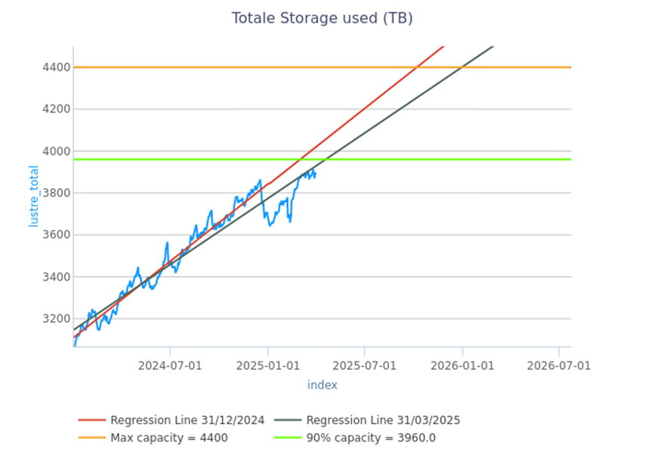
The issue
HPC integrated storage is expensive and limited
Moving/deleting unused/old data is essential for
System health
Useability for all researchers
Cluster storage capacity will not grow at the same speed as data production

Slide 3
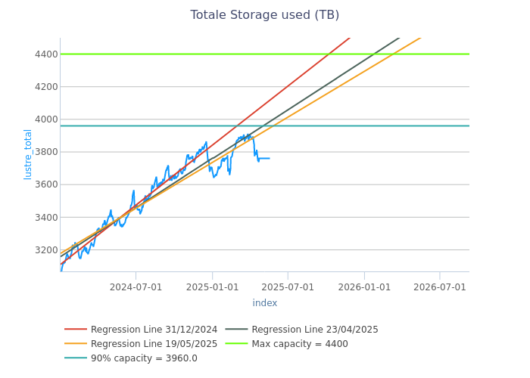
Updated graph

Slide 4
Solutions
Limitations:
Stricter on staging increases and requests
Inode quota
Long-term:
Motivate outflow
Large request will require outflow strategy!
‘elevated permissions’ for moderators of staging directory
Using ACLs
Extended reporting to staging owners

Slide 5
Overview
Choosing the right types of storage
Data outflow to external storage: tools
Data management plan
Structuring your files and directories
Keeping track of your data
Introduction to Tier-1 Data

Slide 6
Choosing the right types of storage
You’ll need two types of storage:
HPC-integrated storage
external storage

Slide 7
Choosing the right types of storage: HPC-integrated storage
$VSC_HOME, $VSC_DATA
Compute storage
Not safe for long-term storage (no double copy, no snapshot)
$VSC_SCRATCH
For individual projects
Recommended for most
Automatically cleaned
Benefit of a free increase
Staging/project storage
For sharing data
Shared input data, enrichment databases
Postprocessing on the same output data
Software in some cases
Data that cannot be automatically cleaned
E.g. input data that needs to be read on an irregular basis
Cost based on maximal usage every month

Slide 8
Choosing the right types of storage: external storage
External storage: for data that is not actively being computed on, could be:
‘in-house’ managed storage
K-drive (archive) or L-drive (large volume)
ManGO or Tier-1 data
Cold storage => KU Leuven pilot project - FriGO
Other external solutions ….
Previously archive storage solution will be phased out
Summer 2026

Slide 9
Data outflow to external storage: tools
Multiple tools available:
Globus (and Globus Flows)
iCommands/Python iRODS client (for Tier-1 Data/ManGO)
Classic command line tools
rsync
sftp
GUI applications
FileZilla

Slide 10
Data management plan
Create a data management plan for your project with your team:
Consult the official RDM data management guidelines
Create this with your whole team
PI for view on past, present and future projects
Researchers for day-to-day HPC usage
Data support staff: technical knowledge
Contact us for HPC related data questions or have a look at: https://www.kuleuven.be/rdm/en for broader support.

Slide 11
Data management plan: HPC-specific suggestions
Map your dataflow (across all cluster/storage platforms)
Estimate storage capacity
Identify shared resources
Identify automation opportunities

Slide 12
Data management plan: HPC-specific suggestions
Map your dataflow (across all cluster/storage platforms)
Estimate storage capacity
Identify shared resources
Identify automation opportunities

Slide 13
Example data/workflow
Legend:
Data types
Software
Storage locations
Transfer tools
Extpar input data
Extpar input data
CCLM output
Extpar tool
Extpar file
Aerosol input data
Aerosol input data
Postprocessing tools
INT2LM
INT2LM output
CCLM output
Postprocessed data
Postprocessed data
CCLM
Postprocessing tools
Input data
OR
Raw input data
Raw input data
(Tier-1) Compute Cluster storage
External storage
Tier-1 Data
Globus transfers
- Globus transfers
- GlobusFlow and ManGO Flow (dev)
Mainly DKRZ cluster

Slide 14
Data management plan: HPC-specific suggestions
Map your dataflow (across all cluster/storage platforms)
Estimate storage capacity
Identify shared resources
Identify automation opportunities

Slide 15
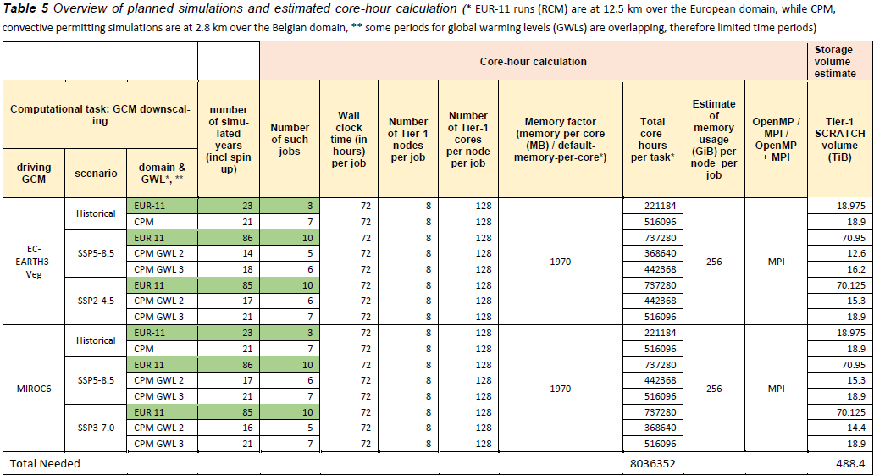
Storage estimations: calculate your total usage

Slide 16
Storage estimations: calculate your max need
Extpar input data
1
CCLM output
1TB
Extpar file
Aerosol input data
10GB
200GB
2
3
4
INT2LM output
CCLM output
Postprocessed data
Postprocessed data
4TB
10TB
15TB
Input data
2TB
3,21TB
6,01TB
14TB
25TB
3,2TB
2,01TB
4TB
10TB
15TB
Compute Cluster storage
External storage
Max storage needed: 25TB

Slide 17
Data management plan: HPC-specific suggestions
Map your dataflow (across all cluster/storage platforms)
Estimate storage capacity
Identify shared resources
Enrichment databases
Shared (input) data
Shared software
Consider centrally installed software! (modules)
Identify automation opportunities

Slide 18
Data management plan: HPC-specific suggestions
Map your dataflow (across all cluster/storage platforms)
Estimate storage capacity
Identify shared resources
Identify automation opportunities
Even if you cannot immediately automate them
Potential automation:
Preprocessing
Outflow + removal

Slide 19
Automation opportunities
Extpar input data
Outflow+removal (Globus Flows)
CCLM output
Extpar file
Aerosol input data
INT2LM output
CCLM output
Postprocessed data
Postprocessed data
Input data
Compute Cluster storage
External storage

Slide 20
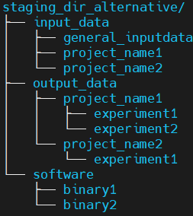
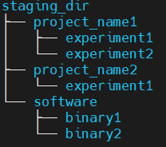
Structuring your files and directories
For shared storage: create guidelines within your team
Structure should reflect your structure on your external storage
Higher level directories contain broader topics
e.g. Projects (-> users) -> experiments
Consider splitting input, (intermediate) and output data
Depends on the level of sharing
Separate software from data
Extra important when using sensitive data
Contact us

Slide 21
Data outflow to external storage
What data needs to copy/move to your external storage
Data that is expensive:
Computation time
Human effort
Data that needs to be shared with externals
Data that needs to be stored temporarily
External storage as a bridge between different machines
Data that needs to be processed later, keeping more quota for current tasks
Public (input) data with large retrieving times (download, processing steps…)

Slide 22
Data outflow to external storage
Data that should NOT be on your external storage
Source code: use version control systems (e.g. Git)
Compiled software
Store installation recipes and logs instead
Public databases (unless retrieving is expensive)
Test data, benchmarks…
Filter out unnecessary test scripts, test experiments…
Point to test status with directory prefixes/suffixes
test_
tmp_
…

Slide 23
Keeping track of your data
Follow up on your team, for example in regular data meetings (or make it a part of the PI-researcher meetings)
Which input data is present on your staging
What experiments are finished and can/should be moved out
How far from reaching quota?
Use available tools to monitor storage
myquota
du
duduckdb : new tool for staging directories
Automate where possible!
Irods transfers
…
Use metadata

Slide 24
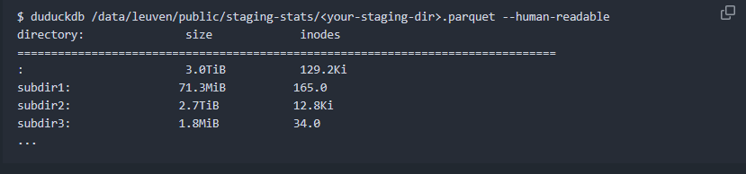
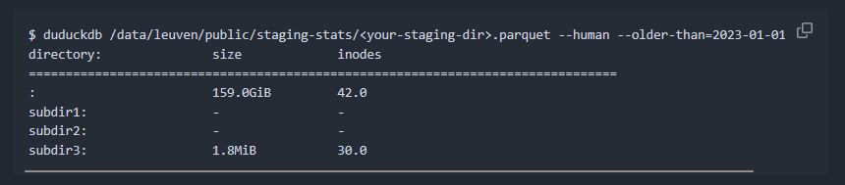
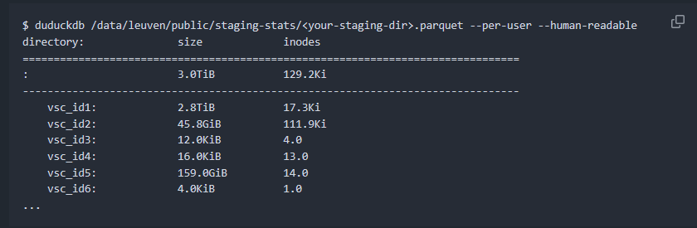
Keeping track of your data: duduckdb
Queries database that will be created on a regular basis
Already available for all staging storages

Slide 25
Tier-1 Data

Slide 26

What is Tier-1 Data?
Management of ACTIVE research data
Based on open-source software
More than storage (metadata, automation, sharing)
Accessible via various clients
Free, application based
To help researchers manage their data according to best practices

Slide 27
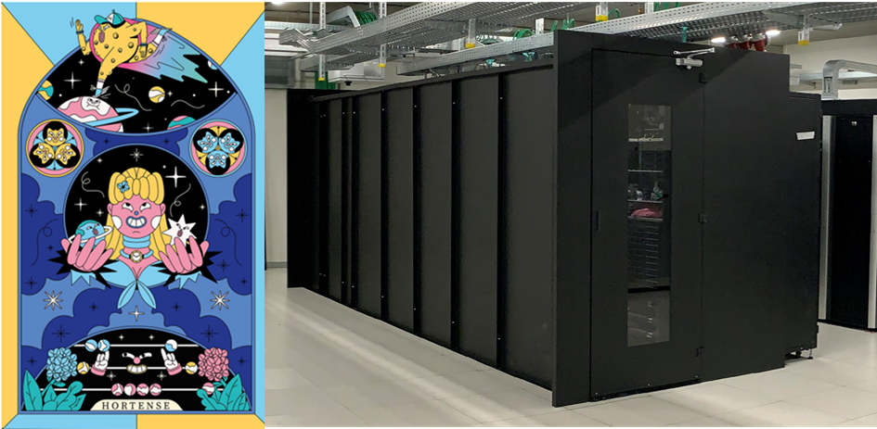










Centralization & Accessibility
Globus
Tier-1 Data
SFTP
Active data
Inactive data
Regional / domain specific repositories
Institutional
repositories
Notes:
OS: there are limitations (no documentation yet). Mac cannot use iCommands but they can use GO commands (which however we do not currently support).
Globus and sftp get a bit separated from the iRODS clients.
icons, in clockwise order: instruments, Tier-1 Cloud, Tier-1 and Tier-2 compute, Laptops/desktops

Slide 28


Data protection
Against mistakes:
Trash folder keeps data for 2 weeks
Regular snapshots
Against machine failure:
Double copy of files in two datacenters (Heverlee & Leuven)

Slide 29
Upload Speed

Slide 30






Permissions
Group-based
Access Levels:
Read
Write
Own
Data creators
Data analysts
Data consumers
Create data
Upload data
Search data
Analyze data
Upload results
Search data
Read data
Download data
Raw Data
Raw Data
@ Objects
@ Collections
Processed Data
Processed Data
Write Access
Read Access

Slide 31












Permissions
lab project
PhD students
Master students
raw data
analysis
by masters
by phds

Slide 32





Metadata: for what?
Give context, describe
ProjectID: FWO99
Title: Thermodynamics of coffee
PI: ProfessorZonnebloem
Funder: FWO
StartDate: 2021-01-01
EndDate: 2024-12-11
Status: ToArchive
SimulationID: FWO99-sim1
System: Caffeine
JobID: 40000001
System: VSC-Hortense
Software: CP2K
Version: 4.1
Date: 2023-04-20
FWO99-simul
Data discovery
Automation
Create a script (e.g in python):
Look for collections with Metadata ‘ToArchive’
Make a read-only copy of the collection
Add metadata: ArticleID=article1
List collections/projects with FWO as founder
List all collections associated to project FWO99
Find all files that were generated with CP2K v4.1

Slide 33




Metadata: how?
Manual addition
Via schemas
Automated extraction
From file headers
From filenames
…
Aperture:7
Colors: RGB

Slide 34
Automation
Client-side automation:
Python client, iCommands
Server-side automation:
Monitoring or event-based trigger
Implemented by support team

Slide 35
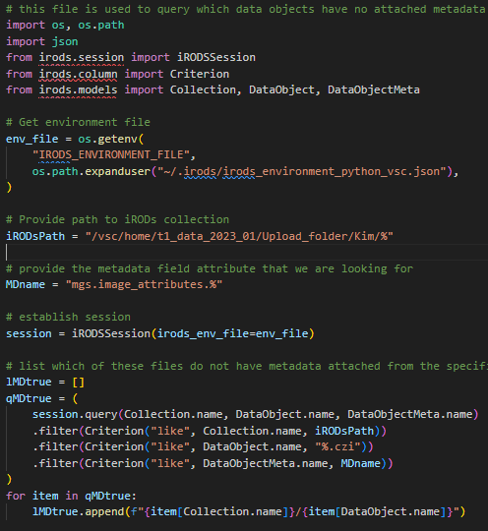
Tier-1 Data clients
$ icd myPath
$ imkdir test
$ itouch test/myfile
See upload tool ManGO-Ingest (https://github.com/kuleuven/mango-ingest)

Slide 36
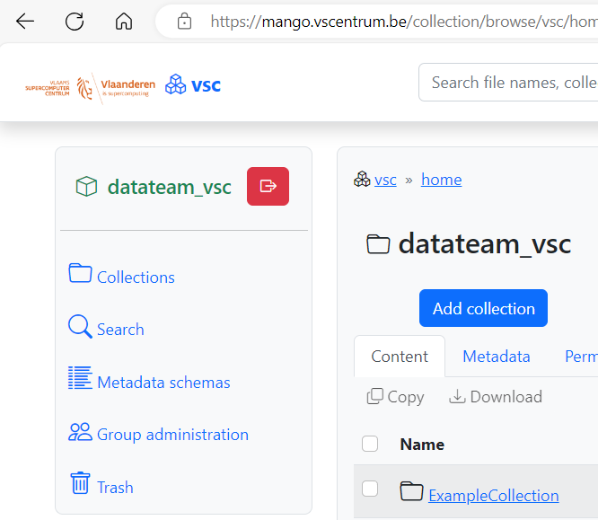
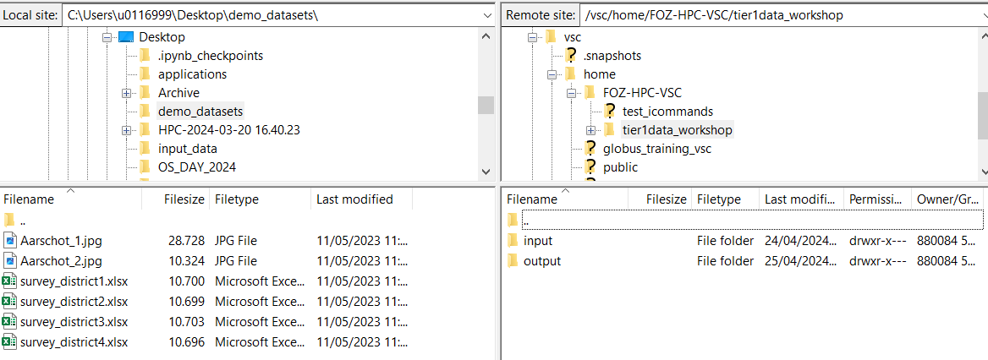

Tier-1 Data clients
SFTP

Slide 37
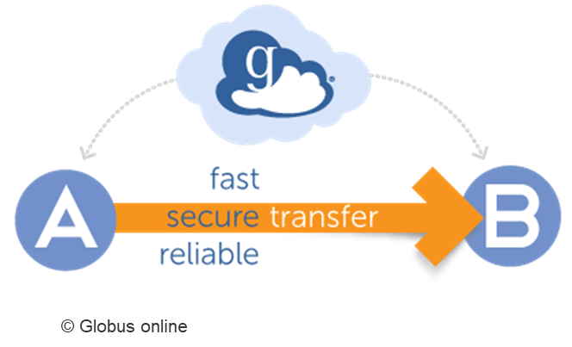
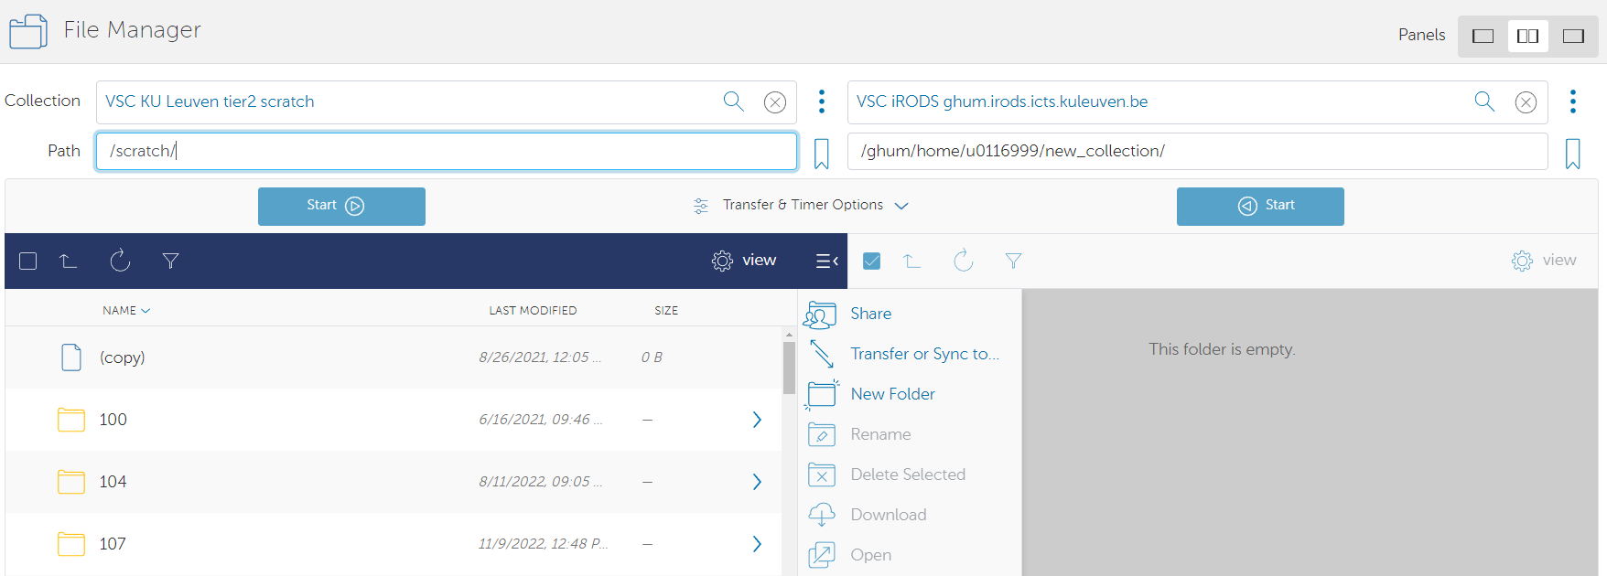
Globus
Notes:
Developed by University of Chicago
Large data transfers; only data, no metadata sharing
Fire-and-forget functionality
Institutional collections, local endpoints
Access via URL or Personal Connect

Slide 38
Exit strategies to cold storage
Choose logical scope for your dataset
Describe your dataset as a whole
Export existing file/folder metadata
Tier-1 Data will allow:
To export via multiple clients
To send data straight to selected repositories
To export metadata in conventional file formats

Slide 39














Realistic workflow example
Upload raw data
Share
Tier-1
Data
Organize
Describe
Publish
Query
Download
Describe
Upload
query data
download data
run some process
-------
-------###
SUCCESS
upload results
add metadata
rinse
repeat
Process
Analyze

Slide 40
Practicalities: Get started & Get support
Requesting a Tier-1 Data project
Project-based access
Criteria:
Flemish Public Research Institution
Active data in the context of VSC: Tier-1/Tier-2 compute, Tier-1 Cloud
Judged on workflow feasibility and research data management aspects
Types:
Starting grant: 5TB for 8 months
Full grant: 5TB-1PB
Request at any time
All info on https://www.vscentrum.be/data
User support
Helpdesk: data@vscentrum.be
Documentation: https://docs.vscentrum.be/data/tier1_data_service.html

