Slide 1
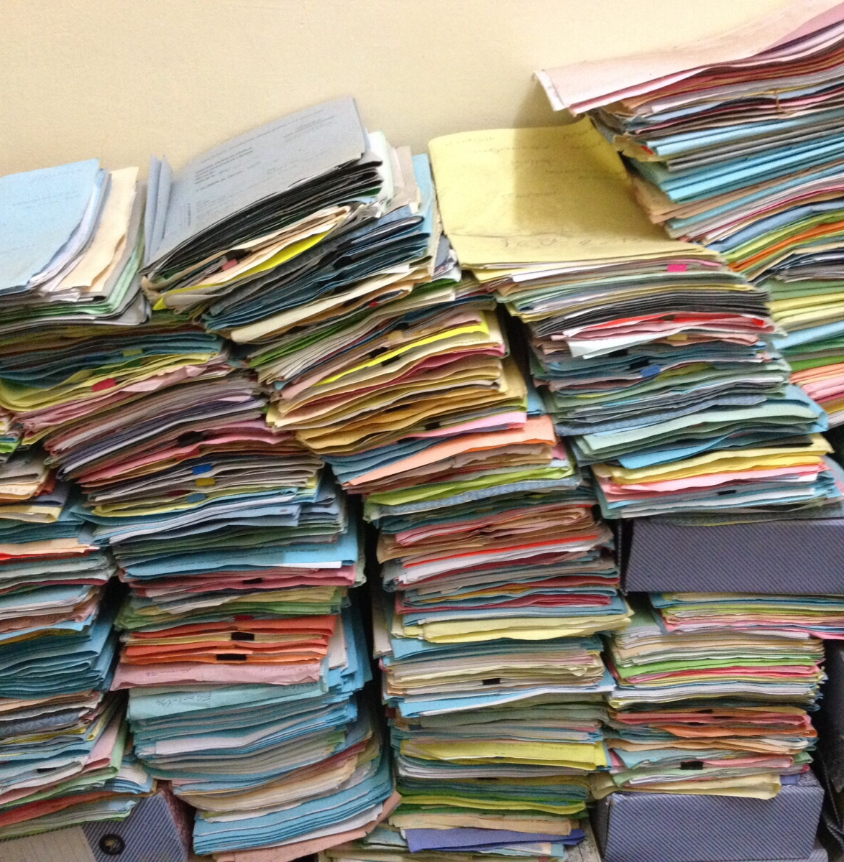
VSC Tier-1 Data
Use Cases
©CarlesBarcenaRoig

Slide 2



Goal of the pilots
Test iRODS configuration and capabilities in a real environment
Gain experience on the development of iRODS rules for a real use case
Implement and experiment data management procedures
Test interoperability with other repositories and services
Icons made by Freepik from Flaticon www.flaticon.com

Slide 3




Tier-1 Data in the research Data Lifecycle
Pre-publication/Active Data
Post-publication/Inactive Data
Planning
Active Research
Sharing/Reuse
Project proposal
Project start
Collect
Create
Use
Analyse
Publication
End project
Data management plans
Copyright, ethics, usage of data
Documentation
Metadata
Storage en backup
Access control
Share with
collaborators
Publication
Link with ‘persistent identifiers’
Discovery and reusage
Long term preservation
Regional / domain specific repositories
VSC Tier-1 Data
HPC
users
Institutional repositories
Tier-1 Compute
Tier-1 Cloud
Notes:
One important aspect is that the Tier-1 Data service focus only on storing data during the active phase of the research data life cycle (that is, when data is collected and analyzed) and has not yet being published. [click]
In addition, the initial scope of the service is restricted to data of research projects that are using the VSC HPC compute infrastructure.
Another important aspect of this service is its integration with institutional or domain specific repositories. Thanks to this integration researchers will have an easy way to transfer their relevant datasets for publication and further preservation and when applicable ensure open access of the data [click]

Slide 4


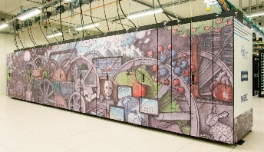
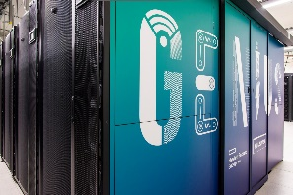



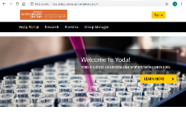




Tier-1 Data architecture
VSC Tier-1
VSC Tier-2
User
Clients
YODA
iCommands
iCommands
PRC-Python API
DAVRods
1,2PB
600TB
1,2PB
HA
Rule Engine
3km
VSC iRODS
1 zone
iCAT
Posix Resc1
Ceph Resc3
Posix Resc2
Replica Resc1
MySQL
cluster
DC Heverlee
DC Leuven

Slide 5





Tier-1 Data - pilots
BCLIMATE Group Hydrology and Climate team (HCG) Remote SensingandData Assimilation (RSDA)
Prof. Dr. Wim Thiery Prof. dr. Diego Miralles Gabrielle De Lannoy
Regional Climate Studies (RCS) VITO
Nicole van Lipzig Dr. Hendrik Wouters
KLIMAAT
UGent KU Leuven Uantwerpen
Sally Chambers Vincent Vandeghinste Wout Dillen
Julie Birkholz
VUB Rijksarchief
Jan Wijffels, Wouter RYCKBOSCH Johan Van Der Eycken
CLARIAH-VL
KU Leuven Uhasselt Belgian Center for Occupational Hygiene (BeCOH)
Dr. Peter Hoet Prof. Dr. Tim Mawrot
Imec, UCLouvain , International partners in Denmark, Spain, UK, Norway, Romania
EXIMIOUS
VIB
VIB (Galaxy.be)
Ignacio Eguinoa
VIB-KU Leuven
Project ASAP
Stein Aerts
FLANDERS MAKE
Project RAISE AM
Kurt de Grave

Slide 6
Tier-1 Data - pilots

Slide 7



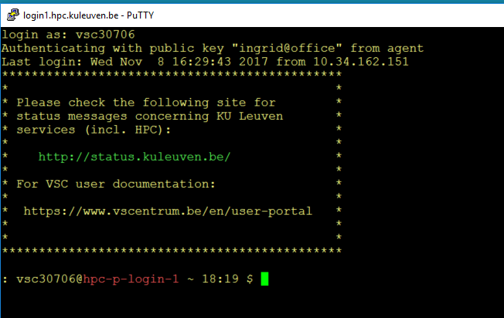





Storage4climate
Tier-1 Data
Tier-1 Compute
YODA
icommands
Extract metadata (known fileformats)
Add custom metadata
Calculate checksum
Quality control
….
Stage-in
Submit job
Replica 1
Stage-out
BrENIAC
HPC Parallel Filesystem
GPFS
Climate simulations
Data sources
CMPI6
CORDEX
LUMIP
…
Landing zone
Replica 2
In development/test: Landing zone, rule for automatic NetCDF metadata extraction

Slide 8





Getuigenissen project (CLARIAH-VL)
Handwritten text
recognition model
Tier-1 Data
Tier-1 Compute
1. Upload files…
2. Select files by metadata
(century, language,…)
3. Train model
+
Scans
Texts
…and add metadata automatically
BrENIAC
4. Store result in iRODS
Predicted text
Predicted text
Texts
Labels
BrENIAC
+
Entity recognition model
Predicted labels
Predicted labels
4. Add labels as metadata
Notes:
The Getuigenissen project analyses testimonies of crimes from the 18th and 19th century.
These handwritten documents are scanned and transcribed (by volunteers, edited by researchers).
Scans and transcriptions are stored in iRODS.
Metadata that researchers already add are added by a script, which also builds the appropriate folder structure.
The right training data is selected based on metadata and copied (Step 1) to the cluster,
where it is used to train a handwritten text recognition model (Step 2).
The output are the predicted texts per line.
These files will be stored in iRODS. (Step 3)
Volunteers have also made labels for all the entities in the texts, which are also in iRODS.
The right texts and labels will be selected based on metadata and copied (step1) to the cluster,
Where they will be used to train an Entity Recognition model (step 2).
The output are the entities that the model recognizes.
These files will be stored in iRODS. (Step 3).
These labels can also be added as metadata to the texts they belong to.

Slide 9


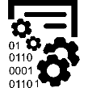








Eximious
Data creators
Data analysts
Data consumers
Read access to data
Search data
Analyze data and upload results
Read access to data
Search data
Download data
Gather patient data
Introduce it to RedCap
Tier-1 Data
PRIVATE DATA
PUBLIC DATA
RO
RW
RW
PartnerA
daily
daily
PartnerB
weekly
weekly
Combined
results
monthly
monthly
Metadata extraction
yearly
yearly
PartnerX

Slide 10

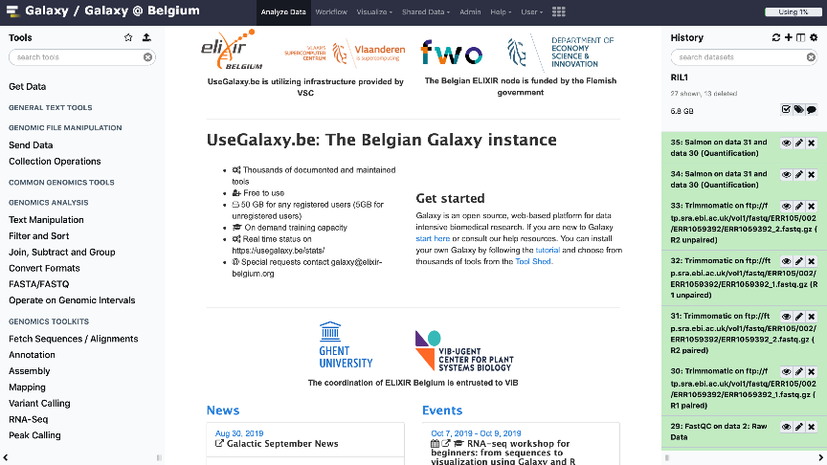
VIB-Galaxy
Tier-1 Data
YODA
icommands
VSC Tier-1 Cloud
Replica 1
Replica 2

Slide 11
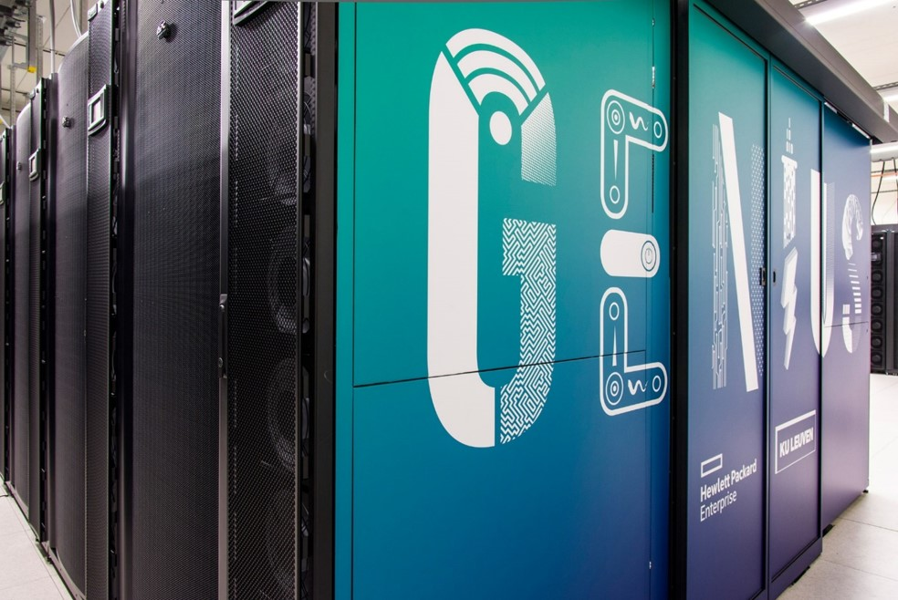






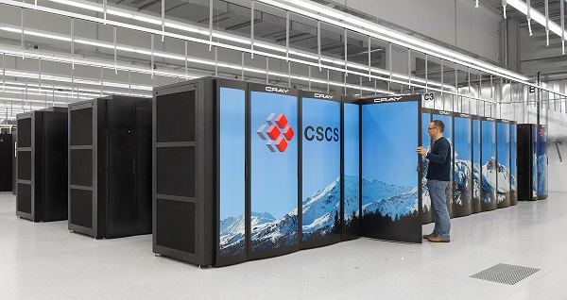
RAISE AM (Flanders Make)
Tier-1 Data
Tier-1 Compute
Submit job
YODA
icommands
Extract metadata
Add custom metadata
Calculate checksum
Quality control
….
HPC Parallel Filesystem
GPFS
BrENIAC
Stage-in
Other HPC systems
Replica 1
Stage-out
VSC Tier-2
3D printer
images
Landing zone
Replica 2
PRACE
Notes:
Analyses defects on 3D printers
Images during the printing are collected from 2 different cameras.
The images are sent to the Tier-2 Data platform, and metadata to files are added to the iRODS
From different HPC systems a number of ML models will be built based on this data to predict printing defects.

Slide 12
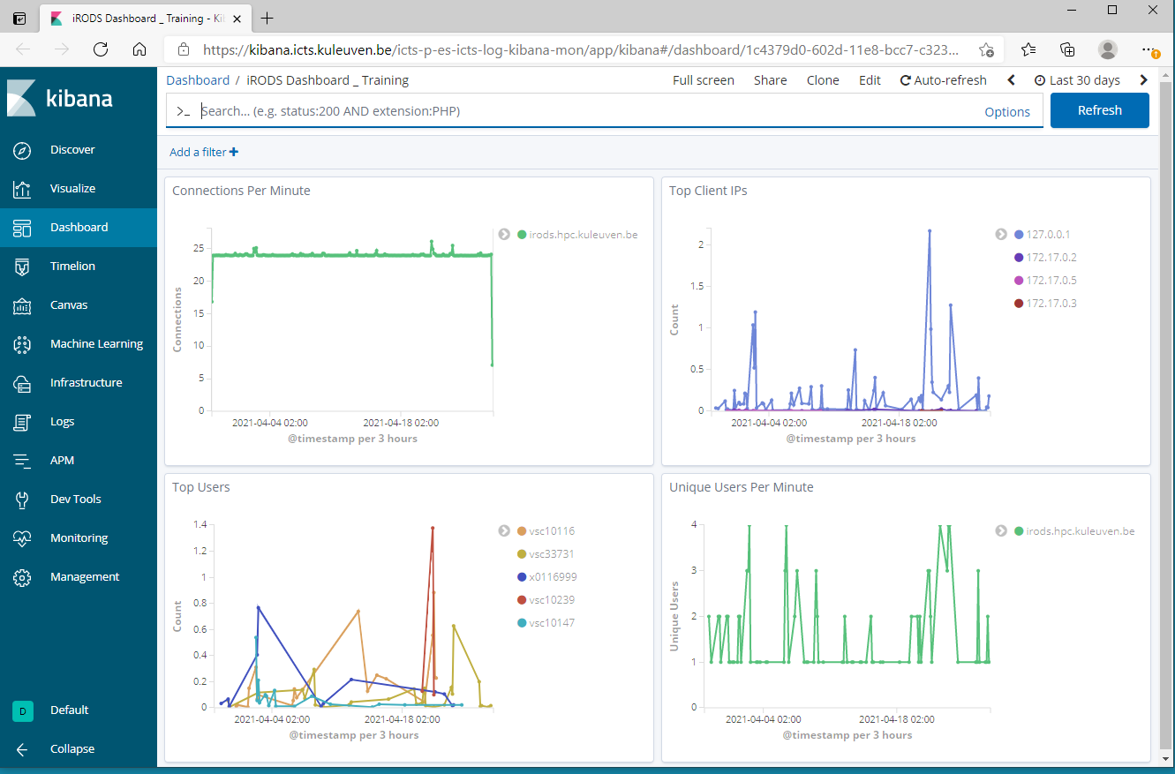
Notes:
Kibana General Dashboard:
-These give some useful information about connections to iRODS based on the selected time – period.

Slide 13
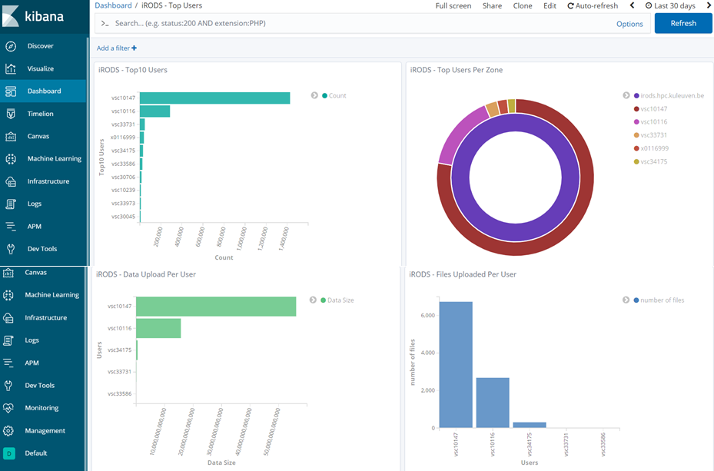
Notes:
Top Users Dashboard:
- Left top shows the top ten users who triggered PEPs - hits
- Right top shows the users who triggered hits based on the Zone.
- Left bottom shows the size of the total uploaded data per user. (Results are here not fully correct/reliable. Because of an issue)
- Right bottom shows the number of data objects uploaded per users.

Slide 14
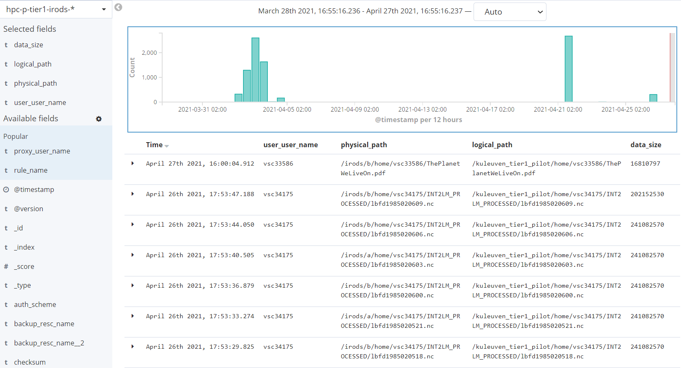
Notes:
This is the discovery section of Kibana:
- You can investigate your all foot-stamp/actions. And you can grab some meaningful results.
- Here you can see some uploaded data objects and some useful info with.

