Slide 1
Agenda
Introduction to iRODS (10m)
VSC Tier-1 Data Use cases (15m)
Introduction to the KU Leuven iRODS testbed infrastructure (10m)
Connecting to the KU Leuven testbed (10m)
Working with iRODS (Basic)
Clients:
GUI: Metalnx (20m)
WebDav (15m)
BREAK -> People not interested on CLI/Python and advanced features can stop here
Command line: icommands (20m)
Python iRODS client (PRC) (20m)
Working with iRODS (Advanced):
Task automation:
Rules (30m)
Other capabilities – not yet implemented (15m)
landing zone
auditing
provenance

Slide 2
Training material
All training material is available on github
https://github.com/hpcleuven/iRODS-local-admin-training

Slide 3
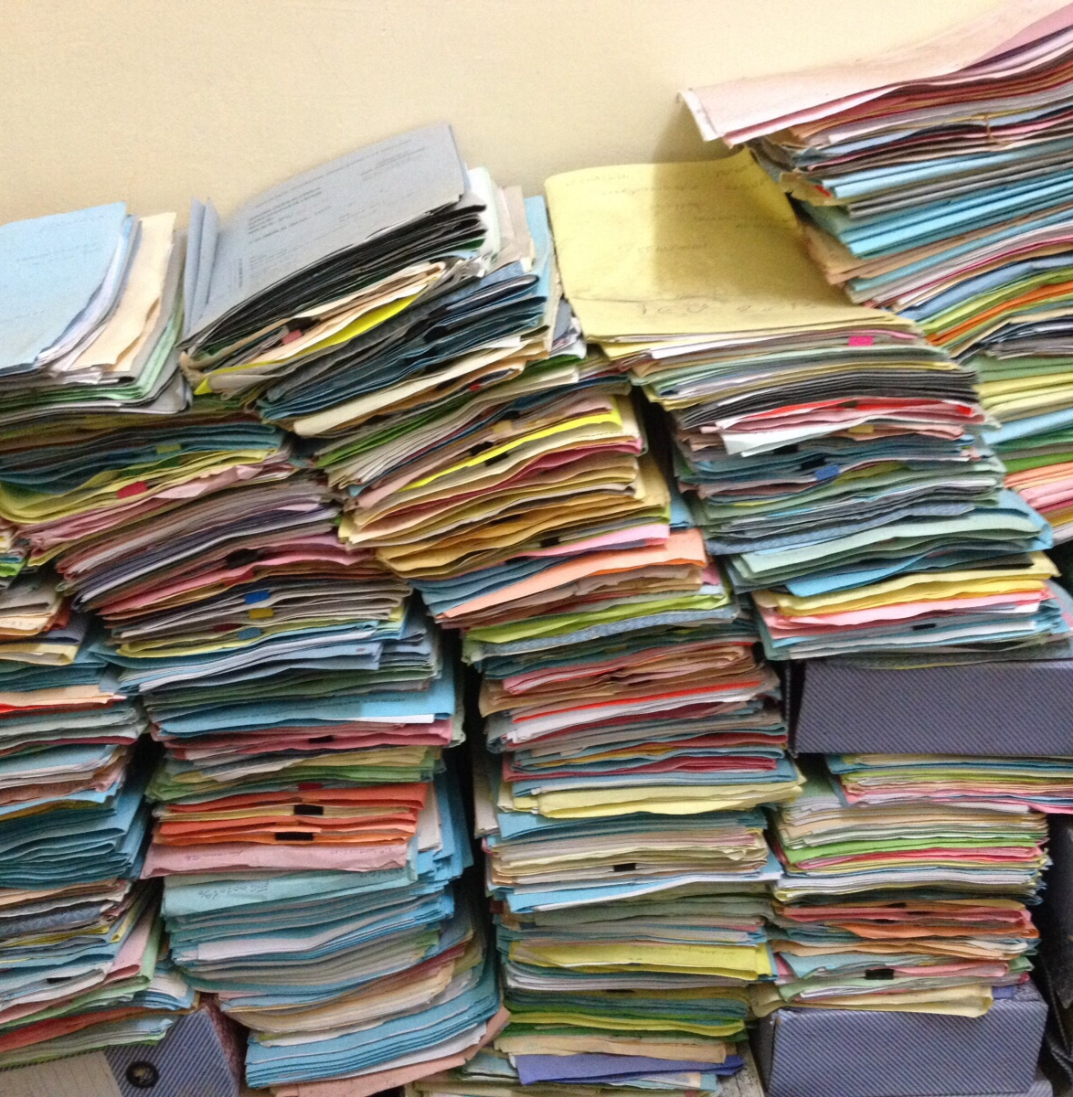
01.Introduction to iRODS
©CarlesBarcenaRoig

Slide 4
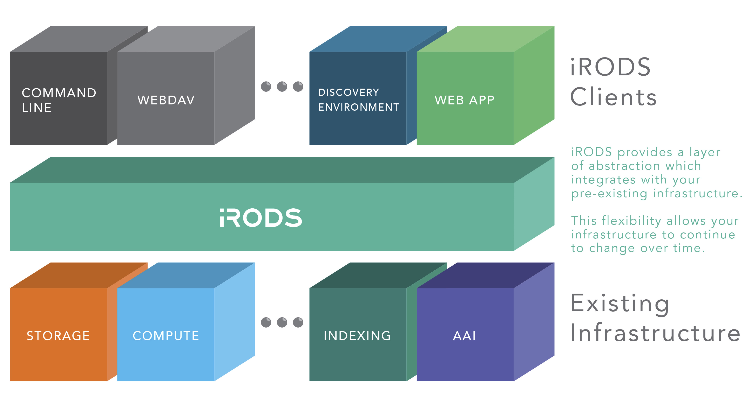
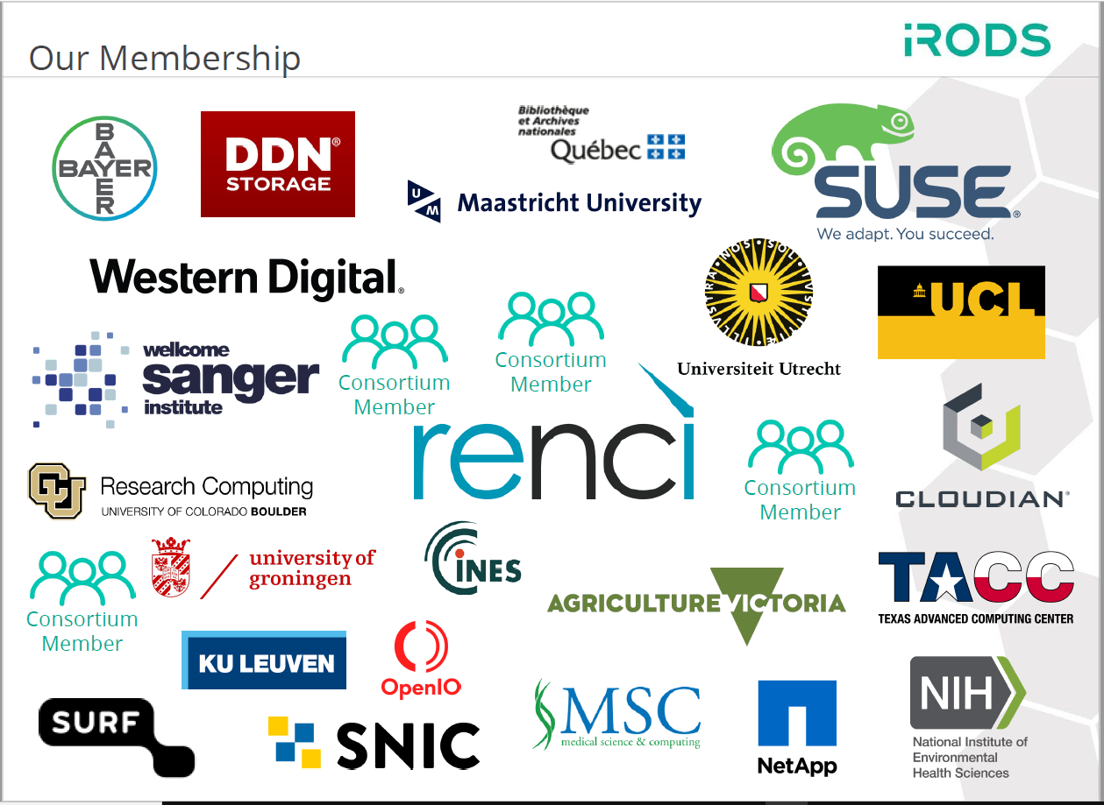
What is iRODS?
Integration layer
iRODS (integrated Rule-Oriented Data System)
Open Source distributed data and storage management system
Configurable data management policies and workflows
Scalable
A flexible framework for the abstraction of infrastructure
©created by iRODS
KU Leuven is part of the iRODS consortium – Sustained member

Slide 5



iRODS architecture
Clients
Provides access to iRODS
Catalogue Service Consumer – Storage server
Provides access to storage and other resources
Catalogue Service Provider – iRODS server
Provides access to the Catalogue
Metadata catalogue (iCAT)
Postgres/Mysql/Oracle
Where everything is written down
Notes:
Catalog Service Consumers:
Connect to the Catalog Service Provider for: resource configuration, authentication, system metadata, user-assigned metadata
Provide scalable access to iRODS services
May be geographically distributed
May have an arbitrary number of resources attached
Catalog Service Provider: Same capabilities as the Consumer with the addition of a database plugin
May serve storage capabilities
Provides access to the metadata catalog
May be placed in a High Availability configuration for failover and load balancing
Metadata Catalog:
Relational Database: PostgreSQL, MySQL/MariaDB, Oracle, CockroachDB
Single source of truth for the Zone
Holds users, groups, resources, system metadata, user metadata
Co-resident with iRODS or a clustered server farm
Referenced by a database plugin implemented with ODBC

Slide 6

iRODS architecture: examples
Clients
Clients
iRODS servers (HA)
iRODS servers
Storage servers
Storage
iCAT- mysql
Storage
iCAT- mysql
Notes:
Catalog Service Consumers:
Connect to the Catalog Service Provider for: resource configuration, authentication, system metadata, user-assigned metadata
Provide scalable access to iRODS services
May be geographically distributed
May have an arbitrary number of resources attached
Catalog Service Provider: Same capabilities as the Consumer with the addition of a database plugin
May serve storage capabilities
Provides access to the metadata catalog
May be placed in a High Availability configuration for failover and load balancing
Metadata Catalog:
Relational Database: PostgreSQL, MySQL/MariaDB, Oracle, CockroachDB
Single source of truth for the Zone
Holds users, groups, resources, system metadata, user metadata
Co-resident with iRODS or a clustered server farm
Referenced by a database plugin implemented with ODBC

Slide 7




iRODS Core competencies
Unified Storage Namespace
Data virtualization of distributed storage systems
Automation
Rule Engine to enforce data policies
Data Discovery
Rich Metadata for collections and data objects (System metadata and user-defined metadata)
Secure collaboration
Three mechanisms: Permissions, Tickets and Federation

Slide 8

Data virtualization in iRODS
Collection1
DataObjectA
Collection2
DataObjectA
DataObjectB
DataObjectC
DataObjectB
Collection3
DataOjectA
iRODS Logical Namespace
/Zone/Collection1/
/Zone/Collection1/DataObjectA/
/Zone/Collection1/Collection2/
/Zone/Collection1/Collection2/DataObjectA
/Zone/Collection1/Collection2/Collection3/DataObjectA
Logical
representation
Physical
representation
DC1
DC2
DC3
/irods1/s1/Collection1/DataObjectA
/irods1/s2/Collection2/DataObjectA
/irods/s3/Collection2/collection3/DataObjectA
/irods2/Collection1/DataObjectA
/irods3/Collection1/DataObjectA
Notes:
• Collections make no reference to the physical storage path. It is possible for two Data Objects in a Collection to be stored in different physical locations. • A Data Object may refer to multiple Replicas. Replicas are exact copies of a file, located in multiple physical locations.
Combine various distributed storage technologies into a Unified Namespace
Existing file systems
Cloud storage
On premises object storage
Archival storage systems
iRODS provides a logical view into the complex physical representation of your data, distributed geographically, and at scale.

Slide 9
Data discovery: Metadata everywhere
System Metadata:
filename, file size, creation date …
User Metadata:
Manual introduction
Metadata templates
Automation (rules/microservices)
©created by iRODS

Slide 10
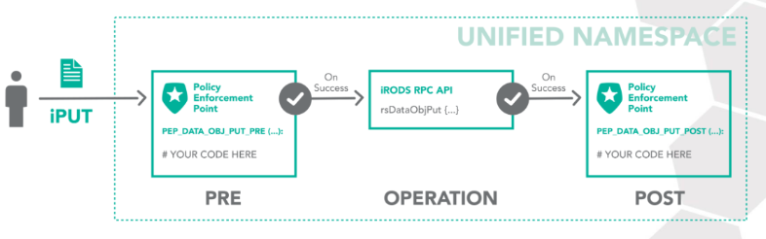
Automation
Integrated policy engine can be triggered by any operation:
Authentication
Storage Access
Database Interaction
Network Activity
Extensible RPC API
Dynamic Policy enforcements
The iRODS rule may:
restrict access
log for audit and reporting
provide additional context
send a notification
Execute a process on the file
©created by iRODS
Notes:
The iRODS rule engine provides the ability to capture real world policy as computer actionable rules which may allow, deny, or add context to operations within the system.

Slide 11
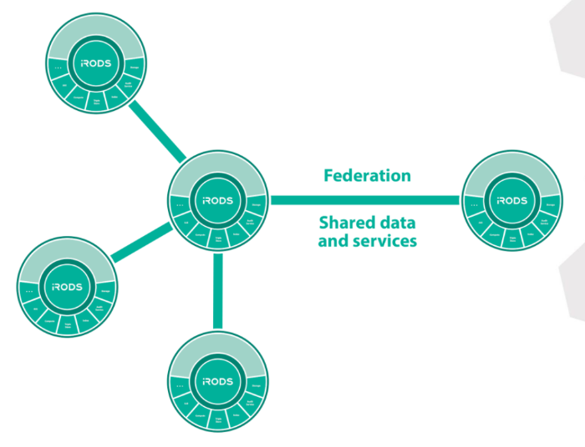
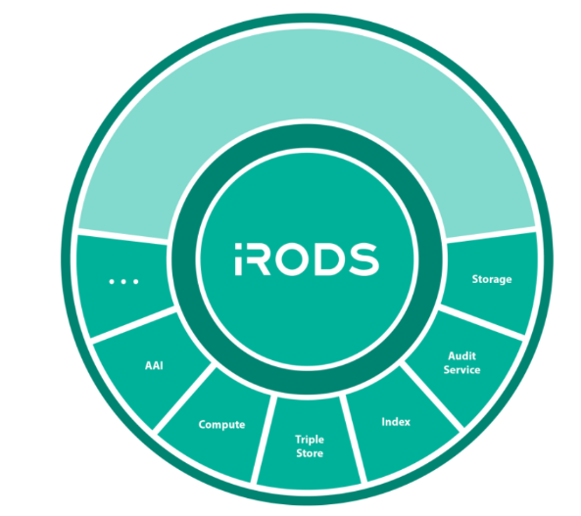
Secure collaboration
Inside a zone
ACL (users, groups)
Tickets:
Temporary access
No iRODS account needed
Between zones: federation
©images created by iRODS

Slide 12
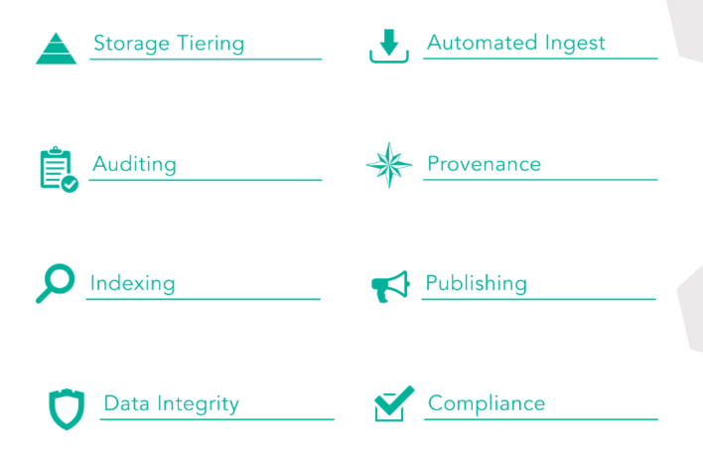
iRODS capabilities
©created by iRODS

