Slide 1
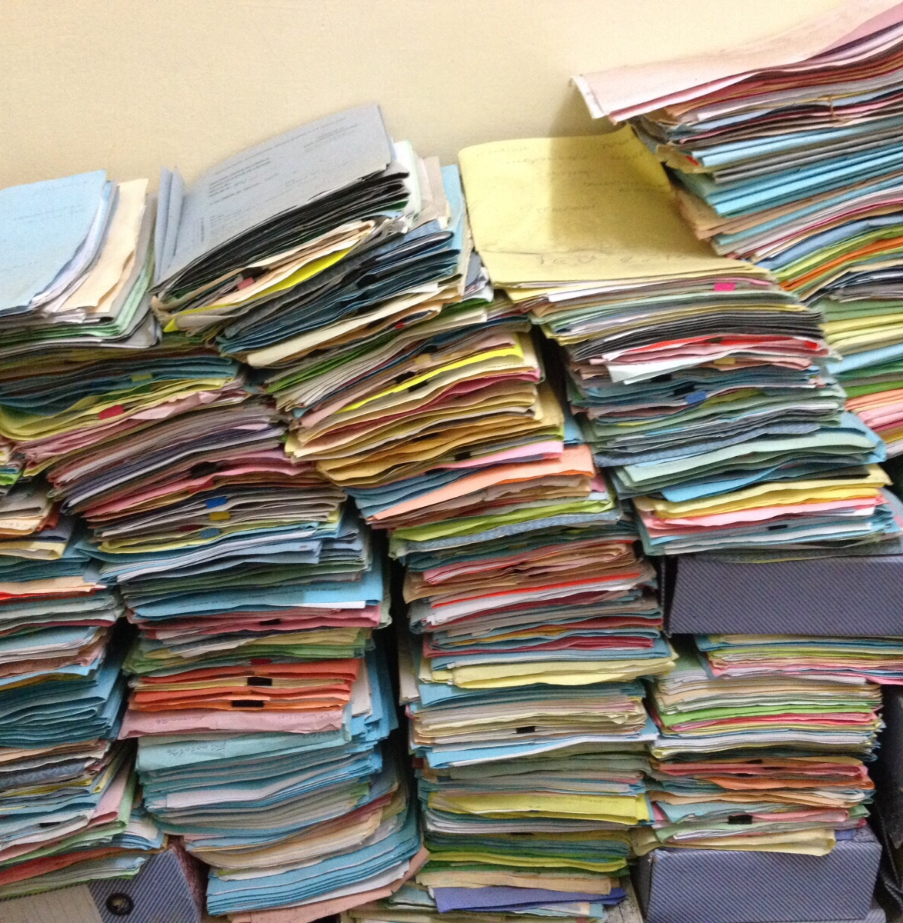
04. Working with iRODS
Basic
©CarlesBarcenaRoig

Slide 2
Goals of this module
Get familiar with the different clients of iRODS: Metalnx, Webdav interface, icommands (CLI), Python iRODS Client (PRC)
You will learn:
moving around iRODS
putting and getting data
adding metadata to objects and collections
query/search data based on metadata*
managing data: create collections, move data, remove data, manage permissions

Slide 3

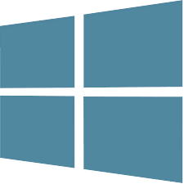




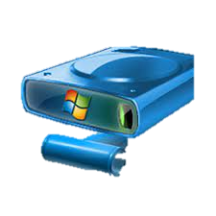
Clients
PRC-Python API
Cadaver client
iCommands
PRC-Python API
DAVRods
DAVRods
CentOS7
Ubuntu16
Ubuntu18
KU Leuven Portal
KU Leuven Portal
References:
KU Leuven portal: https://irods-demo.t.icts.kuleuven.be/
Metalnx: https://irods-demo.t.icts.kuleuven.be/metalnx/
Cyberduck: https://cyberduck.io/
WinSCP: https://winscp.net/eng/download.php
Cadaver client: http://www.webdav.org/cadaver/
Icommands: https://irods.org/download/
Python iRODS Client (PRC) : https://github.com/irods/python-irodsclient

Slide 4
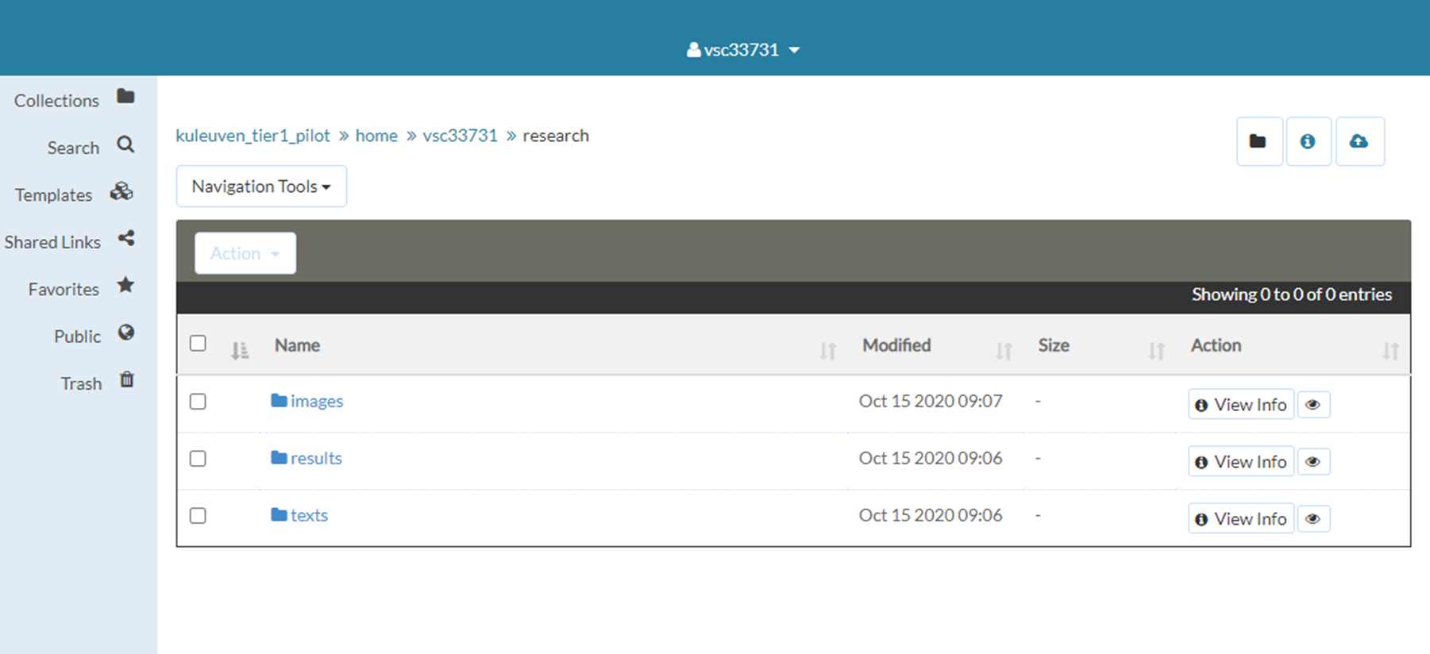
Metalnx
graphical user interface easiness
working with data objects/collections
adding metadata to data objects/collections
downloading data objects
permission
iRODS design

Slide 5
WebDav client
graphical user interface easiness
working with data objects/collections
adding metadata to data objects/collections
downloading data objects
permission
iRODS design

Slide 6
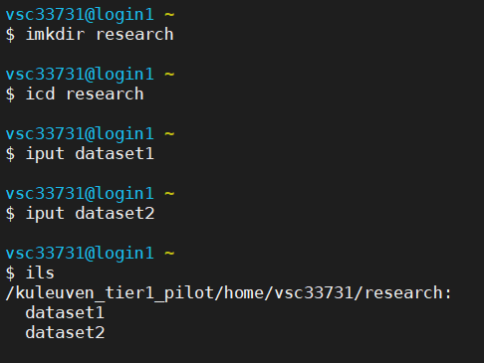
icommands
iput – iget- irsync –imeta...
uploading/downloading data
adding metadata to data objects/collections
querying based on metadata
deleting data objects/collections
synchronization of data
ACLs to data objects/collections

Slide 7
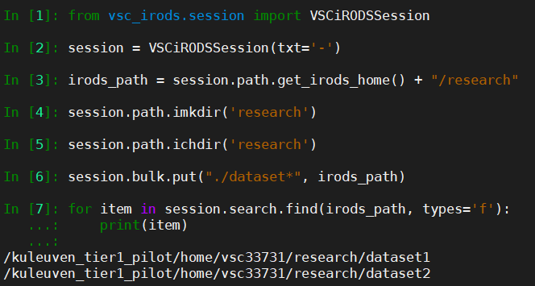
Python iRODS Client (PRC)
Python3, python-irodsclient
working with data objects/collections
adding metadata to data objects/collections
querying based on metadata
deleting data objects/collections
listing the disk usage
ACLs to data objects/collections

