Slide 1
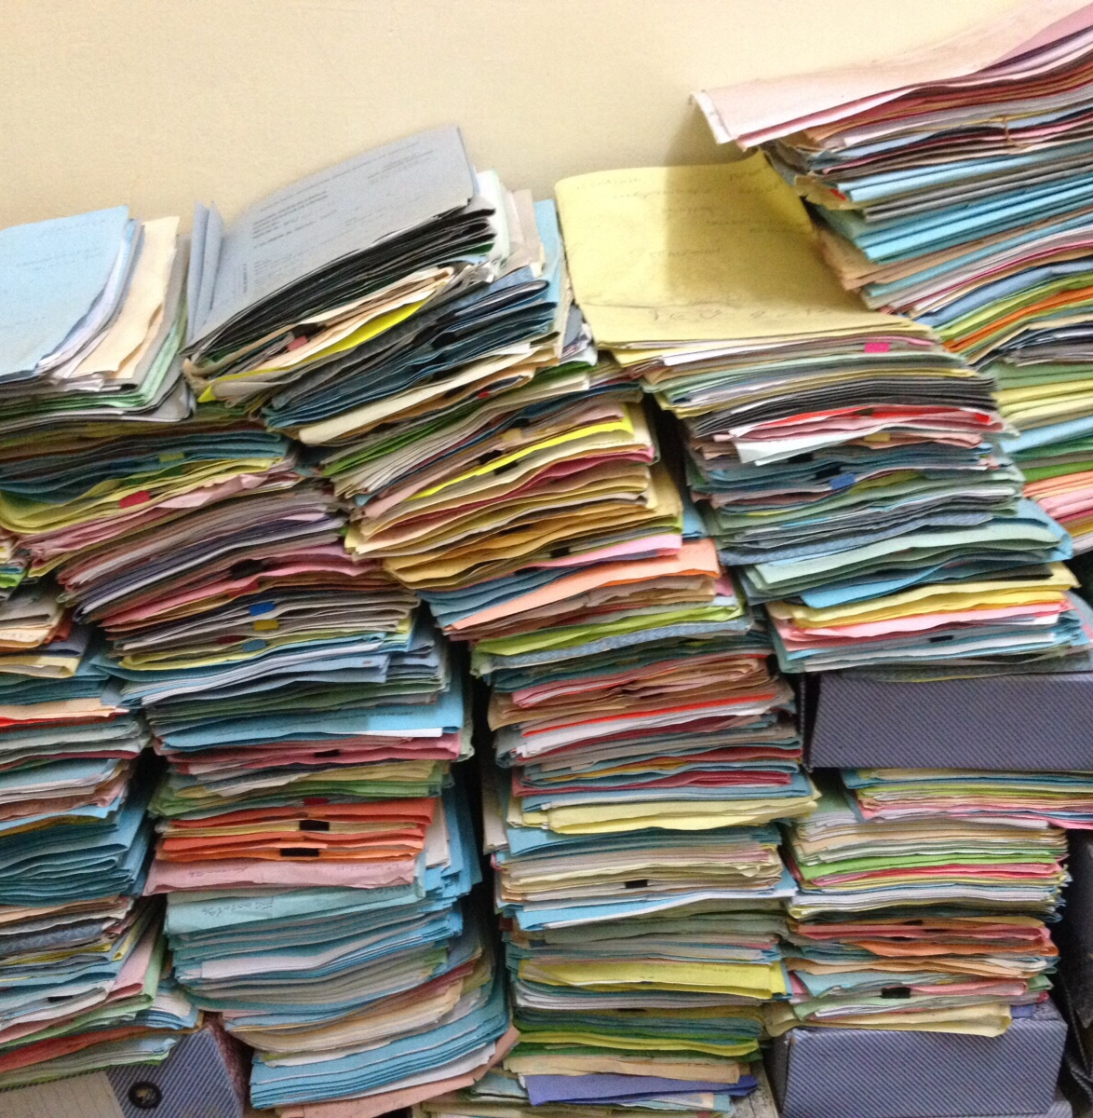
04. Working with iRODS
Basic
©CarlesBarcenaRoig

Slide 2
Goals of this module
Get familiar with the different clients of iRODS: Metalnx, Webdav interface, icommands (CLI), Python iRODS Client (PRC)
You will learn:
moving around iRODS
putting and getting data
adding metadata to objects and collections
query/search data based on metadata*
managing data: create collections, move data, remove data, manage permissions

Slide 3






iRODS Clients
User
Clients
KU Leuven Portal
PRC-Python API
iCommands
DAVRods
Interaction with iRODS
Notes:
Look at Davrods

Slide 4
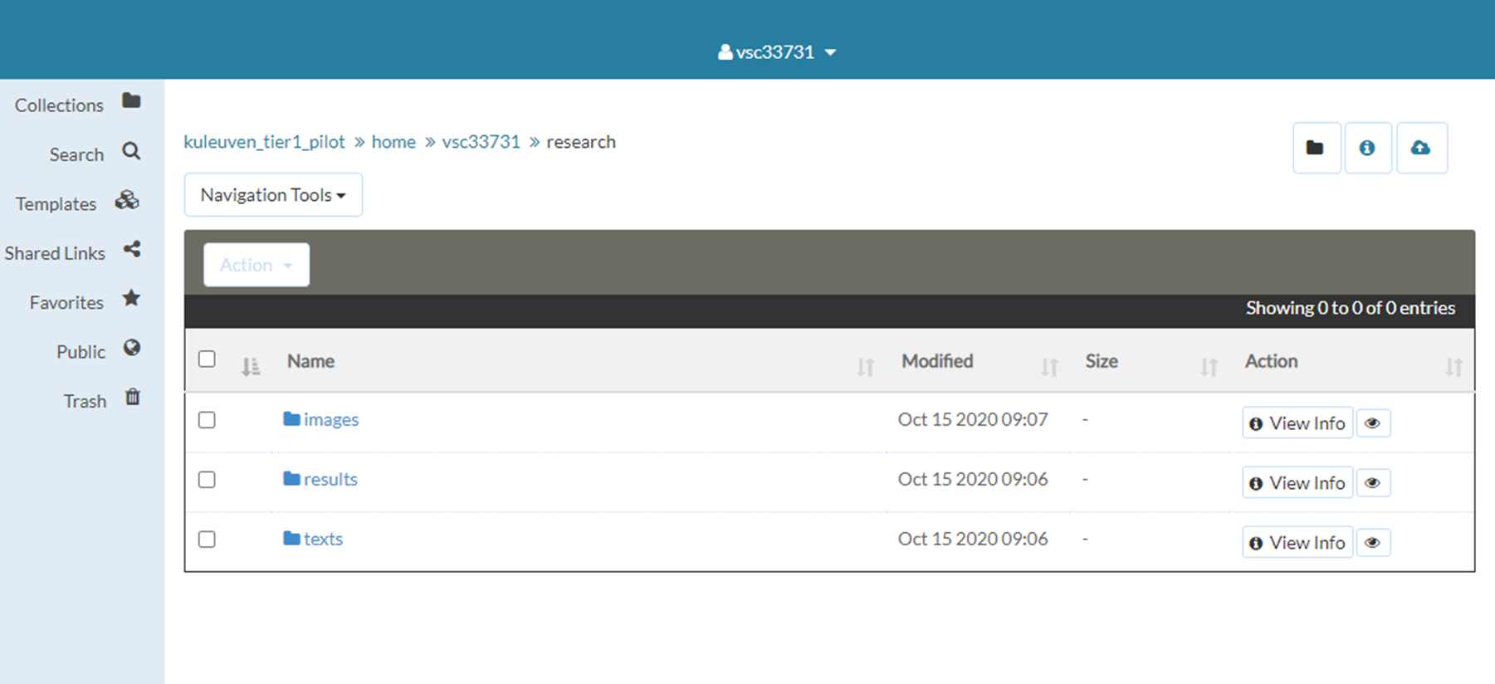
Metalnx
graphical user interface easiness
working with data objects/collections
adding metadata to data objects/collections
downloading data objects
permission
iRODS design

Slide 5
WebDav client
graphical user interface easiness
working with data objects/collections
adding metadata to data objects/collections
downloading data objects
permission
iRODS design

Slide 6
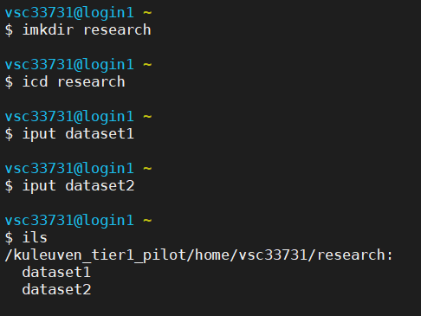
Functionalities
icommands:
iput – iget- irsync –imeta...
uploading/downloading data
adding metadata to data objects/collections
querying based on metadata
deleting data objects/collections
synchronization of data
ACLs to data objects/collections

Slide 7
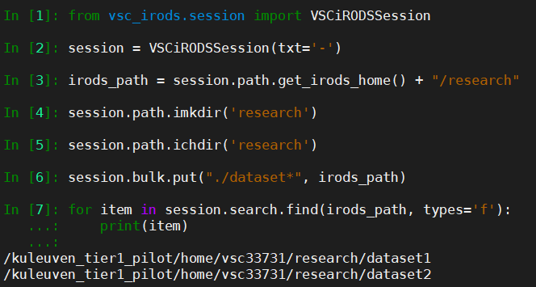
Functionalities
VSC-PRC:
Python3, python-irodsclient
working with data objects/collections
adding metadata to data objects/collections
querying based on metadata
deleting data objects/collections
listing the disk usage
ACLs to data objects/collections

Slide 8
Functionalities
iRODS RULES
irule:
user level rules
written into a local file
execute it when you need
Policies
Community
Rules
dsl, Python
Users/Admins
System
PEP
Users
Manual

