Slide 1
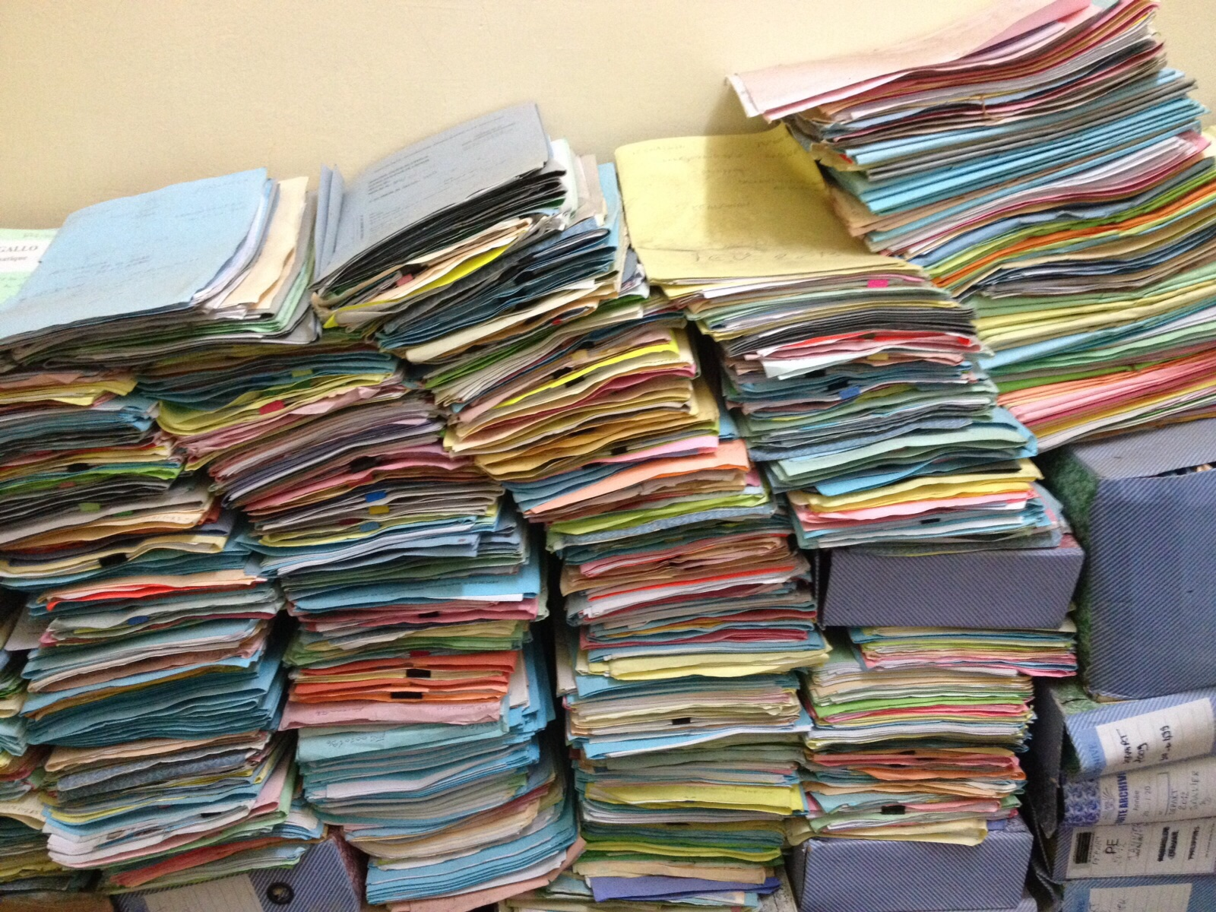
KU Leuven testbed
©CarlesBarcenaRoig

Slide 2









iRODS in de KU Leuven RDM Landscape
Research proposal
Data collection
Data processing
Data publishing
Data archiving
Funding
Ethics
Privacy
IP rights
Data management plan
Storage
Back-up
Data Management:
formats and datatypes
Metadata
Documentation
File organization
Data anonymization
Data encryption
Data analysis
Document processing
Data selection
Deposit data
Link with article
Licensing
Data sharing
Data selection
Long term preservation
Research
idea
START of project
END of project
DMPOnline
PRET Tool
Data register
GitLab KU Leuven
Digitisation
Software solutions
ELN
Qualtrics
Active data Repository
GitLab KU Leuven
Scientific software
Digitisation
HPC
GitLab KU Leuven
Omeka
RDR repository
GitLab KU Leuven
Teneo
RDR repository
Collaborators?
Tools
Tools
Tools
Tools
Tools
Reuse of data

Slide 3







KU Leuven iRODS testbed: architecture
Users
Clients
KU Leuven Portal
iCommands
All infrastructure virtualized:
iRODS servers
Metalnx
Other servers: webdav, …
3 environments:
Test
Quality
production
DAVRods
Python Client
iRODS
Servers
HA
Rule Engine
Metadata
iCAT
Mysql
cluster
Storage
Hardware
NetAPP (NFS)
Single copy
10TB

Slide 4
KU Leuven iRODS: possible architecture
Users
Clients
KU Leuven Portal
iCommands
DAVRods
Python Client
Federation (optional)
Zone W&T
Zone Biomed
Zone HW
Zone A
Rule
Engine
Rule
Engine
Rule
Engine
Rule
Engine
MD
MD
MD
MD
Storage
Hardware
TBD

Slide 5

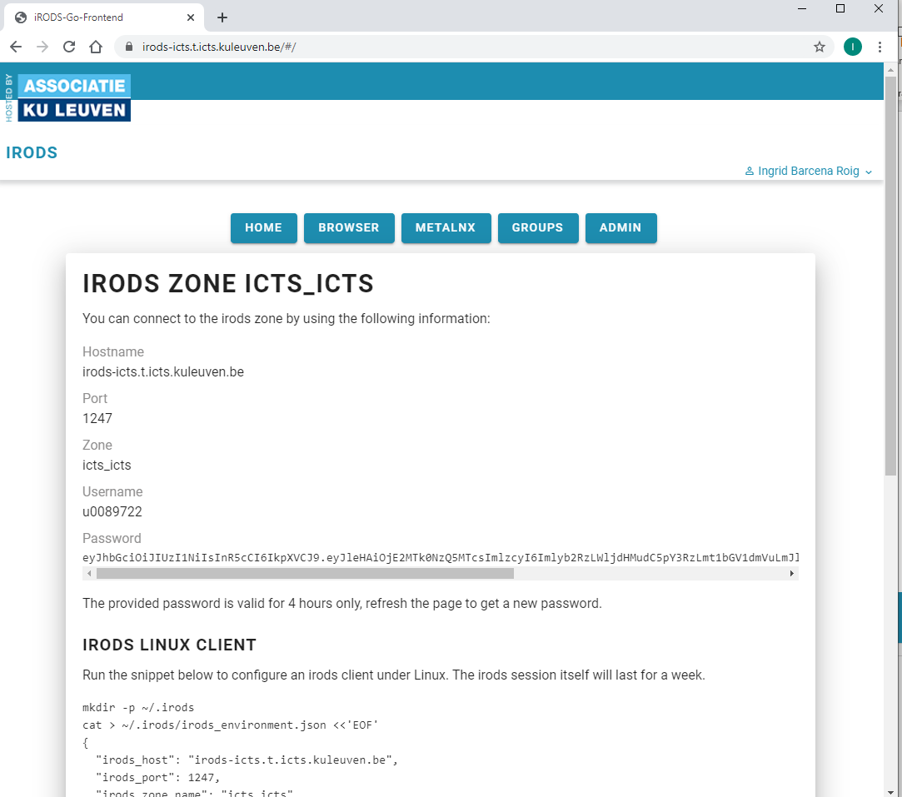


Authentication
User’s home
Limited space
Temporary
Password created
u-account
Group/Project
Quota based
Login portal
User Roles
iRODS user
Access to iRODS will be regulated as Facility
Group administrator
Can create groups
Can join empty groups
Can edit members of groups they belong to
Machine user
long lived tokens
Admin Roles
Zone user administrator (local IT)
Can create groups and assign quotas
Can deploy zone rules
Zone administrator (ICTS)
Can deploy system rules
Can make configurations changes

Slide 6
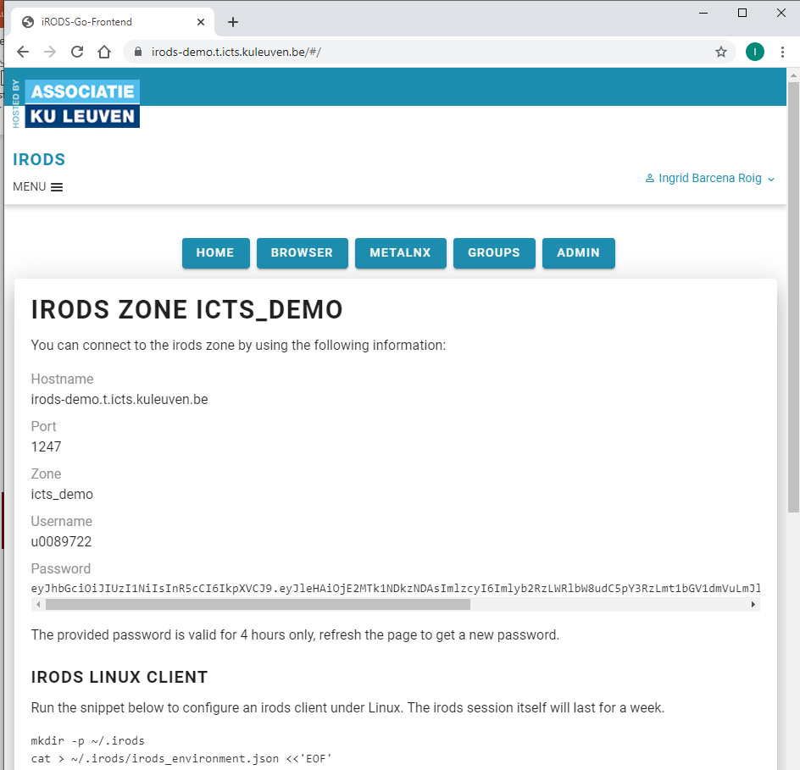
Login portal

Slide 7
Hands-on
Connecting to the KU Leuven testbed

Slide 8
Go to: https://irods-demo.t.icts.kuleuven.be/
Authenticate using your u-account:
You will be sent to the KU Leuven login page
You are in!

Slide 9
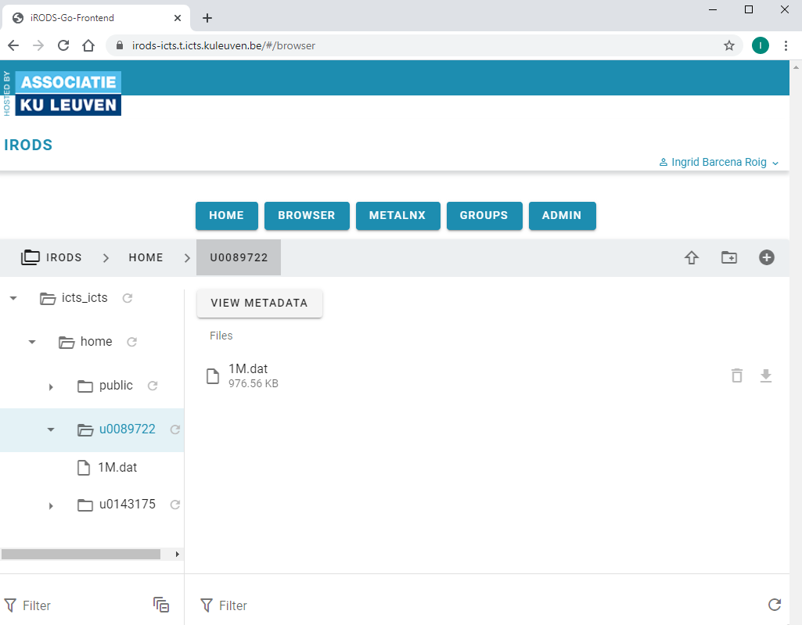
Login portal

Slide 10
Demo admin functions
Admin tab
Users -> add, remove, make group admin
Administrators tab
Groups tab: add quota to group, remove
Group tab
Join group
Click group: add/remove users, add machines

Slide 11
Hands-on
Demo of the functionalities of the Login Portal
Explore the demonstrated functionalities
Navigate to your home
Create a new folder
Upload a file
Download the file
Delete the file
Look at the metadata
Add a metadata attribute

