Slide 1
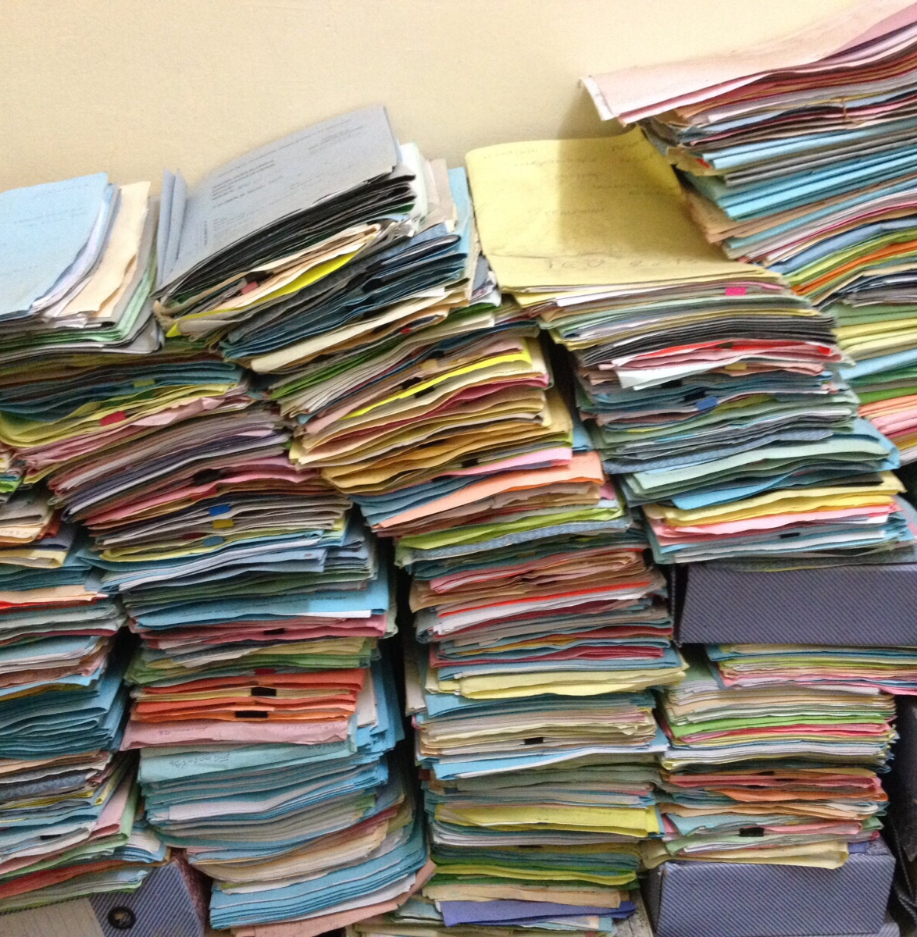
09. Rules User Training
©CarlesBarcenaRoig

Slide 2
Overview
What are rules?
Types of rules
PEP-based rules
User-made rules
Delay rules
How do user-made rules work?

Slide 3
What are rules?
Good data management rests on policies
For example:
“Checksums need to be checked every night”
“After an object gets uploaded, technical metadata should be added”
“Important data should have backups”
Rules are a way of automating and enforcing these policies

Slide 4


Why do we need to automate?
Workload
Managing large collections manually takes a lot of work
Consistency
Humans make (small) errors, for example
when adding metadata
Human | Computer
‘Cat’ | ‘Cat’
‘cat’ | ‘Cat’
‘a cat’ | ‘Cat’
Efficient, reliable and consistent data management

Slide 5



Types of rules
Rules can be classified by the way they are triggered:
PEP-based rules triggered by events
User-made rules triggered by users
Delay rules triggered by time

Slide 6
PEP-based rules
PEP = Policy Enforcement Point = an event
E.g. ‘when a data object is removed’
Actions in the rule are automatically undertaken when this PEP occurs
Meant for automating community-wide policies
Only available for admins

Slide 7
User-made rules
A script written and executed by the user
Meant for personal use

Slide 8
Delay rules
Both PEP-based and user-made rules can be programmed for delayed execution
Rules get executed based on time
At a specified time e.g. ’the 20th of Oktober 2020 00:00’
At a specified interval e.g. ‘every hour’
Combinations e.g. ‘every day until the 1st of January 2021’
Etc…

Slide 9
How do user-made rules work?
Easiest way: storing your rules in a file (e.g. testRule.r)
Executed with the iRule command:
irule –F testRule.r
indicates that the rule is in a file

Slide 10
How do user-made rules work?
File written in the iRODS rule language
Syntax:
rulename(condition){
actions
}
input INPUT
output OUTPUT

Slide 11
How do user-made rules work?
Example
greetingRule{
writeLine(“stdout”, “Hello *name !”);
}
input *name=“Jan”
output ruleExecOut

Slide 12
How do user-made rules work?
Not every rule needs a condition:
this rule is triggered unconditionally
Example
greetingRule{
writeLine(“stdout”, “Hello *name !”);
}
input *name=“Jan”
output ruleExecOut
Output
Hello Jan!
Print output to the screen (instead of writing it to a log, for example)

Slide 13
More useful scenarios
Applying metadata to a whole collection
Checking data checksums every night and sending a mail if something is wrong
Cleaning the trash folder every two weeks
…
You can do this!
The next tutorial will teach you how…

