Slide 1
Parallel I/O and the Lustre file system

Slide 2
Should you care about (parallel) I/O?
I/O typically only takes a small fraction of wall time
Focus on more time-consuming components?
Serial I/O might limit scaling
Parallel output can be more convenient
File system is shared, you might be annoying others

Slide 3
Overview
Theory
What is a parallel file system?
The Lustre parallel file system
Parallel input/output
Use cases
Single writer – single file: Int2lm
Multiple writers – single file: HDF5 hyperslabs
Many writers – many files: High throughput

Slide 4
Overview
Theory
What is a parallel file system?
The Lustre parallel file system
Parallel input/output
Use cases
Single writer – single file: Int2lm
Multiple writers – single file: HDF5 hyperslabs
Many writers – many files: High throughput

Slide 5

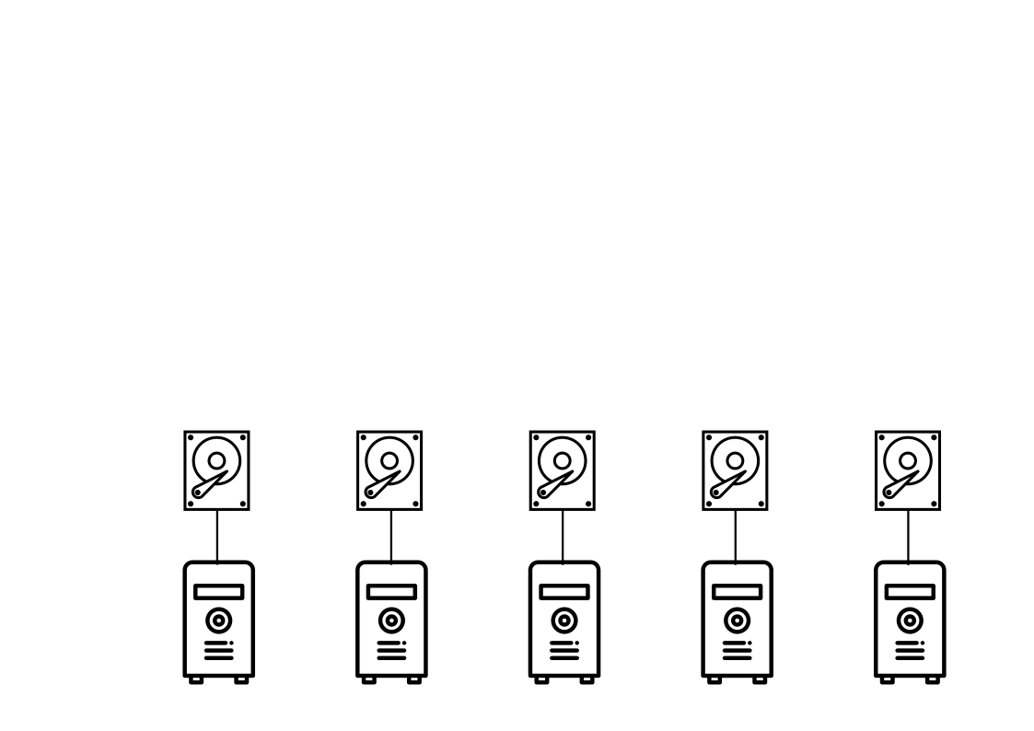
Components of a serial file system
Our cluster has many compute nodes and many storage “devices”
Serial file system: one compute node mounts one storage device
${VSC_SCRATCH_NODE}

Slide 6
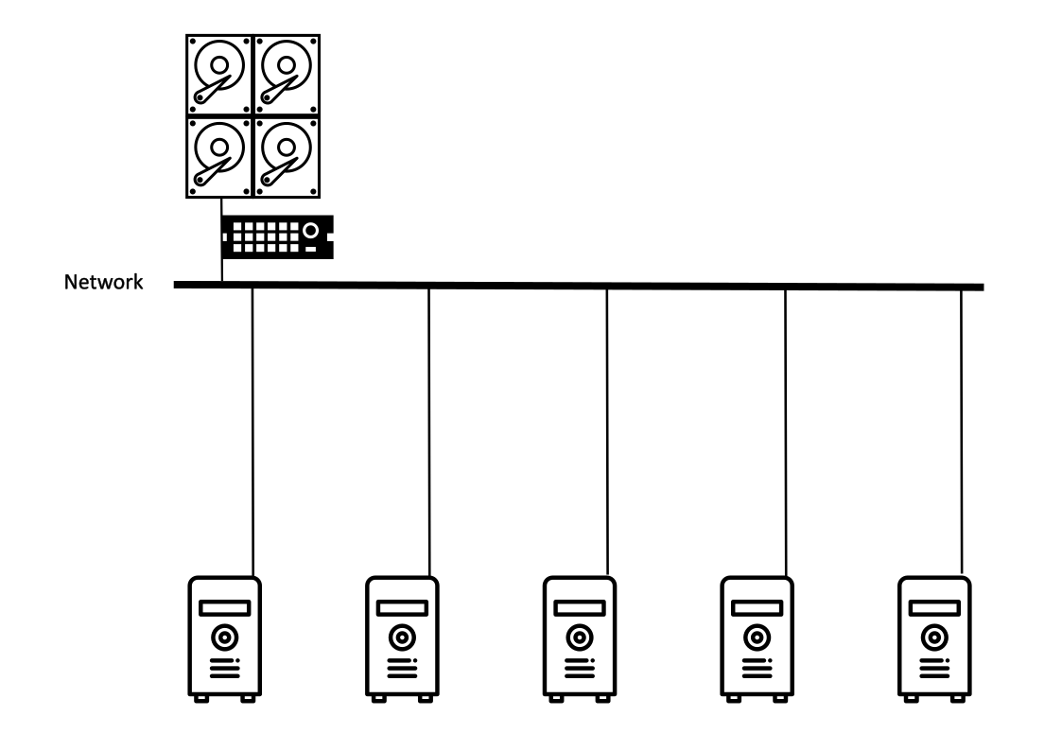
Components of a shared file system
${VSC_DATA} and /apps
Shared file system: one (logical) storage device is accessible from many compute nodes

Slide 7
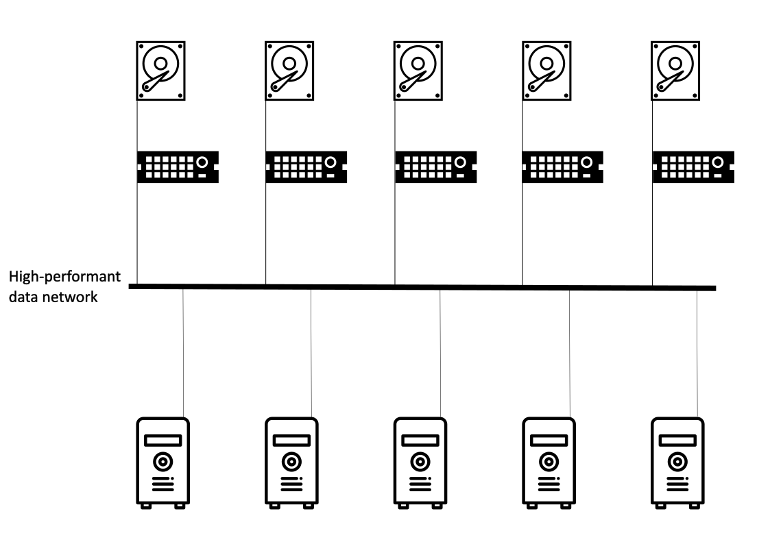
Components of a parallel file system
${VSC_SCRATCH} and /staging
Parallel file system
allows distributing (a) file(s) across multiple storage servers
regulates concurrent access from multiple clients

Slide 8
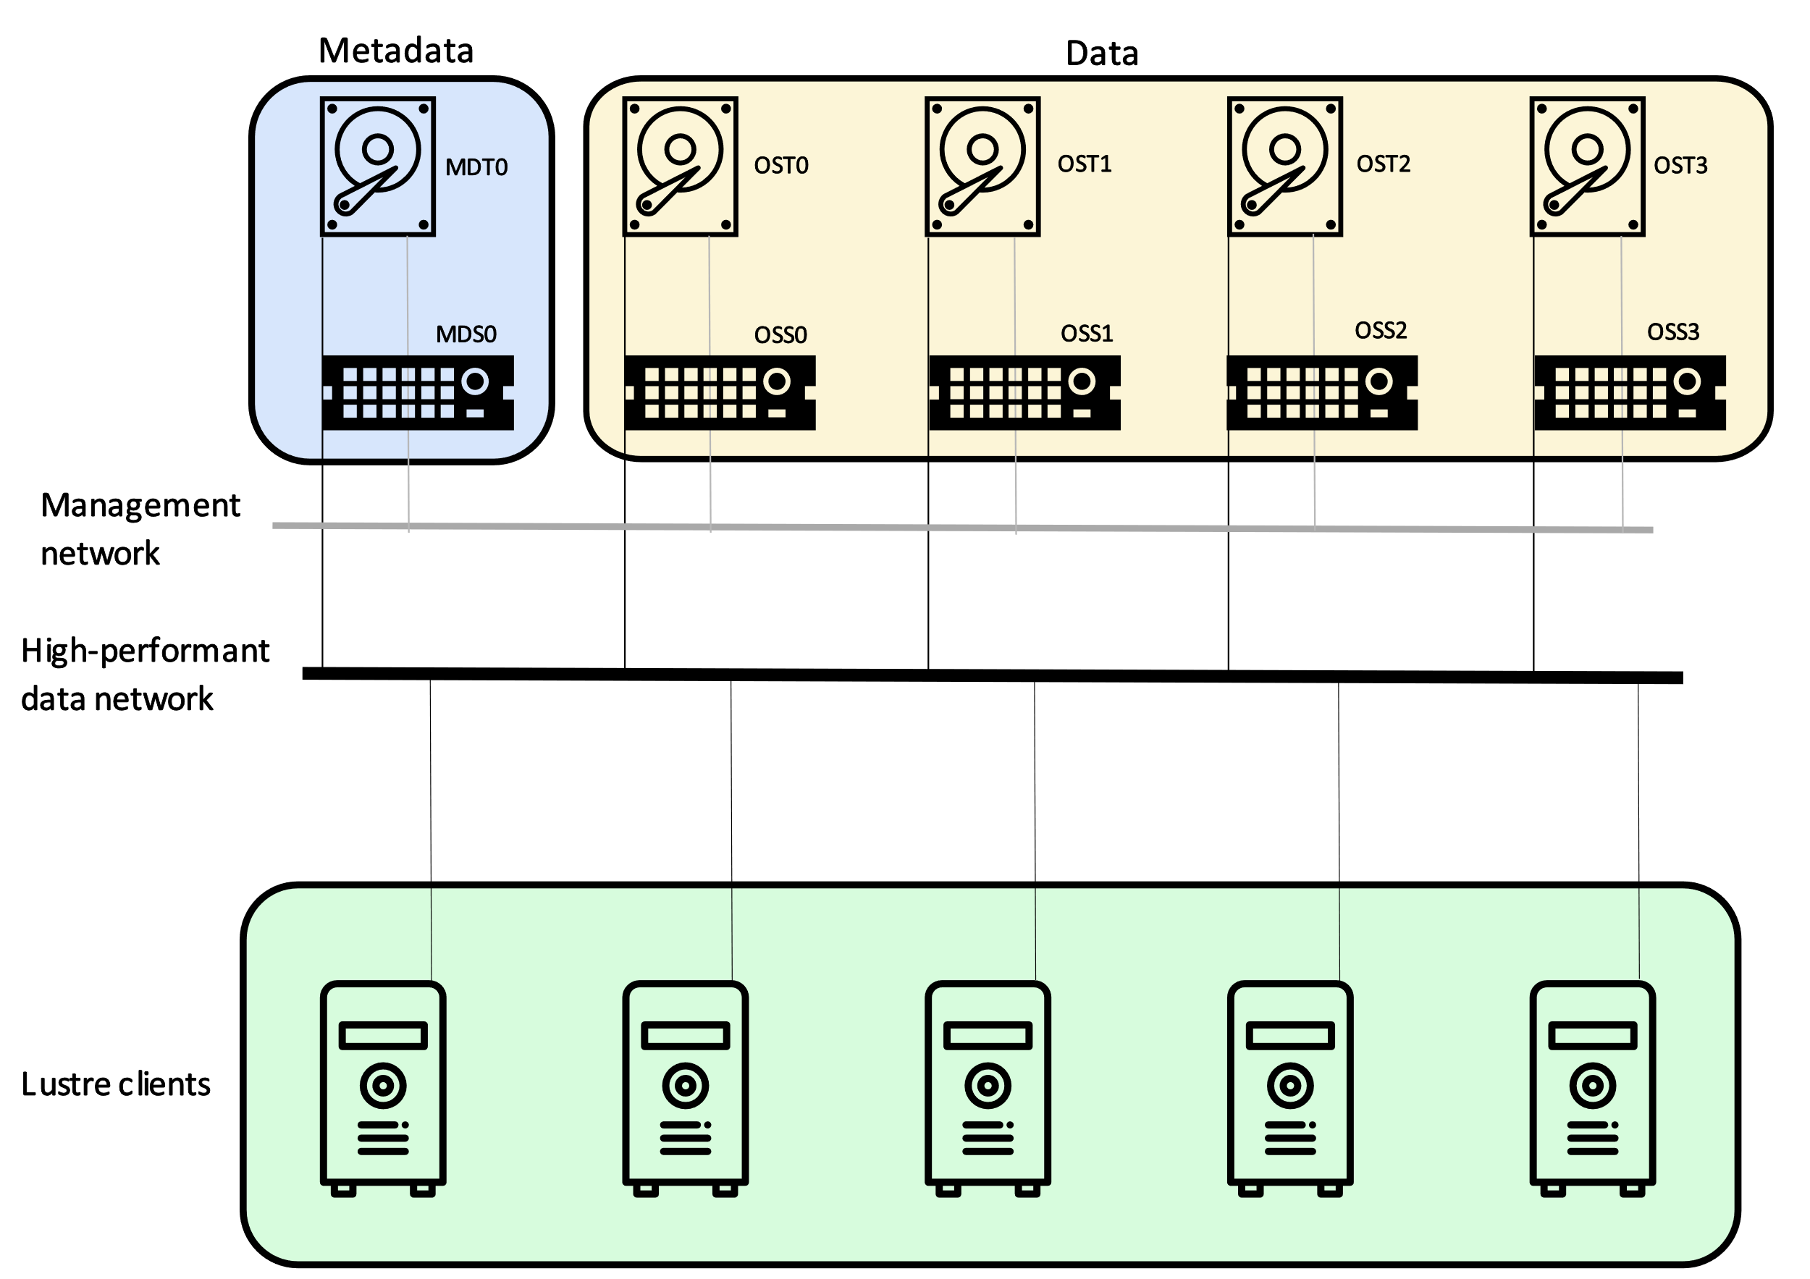
The Lustre parallel file system
Lustre is an open-source parallel file system, generally used for large-scale cluster computing
MDS (metadata servers) provide metadata services
OSS (object storage servers) give access to actual data on OSTs (object storage targets)
Lustre clients expose the filesystem namespace to users

Slide 9
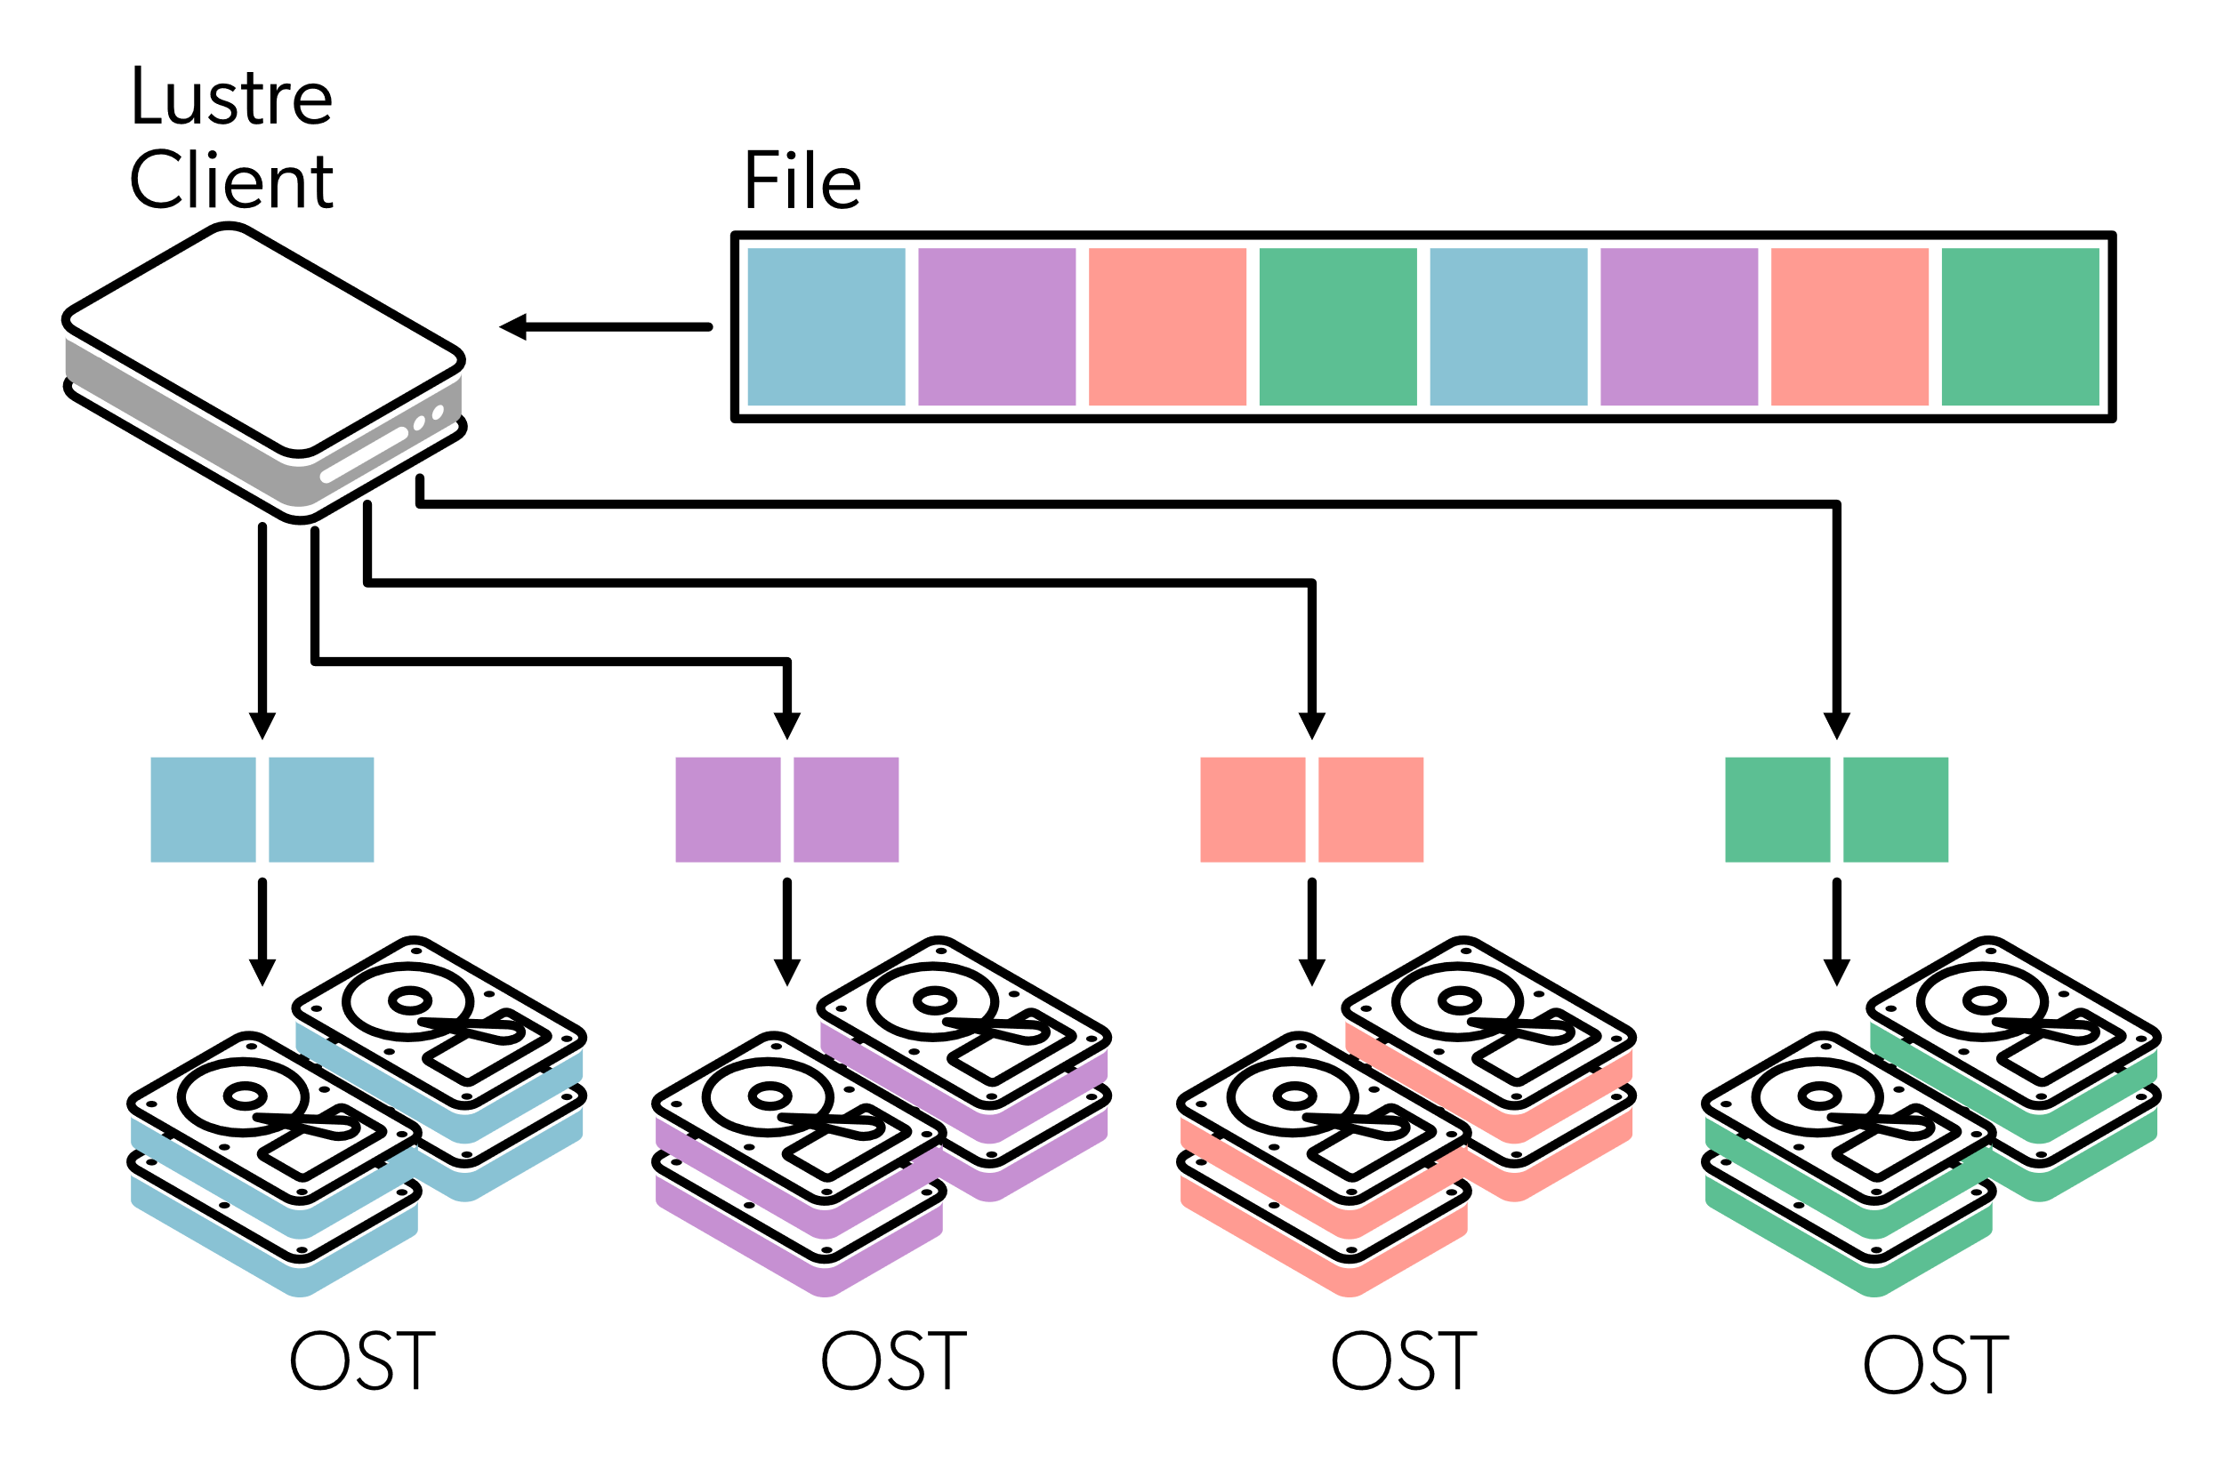
Lustre terminology
A file is striped across multiple storage servers
Stripe count: number of OSTs over which file is distributed
Stripe size: number of bytes per colored block
Can be set by users on a per-file basis

Slide 10
KU Leuven Lustre setup
2 metadata servers
Users/projects are alternated between metadata servers
For 1 user/project: metadata is not striped
Flash pool
Contains 2 OSTs backed by SDDs (60TB total capacity)
Intended for small files and files requiring random access
Disk pool
Contains 8 OSTs backed by HDDs (3 000TB total capacity)

Slide 11
KU Leuven Lustre default striping
Your $VSC_SCRATCH directory
lfs setstripe -E 128k -L mdt \ # Store first 128k of file together with metadata
-E 1M --pool flash -c 1 -S 1M \ # Store next 1M on SDD with stripe
# count 1 and stripe size 1M
-E -1 --pool sdisk -c 8 -S 4M \ # Store rest of file on HDD with stripe
# count 8 (all OSTs) and stripe size 4M
/lustre1/scratch
Staging directories
lfs setstripe --pool sdisk -c -1 -S 4M \ # Store entire file on HDD using all OSTs
# and stripe size 4M
/lustre1/project
You can use these commands to adapt settings for your own folders
Files/directories inherit settings from parent directory
Use it with care, you can mess things up

Slide 12
Overview
Theory
What is a parallel file system?
The Lustre parallel file system
Parallel input/output
Use cases
Single writer – single file: Int2lm
Multiple writers – single file: HDF5 hyperslabs
Many writers – many files: High throughput

Slide 13
Parallel I/O
Parallel file system:
Distributes files over multiple storage servers
in a transparant way to (multiple) clients
Parallel I/O:
multiple processes perform coordinated read/write operations on a file (definition in this presentation)

Slide 14
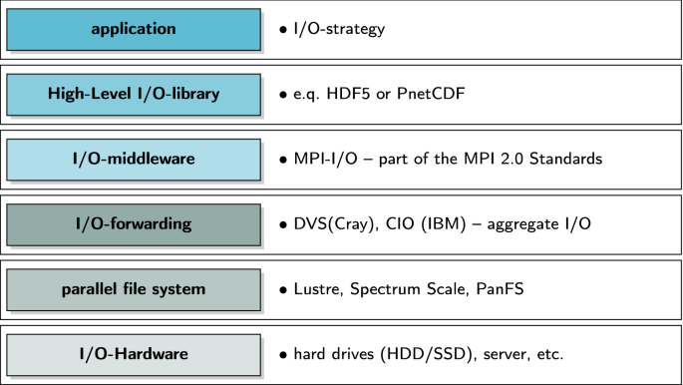
The parallel I/O stack
Do not try to implement parallel I/O from the ground up yourself!

Slide 15
Parallel I/O libraries
MPI-IO: part of MPI standard since MPI-2 Allows simple collective I/O patterns by defining a file view in each MPI rank
HDF5: builds on MPI-IO if compiled with parallel support File format remains the same, allows collective I/O patterns common in science with relatively little code modifications
PnetCDF: parallel version of netCDF high performance library for parallel I/O with minimal changes to the netCDF API syntax

Slide 16
Pitfalls when benchmarking (parallel) I/O
Buffering
No 1-to-1 correspondence between I/O statement in program and disk access
I/O libraries and OS can buffer (e.g. in memory as this is much faster)
Network and file system offer more buffering
If you get incredibly high rates, you might be measuring buffer speed
Network
Parallel file system requires data going through network
You will never see I/O rates higher than the network bandwidth
Other users
Parallel file system is a shared resource
Benchmark results can fluctuate wildly over time
This presentation is user-oriented, benchmark results include these effects

Slide 17
Overview
Theory
What is a parallel file system?
The Lustre parallel file system
Parallel input/output
Use cases
Single writer – single file: Int2lm
Multiple writers – single file: HDF5 hyperslabs
Many writers – many files: High throughput

Slide 18
Single writer – single file: Int2lm
Int2lm: interpolation program related to COSMO (meteorology)
This example writes a few tens of netCDF files (each ±100MB)
No parallel I/O
rank 0 collects all data using regular MPI calls and then one process writes entire file
Example runs on a single node, so serial I/O is sensible (intranode MPI communication will not be the bottleneck)
User noticed significant slowdown after Lustre was initially taken into production

Slide 19
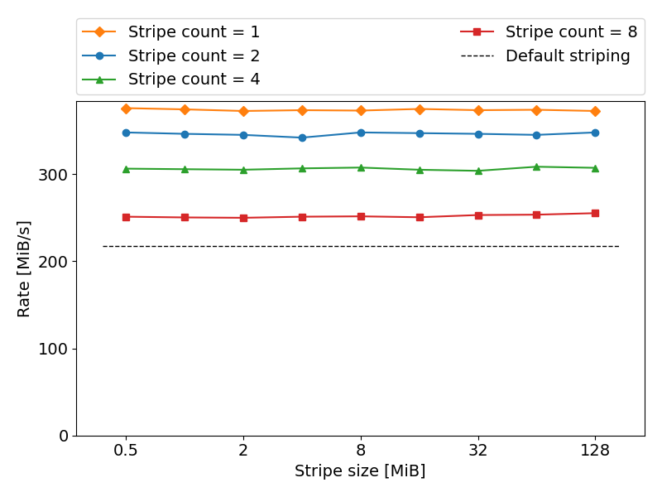
Single writer – single file: Int2lm
Stripe count > 1: no benefits
Only 1 process is writing
No advantage in using multiple storage targets
Higher stripe counts introduce high overhead in this case
Default striping has a stripe count of 8, far from optimal here
Stripe size: very small influence
Colored symbols: entirely on HDD, eg. lfs setstripe -E -1 --pool sdisk -c 4 -S 4M .

Slide 20
Overview
Theory
What is a parallel file system?
The Lustre parallel file system
Parallel input/output
Use cases
Single writer – single file: Int2lm
Multiple writers – single file: HDF5 hyperslabs
Many writers – many files: High throughput

Slide 21
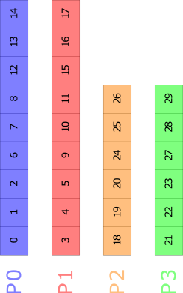

Multiple writers – single file: hyperslabs
Representation in memory
Physical view
Grid-based code with 2D domain decomposition
General: each process “owns” a hyperslab
This example: dump grid values to file
Representation on disk

Slide 22
Hyperslabs: I/O approaches
Each process writes its own data to its own file + very easy to program + performance is probably ok - output is mangled (out-of-order) - many small files
Collect all data in rank 0 + output is correctly ordered - programming effort - I/O is serialized, does not scale
Parallel I/O + output is correctly ordered + (potentially) highly performant - some effort to implement
Example: parallel dataset writing with HDF5

Slide 23
Hyperslabs: serial dataset creation with HDF5
global_counts = (/ Nx, Ny /)
allocate(field(global_counts(1), global_counts(2)))
call h5fcreate_f(fn, H5F_ACC_TRUNC_F, file_id, h5_err)
call h5screate_simple_f(2, global_counts, file_space_id, h5_err)
call h5dcreate_f(file_id, 'field', H5T_NATIVE_DOUBLE, file_space_id,&
dataset_id, h5_err)
call h5dwrite_f(dataset_id, H5T_NATIVE_DOUBLE, field, global_counts,&
h5_err, file_space_id=file_space_id)
① Create field in memory
② Initialize HDF5 file
③ Initialize dataset
④ Write dataset to file

Slide 24
Hyperslabs: parallel dataset creation with HDF5
global_counts = (/ Nx, Ny /)
local_counts = (/ Nx/Px, Ny/Py /)
local_offsets = (/ xrank*Nx/Px, yrank*Ny/Py\)
allocate(field(local_counts(1), local_counts(2)))
call h5pset_fapl_mpio_f(plist_id, MPI_COMM_WORLD, info, h5_err)
call h5fcreate_f(fn, H5F_ACC_TRUNC_F, file_id, h5_err, access_prp=plist_id)
call h5screate_simple_f(2, global_counts, file_space_id, h5_err)
call h5dcreate_f(file_id, 'field', H5T_NATIVE_DOUBLE, file_space_id,&
dataset_id, h5_err)
call h5screate_simple_f(2, local_counts, mem_space_id, h5_err)
call h5sselect_hyperslab_f(file_space_id, H5_SELECT_SET_F, local_offsets,&
local_counts, h5_err)
call h5pset_dxpl_mpio_f(plist_id, H5FD_MPIO_COLLECTIVE_F, h5_err)
call h5dwrite_f(dataset_id, H5T_NATIVE_DOUBLE, field, global_counts,&
h5_err, file_space_id=file_space_id, mem_space_id=mem_space_id,&
xfer_prp=plist_id)
① Create local field in memory
② Initialize HDF5 file in parallel
③ Initialize dataset
④ Create mapping between global dataset and local memory
⑤ Collectively write to file
Notes:
Still need to fix the design of this slide

Slide 25
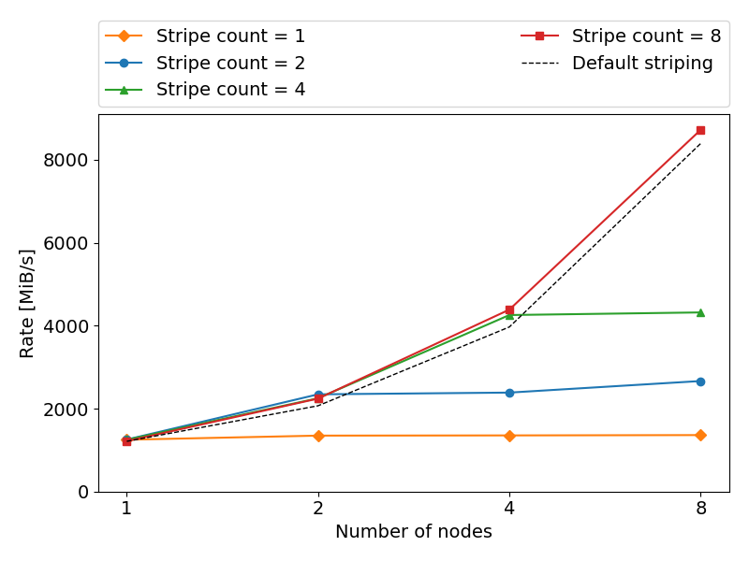
Hyperslabs: write rates for multinode runs
Problem setup
[1024, 1152, 1024] array => 9GiB
Distributed over 2nd (intranode) and 3rd (internode) dimension
72 cores/processes per node
# nodes = 8
Write rate scales with # of nodes
Default is close to optimal
Stripe count = 1
Almost no speed up past 1 node
Single node: independent of stripe?
No intranode scaling?

Slide 26
The parallel I/O stack
Do not try to implement parallel I/O from the ground up yourself!

Slide 27
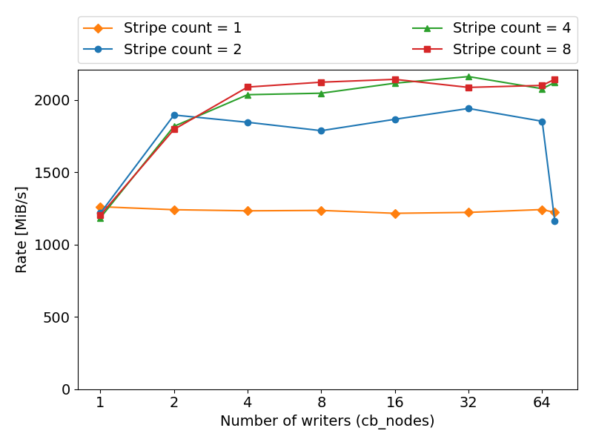
Hyperslabs: write rates for single-node runs
I/O Middleware-Forwarding layer
Outside of HDF5, output from multiple processes is aggregated
Default: 1 writer per node to reduce overhead
Default can be overridden by specifying cb_nodes to ROMIO
Intranode scaling
Same test case as before, all results on 1 node (72 processes)
The write speed increases with number of writers
Scaling limited to stripe count

Slide 28
Overview
Theory
What is a parallel file system?
The Lustre parallel file system
Parallel input/output
Use cases
Single writer – single file: Int2lm
Multiple writers – single file: HDF5 hyperslabs
Many writers – many files: High throughput

Slide 29
Many writers – many files: high throughput
(Anonymous) user running legacy script/code => no I/O problems for single task
Scaling up to 100k tasks, running multiple tasks concurrently => directories containing up to 1M files => jobs doing 1M (10^6) metadata operations per minute => other users notice “ls” commands hanging
Best practices
Try to limit metadata operations where possible
Limit number of files inside a single directory
Use ${VSC_SCRATCH_NODE} if possible
Install conda environments in a container

Slide 30
Conclusions
Lustre is the parallel file system of our Tier-2 clusters
Users may need to tweak stripe count and stripe size (understanding Lustre helps!)
Look at libraries like HDF5 or PnetCDF to make your application to parallel I/O
Lustre (and most other file systems) don’t like many small files => be careful with e.g. high-throughput
Contact support if you think you can improve your I/O

Slide 31
Parallel I/O and the Lustre file system
hpcinfo@kuleuven.be

