Slide 1
Open Ondemand: workshop

Slide 2
General
User interface to use the KU Leuven Tier2 cluster from a browser:
File Explorer
Create, start and monitor jobs
Integrated shell
Interactive apps

Slide 3
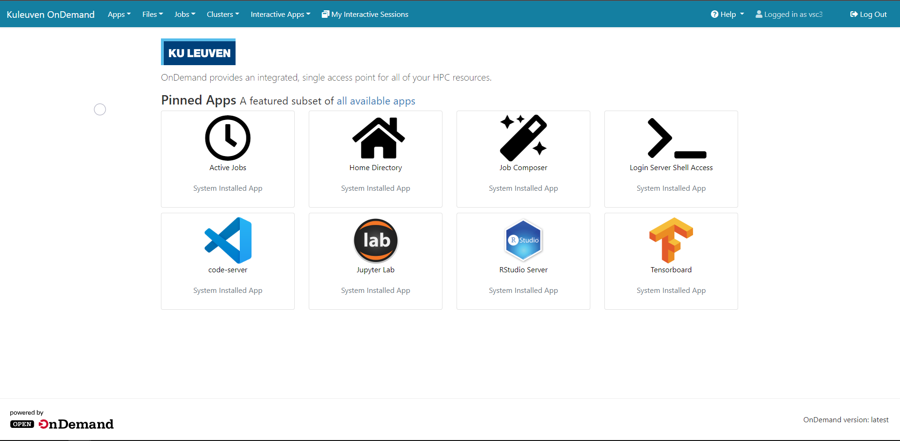
Getting started
Go to https://ondemand.hpc.kuleuven.be
Log in using your KU Leuven credentials
All menus gathering a wide range of options:
Files
Jobs
Clusters
Interactive Apps
My Interactive Sessions

Slide 4
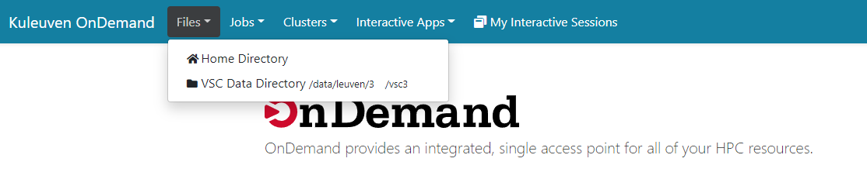
Using the file explorer
Access $VSC_HOME and $VSC_DATA

Slide 5
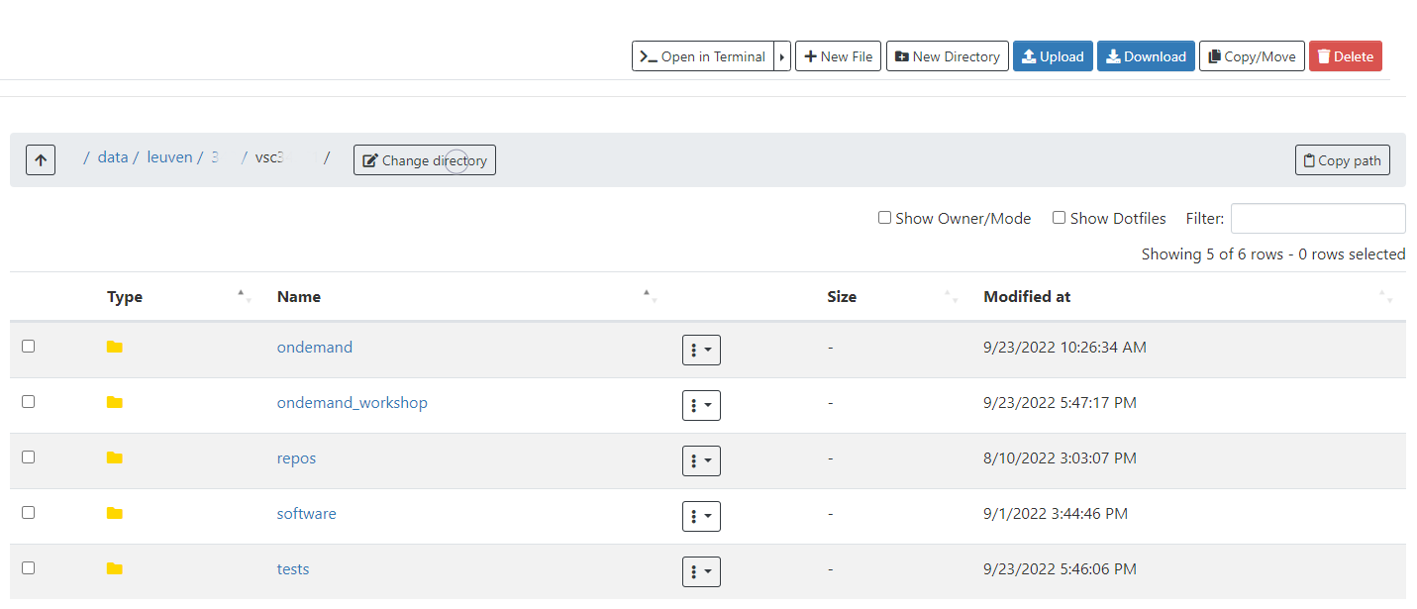
Using the file explorer
File and folder manipulations as in a regular file explorer

Slide 6
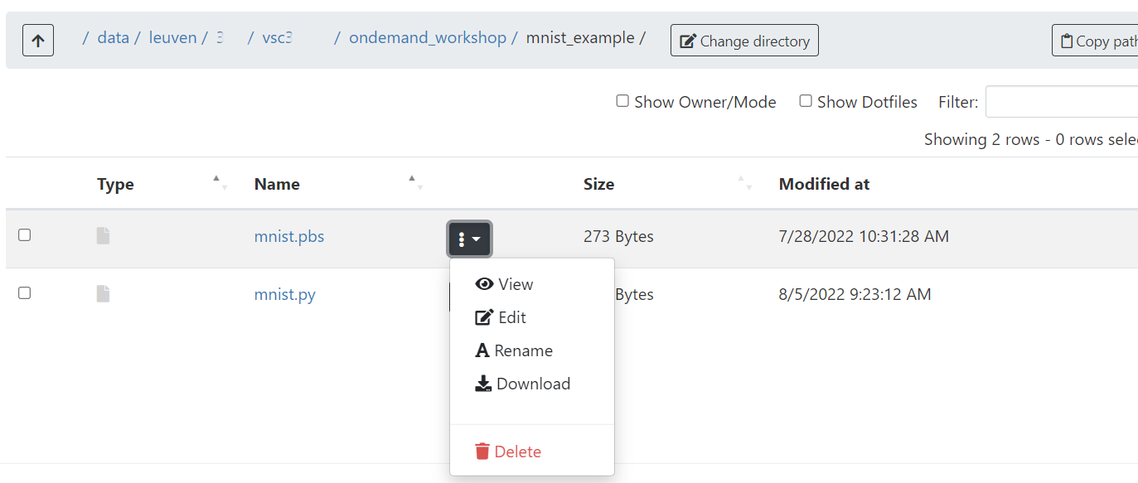
Using the file explorer
File and folder manipulations as in a regular file explorer

Slide 7
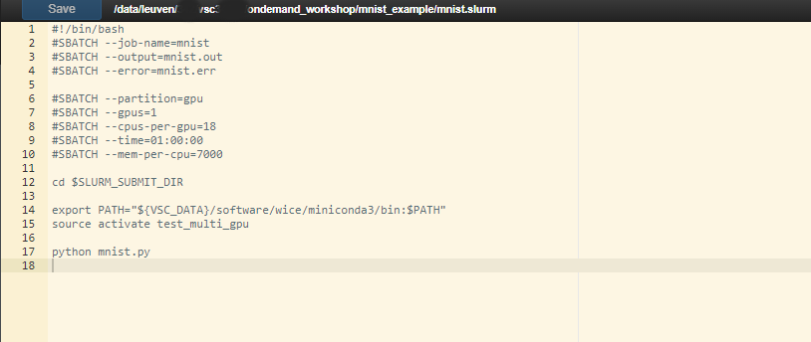
Using the file explorer: editor
File and folder manipulations as in a regular file explorer

Slide 8
Job submission
Job Composer
Create templates
Create jobs
Active jobs
Monitor running, queueing and finished jobs

Slide 9
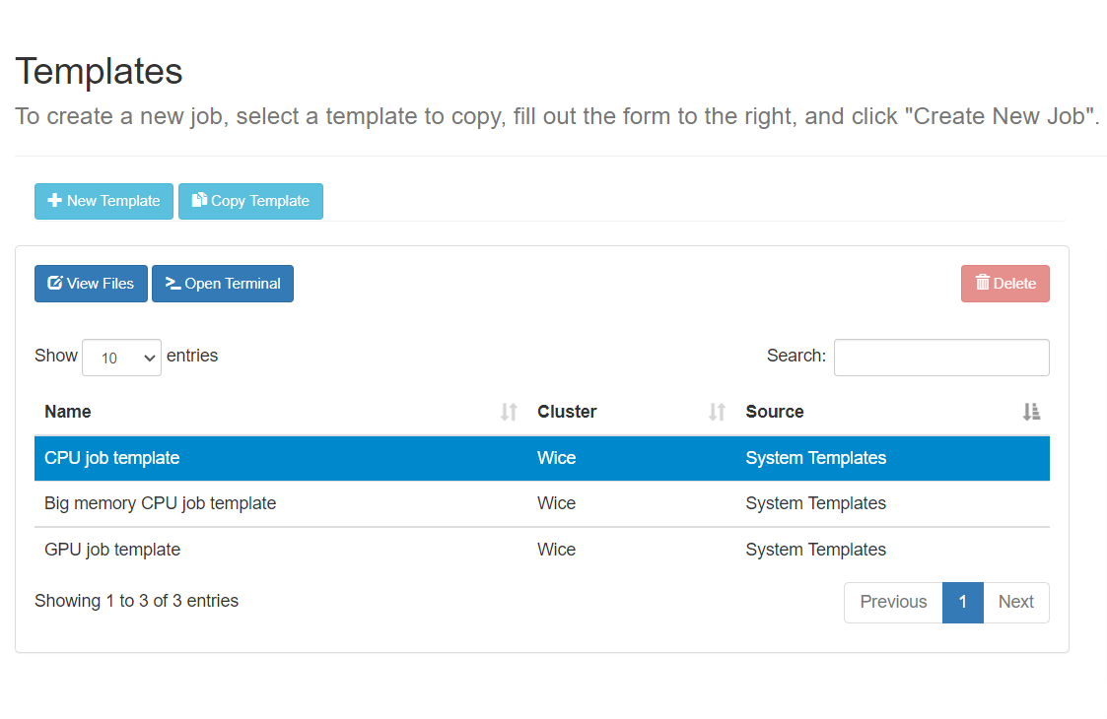
Templates
Create templates to your own preferences
Each template is a folder in $VSC_DATA/ondemand/data/templates/ and contains at least:
Job script
manifest.yml file
Three system templates present:
CPU job template
Big Memory CPU job template
GPU job template

Slide 10
Templates
Creating a new template always starts from another template, copying the whole folder and contents of the original
‘New template’: starts from the default template (default CPU job)
‘Copy template’: use one of the other system templates or a personal template
Adapt to your own preferences with the file explorer (‘View Files’ or ‘Open Dir’ button)

Slide 11
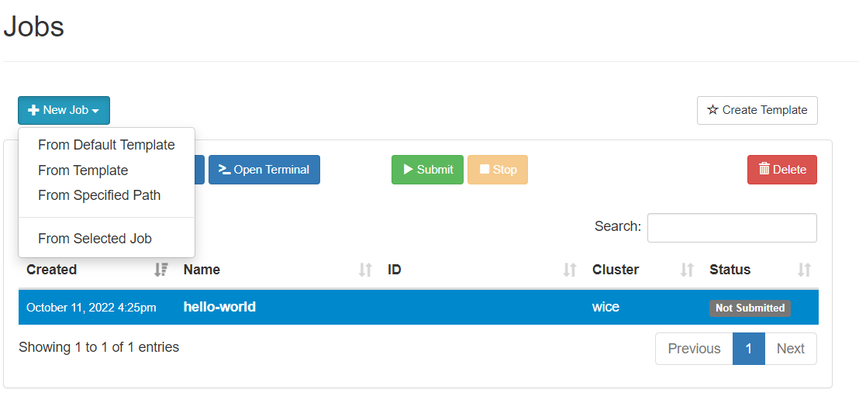
Jobs
Create jobs from the ‘Jobs’ window
Jobs are always created from templates or other jobs
Each job can only be submitted once
Use ‘From Selected Job’ to re-submit the same job

Slide 12
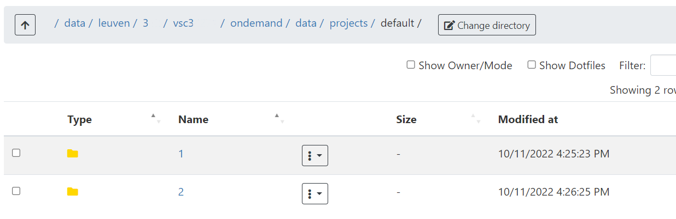
Jobs
New directory for each job in $VSC_DATA/ondemand/data/projects/default
Do not rename the folders, as it will break the linkage with the job menu

Slide 13
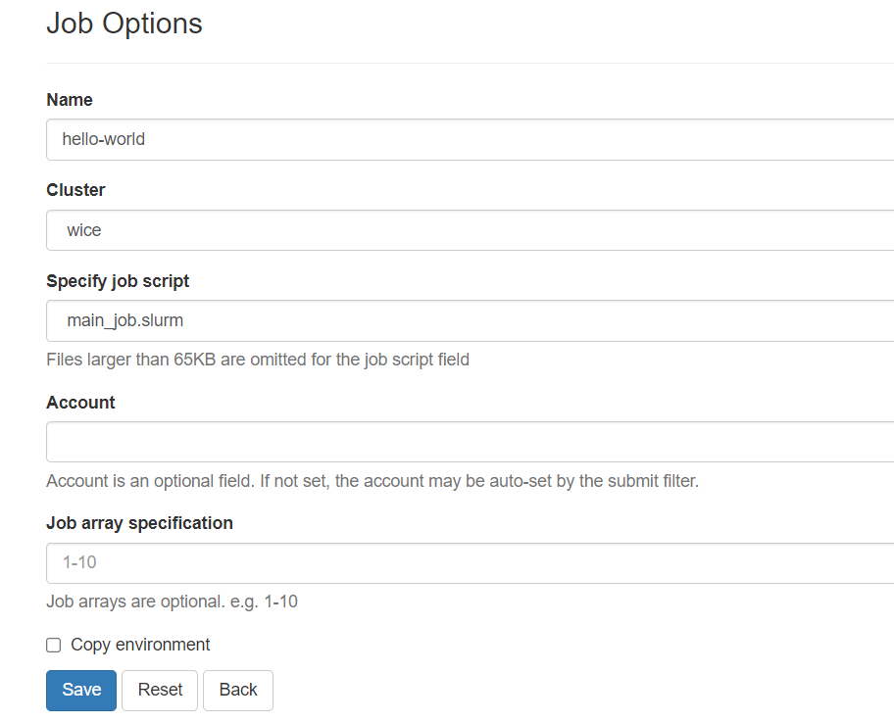
Jobs – Job options
Use the ‘Job Options’ button to specify extra options:
Name
Cluster: only wICE
Specify Job Script
Account: overwrites any account
specified in job script
Job array specification: use ‘worker’
or ‘Atools’ preferably

Slide 14
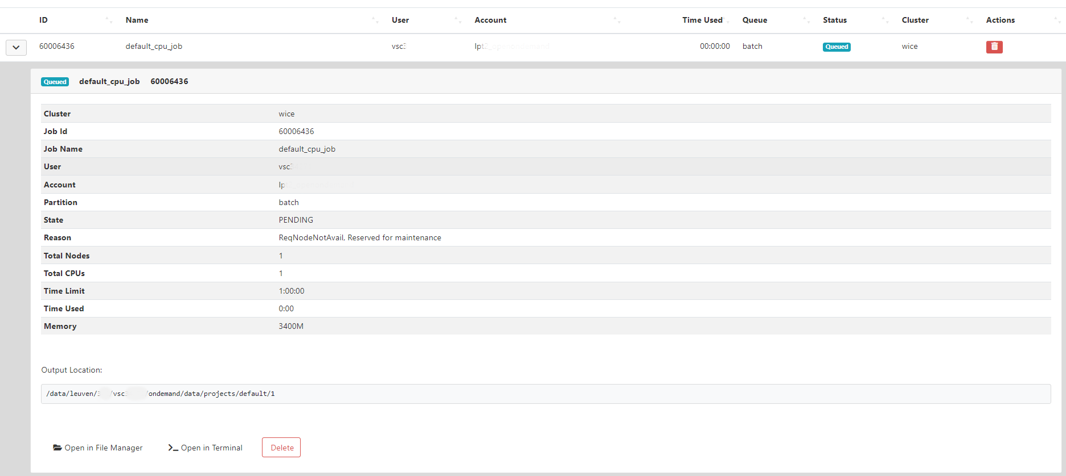
Active Jobs

Slide 15
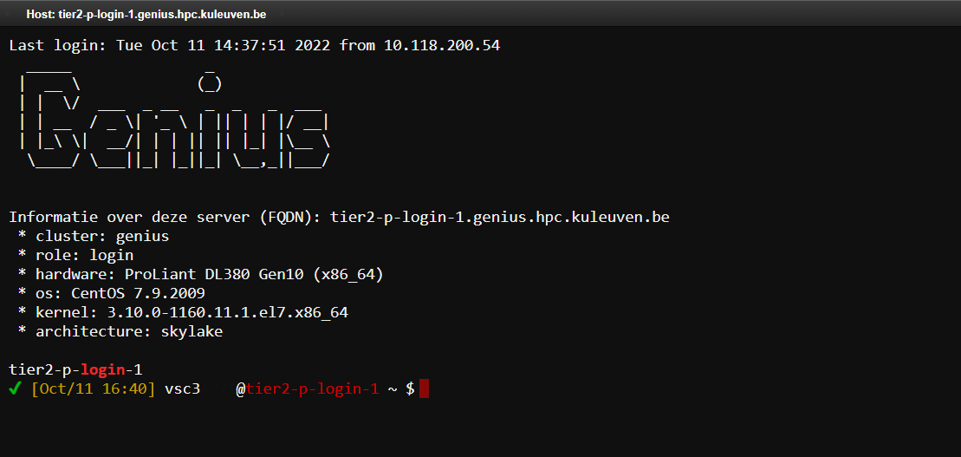
Clusters: shell access
Genius login node
Launch jobs to both Genius (PBS) or wICE(Slurm)

Slide 16
Interactive apps
Currently supported
Jupyter Lab
RStudio Server
Tensorboard
Code-server
In development:
ParaViewWeb
Cryosparc

Slide 17
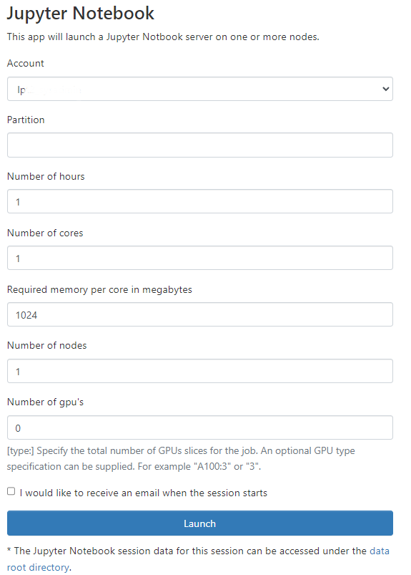
Interactive apps: submitting
Specify resources as for a normal job
Both CPU and GPU jobs possible.
Recommended to use the ‘interactive’
partition for work like debugging, testing,
code development, plotting….
When using the ‘interactive’ partition, one
one ‘GPU’ is one virtual GPU slice (1/7th of
a Nvidia A100 GPU)

Slide 18
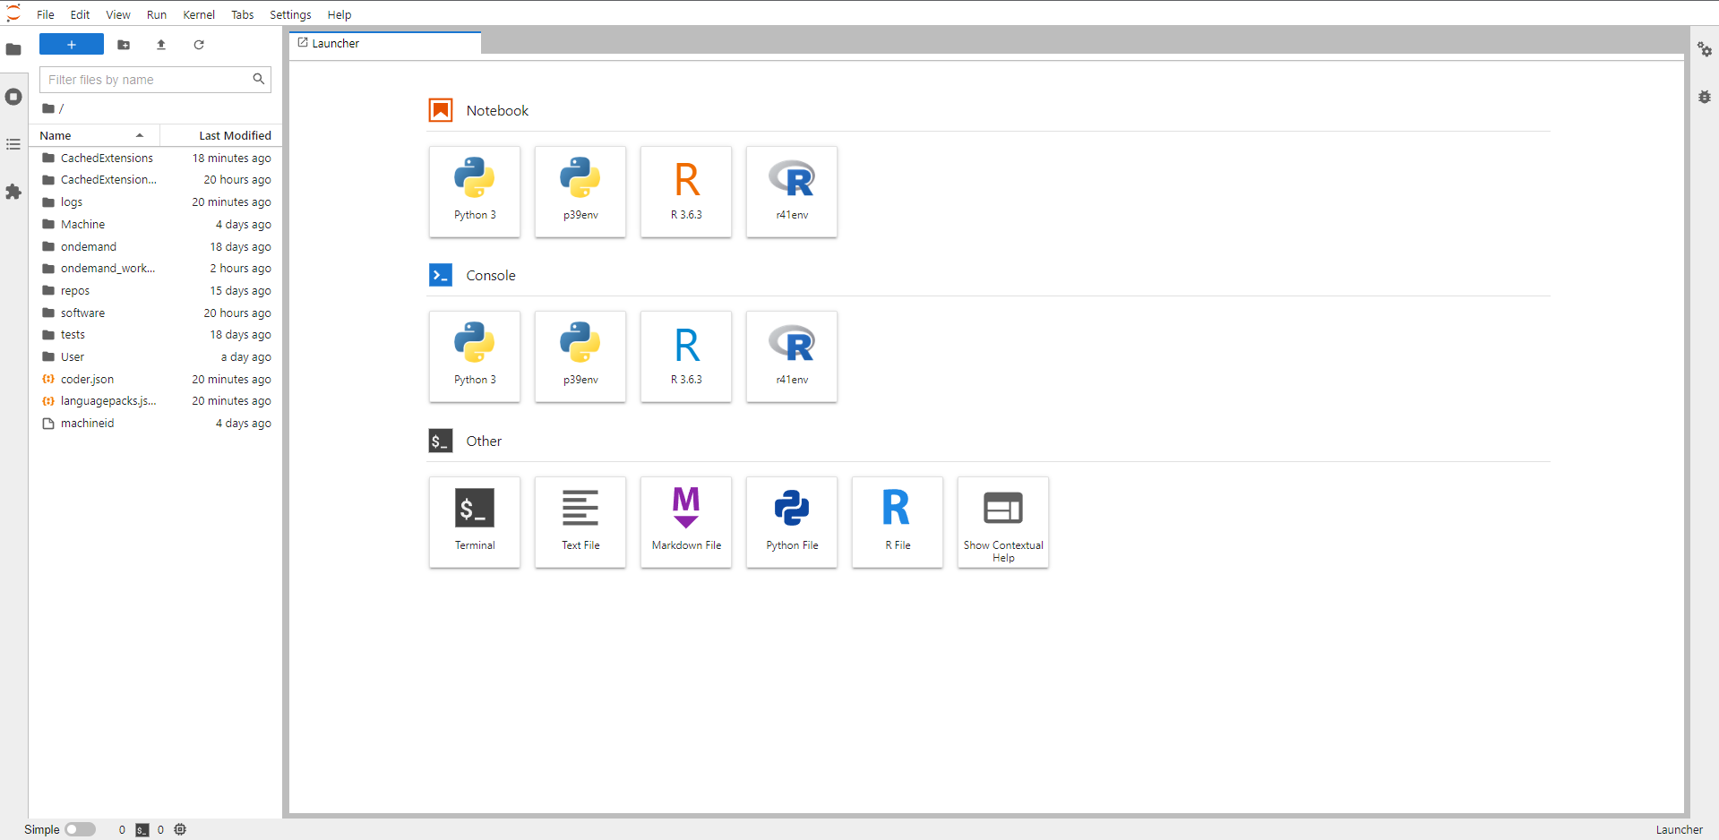
Interactive apps: Jupyter Lab

Slide 19
Interactive apps: Jupyter Lab
Create your own kernels withexisting conda environments
Python
Install ipykernel
conda install ipykernel
Install the kernel
python -m ipykernel install -- prefix=${VSC_HOME}/.local/ --name '<env_name>'
R
Install jupyter-client and irkernel
conda install-c conda-forge jupyter-client r-irkernel
Install the kernel
Rscript -e 'IRkernel::installspec(prefix="${VSC_HOME}/.local/", name="<env_name>", displayname="<kernel_name>")'
Jupyter Lab extensions are not available yet

Slide 20
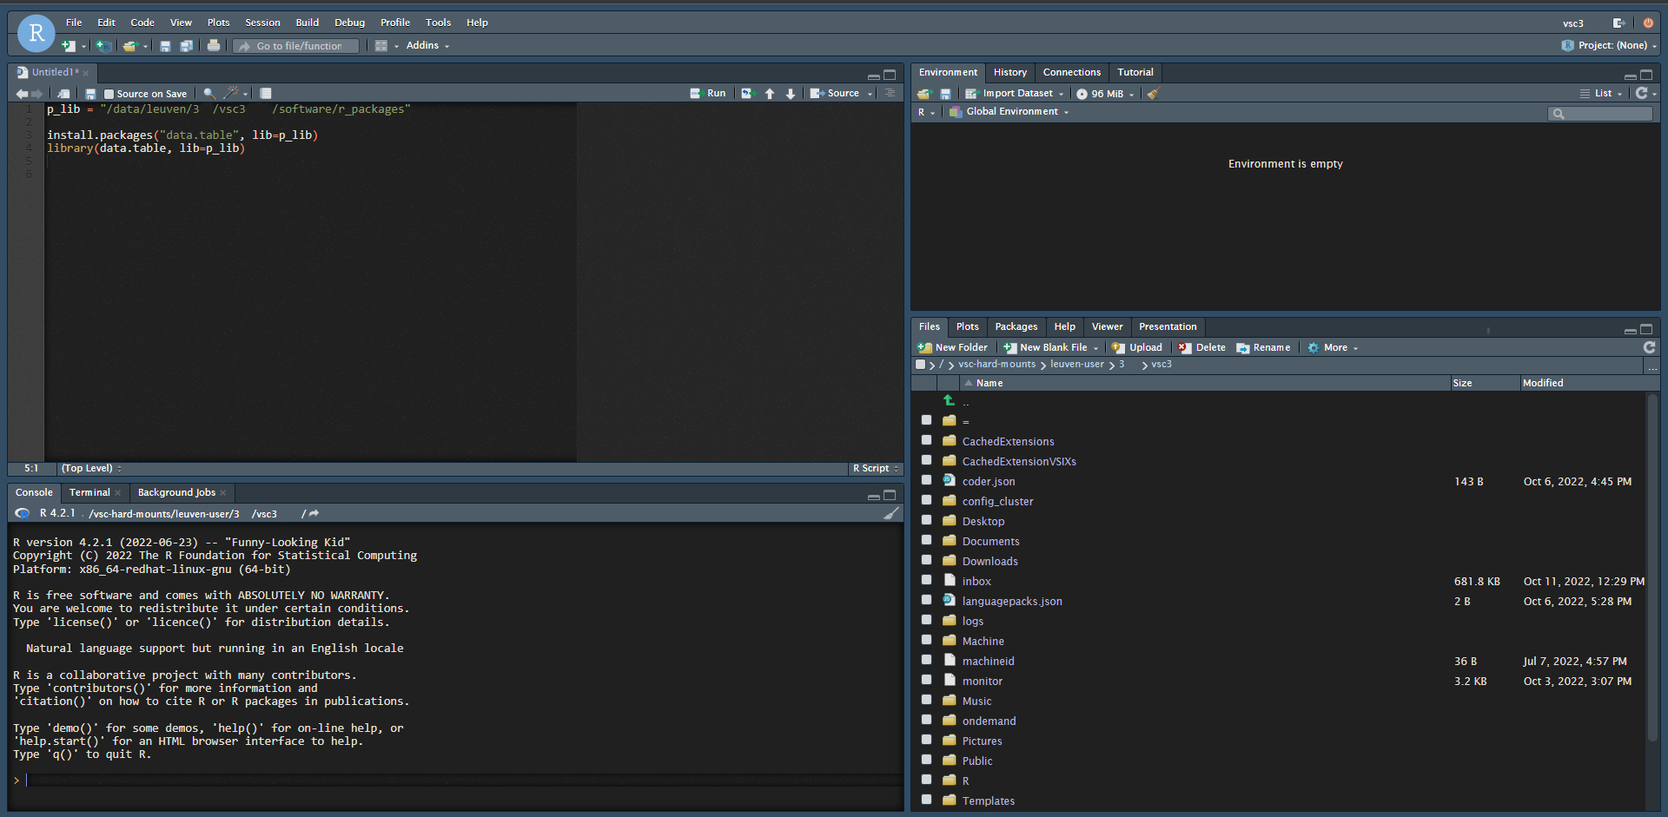
Interactive apps: Rstudio Server
Use ‘lib’ parameter for ‘install.packages’ and ‘library’ functions to save and load packages from custom location (avoid cluttering of $VSC_HOME)
Tools – Install Packages can only install in $VSC_HOME

Slide 21
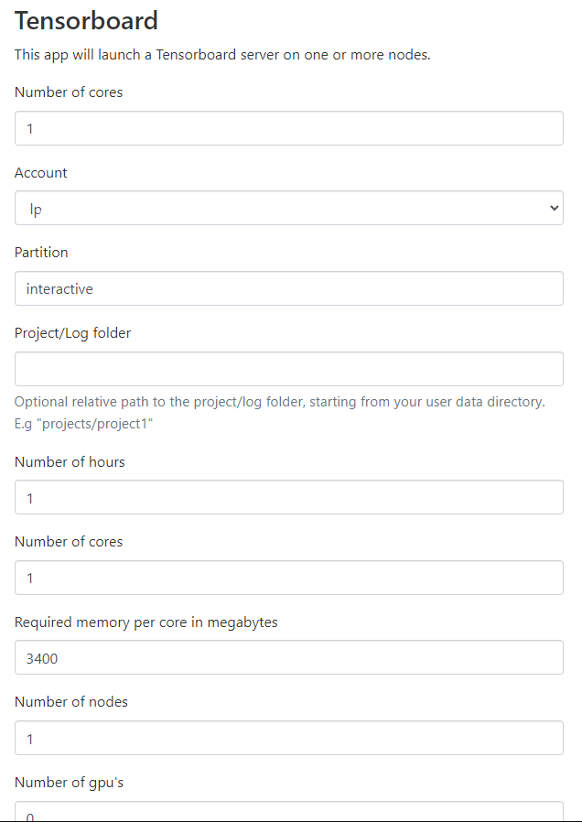
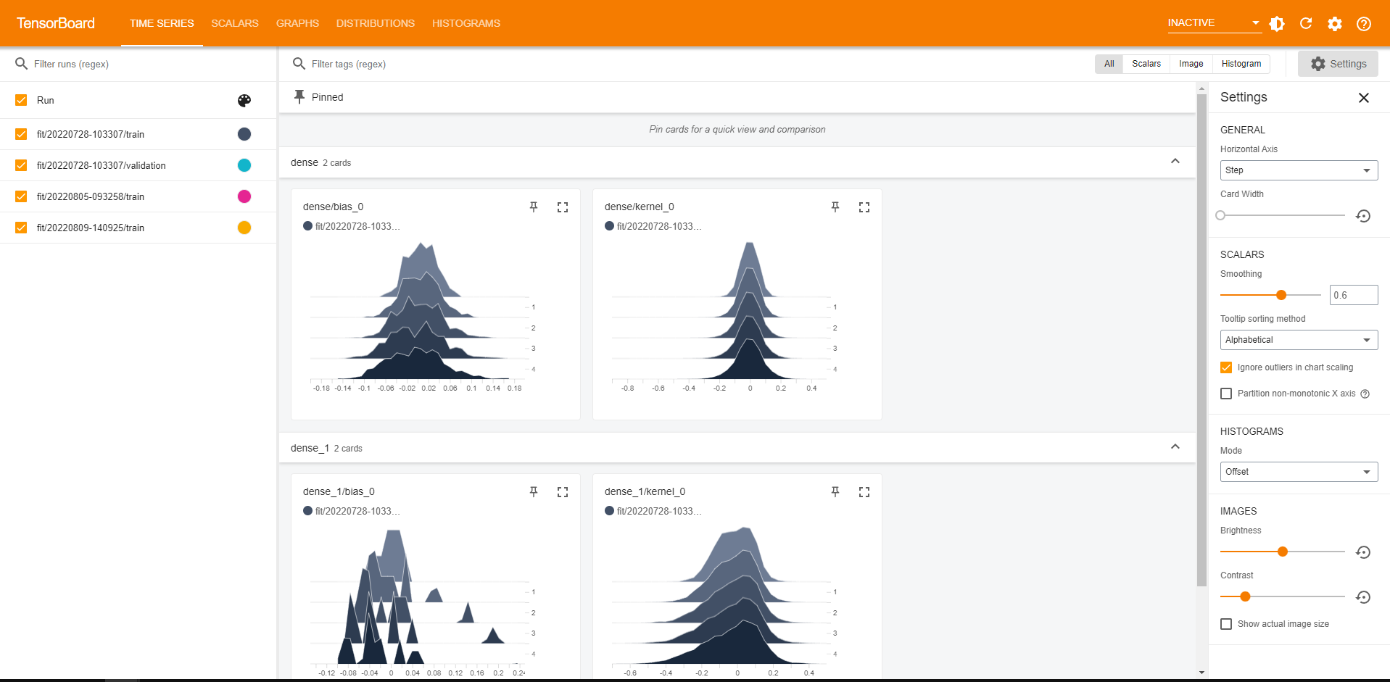
Interactive apps: Tensorboard
Specify your project/log folder relative from $VSC_DATA, as you cannot navigate within Tensorboard

Slide 22
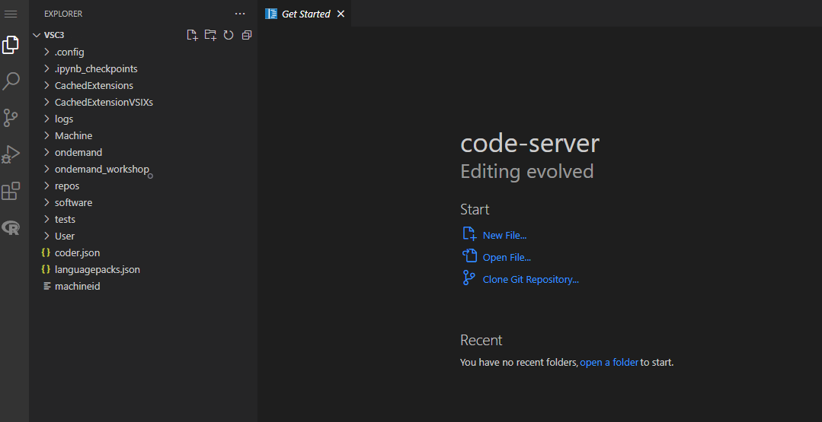
Interactive apps: code-server
Use this IDE with any supported language. You need:
Install of programming language (module, conda env…)
Extension (install through extension menu)

Slide 23
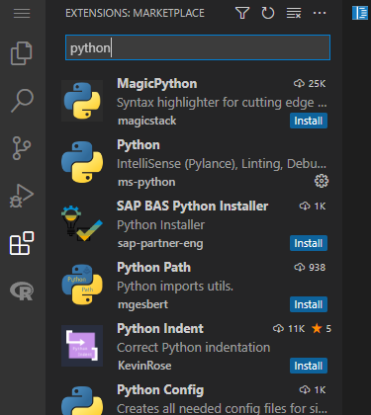
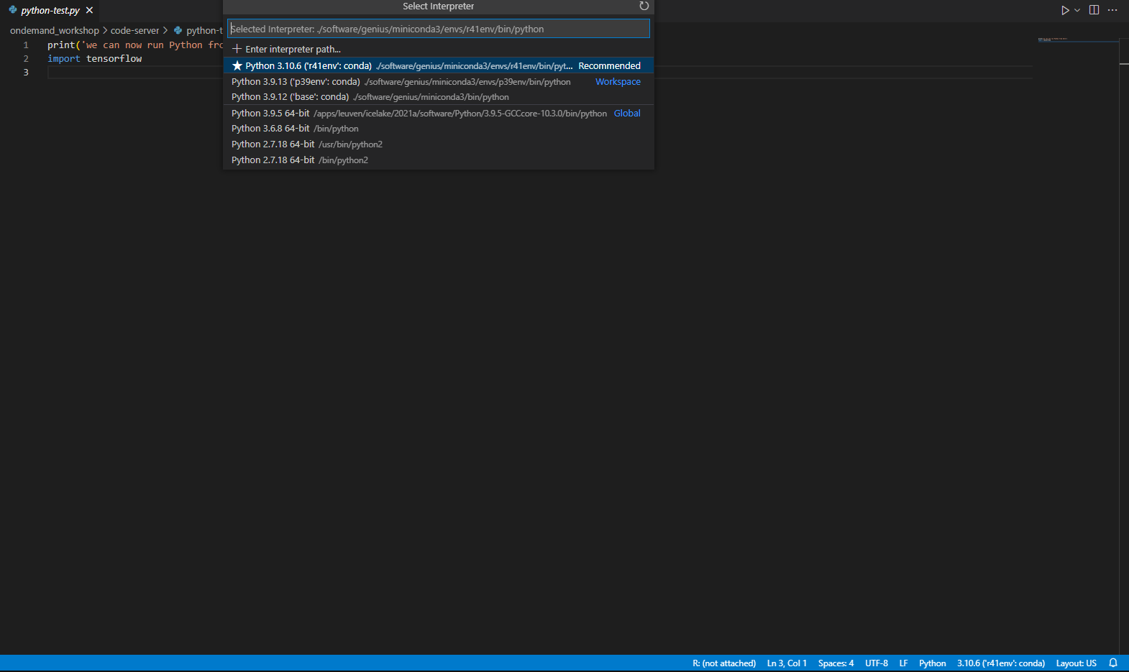
Code-server: example - Python
Install Python from ms-python
Use any module, system or virtual environment Python
Select from version menu
2
1

Slide 24
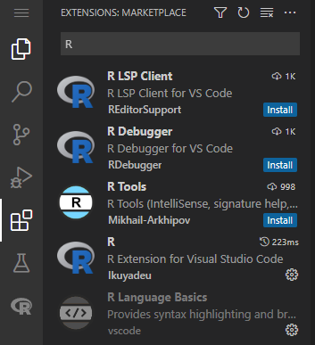
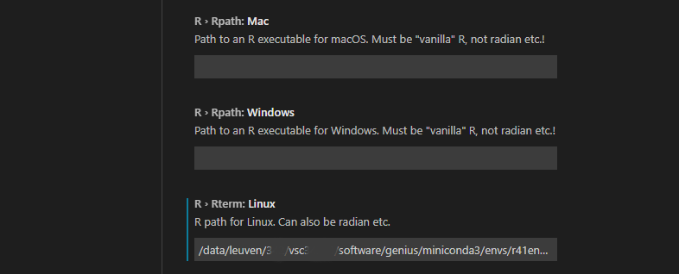
Code-server: example - R
Install R from Ikuyadeu
Click on wheel – ‘Extension settings’ and set ‘R Rterm: Linux’ to your R path (preferably a miniconda installation)

Slide 25
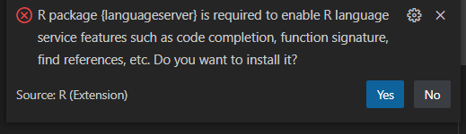
Code-server: example - R
Install ‘r-languageserver’ in your miniconda environment
conda install –c conda-forge r-languageserver
Click ‘No’ on the warning when you open an R script

