Slide 1
Introduction to wICE

Slide 2

Disclamer
The system is in Pilot phase
There can still be configuration changes
Unplanned system downtime can be executed
Jobs can be terminated
Without prior warning
The final cabling is not yet in place

Slide 3
Agenda
System overview
Hardware
Software
Storage
Job system

Slide 4
System overview

Slide 5

General overview
GPU Island
4 nodes
Thin node Island
172 nodes
Large memory Island
5 nodes
Interactive Island
Nieuw
5 nodes
Network: IB HDR100

Slide 6
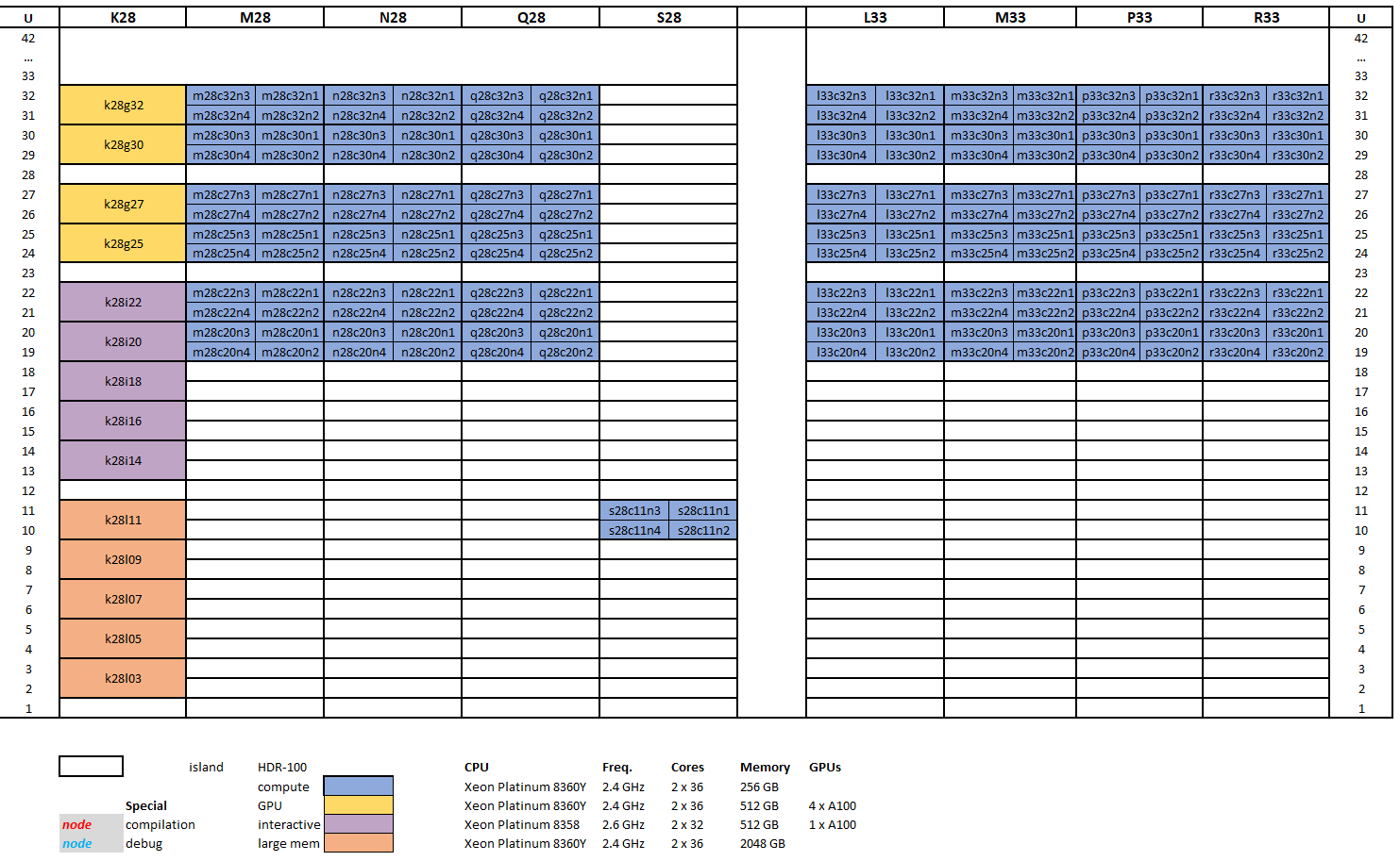
Hardware – naming convention
Indication of rack 8 racks (m28, n28, …, r33)
Type of node
c: Thin nodes
l : large mem nodes
g : GPU nodes
i: Interactive nodes
location of enclosure
Row in rack
Node in enclosure
Only for thin nodes
4 nodes in an enclosure
Notes:
172 * 2 * 36 = 12384 cores

Slide 7
Hardware - thin nodes
172 compute nodes
2 Intel Xeon Platinum 8360Y CPUs@2.4 GHz (Ice lake) 36 cores each => 72 cores per node
256 GB RAM => 3.4 GB per core usable
960 GB SSD local disk
Network setup
HDR-100 - Performance similar as EDR
currently : 24 nodes/island
after final cabling: upto 48 nodes/island (=3456 cores)
Icelake
8 memory channels (instead of 6 before)
higher L1/L2/L3 cache
slightly higher DIMM speed
PCIe 4.0
Notes:
172 * 2 * 36 = 12384 cores

Slide 8
Hardware – large memory nodes
172 thin nodes
5 big memory nodes (bigmem)
2 Intel Xeon Platinum 8360Y CPUs@2.4 GHz (Ice lake) 36 cores each => 72 cores per node
2048 GB RAM => 28 GB per core usable
960 GB SSD local disk

Slide 9
Hardware – GPU nodes
172 thin nodes
5 big memory nodes (bigmem)
4 GPGPU nodes (gpu) 2 Intel Xeon Platinum 8360Y CPUs@2.4 GHz (Ice lake) 36 cores each => 72 cores per node
512 GB RAM => 7 GB per core
4 NVIDIA A100 SXM4, 80 GB GDDR, connected with NVLink
960 GB SSD local disk
Note: currently only 1 node available

Slide 10
Hardware – interactive nodes
172 thin nodes
5 big memory nodes (bigmem)
4 GPGPU nodes (gpu)
5 interactive nodes
2 Intel Xeon Platinum 8358 CPUs@2.6 GHz (Ice lake) 32 cores each => 64 cores per node
512 GB RAM => 7.5 GB per core
1 NVIDIA A100, 80 GB GDDR Partitioned into 7 separate instances
960 GB SSD local disk

Slide 11
Hardware - Overview
Nodes (#) | CPU model Intel Ice Lake generation | Freq [GHz] | Cores/CPU | Memory [GB] | SSD [GB] | GPU model | GDDR [GB]
thin (172) | 2x Intel Xeon Platinum 8360Y | 2.4 | 36 | 256 | 960 | / | /
bigmem (5) | 2x Intel Xeon Platinum 8360Y | 2.4 | 36 | 2048 | 960 | / | /
gpu (4) | 2x Intel Xeon Platinum 8360Y | 2.4 | 36 | 512 | 960 | 4x NVIDIA A100 SXM4 | 80
interactive (5) | 2x Intel Xeon Platinum 8358 | 2.6 | 32 | 512 | 960 | 1x NVIDIA A100 | 80
https://docs.vscentrum.be/en/latest/leuven/tier2_hardware/wice_hardware.html

Slide 12
Hardware - Overview
+70%
+150%
GPU Island
4 nodes
16 Nvidia A100 80GB
512 GB RAM
172 nodes (12384 cores)
72 core/node
256 GB Ram
Thin node Island
Large memory Island
5 nodes
2 TB RAM
+130%
Interactive Island
Nieuw
Network:
IB HDR100
1.5:1 blocking factor, Island 3456 cores
5 nodes
5 Nvidia A100 80 GB RAM
512GB RAM

Slide 13
Software
Operating system
Rocky Linux release 8.6 (Green Obsidian)
Kernel 4.18.0-372.9.1.el8.x86_64
glibc-2.28-189.1.el8.x86_64
Modules​
Default toolchain version: 2021a:
/apps/leuven/icelake/2021a/modules/all
/apps/leuven/icelake/2021a/software
foss/2021a: GCC 10.3.0 + Open MPI 4.1.1 + ...
intel/2021a: Intel compilers 2021.2.0 + Intel MPI 2021.6.0 + ...
Current installed software : module avail or module spider

Slide 14
Software
Miscellaneous
Recompile your code on a wICE node with the 2021a toolchains. This also applies to Conda packages with compile steps.
Currently there is no default Python interpreter: /usr/bin/python --> not present /usr/bin/python2 --> v2.7.18 /usr/bin/python3 --> v3.6.8
Singularity is available (v3.8.7-1.el8)

Slide 15
Storage
$VSC_HOME, $VSC_DATA and $VSC_SCRATCH are available and point to the same directories as on Genius.
Staging storage is mounted as well.
Archive storage is not available.
A job's $TMPDIR makes use of the local SSD (up to 600 GB can be used).

Slide 16
Submitting jobs -> cf Slurm presentation

