Slide 1
Best practices for local software installations on HPC Tier-2
Lunchbox
edition
Maxime Van den Bossche Wouter Van Assche
github.com/hpcleuven/local-software-installations-tier2-lunchbox

Slide 2
Overview
When (not) to go for local installations
What to consider: overview
What to consider: correctness
What to consider: performance
What to consider: reproducibility
What to consider: maintainability
Examples putting it all together
Wrapping up
Questions

Slide 3
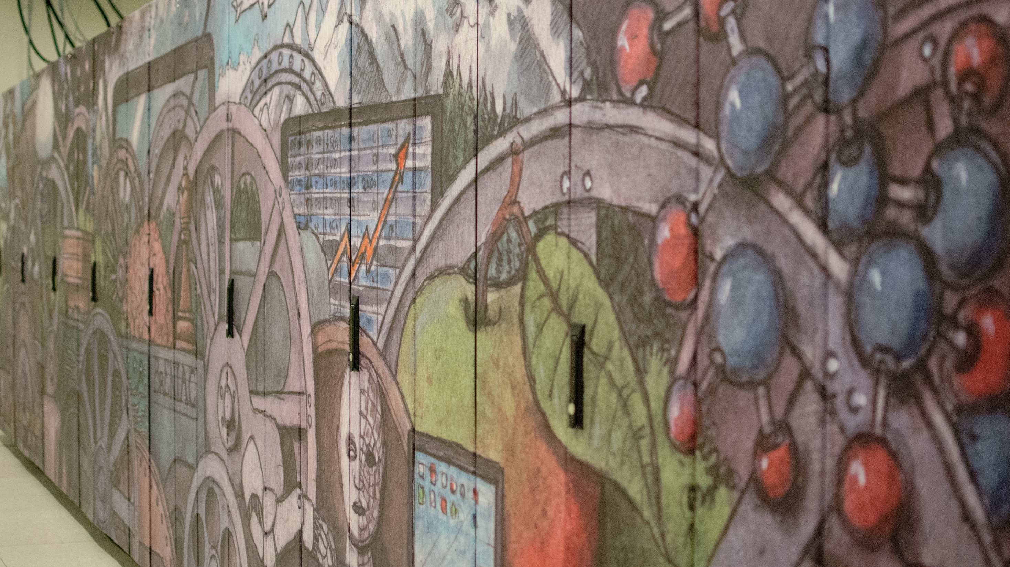
Central versus local installations

Slide 4




When (not) to go for local installations
Central installations (/apps/leuven/... modules):
= preferred approach unless the software:
is either in active development, (package updates, bugfixes, new features, …)
or only consists of interpreted code
In these cases local installations can be more convenient
…
Avoid spending large amounts of compute resources with interpreted code Example: Python lists versus NumPy arrays

Slide 5
When (not) to go for local installations
Tag yourself:
Do some of your Tier-2 calculations use …
Do your some of local installations involve …
… only centrally installed modules?
… compiled code (C/C++/Fortran/…)?
… only locally installed software?
… interpreted code (Python/R/Perl/…)?
… combinations thereof?
… combinations thereof?

Slide 6
What to consider: overview

Slide 7
What to consider: overview
Installing software yourself also means assuming responsibility
Correctness
Performance
Reproducibility
Maintainability

Slide 8
What to consider: correctness

Slide 9

What to consider: correctness
Software won’t be useful if it provides (numerically) wrong results!
Run the automated tests that are usually included in your end application,
especially if some compiling was involved
Potential pitfalls:
Too aggressive compiler optimizations for floating point operations
(e.g. -Ofast, -ffast-math, -fp-model=fast, …)
Problems with dependencies may only show up at test time

Slide 10
What to consider: performance

Slide 11
What to consider: performance
Compute, storage and energy resources are scarce and so need to be used efficiently!
On Tier-2, try to make sure that your installations are at least moderately optimized (if significant resources are involved)
Performance considerations may require you to build from source instead of installing precompiled packages
Runtime options are of course also influential (e.g. choosing the number of processes or threads)
On Tier-1 & Tier-0, resource usage needs to be (near-)optimal

Slide 12
What to consider: performance
Structure for the performance section: - Knowing your application - Compiler options: code transformations and microarchitecture tuning - Choosing dependency providers (MPI, BLAS, …) - Storage considerations

Slide 13
What to consider: performance
A high-performance installation requires knowledge of your application
↳ ‘Software bill of materials’ (SBOM): What are the major components and dependencies? How are these compiled/interpreted/provided/…? Are there any alternatives?
↳ Understanding its main hotspots: Where is most CPU and/or GPU time being spent? Sensitivity to how the compiling is done and how the dependencies are satisfied? Are there other bottlenecks (IO, communication, …)? Profiling tools can help:
Intel VTune
Intel Advisor
Linaro Forge
GNU gprof
Python cProfile
R RProf
NVIDIA Visual Profiler
…
Contact hpcinfo@kuleuven.be if a performance analysis would require too much effort (but start with providing a minimal representative example)

Slide 14
What to consider: performance
SBOM example: electronic structure calculations with tblite through a Python interface (ASE)
Component |  | Influential choices
Runscript
└── self (Python)
└── calls to ASE
└── self (Python)
└── calls to NumPy & SciPy
└── self (Python, C/C++)
└── calls to BLAS
└── calls to tblite
└── self (Fortran, OpenMP)
└── calls to (threaded) LAPACK

Slide 15
What to consider: performance
SBOM example: electronic structure calculations with tblite through a Python interface (ASE)
Component Performance critical? |  | Influential choices
Runscript | N
└── self (Python) | N
└── calls to ASE
└── self (Python) | N
└── calls to NumPy & SciPy
└── self (Python, C/C++) | N
└── calls to BLAS | N
└── calls to tblite
└── self (Fortran, OpenMP) | Y
└── calls to (threaded) LAPACK | Y

Slide 16
What to consider: performance
SBOM example: electronic structure calculations with tblite through a Python interface (ASE)
Component Performance critical? Influential choices |  | Influential choices
Runscript | N | ─┐
└── self (Python) | N | ─┤
└── calls to ASE |  | ─├─ none (only interpreted code)
└── self (Python) | N | ─┘
└── calls to NumPy & SciPy
└── self (Python, C/C++) | N | choice of C/C++ compiler & compiler options
└── calls to BLAS | N | choice of provider (MKL, OpenBLAS, BLIS, …)
└── calls to tblite
└── self (Fortran, OpenMP) | Y | choice of Fortran compiler & compiler options
└── calls to (threaded) LAPACK | Y | choice of provider (MKL, OpenBLAS, BLIS, …)

Slide 17
What to consider: performance
CPU and GPU performance: compiling options for code transformations (ways the compiler is allowed to ‘reorganize’ code)
GCC examples: -funroll-loops -ftree-loop-vectorize (default at –O2)
-floop-interchange (default at -O3)
-freciprocal-math (default at -Ofast)
Nvfortran examples (for CUDA code):
-gpu=unroll (default at –O3) -gpu=fastmath
gcc --help=optimizers
See “Correctness” section for caveats
In general, just using -O2 is a reasonable starting point

Slide 18
What to consider: performance
CPU and GPU performance: compiling options for microarchitecture tuning (instructions that the compiler is allowed to include)
Since many years, reaching peak CPU performance requires using advanced SIMD instructions
Feature level | SIMD extensions | Example microarchitectures that support it
x86-64-v1 | SSE, SSE2 | Baseline for all x86-64 CPUs
x86-64-v2 | + SSE3, SSE4 | Intel Nehalem, AMD Bulldozer, …
x86-64-v3 | + FMA, AVX, AVX2 | Intel Haswell, AMD Milan, …
x86-64-v4 | + AVX512 | Intel Skylake, AMD Genoa, …
and beyond | + AMX | Intel Sapphire Rapids, …
Source: https://en.wikipedia.org/wiki/X86-64#Microarchitecture_levels

Slide 19
What to consider: performance
CPU and GPU performance: compiling options for microarchitecture tuning (instructions that the compiler is allowed to include)
By default, on an x86-64 CPU, all compilers will emit ‘generic’ code that can run anywhere and so only makes use of baseline (x86-64-v1) instructions
Use -march=… (GCC, LLVM Intel) and -x… (classic Intel) to enable microarchitectural optimizations
Examples: -march=native / -xHost / -march=x86-64-v4
On HPC clusters with several different (micro)architectures you may need separate builds of your software (→ ‘Maintainability’ section)

Slide 20
What to consider: performance
CPU and GPU performance: compiling options for microarchitecture tuning (instructions that the compiler is allowed to include)
What with precompiled packages?
Microarchitecture approach | Examples at the time of writing
Runtime dispatching | TensorFlow; PyTorch; OpenCV; NumPy ≥v1.20; OpenBLAS; Intel MKL; BLIS; CUDA
Multiple build variants | Some Conda packages; ORCA; ANSYS Fluent (command-line switch)
Just-in-time (JIT) compilation | Julia code
One build only (x86-64-v1) | Majority of Conda/PyPI/OS/… packages
Try to find out how your precompiled packages and dependencies are handling this

Slide 21
What to consider: performance
CPU and GPU performance: compiling options for microarchitecture tuning (instructions that the compiler is allowed to include)
When compiling C/Cython extensions for Python or C/C++/Fortran extensions for R:
When using a Python or R module, your extensions will by default get compiled with -march=native (not so with Conda-based Python/R!)
python-config --cflags R CMD config CFLAGS # resp. CXXFLAGS, FFLAGS

Slide 22
What to consider: performance
CPU and GPU performance: compiling options for microarchitecture tuning (instructions that the compiler is allowed to include)
More compiler tips:
Try to use the most recent available compilers (e.g. 2024a modules)
especially when targetting newer hardware
If still using the classic Intel compilers (icc, ifort, …), it’s about time to switch to its oneAPI/LLVM compilers (icx, ifx, …)

Slide 23
What to consider: performance
CPU and GPU performance: compiling options for microarchitecture tuning (instructions that the compiler is allowed to include)
For NVIDIA GPUs the story is a bit similar, but different:
Compute capability | Example microarchitectures that support it
6.0 | Tesla P100
7.0 | Volta V100
8.0 | Ampere A100
9.0 | Hopper H100, H200

Slide 24
What to consider: performance
CPU and GPU performance: compiling options for microarchitecture tuning (instructions that the compiler is allowed to include)
For NVIDIA GPUs the story is a bit similar, but different:
By default, NVIDIA compilers choose the compute capability of the available GPU
As of NVIDIA HPC SDK 22.9, NVIDIA compilers by default also embed ‘PTX’ code which allow forward-compatibility
To avoid PTX JIT compilation overhead, consider -gpu=ccXY (nvc / nvc++ / nvfortran) or --gencode=arch=compute_XY,code=sm_XY (nvcc)
(for compute capability X.Y)

Slide 25
What to consider: performance
Choosing dependency providers: There can be different implementations of the same API (and performance may vary)
Dependency | Providers (CPU) | Providers (GPU)
BLAS / LAPACK | MKL, OpenBLAS, (AOCL-)BLIS, … | cuBLAS/cuSOLVER, hipBLAS, …
PBLAS / ScaLAPACK | MKL, (AOCL-)ScaLAPACK, …
MPI | Open MPI, Intel MPI, MPICH, …
FFTW | (AOCL-)FFTW, MKL, … | cuFFT, hipFFT, …
At least make sure you are not using a ‘reference’ implementation like NetLib BLAS
Beware of local MPI installations. Misconfiguration may lead to problems in multi-node runs and/or poor performance.

Slide 26
What to consider: performance
Choosing dependency providers: There can be different implementations of the same API (and performance may vary)
Try to find out which providers were chosen in your Conda/Pip/… installs
conda-tree can be useful to analyze your Conda environment dependencies conda-tree –n <somenv>
For Python virtual environments, try pipdeptree pipdeptree –p <somepackage>
You can switch between BLAS implementations in your Conda environment

Slide 27
What to consider: performance
Storage considerations
Overview of available locations:
Location | Typical quotum (GB) | Automatic cleanup | Notes
$VSC_HOME | 3 | No | Only intended for config files
$VSC_DATA | 75 | No | Usually the preferred install location
$VSC_NODE_SCRATCH | 565 | Yes (after job) | Not on a parallel file system
$VSC_SCRATCH | 500 | Yes (>30 days) | Not well suited for large sets of small files Single-copy
Staging storage | O(10⁴) + inode limits | No

Slide 28
What to consider: performance
Storage considerations
Importing Python modules and R packages tends to involve a lot of metadata operations (but so does loading Lmod modules)
In the absence of caching, these may be comparatively slow on parallel file systems (but this need not be problematic if only happening a few times per job)
Note that other users are also affected when straining a shared file system!

Slide 29
What to consider: performance
Storage considerations
If suspecting metadata limitations, consider containerizing your installation (Apptainer/Podman) or perhaps using a local disk ($TMPDIR/$VSC_SCRATCH_NODE)
Containers can also allow to reduce your installation’s inode usage

Slide 30
What to consider: reproducibility

Slide 31
What to consider: reproducibility
Tips to make it easier to reproduce a software stack elsewhere (different cluster / separate installation for other microarchitecture / project archival / …):
Use your package manager’s restore capabilities
PM | Export | Import
Pip | pip freeze > env.txt | pip install –r env.txt
Conda | conda env export > env.yaml | conda env create –n newenv –f env.yaml
Renv | renv::snapshot() | renv::restore()
Native R | See https://www.r-bloggers.com/2017/07/quick-way-of-installing-all-your-old-r-libraries-on-a-new-device

Slide 32
What to consider: reproducibility
Tips to make it easier to reproduce a software stack elsewhere (different cluster / separate installation for other microarchitecture / project archival / …):
For other platforms or (if relevant) other microarchitectures, you will need to add --no-builds to the Conda export command
Try conda env export --from-history to only see what you requested (without automatic dependencies)
At least specify the base image version in your Dockerfiles / Apptainer recipes (e.g. FROM rockylinux:8.9)

Slide 33
What to consider: maintainability

Slide 34
What to consider: maintainability
Ideally it would be straightforward for you to … … install new versions of your software packages
… take advantage of new hardware
… adapt your software stack to major OS updates
… activate the right environment in your compute jobs
This may influence … … your choice of installation framework
… how you structure your environments

Slide 35
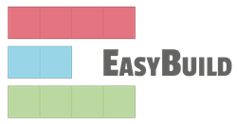


What to consider: maintainability
Choice of installation framework:
General purpose tools with focus on building HPC software from source:
( or ) +
✓ support for many existing installation procedures
✓ good control over dependencies, build options, patches, …
✗ there is some learning curve
With EasyBuild you can build on top of the centrally installed modules (contact us for more information)

Slide 36
What to consider: maintainability
Choice of installation framework:
Installing Python packages (with extensions, possibly building from source) using pip:
$ cat requirements.txt numpy==2.2.5 --no-binary numpy matplotlib==3.10.1
...
✓ quick to set up and use
✗ only for Python packages
± more limited control over build options (e.g. compiler flags)

Slide 37
What to consider: maintainability
Choice of installation framework:
Installing Python packages (with extensions, possibly building from source) using pip:
$ cat requirements.txt numpy==2.2.5 --no-binary numpy matplotlib==3.10.1
...
vsc-venv can help you manage such environments/installations (when building on top of centrally installed Python modules)
Reclaim space in your $VSC_DATA by cleaning package caches pip cache purge

Slide 38
What to consider: maintainability
Choice of installation framework:
Building R packages (with extensions) from source using install.packages/devtools/…:
.libPaths('./Rlib')
library(devtools)
devtools::install_version('RcppXsimd', version = '7.1.6', type = 'source',
repos = c("https://cloud.r-project.org"))
✓ quick to set up and use
✗ only for R packages ✗ package version pinning can be challenging
± more limited control over build options (e.g. compiler flags)
A detailed guide on how to set up your R environment can be found on the VSC Documentation Page | R Package Management.

Slide 39
What to consider: maintainability
Choice of installation framework: Building R packages (with extensions) from source in an RStudio Project: Provides some degree of isolation for your environment Has its own library, .Renviron and .Rprofile Is recognized by R by the presence of a <projectname>.Rproj file
When launching R from within an RStudio Project directory, the .Renviron and .Rprofile of the project are sourced.
Take advantage of .Renviron to set R_LIBS_USER to your project library
When setting up a library for your RStudio Project, do it in a way that respects differences in OS, CPU microarchitecture, and version of R​

Slide 40


What to consider: maintainability
Choice of installation framework:
Tools focused on precompiled packages:
(mini)
✓ quick to set up and use
✗ mostly focused towards Python and R packages (and their dependencies)
✗ application performance may be suboptimal

Slide 41
What to consider: maintainability
Choice of installation framework:
Tools focused on precompiled packages:
(mini)
Reclaim space in your $VSC_DATA by cleaning package caches conda clean --all
Consider using the intel conda channel when targeting Intel CPUs
Keep your base environment clean (see https://www.anaconda.com/docs/tools/working-with-conda/environments)

Slide 42
What to consider: maintainability
Structuring your environments Predefined environment variables on each node: overview
Variable | Description | Examples
${VSC_ARCH_LOCAL} | CPU microarchitecture | See next slide
${VSC_ARCH_SUFFIX} | GPU or interconnect differences | -h100 on gpu_h100
${VSC_OS_LOCAL} | Operating system | rocky8, rocky9, …
${VSC_INSTITUTE_LOCAL} | Institute name | leuven, gent, …
${VSC_INSTITUTE_CLUSTER} | Cluster name | genius, wice, …

Slide 43
What to consider: maintainability
Structuring your environments Predefined environment variables on each node: VSC_ARCH_LOCAL
Cluster | Partitions | ${VSC_ARCH_LOCAL}
Genius | bigmem, gpu_p100, interactive, login nodes, superdome | skylake
Genius | batch, gpu_v100 | cascadelake
Genius | amd | naples
wICE | batch, bigmem, gpu_a100, hugemem, interactive | icelake
wICE | batch_sapphirerapids | sapphirerapids
wICE | gpu_h100 | zen4

Slide 44
What to consider: maintainability
Structuring your environments Example directory structure when building from source:
…
└── apps
└── ${VSC_INSTITUTE_LOCAL}
└── ${VSC_OS_LOCAL}
└── ${VSC_ARCH_LOCAL}${VSC_ARCH_SUFFIX}
└── 20XXx
e.g. ${VSC_DATA}/apps/leuven/rocky8/sapphirerapids/2024a/

Slide 45
What to consider: maintainability
Structuring your environments Directory structure used by vsc-venv:
…
└── venvs
└── venv-${VSC_OS_LOCAL}-${VSC_ARCH_LOCAL}
e.g. ${VSC_DATA}/venvs/venv-rocky8-sapphirerapids/

Slide 46
What to consider: maintainability
$VSC_DATA
└── Rprojects
└── Project1
├── Project1.Rproj
├── library
│ └── rocky8
│ └── icelake
│ └── R-4.4.1
├── Data
│ └── dataset.csv
├── Output
├── Scripts
│ └── MyScript.R
├── .Renviron
└── .Rprofile
Structuring your environments Example directory structure for Rstudio Projects:
Rproject
└── library
└── ${VSC_OS_LOCAL}
└── ${VSC_ARCH_LOCAL}
└── R-${EBVERSIONR}
e.g. ${VSC_DATA}/Project/library/rocky8/icelake/R-4.4.1

Slide 47
What to consider: maintainability
Structuring your environments Directory structure used by conda:
…
└── envs
└── <env1>
└── <env2>
└── …
e.g. ${VSC_DATA}/miniconda3/envs/foo
You normally don’t need to anticipate host OS changes in your Conda setup (packages are built against an old GLIBC and GLIBC tends to be backwards-compatible)

Slide 48
Examples putting it all together

Slide 49
Examples putting it all together
Example 1: FluidFoam (Python)
Example 2: PyTorch (Python/C++/CUDA)
Example 3: tblite (Python/Fortran)
Example 4: CoolProp (C++/Python)
Example 5: mlr3 (R)

Slide 50
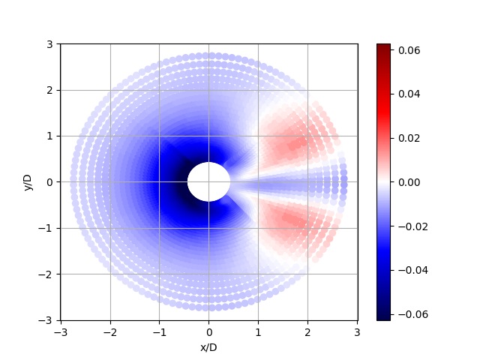
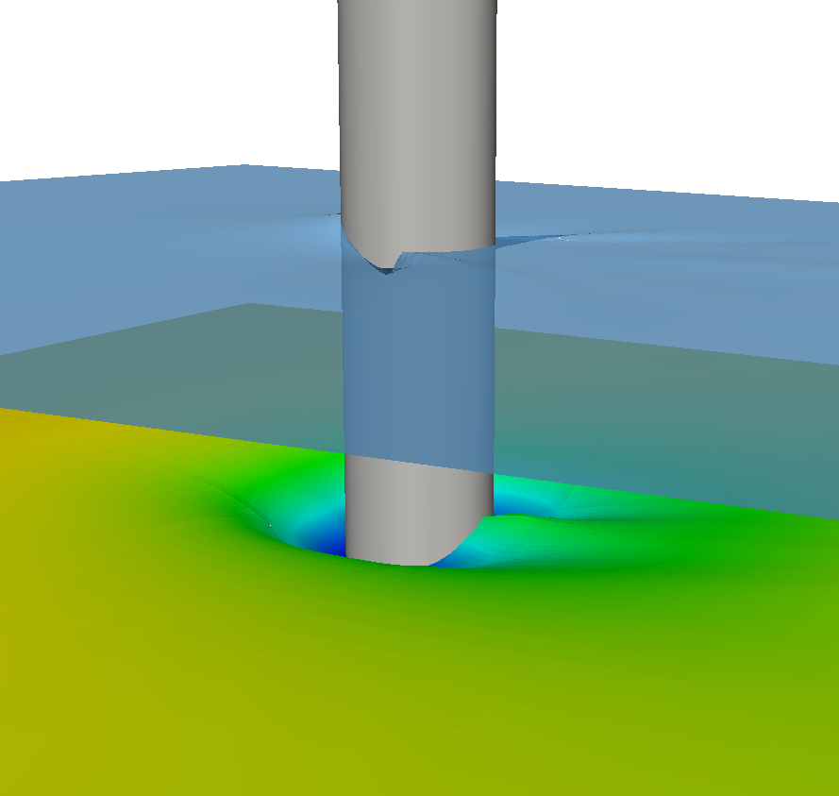
Example 1: FluidFoam
Pure Python package for post-processing OpenFOAM outputs
(Compiled) dependencies: mostly NumPy, SciPy, NetCDF4
examples/advanced/plot_unstructured_simu.py
https://personalpages.manchester.ac.uk/staff/david.d.apsley/cfdpics.htm

Slide 51
Example 1: FluidFoam
Occasional tasks using few resources ⇒ no real need to consider CPU performance
No need for microarchitecture-dependent FluidFoam installations (one will suffice)
Storage requirements do vary:
Method | volume (MB) | inodes (-)
Central modules + venv | 50 | 1200
Miniconda | 500 | 14500
module load Python/3.12.3-GCCcore-13.3.0 module load SciPy-bundle/2024.05-gfbf-2024a module load matplotlib/3.9.2-gfbf-2024a python -m venv testenv source testenv/bin/activate pip install fluidfoam==0.2.9
conda create -n testenv \
-c conda-forge \
python=3.12.3 \
fluidfoam=0.2.9

Slide 52
Example 2: PyTorch
Python package with C++ and CUDA extensions (and many dependencies) for machine learning
Assuming a neural net training project ⇒ good performance is quite important
Main performance bottlenecks for this case: convolution operations in e.g. oneDNN
Precompiled PyTorch packages are well optimized for e.g. NVIDIA GPUs and do runtime dispatching for CPU microarchitecture support

Slide 53
Example 2: PyTorch
Example installation commands (with CUDA support)
module load PyTorch/2.1.2-foss-2023a-CUDA-12.1.1 module load PyTorch-bundle/2.1.2-foss-2023a-CUDA-12.1.1 module load matplotlib/3.7.2-gfbf-2023a python -m venv testenv source testenv/bin/activate pip install –r requirements.txt
conda create -n testenv -c conda-forge python=3.11.3 \ pytorch=2.1.2 cuda-version=12.1 torchvision=0.16.1 source activate testenv pip install –r requirements.txt

Slide 54
Example 2: PyTorch
Example installation commands (without CUDA support, i.e. CPU-only)
module load PyTorch/2.1.2-foss-2023a module load PyTorch-bundle/2.1.2-foss-2023a module load matplotlib/3.7.2-gfbf-2023a python -m venv testenv source testenv/bin/activate pip install –r requirements.txt
conda create -n testenv -c python=3.11.3 source activate testenv # As instructed by Intel pip install torch==2.1.2+cpu torchvision==0.16.2+cpu "numpy<2" \ --index-url https://download.pytorch.org/whl/cpu
pip install –r requirements.txt

Slide 55
Example 2: PyTorch
Similar story as in Example 1:
Method | volume (MB) | inodes (-) | performance (*)
Central modules + venv | 150 | 6000 | Similar performance on 1 NVIDIA A100 GPU
Miniconda | 1500 | 36000
Central modules + venv | 150 | 6000 | Similar performance on 1 Intel Sapphire Rapids CPU
Miniconda | 8000 | 40000
(*) training a resnet50 model on a CIFAR10-like dataset (mixed precision training with bfloat16) adapted from https://github.com/oneapi-src/oneAPI-samples/blob/master/AI-and-Analytics/Features-and-Functionality/IntelPyTorch_TrainingOptimizations_AMX_BF16/

Slide 56
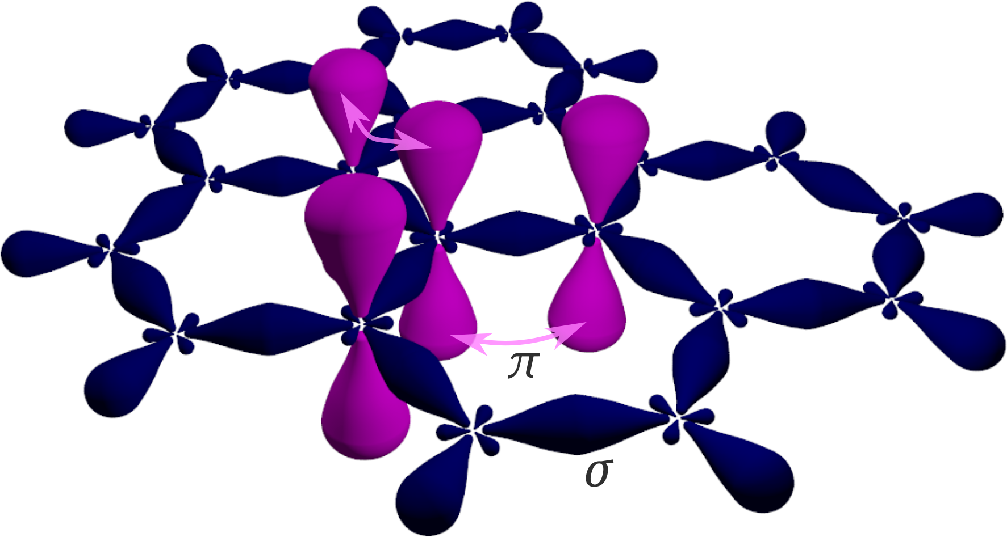
Example 3: tblite
Fortran code for tight-binding electronic structure calculations with a Python interface
Assuming computational screening or molecular dynamics on many medium-sized compounds ⇒ good performance is quite important
Main performance bottlenecks for this example:
Bottleneck | handled by | μarch support
Eigensolver | LAPACK dependency | runtime dispatch
Hamiltonian builds | tblite Fortran code | compiler option
Ponor, CC BY-SA 4.0 via Wikimedia Commons

Slide 57
Example 3: tblite
Example installation commands: EasyBuild
srun –M wice –p batch_icelake … --pty bash -l mkdir –p ${VSC_DATA}/apps-leuven/rocky8/icelake/2022a
source custom-easybuild-setup-script.sh 2022a eb tblite-0.3.0-intel-2022a.eb --missing eb tblite-0.3.0-intel-2022a.eb --robot

Slide 58
Example 3: tblite
Example installation commands: tblite-0.3.0-intel-2022a.eb EasyConfig for tblite
# Adapted from https://github.com/easybuilders/easybuild-easyconfigs/pull/19224
easyblock = 'CMakeMake'
name = 'tblite'
version = '0.3.0'
homepage = 'https://github.com/tblite/tblite'
description = """Light-weight tight-binding framework"""
toolchain = {'name': 'intel', 'version': '2022a'}
github_account = 'tblite'
source_urls = [GITHUB_SOURCE]
sources = ['v%(version)s.tar.gz']
patches = ['tblite-0.3.0_lower_mixer_damping.patch']
checksums = [
'44b6ecff94b29c109f7d1afa3f49eebd3979a2b115fc7bab0c9fc1d7e61bdc27’,
# tblite-0.3.0_lower_mixer_damping.patch '8c56dac14b20bde5a023195d896f442c68306ae481c27139832e938d944d1da5’, ]

Slide 59
Example 3: tblite
Example installation commands: tblite-0.3.0-intel-2022a.eb EasyConfig for tblite (cont.)
builddependencies = [
('binutils', '2.38'),
('CMake', '3.24.3'),
]
dependencies = [
('Python', '3.10.4'),
('mctc-lib', '0.3.1'),
('mstore', '0.2.0'),
('Simple-DFTD3', '0.7.0'),
('dftd4', '3.4.0'),
] configopts = '-DBUILD_SHARED_LIBS=ON'
# run suite of tests with ctest
test_cmd = 'ctest --parallel 1'
runtest = ''
sanity_check_paths = {
'files': ['bin/tblite',
'lib/libtblite.%s' % SHLIB_EXT],
'dirs': ['include/%(name)s', 'lib/cmake’, 'lib/pkgconfig'],
}
sanity_check_commands = ['tblite --help']
moduleclass = 'chem'

Slide 60
Example 3: tblite
Example installation commands: testsuite output
Test project /dev/shm/eb-64437147/tblite/0.3.0/intel-2022a/easybuild_obj
Start 1: C-API
1/22 Test #1: C-API ............................ Passed 0.31 sec
Start 2: tblite/cgto-ortho
2/22 Test #2: tblite/cgto-ortho ................ Passed 0.04 sec
Start 3: tblite/coulomb-charge
3/22 Test #3: tblite/coulomb-charge ............ Passed 0.51 sec
Start 4: tblite/coulomb-multipole
4/22 Test #4: tblite/coulomb-multipole ......... Passed 0.43 sec
Start 5: tblite/fit
5/22 Test #5: tblite/fit ....................... Passed 0.03 sec
Start 6: tblite/gfn1-xtb
6/22 Test #6: tblite/gfn1-xtb .................. Passed 0.22 sec
Start 7: tblite/gfn2-xtb
7/22 Test #7: tblite/gfn2-xtb .................. Passed 0.38 sec
Start 8: tblite/hamiltonian
8/22 Test #8: tblite/hamiltonian ............... Passed 0.03 sec ...

Slide 61
Example 3: tblite
Example installation commands: Miniconda
conda create -n testenv -c conda-forge tblite=0.3.0 "libblas=*=*mkl" source activate testenv
# switching to OpenBLAS: conda install "libblas=*=*openblas" # switching to Netlib: conda install "libblas=*=*netlib"

Slide 62
Example 3: tblite
Microarchitecture optimizations and linear algebra library are indeed important:
Method | volume (MB) | BLAS & LAPACK provider | speed (a.u.)
From source (central + local modules) | 30 | Intel MKL | 100
From source (central + local modules) | 30 | OpenBLAS | 93
Miniconda | 670 | Intel MKL | 83
Miniconda | 670 | OpenBLAS | 80
Miniconda | 670 | Netlib | 38
Single-point calculation (energy + gradients) on a 64-atom Si crystal with GFN1-xTB, three SCF iterations, on an Intel Icelake CPU (single core), after warmup

Slide 63
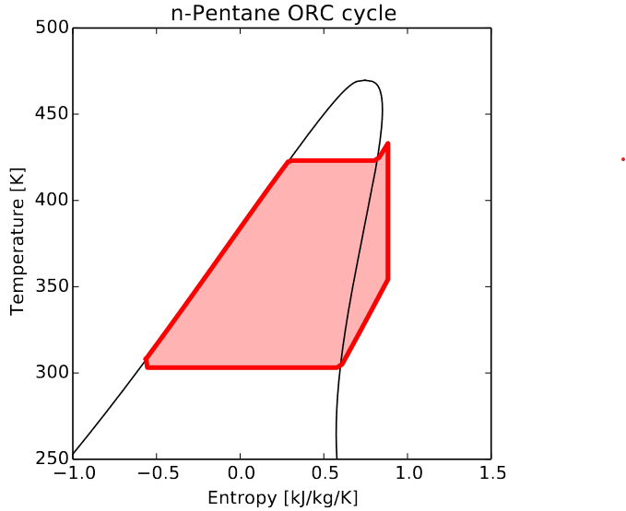
Example 4: CoolProp
Thermophysical property library (C++) with e.g. Python bindings
Bell I., CoolProp: An Open-Source Reference-Quality Thermophysical Property Library ; http://www.coolprop.org/v4/_static/poster.pdf

Slide 64
Example 4: CoolProp
Thermophysical property library (C++) with e.g. Python bindings
Here just illustrating what happens when installing with vsc-venv:
$ cat modules.txt Python/3.12.3-GCCcore-13.3.0
Boost/1.85.0-GCC-13.3.0
$ cat requirements.txt coolprop==6.7.0 --no-binary coolprop
$ module load vsc-venv/1.0.6
$ source vsc-venv --help $ source vsc-venv -r requirements.txt -m modules.txt --activate (builds a wheel and installs it) $ ls ./venvs/venv-rocky8-icelake/

Slide 65

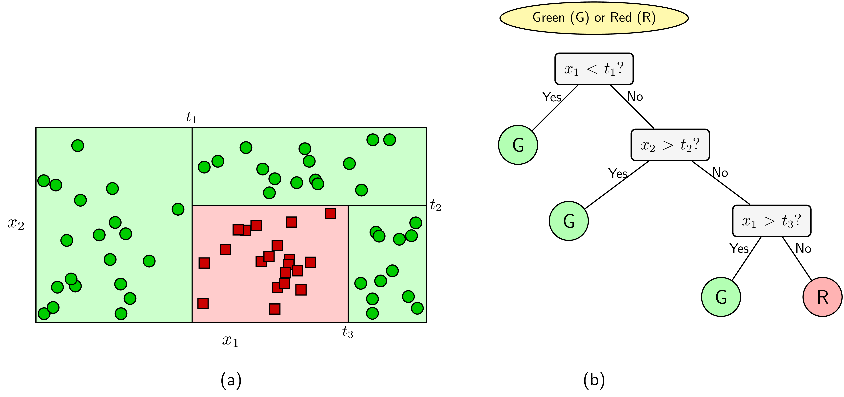
Example 5: mlr3
“mlr3” is an R package that provides a generic, object-oriented, and extensible framework for various Machine Learning applications.
For our hypothetical use case we want to use mlr3 to build a decision tree.
This package is not part of the base R modules, nor is it included in R-bundle-CRAN. This means we will have to install mlr3 ourselves.
https://machinelearningcoban.com/2018/01/14/id3/

Slide 66
Example 5: mlr3
mlr3 is a high-level, lightweight (3.8M) interface with minimal dependencies Dependencies – mlr-org
performance depends on the choice of backend learner
for the purpose of building a decision tree, “rpart” would be a suitable learner on CPU
Many learners are included in R-bundle-CRAN but likely without CUDA support.

Slide 67
Example 5: mlr3
MyRProject.Rproj
Version: 1.0
RestoreWorkspace: No
SaveWorkspace: No
AlwaysSaveHistory: Default
EnableCodeIndexing: Yes
UseSpacesForTab: Yes
NumSpacesForTab: 4
Encoding: UTF-8
RnwWeave: knitr
LaTeX: pdfLaTeX
Creating the RStudio Project:
$ mkdir $VSC_DATA/MyRProject
$ touch $VSC_DATA/MyRProject/MyRProject.Rproj

Slide 68
Example 5: mlr3
Installing mlr3 within an RStudio Project library.​
Load the R & R-bundle-CRAN modules
Create your R project library
Set the R_LIBS_USER variable in the .Renviron file of your R project
$ module load R/4.4.1-gfbf-2023b $ module load R-bundle-CRAN/2024.06-foss-2023b
mkdir -p ${VSC_DATA}/MyRProject/library/${VSC_OS_LOCAL}/${VSC_ARCH_LOCAL}/R-${EBVERSIONR}
$ echo 'R_LIBS_USER="${VSC_DATA}/MyRProject/library/${VSC_OS_LOCAL}/${VSC_ARCH_LOCAL}/R-${EBVERSIONR}"' > ${VSC_DATA}/MyRProject/.Renviron

Slide 69
Example 5: mlr3
Launch R from the Project directory and install mlr3.
$ cd $VSC_DATA/MyRProject
$ R
> .libPaths() # verify the install location
> install.packages("mlr3")

Slide 70
Wrapping up

Slide 71
Wrapping up
Installing software yourself also means assuming responsibility
Correctness
Performance
Know your application!
Reproducibility
Maintainability
Contact us at hpcinfo @kuleuven.be

Slide 72
Links to documentation
https://docs.vscentrum.be/software/software_development.html
https://docs.vscentrum.be/software/python_package_management.html
https://docs.vscentrum.be/software/r_package_management.html
https://docs.vscentrum.be/software/perl_package_management.html
https://docs.vscentrum.be/software/singularity.html
https://docs.vscentrum.be/leuven/wice_advanced_guide.html#compiling-software
https://docs.vscentrum.be/leuven/services/openondemand.html
https://docs.vscentrum.be/leuven/leuven_module_system.html
https://hpcleuven.github.io/artifactory-doc

Slide 73
Links to related VSC training materials
https://github.com/gjbex/Containers-for-HPC
https://github.com/gjbex/Code-optimization
https://github.com/gjbex/Best-practices-for-data-science-on-HPC
https://github.com/gjbex/IO-performance
https://github.com/gjbex/CI-example
https://github.com/gjbex/training-material/blob/master/R/Conda
https://github.com/hpcleuven/Best-practices-for-R-on-HPC
https://github.com/hpcleuven/R-best-practices
https://github.com/hpcleuven/local-software-installations-tier2-lunchbox

Slide 74
Other links
https://easybuild.io
https://spack.io
https://pypackaging-native.github.io
https://docs.nvidia.com/hpc-sdk/compilers/hpc-compilers-user-guide
archspec: A library for detecting, labeling, and reasoning about microarchitectures

Slide 75
Questions?

