Slide 1
L u n c h e r

Slide 2
Launcher is a GUI for
easy resource allocation
job script creation
submitting jobs
retrieving and storing results
VSC clusters
currently only Hopper and Turing

Slide 3
Assignment 1a
write a function to compute a Lennard-Jones potential with appropriate parameters (in Fortran)
en.wikipedia.org/wiki/Lennard-Jones_potential
chemwiki.ucdavis.edu/Physical_Chemistry/Intermolecular_Forces/Lennard-Jones_Potential
phys.ubbcluj.ro/~tbeu/MD/C2_for.pdf
write a test for it (in Python)
write a function that evaluates the total energy of a collection of point atoms (in Python)

Slide 4

Food for thought
How to generate a meaningful collection of atoms?
NVE vs NVT
initial state = physically relevant?
www.engr.ucsb.edu/~shell/che210d/Advanced_molecular_dynamics.pdf
web.mit.edu/bolin/www/MD-LJ.pdf
www2.mpip-mainz.mpg.de/~andrienk/journal_club/thermostats.pdf
www.ncbi.nlm.nih.gov/pmc/articles/PMC2577381/pdf/JCPSA6-000128-245103_1.pdf

Slide 5
Assignment 1b
write a time integrator for integrating position and velocity of a particle feeling a force (use velocity-verlet algorithm)
en.wikipedia.org/wiki/Verlet_integration
write a test for it in Python
numerical schemes do NOT automatically satisfy conservation laws, even not in the absence of round off error
leads to drift
long time evolution requires simplectic integration schemes (velocity verlet is ok)
en.wikipedia.org/wiki/Symplectic_integrator

Slide 6
Assignment 1b
write a function that evolves the collection of atoms in time (in Python)
what is lacking?
make sure you get this right (unit test!)
people.virginia.edu/~lz2n/mse627/notes/Potentials.pdf

Slide 7
assignment 1c
(where) do we need a sqrt?
velocity verlet improvement?
compute accelerations at t=0
loop over # time steps
v = v + 0.5*a*dt
r = r + 0.5*v*dt
compute accelerations
v = v + 0.5*a*dt

Slide 8
assignment 1c
velocity verlet: improvement rearrange the loop
compute accelerations at t=0
v = v + 0.5*a*dt
r = r + 0.5*v*dt
loop over # time steps - 1
compute accelerations
v = v + 0.5*a*dt
v = v + 0.5*a*dt
r = r + 0.5*v*dt
compute accelerations
v = v + 0.5*a*dt
many optimisations are not technicalities but common sense!
merge these into : v=v+a*dt
save a loop over all particles
for each timestep

Slide 9
assignment 1d (optional)
add reflective boundary conditions
with a thermostat
www.mbnexplorer.com/users-guide/6-numerical-methods-interatomic-interactions/63-boundary-conditions/631-reflective
wall
cold
hot

Slide 10
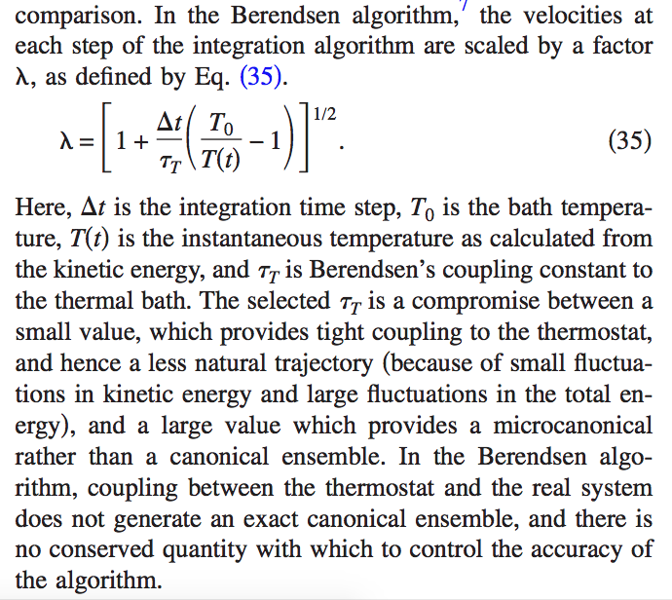
assignment 1e (optional)
add Berendsen thermostat
www.ncbi.nlm.nih.gov/pmc/articles/PMC2577381/pdf/JCPSA6-000128-245103_1.pdf

Slide 11
assignment 1f (optional)
add time step control
dt = f*r_{min}/v
v = <v>, v_{max}, <v²>^{1/2}, ...
f ~0.01

Slide 12
assignment 1g (optional)
visualize your simulation
visualisation helps validating your code (you see what is going wrong – if you are lucky)
write output files (in Python) that can be read by your favourite visualisation program
www.ks.uiuc.edu/Research/vmd/
http://jp-minerals.org/vesta/en/
rasmol.org/
www.umass.edu/microbio/chime/top5.htm
www.paraview.org/

Slide 13
Food for thought
How would you modify your code to account for
different kinds of atoms?
periodic boundary conditions
http://www.mbnexplorer.com/users-guide/6-numerical-methods-interatomic-interactions/63-boundary-conditions/632-periodic
particles in a confining potential well
external fields?

Slide 14
assignment 2
add cputime measurement
in Fortran:
real*8::start,stop,cput
call cpu_time(start)
...
call cpu_time(stop)
cput=stop-start
in Python:
import datetime
cput = datetime.datetime.now()
...
cput = datetime.datetime.now() - cput
cput = cput.total_seconds()

Slide 15
assignment 2
do some experiments for N in [10,10000]
plot cputime vs N, N(N-1)/2
Python
import matplotlib.pyplot as plt
#create arrays with N and corresponding cputime
plt.figure() #create a figure
plt.plot(N,cputime)
plt.show()

Slide 16
assignment 2
Python: saving data to disk: pickle
script a.py
import pickle
data = ...
file_obj = open(“pickled_data”,“w+”)
# “w+” = overwrite mode
pickle.dump(data,file_obj)
script b.py
import pickle
file_obj = open(“pickled_data”,“r”)
# “r” = read mode
data = pickle.load(file_obj)

Slide 17
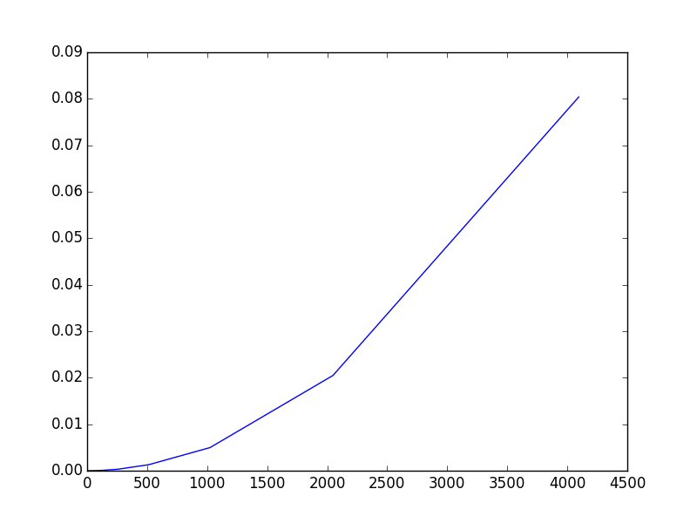
cpu_time vs N
N=16,32,64, ..., 8192
cpu_time ~ N²

Slide 18
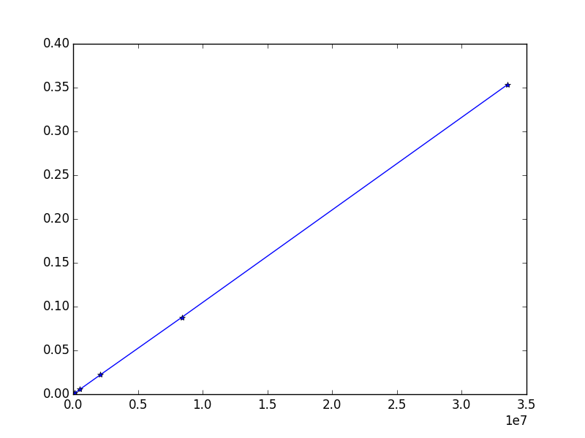
cpu_time vs N(N-1)/2
N=16,32,64, ..., 8192
cpu_time ~ N²
L3 cache =
6 Mb, 4 cores (my mac)
25 Mb,20 cores (hopper)

Slide 19
Going big
we want to scale up to
N=10⁶
N=10⁹
N=...
where do we need adjustments?
li.mit.edu/A/Papers/05/Li05-2.8.pdf

Slide 20
range of forces
assuming uniformly distributed particles
number of particles at distance r is proportional to 4*π*r²
any interaction decaying faster than r⁻² is short-ranged and can be cut off at some distance

Slide 21
numerical experiment
set up a python script to compute
f = 1.0 + 1/r⁵
for r in [10,1000]
what do you observe?

Slide 22
assignment 2a
implement an algorithm that is O(N) by applying a cut off radius r_{c}
i and j interact, i and k don’t
r_{c}
j
i
k

Slide 23
assignment 2a
Verlet list of particle i = list of all particle within cut-off of particle i
add a skin r_{c} -> r_{c}+r_{s}
update verlet list only after t = r_{s}/v_{max}
j
r_{s}
i
k

Slide 24
assignment 2b
apply blocking/tiling to distribute the work over different threads/processes
part of tile interacts with neighbouring tiles
part doesn’t

Slide 25
important aspects of parallellism 1. SIMD vectorization
SIMD vectorization
computer instructions (+,-,*, exp, ...) operate on 4 DP / 8 SP numbers rather than on a single one
requirements:
no dependencies
a[i] = some_function_of(a[i-1]) # not ok
a[i] = some_function_of(a[i-8]) # ok
a[i] = some_function_of(a[i-4]) # ok for DP
to get the data in place we need contiguous data access
no loops with branches
loops calling subprograms ok iff elemental
loop size known in advance
every departure from these criteria costs cputime

Slide 26
important aspects of parallelism 2. multithreading
hopper nodes have 20 cores each of which can execute 2 threads (simultaneous multithreading)
distribute work load among N threads (N<=20,40)
N processes have to be fed with data
if the amount of data per unit of time needed by the N threads exceeds the memory bus capacity, no more speedup
need high arithmetic intensity
threads should be as independent as possible
reading the same data is small problem
writing to the same data can be big problem
false sharing
threads have overhead (start up/stopping/synchronisation)
amount of work in a thread should be significant.

Slide 27
MD constraints
cut off is key to solving O(N²) work problem
Verlet list (VL_{i} = list of particles interacting with i-th particle, taking account of cut off)
conflicts with contiguous access (jump around in memory)
interaction i-j updates force on i and j
several threads may want to update force on j simultaneously
arithmetic intensity per interaction relatively low
LJ contains a division which does not vector-ize well (intel compiler is better at this)

Slide 28
a parallel MD strategy
http://cacs.usc.edu/papers/kunaseth-ScalableHybridMD-PDPTA20110.pdf

Slide 29
a parallel MD strategy
spatial decomposition
partition particles according spatial domains
spatial domain is defined by its center point
particles belong to the spatial domain whose center is nearest

Slide 30
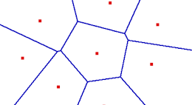
a parallel MD strategy
voronoi tesselation
red points are domain centers
blue lines are domain boundaries = perpendicular bisector of two neighbouring centers

Slide 31
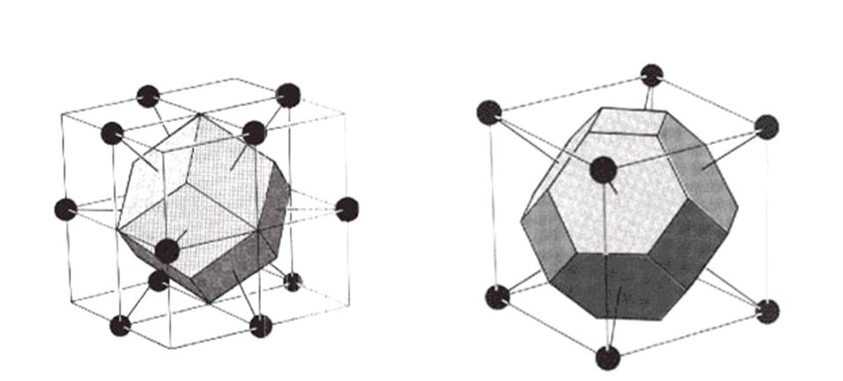
Voronoi cell for FCC, BCC

Slide 32
a parallel MD strategy
if the width of the Voronoi cell equals the cut off radius, then the particles inside a Voronoi cell only interact with particles in the same Voronoi cell and with particles in the neighbouring cells
r_{c} ~ 6 r_{min}

Slide 33
a parallel MD strategy
if cut off is implemented exactly, we must implement Verlet lists (list of particles within r_{c} of central particle)
violates contiguous data access, bad for SIMD and pipelining
if cut off is not implemented exactly, i.e. the cut off sphere is not exactly a sphere, but e.g. the collection of neighbouring Voronoi cells, we may actually compute a bit more interactions, but compute them much more efficiently
there are directions in space for which the cut off radius is larger and for which more interactions are accumulated, we must be careful that the physics is still correct
particles at the boundary of a Voronoi cell have more distant interactions from the other side of the cell -> particles become biased towards center of Voronoi cell

Slide 34
a parallel MD strategy assignment 3
step 1 (sequential)
distribute particles over Voronoi cells
loop over all Voronoi cells Vi
compute interactions between all particles in Vi
loop over all neighbouring cells Vj
compute interactions between particles in Vi and particles in Vj
step 2 : parallellize by distributing the loop over Vi over different threads in an intelligent way

Slide 35
simplifications
use cubic Voronoi cells
simple to find neighbouring cells
simple to compute the Voronoi cell of a particle from its coordinates
cells form a 3D array
a_{V} = r_{c} = 5 r_{min}
put particles also on cubic lattice
a_{P} = r_{min}
assume all Voronoi cells contain the same number of particles at all timesteps
start with computing the accelerations
if there is time left you can add time integration

Slide 36
look before you leap bezint eer ge begint
what are the parallellization issues of our approach?
...
...

Slide 37
simplifications
1st neighbours 2nd neighbours

Slide 38
development strategy
step 1 : use what you already have in lj.so and program everything in Python
when everything works, reimplement what is necessary (for efficiency and parallelization) in Fortran
compare both implementations
correctness
speed
do the parallellization in
Python, use Python standard library module threading, see example parallel_test.py
Fortran, use OpenMP

Slide 39
oPENMP
SHARED MEMORY PARALLELIZATION

Slide 40
OpenMP
parallize a working program by marking loops that must be executed in parallel
relatively simple
to obtain good result, need to think how to code loops that can run efficiently in parallel
compiler directives
!$OMP <directive>
an OpenMP ignorant compiler will ignore the directives

Slide 41
some sequential code (executed by main thread only)
!$omp parallel ...
parallel region
(executed by all threads)
!$omp end parallel
more sequential code

Slide 42
# of parallel threads
environment variable :
OMP_NUM_THREADS
set at runtime :
call omp_set_num_threads(n)
!$omp parallel num_threads(integer-expr)

Slide 43
!$omp do
! = automatically a parallel region
do i = 1,1000
...
end do
!$omp end do

Slide 44
every thread will execute its share of the loop
scope of variables
private : every thread has its own copy, so there are no issues with simultaneous update/read
shared : only one copy exist and is shared by all threads, hence issues with simultaneous update/read

Slide 45
!$omp do
! = automatically a parallel region
do i = 1,1000
... ! executed in parallel
!$omp critical
! executed by a single thread at a time
! (irrespective of wether
! there is a problem or not
!$omp critical end
... ! executed in parallel
!$omp atomic ! ensures that a specific memory location
! is updated atomically, which prevents the possibility
! of multiple, simultaneous reading and writing of threads.
... ! executed in parallel
end do
!$omp end do

