Slide 1
L u n c h e r
[engel]bert tijskens - may 2015

Slide 2
Launcher is a GUI for
easy resource allocation
job script creation
submitting jobs
retrieving and storing results
VSC clusters
currently only Hopper and Turing

Slide 3
make sure your private key for accessing the cluster is in your_home_folder/.ssh

Slide 4
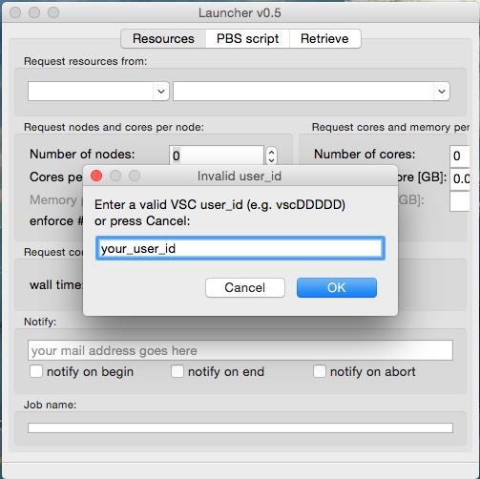
First steps
Enter your VSC user id

Slide 5
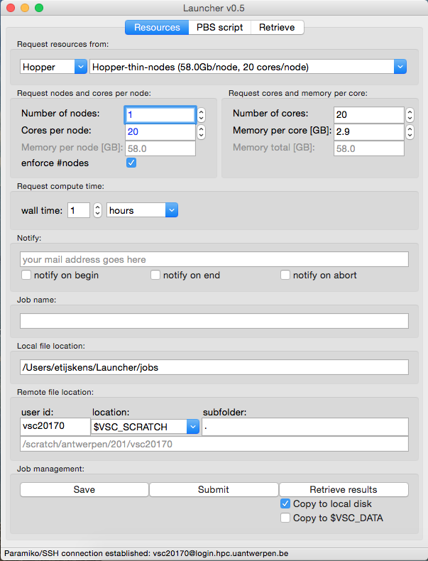
First steps ...
resize the Launcher window until everything is visible
(most settings are remembered between sessions)

Slide 6
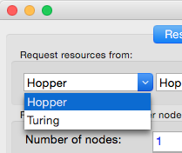
1. Request resources
select the cluster to submit to ...

Slide 7
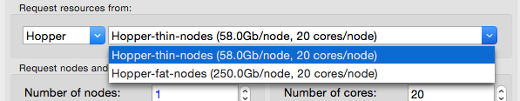
1. Request resources
select the kind of nodes you want to use ...

Slide 8
1. Request resources
In the mean time Launcher already connected to Hopper:
(If Launcher cannot connect, it will continue with what it knows and store your work locally)

Slide 9
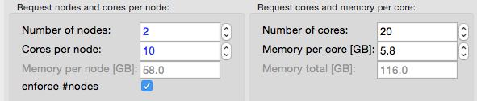
1. Request resources
approach 1 (left column):
request nodes and cores per node:
avoid that the resource manager gives you 2x10 cores on a single node
right column is automatically adjusted

Slide 10
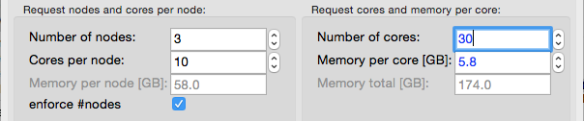
1. Request resources
approach 2 (right column):
requesting cores and memory per core
say, I need 30 cores with at least 6 GB per core
Launcher tries to satisfy your request, treating all nodes in the same way, providing at least what your ask for, and possibly more
automatically adjusted
unchanged (but we need more

Slide 11
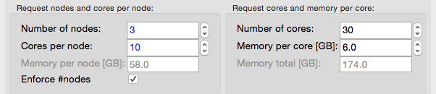
1. Request resources
approach 2 (right column):
requesting cores and memory per core
let’s request 6 GB per core:

Slide 12
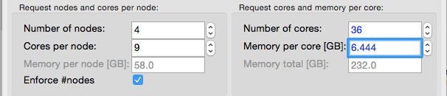
1. Request resources
approach 2 (right column):
you get 36 cores = 4 nodes x 9 cores/node with at least 6.444 GB per core
Launcher tries to satisfy your request, treating all nodes in the same way, providing at least what your ask for, and possibly more

Slide 13
1. Request resources
if you need much more memory per core, make a resource request for Hopper-fat-nodes (250 GB/node)
(you need to ask permission to use them)

Slide 14
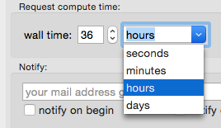

1. Request resources
select the wall time you need ...
select who gets notified when ...

Slide 15
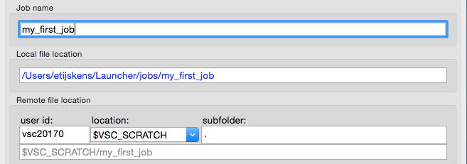
2. I/O destinations
Your job will be stored here (local destination)
enter a job name ...
Your job will be executed here (remote destination).
If a connection to the cluster is available $VSC_SCRATCH will be resolved

Slide 16
2. I/O destinations
enter a job name ...
if the folder already exists, and there is a job script “pbs.sh” that script will be loaded, and all fields above will be set according to the job script

Slide 17
2. I/O destinations
choose the local destination ...
change the local destination folder to your preference, the job name will be added.

Slide 18
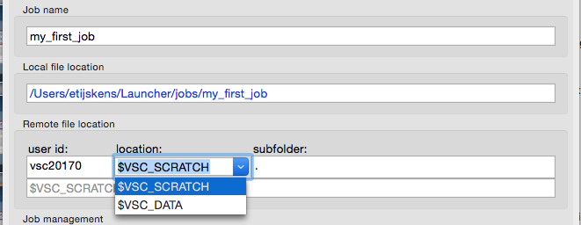
2. I/O destinations
choose the remote destination ...
optional subfolder goes here
change the remote destination folder here

Slide 19
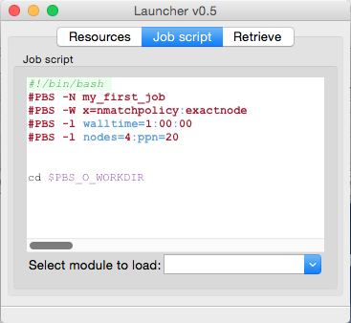
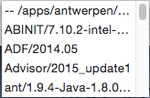
3. Adding commands and modules
select the Job script page
you can edit the job script, the Resources page will follow
add modules here, manually or using the list (which will be empty if you don’t have a connection the first time)

Slide 20
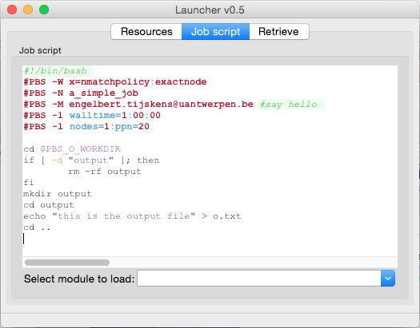
a (very) simple job script

Slide 21
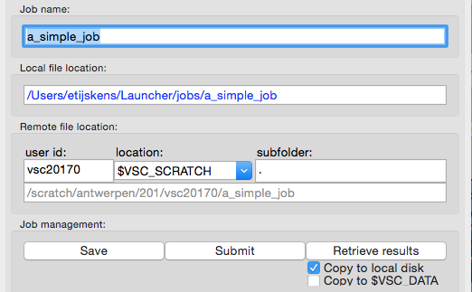
4. job management
save the job script in a local file
(save and) submit the job script
copy the results if the job is finished

Slide 22
4. Job management
use the Retrieve page to
get an overview of your jobs
submitted/running/completed
retrieved
retrieve results
remove jobs from the retrieve list
the remote folder is not removed
add jobs to the retrieve list

Slide 23
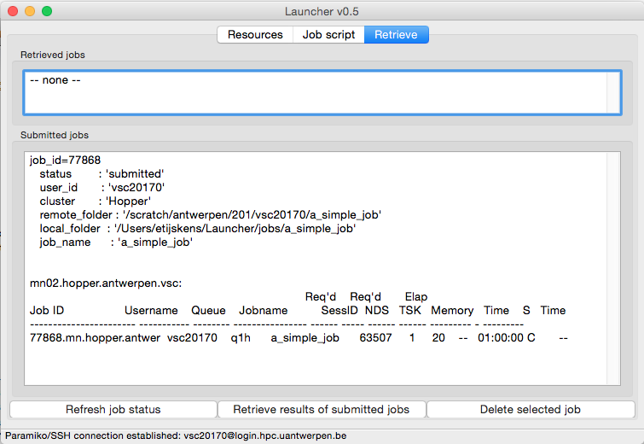
4. Job management
of all submitted jobs non is retrieved
overview of submitted jobs and their properties
status of recently submitted jobs
this job is Completed and hence ready for retrieval

Slide 24
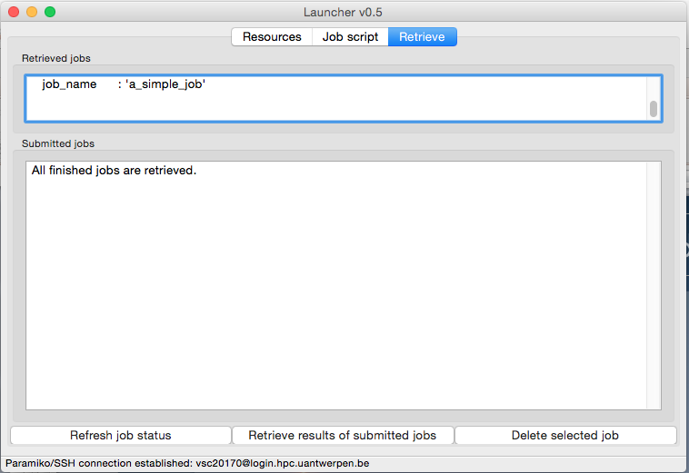
4. Job management
after hitting the Retrieve-results-of-submitted-jobs button
our job is retrieved
the results of all finished jobs are retrieved, and the list is now empty

Slide 25
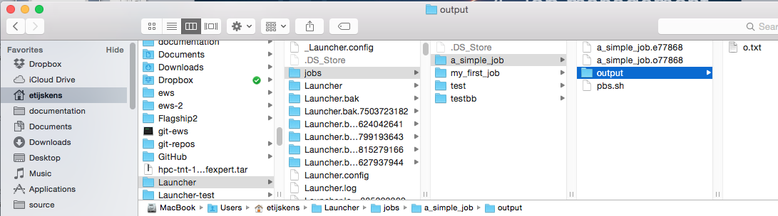
4. Job management
after hitting the Retrieve-results-of-submitted-jobs button the local job folder has the same structure and contents as he remote job folder

Slide 26
help to improve Launcher
are you missing a feature?
is something impractical?
suggestions for improvements are welcome, and will be rewarded:
best suggestion every month will get a beer or chocolates
send suggestions to
engelbert.tijskens@uantwerpen.be

Slide 27
L u n c h e r
installation
[engel]bert tijskens - may 2015

Slide 28
installation instructions
https://github.com/hpcuantwerpen/Launcher

