Slide 1
L u n c h e r
[engel]bert tijskens - may 2015

Slide 2
Launcher is a GUI for
easy resource allocation
job script creation
submitting jobs
retrieving and storing results
VSC clusters
currently only Hopper and Turing

Slide 3
make sure your private key for accessing the cluster is in your_home_folder/.ssh

Slide 4
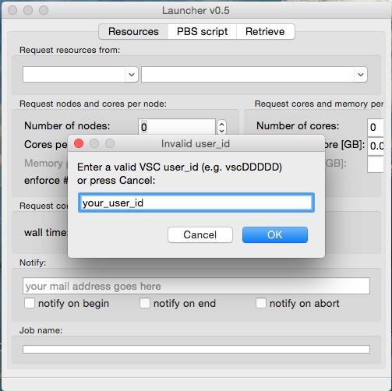
First steps
Enter your VSC user id

Slide 5
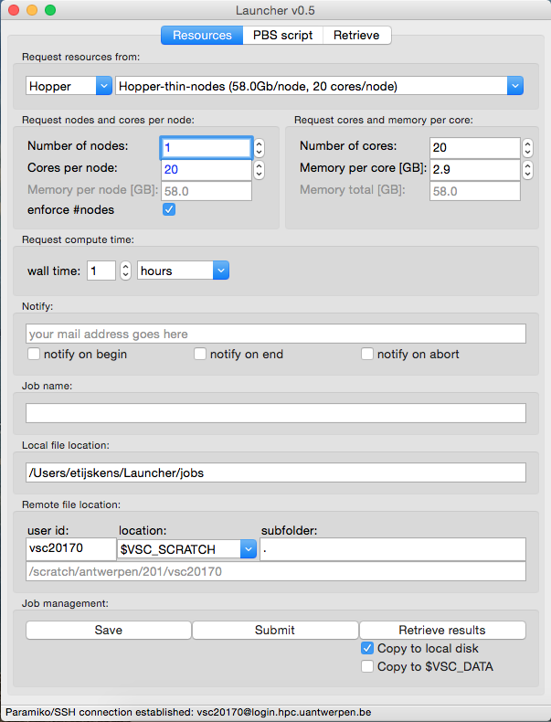
First steps ...
resize the Launcher window until everything is visible
(most settings are remembered between sessions)

Slide 6
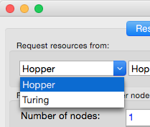
1. Request resources
select the cluster to submit to ...

Slide 7
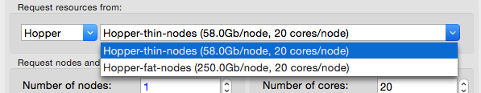
1. Request resources
select the kind of nodes you want to use ...

Slide 8
1. Request resources
In the mean time Launcher already connected to Hopper:
(If Launcher cannot connect, it will continue with what it knows and store your work locally)

Slide 9
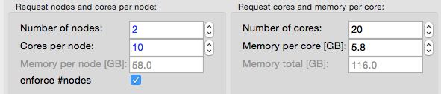
1. Request resources
approach 1 (left column):
request nodes and cores per node:
avoid that the resource manager gives you 2x10 cores on a single node
right column is automatically adjusted

Slide 10
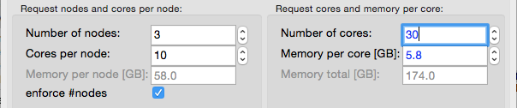
1. Request resources
approach 2 (right column):
requesting cores and memory per core
say, I need 30 cores with at least 6 GB per core
Launcher tries to satisfy your request, treating all nodes in the same way, providing at least what your ask for, and possibly more
not enough memory ...
automatically adjusted

Slide 11
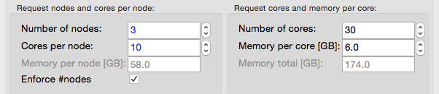
1. Request resources
approach 2 (right column):
requesting cores and memory per core
let’s request 6 GB per core:

Slide 12
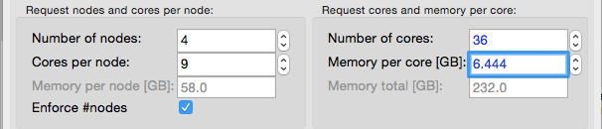
1. Request resources
approach 2 (right column):
you get 36 cores = 4 nodes x 9 cores/node with at least 6.444 GB per core
Launcher tries to satisfy your request, treating all nodes in the same way, providing at least what your ask for, and possibly more

Slide 13
1. Request resources
if you need much more memory per core, make a resource request for Hopper-fat-nodes (250 GB/node)

Slide 14
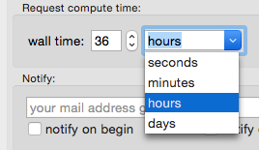

1. Request resources
select the wall time you need ...
select who gets notified when ...

Slide 15
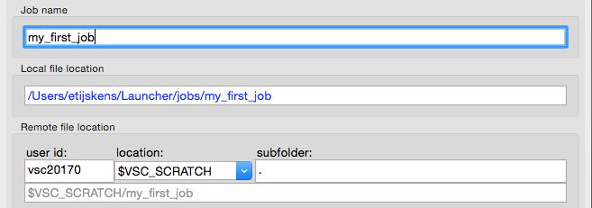
2. I/O destinations
Your job will be copied here (local destination) or stored when working off line.
enter a job name ...
Optional subfolder (relative to location) goes here.
Your job will be executed here (remote destination).
If a connection to the cluster is available $VSC_SCRATCH will be resolved

Slide 16
enter a job name ...
if the folder already exists, and there is a job script “pbs.sh” that script will be loaded, and all fields above will be set

Slide 17
choose the local destination ...
change the local destination folder, the job name will be added

Slide 18
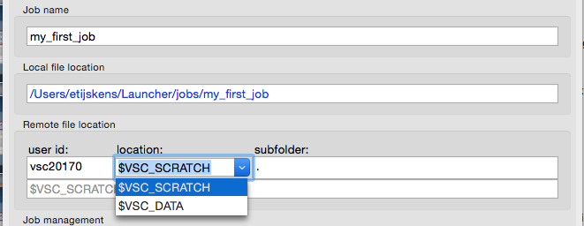
choose the remote destination ...
change the remote destination folder here, ... and here
change the remote destination folder here, ... and here

Slide 19
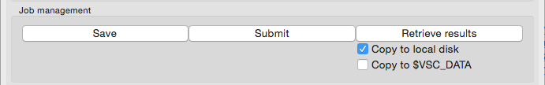
executing your job script ...
change the remote destination folder here, ... and here
create a job script and save it locally

