Slide 1
THE SPASE METADATA MODEL FOR HELIOPHYSICS DATA AND MODELS
Thieman, James¹; Roberts, D Aaron¹; King, Todd²; Fung, Shing¹; Bargatze, Lee²
1. NASA Goddard Space Flight Center, Greenbelt, United States
2. Department of Earth, Planetary, and Space Sciences, University of California, Los Angeles, California,
COSPAR 2018
PSW.4-0001-18

Slide 2
What is SPASE
SPASE
Space Physics Archive Search and Extract
Community developed metadata standard
Used by the NASA-funded space and solar physics community
Used by the international community
and by other U.S. agencies (NOAA)

Slide 3
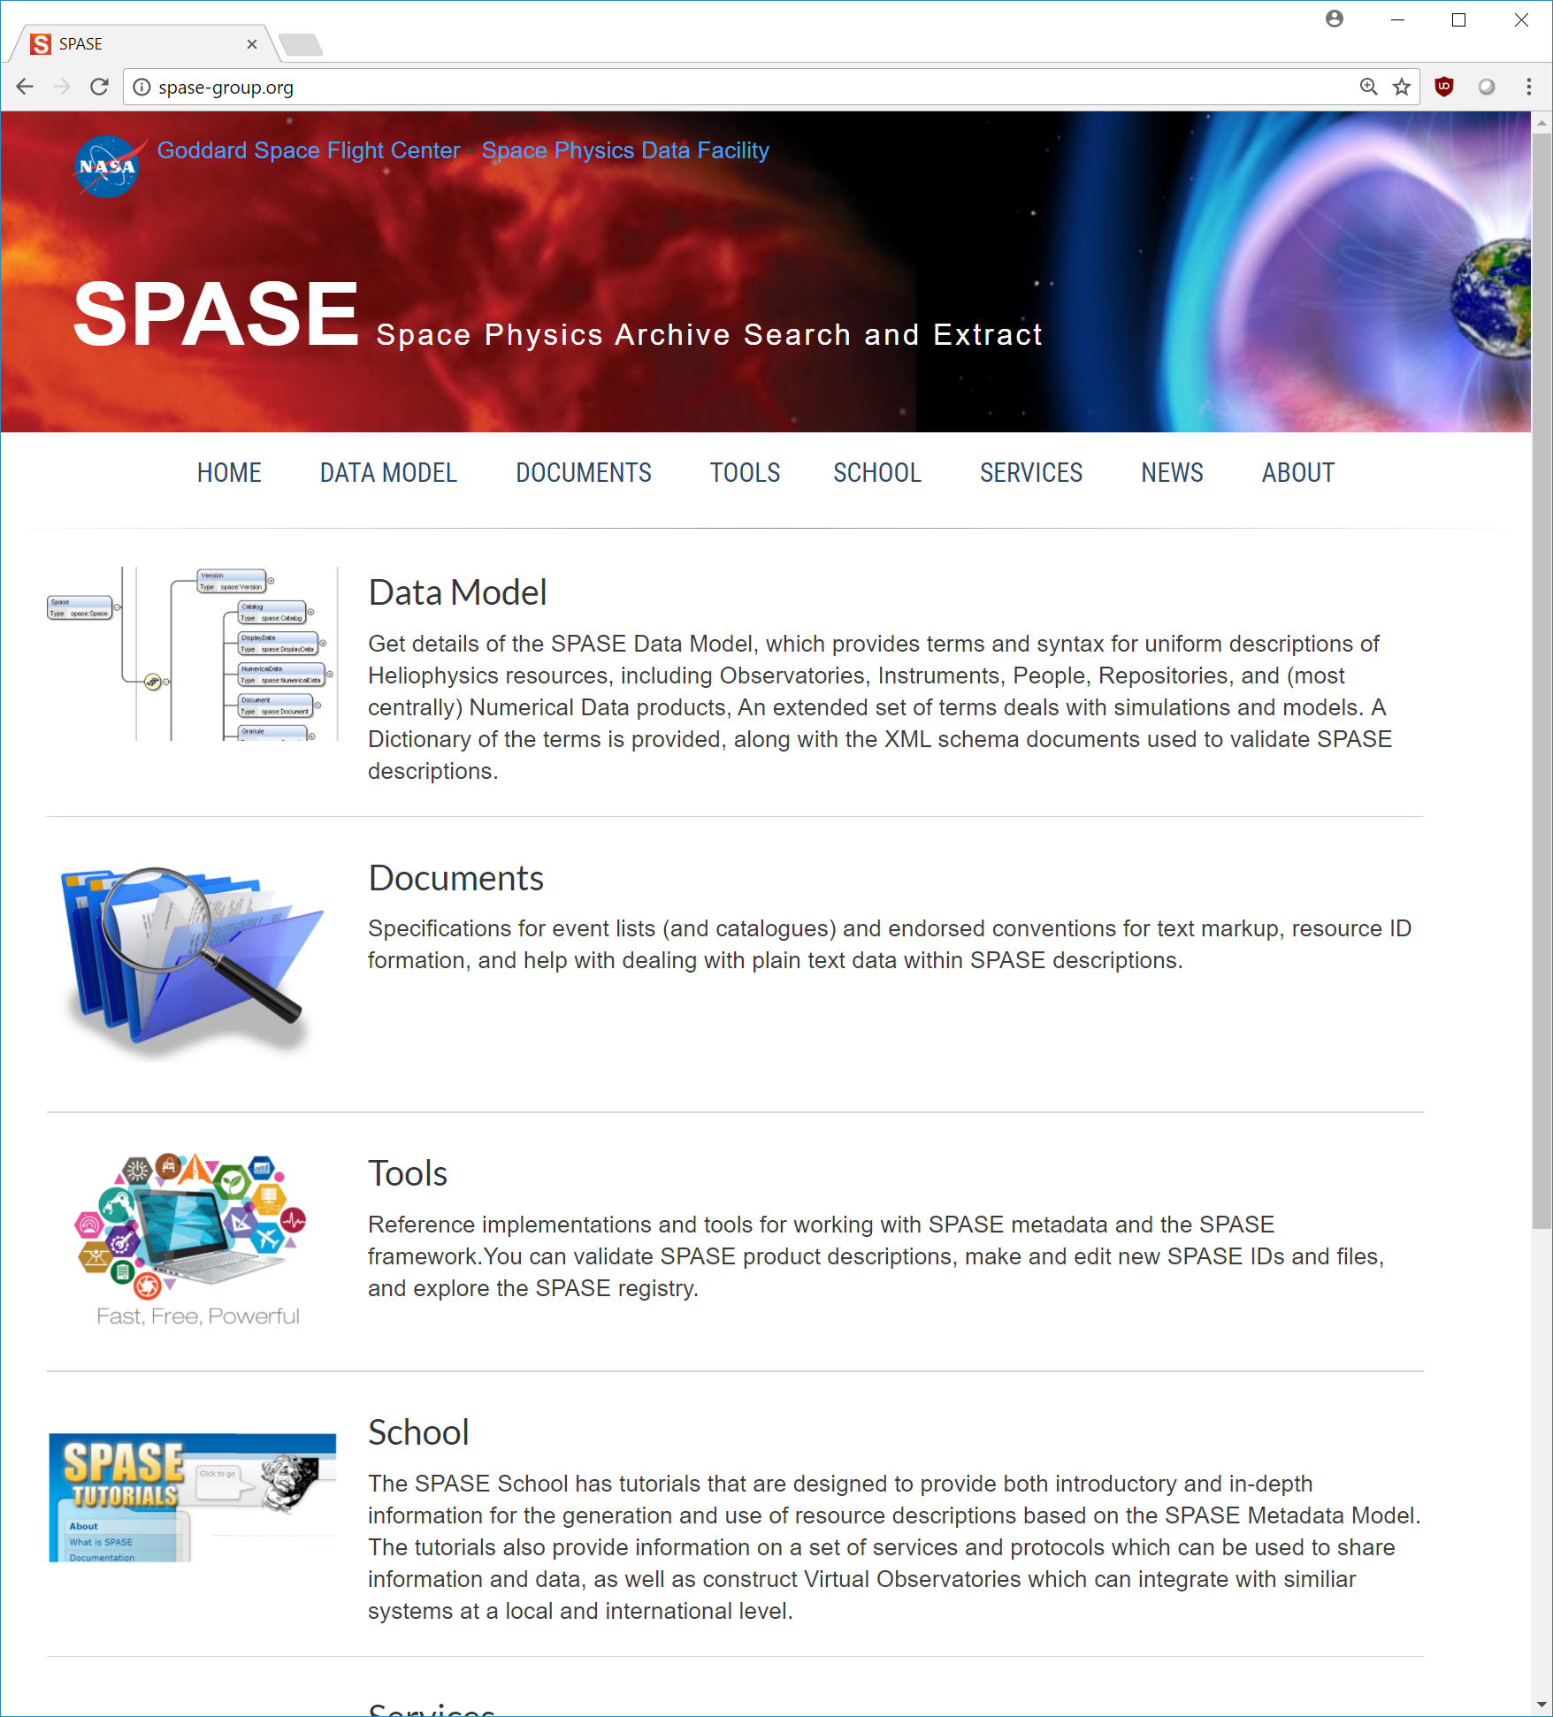
The SPASE Design Principles
Pleasantly Parallel
Metadata and Data generation are created independently
Scalable to Big Data
Storage of metadata and data are seperate - Data is referenced by URL
Designed for Discovery
Metadata is contextually rich (and scientifically useful)
http://spase-group.org

Slide 4
A Brief Time Line
ISTP @ RAL
Call to action
Grassroots
DOI 2.3.0
1.0
1.0
2.0.0
2.2.0
2001
2003
2006
2007
2007
2014
1998
2002
2005
2005
2009
2011
2018
Community
1.2.0
2.1.0
AISRP (NASA)
Proposal
VxOs
Selected
Simulation Extension

Slide 5
SPASE Metadata Model
O
r
g
a
n
i
z
a
t
i
o
n
Document
Instrument
part-of
from
Catalog
Observatory
D
a
t
a
Person
Display Data
Annotation
found-in
Base Model
12 Resource Types
author-of
Numerical Data
Repository
Service
Registry
Granule
part-of
Infrastructure
Simulation Extensions
4 Resource Types
Simulation Model
Simulation Run
Display Output
Numerical Output
instance-of
output-from
Simulation Extensions

Slide 6
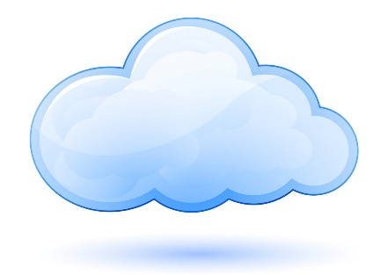
Resource Description Overview
Attributes
Outline
Name
Description
Resource ID
DOI
Header
Information URL
location
Repository ID
Contact
Data Resources
Measurement Type
Name
Access URL
Numerical Data
Access Information
Description
Acknowledgement
Display Data
URL
location
Instrument ID
Time Span
Product Key
Catalog
Granule
Temporal Description
Cadence
Field
Name
Annotation
Exposure
in
Parameter
Description
Particle
Numerical Output
Wave
•••
Units
Display Output
Parameter
Mixed
{Parameter Type}
Support
Parameter Key

Slide 7
Simulation Extensions
Based on the work done by the EU’s Framework 7 Integrated Medium for Planetary Exploration (IMPEx) project.
Extensions have been adopted by the multi-agency Coordinated Community Modeling Center (CCMC) to describe supported models and run results.
Planned use to describe results from simulation research.

Slide 8
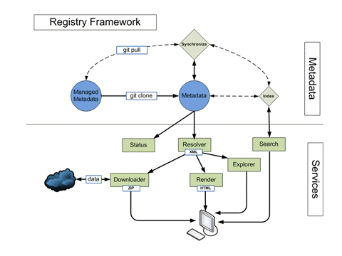

Tools and Services
Registry Services
A web app that includes resolver, search, render and download services for SPASE XML resource descriptions.
http://spase-group.org/tools/registry/
Resource Tools
A set of command-line applications which can be used to generate, validate, referentially check, use and organize resource descriptions written in SPASE XML.
http://spase-group.org/tools/registry/
npm install -g spase-resource-tools
On-line Validator and Editor
http://spase-group.org/tools

Slide 9

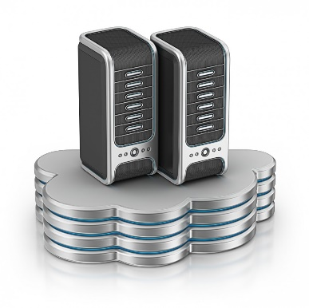

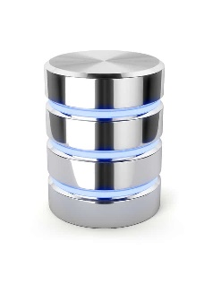


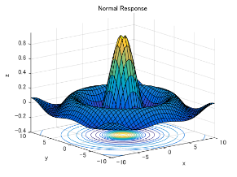


Data Environments
Repository
Describe
SPASE
Harvest
Share
Metadata
Data
Discover
HAPI
Visualize
URL
Download
Portal
Users

Slide 10
Digital Object Identifier (DOI) Integration
DOI for data = Citable data
DOI assign by a registration authority (SPASE Group can do this)
Required DOI information (title, authors, publisher, etc.) can be extracted from SPASE descriptions.
Assigned DOI can be included in SPASE description.
Landing page provided by registry (http://spase.info)
Data access provided through AccessURL (and portals)
More publications for researchers.

Slide 11
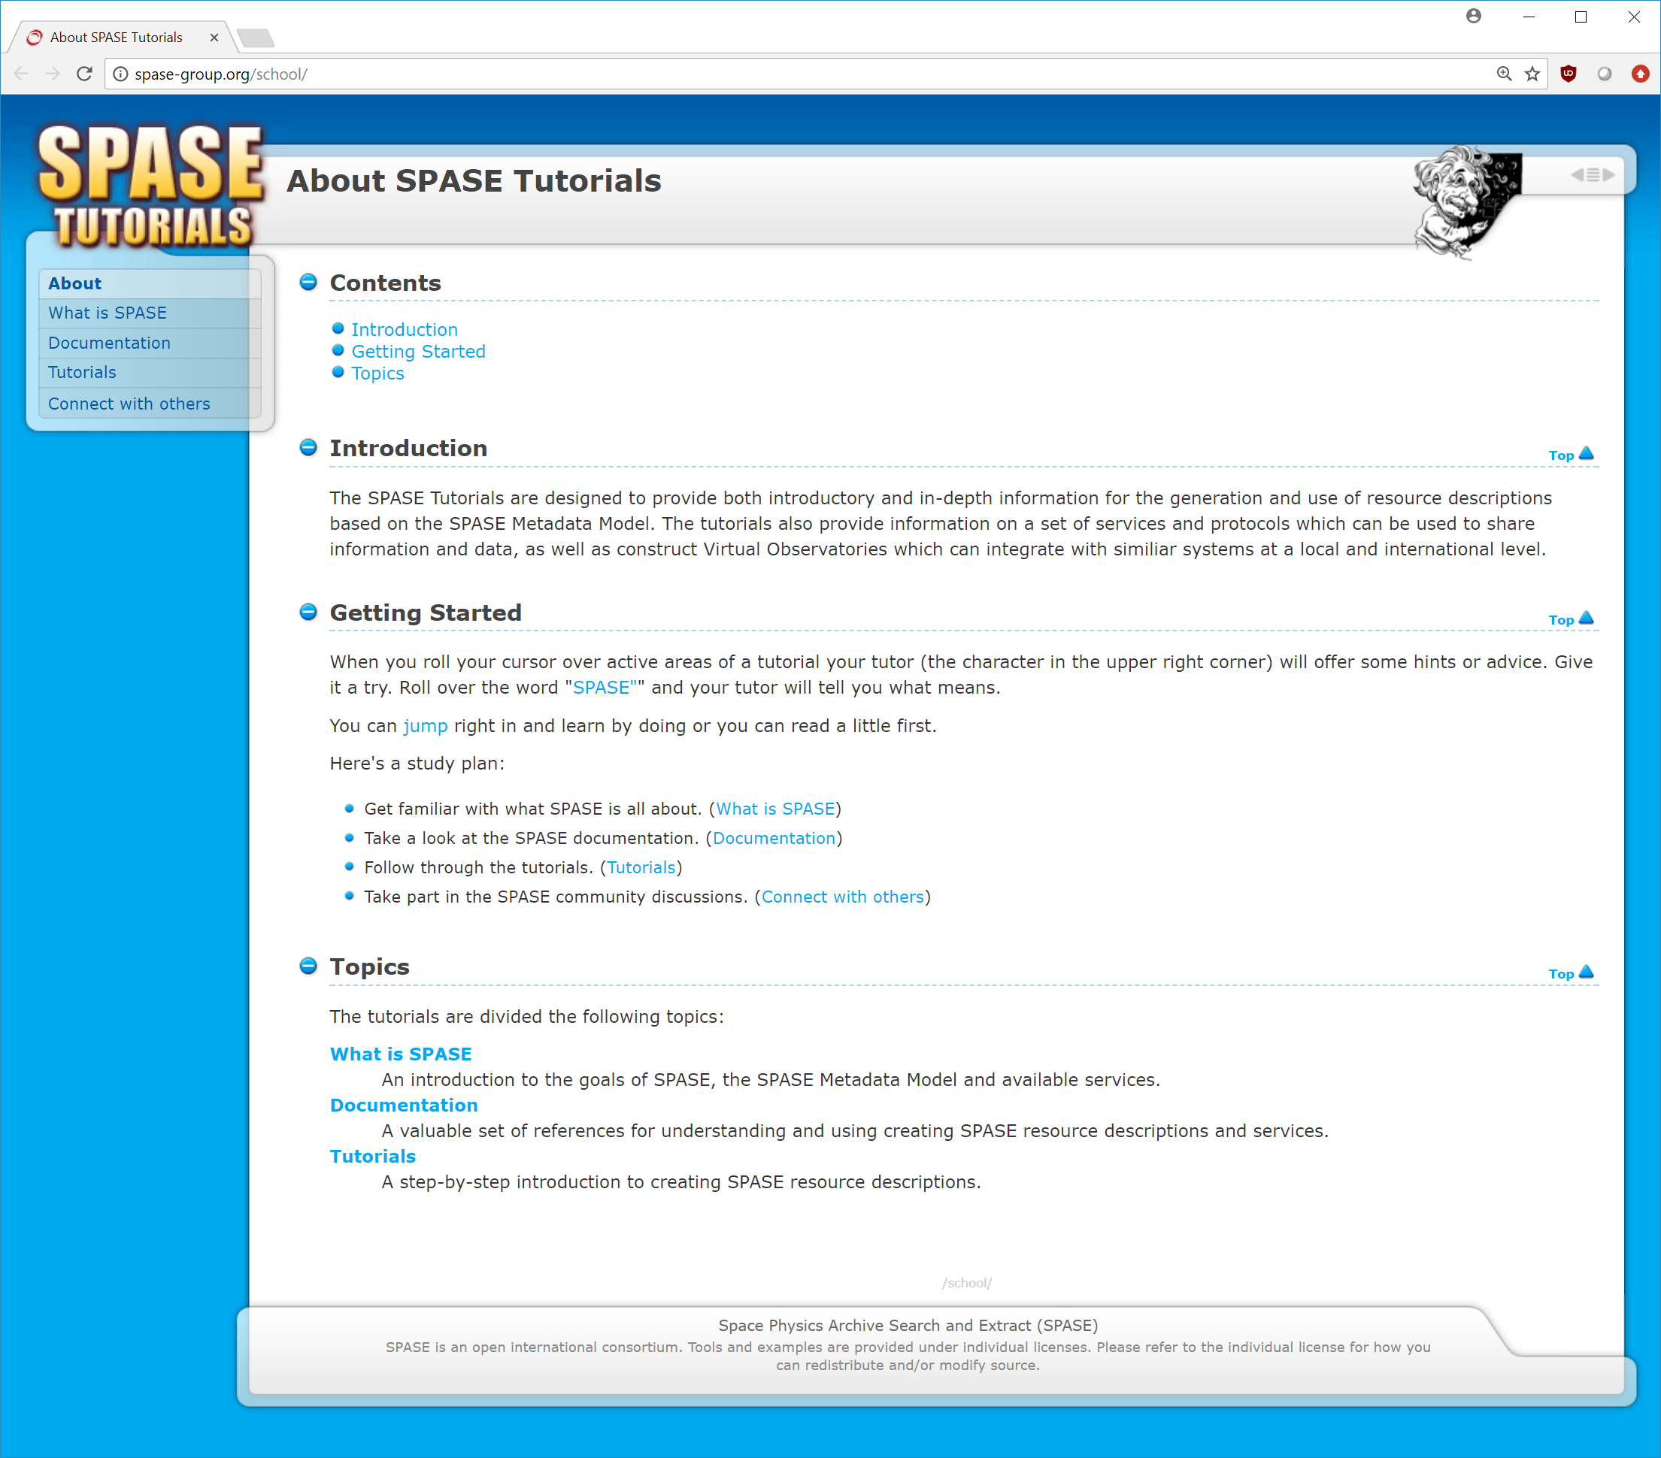
SPASE School
Tutorials
Examples
… and more
http://spase-group.org/school

Slide 12
A few Stats
11 Repositories (all on https://github.com/hpde)
ASWS, CCMC, CSSDP, ESA, GBO, ISWI, JAXA, NOAA, NSF, SMWG, VSPO
SMWG (Organization and Infrastructure resources)
1,885 Observatories
2,268 Instruments
4,904 Persons
147 Repositories
15 Services

Slide 13
A Few More Stats
Described Resources
ASWS : 150
CCMC : 7
ESA : 185
GBO : 1,222
JAXA : 56
VSPO : 2,446
=======
4,066

Slide 14
Happenings
Improvements to web site and services
Continuous additions of SPASE descriptions (lead by Spase Metadata Working Team - SMWT)
New Web based editor
HAPI time series data access
International Heliophysics Data Environment (IHDE)

Slide 15
Summary
Overall SPASE metadata is capable of providing the infrastructure to connect data, documents, people, software, services and published works.
… and when SPASE metadata is harvested by a portal it can enable rich discoverability.
… and we’re constantly improving and enhancing the metadata model and services to meet the needs of the community.

Slide 16


Slide 17
Abstract
The Space Physics Archive Search and Extract (SPASE) Metadata standard is a community developed standard that is being supported and used by the NASA-funded space and solar physics community. It is also in use by the international community and by other U.S. agencies (NOAA). SPASE metadata has long been used to describe experimental data, software, documents and more. The most recent additions to the SPASE information model are extensions to support describing a simulation or model and the results generated from a run. These extensions are based on the work done by the EU’s Framework 7 Integrated Medium for Planetary Exploration (IMPEx) project. In addition to IMPEx, these extensions have been adopted by the multi-agency Coordinated Community Modeling Center (CCMC) to describe supported models and run results. These extensions, along with the core SPASE metadata, enable the discovery of related observational and theoretical data resources through search portals such as NASA’s Heliophysics Data Portal. In addition, SPASE provides a variety of tools and services related to generating and validating resource descriptions. One new service is that SPASE now provides support for issuing Digital Object Identifiers (DOI) for resources that are described with SPASE. The SPASE Metadata Working Team (SMWT) will work with data producers who lack other avenues for producing DOI so that their registered data may be referenced in publications. SPASE also provides generated landing pages based on the content of SPASE resource descriptions which can be used for any DOI. Overall SPASE metadata is capable of providing the infrastructure to connect data, documents, people, software, services and published works. And when SPASE metadata is harvested by a portal an ability to have rich discoverability.

