Slide 1
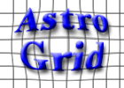
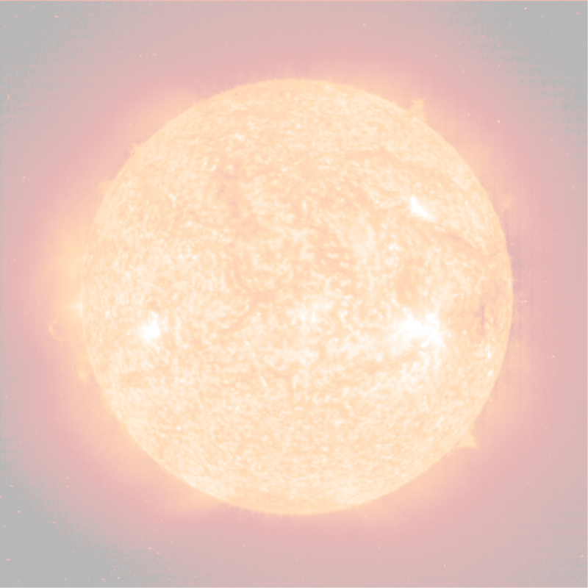
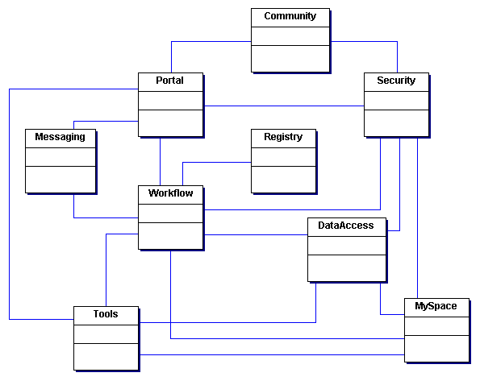
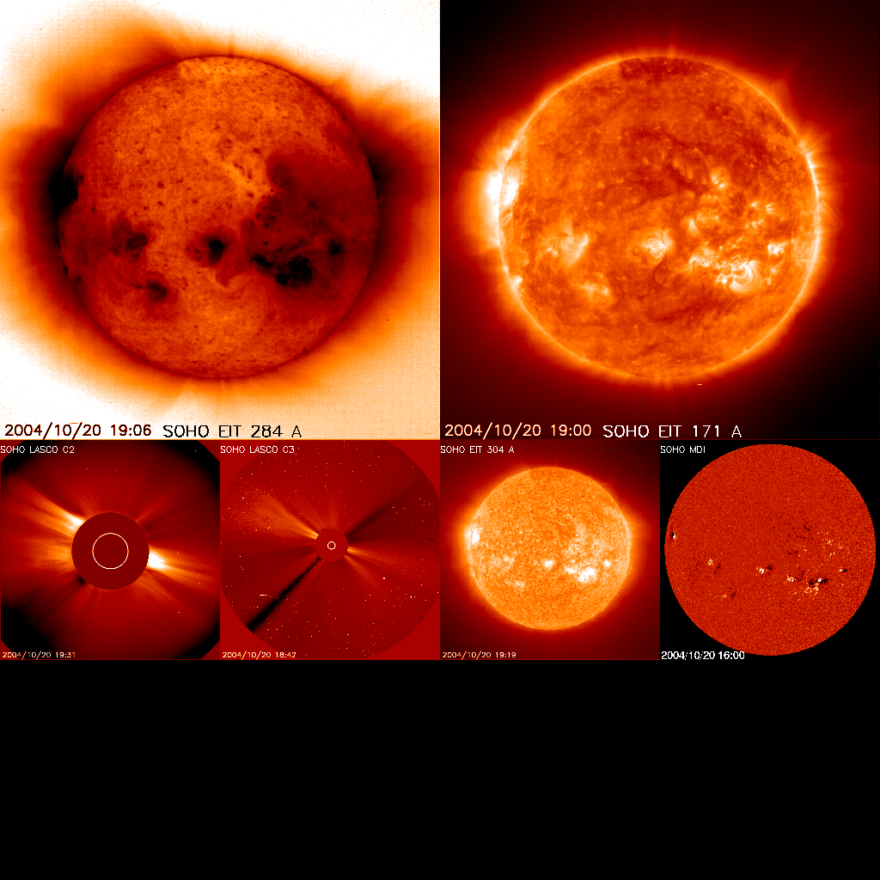
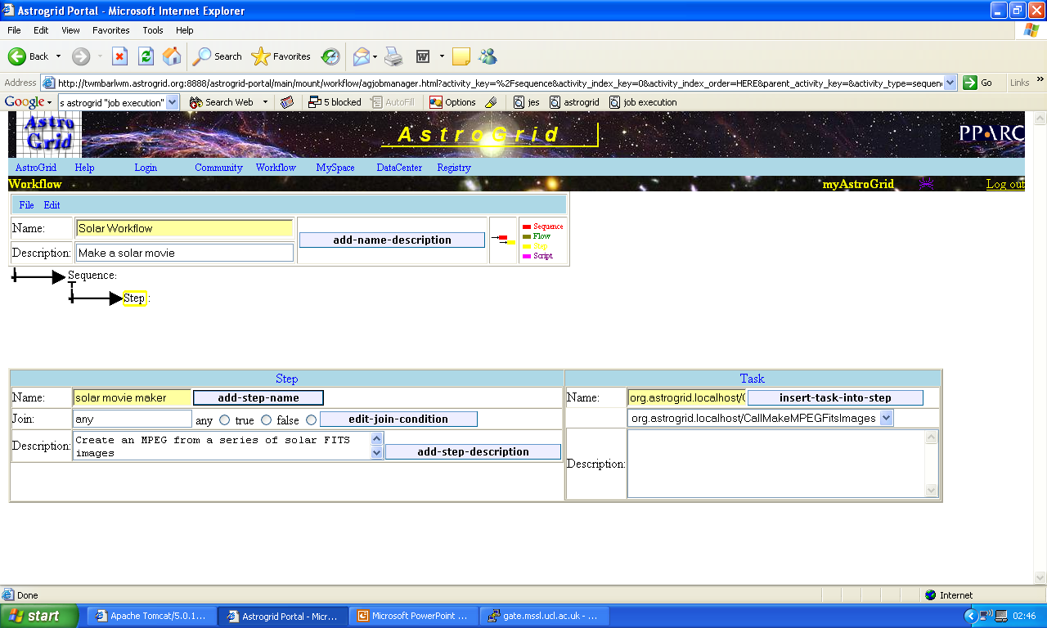











Solar and STP Physics with AstroGrid
E.C. Auden¹, S. Dalla², T. Linde³, N. Walton⁴
AstroGrid
AstroGrid Components
Solar Data
A PAL has been installed at MSSL to facilitate access to the SURF archive. Currently, data from TRACE and SOHO-CDS have been integrated with the PAL system. The SURF archive allowed users to request data via an HTML form, after which the prepared data would be sent via FTP or email. The PAL can now accept an AstroGrid query for TRACE or SOHO-CDS data and transfer the relevant files from MSSL to the user’s MySpace area.
AstroGrid is a £5 million PPARC-funded e-Science project to build a UK virtual observatory (VO). The project formally began in September 2001, and AstroGrid version 1.0 will be released at the UK’s National e-Science Centre in December 2004. AstroGrid II has been funded for a further two years of VO research and development.
AstroGrid is working towards goals such as key UK databases interfaces, standardized archive queries, simultaneously browsing multiple datasets, on-line data analysis tools, and resource discovery. Once achieved, these goals will enhance a working datagrid for space scientists in astronomy, astrophysics, solar physics, and solar terrestrial physics.
Registry – Stores vast amounts of metadata for resources such as data sets, web services, services, and information on other registries in a repository. Registry entries can be updated manually, or by harvesting entries from other registries.
Data Centre – Provides ability to publish a collection of space data as a data centre to AstroGrid using the Publishers AstroGrid Library (PAL). Also provides a client interface to the data centre.
Workflow – Provides an interface to the Job Execution System, which submits, schedules and monitors jobs submitted by AstroGrid users. Jobs can be asynchronous catalogue queries, running applications, or registry searches.
CEA – Common Execution Architecture, which integrates VO applications, such as image processing tools, solar models, and mathematical routines, with the AstroGrid infrastructure.
MySpace – Data storage area provided for space scientists. This storage may be at a local or remote institution, and it can be used to store result sets from queries, workflows, private datasets and more obtained from the AstroGrid system.
Portal – Allows a customizable web-based GUI interface to the AstroGrid system and all its components – registry, workflow, MySpace, CEA, etc.
Figure 2: SOHO data from 20 October 2004, available in the SURF archive at the Mullard Space Science Laboratory.
STP Data
AstroGrid developers are currently working with the RAL World Data Centre to install a PAL that would publish Ionosonde and the Equatorial Disturbance Storm Time Index (DST). One of the AstroGrid “big ten” science cases involves the association of high activity in the Earth’s magnetic field with specific solar events in the following workflow:
1. Query for Ionosonde and DST data corresponding to periods of high magnetic activity.
2. Use timestamps from query results to launch query for coverage of solar events occurring hours or days before the high magnetic activity.
3. Store relevant solar and STP data in MySpace.
4. Either continue by using solar and STP data as input to a magnetic model deployed through CEA, or cease workflow so user may analyse the data locally.
Figure 1: A schematic of the AstroGrid architecture highlighting the interaction between the Registry, Workflow, MySpace, Data Access, CEA Tools, Portal, and other AstroGrid components.
Continuing development
Solar coordinates in IVOA resource metadata schemas: AstroGrid is working with the IVOA to include solar and STP coordinate systems in the next drafts of the resource metadata schemas:
Solar spherical, solar Cartesian, solar magnetic
Geodetic, geomagnetic, geographic
Geocentric equatorial, geocentric equatorial inertial, geocentric solar ecliptic, geocentric solar equatorial, geocentric solar magnetospheric
2. Integration of GUI-based tools with AstroGrid CEA system
Currently, the CEA only supports commandline-based tools, including IDL and solarsoft routines with commandline interfaces. However, during development of AstroGrid II, the CEA will be evaluated for support of GUI based tools. This will allow AstroGrid users to access familiar movie applications, calibration tools and other GUIs through the AstroGrid web interface.
3. Deployment of SolarSoft as a CEA application
Research into deploying specific SolarSoft routines as commandline-based tools is underway in AstroGrid I, such as the MakeMPEGFitsImages tool. During AstroGrid II, developers will assess the feasibility of integrating more SolarSoft routines with the AstroGrid system. Possibilities include
Deploying the most common 10, 20, or 50 top level routines as AstroGrid tools
Encouraging scientists to develop specific tools based around SolarSoft routines
Providing scientists with an easy interface to analyse data stored in MySpace with SolarSoft installations already running on their university machines
IVOA
IVOA – AstroGrid is a member of the International Virtual Observatory Alliance (IVOA). The IVOA consortium of more than 20 virtual observatories from countries around the world. Its mission is to provide a forum where scientists and engineers can collaborate on development and deployment of standards, protocols, tools, systems, and organization protocols with one aim in mind: to allow interoperation between virtual observatories.
Some areas in which IVOA is working towards standards and protocols for interoperating VOs:
Resource registries
Data models
Data access layer
VO query language (VOQL)
Content description
VOTable
Solar and STP Tools
The MakeMPEGFitsImages tool accepts FITS images as input, and creates an MPEG as output. Currently, this tool can accommodate TRACE images; the TRACE files are processed using SolarSoft routines before compilation into an MPEG file with further IDL routines. Further development will add support for SOHO-CDS data, pointing information, time rotation, and overlay of multiple wavelengths.
1. Mullard Space Science Laboratory, University College London.
2. School of Physics and Astronomy, University of Manchester.
3. Department of Physics and Astronomy, University of Leicester.
4. Institute of Astronomy, Cambridge University

