Slide 1

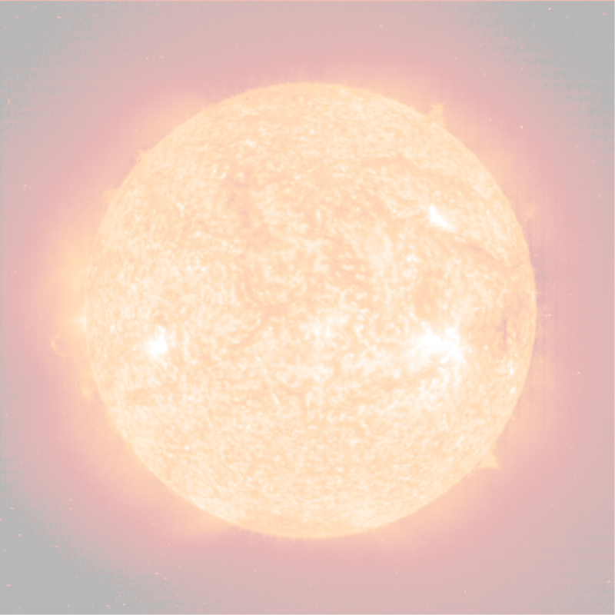


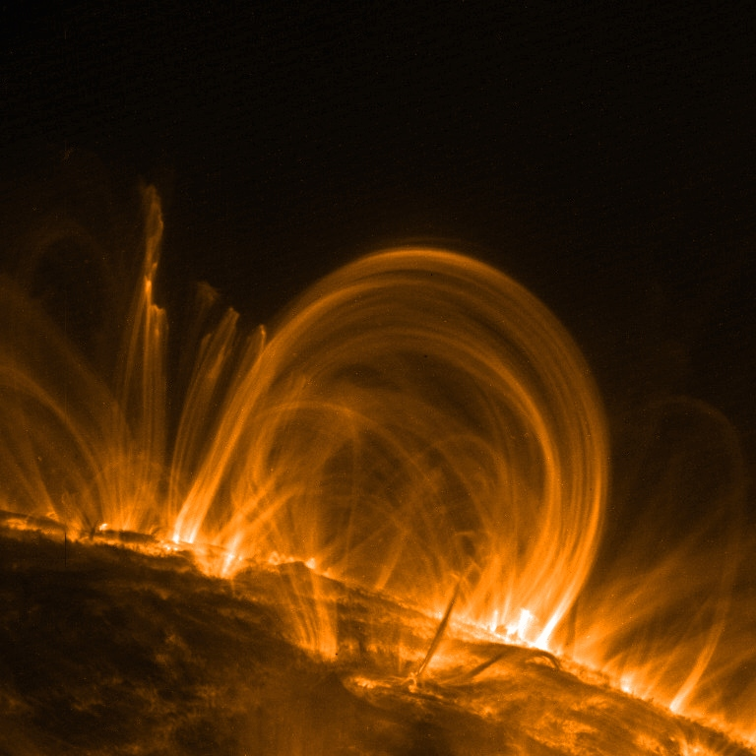
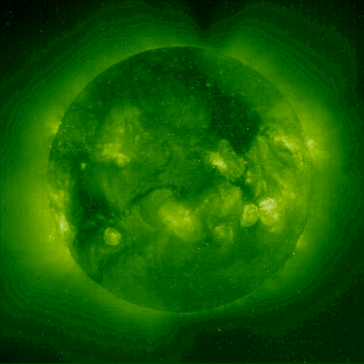
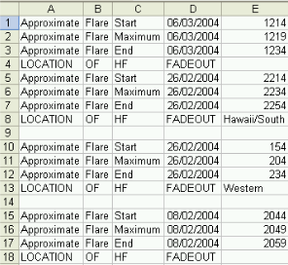
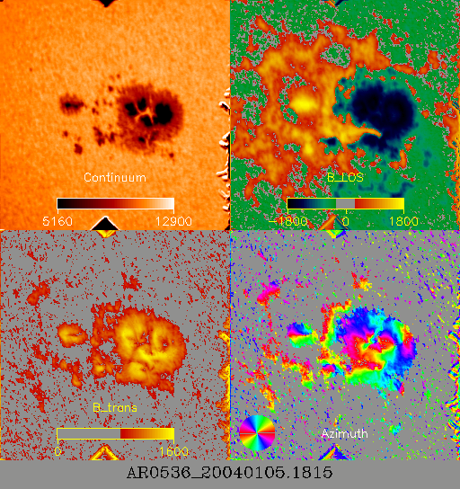
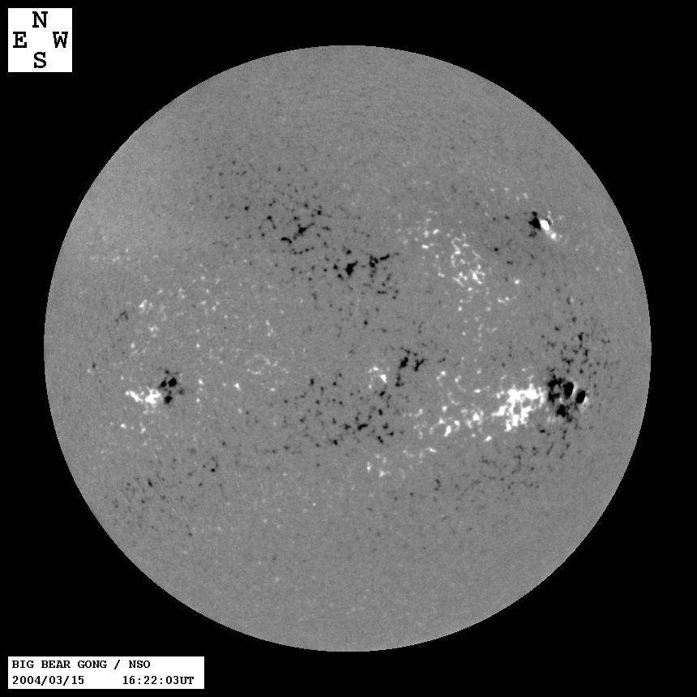
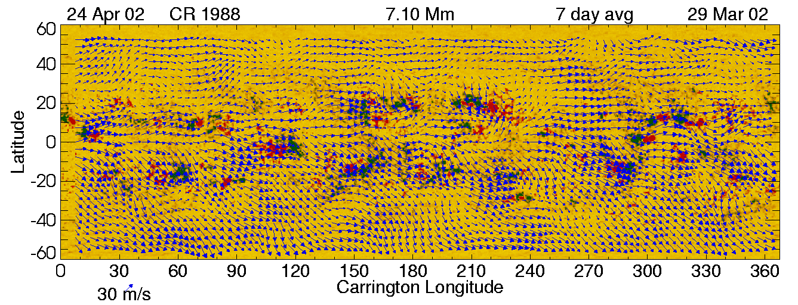
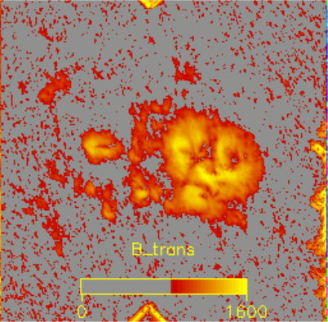
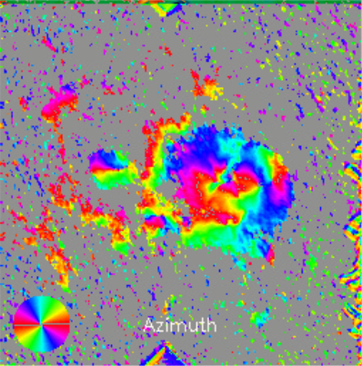






Algorithm Preparation and Data Availability
for the SDO Investigations in the Context of the UK Virtual Observatory
J.L. Culhane¹, E.C. Auden¹, Y.P. Elsworth², R.A. Harrison³, M.J. Thompson⁴
SDO Data on the Grid
The SDO on the Grid project will integrate UK grid projects such as Astrogrid with SDO databases to provide access to data and specialist processing for the solar community. Specialist algorithms for processing AIA, HMI global, and HMI local data will be deployed as solar grid applications. Four UK Solar Physics groups have Co-Investigator involvement in the SDO AIA and HMI investigations: MSSL, Rutherford Appleton Laboratory, and the Universities of Birmingham and Sheffield. The huge SDO data volume (~ 2.5 TBytes/day) requires special measures to ensure effective data handling:
Specialist algorithms for local and global helioseismology data products and for feature recognition in AIA and HMI images
Development of data summary formats to allow high speed searches of the SDO databases
Production of Grid-compatible software to enable distributed processing and storage of SDO data
The UK-based SDO e-Science consortium has been funded by PPARC (PP/C502930/1) as a three year project to assist US SDO investigation teams to extract data products and enable data access by the UK Solar Physics community.
SDO Data Centre: Integrating with PAL
The SDO data centre will use infrastructure developed by the Astrogrid project to make SDO data available to the UK solar community via a web browser. A “Publisher’s Astrogrid Library”, or PAL, can be installed wherever SDO data products are queried. Although the PAL does not need to be installed at the same physical location as the data, the Astrogrid data centre software works most efficiently when the PAL installation is near the data in terms of network proximity.
For instance, the scenario illustrated with the above map shows these details:
1 PAL installed in California where SDO post-pipeline data is located
1 PAL installed in UK near location of SDO data processed by specialist solar grid applications
Other PAL scenarios for SDO include installation of a UK PAL for post-pipeline data obtained from an interface with VSO, or a UK PAL for data processed by the specialist algorithms only with no corresponding PAL for SDO post-pipeline data.
Preparation of Specialist Algorithms
The European Grid of Solar Observatories (EGSO) is developing several relevant tools including algorithms for recognition in white-light images and magnetograms of active regions, sunspots, and filaments. These could be adapted where appropriate given the UK involvement in EGSO. In addition, other feature recognition and data analysis tools will be developed as grid applications for the HMI and AIA instruments.
1. Image Feature Recognition Tools (AIA / HMI)
  Recognition of coronal loops
  Recognition of multiple overlapping loops
  Recognition of coronal dimming regions
  Correlation between coronal voids and CME times
  Distinction between dimming regions and coronal holes
  Recognition of flares
  Recognition of active region outflows
  Detection of “EIT” waves
2. Helioseismology Tools – Global (HMI)
  Extrapolation of birth of solar farside activity
  Estimation of wave travel times between a set of points on a Dopplergram
  Distribution of parallel processing load for Dopplergram computations
  Creation of helioseismic subsurface flow maps
  Correlation of active regions and subsurface flow maps with ≤ 24 hour lookback
  Creation of wave speed perturbation maps
  Deduction of magnetic field speed and direction from wave speed perturbation maps
Simple Summary Formats:
1. Images: convert to thumbnails
2. Tables: extract basic metadata & column minima / maxima
Benefits of Grid Integration:
provision of SDO data products via web interface
access to SDO post-pipeline solar grid applications
registration of SDO data products
registration of SDO solar grid applications
display of data product summaries (i.e., thumbnails)
3. Helioseismology Tools – Local (HMI)
  Determination of mode frequencies on timescales matching solar magnetic activity
  Determination of solar rotation profile with radial and latitudinal precision, based on mode splitting.
  Determination of oscillation source locations using mode asymmetry
  Correlation between mode frequency, source location and other oscillation data over short and long timescale
  Combined use of HMI data with GONG and BISON observations
TRACE image of a coronal loop from
http://solar-center.stanford.edu/news/trace.html
Data Product Summary Formats
An important part of the SDO software project is the development of summary formats for SDO data products such as images and tables, as well as more complex products such as magnetograms and helioseismology data. SDO product summaries will take two forms: simple and complex.
Simple data summaries will include image thumbnails and table column headers or minima and maxima for each column. Complex data summaries will be developed for vector magnetograms and helioseismic products, e.g. solar movies.
By investing development time in data product summaries, users will benefit from high speed searches, high speed data downloads, and high rapid decisions about which full-size data products are suitable for further investigation.
Flare# Observatory Start Time/Date
2354 Hawaii 20040312 00:12:45
Complex Summary Formats:
3. Vector Magnetograms: compile full-disk line-of-sight magnetograms accompanied by intensity, line-of-sight, and transverse magnetogram thumbnails for active regions
4. Synoptic Flow Maps: extract averages from flow maps showing daily activity over a 26-day Carrington rotation, as shown in the 7-day average map below:
1. Mullard Space Science Laboratory, University College London.
2. Physics and Astronomy Department, University of Birmingham.
3. Rutherford Appleton Laboratory.
4. Physics and Astronomy Department, University of Sheffield
Vector magnetograms of AR0536 on 05/01/04, from http://www.solar.ifa.hawaii.edu, and full disk line-of-sight magnetogram taken on 15/03/04 by the Big Bear GONG+ instrument.
Synoptic flow map showing solar magnetic fields between 29/03/02 and 24/04/02 from http://www.boulder.swri.edu/~deforest/wxmaps/

