Slide 1

A Paradigm for Space Science Informatics
Kirk D. Borne
George Mason University and QSS Group Inc., NASA-Goddard
kborne@gmu.edu or kirk.borne@gsfc.nasa.gov
and
Timothy E. Eastman (presenter)
QSS Group Inc., NASA-Goddard
eastman@mail630.gsfc.nasa.gov

Slide 2
What is Informatics?
Informatics is the discipline of structuring, storing, accessing, and distributing information describing complex systems.
Examples:
  Bioinformatics
  Geographic Information Systems (= Geoinformatics)
  New! Space Science Informatics
Common features of X-informatics:
  Basic data unit is defined
  Common community tools operate on data units
  Data-centric and Information-centric approaches
  Data-driven science
  X-informatics is key enabler of scientific discovery in the era of large data science

Slide 3
X-Informatics Compared
Discipline X
Bioinformatics
Geoinformatics
Space Sc. Informatics
Data Unit
Gene Sequence
Points, Vectors, Polygons
Time Series, Event Lists, Catalogs, Object Parameters
Common Tools
BLAST, FASTA
GIS
CDAWeb, Bayes Inference, Cross Correlations, Principal Components

Slide 4
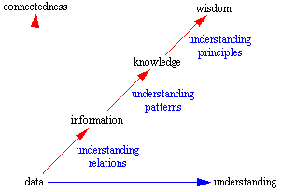
Data-Information-Knowledge-Wisdom
T.S. Eliot (1934):
“Where is the wisdom we have lost in knowledge?
Where is the knowledge we have lost in information?”

Slide 5
Key Role of Data Mining
Data Mining = an information extraction activity whose goal is to discover hidden knowledge contained in large databases
Data Mining is used to find patterns and relationships in the data
Data Mining is also called KDD
  KDD = Knowledge Discovery in Databases
Data Mining is the killer app for scientific databases
Examples:
  Clustering Analysis = group together similar items and separate dissimilar items
  Classification Prediction = predict the class label
  Regression = predict a numeric attribute value
  Association Analysis = detect attribute-value conditions that occur frequently together

Slide 6
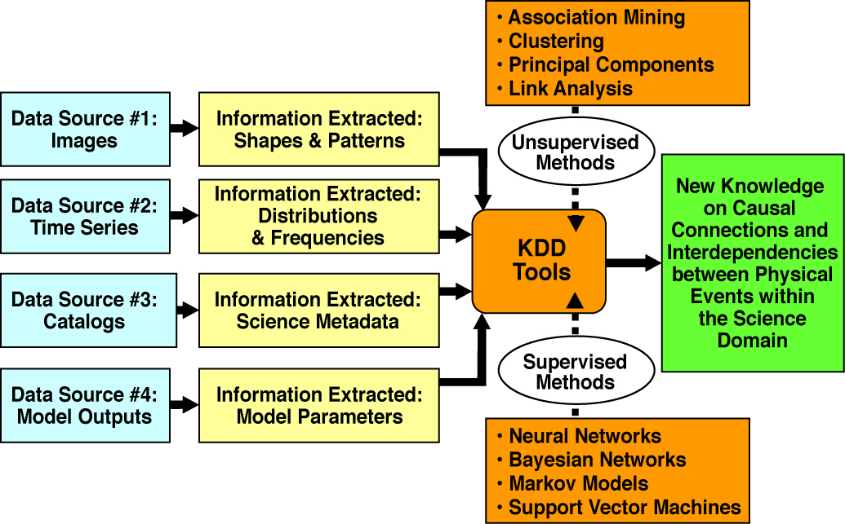
Space Science Knowledge Discovery

Slide 7
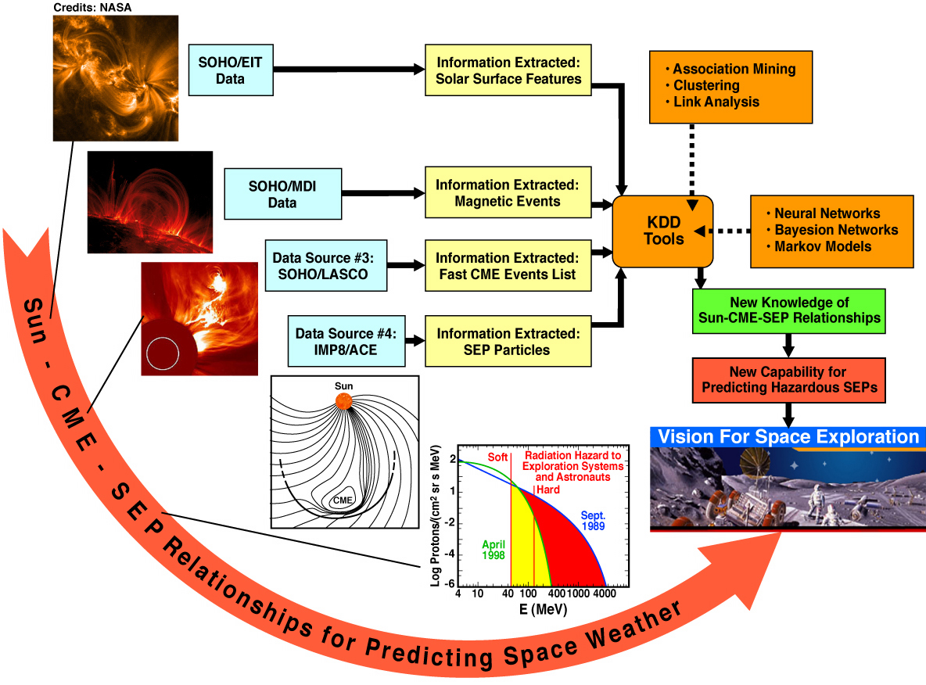
Space Weather Example

Slide 8
Space Science Informatics
Key enabler for new science discovery in large databases
Large data science is here to stay
Common data browse and discovery tools, and common data structures, will enable exponential knowledge discovery within exponentially growing data collections
X-informatics represents the 3rd leg of scientific research: experiment, theory, and data-driven exploration
Space Science Informatics should parallel Bioinformatics and Geoinformatics: become a stand-alone research sub-discipline

Slide 9
Future Work: Informatics Applications
Query-By-Example (QBE) science data systems:
  “Find more data entries similar to this one”
  “Find the data entry most dissimilar to this one”
Automated Recommendation (Filtering) Systems:
  “Other users who examined these data also retrieved the following...”
  “Other data sets that are relevant to this data set include...”
Information Retrieval Metrics for Scientific Databases:
  Precision: “How much of the retrieved data is relevant to my query?”
  Recall: “How much of the relevant data did my query retrieve?”
Semantic Annotation (Tagging) Services:
  Report discoveries back to the science database for community reuse
Science / Technical / Math (STEM) Education:
  Transparent reuse and analysis of scientific data in inquiry-based classroom learning (http://serc.carleton.edu/usingdata/ , DLESE.org )
Key concepts that need defining (by community consensus): Similarity, Relevance, Semantics (dictionaries, ontologies)

