Slide 1
Collaborative Sun-Earth Connector: A Primer
N. Hurlburt, P. Bose, S. Freeland, M. Woodward, G. Slater
LMATC
Supported by NASA through contract NNH04CC00C.

Slide 2
A Question
Is there a correlation between sunspot complexity and maximum magnetic flux?
  Type of question we would like to ask
  Can one answer it using VO’s?
  How would you use VO’s to do it?

Slide 3
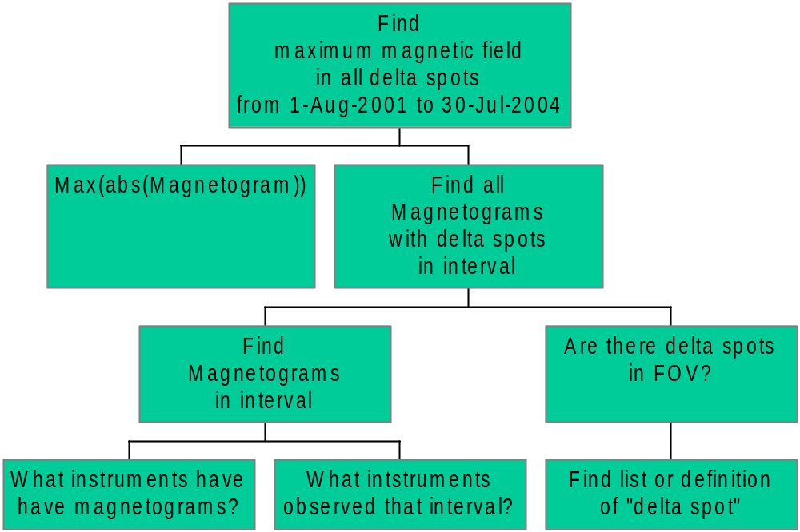
Solar Semantics

Slide 4
Scientific Workflow
Find Instruments
With Magnetograms
VSO
Start Date
Find
Magnetograms
End Date
List
Delta Spots
Match
FOV
Get
Magnetograms
Max(ABS(Magnetogram))
Plot/List
Maximum Flux

Slide 5
The CoSEC Solution
Distributed data analysis system using
  Scientific workflow systems
  Semantic composition & integration
  Existing SolarSoft services & tools
Focused on solar and space physics service
Collaborative environment for sharing data, software and higher-level products
Complements existing efforts in Virtual Observatories

Slide 6




CoSEC Components and
Interactions
2.1 Query/Browse
Create Process Graph
Service
1.1 Register Service
Composition
Service
Registry
Service-1
Agent
2.2 Bind Services/
Inputs/Ouputs
Services KB
2.3 Execute / Return
results as URL
Results
Registry
3.1 Spawn Execution
3.6 Notify Results
Manager Agent
3.2 Execute Service1
Service-x
Service
3.3 Post Results
Coordination
Agent
3.4 Execute ServiceX
3.5 Post Results
Service-y

Slide 7
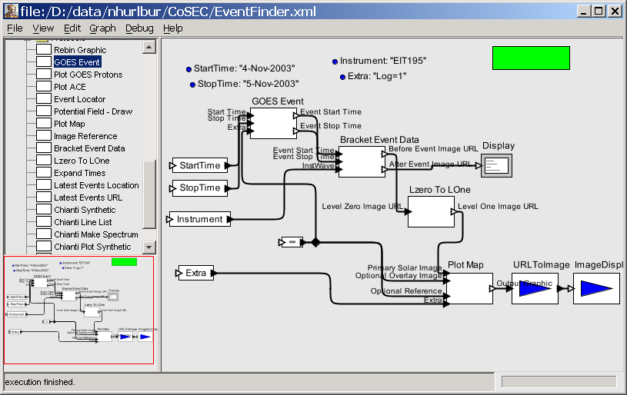
Example: Find nearest flare image

Slide 8
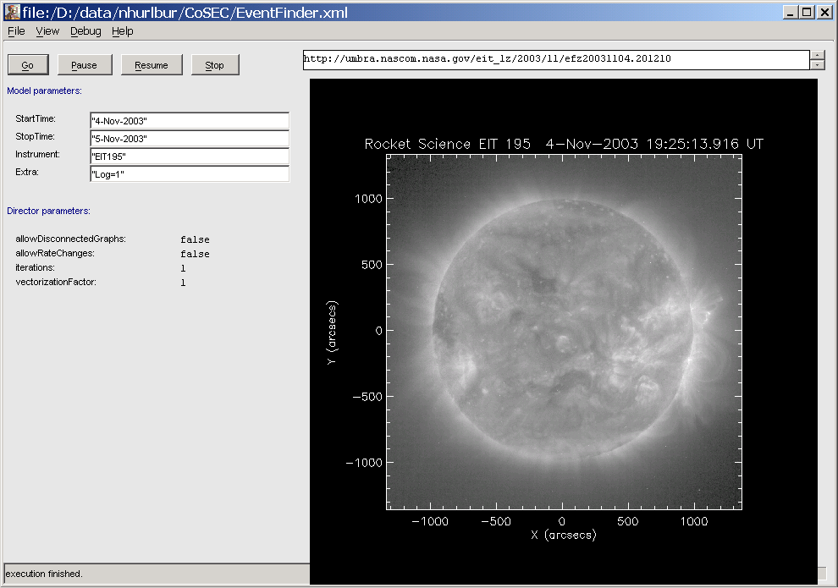
Nearest Image Widget

Slide 9
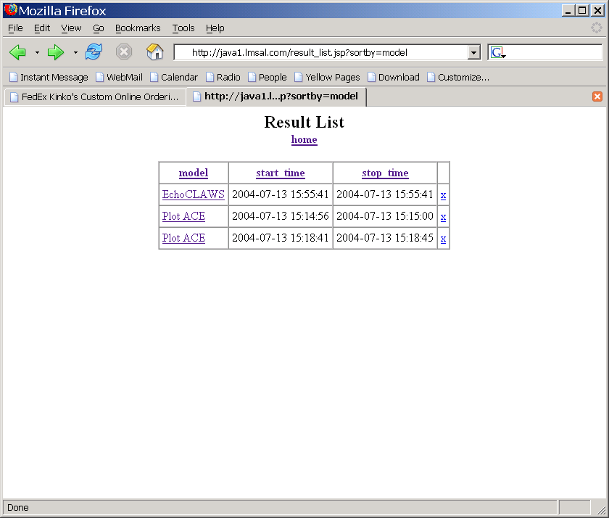
Draft ResultSpace

Slide 10
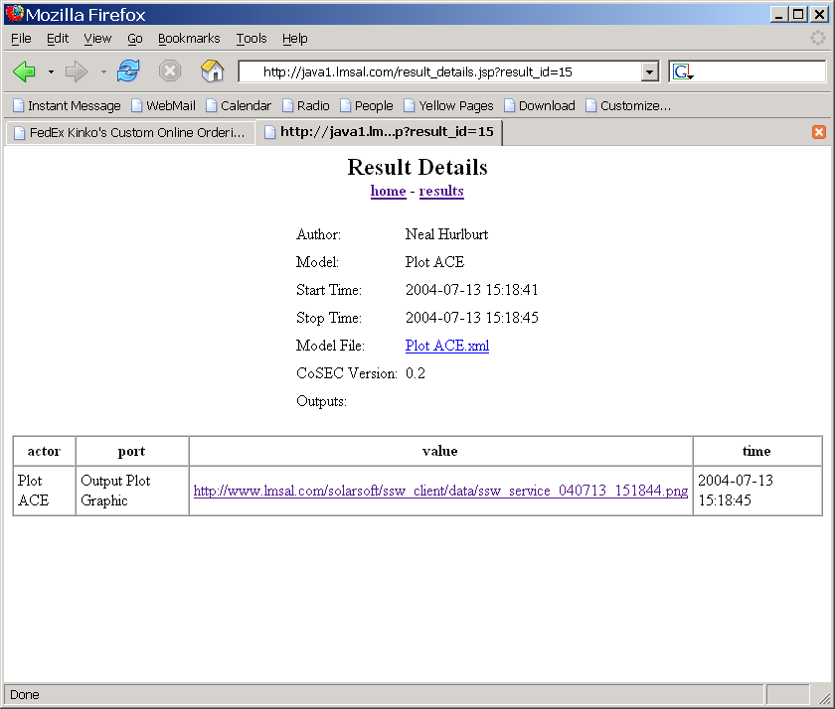
Draft ResultSpace

Slide 11
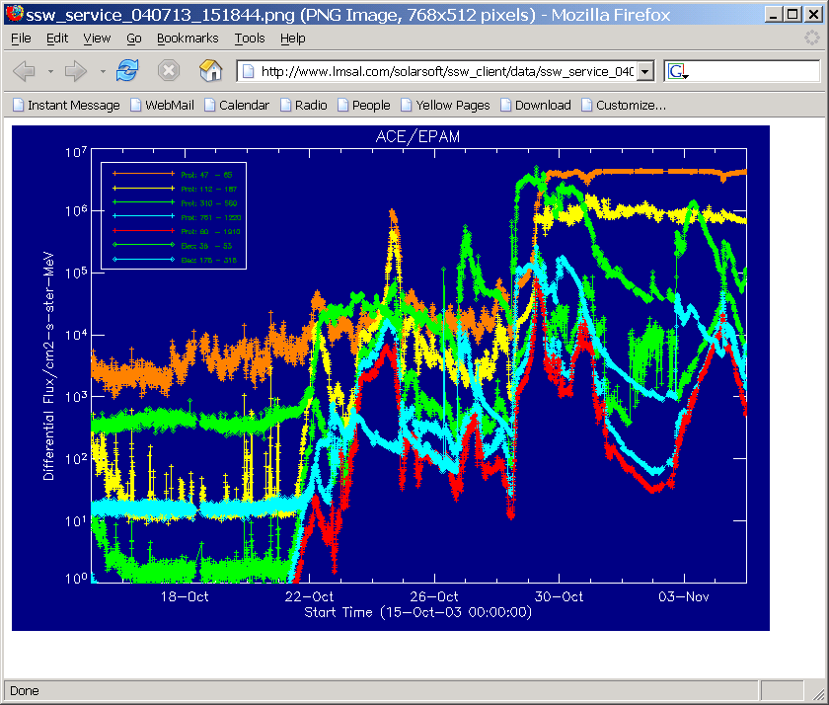
Draft ResultSpace

Slide 12
Collaboration
Contributing Services
Sharing model maps
Sharing results
  Publishing
  Searching
Collaborative Spaces

Slide 13
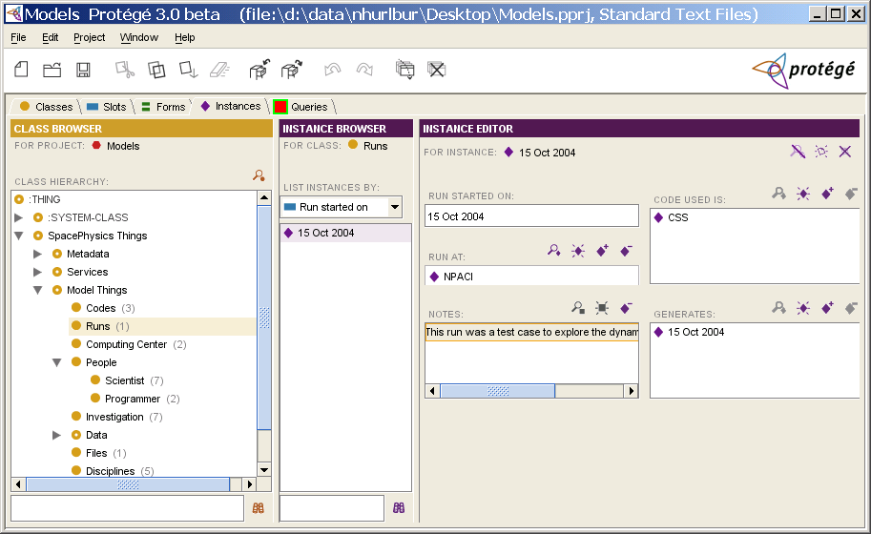
Draft Results Knowledgebase

Slide 14
How to use CoSEC
Download & install beta client
  http://cosec.lmsal.com/Downloads
  Requires: Java 1.4.2 & lots of memory
  Platforms: Linux, Solaris, Windows, OSX
Download examples at ModelSpace
  http://cosec.lmsal.com/ModelSpace
Register in Results Center
  http://cosec.lmsal.com/ResultSpace
Launch CoSEC and load examples

Slide 15
To contribute today…
Register at team site
Add model maps
  Create & test model using CoSEC client
  Save to disk
  Upload to ModelSpace
Add services
  Create CoSEC-compliant service
  Create local actor with CoSEC client
  Save to disk
  Upload to ServiceSpace
Add comments & advice

Slide 16
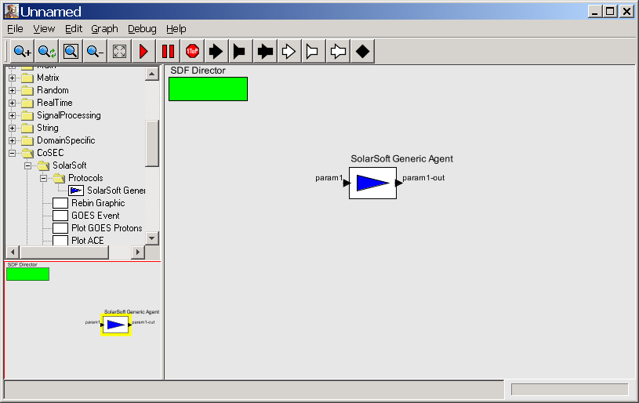
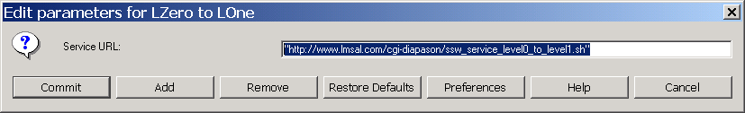
Add service to client
<result>
Param1_out=url
</result>
http://www.lmsal.com/cgi-diapason/ssw_service_level0_to_level1.sh&param1=input

Slide 17
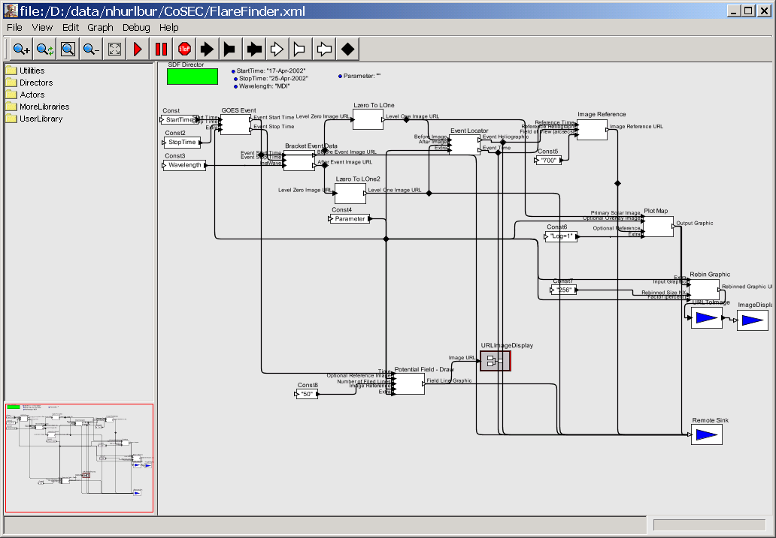
Status
Beta client available but…
  Mostly workflow & services
  Little semantic support
  Custom communication protocol
  Incomplete documentation
  Too fat
Draft Ontologies for semantic support
Draft Collaborative Spaces

Slide 18
Plans for 2005…
Client
  WSDL support
  Semantic composition aids
  Thin client using remote execution agent
Semantic & Knowledgebase
  Data, services, models & results KB
Collaborative Spaces
  Cleaner web interface
  Queries using knowledge bases

Slide 19
Conclusions
Beta client available for adventurous
Crude collaborative spaces open for business

