Slide 1
Collaborative
Sun-Earth Connector
N. Hurlburt, P. Bose, S. Freeland, G. Slater
LMATC
F. Hill, VSO/NSO
R. Bentley, EGSO/MSSL
Supported by NASA through contract NNH04CC00C.

Slide 2
Coordinated Observations
How do we share data and coordinate observation between missions?
VSO
Find
Get
Find
Get
Find
Get
Find
Get
Find
Get
Find
Get
SOT
XRT
EIS
HMI
AIA
EVE
Solar B
SDO

Slide 3
Coordinated Data Services
Generalized Services + orchestration
CoSEC
WSDL/SOAP
Solarsoft/ http or tcp
Find
Get
Cal
Extrap
…
Find
Get
Cal
DEM
…
Find
Get
Cal
Fit
…
HMI
AIA
EVE
Solar Dynamics Observatory

Slide 4
Coordinated Analysis
Distributed data analysis system using
  Scientific workflow systems
  Semantic composition & integration
  Existing SolarSoft services & tools
Focused on solar and space physics service
Collaborative environment for sharing data, software and higher-level products
Complements existing efforts in Virtual Observatories

Slide 5
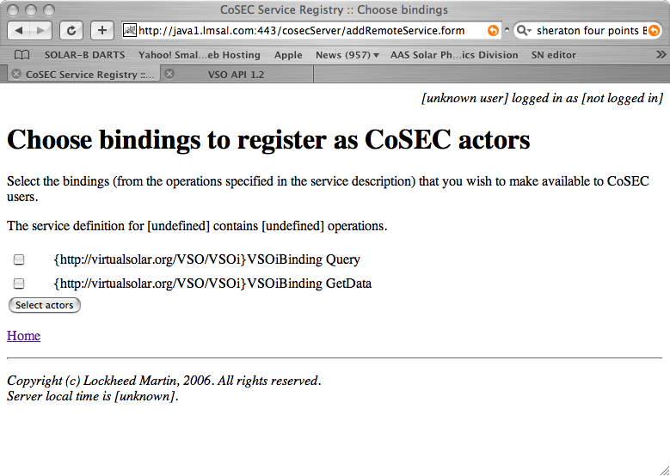
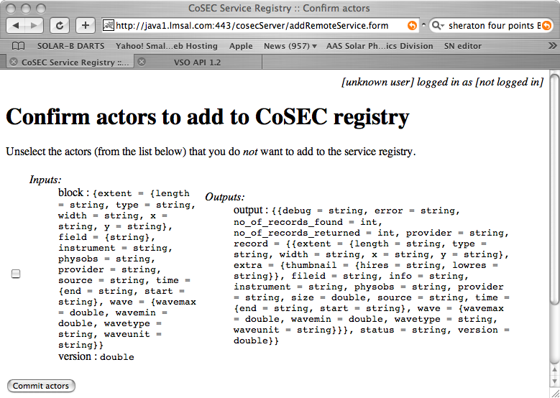
Registering WSDL Services

Slide 6
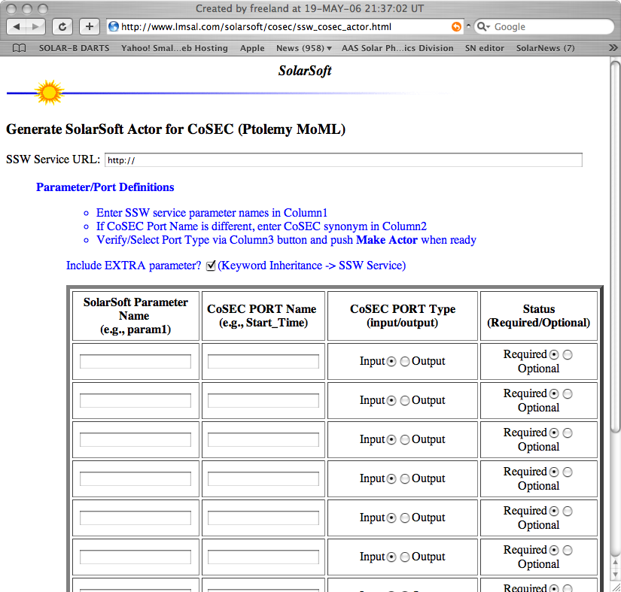
Registering SolarSoft Services

Slide 7
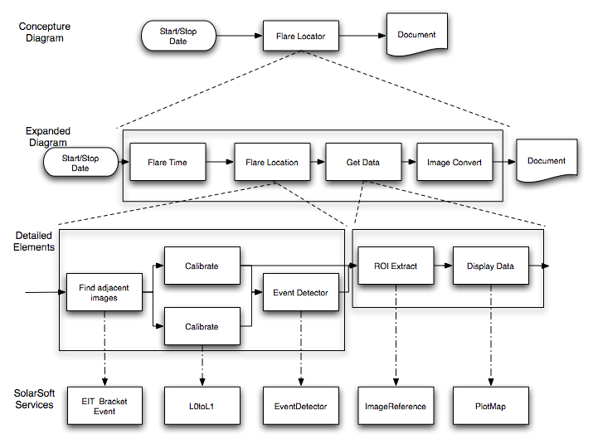
Building Workflows
1. Start with concept
2. If it doesn’t exist,
refine it recursively
3. When services
exist,‘bind’ them

Slide 8
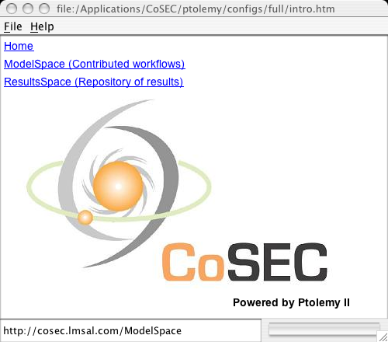
CoSEC Client

