Slide 1
Advances in Data Coordination for Establishing Heliophysics as a Basic Science
A Researcher’s Perspective in the Context of New Directions for the Field

Slide 2
Topics
Heliophysics as a basic science
  Great Observatory as aspect of larger endeavor
  Need for diverse data to establish universal laws
Areas for advancement in data coordination
  Virtual observatories
  Data formats
  Data availability
Informatics sessions at this meeting

Slide 3
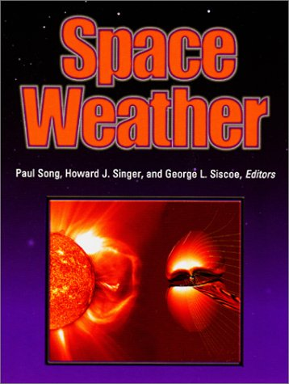

Heliophysics as a basic science
Movement to establish what we do as a basic academic field
  Parker’s advocacy
  2004 NRC report
  IHY science theme
  NASA strategy
    Funding justification
    Preservation and growth of the Great Observatory
Heliophysics
A Universal Science

Slide 4
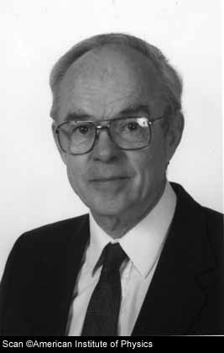
Parker’s Advocacy
“It cannot be emphasized too strongly that the development of a solid understanding of the magnetic activity, occurring in so many forms in so many circumstances in the astronomical universe, can be achieved only by coordinated study of the various forms of activity that are accessible to quantitative observation in the solar system.”
E. Parker, 1979
Cosmical Magnetic Fields

Slide 5
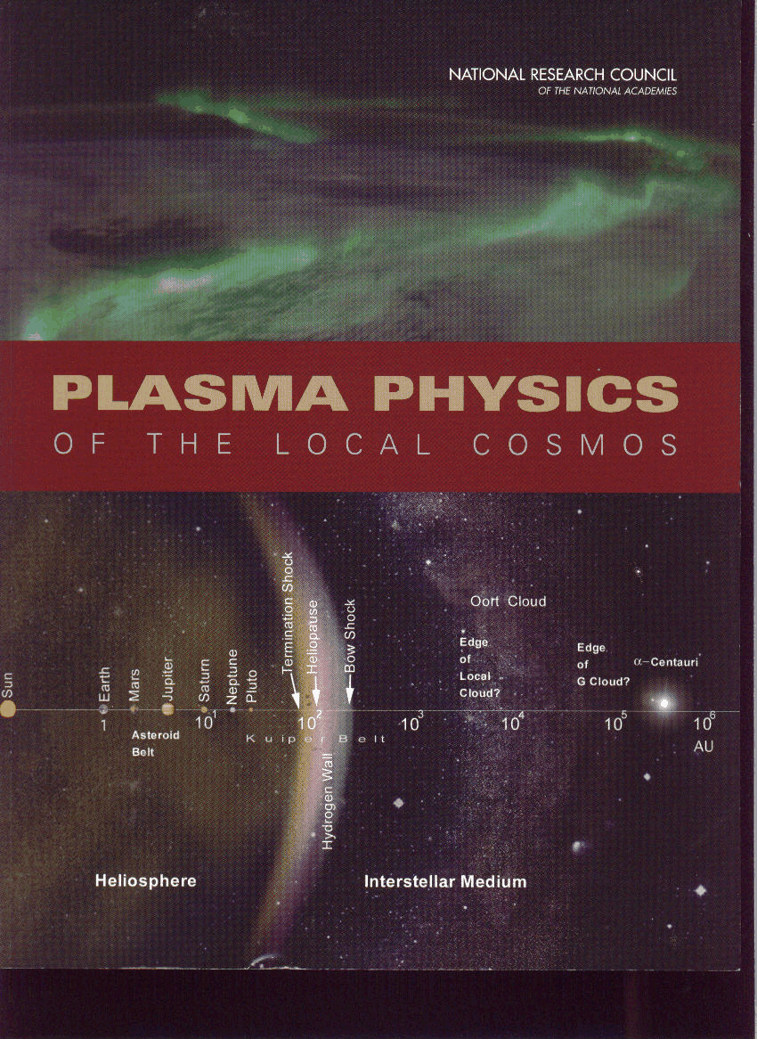
Plasma Physics of the Local Cosmos
A scientific assessment and strategy for the study of magnetized plasmas
Creation and annihilation of magnetic fields
  Dynamos
  Reconnection
Formation of structures and transients
  Collisionless shocks
  Cellular structures and current sheets
  Boundary layers and flux ropes
  Cross-scale coupling
Explosive energy conversion
  CMEs
  Substorms
Plasma interactions
  Electromagnetic (non-contact)
  Flow-object
  Plasma-neutral
  Radiation-plasma
Energetic particle acceleration
NATIONAL RESEARCH COUNCIL
OF THE NATIONAL ACADEMIES
2004

Slide 6









International Heliophysical Year
Science Goals and Themes
IHY 2007
Goal 1: Develop the basic science of heliophysics through cross-disciplinary studies of universal processes
Selected Themes
  Evolution and Generation of Magnetic Structures and Transients
  Energy Transfer and Coupling Processes
  Flows and Circulations
  Boundaries and Interfaces
From http://ihy.gsfc.nasa.gov

Slide 7

Justification for funding?
Striving to establish heliophysics as a basic science may be the most viable way to maintain the health of the field
  Avoids slipping into role of applied heliophysics on demand without concurrent basic heliophysics support
  As the applied side of heliophysics grew strong through the focus on space weather in the 90s, so the basic side can grow strong through the new focus on universal laws
  New focus makes us relevant to the larger science endeavor
Larger space enterprise
Basic
heliophysics
Applied
heliophysics

Slide 8
Data Needs for Heliophysics
Establishing heliophysics as a basic science calls for
  Discovery of universal physical laws that apply in diverse environments
  Comparative studies using diverse data sets
  Advancement in data management that facilitates usage by scientists from diverse fields
Areas for advancement
  Virtual observatories
  Data formats
  Data availability

Slide 9
Virtual Observatories
Major advance in data availability occurred in the ISTP era in the ’90s, on websites like CDAWeb
Virtual observatories are a welcome outgrowth
Future efforts
  Promote one-on-one indoctrination
  Improve search engine (e.g., to recognize phenomenological terms like “coronal hole”)

Slide 10
Data Formats
Past experience: Encountering Common Data Format (CDF) files
  Learn from manual?—written in computer jargon
  Learn from someone who knows
  Hire programmer or graduate student
  Now can get some help from NASA/GSFC web site, “Space Physics Guidelines for CDF”
Recent experience: Encountering Flexible Image Transport System (FITS) files
  Purchase “Liberator(!)” to view files in Adobe Photoshop
  Other help options available from NASA/GSFC web site

Slide 11
Data Availability Problems
Lack of documentation
  Files of excellent data exist without meaningful labels and physical units
  One must contact the P.I.’s graduate students, who pass on the information by word of mouth
P.I. firewalls
  In some cases, P.I.s still maintain control of data in order that it be used accurately
Too little support for organizing data

Slide 12
Example
Special note:
We are in the process of re-organizing our file system. Some of the directories above may be empty…. The files are still available! They just haven't been moved into the proper directories yet. If you wish to search for these files on your own, please follow the directory structure on one of many scattered disks located here.… There is also an index directory that will provide clues to the location of individual files.
I apologize for this (temporary) inconvenience but there are literally tens of thousands of files that need to be moved and it is a slow process.

Slide 13
Conclusions
Building heliophysics into a basic science with universal laws calls for comparative studies of data from a wide array of instruments in the Great Observatory
Ways to facilitate usage of these data by researchers with diverse backgrounds are
  Provide software packages for data analysis in which the programming is transparent to the user
  Provide sufficient support for organizing and documenting data so that future generations can use it without help from the P.I. or his/her minions
  Give instructions in language that is not jargon

Slide 14
Earth and Space Science Informatics (IN) Sessions
All joint with SA, SM, and SH
Wednesday afternoon through Friday morning
For example, IN42A, IN43D: Semantic Scientific Data Integration
  “The vast majority of data-driven science investigations of the Earth-Sun system are limited in their ability to effectively explore the most important (often most difficult) problems because they are forced to interconnect at the data-element, or syntactic, level rather than at a higher scientific, or semantic, level. In many cases, syntax-only interoperability IS the state-of-the-art. In order for scientists…to discover, access, and use data from unfamiliar sources, they are forced to learn details of the data schema, other people’s naming schemes and syntax decisions. The need is for a way to provide scientists with the option of describing what they are looking for in terms that are meaningful and natural to them, instead of in a syntax that is not. ...”

