Slide 1
Key Architecture Elements of a
Great Observatory for Space Physics
Timothy E. Eastman and Kirk D. Borne
QSS Group, Inc. & Space Physics Data Facility
NASA Goddard Space Flight Center

Slide 2
Distributed Data Environment
Distributed, on-line, multi-source/media/format
Web-based, machine/application-accessible data archives
Registries of products and services
Front-end applications
Brokers to connect archives to front ends
Diverse metadata, emerging standards/ontologies
High-order search capabilities
Data mining, knowledge discovery tools
[Projects: e-Science, cyberinfrastructure, collaboratories, VOs]
[examples: NVO, VSO, CDAWeb, VSPO]

Slide 3
Interoperability
Data guidelines (format, archive process)
Metadata (content, format, ontologies)
Middleware and services (Web Services)
Software and systems (marketplace, ISO)
Systems architecture (Grids, e-Science)

Slide 4
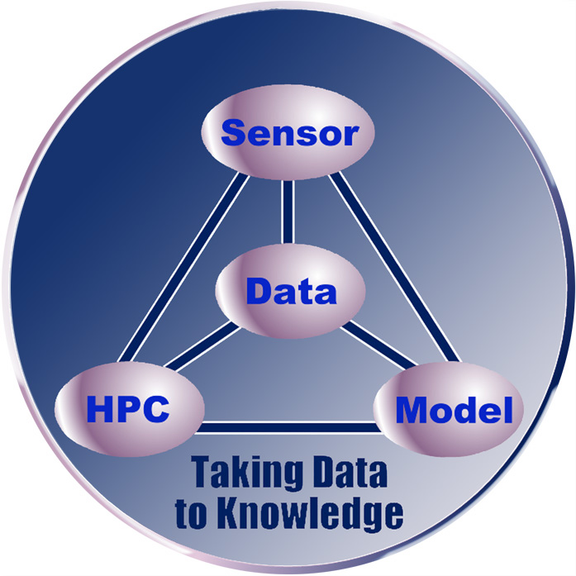
Data & Data Systems as Central to Science
PROBLEMS
Information Explosion
Understanding Multiscale Physical Systems
Solving Complex Systems
New High Data Rate Sensors
Distributed, Intelligent Sensor Networks
SOLUTIONS
Distributed Data Environments
Grid Services
Virtual Observatories
Data Mining
Data Archive Standards
Sensor Web
Sensor Development
Scientific Modeling
Advanced Visualization

Slide 5
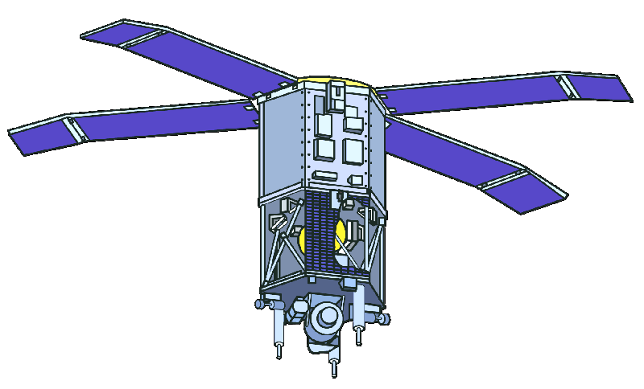
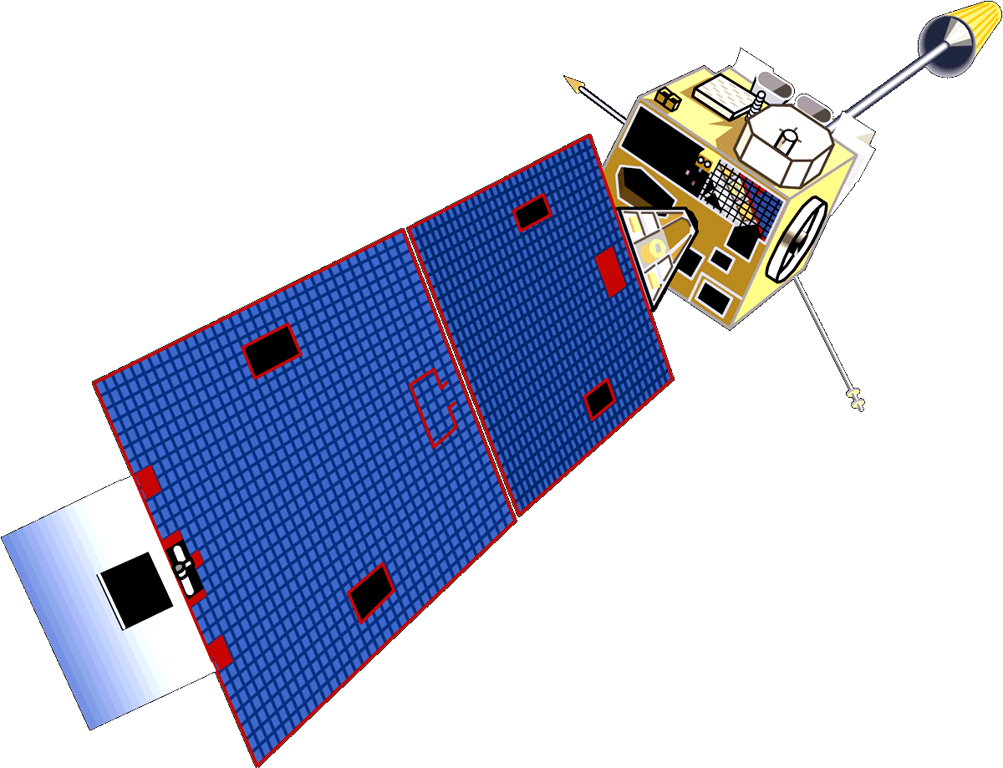
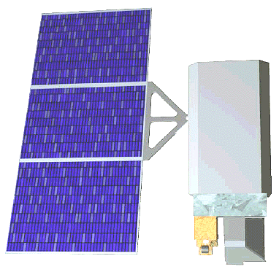
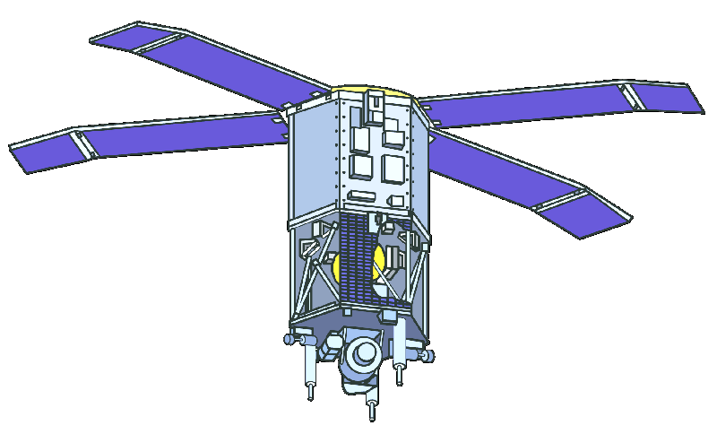
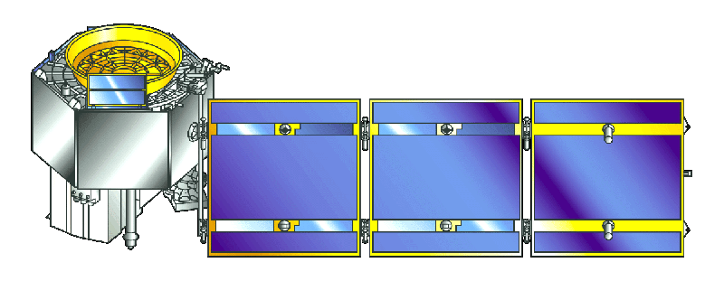
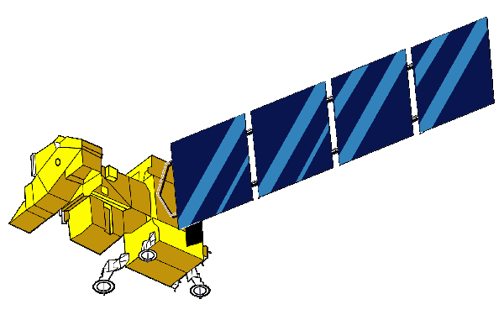
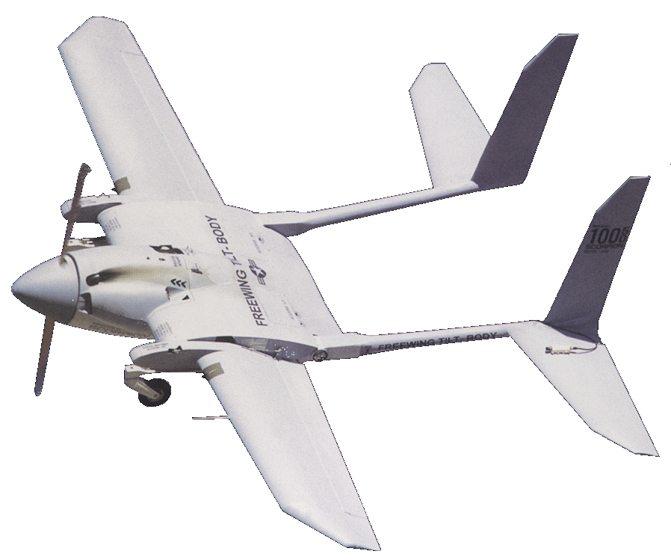
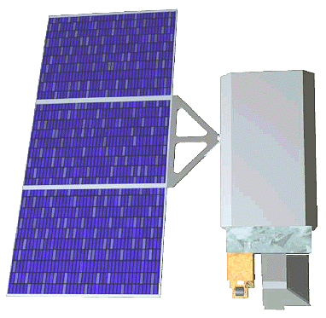
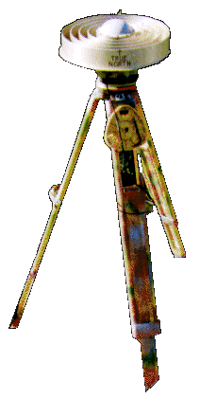
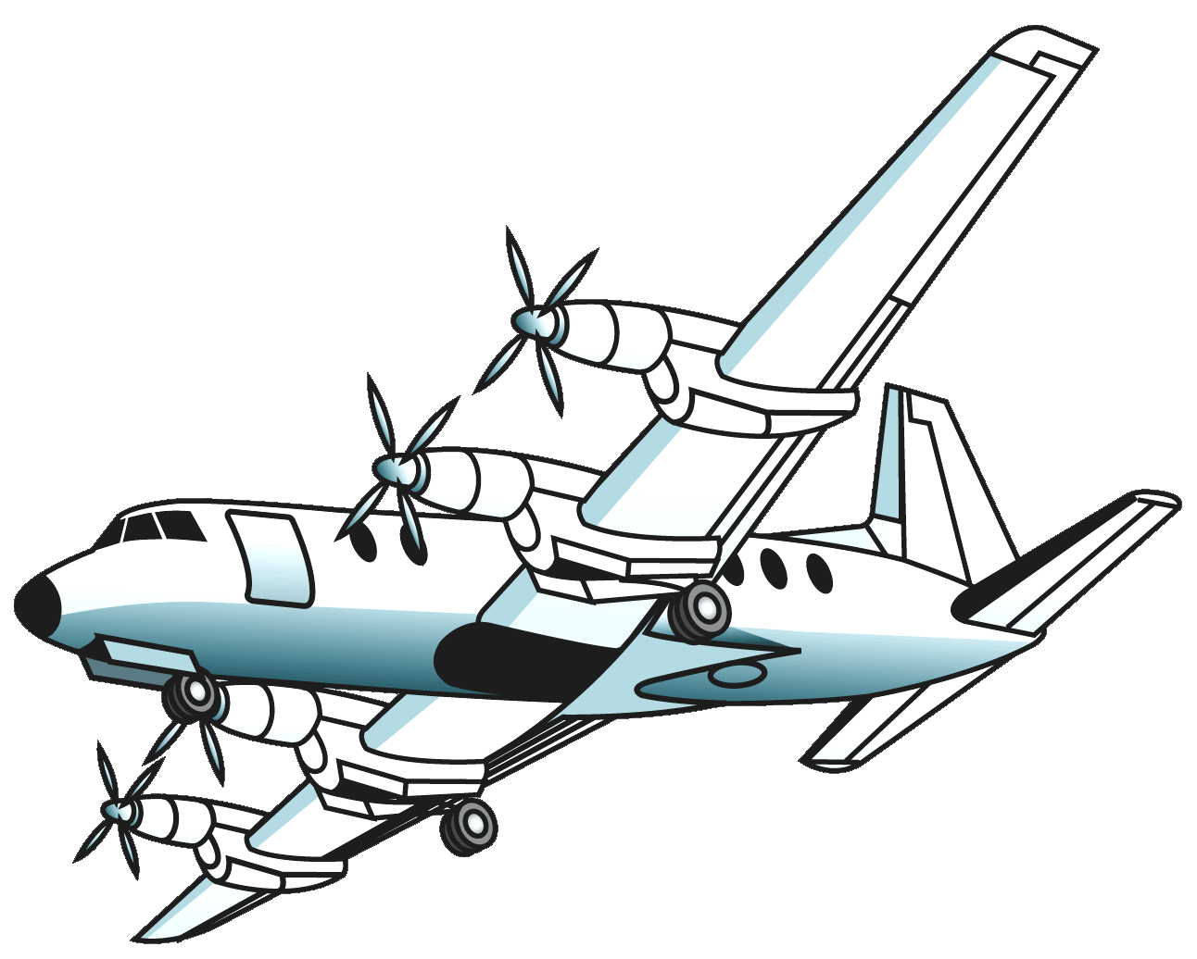
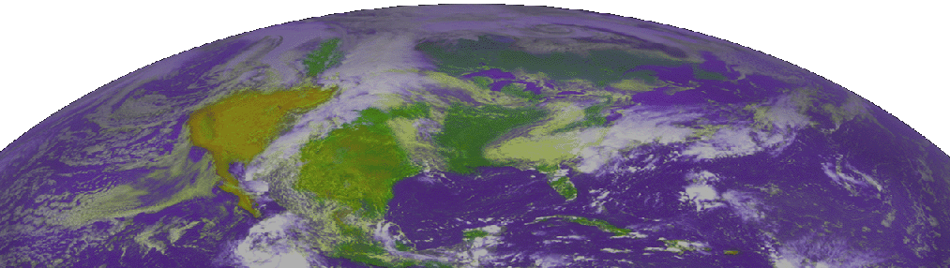
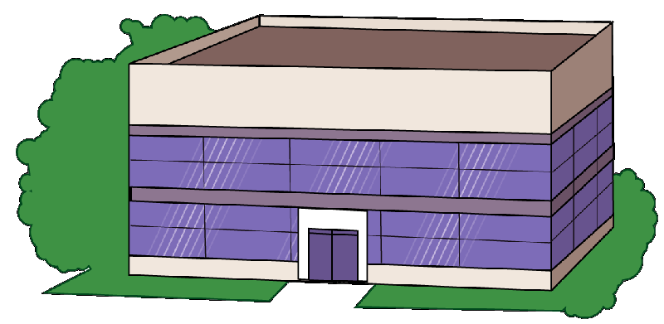
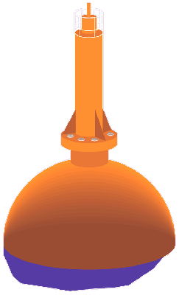
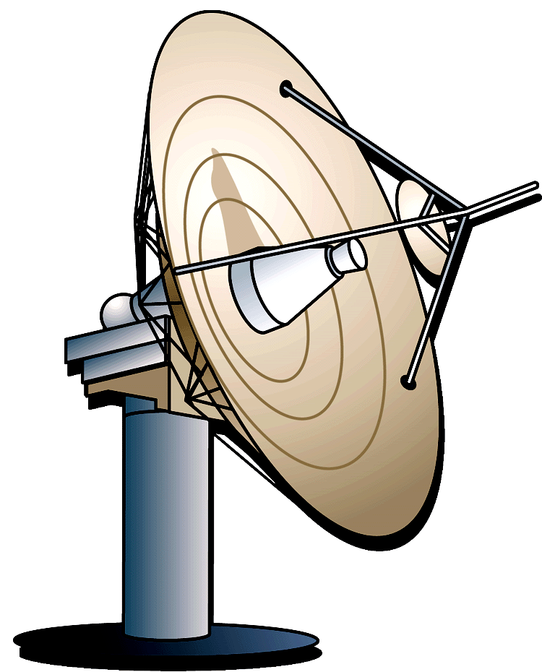
Sensor Webs
Distributed Sensor Systems
Graphic Credit: NASA/GSFC: 2000 Survey of Distributed Spacecraft Technologies and Architectures for NASA’s Earth Science Enterprise in the 2010-2025 Timeframe

Slide 6
Grid Services
Communications
Fabric
Sensor
Nodes
Computing
Nodes
Information
Storage
Nodes
Predictive models,
information fusion,
data assimilation
Historical archives
mined information,
metadata
Graphic courtesy of Steve Talabac, NASA GSFC

Slide 7
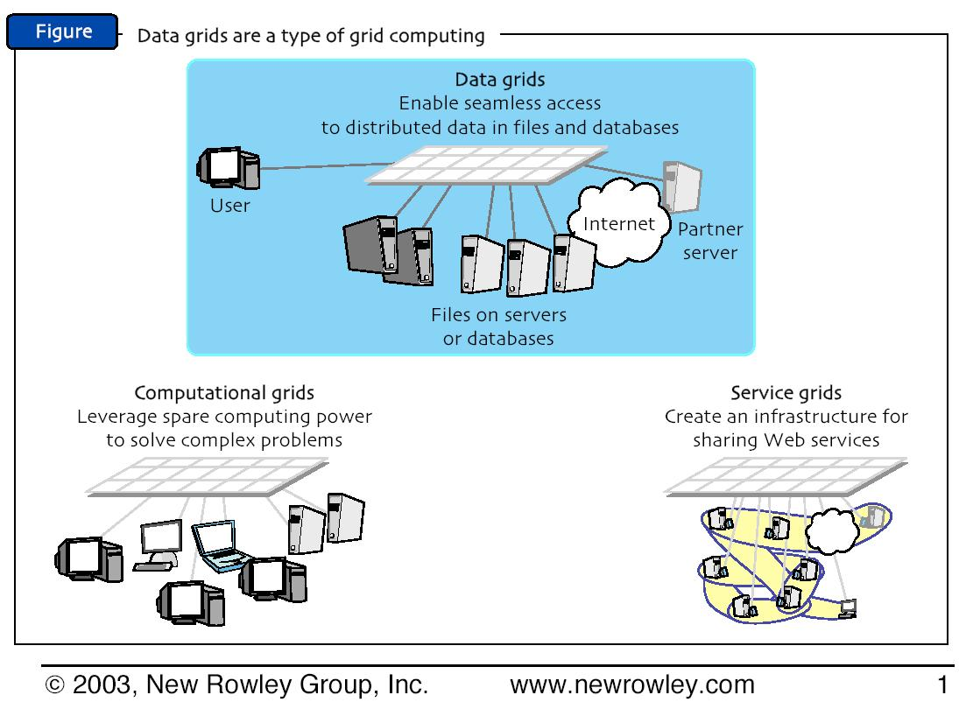
Service Grids, Data Grids, Compute Grids

Slide 8
Grid Frameworks
KDD
Data Mining
Knowledge Grid
Metadata
Ontologies
Semantic Grid
Sensor
Data
Computation
Grid Services

Slide 9
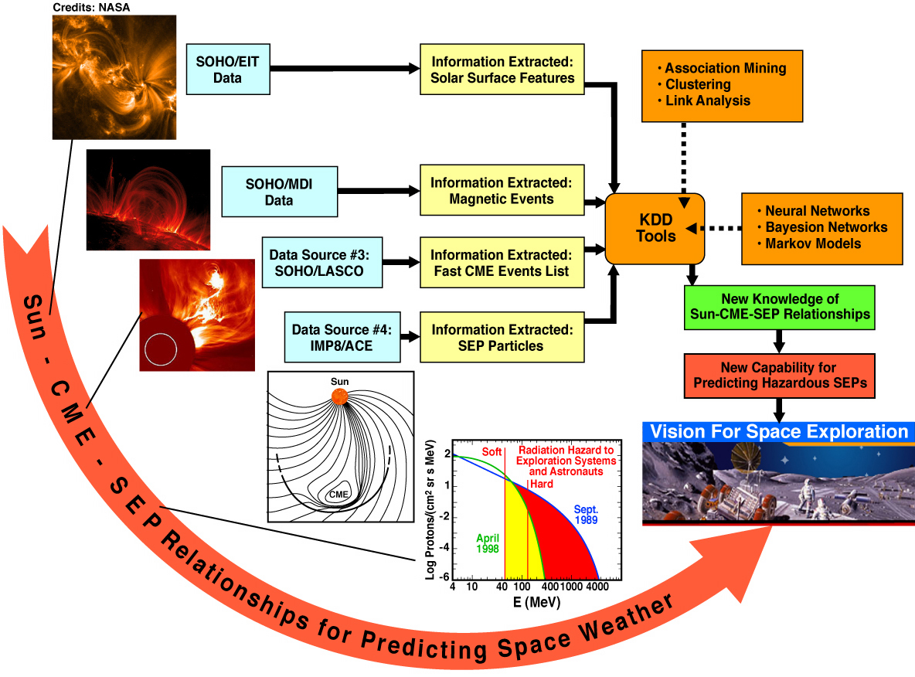
Space Science Informatics as a key enabler of
the Heliophysics Great Observatory program

Slide 10
Key Architecture Elements
Services Grid (sensor, data, computation)
[multi-note, dynamically adaptive grid systems;
service oriented architecture (SOA), including Web Services]
Semantic Grid
[ontologies, metadata]
Knowledge Grid
[unified schema, data mining, ontology inference layer]
Publishing of and access to data through web-enabled
end-to-end systems with metadata, software and science results
Towards a new Space Science Informatics
see Borne and Eastman, IN51A-05, Fri. 9;30am

