Slide 1
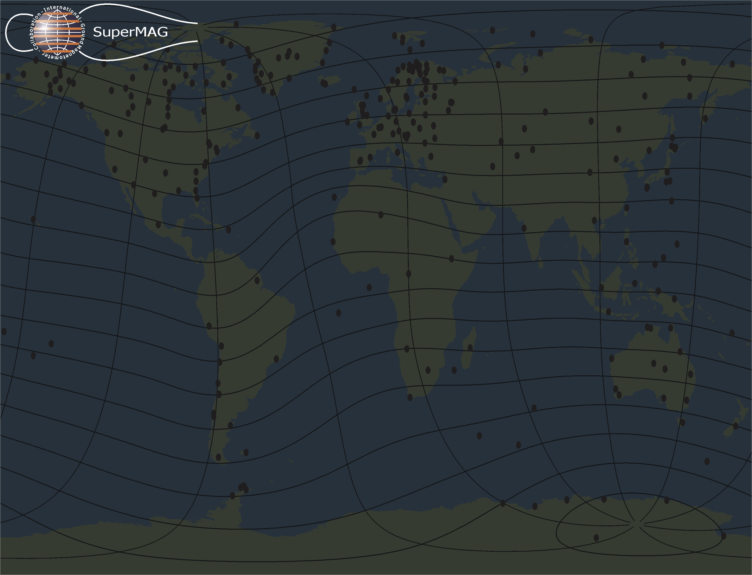

USGS, Dr. Jeffrey J. Love; MEASURE, UCLA IGPP and Florida Institute of Technology; CARISMA, PI Dr. Ian Mann; The MACCS program, PIs Dr. W. J. Hughes and Dr. M. Engebretson as well as the Geomagnetism Unit of the Geological Survey of Canada; The S-RAMP Database, PI Prof. K. Yumoto and Dr. K. Shiokawa; The SPIDR database; Intermagnet; The institutes who maintain the IMAGE magnetometer array; AARI data, PI Prof. Oleg Troshichev; Danish Meteorological Institute, Mr. Ole Rasmussen and Project Scientist Dr. Jurgen Watermann; MAGIC, PI Dr. C. Robert Clauer; GIMA, PI Prof. John Olson; SAMBA, PI Dr. Eftyhia Zesta; 210 Chain, PI K. Yumoto; SAMNET, PI Prof. Farideh Honary; IMAGE, PI Dr. Ari Viljanen; The SuperMAG initiative, PI Dr. Jesper W. Gjerloev;
Dr. Jesper W. Gjerloev
Johns Hopkins University, Applied Physics Laboratory, Laurel, Maryland, USA
The Global Magnetometer Network Initiative: SuperMAG
Notes:
Image is DE from 81 286 1616 UT. UV 132nm wavelength.

Slide 2
Motivation
The data set provided by the ground magnetometer community is truly unique since it provides a nearly global and continuous measurement of a fundamental parameter– the ground level magnetic field perturbations. SuperMAG will lead to a new level of utilization of this data set.
Ground based magnetometers provide:
  a high quality dataset;
  decades of data;
  continuous coverage in time;
  nearly global coverage.
Unfortunately global studies using the various data sources are complicated since:
  data are distributed over numerous data-bases;
  data are stored in different formats;
  different coordinate systems (often with identical names) are used;
  different baseline determination techniques are utilized.
SuperMAG will remove these obstacles by means of a user-friendly web interface that provides data in a common coordinate system, common time resolution and common baseline removal technique.
The objective of SuperMAG is to provide a tool for the community that will enable studies of the large-scale ionospheric electrodynamics and its coupling to the magnetosphere.

Slide 3
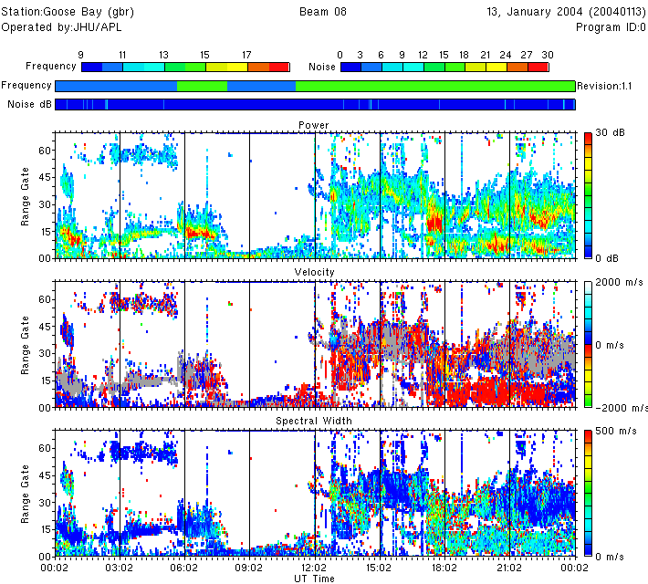
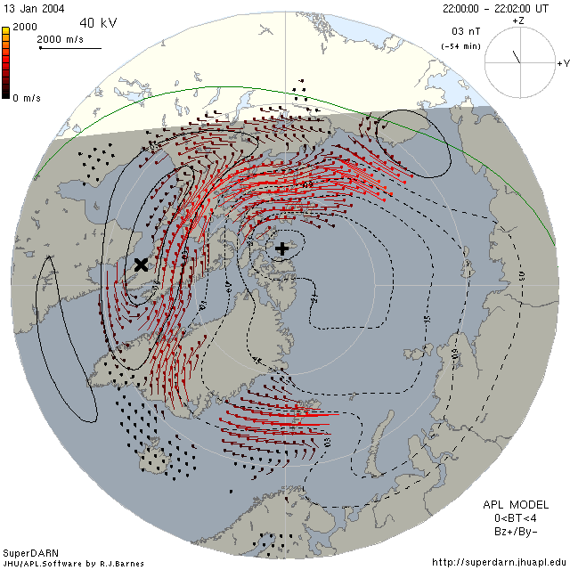
Motivation
SuperDARN:
~1005 registered users
~600,000 external web site hits a month
~6400 unique visitors (by IP address) a month
~8000 plots viewed per month
>650 requests for digital data since January 2005.
>600 published papers
>2,000 convection map downloads per month

Slide 4
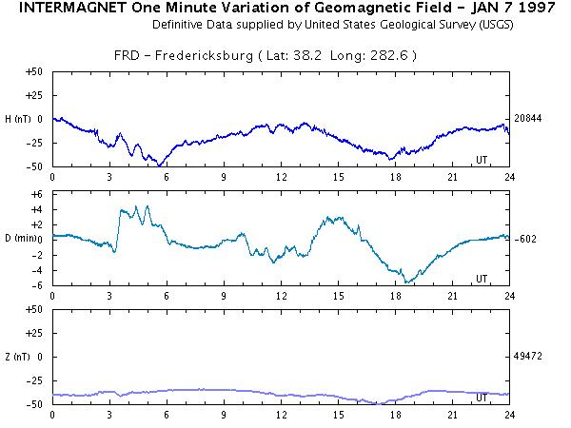
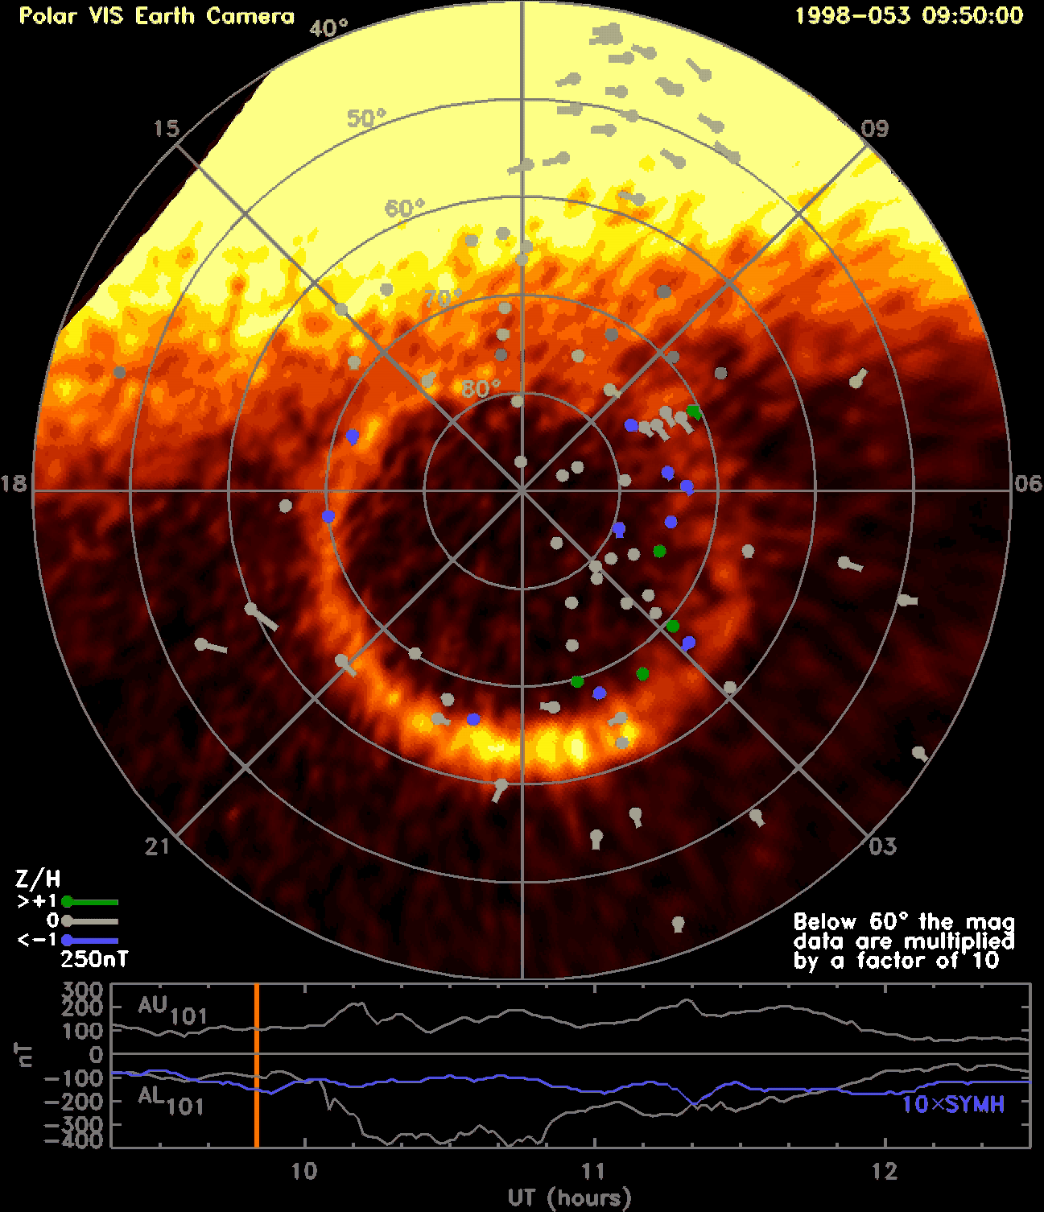
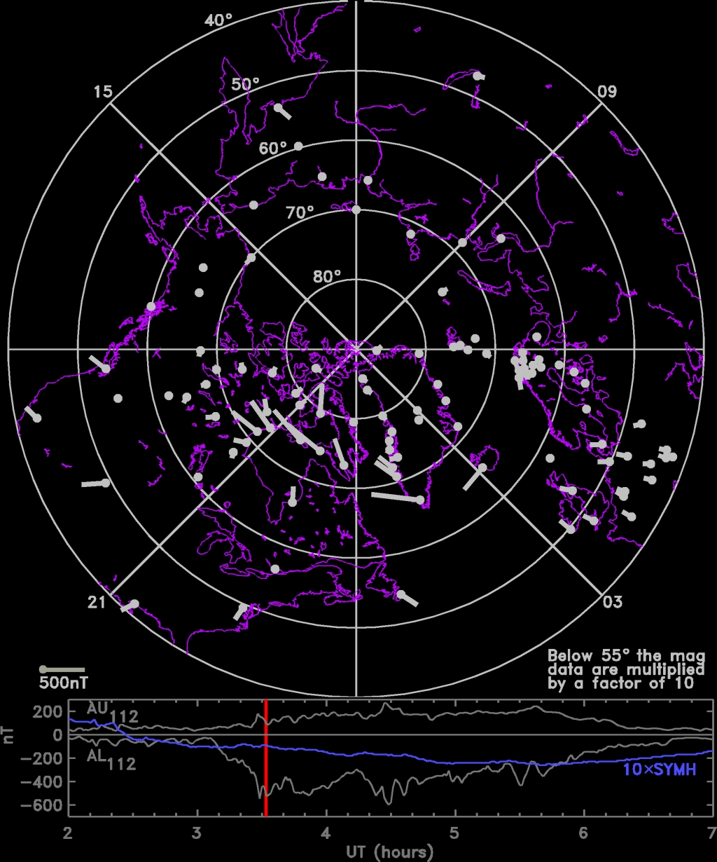
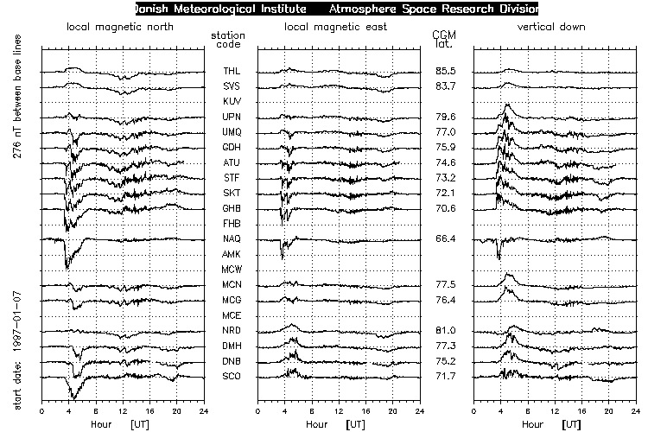
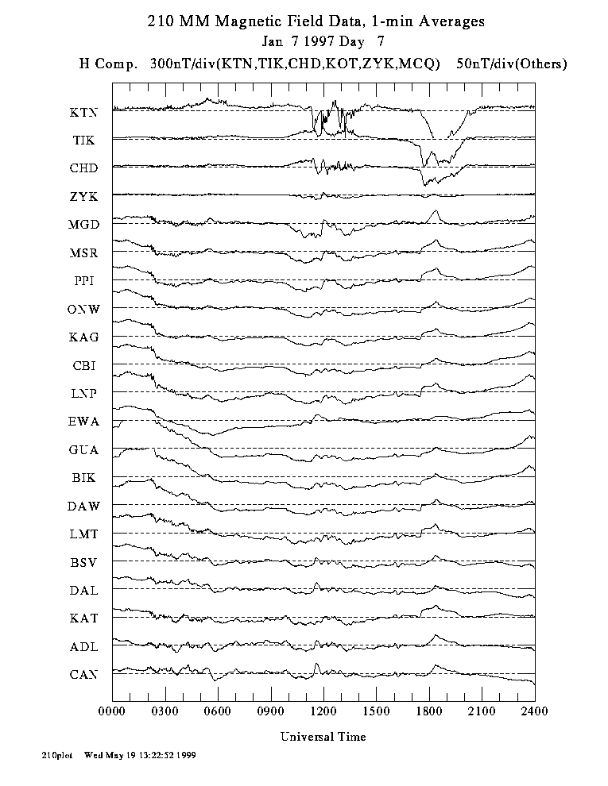

Slide 5
Complications
Coordinate System
What is H, D, Z coordinates?
SuperMAG uses:
B=( B_{N} , B_{E} , B_{Z} )
where
N-direction is local magnetic north
E-direction is local magnetic east
Z-direction is vertically down
No use of IGRF declination;
Declination angle is determined by minimum variance analysis;
Independent of the actual orientation of the magnetometer axis except the Z-axis which
we must assume is indeed vertical.

Slide 6
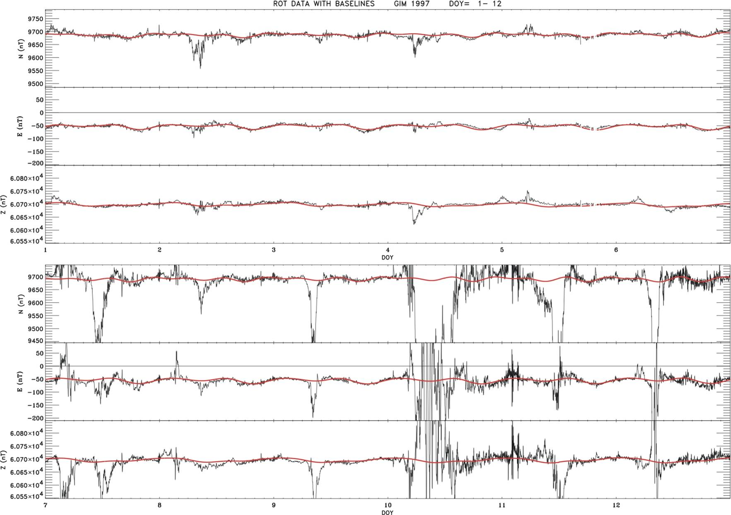
Complications
Baseline

Slide 7
Data Flow
Step | Purpose | File Input | File Output | Coordinates
1 | Converts data from station/chain dependent format to yearly binary files with 1-min resolution. | Station data | year_IAGACODE_ini.xdr year_IAGACODE_ini.png | All types
2 | Clean data for artifacts. | year_IAGACODE_ini.xdr | year_IAGACODE_dat.xdr year_IAGACODE_dat.png | All types
3 | Rotate into local magnetic coordinate system: N, E, Z. | year_IAGACODE_dat.xdr | year_IAGACODE_rot.xdr year_IAGACODE_rot.png year_IAGACODE_angle.png | N, E, Z
4 | Remove yearly and daily baselines. | year_IAGACODE_rot.xdr | year_IAGACODE_final.xdr year_IAGACODE_final.png year_IAGACODE_final.ps | N, E, Z

Slide 8
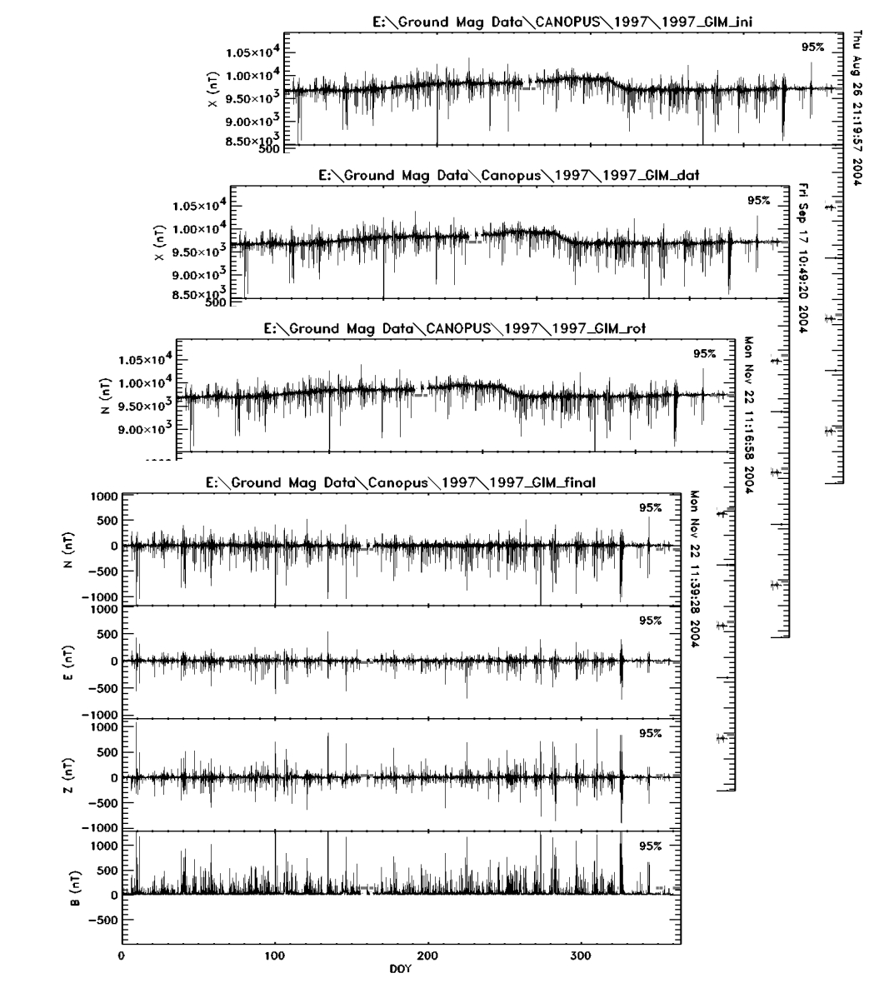
Housekeeping

Slide 9
SuperMAG Collaborators
Chain | Have Agreed To Collaborate With SuperMAG | Number of stations
Intermagnet | Yes | 99
Greenland | Yes | 22
Carisma | Yes | 13
Image | Yes | 27
SAMBA | Yes | 11
SAMNET | Yes | 18
MEASURE | Yes | 10
MACCS | Yes | 13
210 Chain | Yes | 37
AARI | Yes | 13
USGS | Yes | 14
GIMA | Yes | 8

Slide 10
Science
Historically ground based magnetometers have been the workhorse of ionospheric research for decades. They ground magnetic perturbations have been used widely to study the horizontal ionospheric currents and their coupling to the magnetosphere through field-aligned currents. A distinct strength of this data-source is the continuous data acquisition which enables an uninterrupted monitoring.
For example topics of research that can be addressed:
Spatiotemporal behavior of the auroral electrojet system under various conditions;
How does ionospheric electrodynamics evolve during active times?
What is the role of the terminators in the dayside-nightside coupling?
Are the convection electrojets truly directly driven?
What storm-time dynamics do physics based models predict well and what do they miss?
What are the large-scale electrodynamics of magnetic storm time auroral disturbances? Are
they different from non-storm substorms?
What is the behavior of the large-scale dayside current system as a function of IMF and
nightside conditions?
Are geomagnetic storms super-positions of intense classical substorms?

Slide 11
Highlights
The data set provided by the ground magnetometer community is truly unique since it provides a nearly global and continuous measurement of a fundamental parameter – the ground level magnetic field perturbations. SuperMAG will lead to a new level of utilization of this data set.
SuperMAG:
- is the next logical step for the ground magnetometer community to take in the development
of a user friendly data service enabling an understanding as well as monitoring of the global
electric current system;
- does not compete with any existing data service;
- is the first site to provide global coverage of user-friendly data products;
- data handling technique and software have been developed;
- will be based on the website interface and visualization developed for the SuperDARN site
with a record of success.
- currently manages >800,000 data files from >200 stations.
Written collaboration agreements between SuperMAG and organizations have been obtained.
Supported by NASA LWS02-0000-0084 and NASA SRT02-0000-0081.

Slide 12
“Final easy to understand data-products can not be more than 3 mouse clicks away from a user”
Robin Barnes, SuperDARN software engineer

Slide 13
Acknowledgements
For the ground magnetometer data we gratefully acknowledge:
Intermagnet;
USGS, Dr. Jeffrey J. Love;
Danish Meteorological Institute, Mr. Ole Rasmussen and Project Scientist Dr. Jurgen Watermann;
CARISMA, PI Dr. Ian Mann;
The S-RAMP Database, PI Prof. K. Yumoto and Dr. K. Shiokawa;
The SPIDR database;
The institutes who maintain the IMAGE magnetometer array;
AARI, PI Prof. Oleg Troshichev;
The MACCS program, PIs Dr. W. J. Hughes and Dr. M. Engebretson as well as the Geomagnetism Unit of the Geological Survey of Canada;
GIMA, PI Prof. John Olson;
MEASURE, UCLA IGPP and Florida Institute of Technology;
MAGIC, PI. Dr. C. Robert Clauer;
SAMBA, PI Dr. Eftyhia Zesta;
210 Chain, PI K. Yumoto;
SAMNET, PI Prof. Farideh Honary;
IMAGE, PI Dr. Ari Viljanen;
SuperMAG, PI Dr. Jesper W. Gjerloev.
Supported by NASA LWS02-0000-0084 and NASA SRT02-0000-0081.

