Slide 1
Automated Identification of Magnetopause Crossings
H. Karimabadi, L. Valera-Guallar, J. Driscoll, N. Omidi, H. White
Data comparison
Data processing
Summary statistics
Modeling process
Model description
Model results

Slide 2
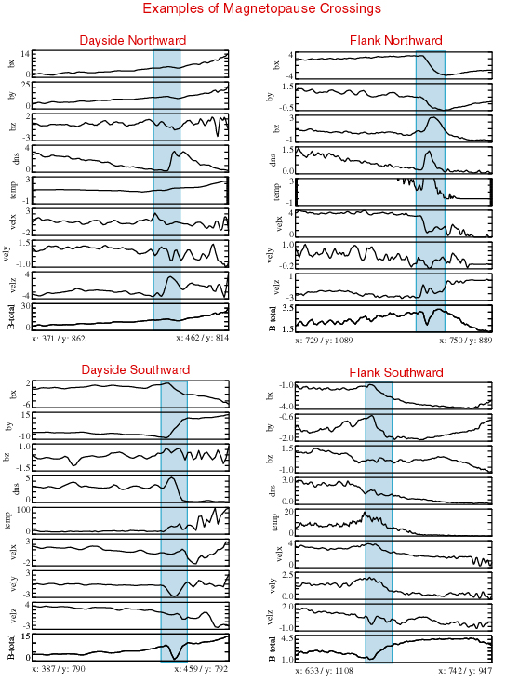

Slide 3
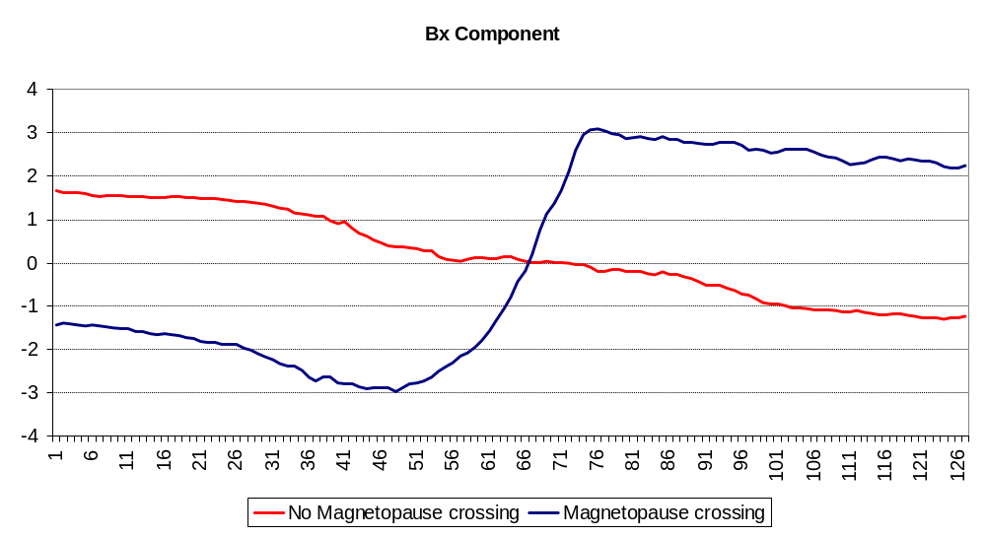
Comparison of Bx: Magnetopause crossing vs. Non-magnetopause crossing
Two observations selected at random, permit us to inspect the characteristics of key components when in the presence of, and in the absence of, a magnetopause

Slide 4
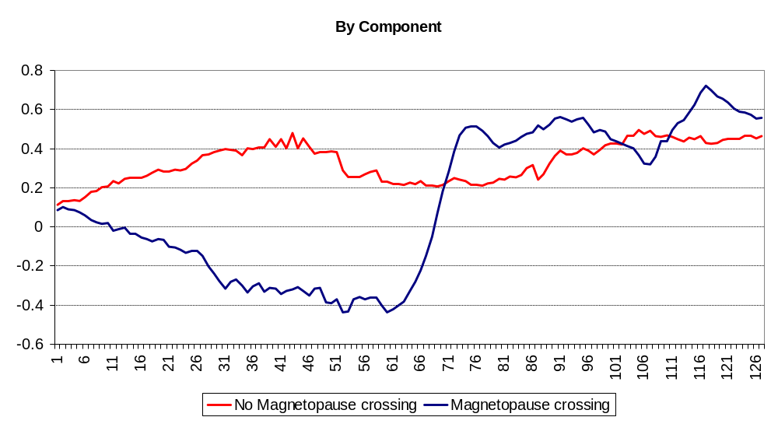
Comparison of By: Magnetopause crossing vs. Non-magnetopause crossing

Slide 5
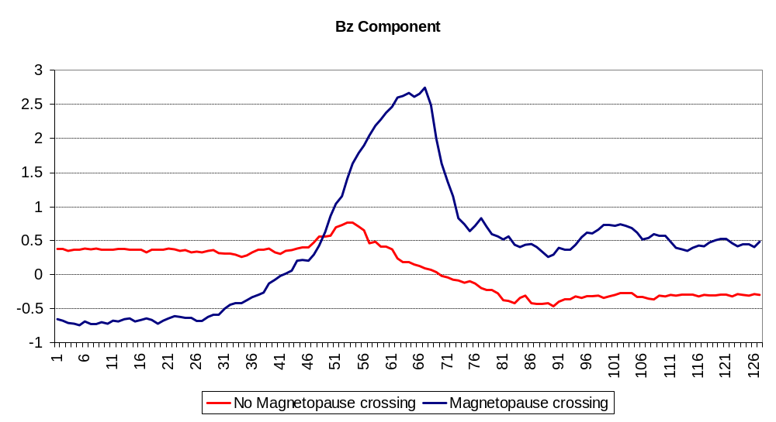
Comparison of Bz: Magnetopause crossing vs. Non-magnetopause crossing

Slide 6
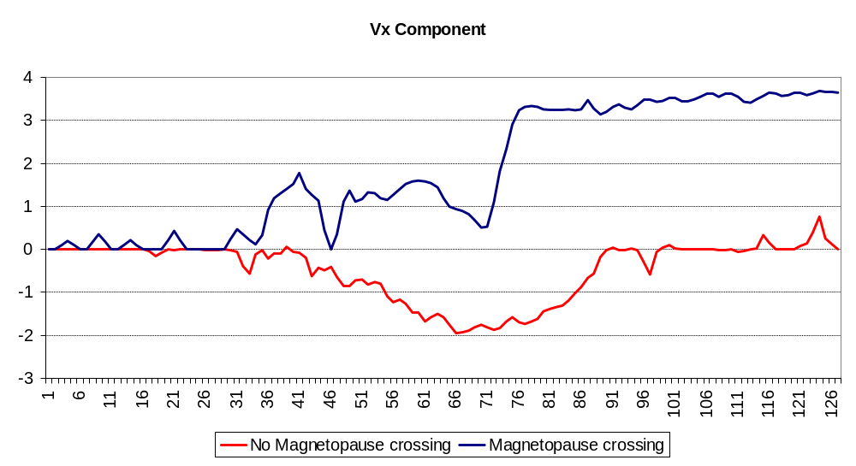
Comparison of Vx: Magnetopause crossing vs. Non-magnetopause crossing

Slide 7
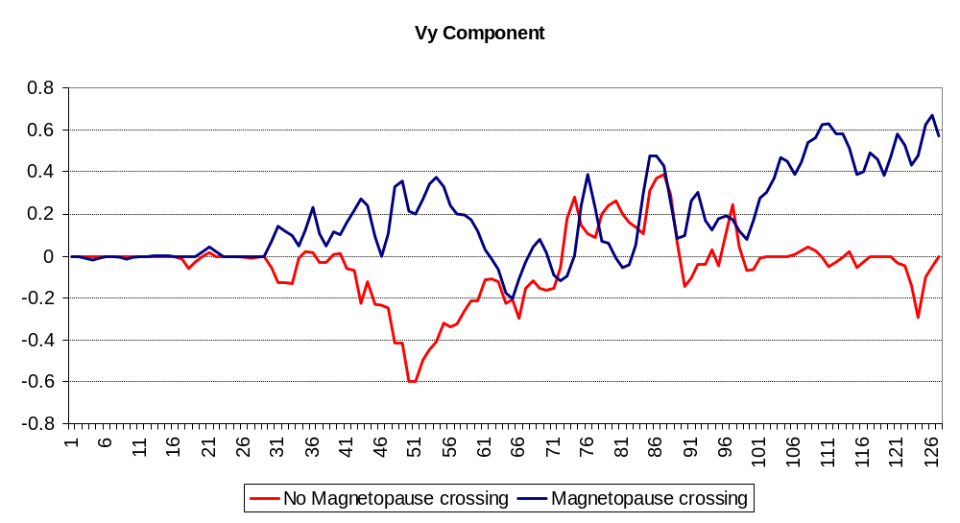
Comparison of Vy: Magnetopause crossing vs. Non-magnetopause crossing

Slide 8
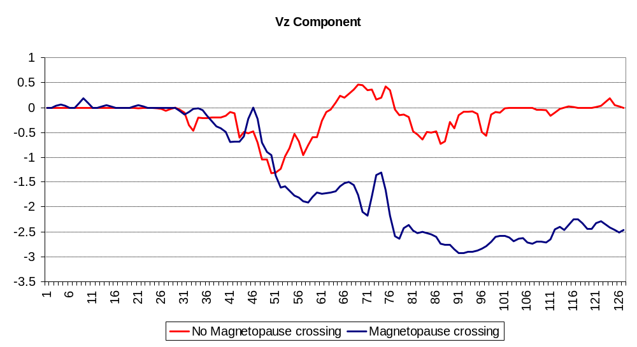
Comparison of Vz: Magnetopause crossing vs. Non-magnetopause crossing

Slide 9
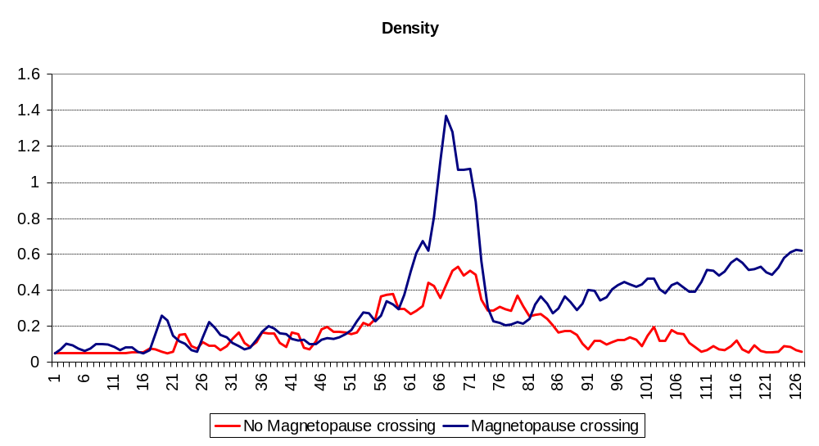
Comparison of density: Magnetopause crossing vs. Non-magnetopause crossing

Slide 10
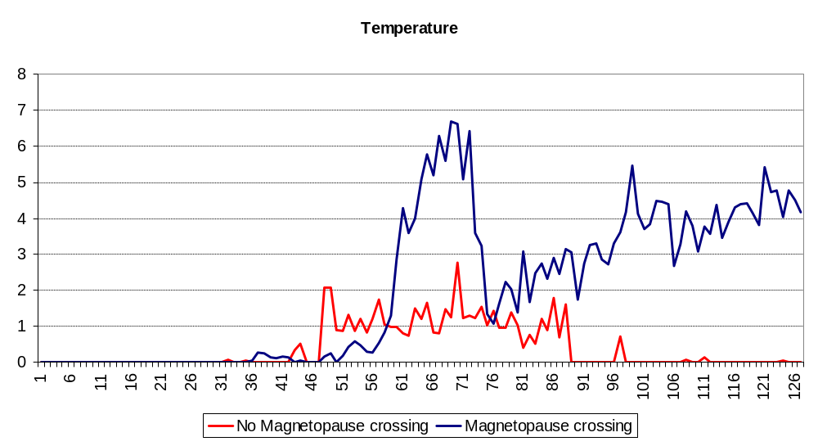
Comparison of temperature: Magnetopause crossing vs. Non-magnetopause crossing

Slide 11


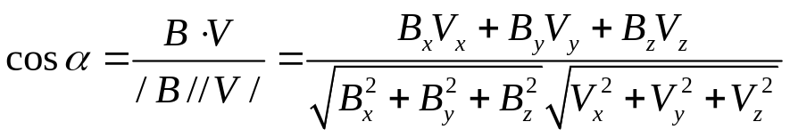
Data processing
We added 3 additional components to each observation
  Magnitude of B:
  Magnitude of V:
  Angle between B and V:
We obtained characteristics of the different components
  Summary statistics
    Mean
    Standard deviation
    Median
    Interquantile range
    Minimum and maximum
  Number of times a component value crosses zero

Slide 12
Summary statistics: Mean
 | Magnetopause |  |  |  | No Magnetopause
Variable | Mean | Stand. Dev. | Min. | Max. | Mean | Stand. Dev. | Min. | Max.
Bx | -0.33 | 2.58 | -8.34 | 8.41 | 0.54 | 0.48 | -0.06 | 1.76
By | 2.85 | 4.85 | -0.54 | 18.88 | 0.88 | 0.78 | 0.06 | 4.43
Bz | 0.44 | 0.38 | -0.32 | 1.43 | 0.53 | 0.50 | -0.21 | 1.51
Vx | 1.28 | 0.68 | -0.04 | 2.38 | 2.59 | 2.12 | -0.75 | 4.94
Vy | 0.07 | 0.21 | -0.53 | 0.52 | 0.43 | 0.41 | -0.07 | 1.63
Vz | -1.16 | 0.21 | -1.72 | -0.45 | -1.11 | 0.99 | -4.20 | 0.11
Density | 0.61 | 0.48 | 0.25 | 1.86 | 0.98 | 0.73 | 0.13 | 3.41
Temperature | 9.39 | 13.84 | 1.29 | 66.11 | 3.47 | 2.86 | 0.24 | 13.65
Cos α | -0.08 | 0.27 | -0.61 | 0.49 | 0.16 | 0.17 | -0.35 | 0.69
Magnitude B | 5.55 | 4.77 | 1.19 | 18.98 | 1.61 | 0.62 | 0.89 | 4.61
Magnitude V | 2.08 | 0.35 | 1.43 | 2.81 | 3.28 | 1.96 | 0.24 | 5.39

Slide 13
Summary statistics: Standard deviation
 | Magnetopause |  |  |  | No Magnetopause
Variable | Mean | Stand. Dev. | Min. | Max. | Mean | Stand. Dev. | Min. | Max.
Bx | 3.83 | 2.66 | 1.09 | 13.76 | 0.58 | 0.36 | 0.02 | 1.30
By | 1.99 | 8.78 | 0.074 | 19.50 | 0.28 | 0.36 | 0.03 | 1.75
Bz | 0.75 | 0.19 | 0.30 | 1.49 | 0.37 | 0.21 | 0.04 | 0.99
Vx | 1.17 | 0.37 | 0.29 | 1.64 | 0.51 | 0.42 | 0.03 | 2.04
Vy | 0.32 | 0.15 | 0.09 | 1.35 | 0.30 | 0.21 | 0.05 | 1.07
Vz | 1.28 | 0.19 | 0.86 | 2.38 | 0.45 | 0.47 | 0.04 | 2.01
Density | 0.45 | 0.27 | 0.16 | 1.08 | 0.33 | 0.30 | 0.07 | 1.43
Temperature | 13.07 | 22.53 | 1.52 | 105.06 | 1.51 | 1.66 | 0.13 | 8.09
Cos α | 0.62 | 0.20 | 0.17 | 0.85 | 0.38 | 0.29 | 0.02 | 0.93
Magnitude B | 2.29 | 3.87 | 0.22 | 19.53 | 0.41 | 0.35 | 0.02 | 1.80
Magnitude V | 1.52 | 0.33 | 0.67 | 1.99 | 0.41 | 0.19 | 0.03 | 1.27

Slide 14
Steps in the modeling process
We divided the dataset in three samples
  Estimation sample
    It consists of data that are strictly used for the training of the models
    It contains 50% of the data (2,500 observations)
  Validation sample
    It consists of data that are used for cross-validation purposes in order to select the appropriate complexity of the candidate models
    It contains 25% of the data (1,250 observations)
  Test sample
    It consists of pure out-of-sample data used for comparing the performance of the models
    It contains 25% of the data (1,250 observations)
The three sample were constructed in such a way that the predictive power of each variable is similar across the samples
This sampling strategy avoids overfitting the model

Slide 15
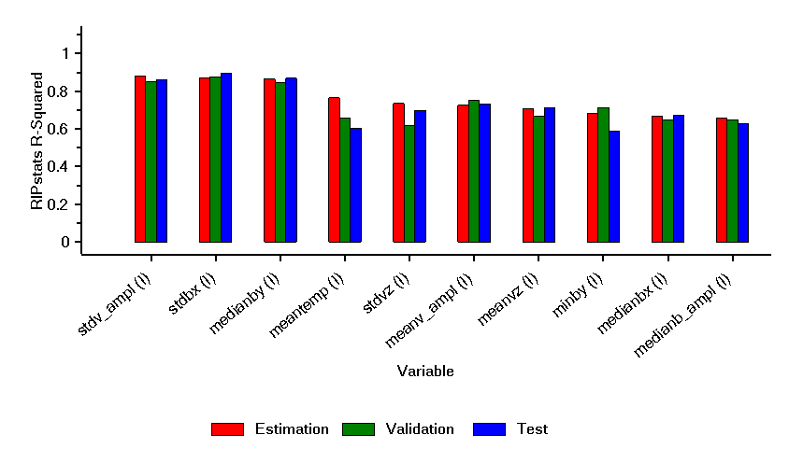
Steps in the modeling process (continued)
R-squared Across Sub-samples
The comparable R-squared performance of these variables across
samples illustrates the strategy of controlling for model overfit

Slide 16
Steps in the modeling process (continued)
We ran the Anomaly algorithm to detect outliers
  No outliers were found
We fit several models, starting from the simplest linear model and then increasing in complexity
  The benchmark model consists of a linear model in the inputs (which themselves are non-linear transformations of the data)
  We increased the complexity of the candidate models by adding transformations
    Cross-products
    Squares
    Betas
    Neural networks units

Slide 17
Steps in the modeling process (continued)
The model estimation algorithm makes use of the validation sample to select the variables that will be included in each one of the models
The first variable included in the model is the one presenting the highest R-squared
Additional variables are selected using an iterative process:
  Variables with higher R-squared are considered first
  Each variable considered is selected based on its correlation with the already included ones
  This method allows to select only variables with additional predictive information

Slide 18
Steps in the modeling process (continued)
Data Mining Reality Check (DMRC)™ selects the best predictive model
  This patented algorithm tests whether a candidate model is superior to the benchmark, using a p-value that indicates whether performance gain/loss is statistically significant
  This test establishes the likelihood that the best candidate model could have occurred by chance; the higher the p-value the more likely the result occurred by chance
  These p-values are valid
All candidate models perform worse than the benchmark model
Model | Performance (Log-likelihood) | Performance Relative to Benchmark | P-value
Benchmark | -0.008
Candidate 1 | -0.011 | -0.003 | 0.52
Candidate 2 | -0.009 | -0.001 | 0.49
Candidate 3 | -0.011 | -0.003 | 0.59
Candidate 4 | -0.313 | -0.305 | 0.44
DMRC is cited in “A Reality Check for Data Snooping”
Econometrica, vol. 68, num. 5, September 2000, pp 1027-1126

Slide 19
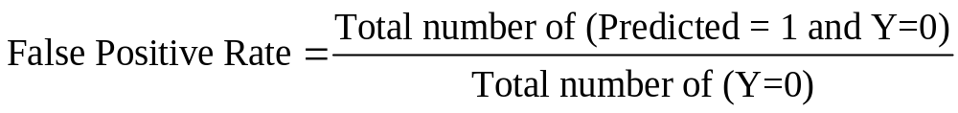
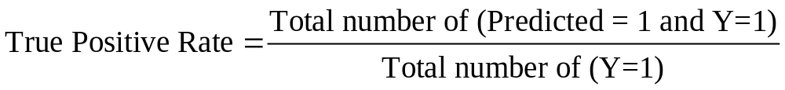
Evaluating model performance using a ROC curve
Once we obtain the predicted probability of observing a magnetopause crossing, we assess the accuracy of the model with a Receiver Operating Characteristic (ROC) curve
Now we can classify each observation in one of the two possible categories as a function of different risk-reward trade offs
  A magnetopause crossing appears
  A magnetopause crossing does not appear
Calculating false positive and true positive rates
A ROC curve is a graphical representation of the trade-off between the false negative and false positive rates for all possible combinations between 0 and 1

Slide 20
Interpreting the ROC curve
Along the 45-degree line, the false positive rate is equal to the true positive rate, and therefore such a model is equivalent to flipping a coin, as it predicts correctly 50% of the time
The Gini coefficient is a measure of the area between the ROC curve and the 45-degree line as a percentage of the area of the upper triangle of the graph
The Gini coefficient provides another measure of model performance
  A Gini coefficient equal to 1 indicates that the model is predicting perfectly
  A Gini coefficient close to 0 indicates that the model is predicting no better than random chance

Slide 21
Model results: Inputs from the best candidate model
The best model is the benchmark
RDMS selected the following ten explanatory variables
Variable | R-squared | Variable | R-squared
St. Dev. of Magnitude of V | 0.88 | Mean of Magnitude of V | 0.72
St. Dev. of Vz | 0.73 | Mean of Temperature | 0.76
St. Dev. of Bx | 0.87 | Minimum of By | 0.68
Median of Bx | 0.66 | Median of By | 0.86
Median of Magnitude of V | 0.65 | Mean of Vz | 0.71

Slide 22
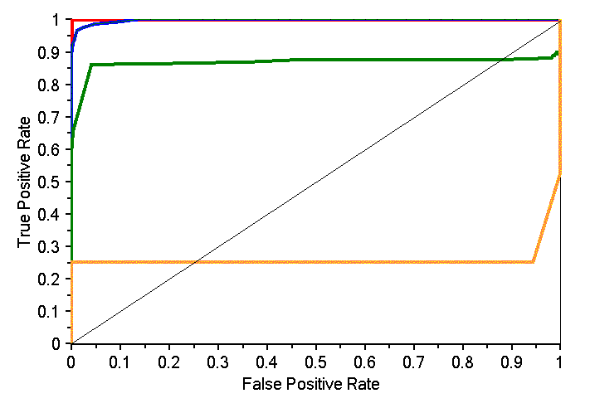
Comparing the relative performance of the models
ROC Curve
Best model –Benchmark
Example 1 – Median of By
Example 2 – Median of By, Mean of Vz, Mean of Temp.
Example 3 – Median By, Mean Vz, Mean of Temp., St. Dev. of Vz
Gini coefficient = 0.99

Slide 23
Model estimation performance: execution time
Using RDMS, model estimation results are available in 1/20th – 1/50th of the time of a traditional artificial neural network (ANN)
  Total modeling processing time = 20 minutes
  Total model estimation time = 7 seconds

