Slide 1
Implementing the Data Environment for the Living-with-a-Star era
Charles P Holmes
Joseph H Bredekamp
NASA Hq

Slide 2
The Sibeck-Kucera et al Vision of the LWS Data Environment
“Report and Recommendations of the LWS Data System Planning Team”, Winter, 2002.
The LWS data environment:
  Based on existing services and evolve in response to user needs
  End-to-end management of all research-quality data sets and extensions
  Science participation in data management
  Peer-reviewed process for elements of the environment
  Begin now; community driven; integral to the Target Research & Technology program

Slide 3
Authors’ Extensions to the Vision
LWS data environment needs to support all SEC research activities and programs.
The data environment will evolve from current data entities.
The “Right Amount of Glue” sets the philosophy
  J.B. Gurman (Fall 2002 AGU, SH52C-03)
The Virtual Solar Observatory is a path-finder.
Activate/Energize discipline-based approaches to the evolution of the data environment.
Distributed funding and implementation activities.
Blend ‘bottoms-up’ implementation approaches with ‘top-down’ vision for the whole scope of an integrated data environment.

Slide 4
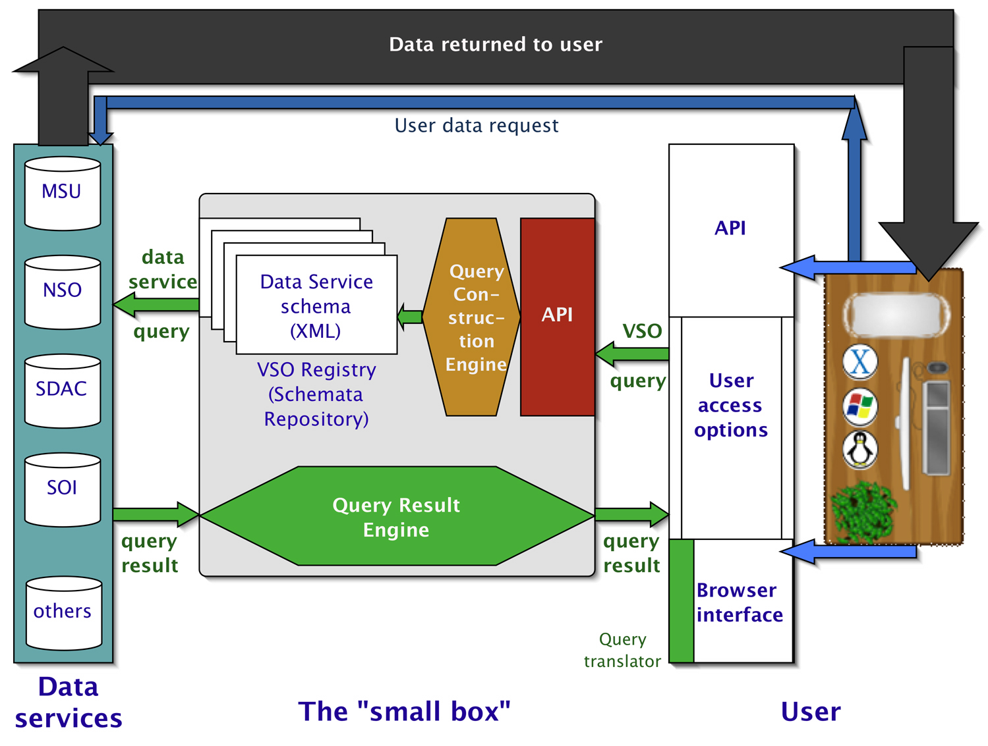
The Virtual Solar Observatory
Beginning prototype development
Organized by the solar data services
  SDAC
  NSO
  Stanford
  Montana State Univ
Small box approach but ‘extensible’
See the Design Proposal and other info at http://virtualsolar.org

Slide 5
The VxO concept:
Separable Elements
Data Services:
  Data online
  Searchable capability
The VxO broker mediates between the data services and data user:
  Metadata library employing XML Schema as the standard
  Discipline-specific query engine
  Returns queried data of instructions to retrieve queried data
  APIs to analysis tools
  Logged searches would be cited and acknowledged in published articles
The analysts’ work bench:
  Accesses the VxO
  Software library of analysis tools, data manipulation and translation
  Some results can in turn become new or updates to the data services

Slide 6
A Concept for the
LWS Data Environment via ‘small boxes’
Virtual Solar Observatory
Virtual Heliospheric Observatory
Virtual Magnetospheric Observatories
Virtual ITM Observatories
Services <-> VxOs <-> Analysts’ tools

Slide 7
Think ‘small box’
Limit the initial set of data services
  Place additional or future data services on the ‘to do’ list
Limit functionality and capability
  Focus on the core functions of data query and retrieval
Share (publish) the schemata
  Schemata are referenced via registered URLs
VxOs work w/ data services to create and maintain schemata
Analysts work w/ the VxOs to create, debug and update the query engines and APIs
Each VxO needs an associated software library of data manipulation and analysis tools
  E.g. SolarSoft library serves the solar research community

Slide 8
Attributes of a VxO
‘x’-community organized
  Share data
  Share and organize tools
  Share experiences - search/query paths
Separate the elements
  Data services
  VxO engine
  Analysts’ tools
Extensible architecture
  The ‘right glue’ - XML becomes the ‘new standard’
Programmatic:
  Data services funded from MO&DA and by other operations budgets
  (under consideration) -> VxO engines from a new SEC data environment line for development and maintenance of the VxOs
  Analysts’ tools funded via AIRSP, TRT, etc.

Slide 9
Progress
VSO
  Starting to prototype
VHO
  The ‘L1-in-situ’ community is organizing and preparing white paper
  NRA for the L1 Cluster
VMOs
  Several initiatives - SPASE, etc.
  Presentation at Yosemite conference
  Etc.
VItmO
  Organizing white paper around the TIMED data system

Slide 10
New Tools, etc.
Presentations/Posters at Fall 2002 AGU:
D. Han (NSSDC) et al. have used XML as the glue in a translation facility that allows CDF, HDF, and FITS users to access each other’s data without provoking religious warfare (SH51A-0424)
Orbit display tools in SSCWeb: XML (Candey et al. SH51A-0422)
OpenDAP (Fox SH51A-0419) – another data interchange tool
Scientific Resource Access System (Daley et al. SH51A-0417) for search and discovery: It’s the metadata, stupid!
Collaborative Sun-Earth Connector (Hurlburt SH51A-0420): distributed software
Aaron Roberts,etc. activities.
Etc.

Slide 11
Towards the future
Need to consider integrating of cross-disciplinary items:
  HQ to organize an implementers forum to promote the sharing experiences and working towards the scope of a larger data environment
  Other integration approaches: TBD??
Follow the path and learn from VSO, EGSO, other VOs.
Create and/or tailor future research announcements:
  To foster and promote the elements of the LWS data environment.
  Promote research and technology for integrating the environment
    E.g., cross VxO interactions, data mining, grid-like features, etc.
Create new and/or tailor existing management structures to carry on with the rEvolution.
  Existing include the SDAC, NSSDC/SPDF, LWS systems engineering, etc.
  New are TBD?
[??What about permanent archiving??]

Slide 12
Abstract
Current practices for analysis of SEC data and the anticipation of performing research under the Living-With-a-Star (LWS)-era programs have created an expectation for an environment which will greatly enhance access to SEC data and analysis tools. The vision for this new data environment has been espoused by Sibeck, Kucera et al and presented recently at AGU meetings and community workshops. The Sibeck-Kucera group recommends an interdisciplinary environment of distributed data federations, coupled with analysis tools and phenomenological models, with access to the environment provided through consistent and common user interfaces. We present an approach for evolving toward the envisioned environment. An integral element of the approach is the "virtual observatory" concept. The Virtual Solar Observatory (VSO), currently in prototype development, offers an architecture which can be replicated to the other SEC disciplines. Common features of the architecture include separation of the functions for data serving, data access and query, data analysis, mining, and modeling but glued together through the power of the eXtensible Markup Language (XML). Another feature of the VSO is that of the 'small box' approach - start small and don't solve all requirements. Through bottoms-up, science-driven, and technology-enabled activities we envision the creation of several VxOs which will evolve into the environment needed for the LWS era.
N
Notes:
The ‘N’ in the lower left corner of the chart denotes that there is an appended note.
Use this space to supply additional explanations and other background information.

