Slide 1
CAWSES, ILWS, IHY, eGY, ICESTAR Sun-Earth Science eWorkshop
Joining Observations from the HPS Great Observatory with Worldwide Satellite and Ground-Based Resources
J U Kozyra, K Shibata, R J Barnes, S Basu, J M Davila, N J Fox, N Gopalswamy, M M Kuznetsova, D Pallamraju, L J Paxton
New Co-Author: C. Alex Young

Slide 2
Our Goal is to Identify the “Grand Challenges” in Heliophysics
We plan to hold a virtual workshop in September 2006.
This workshop is a stepping stone toward enabling the community to address “Grand Challenges”
  We want to identify important science questions.
  We want to identify the technology that must be present in our to carry out the workshop.
    What works? How well does it work? What more do we need?

Slide 3
Needs Identified
The Big Problems
New Tools
Characterizing the simultaneous couplings & feedbacks - requires large (international) data sets
  Need observations in a range of locations within the system
  Micro- and macro- scales are both important in space & time
  Need global specification of key parameters (snapshots not climatologies)
Identifying the physical mechanisms that underlie the system behaviors - accelerated by the use of high performance computers & cyberinfrastructure
  Global & assimilative models are the best (and possibly only) means of exploring the system behavior
  Close coupling between data and models is necessary
Cyberinfrastructure
  Virtual observatories
    Data mining
    Mapping between regions
  Information commons
    Electronic journals
    Software
    Empirical models
Distributed dynamic virtual collaborations - The Human Element (The Subject of this Talk)
  Utilize cyberinfrastructure elements to accelerate the pace of scientific discovery
  Catalyze interdisciplinary research
    Educate researchers about the key questions in other disciplines
    Provide global context
  Educate international students
  Build science capacity in developing countries

Slide 4







Grand Challenge Problem in Sun-Earth System Science
Large distributed data collections: HPS Great Observatory, Other National & International Ground-Based & Satellite Observations
Global & Assimilative Modeling, New Visualization tools
CAWSES, IHY, eGY, ICESTAR, ILWS
CCMC, researchers
Virtual observatory
IHY, eGY, researchers
Information Common: Shared model output for global context, journal articles & preprints, data analysis tools, empirical models
eJournals, CCMC, researchers
CAWSES, ICESTAR
CAWSES / ILWS eWorkshop Distributed Dynamic Virtual Collaboration
CAWSES
New global data analysis tools & higher resolution in existing ones (AMIE, etc.)
Anticipated Result: Accelerate the pace of scientific discovery, Catalyzes interdisciplinary research. Leave a lasting legacy
Capacity Building & Cross-Disciplinary Education

Slide 5
Our goal is not to run another event study.
Our goal is to define those problems and locate and analyze the data that enable us to address grand challenges in the study of the interaction of the Sun and Earth.
In the following slide we provide an example of an event.

Slide 6
Selecting a Grand Challenge Problem in Heliophysics Provides Focus
Criteria
Problem is interdisciplinary and on a large enough scale that community collaboration using large distributed data sets, and high performance computing are needed to make progress
  No one team can address the issues.
Preliminary Selection
Preliminary analysis of CAWSES campaign & comparison events in small interdisciplinary workshops (CEDAR 2005, Stanford CAWSES Space Weather Workshop 2005)
  We want to build on these pathfinding meetings.
Final Selection of Questions:
Carried out soon based on inputs from CAWSES, ICESTAR, ILWS, IHY, eGY organizers via the Internet
  We solicit input from the community.

Slide 7
Example: Initial Look at Events During & Related to CAWSES Campaigns
WHAT HAPPENED?
~1-hr spike of IMF Bz~-55 nT on 24 Aug 2005 from AR 798.
  Min Dst reached ~-219 nT
    A similar strength but longer lived IMF Bz produced min Dst ~-472 nT on 20 Nov 2003
  AL reached -4000 nT!; HP reached ~1285 GW!
The next transit of this same active region produced a min Dst ~-123 nT on 11 Sept 2005 but a Kp of 9!.
Initial Question: Did this active region have characteristics that funneled disproportionately more energy into the auroral region than into the ring current?

Slide 8
Example: Initial Look at Events During & Related to CAWSES Campaigns
PRELIMINARY ANALYSIS
AR 798 anemone active region. [Ayumi Asai, NSRO, 2005]
Produced CME with high velocity; high dynamic pressure in the sheath
A major substorm was triggered just as the IMF Bz reached it’s minimum values
Unusual auroral oval configuration with large vortex on the dawn side and double oval structures (possibly another vortex) on the duskside. Thick nightside oval & very thin dayside oval. [Kozyra et al., Spring AGU, 2006]
Evidence for new type of storm-substorm coupling
20 Aug 2005, 00:50 UT Anemone Active Region [Asai, Stanford Workshop, Dec. 2005]
Super-Substorm
Substorm
10:07:15 UT
19:04:01 UT
[Kozyra et al., Spring AGU, 2006]

Slide 9
What is the state of the Sun-Earth System during Extreme Events?
SUN & HELIOSPHERE
What effect does close proximity to an active region have on the release & propagation of CMEs?
Does an active region leave a “fingerprint” on the CMEs? Do they have common characteristics?
How important were propagation?
MAGNETOSPHERE
How important is the duration of the IMF Bz in how energy is apportioned?
Are there truly supersubstorms that represent a new state of the magnetosphere?
  Effects of super-substorms throughout geospace?
  Underlying physical processes?
  Explain some of the unusual features of superstorms?
Is this a new form of storm-substorm coupling?
IONOSPHERE - ATMOSPHERE
How do these large current vortices effect the state of the ionosphere-atmosphere
Strong sources of Joule heating?
Produce upwelling or other feedbacks to the magnetosphere?

Slide 10
To Fully Utilize the 5th Great Observatory, Tools and Resources Must be Identified and Put in Place
One of the goals of this project is to learn by doing
  We want to find out what is missing
    Data, models, and tools need to be brought together
    Do we have the tools the allow us to know how to get into all the data sets?
    Do we know enough about what went into the models and do we preserve that knowledge?
  How will the VO activity enable new research?
    How practical is it for a person from outside a specific discipline to use a VO?
    Can the things we learn from the VO be used to help mine data produced by models/
    How do we find/compare multipoint measurements?
To do this we introduce some new concepts & approaches.

Slide 11
We Will Create an “Information Commons”
Like the village commons, key resources will be made available to all
  Library of published articles on the events
    Can we get workshop license under special arrangement with electronic Journals for papers on the events we are investigating
  Library of global model results -- unifying formats from CCMC
  Library of important interdisciplinary tools -- mapping along B field from dynamic models, static models; new visualizations
  Library of assimilative model results
  Library of global maps and continuous time series
  Library of observations (ground-based and satellite)
  Listing of all ongoing studies and collaborations

Slide 12
The CCMC Has Made a Commitment to Support the Information Commons

Slide 13
We are not developing the cyberinfrastructure – but we do need it.
This workshop will provide a high value test of the cyber-infrastructure for data access & manipulation.
The participants will provide feedback and evaluations of the
  IHY/CAWSES Observation Database [Contacts: C. A. Young, J. Davila]
  JHUAPL/eGY/CAWSES virtual observatory software [For example: Serving ITM data using the Virtual Ionosphere Thermosphere Mesosphere Observatory (VITMO) (contacts: D. Morrison, M. Weiss, R. Daley)]
  ICESTAR virtual magnetometer software (VGMO) [Contacts: A. Ridley, V. Papitashvili, C. R. Clauer]
  And other partners

Slide 14
An eWorkshop has Advantages
Tool for supporting collaboration among nations and between discipline areas
  Low bandwidth (virtual poster session with simple features) to allow participation of all nations
Little or no learning curve for the software
  Minimum time investment in order to participate
  Similar to familiar face-to-face conference formats
Include features that support sharing of high level interpretation of discipline specific results across a broad range of disciplines

Slide 15
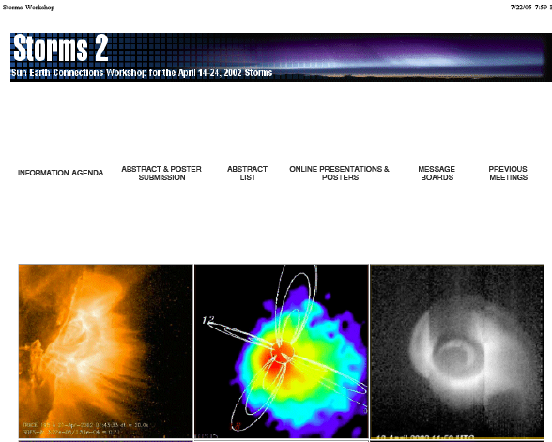
We Take Advantage of Lessons Learned from Earlier Event-Oriented Workshops
The basic collaborative infrastructure is in place.
The format is a virtual poster session.
Participants could post comments,upload whole talks, and add value in other ways.
Invited tutorials on instruments, models or events would encourage broader participation.
The sessions would be “self organizing” - the leads for the various topics would decided how to approach/focus the discussions and submissions.

Slide 16
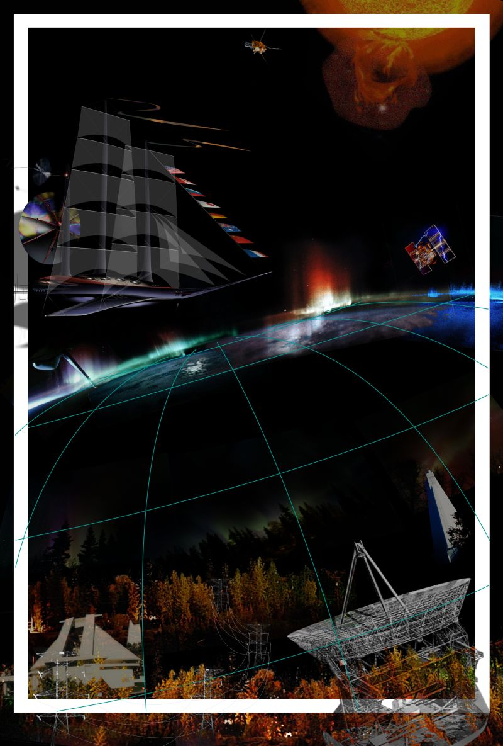
CAWSES Space Weather Science and Applications
Website for CAWSES Virtual Poster sessions is under development at JHU/APL
Examples follow of how the website was set-up for a previous workshop which had a virtual poster session as one component
Worldwide Internet Workshops
Dates TBD
Workshop Goals
Assess the data collected by participants
Identify key science issues
Provide access to CAWSES worldwide space weather maps and continuous solar observations to address outstanding science questions in new ways.
Support worldwide collaborations
CAWSES March-April 2004 Campaign
CAWSES-ICESTAR 15-24 Jan 2005 Long -Duration Flare Events
Collaboration with Johns Hopkins Applied Physics Lab, NASA LWS program, Community Coordinated Modeling Ctr

Slide 17
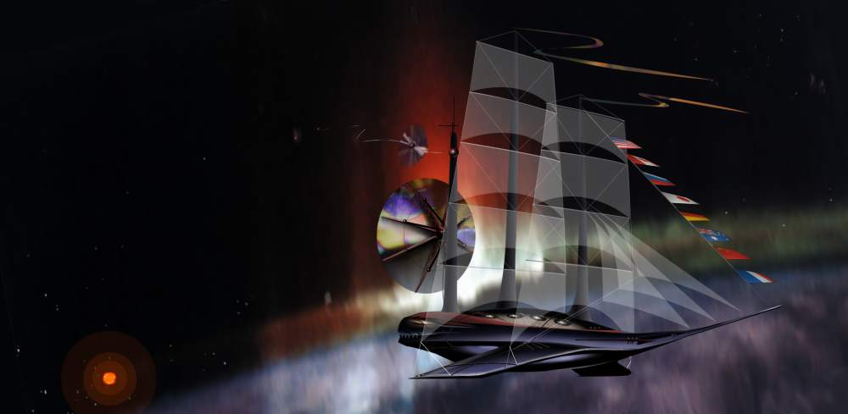
CAWSES Space Weather
Worldwide Internet Workshop
Apply the virtual poster software developed by Rob Barnes to run eWorkshops.
Comprised of both invited and contributed posters arranged within a series of sessions that span 5 days - Participants recruited from all countries, discipline areas.
Tutorial talks on issues specific to the event being investigated.
Communication with authors through message boards and email exchanges.
Authors would agree to respond rapidly to questions and comments during the day of their poster and as possible throughout the week of the workshop.
Moderators would be appointed to
  oversee message boards
  update a running list of important science questions, unusual observations, and interesting results

Slide 18
Next Steps
CAWSES, ICESTAR, ILWS, eGY2007, IHY2007 committees develop plan for science topics, presenters and themes for the eWorkshop. Community input.
Collaborators and Presenters fill the Information Commons between now and the eWorkshop
Key data sets are selected for the Virtual Observatories
Key data analysis products, tuned to the chosen questions, are produced & made available in the Information Commons (i.e., assimilative maps of potential, field-aligned currents, and electric fields)
Tentative dates for the campaign in September 2006.

