Slide 1
Connecting Virtual Observatories with Grid Enabled Services
Tom Narock - NASA/GSFC
Katie Rash - NASA/GSFC
Adam Szabo - NASA/GSFC
Homa Karimabadi – SciberQuest, Inc.

Slide 2
What is a Service?
Data analysis or processing done after the data is retrieved from a data source
Data sources can range from PI to data center to Virtual Observatories

Slide 3
Why Do We Need Services?
Virtual Observatories address only part of the problem - data description, search and retrieval
Data may not be readily compatible
Services will reduce research startup time and enable new ways of multi-source science

Slide 4
Grid Enabled Services
Service Node
Service Node
User Interface
Distributed Environment
Capable of Finding and Accessing Services
Transparency to User

Slide 5
Grid Enabled Services
Metadata
Each service has metadata description
Describes inputs/outputs and service type
Allows for coupling of services
Service Node
Houses a number of services and associated libraries

Slide 6
Service Metadata
Use existing metadata standards (SPASE) when available and develop additional Service Metadata
Collaborate with SPASE group in order to create metadata standards for data providers and service providers

Slide 7
How would this work with a VO?
Grid services are not limited to one discipline or Virtual Observatory
Encourage VO’s to provide access to Services although not required
Future release of VHO will demonstrate VO interface to Services
Either VO or user passes data URLs to Service User Interface and proceeds to select service(s)

Slide 8

Extracting Data
Service
Autonomous extraction of data requires detailed SPASE metadata
Need to not only describe data contents but describe how it is laid out in the files
“Groundwork for Integrated Analysis of Distributed S3C Data” - J. Vandergriff et. al., SM23A-01
Data from VO

Slide 9
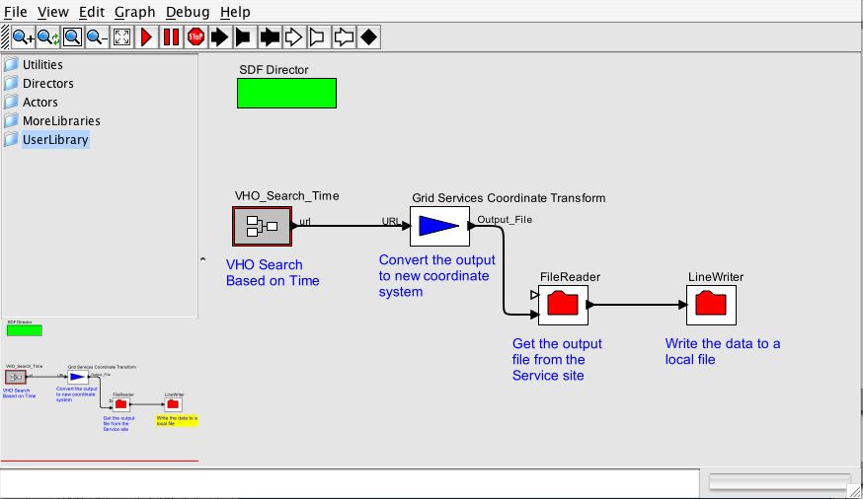
Existing Community Tools
Existing tools such as CoSEC provide additional means of using and accessing Grid Services

Slide 10
Current Status
Beginning initial development of framework for Grid Services
Creating metadata standards for Services
Will soon begin creating user interface and putting basic services in place
Collaborating with H. Karimabadi on development of advanced data mining services

Slide 11

Advanced Data Mining Services
Service Center
End User
Data
Preparation /
Assimilation
Pre-mining
Content
Metadata
Pattern Recog.
Prediction
Visualization
RemoteMiner
Cross-collaboration
Standardization
Knowledge-base
Search Engine

Slide 12
Community Involvement
Encourage community participation at this early stage
Service suggestions
Once system is in place the community can contribute computational resources in addition to service code

