Slide 1
The Virtual Heliospheric Observatory and Distributed Data Processing
T.W. Narock^{1,2}, A. Szabo², A. Davis³ tom.narock@gsfc.nasa.gov
1. L3 Communications, GSI
2. NASA/Goddard Space Flight Center
3. ACE Science Center, Caltech

Slide 2
Foundations of the
Virtual Heliospheric Observatory (VHO)
Data Synchronization
Data is synchronized autonomously among all participating data providers using Rsync software
MIT
GSFC
ASC
UMd
Berkley
Los Al
GSFC – Goddard Space Flight Center – WIND MFI Data
MIT – Massachusetts Institute of Technology – WIND SWE Data
UMd – University of Maryland, College Park – SOHO Celias Data
Berkley – University of California, Berkeley – WIND 3DP Data
ASC – ACE Science Center, California Institute of Technology – ACE MAG and SWEPAM Data
Los Al – Los Alamos National Laboratory – Genesis Data
Implemented
In process of being
implemented

Slide 3
Foundations of the
Virtual Heliospheric Observatory (VHO)
Data Synchronization (Continued)
Benefits to the Community
1.) Allows creation of new data products
- example: Merged WIND MFI and SWE data
http://lepmfi.gsfc.nasa.gov/plots.html
2.) Principle investigators can use other data sets
to calibrate their own instruments thus providing
higher quality data

Slide 4

VHO Prototype - Requirements
3.) Data Providers
should provide
metadata which is
searchable and
provide means to
retrieve data
Data Provider 1
Data Provider 2
Services
Heliosoft
Middleware
1.) Must provide the
user with an easy to
use interface that can
query multiple data
sets simultaneously
4.) Provide processing
services as well as
software libraries for
the analysis and
display of data
2.) The user need not know the data set or how it is described

Slide 5
VHO Prototype - Design
A Prototype VHO was developed at GSFC
- Being tested at GSFC to later be deployed nationally
It utilizes all datasets which are currently synced to GSFC and provides access to most recent data
Provides one interface to many data sets, via web access or stand alone program
Provides search and retrieval capabilities for Heliospheric data, allows searches by date, instrument and/or spacecraft position
Lays the foundations for services and presently provides first service - coordinate transformations

Slide 6

VHO Prototype - Design (cont.)
User
Users communicate
with middleware via
SOAP messages or
web interface.
Middleware distributes
the query to data
providers.
Users then obtain data
directly from data
provider.
Or service peer group
can provide processing
prior to download
SOAP message
Service
Peer Group
Middleware
Data synced from VHO providers
Data 1
WIND MFI
In house
Data
SOAP message

Slide 7
Prototype Queries
Data Provider
Query Engine sits on Data Provider and listens
for incoming SOAP messages.
Search Parameters are removed from message and
metadata is searched
XML metadata consists of one metadata file for each
data file. Files are small and contain date and
min/max values of spacecraft orbit over the time
period covered by the corresponding data file
An advanced search was implemented using higher
level science terms such as searching for “L1 data”,
“solar wind data” or “inner heliosphere data”
Query Engine
XML Metadata

Slide 8
Services
Search and retrieval can only go so far
Users need more than access to data
Services will provide commonly used processing capabilities
They will save the community time and effort and provide data in a form ready for use

Slide 9
Services – Design
Designed as a peer-to-peer
network
Services are more dynamic
than data providers
Multiple peers may offer
similar services
VxOs can join peer group and
use services (VHO Middleware
is a peer)
Peer group is closed, i.e.
must be approved user to
contribute services
VHO
Middleware
Service
Peer 1
Service
Peer 2
Other
VxO

Slide 10
Services - Implementation
VHO middleware understands SOAP messages
and is also a peer in the service peer group
Allows VHO middleware to quickly and easily
find and use services
Users need not learn another interface. To
request a service they communicate with
middleware using SOAP as they would if they
were sending a data request (only inputs in
SOAP message change slightly)
Additionally, some common services will also
have a web interface for easy use by
non-programmers
VHO
Middleware

Slide 11



Services – Technical
Service Peer Group Implemented using Sun’s JXTA Protocols
JXTA allows peers to communicate directly and share resources even though some peers are behind firewalls or using different network transports
Service Peers retrieve data on their own or by using VHO
First service obtains data through direct access using APIs developed by ACE Science Center

Slide 12
Services – Layout
Service
Peer
GSFC Firewall
Service
Peer
Service
Peer
JXTA
Relay
Peer
VHO
Middleware
Service
Peer
GSFC Firewall

Slide 13
Why not have it all P2P?
JXTA does not guarantee messages will arrive or be responded to
Requires an all Java implementation and forces users to implement their own VxO software in Java with extensive JXTA
New JXTA releases are frequent and some have been found to worse in performance [Seigneur et. al., ACM International Conference 2003]
Unnecessary overhead (both programmatically and in network traffic) in querying data
Data providers are static and simple message passing, which SOAP provides, is sufficient

Slide 14
What is needed to participate?
Basic User
Web Browser
Advanced User
Programming experience
SOAP library (available for most languages – C, Perl, Java, etc.
Data Provider
SOAP daemon – provided by VHO team
SOAP library – available free online
Perl XML software – available free from CPAN
Query Engine – provided by VHO team

Slide 15
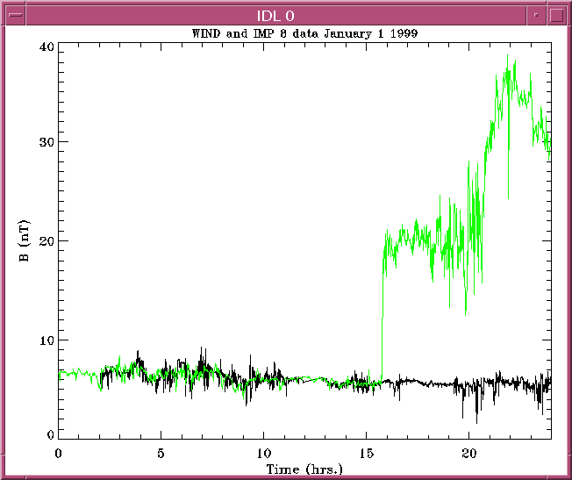
Future Plans
Add more Heliospheric data sets and services
Finalize prototype and distribute to PI sites
Incorporate a “Heliosoft” library of analysis and reading routines
Provide the community with a stand alone application which utilizes the full power of the VHO

Slide 16
Additional Information and Resources
VHO home page – http://vho.nasa.gov
VHO Prototype basic search page http://vho.nasa.gov/search.html
VHO API information http://vho.nasa.gov/api.html
VHO Advanced search and service documentation http://vho.nasa.gov/services.html

