Slide 1

The SPASE Data Model and the SPASE Consortium
Virtual Observatories in Space and Solar Physics Workshop
October 27, 2004

Slide 2
WHAT IS SPASE?
Space Physics Archive Search & Extract
SPASE is an international consortium of space physics data provider groups interested in making the data search and retrieval process easier for the space physics community.
SPASE is open to other groups that wish to join the effort…..

Slide 3
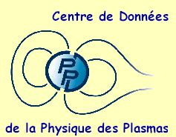

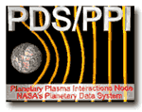




PRESENT PARTICIPANTS
• CNES/CNRS Plasma Physics (CDPP) Data Archive
• NASA/Goddard Space Flight Center
• NOAA/National Geophysical Data Center
• Planetary Data System- UCLA Plasma Physics Interactions Node
• Rutherford Appleton Laboratory
• Southwest Research Institute
• Applied Physics Laboratory
• Jet Propulsion Laboratory
• Augsburg College

Slide 4
WHY IS SPASE NEEDED?
Space Physics data archives are increasing in both size and geographic distribution
Simple browser searching for data is inefficient and often incomplete
Lists of web links have grown very large and quickly go out of date
A uniform method to search for and retrieve data from many different archives would be a useful and important tool for the community

Slide 5
SPASE GOALS
    • Develop a SPASE Data Model and Data Dictionary
    Define a System Model.
    Determine methods for exchanging information. This involves two parts:
      a. Define formats for encapsulating the information (e.g., XML)
      b. Define protocols for exchanging the information. (e.g., SOAP)
    Develop example front-end interfaces and middleware
    Apply the SPASE model to data holdings:
      Make the majority of important space physics data sets machine-accessible
    Develop or adapt other software to access and use data products at the file and variable (subset) level and to make retrieved data useful.

Slide 6
History of SPASE
• SPASE Idea began at ISTP Workshop at Rutherford Appleton Laboratory in September, 1998
• Soon after a consortium formed of interested data centers
• Occasional meetings became periodic international teleconferences (now biweekly)
• SPASE received funding from LWS TR&T Program in August, 2004
• Teleconferences continue together with biannual meetings (Monday and Tuesday of this week)

Slide 7


SYSTEM ELEMENTS
EXAMPLE ARCHITECTURE
Community
Community
S
Access Point
Application
S
S
SPASE Message
S
Application
S
Repository
Gateway
S

Slide 8
Data Model Work
Why are we doing this?
  To make it easier to locate information in a cooperative of autonomous data systems.
Where are we now?
  We have evaluated needs, compared existing data center situations (CDPP, NSSDC, SwRI, etc.), and formulated a draft for a Data Model/Data Dictionary
What do we want to accomplish?
  Register data products using the Data Model and revise the model based on this experience and community comment
  Decide what technology should be used to implement use of the content
… and then
  Implement and revise as needed.

Slide 9
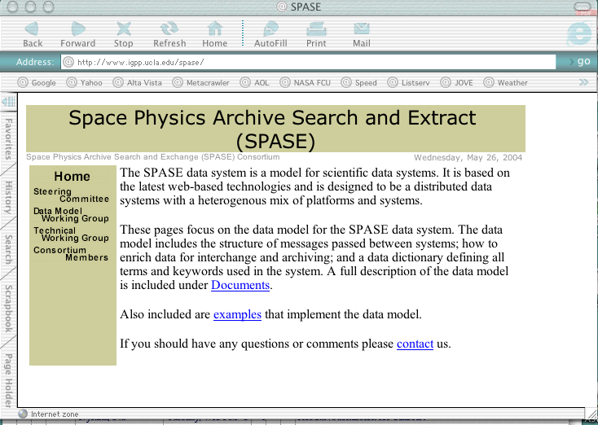
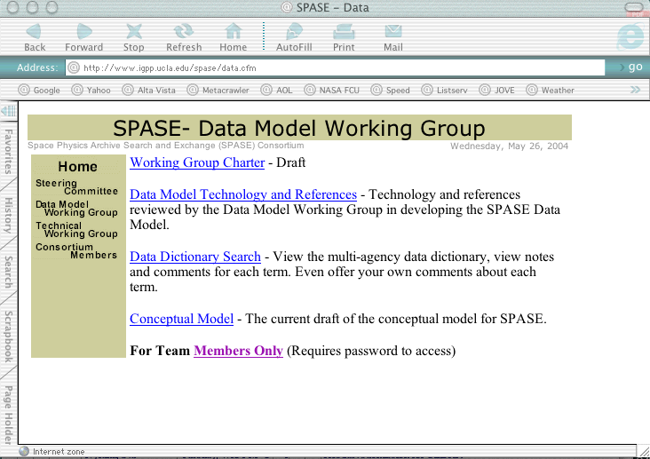
SPASE Website
Copy of Data Model
http://www.igpp.ucla.edu/spase

Slide 10
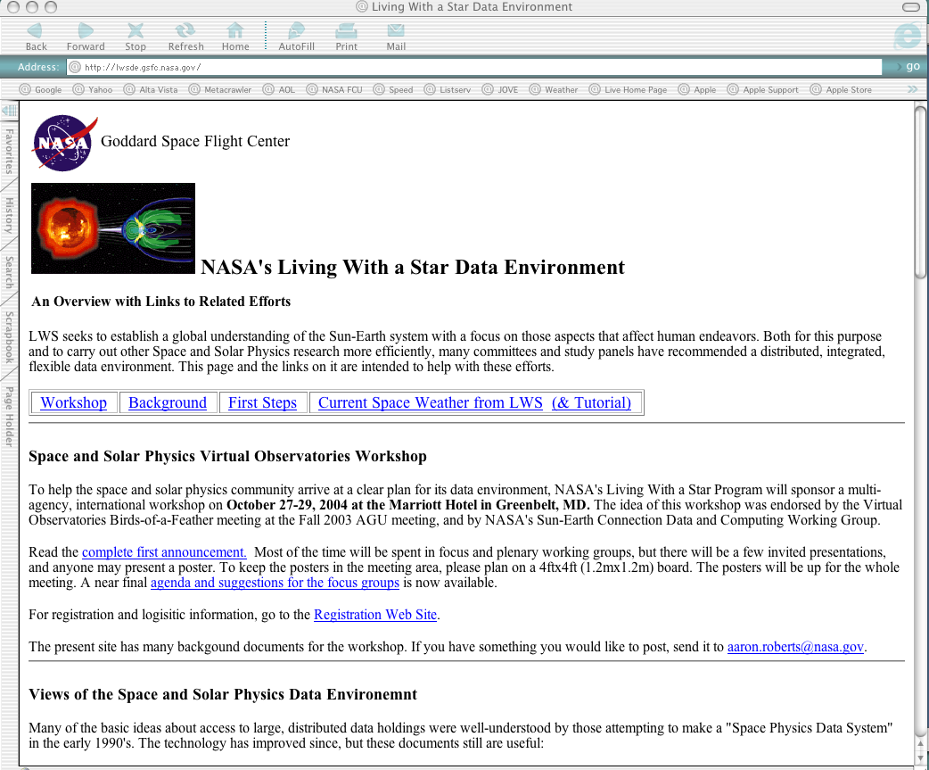
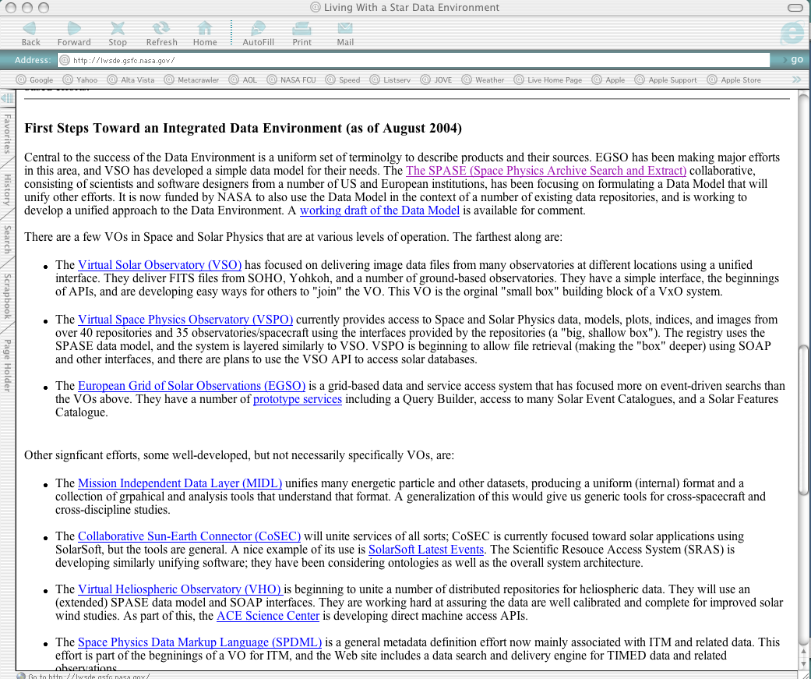
Living With a Star
Data Environment Website
Alternative Access to Data Model
http:lwsde.gsfc.nasa.gov

Slide 11
SPASE Data Model Features
Hierarchy
A hierarchy of terms has been created for describing the data products based on the natural taxonomy of the physical world. These are being reviewed, tested, and refined.
Top level categories in the hierarchy are:
• External Elements - General metadata defining the data product
Examples: Product ID, Product Description, Contact, Project, etc.
• Measurement Description Elements - How and where measurements were made
Examples: Measurement Type, Observed Region, Processing Level, etc.
• Physical Parameter Elements - What was being measured
Examples: Photon, Field, Particle, etc.
Dictionary
The terms in the hierarchy are all defined and the definitions are hyperlinked to the list.

Slide 12
SPASE Data Model
Example Data Product Description
Product ID: ACE_MAG_1hr_ASC
Product Description: ACE/MAG 1-hr, 1-day, 27-day magnetic field averages at ASC
Contact: Norman Ness at Bartol is Experiment Manager, Chuck Smith at UNH is Data Manager
Instrument Abbreviation: MAG
Access URL: http://www.srl.caltech.edu/ACE/ASC/level2/lvl2DATA_MAG.html | ACE Science Center: ASC
Access URL: ftp://mussel.srl.caltech.edu/pub/ace/level2/mag/ | in HDF via ftp from ASC
Storage Repository: ASC
Product Type: Data
Observatory Region: Heliosphere, Bowshock to ~L1
Observatory: ACE
Measurement Type: Magnetic Field Type
Processing Level: Calibrated
Access Rights: Public/Citable
Availability Status: Online
File Format: ASCII
Resolution: 3600.0 nT
Time Span: 1997.09.01 - PRESENT
Data Currency: Data are presently ~5 months delayed

Slide 13
WHAT WILL SPASE DO FOR ME?
• PROVIDES A DATA MODEL
- Facilitates correlative studies
- Enables access to a wide range of space and solar physics data
- Facilitates interoperable interfaces to data holdings
- Permits direct intercomparison of disparate data sets

Slide 14
SUMMARY
The Data Model work is the important first step for SPASE
Data Model versions will continue to be presented to the community for comment
The Model and its applications will be tested through various technical implementations
Results and current work can be found at: http://www.igpp.ucla.edu/spase

Slide 15
SPASE Technical Plans

