Slide 1
Space Physics Data Facility
Focus is multi-mission, cross-disciplinary data services
  Enable large scale science and integrated access to data of Great Observatory
  Enable and leverage the evolving (distributed) Heliophysics Data Environment
Develop / operate a range of well used public data services
  CDAWeb, SSCWeb, 3D Orbitviewer, CDF (see http://spdf.gsfc.nasa.gov)
    Underlying s/w has been generally made open source
  Emphasize current data, high-utility data and data from many sources
    Operate Data Format Translations
  Variety of current metrics (last slide)
  Working to bring together our multiple services into a unified framework
    And then extend to external services
    Preserving unique strengths and access to full range of data holdings
    Built on general CDAWeb model
Notes:
Talk slowly through each line - don’t skip
OPeNDAP = Open-source Project for a Network Data Access Protocol
3D Orbit Viewer is also known as TIPSOD = Tool for Interactive Plotting, Sonification and 3D Orbit Display
Working on other Web Service connections; e.g. SPIDR
Wind 3DP is in progress
- Adding this data to a revamped data flow based on VHO rsync
- We are dependent on data producers for content and metadata confirmation
- We are opportunistic some times. In this case, there was a user request that came to us for access to 3DP data that we didn’t yet properly hold (we had test cases pending many months). We’re using user request to elevate priority provider is placing on finishing their work.
- This has happened before with other datasets.

Slide 2
Space Physics Data Facility
Thrust to a more distributed “virtual” environment
  Invested in offering our data & capabilities through web services APIs
    Basis on which others can build
    With methods to determine valids and access metadata
  General goal to make our data and capabilities accessible as users need those functions
    e.g. HTTP, FTP, SOAP, REST, prototype OPeNDAP server
    use of Java and WebStart
  Leverage the evolving VxO infrastructure (e.g. VSO, VHO rsync, VSPO’s SPASE work, CoSEC) & external services
SPDF program is presently awaiting outcome of D&MC Senior Review
  How can SPDF further advance the work of the new VxOs?
Notes:
Talk slowly through each line - don’t skip
OPeNDAP = Open-source Project for a Network Data Access Protocol
3D Orbit Viewer is also known as TIPSOD = Tool for Interactive Plotting, Sonification and 3D Orbit Display
Working on other Web Service connections; e.g. SPIDR
Wind 3DP is in progress
- Adding this data to a revamped data flow based on VHO rsync
- We are dependent on data producers for content and metadata confirmation
- We are opportunistic some times. In this case, there was a user request that came to us for access to 3DP data that we didn’t yet properly hold (we had test cases pending many months). We’re using user request to elevate priority provider is placing on finishing their work.
- This has happened before with other datasets.

Slide 3
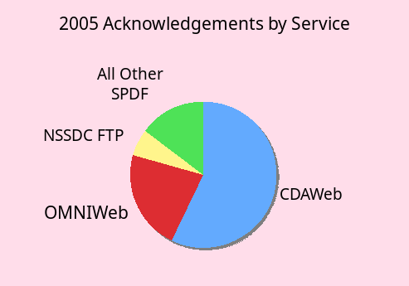
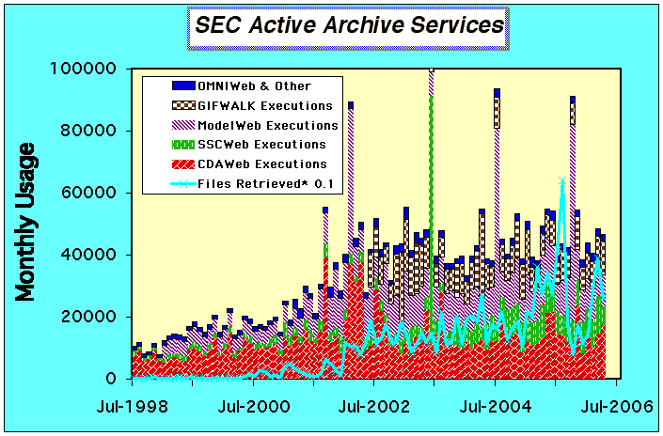
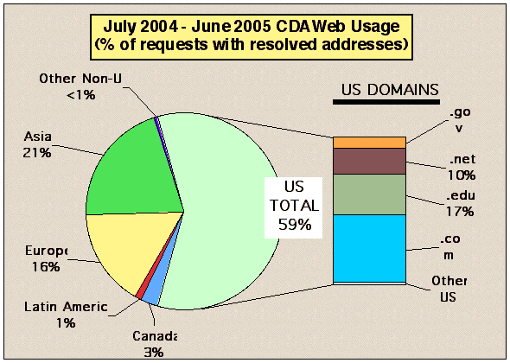
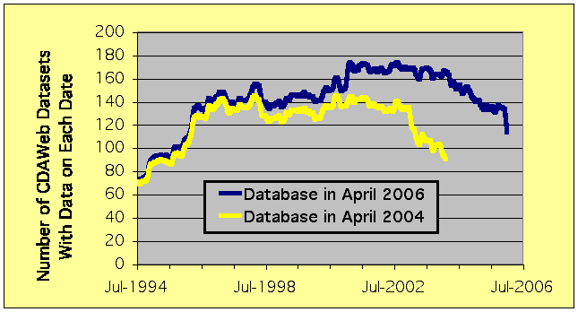
Example measures used by SPDF
>124 acknowledgements of our services and data in 2005
  Supported >107 of 520 papers in JGR Space Physics (20%)
Strong and steadily growing user community
  1300 distinct users who made >10 requests, 300 users who made >100 requests, in one year
CDAWeb serves 500 datasets
  >3000 variables
  >1500 public datasets in CDAWeb Plus
  CDAWeb has ~140-170 datasets available every day 1995-2005
User feedback (from all SPDF pages)
  Case studies and advisory committees (see SPDF website)
Notes:
Main emphasis is
- new normalization of JGR citations
- # of distinct users seems could be a non-trivial fraction of “the community”
- uniqueness of the combined data resource served

