Slide 1
The 25-year March Toward a Space Physics Data System
Raymond J. Walker
UCLA
Presented at Virtual Observatories in Space and Solar Physics
Greenbelt, Maryland
October 27, 2004

Slide 2
Why Bother?
“Since the first satellites had orbited, almost fifty years earlier, trillions and quadrillions of pulses of information had been pouring down from space, to be stored against the day when they might contribute to the advance of knowledge. Only a minute fraction of this raw material would ever be processed; but there was no way of telling what observation some scientist might wish to consult, ten, or fifty, or a hundred years from now. So everything had to be kept on file, stacked in endless air-conditioned galleries, triplicated at the three centers against the possibility of accidental loss. It was part of the real treasure of mankind, more valuable than all the gold locked uselessly away in bank vaults.” –
ARTHUR C. CLARKE, 2001

Slide 3
Space Physics Data Analysis in the 21st Century
We are entering an era with unprecedented data management challenges.
  Much more sophisticated instruments are being proposed.
  Data volumes are growing exponentially. (Future missions will produce ~10¹⁵ B of data!)
Studies increasingly require data from more than one source.
Data from older missions help us place observations from current missions in context by providing continuity through time.
Wide spread use of the data will maximize the scientific return of the data!

Slide 4
The State of Space Data 25-Years Ago
[CODMAC 1 Bernstein et al., 1982]
“The distribution, storage and communication of data currently limit the efficient extraction of scientific results from space missions.”
The most successful scientific data activities are run by scientists for scientists.
There are no technical barriers to impede data handling.
Recommended a restructuring of the data chain to adhere to basic principles for scientific data management.

Slide 5
Principles for Successful Science Data Management
[CODMAC Report, Bernstein et al., 1982]
Scientific Involvement
  Scientific involvement in all stages of space missions.
Scientific Oversight
  Peer Review
Data Availability
  Timely access determined by the scientific community.
  Easy to use formats. (Make correlative studies easy.)
  Appropriate ancillary data
  Enforce contractual obligations for investigators to place data in the archive.
  Proper documentation.
Facilities
Software
  Structured, transportable and well documented.
Scientific data storage
  Stored in a permanent and retrievable form.
Data-System Funding
  Secure funding from mission overruns.

Slide 6
Since CODMAC 1
CODMAC 2 and 3– Arvidson et al., 1986; Russell et al. 1988.
  Geographically distributed, discipline orientated solutions to CODMAC 1 issues.
CSSP/CSTR Data Panel – Williams, Shea et al., 1984.
  Focused on accessibility. Create a Solar-Terrestrial Data Catalog.
Community Wide Workshop on NASA’s Space Physics Data System – Rice University, June 1993.
Space Science Data Systems Technical Working Group
  Report of Panel on the State of Space Physics Data - 1997
  Report of Sun-Earth Connection Study Team (The River Bend Workshop) – 1998.

Slide 7
Community Wide Workshop on NASA’s Space Physics Data System
SPDS was an attempt to carry out the CODMAC recommendations for space physics.
  Volunteer organization of data users.
  Small funding to restore in danger of being lost.
  Did not solve the problem of making well documented data available to the research community.
Workshop was an attempt to go beyond a small volunteer organization – it was not a success.
State of Space Physics Data report
  Importance of research across sub-disciplines not appreciated.
  PI reluctance to cooperate
    Incentive is to make discoveries and get them published.
    Concern others will abuse the data.
    Resources were inadequate for making the data available.

Slide 8
The River Bend Report
Plan for a distributed data system for SEC.
Data managed at a number of sites actively engaged in research.
Three level 2 entities responsible for managing data at a number of sites.
  Solar Physics
  Terrestrial Environment Imaging
  In situ Space Physics
Organize views of data in three thematic catagories.
  The Sun as a Star
  The Sun in Space
  The Earth in Space
Science experts organize the data but the data view extends across discipline boundaries.

Slide 9
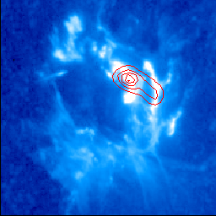
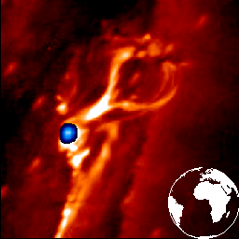

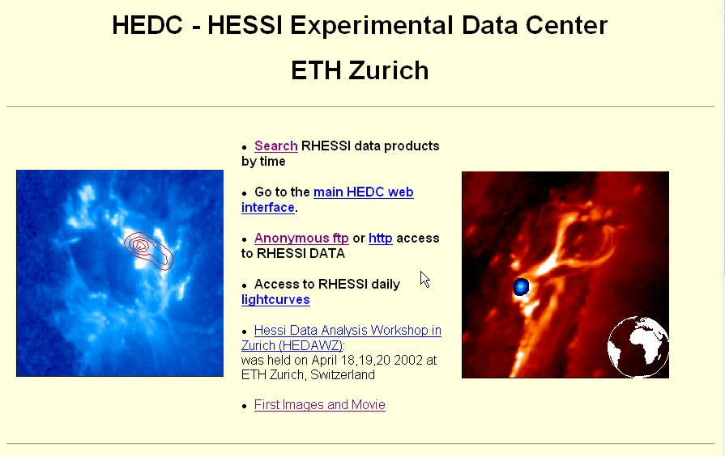
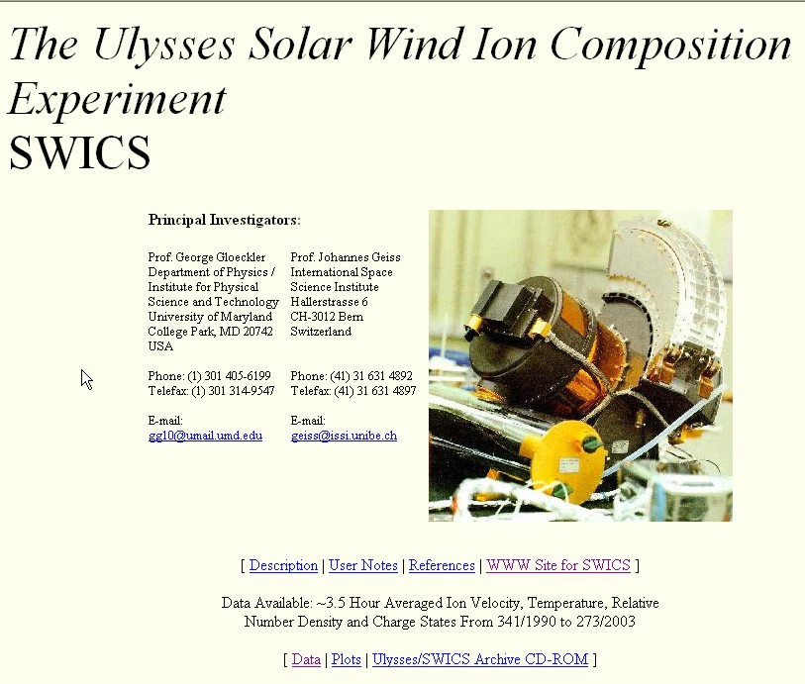
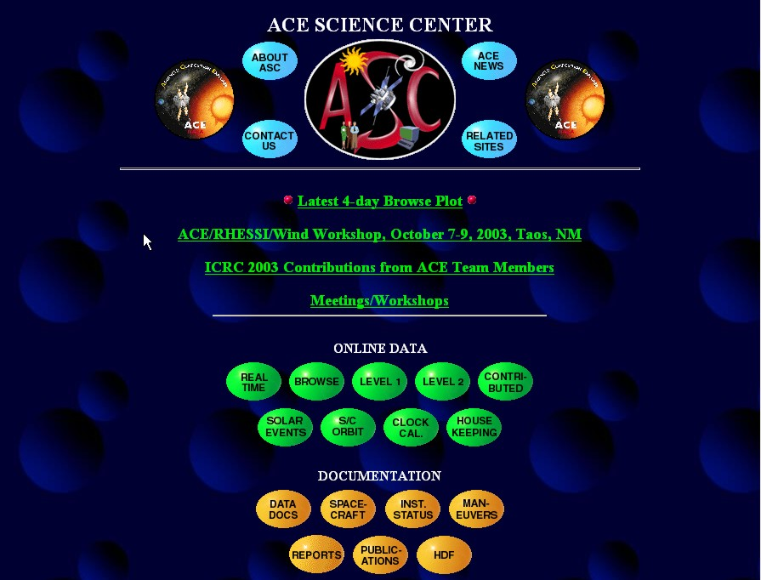
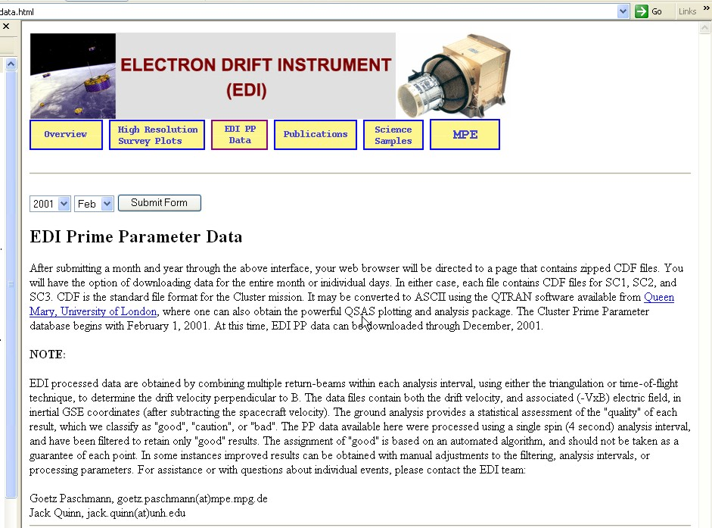
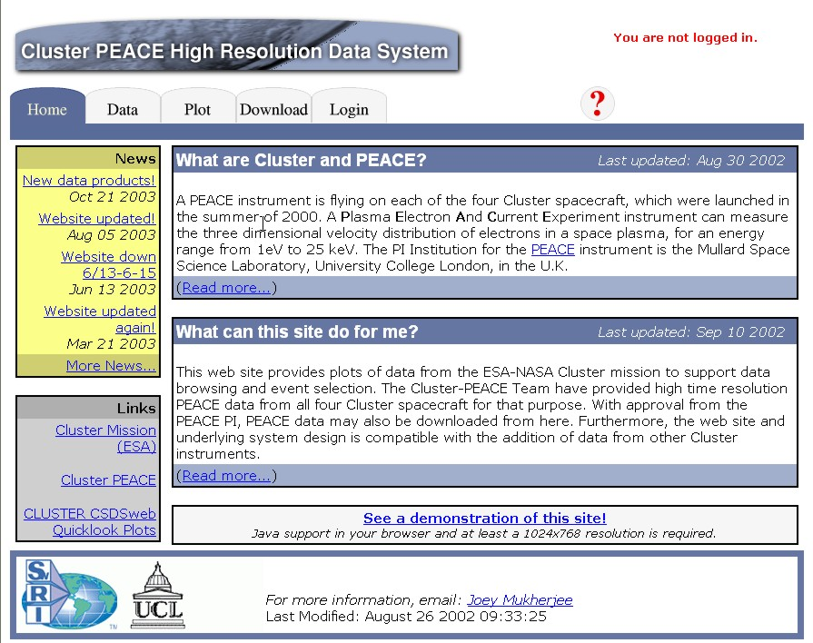
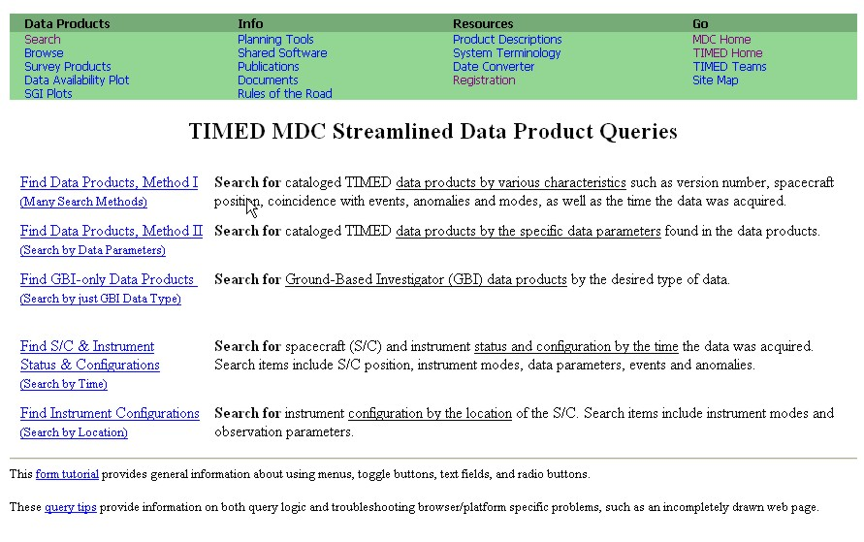
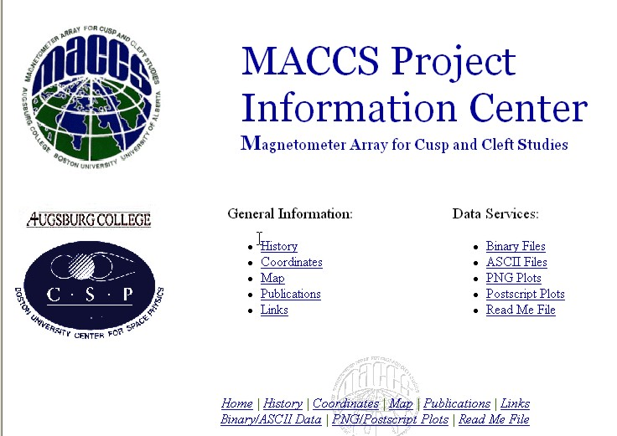
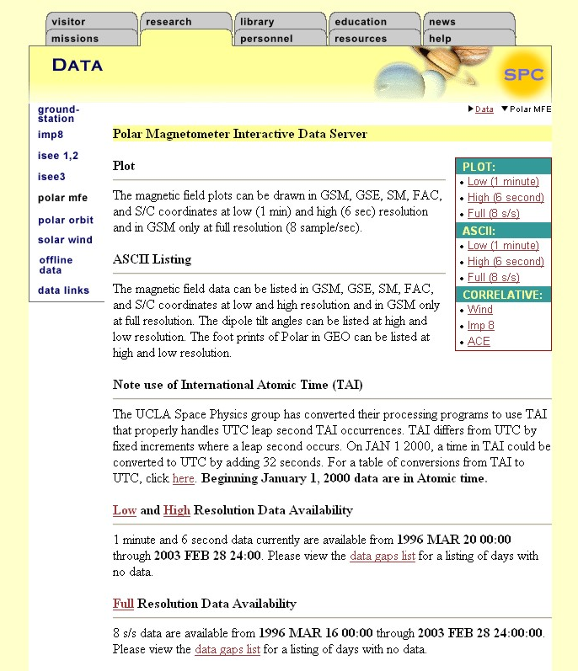
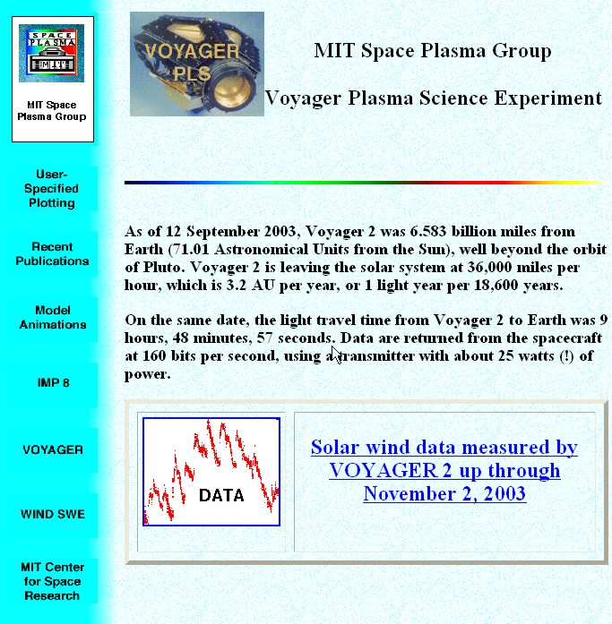
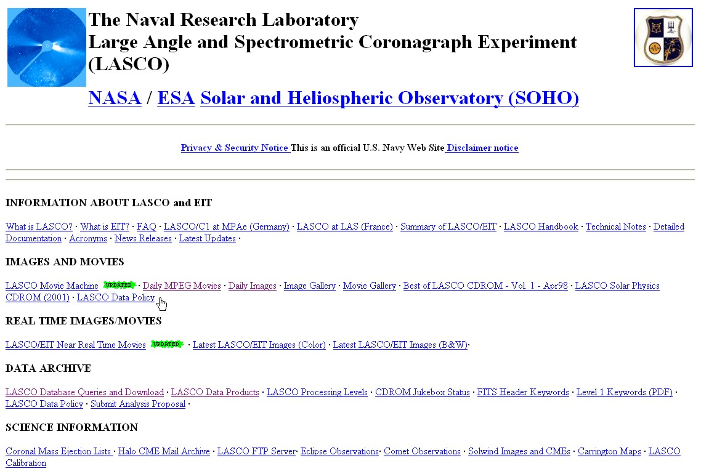
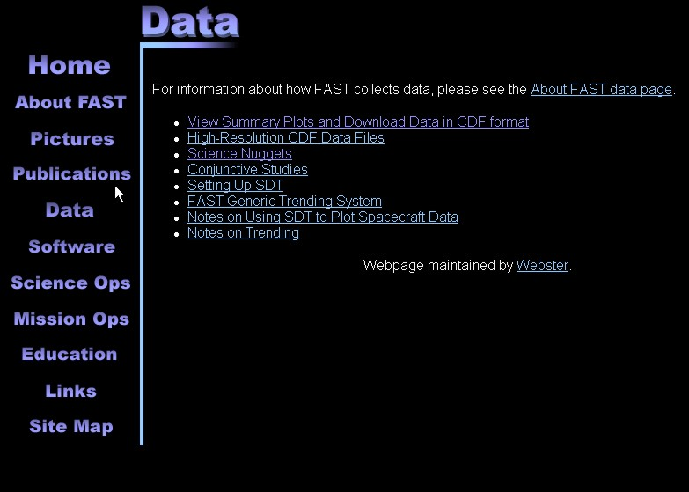
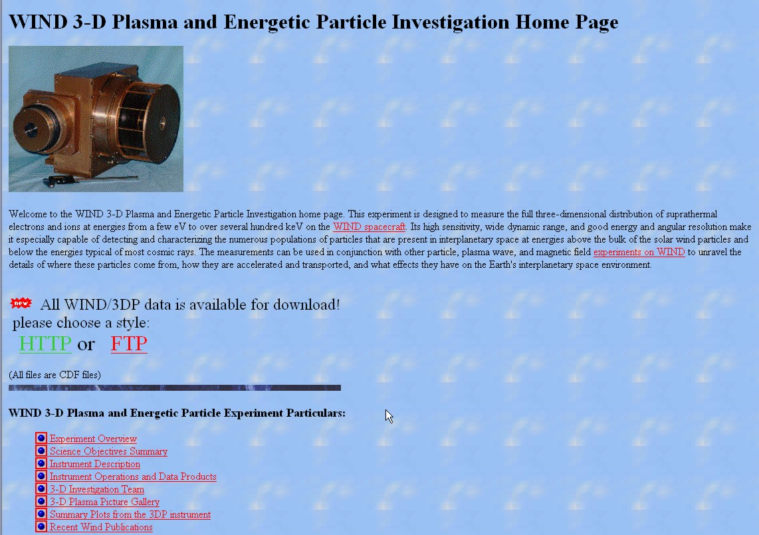
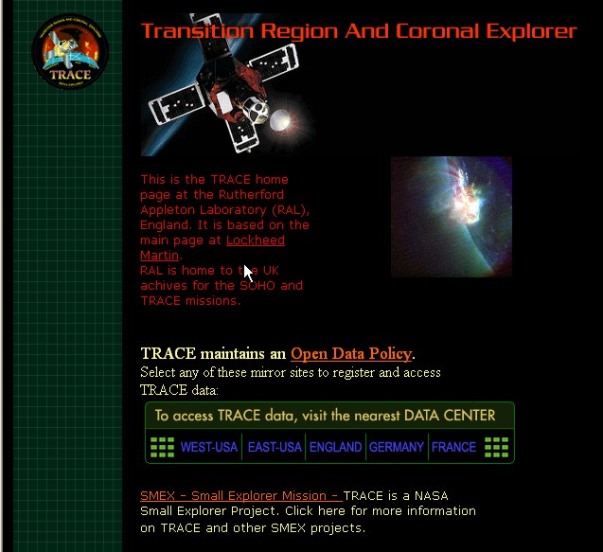
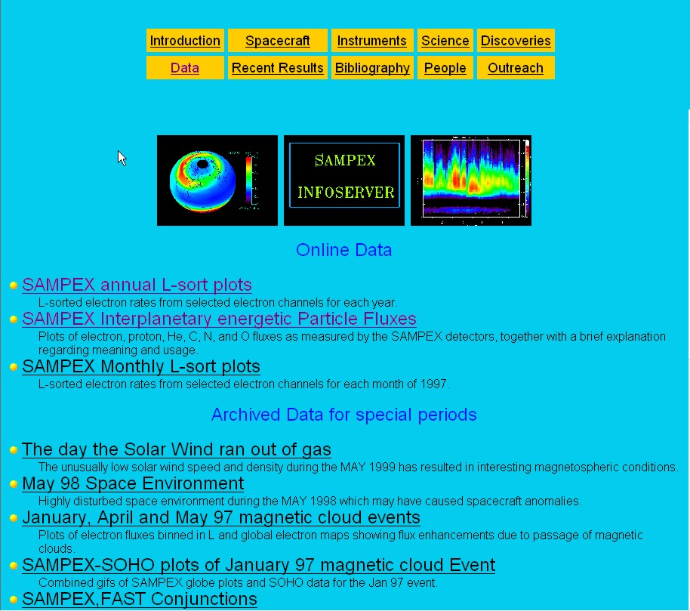
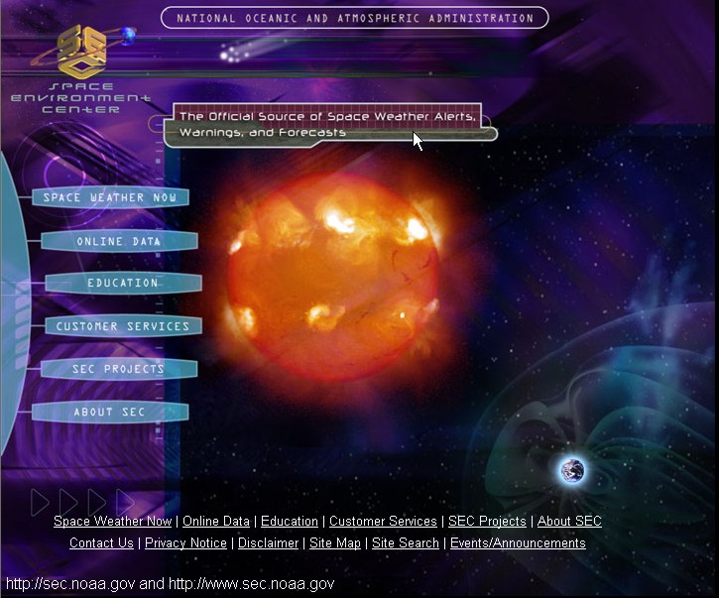
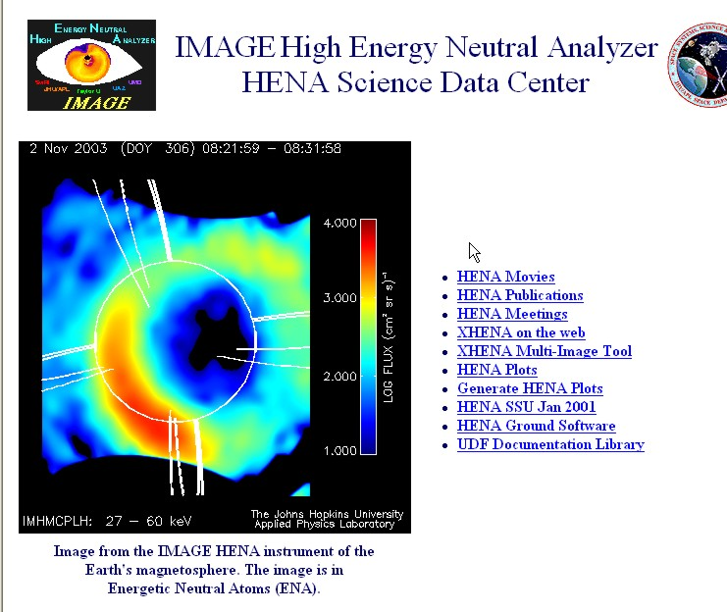
HEDC - HESSI Experimental Data Center
ETH Zurich
 | Search RHESSI data products by time Go to the main HEDC web interface. Anonymous ftp or http access to RHESSI DATA Access to RHESSI daily lightcurves Hessi Data Analysis Workshop in Zurich (HEDAWZ): was held on April 18,19,20 2002 at ETH Zurich, Switzerland First Images and Movie
HEDC - HESSI Experimental Data Center
ETH Zurich
HEDC - HESSI Experimental Data Center
ETH Zurich
 | Search RHESSI data products by time Go to the main HEDC web interface. Anonymous ftp or http access to RHESSI DATA Access to RHESSI daily lightcurves Hessi Data Analysis Workshop in Zurich (HEDAWZ): was held on April 18,19,20 2002 at ETH Zurich, Switzerland First Images and Movie
 | Search RHESSI data products by time Go to the main HEDC web interface. Anonymous ftp or http access to RHESSI DATA Access to RHESSI daily lightcurves Hessi Data Analysis Workshop in Zurich (HEDAWZ): was held on April 18,19,20 2002 at ETH Zurich, Switzerland First Images and Movie
The Current Space Physics Data Environment

Slide 10
State of Solar and Space Physics Data Today
(with help from T. King and S. Joy)
Carried out a study of sources of space physics data with emphasis on NASA missions.
Sent a detailed questionnaire to the project scientist of each NASA Sun Earth Connections mission. (All except one responded.)
Along with a student Erin Means, I examined web pages for all of the missions and most of the instruments – over 200.
Tested each system by requesting recent data.
Examined NSSDC holdings for each mission.

Slide 11
Questions
How hard is it to obtain and use data from current Sun-Earth Connections missions?
  How easy is it to find the data needed for a given study?
  If the data were acquired are they available to the scientific community?
  If the data are available how hard is it to access them?
  After you have accessed data how hard is it to use them?
  If you use the data how confident can you be that they are correct?
Will data be available and useable after the mission ends?
  Do the mission data repositories have procedures to protect the data from loss?
  Are the data of archival quality?

Slide 12
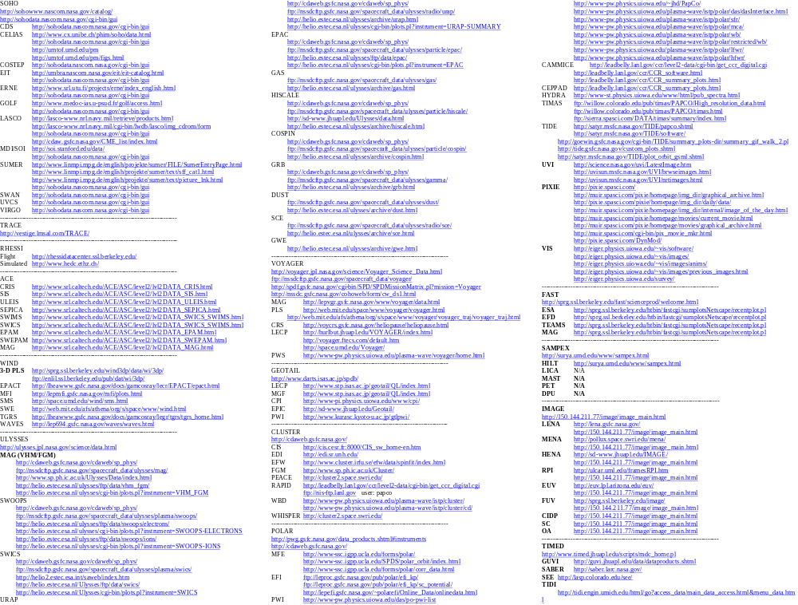
The Current Space Physics Data Environment

Slide 13
The Answers
Data Access and Use
How easy is it to find the data needed for a given study?
  It is not very easy. There are over 200 sources of space physics data. If you aren’t one of the cognizanti it is hard to find the data you need. Multi-spacecraft and multi-instrument studies are very difficult.
If the data were acquired are they available to the scientific community?
  In general they are available. We are much closer to an open data environment then ever before. Missions need to be encouraged to provide all of the data including the highest resolution data.

Slide 14
More Answers
Data Access and Use
If the data are available how hard is it to access them?
  Mixed. Some missions have excellent interfaces and accessing the data is very easy (e.g. ACE, Geotail ). Older missions tended to have the worst interfaces.
After you have accessed data how hard is it to use them?
  Mixed. Many formats are used. Where documentation is good this is not a serious problem. The quality and thoroughness of the documentation is mixed.
If you use the data how confident can you be that they are correct?
  Mixed. Many missions either do not have data quality programs or left that question blank.

Slide 15
More Answers
Data Archiving
Do the mission data repositories have procedures to protect the data from loss?
  Yes!
Are the data of archival quality?
  No! As noted above the documentation is not uniformly complete. Many data systems have warnings telling users to check with the instrument team before using the data. The instrument team won’t always be available. Too many don’t get that.

Slide 16
Future Challenges for Space Physics Data Management
We have moved much closer to an open data environment. We no longer have to convince people of the value of wide access to the data. We have to figure out how to do it in an efficient way.
The next generation of space physics missions will produce vast data volumes. We will need much better tools for finding, subsetting and accessing the data needed for a given study.
In space physics in general and the Living with a Star program in particular researchers will increasing need data which cross traditional discipline boundaries.
Space physics needs to establish standards and procedures for producing archival quality data.

