Slide 1
SPASE: Metadata Interoperability in the Great Observatory Environment
Jim Thieman
Todd King
Aaron Roberts
Joe King
AGU - 2006 Joint Assembly
May 23, 2006

Slide 2
What is SPASE?
Space Physics Archive Search & Extract
An International, community-based standards organization with the goals of:
  Easing data search and retrieval across the Space and Solar Physics data environment
  Defining and maintaining a Data Model for Space and Solar Physics interoperability
  Demonstrating the Model’s viability
Initiated in late 2002 as a discussion among space physics data archive representatives.
Organized in 2003 as an international consortium with an open invitation for anyone in the community to participate
U.S. participants funded by NASA in July 2005.

Slide 3


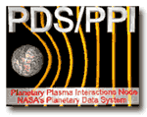






Current Participants
• CNES/CNRS Plasma Physics (CDPP) Data Archive
• NASA/Goddard Space Flight Center
• NOAA/National Geophysical Data Center
• Planetary Data System- UCLA Plasma Physics Interactions Node
• Rutherford Appleton Laboratory
• Southwest Research Institute
• Applied Physics Laboratory
• Jet Propulsion Laboratory
• Augsburg College
• European Grid of Solar Observations (EGSO)
• Institute of Space and Astronautical Science (ISAS/JAXA)

Slide 4
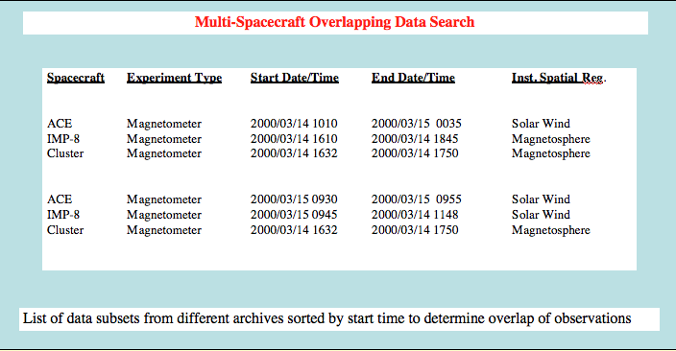
What will SPASE do for Researchers?
• SPASE serves as the interlingua or standard of metadata communication among the diverse data holders
• Researchers can use the common language to find data throughout the Heliophysical Observatory environment
• Mapping of the local metadata language to a common standard allows important quantities to be intercompared (e.g. times of observation)

Slide 5
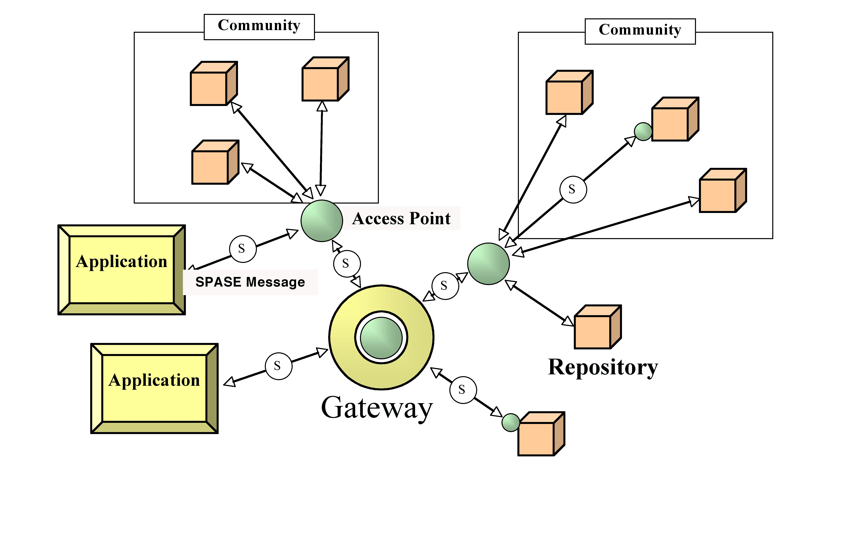
Data Environment Architecture

Slide 6
What is the
SPASE Data Model?
The SPASE Data Model is a set of terms, definitions, naming conventions and relationships intended for use in describing space physics data resources
A data model must also include at least one representative form of the model (XML, data schema, etc)
The SPASE Data Model defines a metadata standard for space physics data search and retrieval
• Why create a new Data Model? No existing data model had all that was needed by the Space Physics community

Slide 7
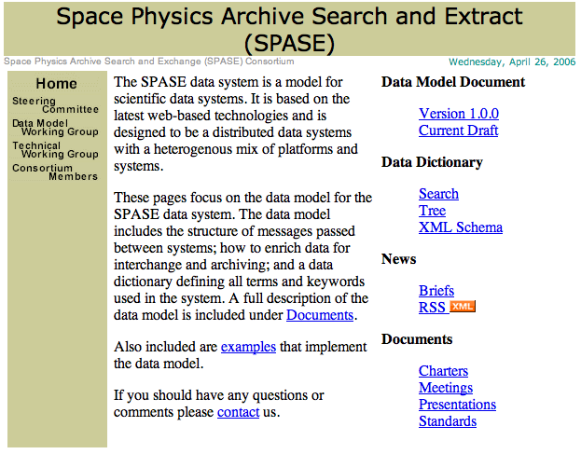
SPASE Data Model and SPASE Home Page
The SPASE Data Model Version 1.0.0 and the Current Draft can be found on the SPASE Home Page at UCLA as well as much other information about SPASE
http://www.igpp.ucla.edu/spase/

Slide 8
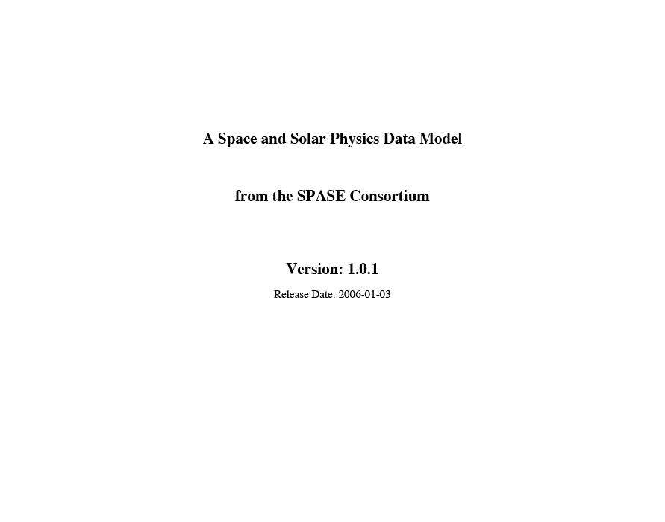
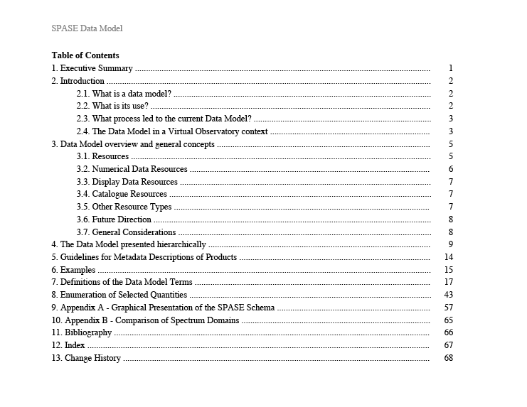
SPASE Data Model
The main work of the SPASE Consortium has been the
SPASE Data Model

Slide 9
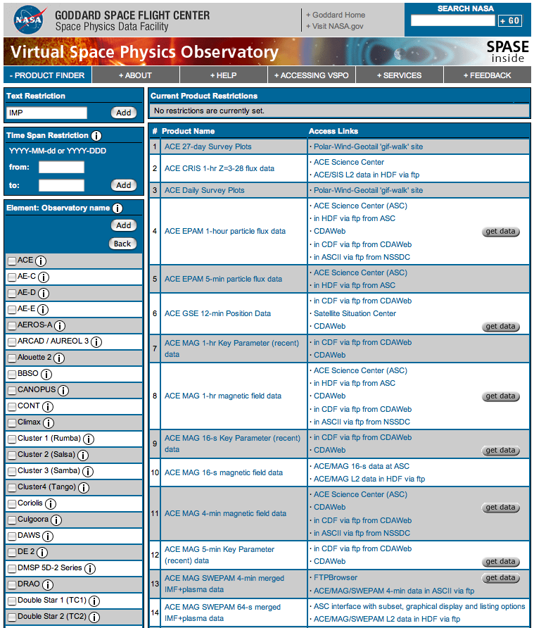
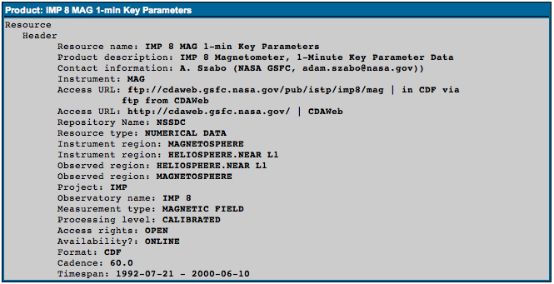
Data Model Implementation - VSPO Search Interface
Information in the Virtual Space Physics Observatory Product Finder is closely compliant with the SPASE Data Model.
http://vspo.gsfc.nasa.gov/websearch/dispatcher

Slide 10
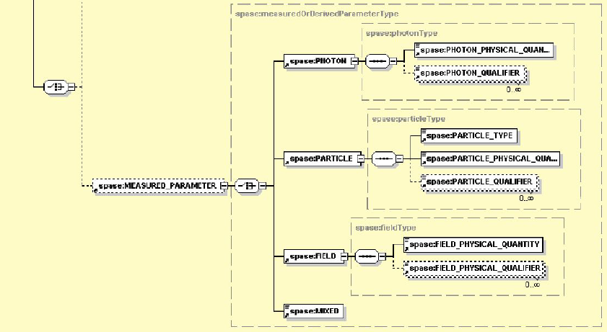
Community Assistance Request
We ask the Space and Solar Physics community to use the Data Model in describing important data sets and let us know where problems arise. We need feedback on terminology, definitions, schema, etc.

Slide 11
Tools for Data Model Use
The SPASE data model is available as an XML schema. Existing XML-based tools can be used.
Tools for Data Model usage and testing are in development, for example:
  Generator – Creates SPASE descriptions using external sources of information
  Validator - Determines compliance with SPASE data model

Slide 12
Summary
SPASE enables data search, retrieval, and intercomparison across the diverse data holdings
Version 1.01 of the Data Model is available and it will continue to be updated in new versions
Tools will be available for facilitating SPASE participation
VSPO is an example of SPASE usage in a Virtual Observatory environment
Feedback from the community is particularly important for SPASE progress and use
Results and current work can be found at: http://www.igpp.ucla.edu/spase

