Slide 1
NASA/LWS Workshop: Virtual Observatories in Space and Solar Physics
Greenbelt, MD; October 27-29, 2004
A VIRTUAL GLOBAL MAGNETIC OBSERVATORY NETWORK
VGMO.NET: Concept and Realization
Vladimir Papitashvili*, Anshuman Saxena**,
Valeriy Petrov, and Robert Clauer
Space Physics Research Laboratory
University of Michigan, Ann Arbor, MI, U.S.A.
http://maggy.engin.umich.edu/mist/vgmo.html
*Also at the Office of Polar Programs, NSF, Arlington, VA, U.S.A.
**Now at TATA Consultancy Services, Bangalore, India

Slide 2





To get scientific data from various, mostly distributed sources, a scientist may have to:
Search through a number of data centers, various institutions, observatories, contact colleagues..
Process collected data using mostly proprietary codes, run models…
and…
Finally, do some science
Get data via snail-mail, air-mail, e-mail, Web…
Increasing Requirements
Geospace and Earth Systems Science
Higher Resolution – Space and Time
Assimilation into Models
Then ingest retrieved data into a local database…

Slide 3

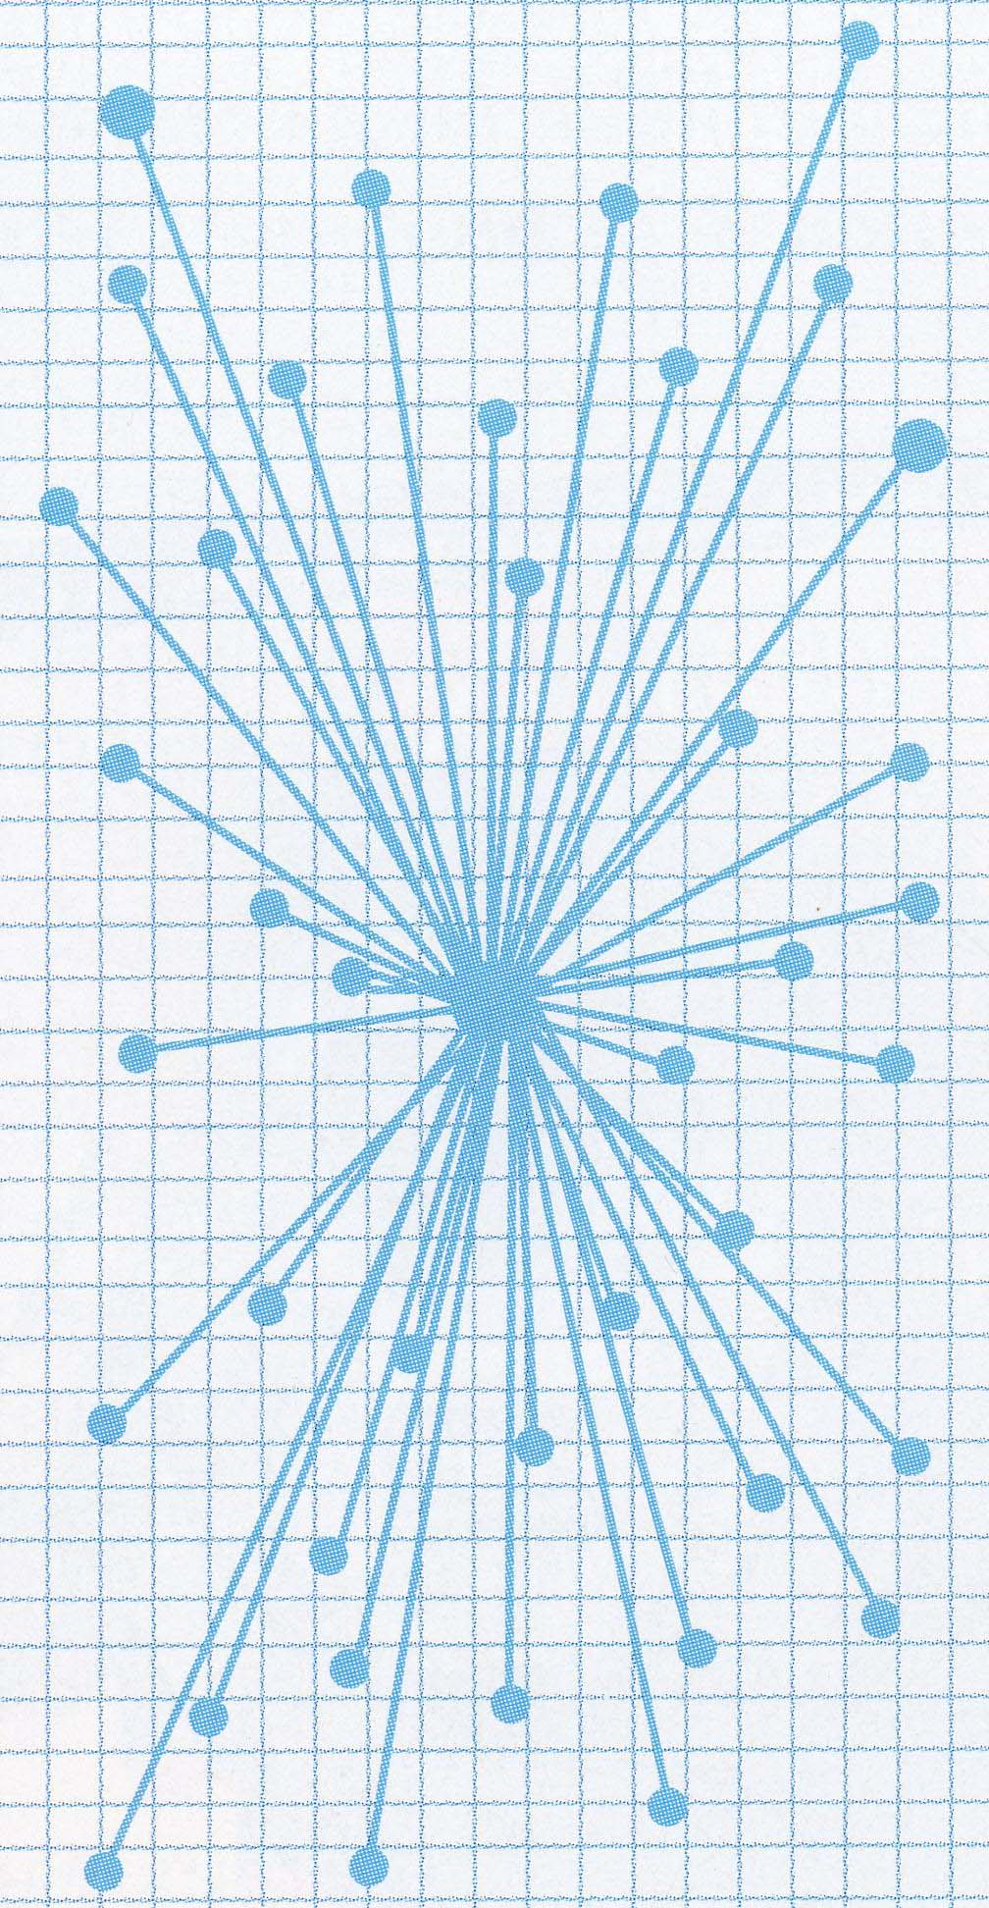
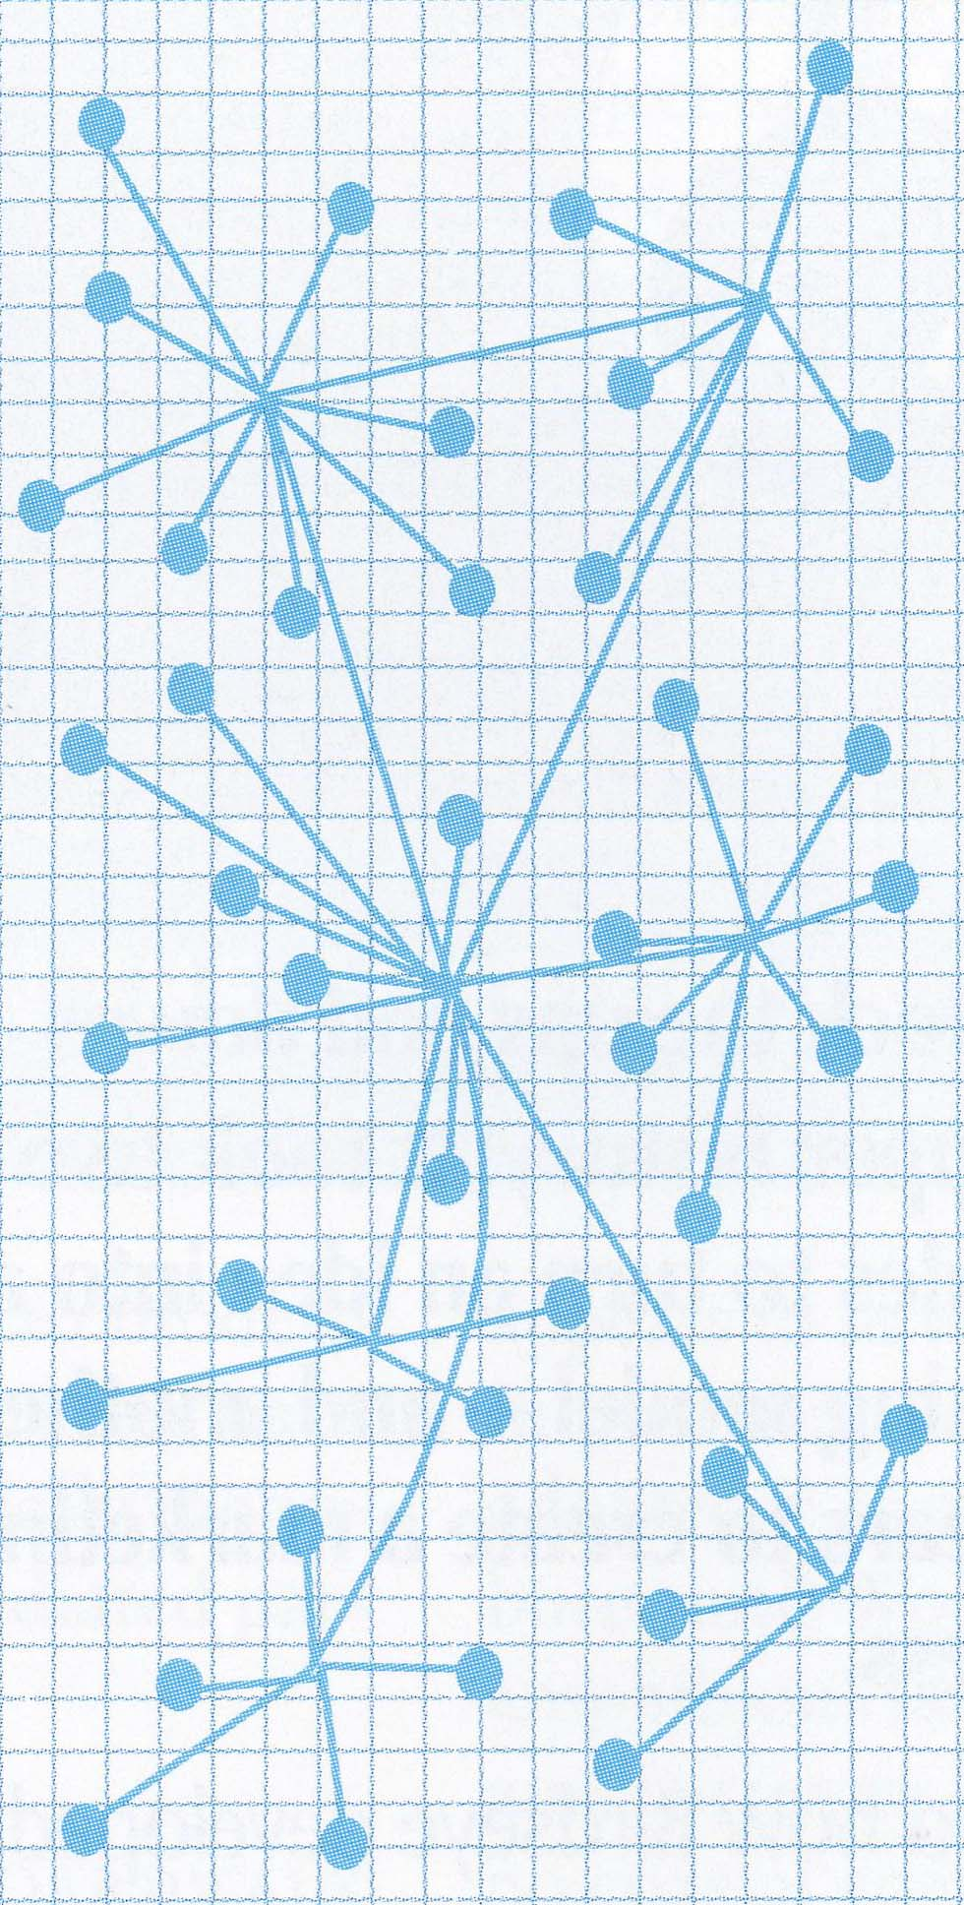
Current Forms of Sharing Geomagnetic Data
Centralized distribution schemes – e.g., World Data Centers (WDC):
  Require persistent support for the data acquisition, storage, and distribution
  Submission of data remains voluntary
  Often data are not suitable for submission – e.g., WDCs only accept absolute geomagnetic measurements
  However, geomagnetic data collected outside of the standard magnetic observatories are mostly variational in nature
“Push Data” Concept

Slide 4
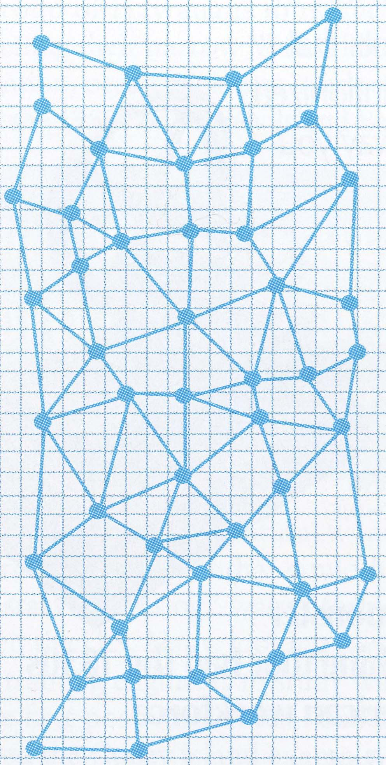

Sharing Distributed Geomagnetic Data
Publishing and sharing data through World Wide Web:
  Allows to avoid additional steps of data preparation for submission to WDC
  Achieves greater visibility amongst the scientific and user communities
  Increases computing power and bandwidth – lots of untapped potential at the edge of networking
  A “GRID” (“Fabric”) of many inter-connected data nodes is a new vision of distributed, self-populating data centers
Such diversity of available geoscience data-bases argues for more sophisticated search engines capable of identifying data repositories on the Web and then pulling the data out for scientific analyses
“Pull Data” Concept

Slide 5
Virtual Observatory Components
Distributed databases accessed through a single GRID node:
Data Visualization
Format Conversion
Data Acquisition
Location Discovery
A concept for the electronic Geophysical Year (eGY) initiative - IUGG/IAGA, ICSU/WDC Panel

Slide 6

VGMO.NET
Virtual Global Magnetic Observatory
VGMO.NET - Virtual Global Magnetic Observatory Network
VGMO.NET is a middleware architecture that provides a new way for the worldwide geomagnetic community to share data and functionality in a platform-independent and location-neutral environment
Design Goals
  Identify prospective geomagnetic data repositories and provide transparent access to these remote databases through a common interface
  Perform online processing of the acquired data sets
  Ability to construct self-populating databases on individual machines; these self-populated sub-centers can be made available to other users through future request chains (i.e., building a GRID-type access and computing)
Lowest layer - Location Discovery Module, GeoMagnetic Crawler (GeoMaC), which continuously forages Web for prospective geomagnetic data repositories
Data Acquisition downloads requested data from remote sites (using specific site information) from the shared data structures
A2F converts downloaded data into a Flat-File Format (or even to a proprietary format)
Integrated Visualization Layer, e.g., Flat File Manager (FFMN) or other tools, can be used to perform analysis of data
FFMN
IDL
Matlab
Simulink
FORMAT CONVERSION (A2F)
DATA ACQUISITION (HTTP/FTP/OPeNDAP/….)
LOCATION DISCOVERY (GeoMaC)
A four-tier architecture of VGMO.NET

Slide 7
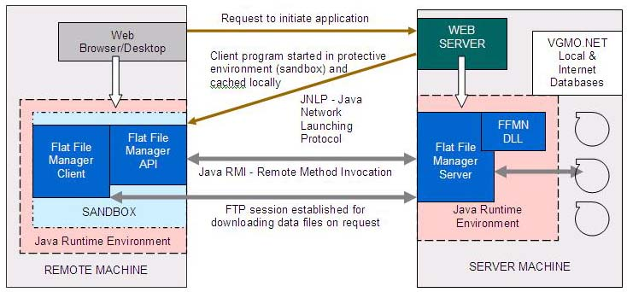
Two Implementations of VGMO.NET
Web-Based Portal – http://maggy.engin.umich.edu/mist/vgmo.html
  A secure, scalable, platform independent, and user-friendly software framework for remote access to VGMO.NET Flat File Manager
  The Flat File Manager Client is written to the Java 2 platform that requires a Java Web Start (JNLP - Java Network Launching Protocol)
Self-Populating Standalone Version - available for download from above Web site
  An alternate version to create, manage, and populate local geomagnetic databases from INTERNET; aims on building a geomagnetic GRID access

Slide 8

VGMO.NET Highlights http://maggy.engin.umich.edu/mist/vgmo.html
Remote (Client) Machine Requirements
Java Runtime Environment (JRE), version 1.2.2 or later
Java Web Start (available for Windows 98/ME/NT/2000/XP, Linux, and Solaris OE)
The library and “Java thin client” for the FFMN Client
Server Requirements
Any standard Web server configured for JNLP (Java Network Launching Protocol)
Flat File Manager DLLs and Flat File Manager Server software
Platform Independence
FFMN Server can be deployed on a wide-variety of platforms (Linux, Solaris OE, Windows 98/ME/NT/2000/XP) and launched remotely from any platform
Client Side Security and Notification of Application’s Origin
The FFMN service provider signs the downloadable code to ensure that no other party can impersonate the application on the Web; thus, the VGMO framework provides flexibility without compromising security.
The user is shown a dialog displaying the application's origin (based on the signer's certificate) before the application is launched; thereby, the user can make an informed decision whether to grant additional privileges to the downloaded code
If the user trusts the FFMN service provider, he/she can choose to grant additional system privileges, such as a write access to a local disk

Slide 9

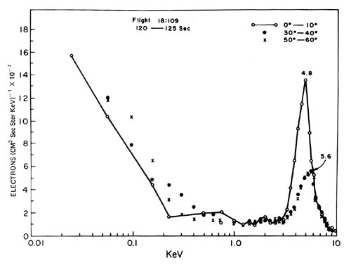
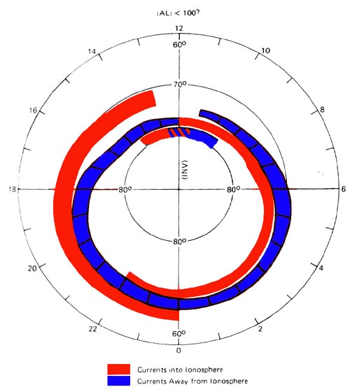
VGMO.NET - Architecture Unleashed
Active Section
A2F - Any to Flat File Conversion Module
Remote Site | Site Info | Format Info | Conversion Pointer
ftp.dmi.dk | 1980-2002 | /pub/wdcc1/obsdata/1minval/ YYYY/
ftp.ngdc. noaa.gov | 1970- 2002 | /STP/GEOMAGNETIC_DATA/ONE_ MINUTE_VALUES/YYYY/
………… | ……… | ………………………………………… | ………
FFMN
Flat File Manager
INTERNET
.
Prospective Section
Remote Site | Site Info | Format Info | Conversion Pointer
ftp.iki.rssi.ru | - | - | -
ftp.abs.xyz.edu | - | - | -
Geo Magnetic Crawler (GeoMaC)
LOOKUP TABLE

Slide 10

VGMO.NET - The Local Database
Geomagnetic data are published in widely different, often proprietary formats
We convert all downloaded data sets into a Flat-File database
Databases built via VGMO.NET conform to the Flat-File DBMS architecture
Flat DBMS revisited [A. Smith, C. R. Clauer, 1984]
Each dataset consists of two files: a header file, which is an ASCII description of the dataset and a binary data file that is the data itself
Leverages advantages of ASCII presentation (readable and editable data description), as well as binary presentation (compact data storage and fast random access)
A sample header file:
    Name of header and data files: VOS01
    Date files created: 13-May-2002
    Record length of data file, in bytes: 20
    Number of columns: 4
    Number of rows: 3137310
    Flag for missing data: -0.10E+33
    # name units source type loc
    1 Time seconds T 1
    2 VOCE nT Antarctic magnetometer R 9
    3 VOSH nT Antarctic magnetometer R 13
    4 VOSZ nT Antarctic magnetometer R 17
    NOTES:
    Start time = 01-JAN-01 00:02:00.000
    End time = 31-DEC-01 23:58:00.000
    Antarctic magnetometer high resolution data
    END
Note that the local database can hold a mixture of various “flat files”: interplanetary magnetic field/solar wind data, ionospheric data, etc.

Slide 11

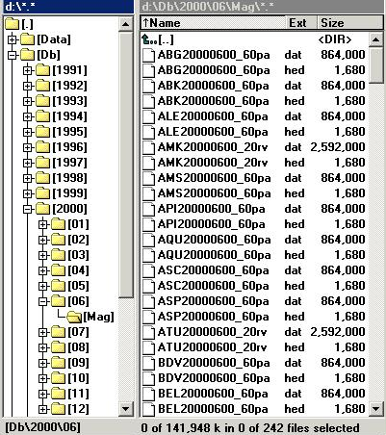
VGMO.NET - The Local Database (cont’d)
Directory structure and naming convention
File Name consists of three parts – a station IAGA 3-letter code, followed by a timestamp in YYYYMMDD format and some special tags that are attached for housekeeping purposes:
Special Tags:
absolute measurements: a
variation measurements: v
public access: p
restricted access: r
rate of data sampling (in sec): 60/30/1/
For example, a publicly accessible dataset consisting of 60-sec samples of absolute geomagnetic measurements from Antarctic magnetic observatory VOSTOK for December 2002 will be stored in the flat files named:
\2000\06\MAG\VOS2000600_60pa.hed
VOS2000600_60pa.dat

Slide 12

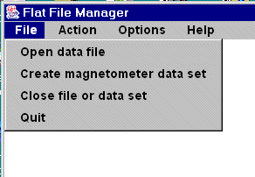
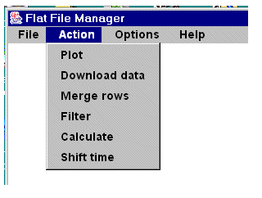
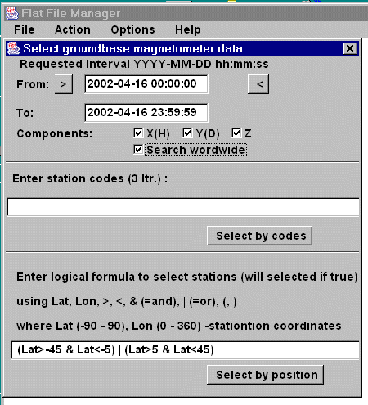
VGMO.NET at Work http://maggy.engin.umich.edu/mist/vgmo.html
FFMN Main Menu allows the user to select up to three data sets (File), then do certain operations with selected data sets (Action) by setting Options
The File item allows the user to open the server database files or to create a temporary data set for the selected geomagnetic stations (selected either by names or geographic location)
If the selected data are found in the server’s database, then the FFMN Server retrieves requested data for the plotting (and possible uploading) to the remote, FFMN client machine
In addition, if the “Search worldwide” box is checked, the FFMN Server will look for the selected data on a number of remote FTP sites (listed in the FFMN Lookup File); these data are then downloaded, converted to flat files, and added to the FFMN server database
When new FTP sites with geomagnetic data are found, they can be easily linked through additions to the FFMN Lookup File

Slide 13
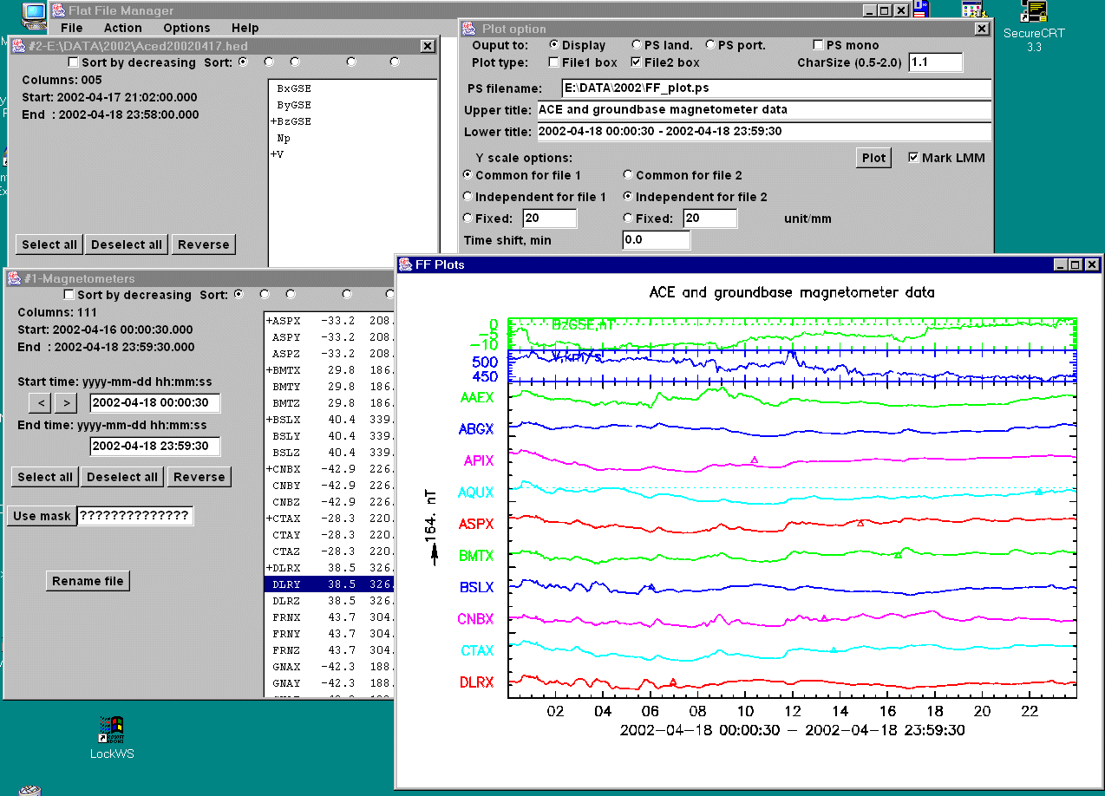
VGMO.NET – Search & Plot Examples http://maggy.engin.umich.edu/mist/vgmo.html

Slide 14

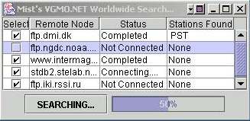
VGMO.NET: WWW Search http://maggy.engin.umich.edu/mist/vgmo.html
By default all the sites presented in the list are contacted for world wide search
The user can drop some sites from the list by making appropriate selections
Each site remains in one of the following states
Not connected : Site has not yet been contacted
Connecting : Synchronization with the site is in progress
Completed : Synchronization with the site has been completed
The list of matching stations found are listed against each site

Slide 15

Summary
Existing World Data Centers continue to serve the worldwide scientific community in providing free access to global geophysical databases.
Recently many digital geomagnetic datasets have been placed on the Web, often in near-real time, but some of these data are not even submitted to any data center.
In this study, we formulated a concept and developed a prototype of a Virtual Global Magnetic Observatory (VGMO).
The proposed concept is developed under the framework of the electronic Geophysical Year.

Slide 16
Summary (cont’d)
Saving retrieved data locally from multiple requests, a VGMO.NET user can build a personal data sub-center, avoiding to search the Web if a new request falls within a span of earlier down-loaded data.
If this self-populating, sub-center is made available to other VGMO.NET users, then the “GEOMAstered” network is integrated into the global GRID (“Fabric”) of users/centers, where the Web data-crawling is transparent to everyone.
However, more studies are needed to learn how newly “Webbed” digital geomagnetic data can be identified on the Web; a Semantic Web approach looks the most promising.

