Slide 1
Joining Subfield Data Repositories
VHO
Design Philosophy
Adam Szabo
NASA Goddard Space Flight Center

Slide 2
Primary Purpose
Enable wider access / use to the best quality
heliospheric data.
Enhance calibrational capabilities available to
data providers.
Encourage the generation of new multi-instrument,
multi-spacecraft data products.
Provide common tools for data analysis.

Slide 3
Consequences
Enable wider access / use to the best quality heliospheric data.
The best data tends to be at the instrument sites for active missions
Need to connect a distributed data environment
Wider access / use
Uniform interface
Middleware
Wider use
Multi data set searches
Common dictionary metadata

Slide 4
Consequences
Enhanced calibrational capabilities
Enable multi-instrument, multi-spacecraft intercalibration
Sufficiently detailed, accurate metadata
Data exchange with guaranteed updates
New multi-instrument, multi-spacecraft data products
Merged data products
Common metadata standard
Update propagation
Data exchange with updates
Common data analysis tools
The instrument sites already have software tools to access
and analyze their data.
Make tools publicly available with uniform documentation

Slide 5


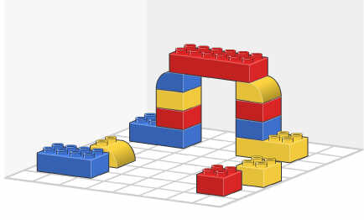






Design Philosophy
Elements of the system:
Middleware with search capability
Dictionary for metadata to describe data and software
Data exchange mechanism
Approach:
Minimum possible requirements on current and future repositories
Rapid and low cost deployment Extensible system
Assume that we do not know everything open, documented
architecture

Slide 6

The Concept
DR1
DR2
Modeling Center
A
B
Library
1
2
3
a
Library
Library
b
c
Query
links
Query
links
Query
DATA
links
VHO
VxO
Query Exchange
Combined links
links
Query
Query
Service
DATA
User
Web Services

Slide 7
The Concept
Data Exchange Backbone
DR1
DR2
DR3
1
2
3
A
a
a
b
c
local
DR4
VHO
1
A
b
local
1Ab

Slide 8
Who Is Going To Do It?
Enable existing data service sites to achieve common goal.
- Data expertise and infrastructure already there.
- Minimal incremental funding required.
- Science participation in data management.
Support from small VHO team.
- Setup expertise, middleware maintenance and development
Evolve in response to user needs.
Will have peer-reviewed process for elements of the environment.
Development already started on the grass-roots level.

Slide 9
VHO Development Team
Current VHO team members:
Andrew Davis Caltech ACE/ASC
George Ho APL ACE, WIND energetic particles, composition
Fred Ipavich U. Maryland SOHO in-situ plasma
Justin Kasper MIT WIND, IMP 8, Voyager plasma
Davin Larson Berkeley WIND, LP, RHESSI, plasma, energetic part.
Tom Narock L3/GSFC Distributed data systems
Aaron Roberts GSFC Helios, modeling, visualization
Peter Schroeder Berkeley STEREO
Ruth Skoug LANL ACE, Ulysses plasma
John Steinberg LANL Genesis, ACE, WIND plasma
Adam Szabo GSFC WIND, IMP 8, Voyager magnetic field, plasma
Jon Vandegriff APL High-energy particles, data models
Role of VHO Team:
- Setup expertise, middleware development and maintenance.
- Data and system expertise and most of infrastructure already there.

