Slide 1

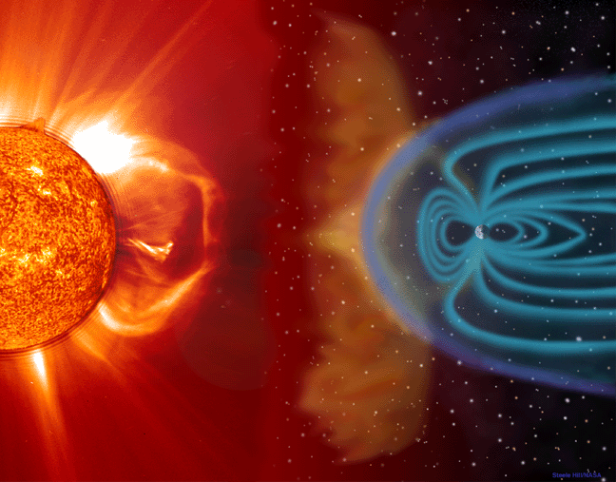
...00101110010101...
...0 1 1 0 0 1 0 1 0 1 0 1 1 0 0 1 0 1 0 0 1...
VHO
...1 1 0 0 1 0 1 1 0 0 1 1 0...
The Virtual Heliospheric
Observatory
VHO

Slide 2
The VHO Team
Adam Szabo (lead) NASA/GSFC
Andrew Davis Caltech
George Ho JHU/APL
Justin Kasper MIT
Jan Merka U. Maryland, Baltimore County
Thomas Narock L3 Communications
Jim Raines U. Michigan
Kathryn Rash NASA/GSFC
D. Aaron Roberts NASA/GSFC
Peter Schroeder U. California, Berkeley
Jon Vandegriff JHU/APL
Collaborators:
Paul Gazis SETI Institute Richard Keller NASA/ARC
Neal Hurlburt Lockheed Martin SAL Shawn Wolfe NASA/ARC
Team membership is dynamic as new data products and services will be added.

Slide 3
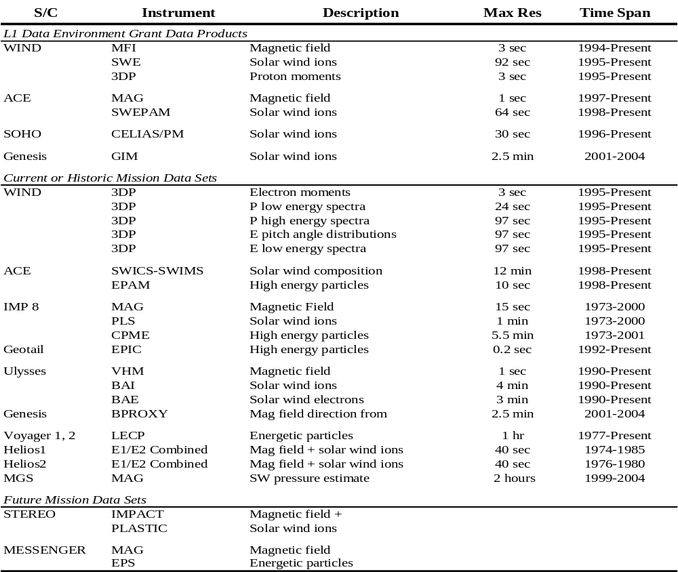

Slide 4
VHO Services
No data flow through the VHO middleware!
Our Role: Connecting data to independent services.
Enable services not develop them ourselves.
Ability to search for services
  Metadata of service description
Ability to search for data related IDL routines (HelioSoft)
  Metadata of routines
  Mission independent VHO Data Environment

Slide 5
VHO Architecture
Lightweight middleware with search capability.
Common metadata description of products and
services based on SPASE dictionary.
Data exchange and synchronization mechanism.
Minimum possible requirements on data providers.
Low cost extensible system deployed in phases.

Slide 6
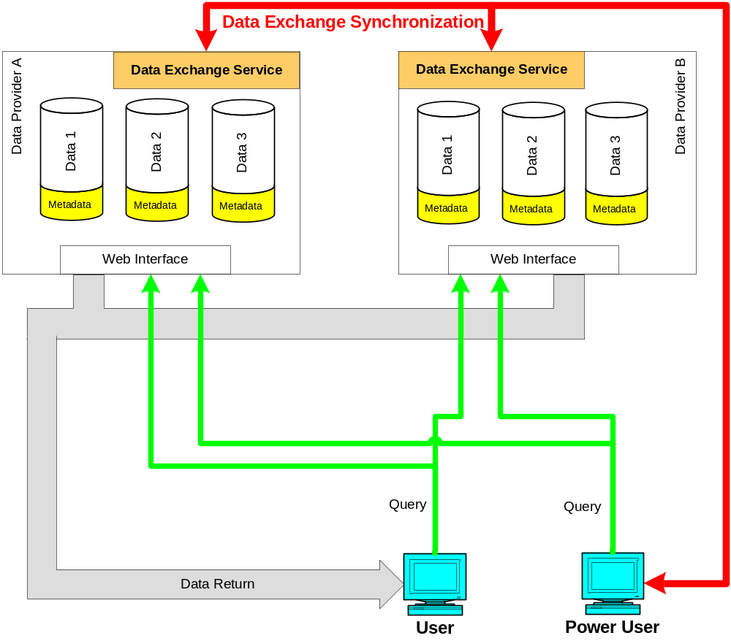
VHO Development Phases (1)
L1 Data Environment
L1 data sets made
web accessible.
Data products
described in SPASE
compliant metadata
format.
Data exchange
synchronization
established between
data providers.

Slide 7
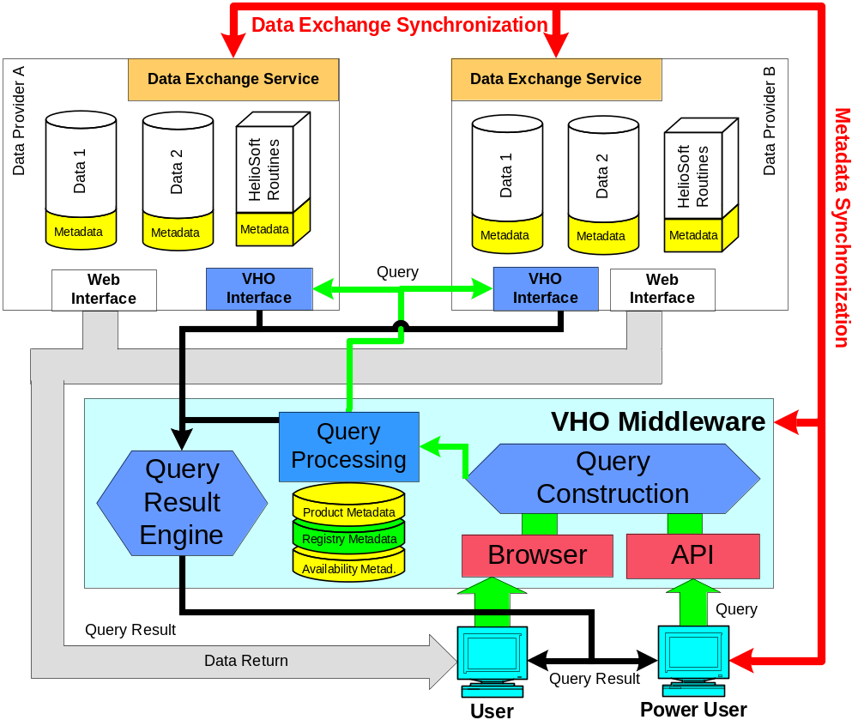
VHO Development Phases (2)
Basic VHO
Middleware with both
Web and API user
interfaces.
All middleware
static and dynamic
metadata products
developed.
Public access to
software tools with
metadata.

Slide 8
VHO Metadata
Static Metadata (requiring no or infrequent updates)
Product Metadata – Complete description of data content.
Registry Metadata – Data service information
Service Metadata – Complete description of added-value
data processing services.
VHO Metadata – WSDL description of VHO functionality.
Dynamic Metadata (requiring daily updates)
Availability – Current range of available data.
Software – Current list of available software tools.

Slide 9
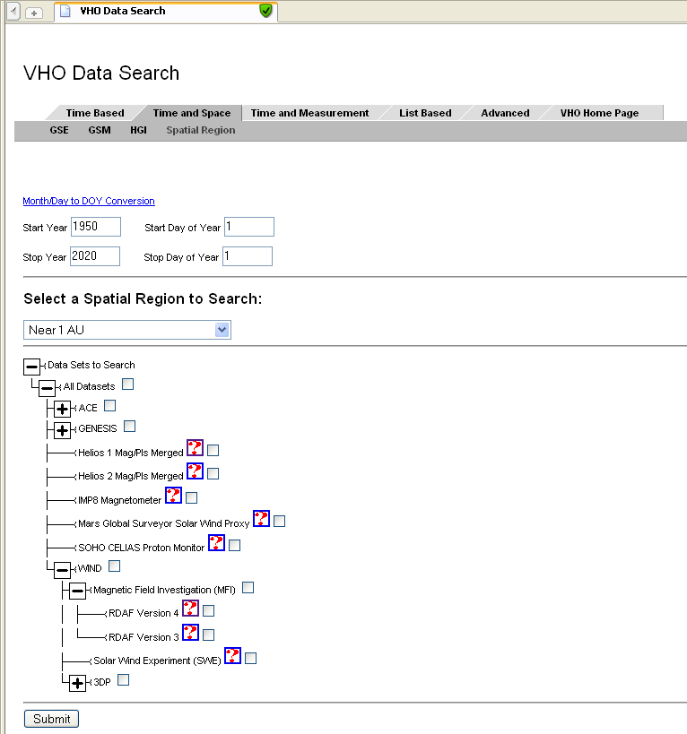
VHO Web Interface
Data can be searched for by the following ways:
Time
Date/Time
Bartel/Carrington Rot.
S/C Location
GSE/GSM/HGI coord.
Region name
Measurement Type
e.g., magnetic field,
thermal plasma,
energetic particles
Select
time period
Select
region of interest
Optionally
refine S/C
selection

Slide 10
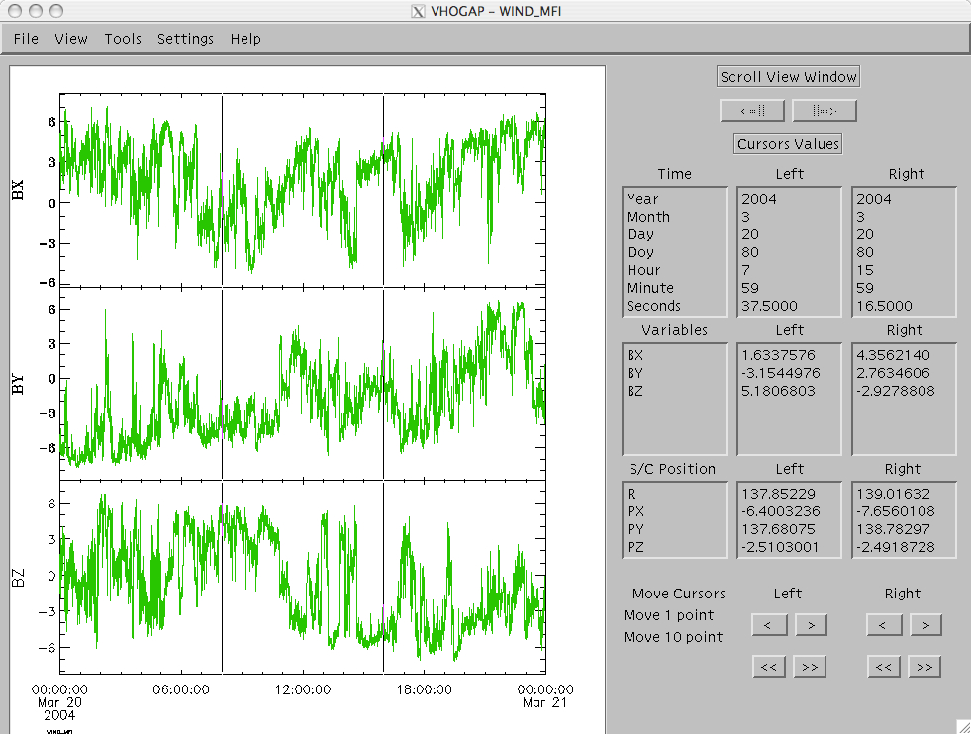
VHO API
The VHO API will allow access to all VHO functions.
IDL VM Demo
software
Library
  Perl
  Java
  CoSEC
  IDL (soon)

Slide 11
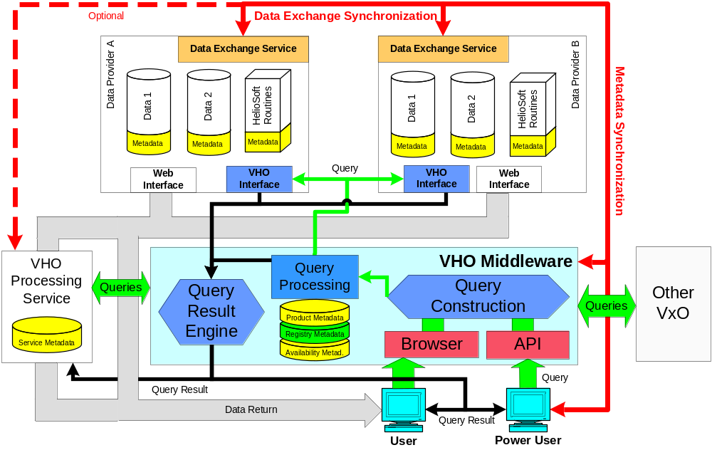
VHO Development Phases (3)
Full VHO
Connection
to processing
services.
Connection
to other VxOs

Slide 12
Community Input
Large, diverse and dynamic team membership.
Submit recommendations via our web page:
http://vho.nasa.gov
Ask users to prioritize upcoming feature additions.
Web statistics
Bi-annual VHO meetings at AGU conferences.

Slide 13
VxO Interaction
Our first focus will be on interacting with VSO.
Will not attempt to recreate full VSO web interface. Rather,
a heliosphere centric view will be provided. API will have
access to most VSO capabilities.
WSDL description of VHO services.
Passing dynamic metadata between VxOs would allow
the execution of complex queries.

Slide 14
BACKUP

Slide 15
Data Provider Requirements
The VHO is designed to minimize requirements on
data providers. The VHO will work with any currently
available data formats or services.
The VHO team will assist data providers in the one-time
generation of the detailed product metadata.
Data providers will have to allow access to their products.
The preferred mechanism will be via the VHO team provided
SOAP interface for local queries. But implementing this
SOAP interface will not be mendatory.
Data providers will have to allow the VHO synchronization
routines to run on their machine providing metadata updates.

Slide 16
Data Exchange Synchronization
Data Exchange Backbone
DR1
DR2
DR3
1
2
3
A
a
a
b
c
local
Synchronized copy of data from similar instrument used to improve calibration.
DR4
VHO
1
A
b
local
1Ab
Synchronized copies of various other data products used to generate merged or added value new product.

