Slide 1


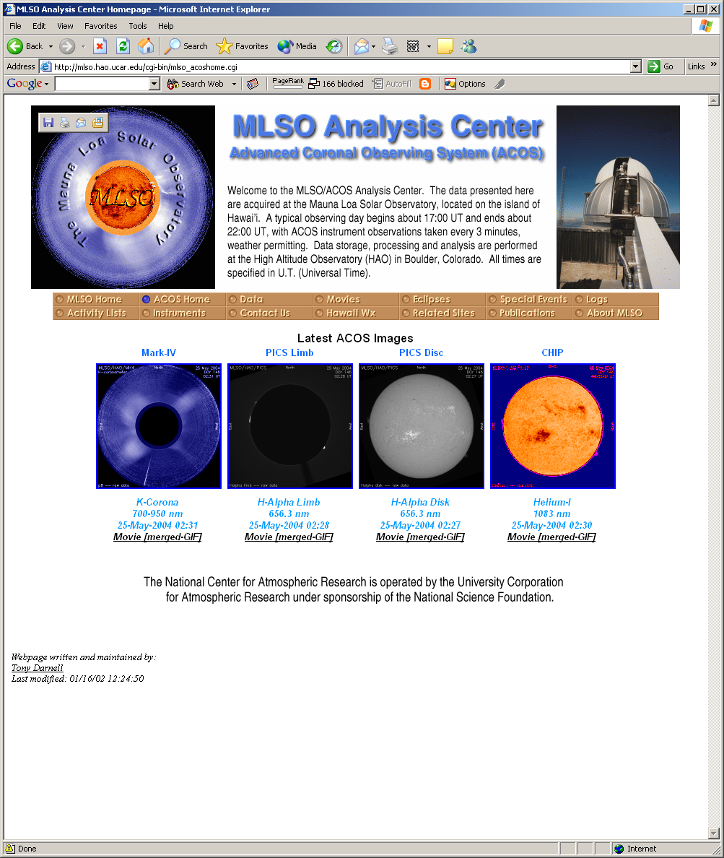
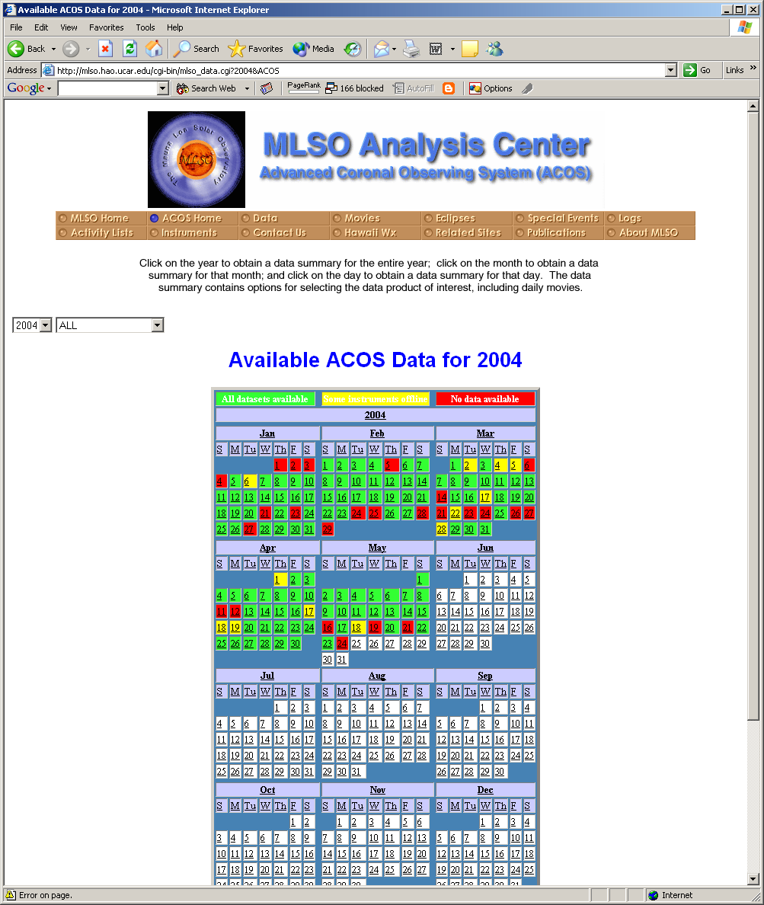
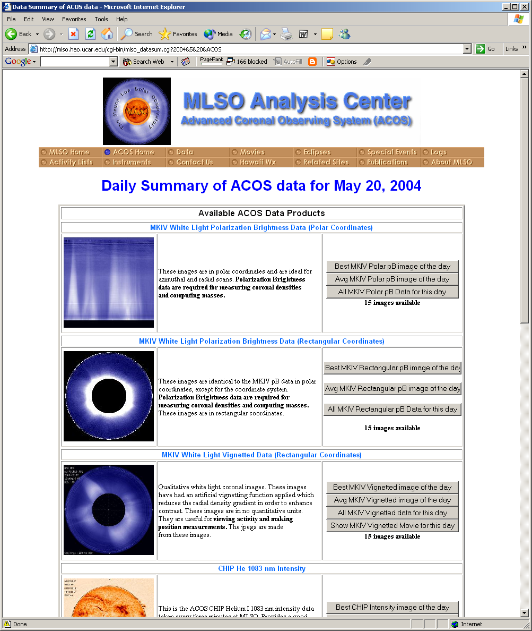
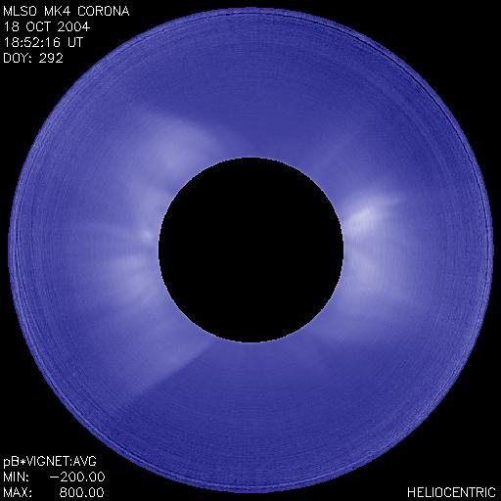
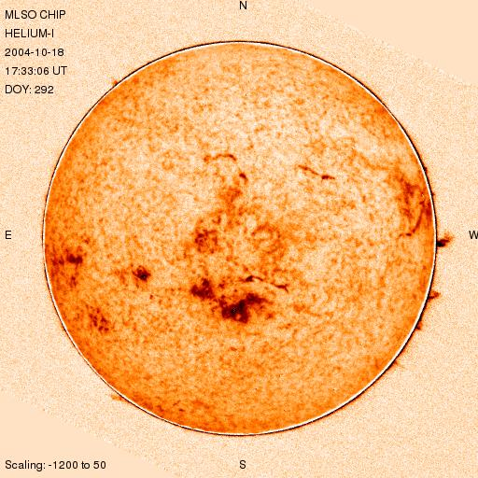
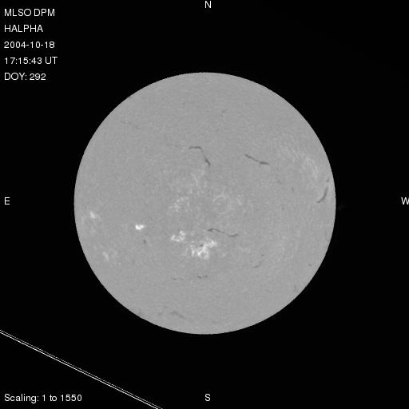
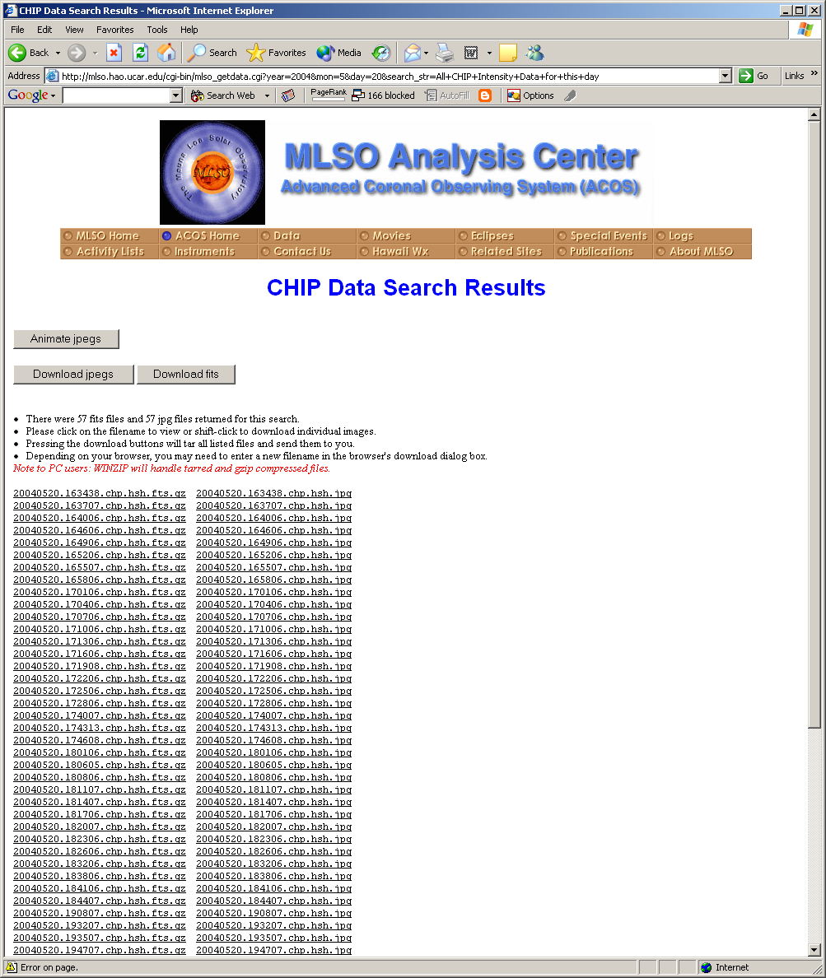
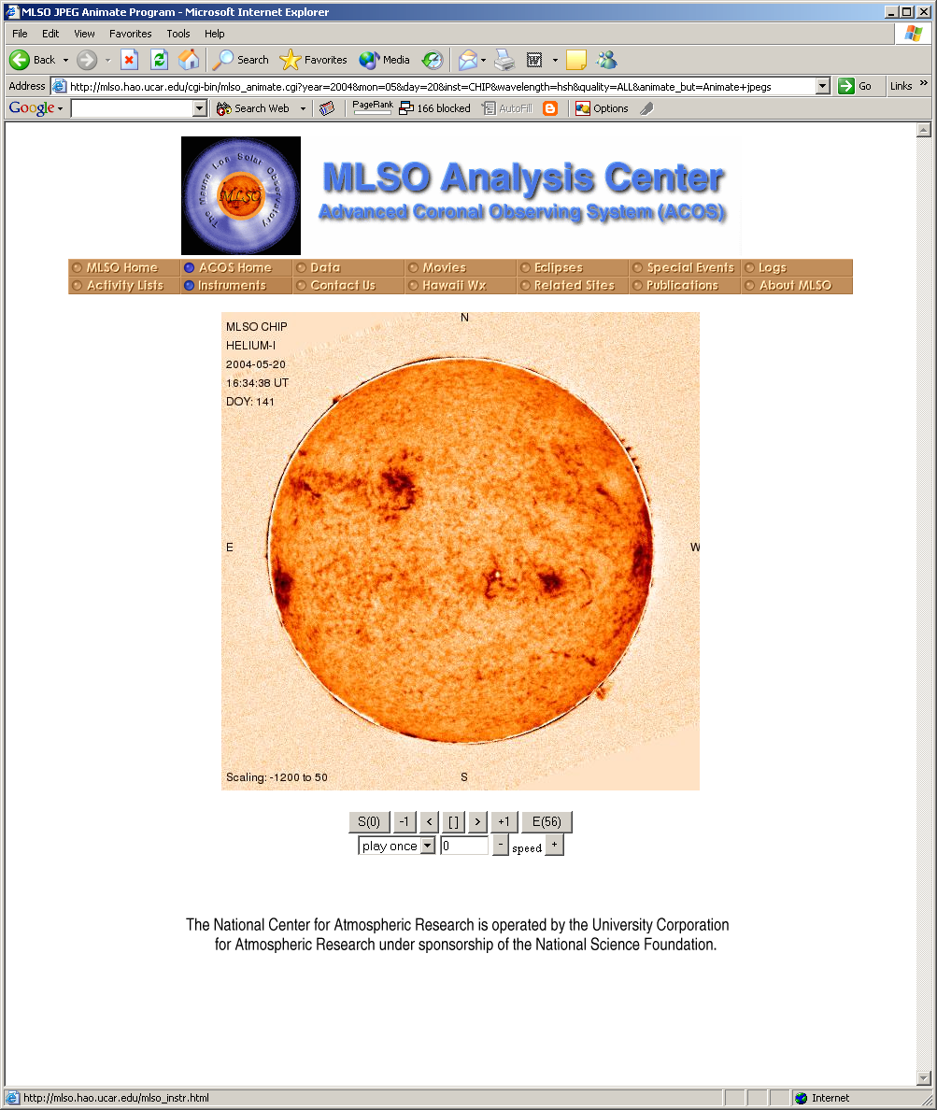
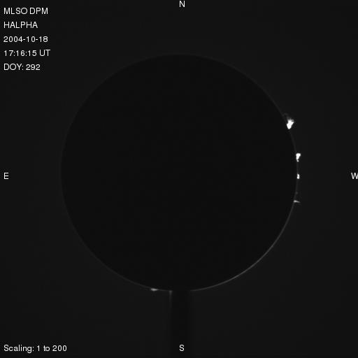
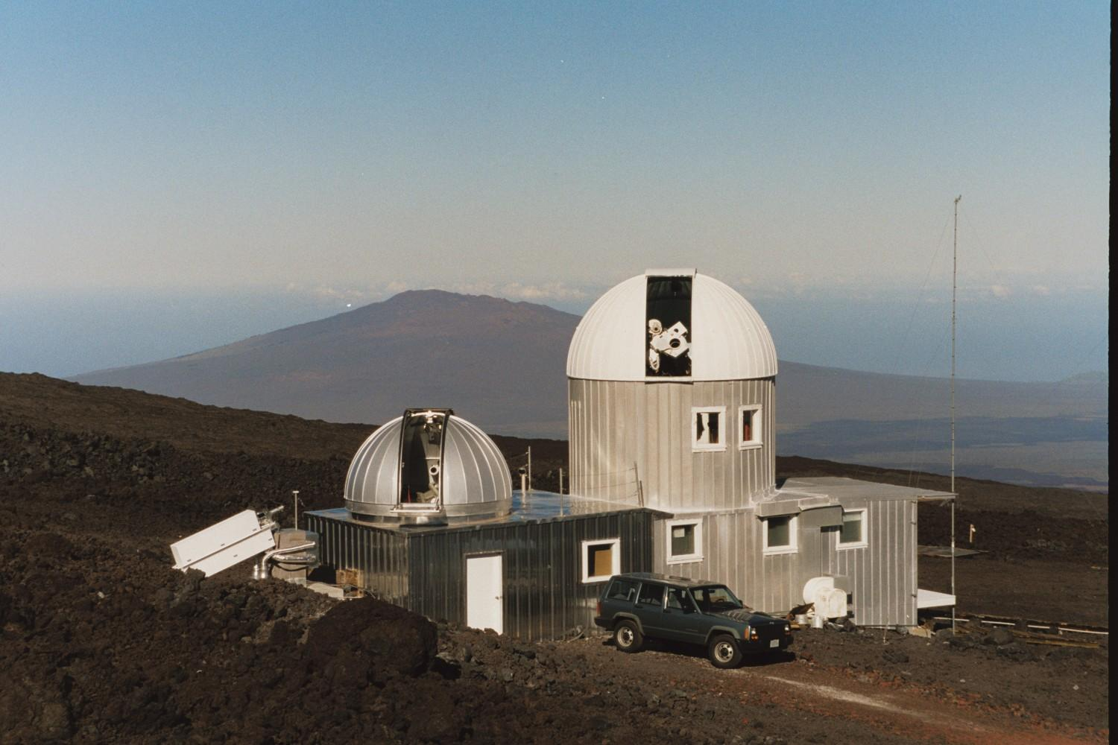
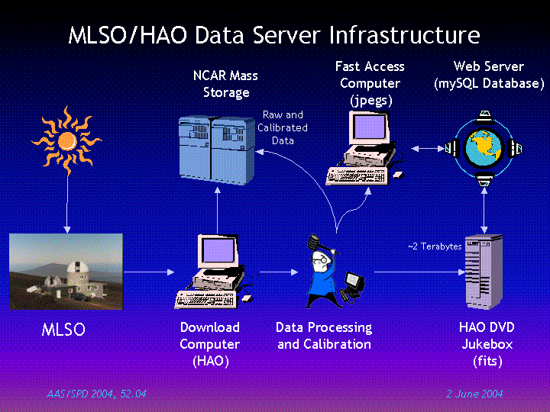
The Mauna Loa Solar Observatory (MLSO) Data Archive
Tony Darnell (tdarnell@ucar.edu), Joan Burkepile and Andrew Stanger
High Altitude Observatory
P.O. Box 3000
Boulder, CO 80307
http://mlso.hao.ucar.edu
Introduction
The MLSO has been taking coronal data since the 1960’s with the implementation of the MKI K-coronameter. Since that time, the observatory has grown and has become home to many instruments operating at a variety of wavelengths, each making routine synoptic observations of the inner corona, chromosphere and photosphere. The instruments, collectively known as the Advanced Coronal Observing System (ACOS), currently operating at MLSO are:
The MLSO Data Archive User Interface
Below are some screenshots showing various parts of our web page. These pages are the portal at HAO for gaining access to all of the data taken at MLSO.
MkIV k-Coronameter
CHIP He 1083.0 nm
PICS H-alpha Disk
Main MLSO/ACOS homepage. Here is where the user generally starts. Latest images from MLSO for the current observing day are shown and animated gif movies are available here.
Quick-look calendar provides information on available data at a glance. Click on a calendar day to get find out how much data are available or that day.
Daily summary of all datasets for a given calendar day. Here a brief description of the data is given and a count of how many images are available for download. Click on one of the buttons on the right to get a listing of the data.
Observes the white light, electron scattered K-corona using a linear CCD detector that scans the entire corona once every three minutes with a field-of-view from 1.15 to 2.8 Rsun.
Chromospheric Helium Imaging Photometer (CHIP). Provides full disk images taken at a wavelength of 1083.0 nm and doppler images every three minutes.
The instrument for Prominence and Inner Coronal Studies (PICS). Designed to look at the chromosphere in H-alpha and the low K-corona near the limb. Full disk observations every three minutes.
PICS H-alpha Limb
The Mauna Loa Solar Observatory
ECHO
PSPT
ACOS
PICS H-alpha limb. These are occulted disk observations made with a wider (10 Å) filter and slightly longer exposure time than the disk. Time cadence is one image every three minutes.
The Mauna Loa Solar Observatory. This photo shows many of the instruments that are in operation daily (GONG is not visible). The PSPT provides photospheric data in the Red (605-610 nm), Blue (408-412 nm) and CaIIK (393 nm). The ECHO instrument provides helioseismic observations.
Listing of data from previous screen. Here is a list of all available fits and jpg images. Users can click on an individual image, or press Download FITS, Download JPEGS or Animate JPEGs.
Jpg animator. This javascript will animate all images from previous screen. Users can play once, loop, or step through the animation in each direction.
Data Flow and Server Infrastructure Schematic
Below is a diagram which illustrates how the data flow from the instruments at MLSO to the end user. All datasets (except PSPT which will be coming online soon) are available on the web and through the VSO.
ACOS Datasets Currently Online
The following datasets are available for download through our data archive or through the VSO. All data on the archive are stored as both FITS and JPG images. The MkIV images are available in both cylindrical coordinates and rectangular. Further, MkIV images are available both in polarized brightness (pB) and with an artificial vignetting function applied for more qualitative analysis. All JPG images supplied are in 512x512 resolution for quick downloading.
Dataset | Wavelength | Object | Resolution (FITS) | Dates Available Online
MKIV | White light | K-corona | 960x960 Rectangular | 1999-Present
 |  |  | 720x384 Cylindrical
CHIP | 1083.0 nm | Chromosphere | 1024x1024 | 1996-Present
PICS | 656.30 nm | Chromosphere | 1024x1024 Disk | 1999-Present
 |  |  | 1530x1030 Limb
MLSO/VSO and Future Plans
The MLSO became a data provider to the VSO in June 2004. All ACOS datasets are currently available via the web interface the VSO provides. All data requests are parsed by the VSO software and a MySQL query is constructed and sent to the MLSO/HAO database. At HAO, the query is executed and the results are sent back the the VSO where it is displayed to the user. From here, the user can click on the images of interest and they will be sent straight to them.
At HAO, plans are underway to present an advanced search engine to users who need more flexibility in their data requests. This search will allow users to make more complex queries that may better suit their needs. Further, the queries sent to HAO from the VSO should allow for more flexibility in obtaining our data from them. This engine should come online before the end of 2004.
We are currently working on integrating datasets from the PSPT and the SMM mission of the 1980’s into our data archive. This should be complete sometime next year. There is also an ongoing effort to put older data, that is, prior to 1997, into our data archive. Finally, efforts to put MkIII online are underway with the hope that it is online sometime next year. MkIII was in operation from 1980 to 1996.

