Slide 1
Virtual Space Physics Observatory (VSPO)
(vspo in Google)
22 May 2006
Overview
D. Aaron Roberts
NASA GSFC

Slide 2
Science constituency served
Cross-cutting for Space and Solar Physics
“One stop shopping”
Access to data and services for both global and focused problems

Slide 3
Who Is Doing What (People and Institutions)
Software development:
  Aquilent team
  Jon Vandegriff, APL; DataShop
Product development, Joe King, QSS
Visualization (ViSBARD), Aquilent plus
  Ryan Boller, GSFC
We collaborate with many others, e.g., SECAA/SPDF, SPASE, other SBIR

Slide 4
Datasets to be made available
Any and all in Space and Solar Physics, with the emphasis on those that are demonstrably (through various means) of most utility to the community.

Slide 5
Services
Product Finder
Initially populated registries of resources
API for direct access to Gateway and via this to products
Data-driven (“higher order”) query service
DataShop; browse plot access, and “Photoshop”-like multi-format reader/visualizer
ViSBARD 3-D data visualization

Slide 6
Services (cont)
SPDF Web services interfaces (including NSSDC FTP and other services coming)
Experience/expertise (jointly SPDF) in web services, Java 3D Web Start and enabling services such as:
Format Translation technologies, etc.

Slide 7
Overall architecture including Technology, Data Model, etc.
Mostly Java-based software
OAI-based registry
Initial example of SPASE-compliant VO
Uses Web-Service connections, as well as others (ftp, etc.) as needed
Overall architecture seen on next slide

Slide 8
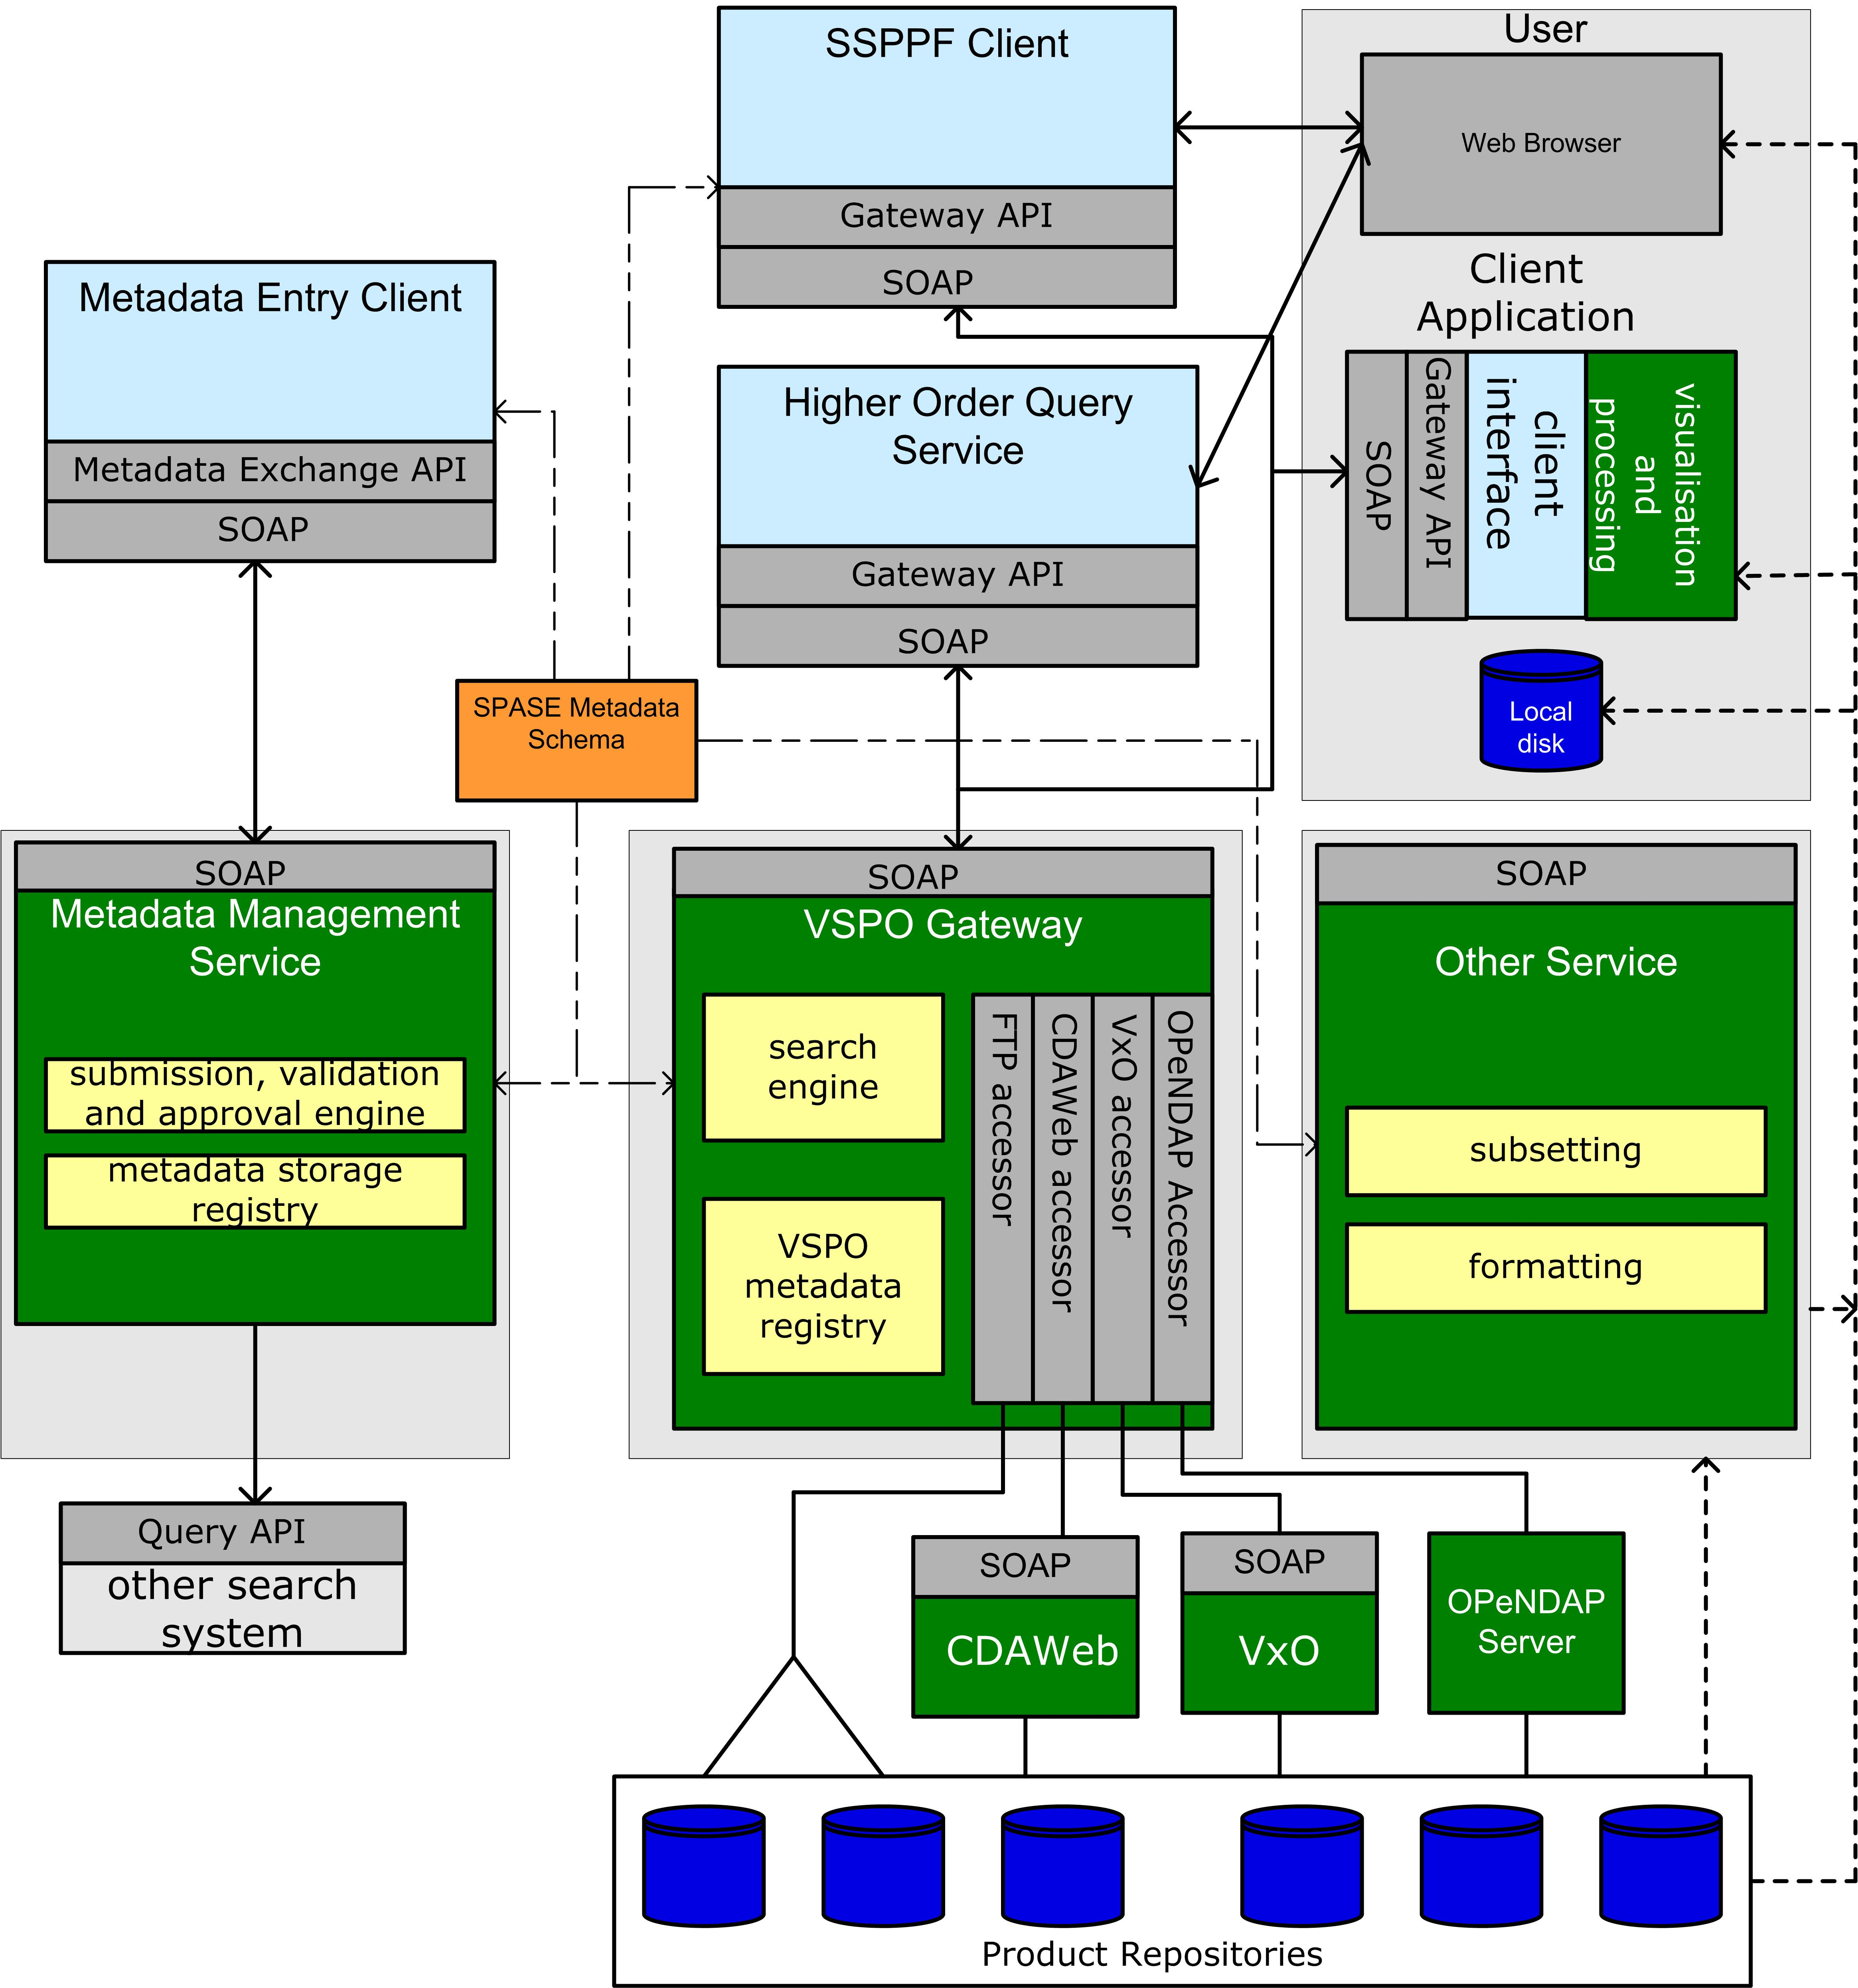

Slide 9
Milestones/Timeline
Next couple of months: complete end-to-end SPASE-based registry-to-product delivery
Few Months: “Version 1” of DataShop
6 months: initial operational HOQS
With a year: add VxO, etc. access as available; improved DataShop
Longer-term: data mining, data-driven query integration; better visual and other front-end integration. Seamless data access to applications such as IDL.

Slide 10
Methodology for user feedback
Meeting presentations, comment requests on web sites (neither highly effective); web stats
Advisory group, possibly as part of SPDF
Focused requests of specific users
Watching user interaction with tools

